Slide 1

CareerPilot
PLAN · PREPARE · PERFORM · SUCCEED
Mid-Evaluation Progress Review
Karan Rana · B.Tech Computer Science & Engineering · 2nd Year
Madhav Institute of Technology and Science, Gwalior
github.com/karan-rxna/Career-Pilot
All-in-one student preparation & placement platform
01 / 18
Notes:
Open plainly: CareerPilot is a placement-preparation workspace for engineering students. It does not list opportunities — it reads the progress a student is already generating on the platforms they already use, and turns it into analytics, a plan and a portfolio. This review covers the problem, the objectives, the architecture and exactly what is built and verified so far.

Slide 2
CareerPilot
CONTENTS
What this review covers
Ten areas, from the problem to the plan for the next milestone.
01
Introduction
02
Problem Statement
03
Objectives
04
Motive
05
Technology Stack
06
System Architecture
07
Database Design
08
Authentication & Security
09
Current Status
10
Product Walkthrough
11
Roadmap & Future Scope
12
Conclusion
CareerPilot · Mid-Evaluation Progress Review
02 / 18
Notes:
Signpost the structure so the invigilator knows where you are going. Flag up front that the last third is about what is already verified and what comes next — that is where the questions usually land.

Slide 3
CareerPilot
01 · INTRODUCTION
One workspace for the whole placement journey
CareerPilot connects to the platforms a student already uses, reads the progress already there, and turns it into analytics, a plan and a portfolio.
Existing tools stop at listing opportunities. CareerPilot starts where they stop — with the student's own activity.
Portals only list
Trackers make you type
Evidence is scattered
Placement portals publish openings, but offer no path from 'interested' to 'ready'.
DSA trackers ask the student to mark problems solved by hand, so they go stale within a week.
Solved counts, contest ratings and commits live on separate platforms with no single view.
The answer: one dashboard that reads what you have already done and plans what to do next.
CareerPilot · Mid-Evaluation Progress Review
03 / 18
Notes:
The single sentence that matters: portals list, CareerPilot prepares. If asked 'isn't this just LeetCode plus a dashboard?' — no, LeetCode reports what you did on LeetCode. CareerPilot is the only place where DSA progress, contest rating, GitHub activity and the placement plan sit in one model.

Slide 4
CareerPilot
02 · PROBLEM STATEMENT
Preparation is fragmented, and progress is invisible
Opportunities without preparation
Manual, self-reported DSA tracking
Placement portals post jobs and internships, but nothing helps a student become the candidate who gets shortlisted.
Every DSA tracker depends on the student marking problems solved — and rots the moment they stop.
No unified progress view
Scattered placement material
Platform statistics live in silos, so weak topics stay invisible until an interview exposes them.
Contests, hackathons, roadmaps, notes and interview preparation sit in unrelated tools and browser tabs.
The gap: students are already generating the data — it is simply never assembled into a picture they can act on.
CareerPilot · Mid-Evaluation Progress Review
04 / 18
Notes:
Frame this as an information problem, not a motivation problem. Students are working hard; the data exists but is scattered across four platforms. That framing is what makes the solution obviously worth building rather than another to-do app.

Slide 5
CareerPilot
03 · OBJECTIVES
Six concrete objectives for version 1
01
02
03
Unify analytics
Auto-sync progress
Plan the work
One dashboard for DSA progress, GitHub activity and contest performance.
Connect a profile and statistics update themselves — no manual entry anywhere.
Goals, roadmaps and a daily plan derived from real activity.
04
05
06
Surface opportunities
Centralise knowledge
Be AI-ready
Contests and hackathons, searchable, filterable and bookmarkable.
A notes vault and a categorised interview-preparation hub.
An architecture where recommendations need no rework to switch on.
CareerPilot · Mid-Evaluation Progress Review
05 / 18
Notes:
Objectives 1–5 are the product. Objective 6 is the engineering promise: the database already has the tables and the AI endpoints are already in the API contract, so switching AI on is configuration plus one adapter, not a rewrite.

Slide 6
CareerPilot
04 · MOTIVE
Why I am building this
Built from the inside
Practice without proof is invisible
Consistency needs feedback
As a 2nd-year CSE student preparing for placements, every problem in this deck is one I have hit myself.
A recruiter sees a résumé, not the 300 problems behind it. Progress needs to be presentable.
Streaks, heatmaps and weekly analytics turn daily practice into something sustainable.
“The problem was never a lack of effort — it was never having one place to see it.”
That sentence is the whole product requirement.
CareerPilot · Mid-Evaluation Progress Review
06 / 18
Notes:
This slide exists to answer 'why you, why this'. Keep it personal and short. The strongest point is the résumé one: students do the work but cannot show it, and that is a solvable engineering problem.

Slide 7
CareerPilot
05 · TECHNOLOGY STACK
Chosen for the job each layer actually does
Frontend
Backend
Data
Delivery
React 19
Java 21
PostgreSQL 17 (Neon)
Docker (multi-stage)
Vite 8
Spring Boot 4.1
Hibernate · validate
GitHub Actions CI
TypeScript
Spring Security
23 tables
Render (API)
Tailwind CSS v4
JWT (HS256)
Flyway V1 + V2
Vercel (SPA)
React Router 7
Spring Data JPA
127 seed rows
Actuator health
Framer Motion
Bean Validation
HikariCP pooling
Neon pooled URL
Recharts
Flyway
TIMESTAMPTZ (UTC)
lucide-react
Maven
JSONB snapshots
Type-safe SPA with a component model that keeps 11 feature screens maintainable.
Batteries-included REST API: dependency injection, security and transactions built in.
Managed Postgres with branching and scale-to-zero; Flyway owns every schema change.
Both halves deploy from main; a free-tier stack that still mirrors production.
CareerPilot · Mid-Evaluation Progress Review
07 / 18
Notes:
Do not read the chips out loud — point at the layers and talk about choices. The two worth defending: Flyway instead of Hibernate DDL, because schema changes must be reviewable; and validate mode, so the app refuses to boot when an entity drifts from the table rather than silently corrupting data.

Slide 8
CareerPilot
06 · SYSTEM ARCHITECTURE
Three tiers, one contract
CLIENT
DELIVERY
React 19 SPA
Route guards
fetch client + auto-refresh
Recharts · Framer Motion
GitHub Actions
build + test on every push
HTTPS · JSON · Bearer JWT
Docker image
API · SPRING BOOT 4 · JAVA 21
multi-stage, backend only
Security filter chain
Controllers @RestController
Services ownership rules
Repositories Spring Data JPA
Render
API · /actuator/health
JDBC · HikariCP · SSL
Vercel
React SPA build
DATA
Neon
PostgreSQL on Neon
23 tables
Flyway V1+V2
scale-to-zero
pooled connection, SSL
CareerPilot · Mid-Evaluation Progress Review
08 / 18
Notes:
Walk the request path once, left to right, then top to bottom: browser → security filter → controller → service → repository → Postgres. The important point is the middle tier — ownership is enforced in the service layer, so the user id always comes from the token's subject claim, never from a URL or request body. It is therefore structurally impossible for one account to read another's rows.

Slide 9
CareerPilot
07 · DATABASE DESIGN
23 tables, all under migration control
IN USE TODAY
DESIGNED & SEEDED — 19 MORE
users
Coding & portfolio
id · email (unique) · password_hash · name · handle · college · batch · headline · readiness_score · role · timestamps
platform_accounts · coding_snapshots · topic_stats · repos · activity_events
user_skills
Productivity
user_id → users · skill · proficiency — the profile's skill list
goals · notes · bookmarks · daily_plans · daily_plan_items
refresh_tokens
Learning
token_hash · user_id · expires_at · revoked_at — rotated on every use
roadmaps · roadmap_stages · roadmap_resources · roadmap_progress
Interview & discovery
password_reset_tokens
interview_categories · interview_topics · interview_progress · contests · hackathons
token_hash · user_id · expires_at · used_at — single-use, 60 min
23 tables
2 Flyway migrations
127 seed rows
Flyway owns DDL
ddl-auto = validate
TIMESTAMPTZ stored in UTC
CareerPilot · Mid-Evaluation Progress Review
09 / 18
Notes:
Two design decisions to defend here. First, Flyway owns the schema and Hibernate runs in validate mode, so the app refuses to start if an entity drifts from its table — that converts a silent data-corruption class of bug into a startup error. Second, the 19 unused tables are not dead weight: they are the contract already written down, seeded with 127 rows of real content, so each feature is a vertical slice rather than a schema redesign.

Slide 10
CareerPilot
08 · AUTHENTICATION & SECURITY
Login, then a session that survives a reload
Browser
Spring API
Security filter
PostgreSQL
POST /api/auth/login { email, password }
SELECT user WHERE email = ?
BCrypt.matches(raw, password_hash)
200 · access JWT (15 min) + httpOnly refresh cookie (30 d, rotated)
GET /api/users/me Authorization: Bearer <jwt>
verify signature · read user id from sub claim
401 expired → POST /api/auth/refresh → 200 new token → replay request
POST /api/auth/logout → 204 · refresh row revoked
Access token lives in memory only — never localStorage — so an XSS payload cannot read it.
CareerPilot · Mid-Evaluation Progress Review
10 / 18
Notes:
The two things to emphasise. One: the access token is kept in memory and never in localStorage, which is exactly why the httpOnly refresh cookie is load-bearing — a reload restores the session through a refresh call rather than a stored credential. Two: refresh tokens are rotated and single-use, so a stolen refresh token is detectable because reusing it fails. Expect the question 'why not just a long-lived JWT?' — answer: because it cannot be revoked, whereas this design has a server-side revocation point.

Slide 11
CareerPilot
09 · CURRENT STATUS
What is verified, what is seeded, what is next
Stated precisely — the deeper feature screens still render mock data by design.
LIVE & VERIFIED
DESIGNED & SEEDED
NEXT MILESTONES
Register · login · refresh · logout
goals · notes · bookmarks
Goals vertical slice (real DB reads/writes)
Forgot & reset password (single-use)
daily_plans · daily_plan_items
Feature fan-out across all 11 sections
GET · PATCH /api/users/me
roadmaps (+ stages, resources, progress)
Platform sync: GitHub · Codeforces · LeetCode
GET /api/users/me/stats
interview categories, topics, progress
Rule-based recommendations + daily plan
23-table schema applied on Neon
contests · hackathons
AI layer: portfolio review, README, bullets
BCrypt ($2a$10$) password hashing
127 seed rows already loaded
Retire mock.ts entirely
JWT + rotated httpOnly refresh cookie
Endpoints defined in the API contract
Production deploy: Vercel + Render
Route guards · 401 for anonymous
Frontend screens already built
Rate limits, monitoring, backups
GitHub Actions CI green
Mock data layer still in use
Root README + LICENSE
CareerPilot · Mid-Evaluation Progress Review
11 / 18
Notes:
This is the honesty slide and it is deliberate. Say plainly: the authentication and data layer is production-shaped and verified end to end; the feature endpoints are designed and seeded but not yet exposed; the UI is built ahead of the API against a frozen contract. Invigilators reward a candidate who knows exactly where their own boundary is — and it pre-empts 'so does the dashboard work?', which you want to answer before they ask it.

Slide 12
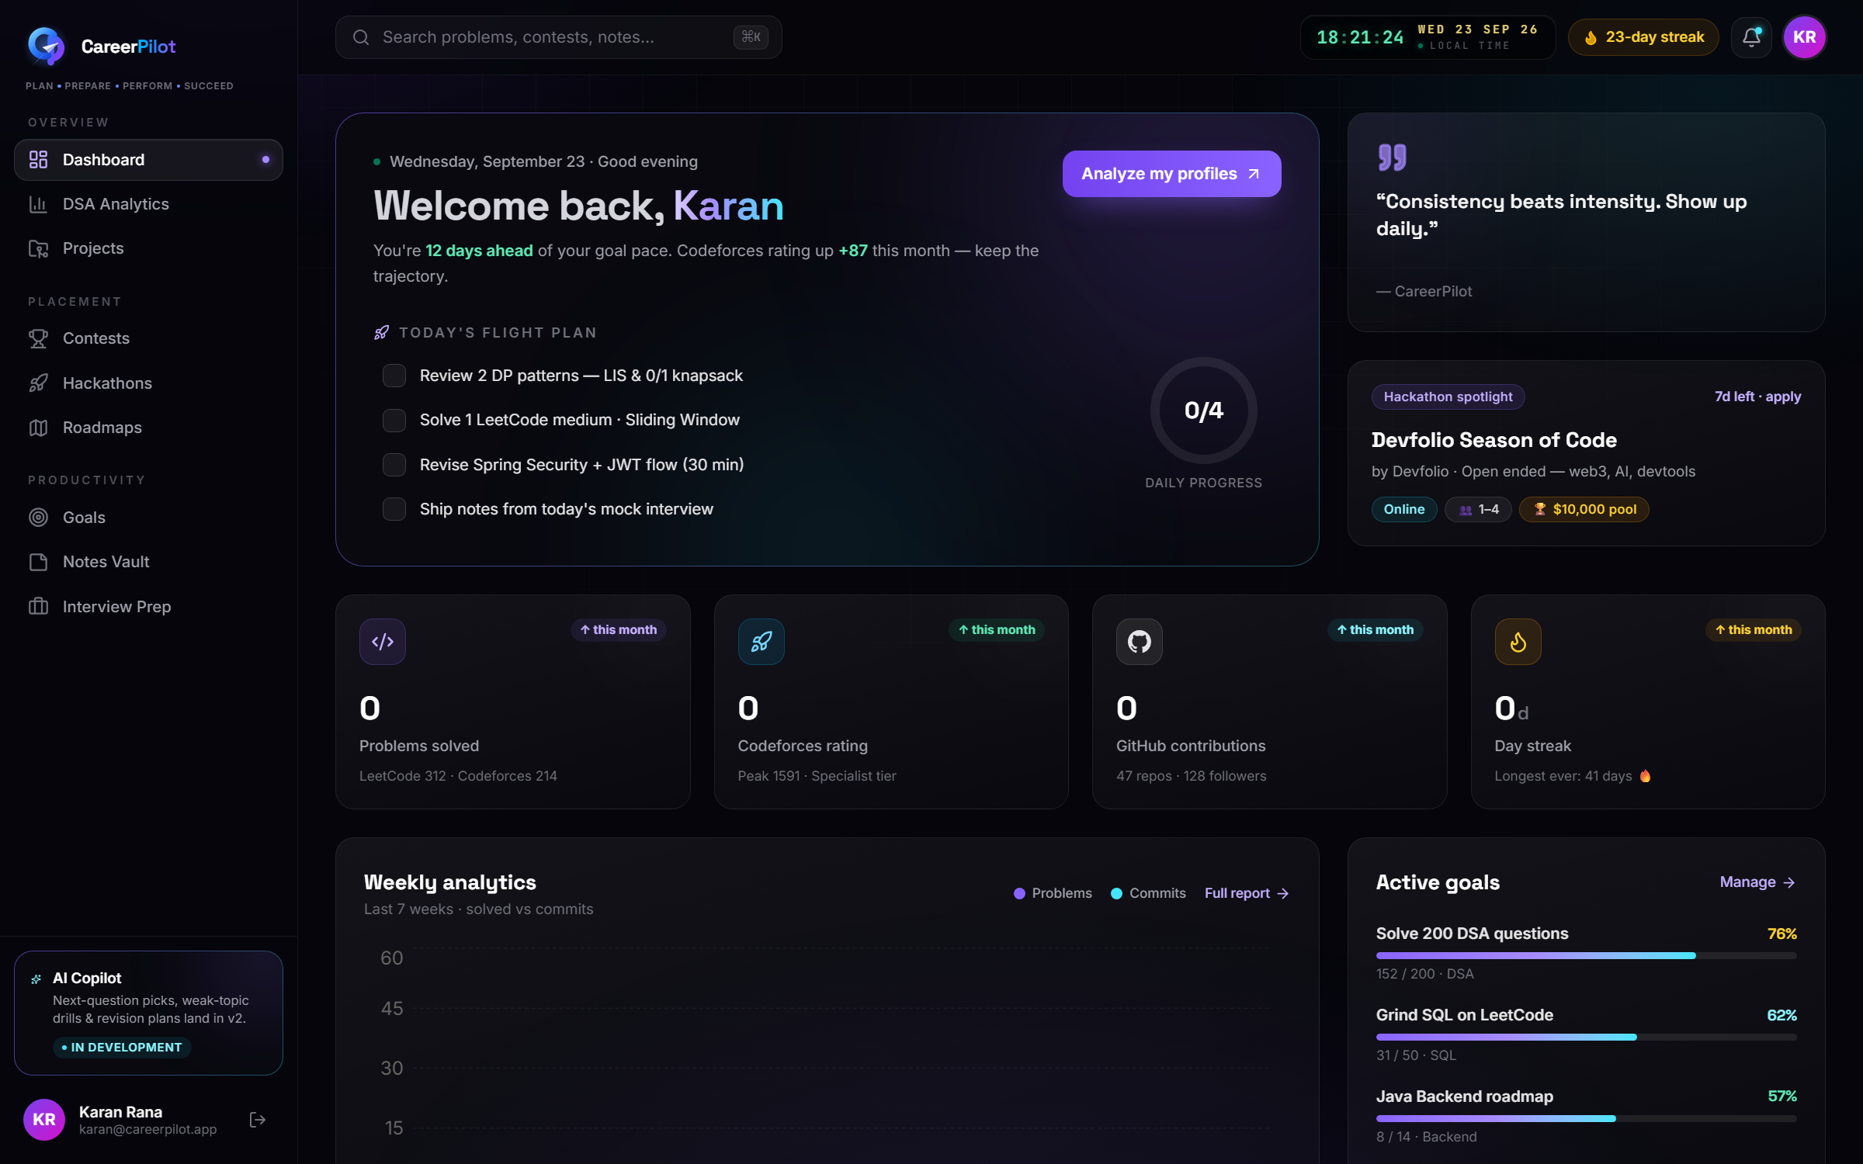
CareerPilot
10 · PRODUCT WALKTHROUGH
The dashboard: everything in one screen
Welcome & pace
Goal pace, streak and a nudge, computed from the week's activity.
Daily flight plan
A short, achievable checklist for today — not a backlog.
Stat tiles
Problems solved, contest rating, GitHub contributions, day streak.
GitHub heatmap
Contribution graph with longest streak and top language.
Contests & roadmaps
What's coming up, and where you are in each learning path.
Real screenshot from the running build — the sidebar, top bar and avatar all resolve from the live API.
CareerPilot · Mid-Evaluation Progress Review
12 / 18
Notes:
Point at five things, no more. The most persuasive detail is the top-right clock and the streak chip — small touches that make it feel like a product rather than a college project. Be ready to say which numbers are live (the user identity) and which are still mock (the statistics), because that question will come.

Slide 13
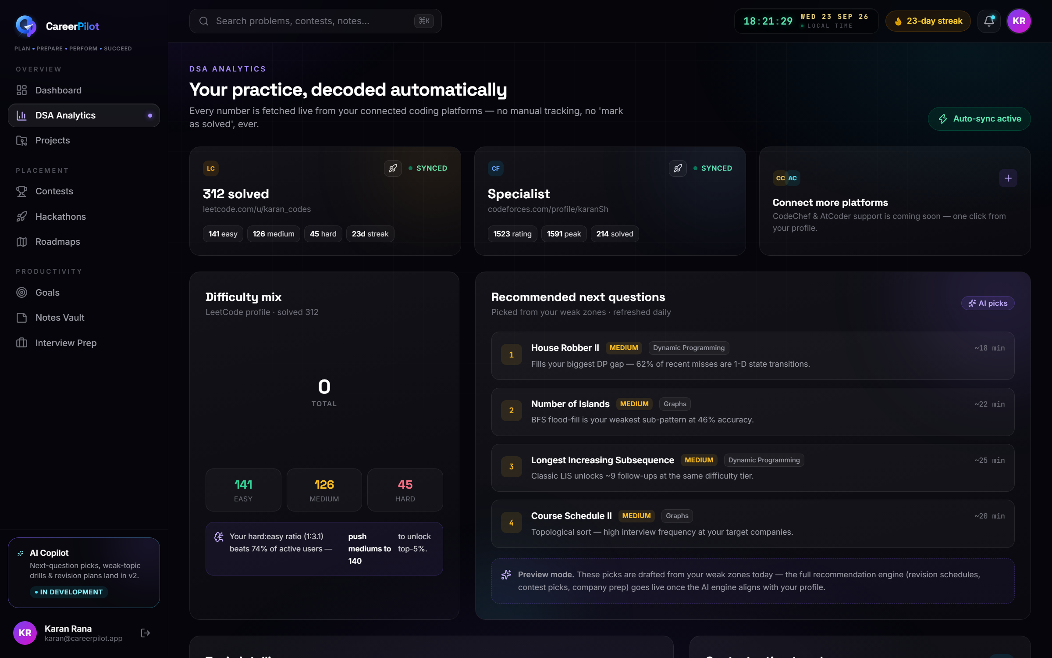
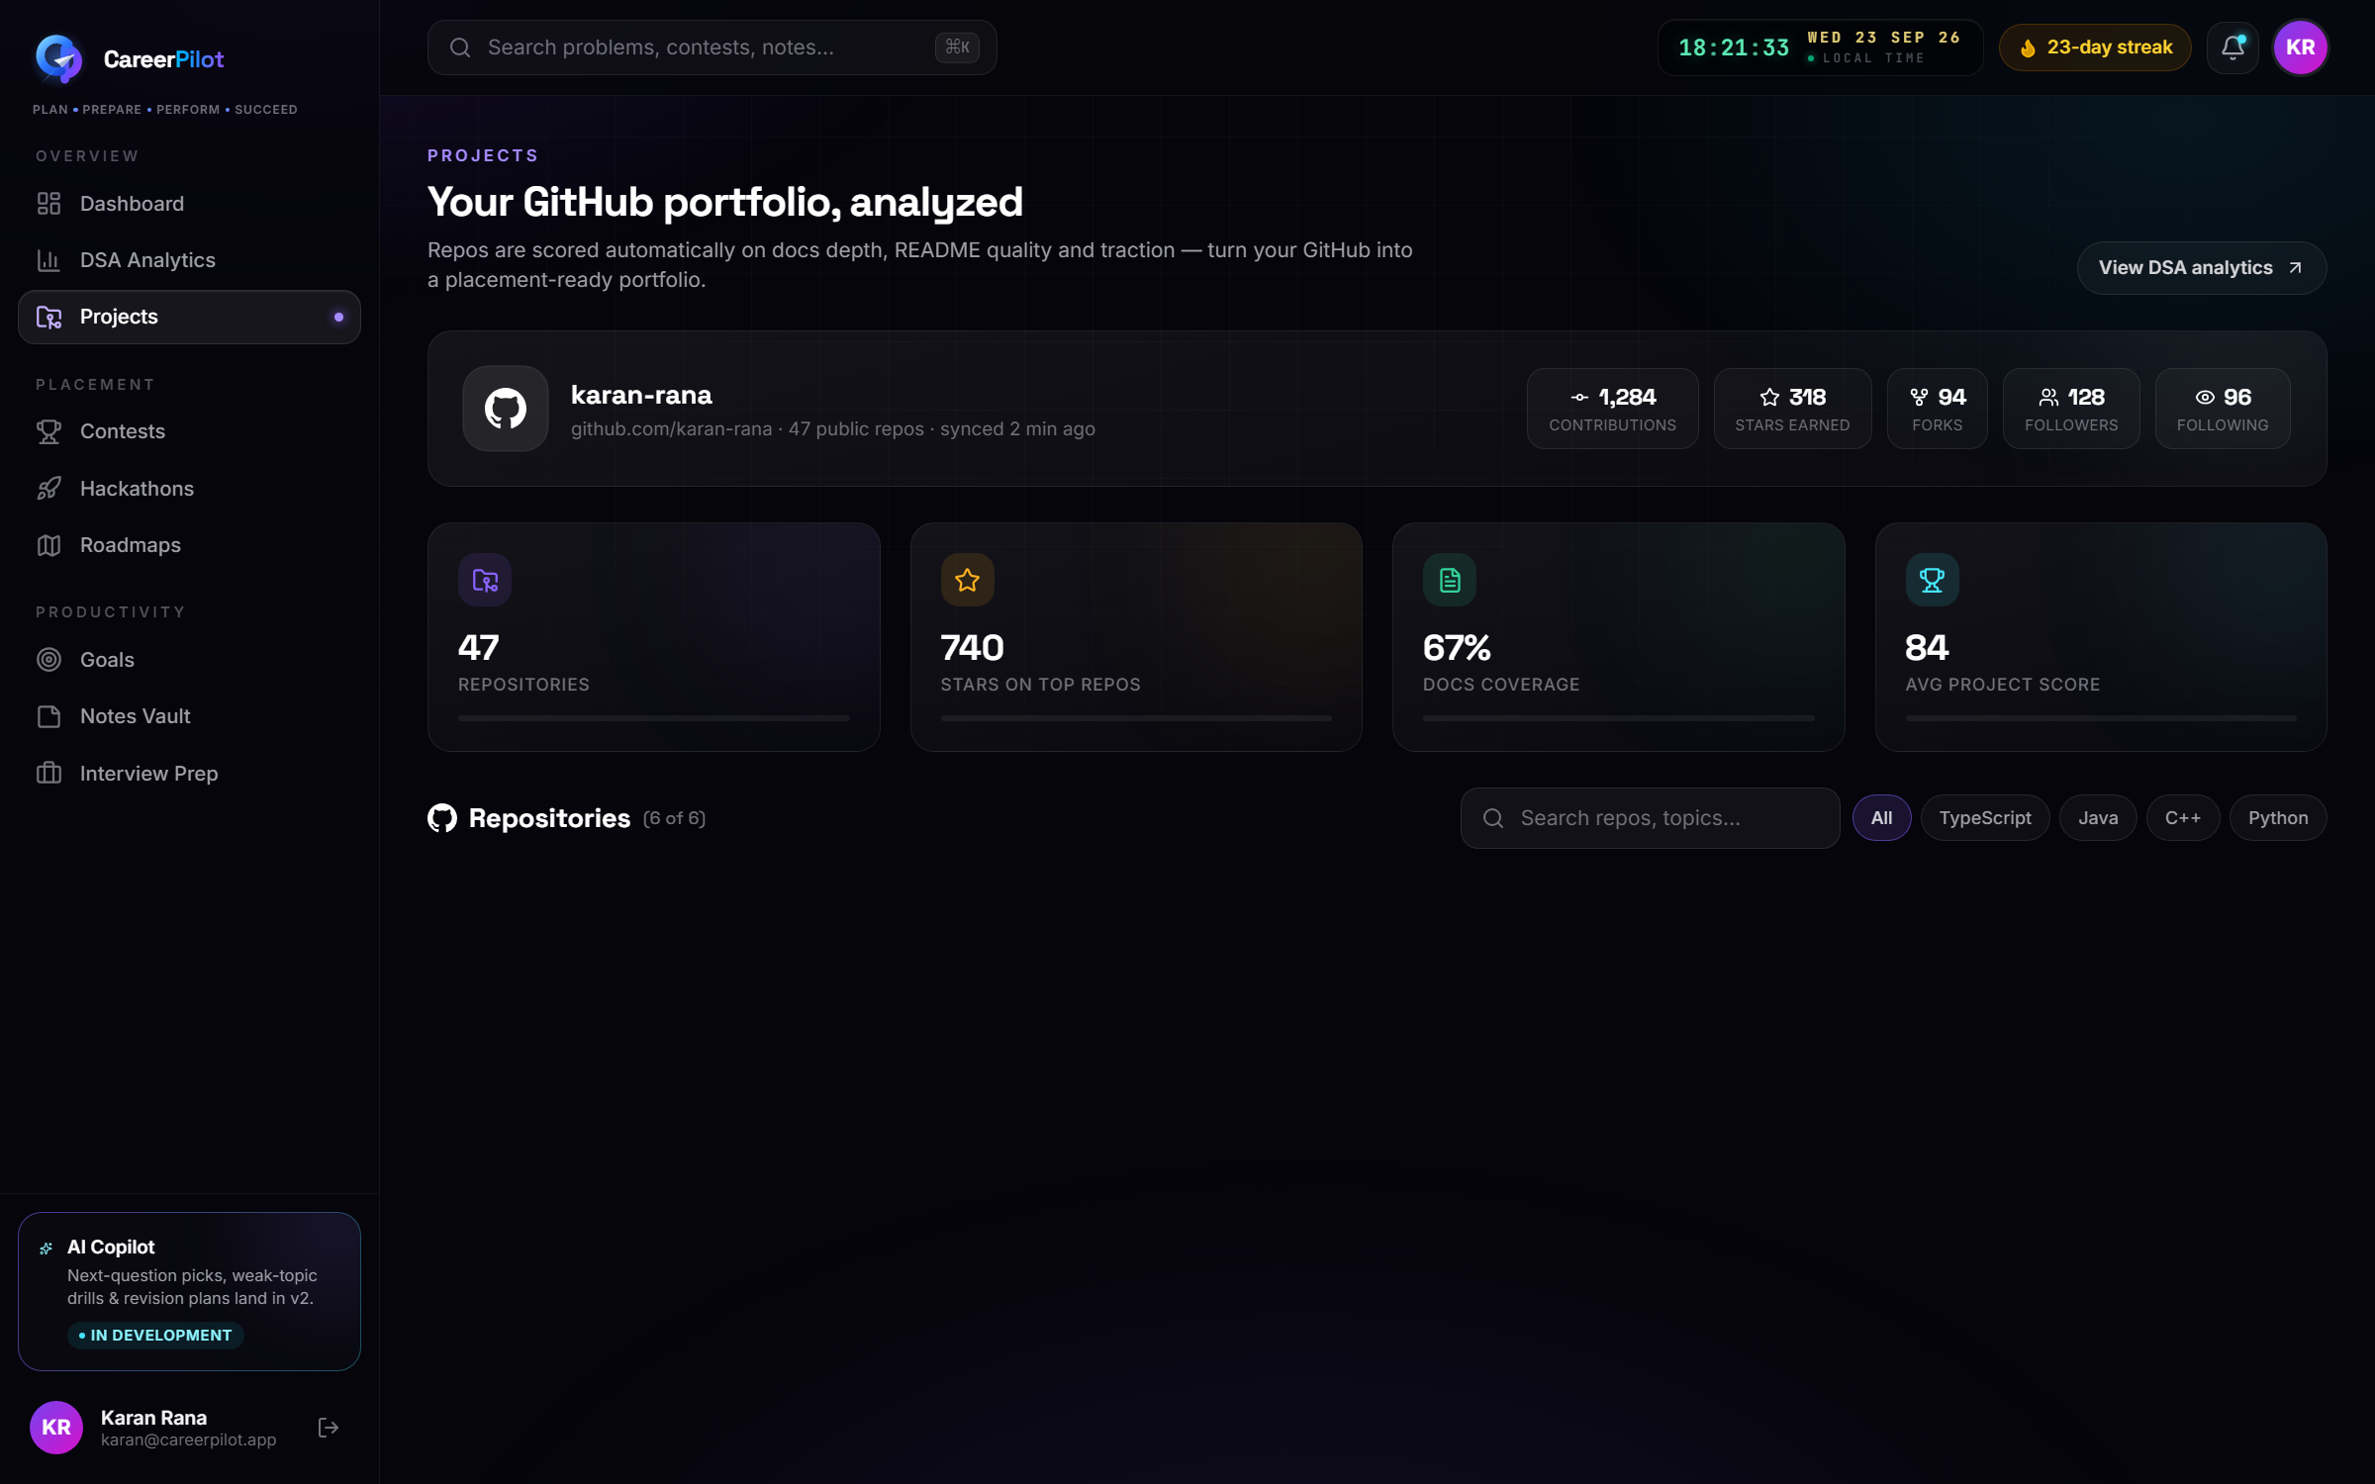
CareerPilot
10 · PRODUCT WALKTHROUGH
DSA analytics and the GitHub portfolio analyzer
These two pages replaced a single combined 'coding analytics' screen — the data they show has different refresh rates and different owners.
DSA Analytics — platform cards per profile, difficulty split, topic intelligence with weak-topic flags, Codeforces rating trend, practice heatmap, and a reserved card for AI recommendations.
Projects — GitHub statistics, a repo grid with live-demo and source links, language breakdown, and portfolio-quality scoring across documentation and structure.
CareerPilot · Mid-Evaluation Progress Review
13 / 18
Notes:
Explain the split deliberately: DSA is a fast-moving, per-platform time series, while a portfolio changes slowly and is analysed as a document set. Merging them produced a screen that did neither job well, so they are separate routes driven by separate data. This shows product judgement, which is what separates a build from a project.

Slide 14
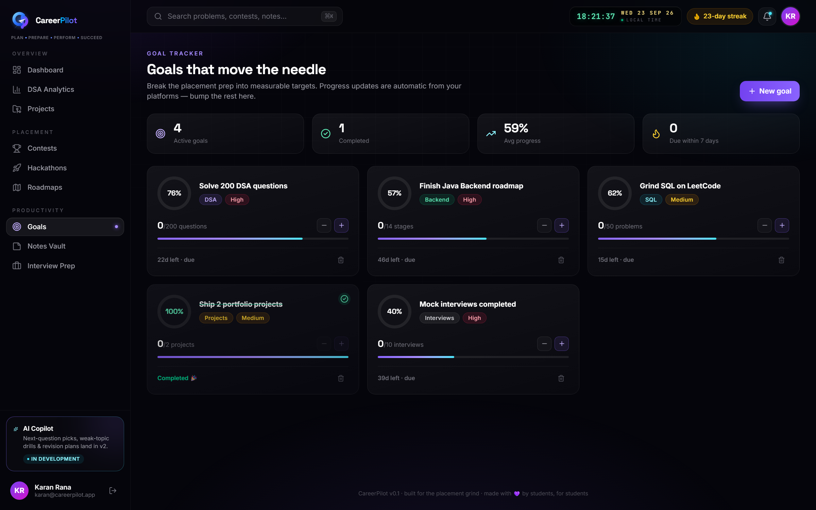
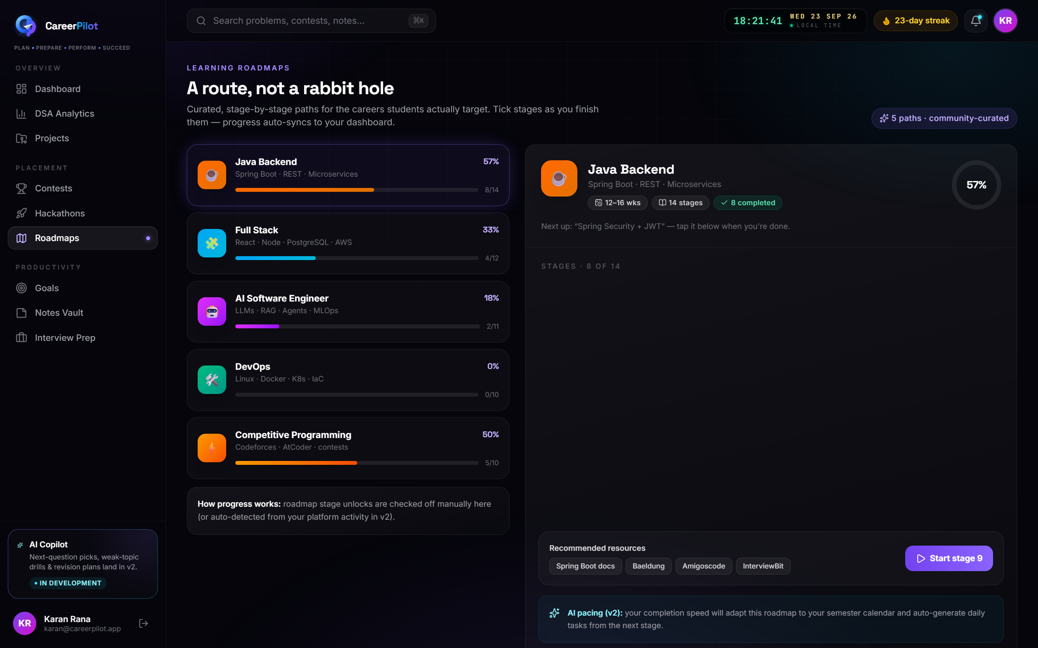
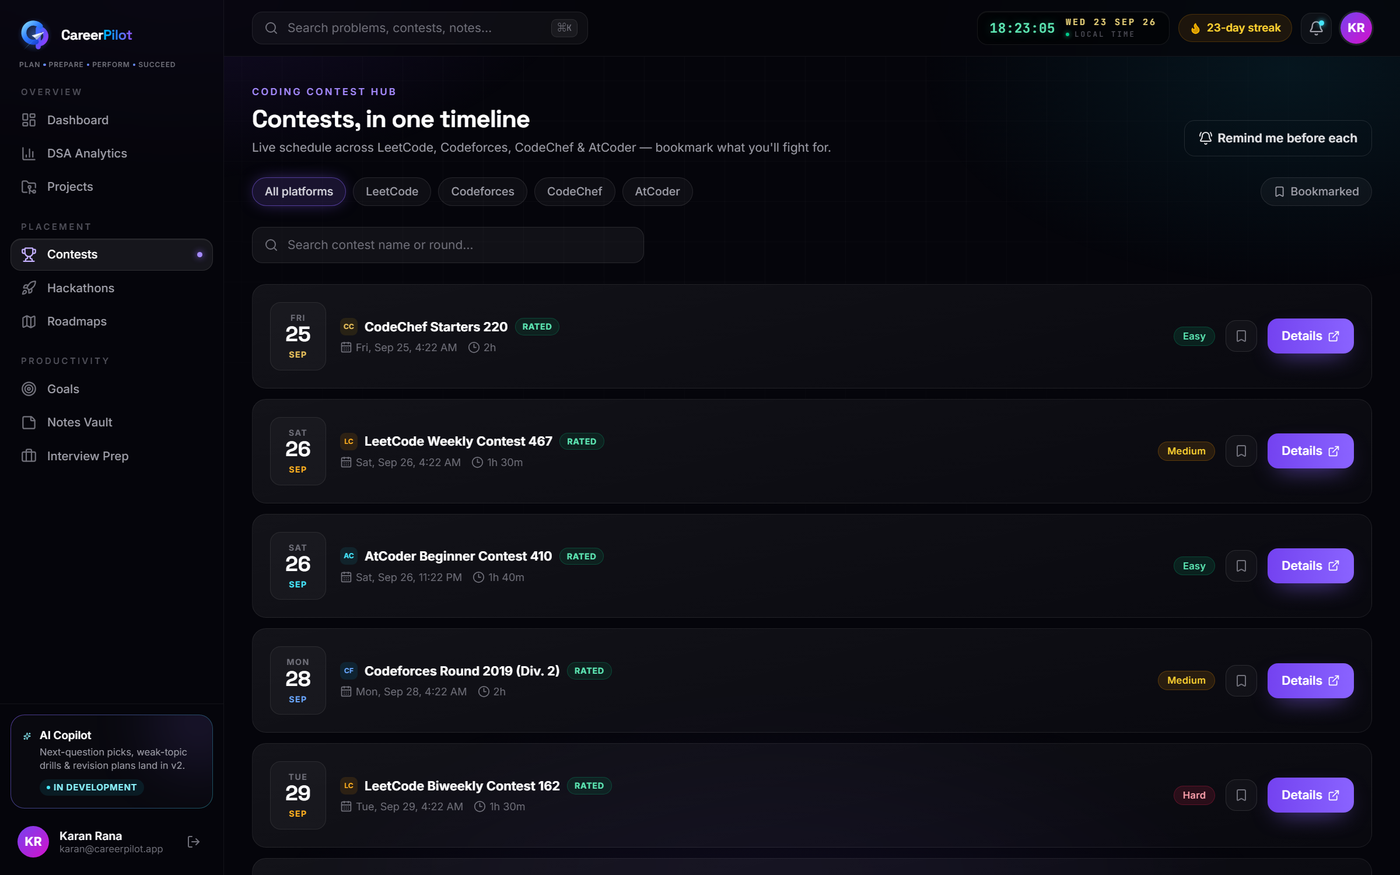
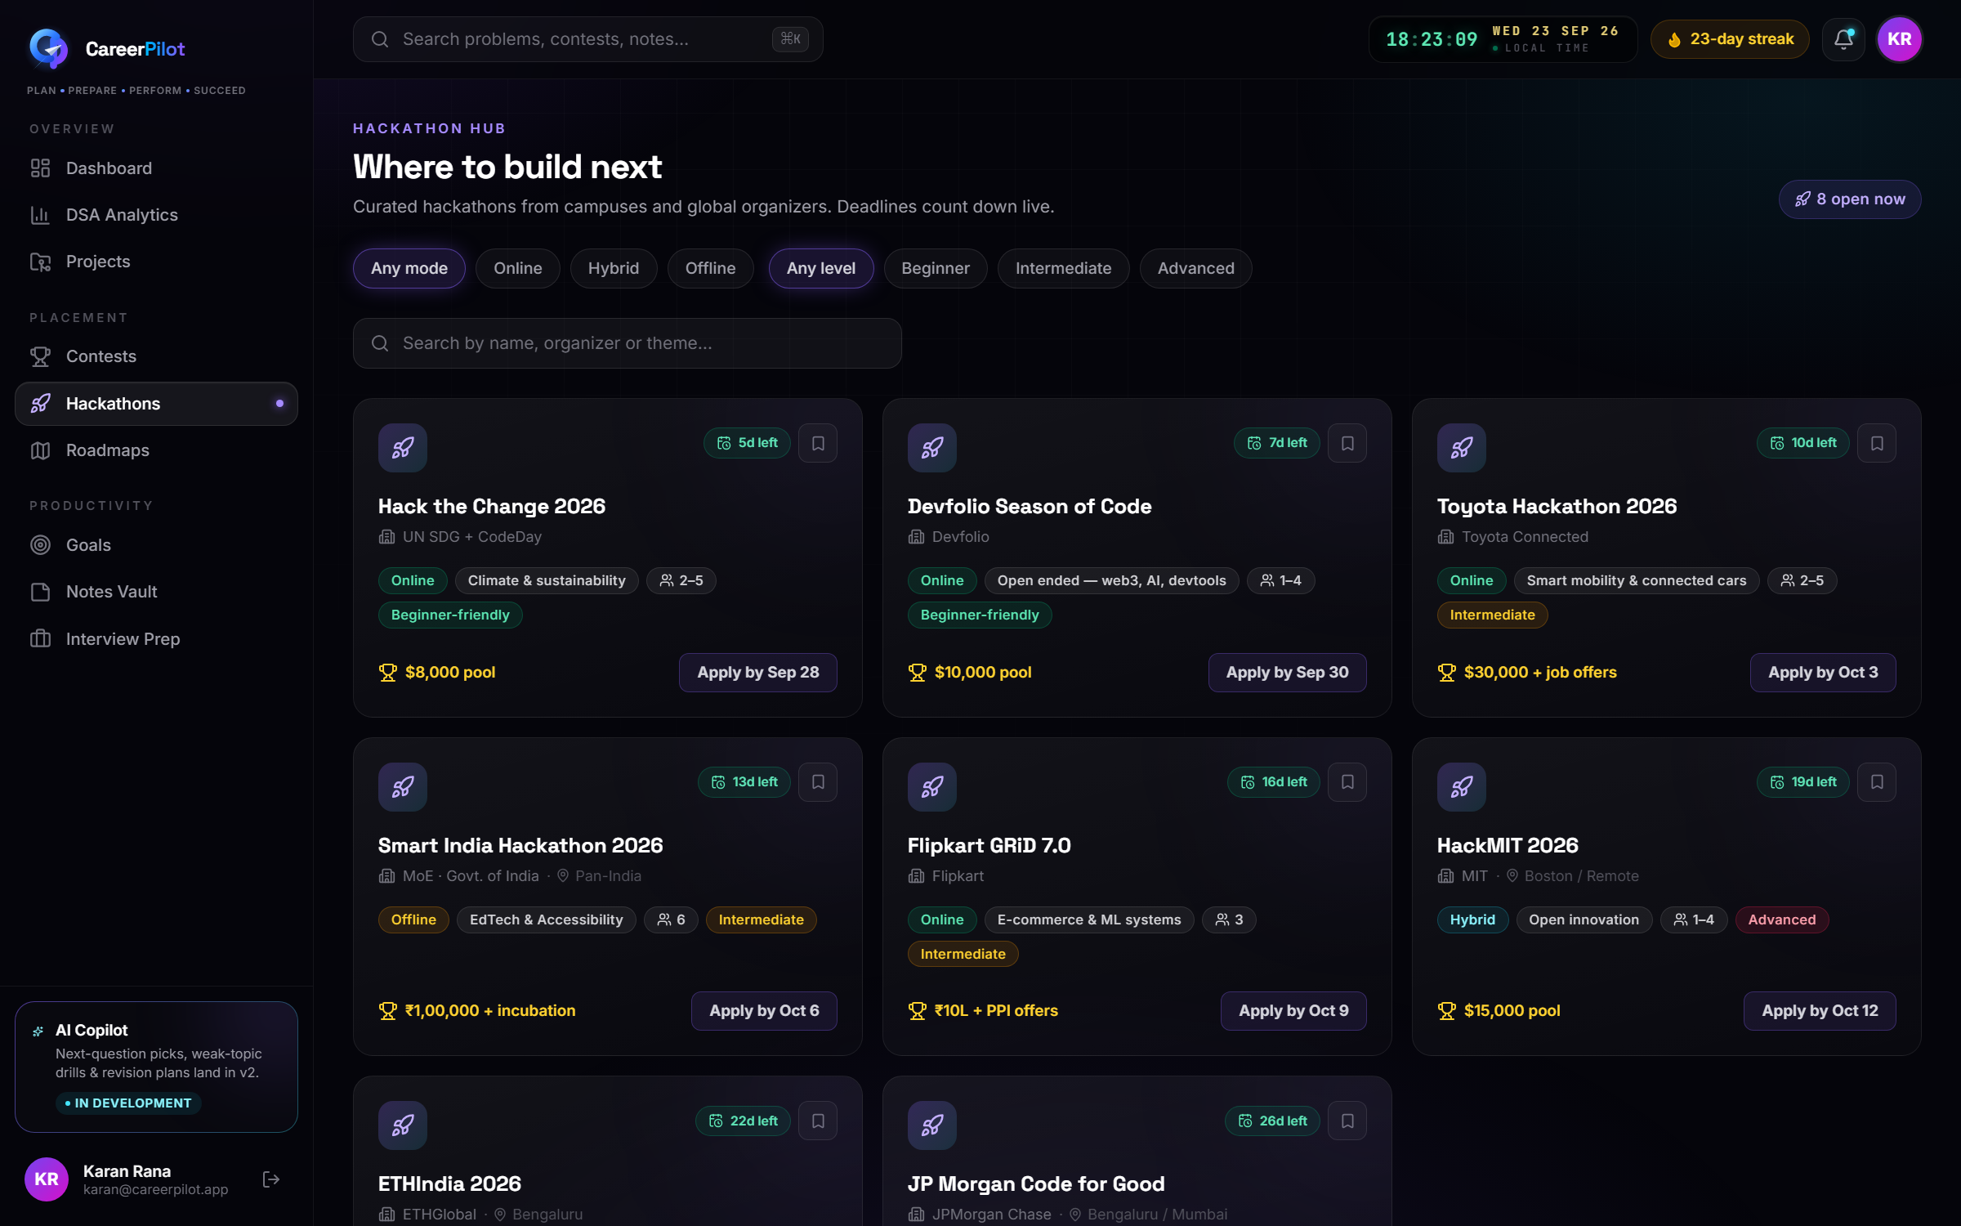
CareerPilot
10 · PRODUCT WALKTHROUGH
Planning and discovery surfaces
Goals
Roadmaps
Progress, deadlines, priority and status — with completion percentages that update from linked activity.
Curated Java Backend, Full Stack, AI, DevOps and Competitive Programming paths with staged progress.
Contests
Hackathons
A single timeline across LeetCode, Codeforces, CodeChef and AtCoder, with start times and bookmarks.
Search and filter by mode, team size, theme and prize pool, with bookmarks and admin management.
CareerPilot · Mid-Evaluation Progress Review
14 / 18
Notes:
Move quickly here — these are the productivity surfaces, and the argument is breadth: goals, roadmaps, contests and hackathons all live behind the same navigation, the same design system and the same data contract. Notes and the interview hub are two more screens built the same way.

Slide 15
CareerPilot
11 · ROADMAP & FUTURE SCOPE
Where the build stands, stage by stage
Stages 0–3 complete · roughly 40% of the planned build
8–10 weeks part-time remaining
STAGE 0
STAGE 1
STAGE 2
STAGE 3
STAGE 4
Contracts & docs
Database & migrations
Backend skeleton
Auth & identity
Goals vertical slice
Verified
Verified
Verified
Verified
In progress
STAGE 5
STAGE 6
STAGE 7
STAGE 8
STAGE 9
Feature fan-out
Platform sync engine
Recommendations
AI layer
Hardening & ship
Planned
Planned
Planned
Planned
Planned
Milestone 1 (Stages 0–3) is complete and verified. Milestone 2 begins with the Goals vertical slice, which proves the full browser → API → database path on real data.
CareerPilot · Mid-Evaluation Progress Review
15 / 18
Notes:
Be explicit that stages 0–3 are done *and verified*, not merely written. Explain why auth came first: every later feature inherits ownership rules and the request pipeline from it, so building it after the features would mean retrofitting security into eleven screens. The Goals slice is next because it proves Vercel → Render → Neon end to end with real writes.

Slide 16
CareerPilot
11 · FUTURE SCOPE
What version 2 unlocks
AI recommendation engine
Live platform sync
AI portfolio review
Career readiness score
Harden & scale
Next question to solve, weak-topic drills, a weekly practice plan and a revision schedule.
Codeforces, GitHub and LeetCode pulled on a schedule into time-series snapshots, with a 'synced X ago' badge.
Resume bullets, README suggestions and project improvements generated from real repository data.
A single score built from solved problems, contest rating, portfolio quality and interview coverage.
Rate limits, lazy-loaded routes to cut the bundle, monitoring, PITR backups and a separate production environment.
The AI layer is deliberately last, and deliberately optional. Stage 7 is a rule-based engine that produces the same recommendations deterministically — so recommendations work, and keep working, with no model in the loop. AI then explains and personalises them; it never invents the numbers.
CareerPilot · Mid-Evaluation Progress Review
16 / 18
Notes:
The line to land: deterministic analytics stay deterministic, and AI only explains and suggests. If the invigilator asks 'what if the AI is wrong?', the answer is that no number on any screen depends on a model — the rule-based engine is the permanent fallback, and the AI layer adds prose on top of computed facts.

Slide 17
CareerPilot
12 · CONCLUSION
What this milestone establishes
The foundation is real
The contract is frozen
The UI is ahead by design
A 23-table schema on managed Postgres, a secured REST API and a complete authentication lifecycle — all running, not sketched.
Every endpoint, request body and error code for all eleven feature areas is written down, so features are built against an agreed interface.
Eleven screens are already built against that contract, which is why swapping mock data for live data is a data-layer change, not a rewrite.
CareerPilot is not another opportunity board or manual DSA tracker — it is the workspace that reads what a student has already done and turns it into a plan.
Next: finish the feature slices on this foundation, then switch on the recommendation engine.
CareerPilot · Mid-Evaluation Progress Review
17 / 18
Notes:
Close on the engineering story, not the feature list: schema under migration control, authentication verified in both directions, a frozen API contract and a UI built against it. Then state the next step concretely — the Goals vertical slice — so the reviewer leaves knowing exactly what comes next.

Slide 18
Thank you
Questions and discussion
Karan Rana · B.Tech Computer Science & Engineering · 2nd Year
Madhav Institute of Technology and Science, Gwalior
github.com/karan-rxna/Career-Pilot
Plan · Prepare · Perform · Succeed
18 / 18
Notes:
Stop talking and invite questions — the deck has already made the argument. Have the running app open in a second window so you can jump straight to a live login and the dashboard rather than describing it.

