Slide 2
Managing Events
An event is a specific occurrence within the Web browser. For example:
opening up a Web page
positioning the mouse pointer over a location on that page
Events are an important part of JavaScript programming, you can write scripts that run in response to the actions of the user, even after the Web page has been opened.

Slide 3
Working with Event Handlers
Events are controlled in JavaScript using event handlers that indicate what actions the browser takes in response to an event.
Event handlers are created as attributes added to the HTML tags in which the event is triggered.
The general syntax is:
< tag onevent = “JavaScript commands;”>
tag is the name of the HTML tag
onevent is the name of the event that occurs within the tag
JavaScript commands are the commands the browser runs in response to the event

Slide 4
JavaScript Event Holders
This figure describes event handlers that JavaScript provides.
Category | Event Handler | Description | Netscape | IE
Window and Document events | onload | The browser has completed loading the document. | 2.0 | 3.0
 | onunload | The browser has completed unloading the document. | 2.0 | 3.0
 | onabort | The transfer of an image as been aborted. | 3.0 | 4.0
 | onerror | An error has occurred in the JavaScript program. | 3.0 | 4.0
 | Onmove | The user has moved the browser window. | 4.0 | 3.0
 | onresize | The user has resized the browser window. | 4.0 | 4.0
 | onscroll | The user has moved the scrollbar. |  | 4.0
Form events | onfocus | The user has entered an input field. | 2.0 | 3.0
 | onblur | The user has exited an input field. | 2.0 | 3.0
 | onchange | The content of an input field has changed. | 2.0 | 3.0
 | onselect | The user has selected text in an input or textarea field. | 2.0 | 3.0
 | onsubmit | A form has been submitted. | 2.0 | 3.0
 | onreset | The user has clicked the Reset button. | 3.0 | 4.0
Keyboard and Mouse events | onkeydown | The user has begun pressing a key. | 4.0 | 4.0
 | onkeyup | The user has released a key. | 4.0 | 4.0
 | onkeypress | The user has pressed and released a key. | 4.0 | 4.0
 | onclick | The user has clicked the mouse button. | 2.0 | 3.0
 | ondblclick | The user has double-clicked the mouse button. | 4.0 | 4.0
 | onmousedown | The user has begun pressing the mouse button. | 4.0 | 4.0
 | onmouseup | The user has released the mouse button. | 4.0 | 4.0
 | onmousemove | The user has moved the mouse pointer. | 4.0 | 4.0
 | onmouseover | The user has moved the mouse over an element. | 2.0 | 3.0
 | onmouseout | The user has moved the mouse out from an element. | 3.0 | 4.0

Slide 5

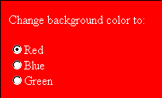
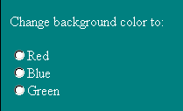
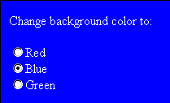
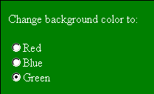
Using the Onclick Event Handler
This figure shows an example of the onclick event handler used with a collection of radio buttons.
When the user clicks a radio button, the click event is initiated and the onclick event handler instructs the browser to run a JavaScript command to change the background color of the Web page.
JavaScript commands
users clicks the red button
users clicks the blue button
initial Web page
users clicks the green button

Slide 6
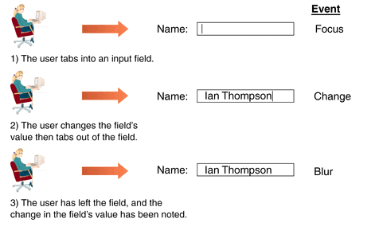
Events Initiated by the User During Data Entry
This figure shows that events often take place in rapid succession.

Slide 7
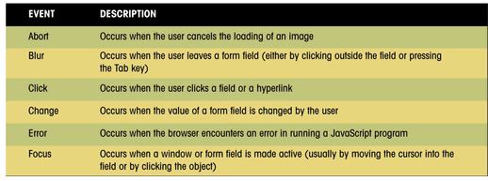
JavaScript Events
This figure shows JavaScript events.

Slide 8
Browser and Event Handlers
Generally, Internet Explorer and Netscape 6.0 can apply event handlers to most HTML tags.
Versions of Netscape prior to 6.0 apply event handlers to a smaller number of HTML tags.
Test Web pages with a variety of browsers and browser versions, especially if the Web page relies on JavaScript functions to operate correctly.

Slide 9
Running JavaScript Commands as Hyperlinks
To run a command in response to the click event, an easy way of doing this is to create a hyperlink around the object to receive the mouse click.
The syntax for doing this is:
<a href=“javascript:JavaScript commands”>Hypertext</a>
JavaScript commands are the commands you want to run when the text link Hypertext is clicked by the user

Slide 10
Running JavaScript Commands as Hyperlinks Continued
The following code changes the Web page’s background color to red when the hypertext “Change background to red” is clicked.
<a href=“javascript:document.bgcolor= ‘red’;”>
Change background to red
</a>
One advantage of this technique is that you can apply it to objects that might not support the onclick event handler in all browsers or browser versions.

Slide 11
Using the onload Event Handler
The event handler for loading the Web page is the onload event handler.
This handler is associated with the document object and must be placed in the <body> tag of the HTML file.
When the browser encounters the load event, it runs the startform() function.

Slide 12

Events Initiated by the User During Data Entry
This figure shows events initiated by the user during data entry.
event handler
function to run when the page is loaded by the browser

Slide 13
The startform() Function
The startform() function relies on another JavaScript function named todaytxt().
The code for the todaytxt() function is as follows:
function todaytxt() {
var Today=new Date();
return today.getMonth()+1+”/”+Today.getDate()+”/”+Today.
getFullYear();
}

Slide 14
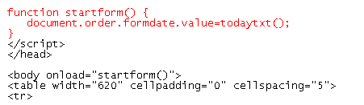
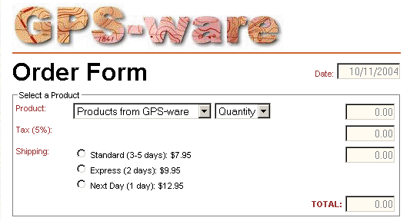
Creating The startform() Function
This figure shows that one of the purposes of the startform() function, is to retrieve the date string and display it in the formdate field of the order form.
current date

Slide 15
Properties, Methods, and Event Handlers of Input Fields
This figure shows additional properties and methods that can be associated with fields.
Property | Description | IE | Netscape
defaultvalue | Default value of the field | 3.0 | 2.0
maxlength | Maximum number of characters in the field | 4.0 | 6.0
name | The name of the field | 3.0 | 2.0
size | The width of the field in characters | 4.0 | 6.0
type | The type of input field | 4.0 | 3.0
value | The value of the input field | 3.0 | 2.0
Method | Description | IE | Netscape
blur() | Remove the focus from the field | 3.0 | 2.0
focus() | Give focus to the field | 3.0 | 2.0
select() | Select the field | 3.0 | 2.0
Event Handler | Description | IE | Netscape
onfocus() | Run when the field receives the focus | 3.0 | 2.0
onblur() | Run when the field loses the focus | 3.0 | 2.0
onchange() | Run when the value of the field changes | 3.0 | 2.0

Slide 16
Initiating Events and JavaScript
When using JavaScript to initiate an event, you are instructing the Web page to perform an action that a user would normally do.
for example, such as moving the cursor to a specific field in the form

Slide 17
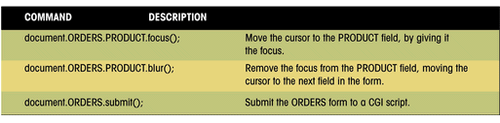
Initiating an Event with JavaScript
This figure shows three examples of JavaScript commands that initiate events in a order form.

Slide 18
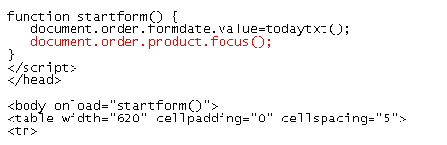
Moving the Focus to the Product Field
This figure shows an example of moving the focus to the product field.
the product field receives the focus of the cursor after the current date is entered in the formdate field

Slide 19
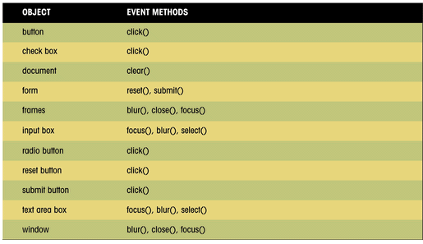
Emulating an Event with Event Methods
This figure shows additional events you can emulate in forms.

Slide 20
Working with Radio Buttons
The JavaScript reference for a radio button is:
document.form.field[i]
form is the name of the Web page form
field is the name assigned to the radio button
i is the index number of specific radio button
The first radio button has an index value of 0, the second button has an index value of 1, and so on.
the JavaScript object references for three shipping radio buttons are:
document.order.shipping[0]
document.order.shipping[1]
document.order.shipping[2]

Slide 21
Properties, Methods, and Event Handlers of Radio Buttons
This figure describes some of the properties, methods, and
event handlers associated with radio buttons.
Property | Description | IE | Netscape
checked | A Boolean value indicating whether the radio button has been checked | 3.0 | 2.0
name | The name of the radio button field | 3.0 | 2.0
value | The value of radio button | 3.0 | 2.0
Method | Description | IE | Netscape
focus() | Give focus to the radio button | 3.0 | 2.0
blur() | Remove focus from the radio button | 3.0 | 2.0
click() | Click the radio button | 3.0 | 2.0
Event Handler | Description | IE | Netscape
onfocus() | Run when the radio button receives the focus | 3.0 | 2.0
onblur() | Run when the radio button loses the focus | 3.0 | 2.0
onclick() | Run when the radio button is clicked | 3.0 | 2.0

Slide 22
Working with Radio Buttons Continued
For example, the values of the three shipping radio buttons can be expressed as follows in JavaScript:
document.order.shipping[0].value = “7.95”;
document.order.shipping[1].value = “9.95”;
document.order.shipping[2].value = “12.95”;

Slide 23
A Problem with Radio Buttons
There is no JavaScript object that refers to the entire collection of radio buttons; thus there is no single value property that tells us which button was selected.
There are only value properties for the individual radio buttons.
You could treat each radio button as a different field and run a different function for each button.
You could use an If…Then statement to test which radio button was selected.
There is an easier way: use the “this” keyword.

Slide 24
Working the “this” Keyword
The “this” keyword is a JavaScript object name that refers to the currently selected object.
Useful in situations where several different objects on the page might access the same function.
in that situation, the “this” keyword can pass along information about the object that initiated the function

Slide 25
Properties, Methods, and Event Handlers of Check Boxes
This figure lists some of the properties, methods, and event handlers of check box objects.
Property | Description | IE | Netscape
checked | A Boolean value indicating whether the check box has been checked | 3.0 | 2.0
name | The name of the check box field | 3.0 | 2.0
value | The value of the check box | 3.0 | 2.0
Method | Description | IE | Netscape
focus() | Give focus to the check box | 3.0 | 2.0
blur() | Remove focus from the check box | 3.0 | 2.0
click() | Click the check box | 3.0 | 2.0
Event Handler | Description | IE | Netscape
onfocus() | Run when the check box receives the focus | 3.0 | 2.0
onblur() | Run when the check box loses the focus | 3.0 | 2.0
onclick() | Run when the check box is clicked | 3.0 | 2.0

Slide 26
Submitting a Form
If a condition of the form is not met, the browser should refuse the form submission and indicate to the user why the form was not submitted.

Slide 27
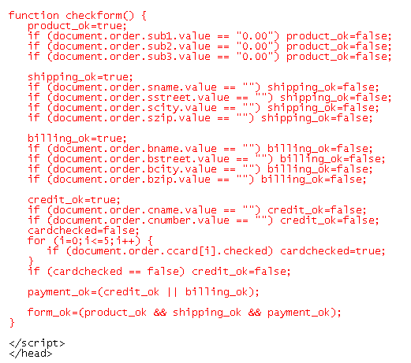
Creating the check_form() Function
test that a product, quantity, and shipping method has been selected
test that a shipping address has been entered
test whether a billing address has been entered
test whether a card name and number has been entered
test whether a credit card type has been selected
test whether the user has entered a billing address or complete credit information
test whether the entire form has been completed properly

Slide 28
Controlling Form Submission
When a user completes a form and then clicks the submit button, a submit event is initiated.
JavaScript provides the onsubmit event handler that allows you to run a program in response to this action.
The submit event is associated with the form object, the event handler must be placed within the <form> tag.
The onsubmit event handler must be able to override the act of submitting the form if the form fails a validation test.

Slide 29
The onsubmit Event Handler
The syntax for doing this is:
<form onsubmit=“return function();”>
function is the name of the function that validates your form
the function must return a value of true or false
if the value is true, the form is submitted
if the value is false, the submission is canceled, and the user is returned to the form
the keyword return in this syntax.
if the return keyword is not included, the browser submits the form whether or not it passes the validation test

Slide 30
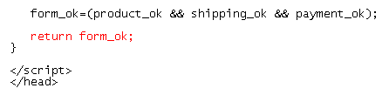

Using the onsubmit Event Handler
This figure shows the code to return the value of the form_ok variable that indicates whether or not the form was completed properly.

Slide 31
Question - 1
Form 10 question and answers about your best mate and form a quiz with them.
The quiz should finally calculate the score of all the correct answers and should display a prompt message when the user submits the form

