Slide 1
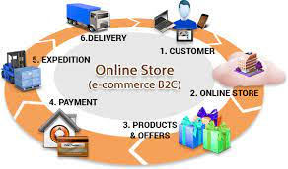
Name:- karan Mane
Roll.no:- 30
Branch:- INFT
Subject:-E Commerce & E Business
Topic:- Case study-Flipkart
Model:- Business To Customer(B2C)

Slide 2
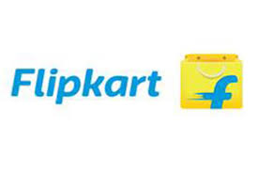
Introduction
Flipkart is an electronic commerce company headquartered in Bengaluru India.
It was founded in October 2007 by Sachin Bansal and Binny Bansal Flipkart has launched its own product under the name “DigiFlip” with product including tablets, USBs and Laptop bags.
As of April 2017, the company was valued at $11.6 billion
Flipkart is world’s top 10 most visited E-commerce website in India with regards to traffic.
Multiple Payment method is available for it’s customer to make payment easier.
Fastest growing e-commerce website in India.
It sells 30 product per min

Slide 3
Problem Statement
Marketing of product and sales happening on web-site.
Consumers thinking towards online shopping.
Proof for legality of product.
Safer payment Gateway for consumers.

Slide 4
Need
As time passes Flipkart also need to increases the stock of product and introduces new product likes clothing and groceries.
Flipkart also increases method of payments which helps a lot of people ex, it gives EMI on electronic devices which have price over 10,000 and it helps a lot of people to buy new technology in easy way.
Return of product method should be easy.
Due to this pandemic happening around the globe flipkart should provide contactless deliveries to their consumers.

Slide 5
Literature Survey
The study presents a review about consumer’s attitude towards grocery shopping, in both offline and online retail channels. The purpose was to acquire an overview of grocery shopping online. Whether by launching online grocery service will able to compete with local competitors in India.
Sherah Kurnia (2003) : According to his research paper about the acceptance of online grocery shopping the attitude of the potential consumer in terms of usefulness, continence and risk as well as the existence towards the social influence and visibility of technology influence the perception of customer towards online grocery shopping
Mishra & Kotkar(2015) trace the timeline and development of B2C e-commerce in “A Study on Current
Status of E-Commerce in India: A Comparative Analysis of Flipkart and Amazon”with its inception in the
mid 1990s through the advent of matrimonial and job portals. However, due to limited internet accessibility,
weak online payment systems and lack of awareness, the progress was very slow. The Indian B2C
ecommerce Industry got a major boost in mid 2000s with the expansion of online services to travel and hotel
booking which continue to be major contributors even today.
Link:-https://www.researchgate.net/publication/317496972_Growth_of_E-commerce_in_India_An_Analytical_Review_of_Literature

Slide 6
Problem Solution
Flipkart starts advertisment of product on Television,Newspaper,Online Blog ,YouTube,etc.
BRAND LOYALTY Excellent user experience on the e-commerce website in term of usability speed clarity will enhance the loyalty of existing customer and move a step a head of brand awareness towards customer retention.
Added an verification QR-code method to verify the product are original or not by the product company itself
Make Payment through Google payment gateway system or visa payment gateway which are safer to use.
Cash on delivery creates trust in the mind of Indian customers who are always have feared of making payments online. Flipkart focuses on providing the relevant information possible into every single page.

Slide 7
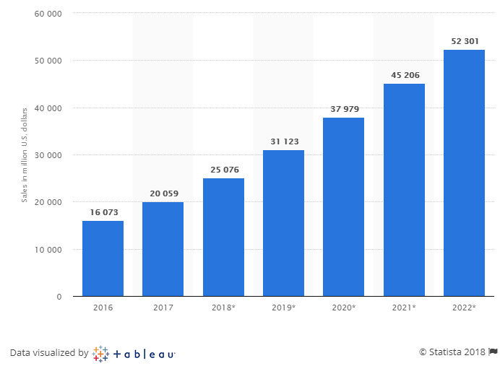
Future Scope
BRAND AWARENESS are key success factor in the market.
Artificial Intelligence :- Companies are now able to gather and investigate data in real-time thus facilitating competence and efficiency in the business.
Google’s Buy Now Button :- ‘Buy Now’ style button allow e-shoppers to search for any products on Google and purchasing can be done using single click only. The button offers customization and thus shopping process becomes flexible online. Thus without any headache product can be availed to the customer in less time.

Slide 8
Conclusion
Every time they require to update their Internal Structure Systems and Innovative Management System with sound database to provide end-to-end connectivity across all the different processes to reach out its suppliers, partners and customers effectively.
Online retail industry in India pegged to reach $73 billion 2022 so suggest that e-commerce is just hotting up in India. We may soon see many more internet companies achieving similar success.

Slide 9
Thank you

