Slide 1
BroadCastingChatServer Bhavya.A Devilal Godara Karan Singh Kavipriya Gudisa Madhuri

Slide 2
Abstract
Chat-Application provide the process of talking to other people who are using the Network at the same time you are.
Several network systems are built to communicate with one another as well as made available through service-oriented architectures. In this project, the client server architecture is used to develop a chat application. Firstly a chat application is created for both Client and Server which is based on Transmission Control Protocol(TCP) where TCP is connection oriented protocol and is a reliable connection protocol.
It is the Concept of “Chat Server” by using GUI Application and Socket Programming. Chat server should support multiple connection of users and messages sent to the server are broadcast to all currently connected users.

Slide 3
Introduction
Chatting is a process of utilizing technology to bring people and their ideas together despite of the geographical obstacles.
Through the help of this project, the users can easily communicate and also interact with each other.

Slide 4
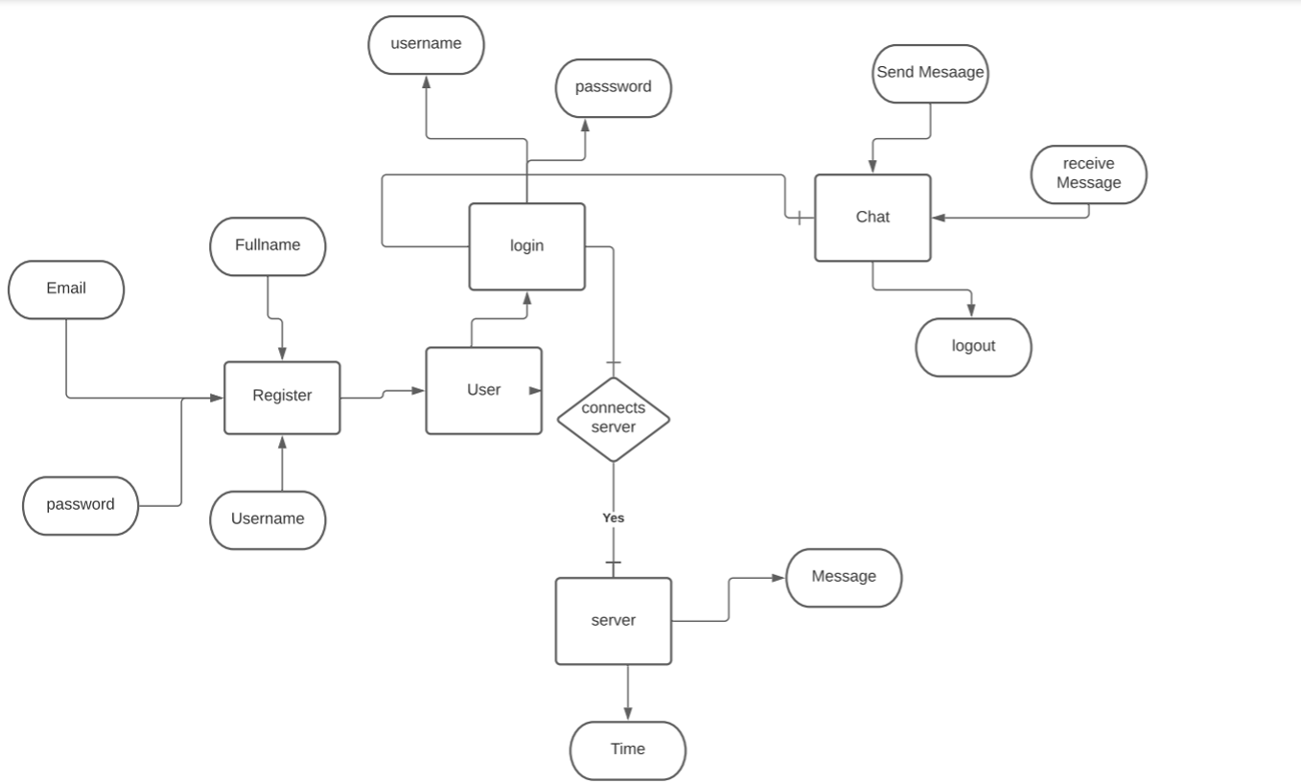
ER Diagram

Slide 5
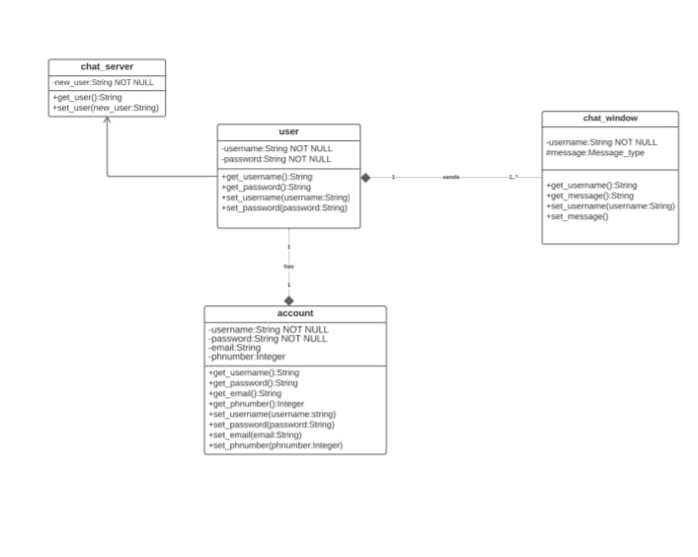
UML Diagrams Class Diagram

Slide 6
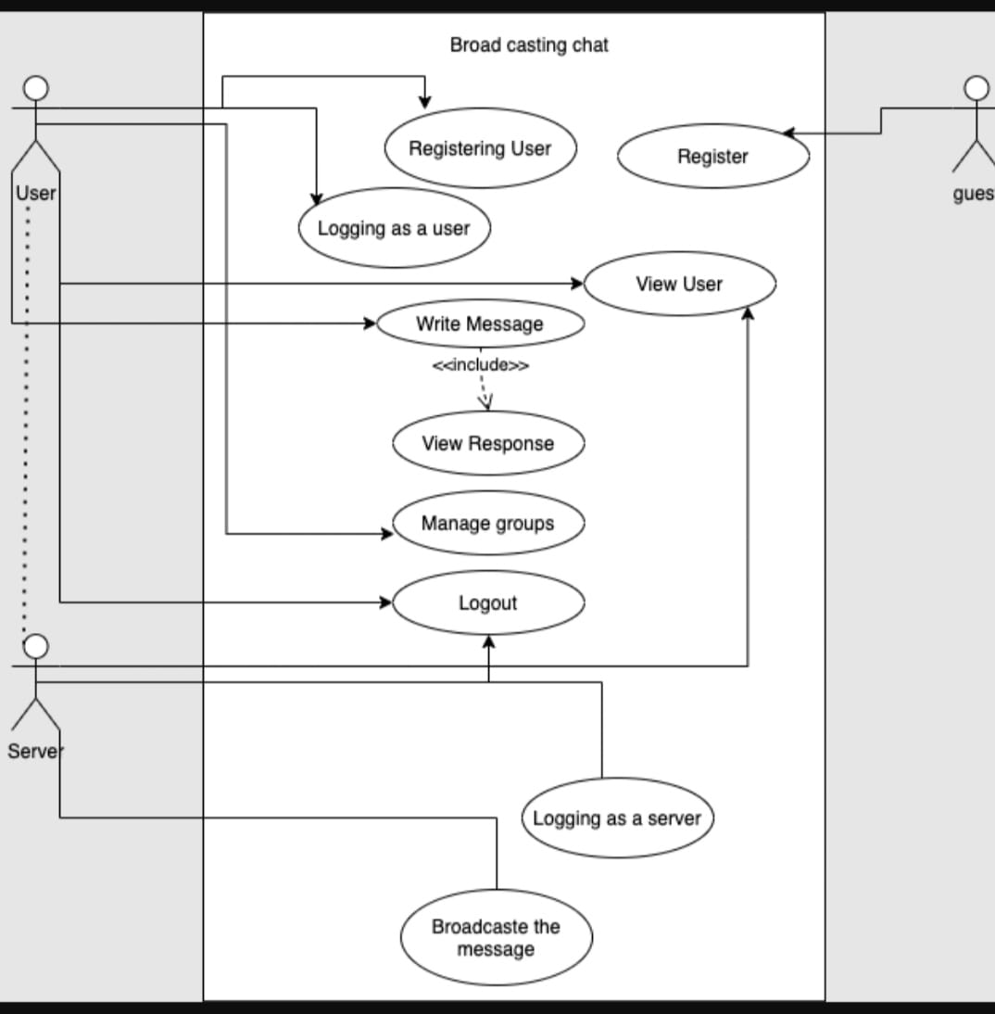
UseCase Diagram

Slide 7
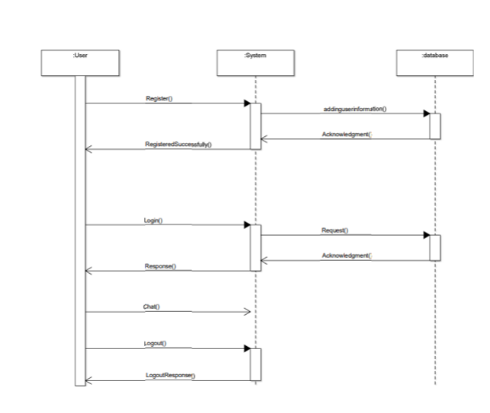
Sequence

Slide 8
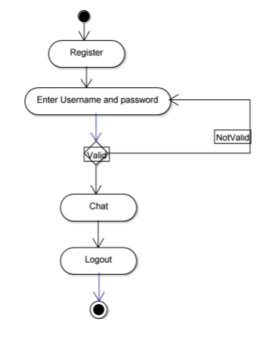
Activity Diagram

Slide 9
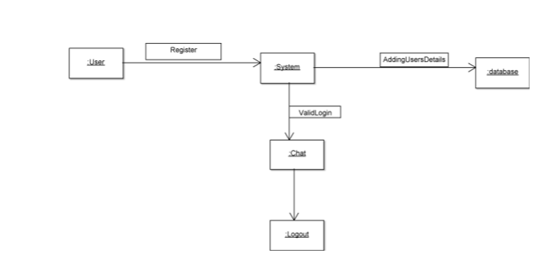
Collaboration Diagram

Slide 10
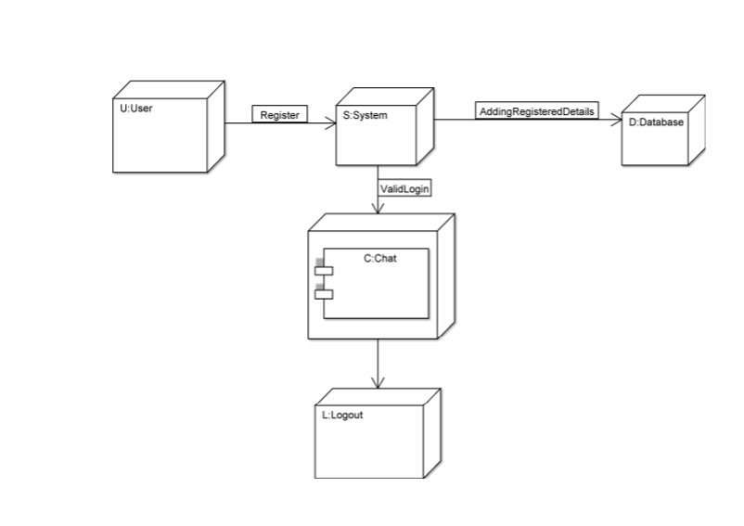
Depolyment Diagram

Slide 11
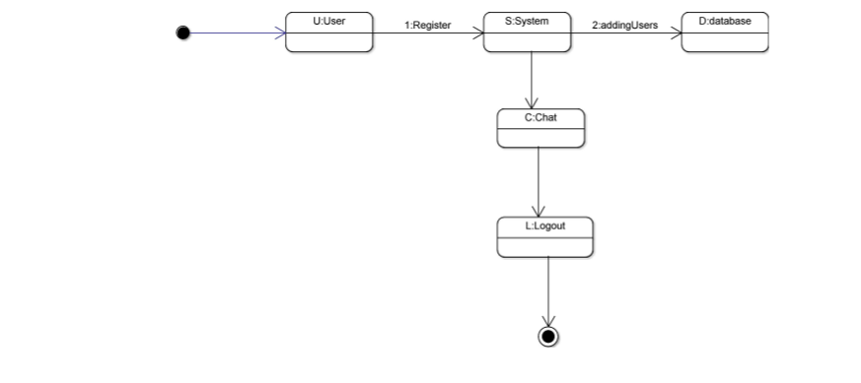
StateChart Diagram

Slide 12
Technologies Used
Uml
Mysql
html
Css
bootstrap
Javascript
Servlet
spring boot, spring web mvc for the web layer
spring data jpa with hibernate framework
spring security for authentication login and logout
thymeleaf
junit and assertj for unit testing
Hql
restfulservices

Slide 13


Slide 14
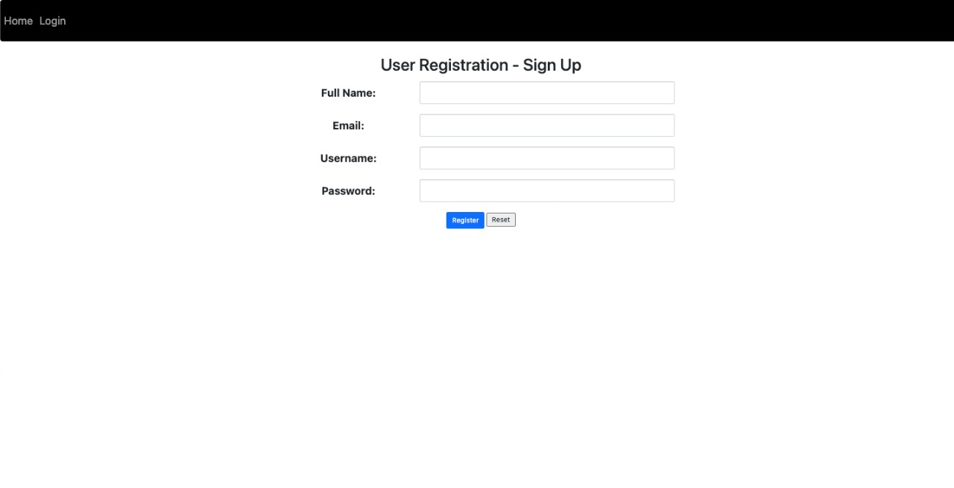

Slide 15
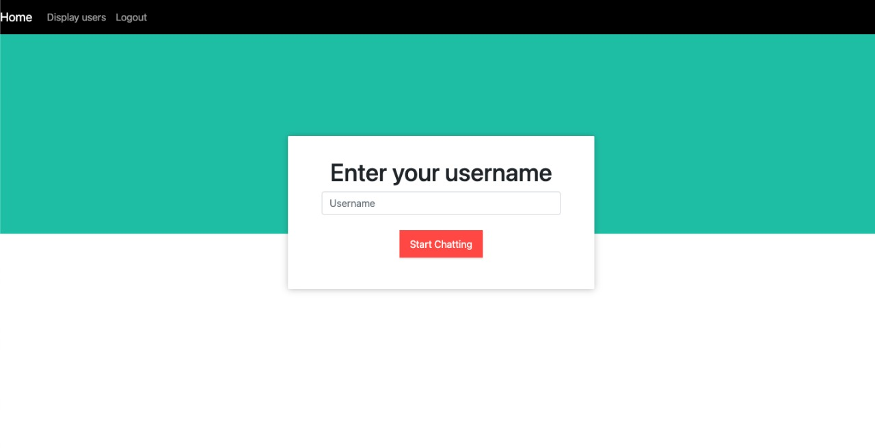

Slide 16
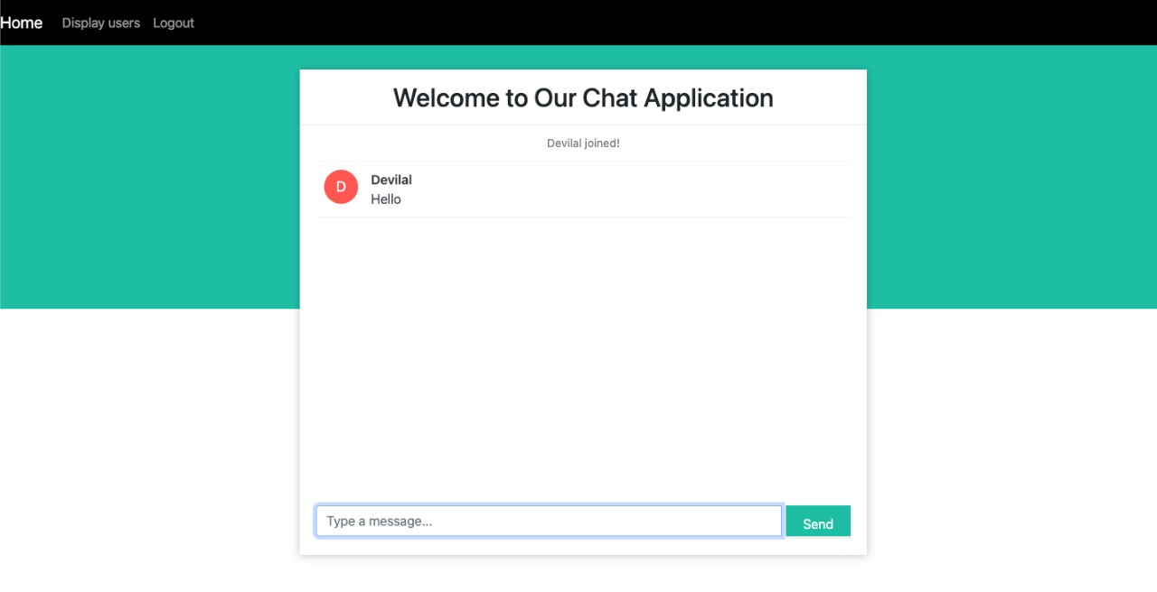

Slide 17
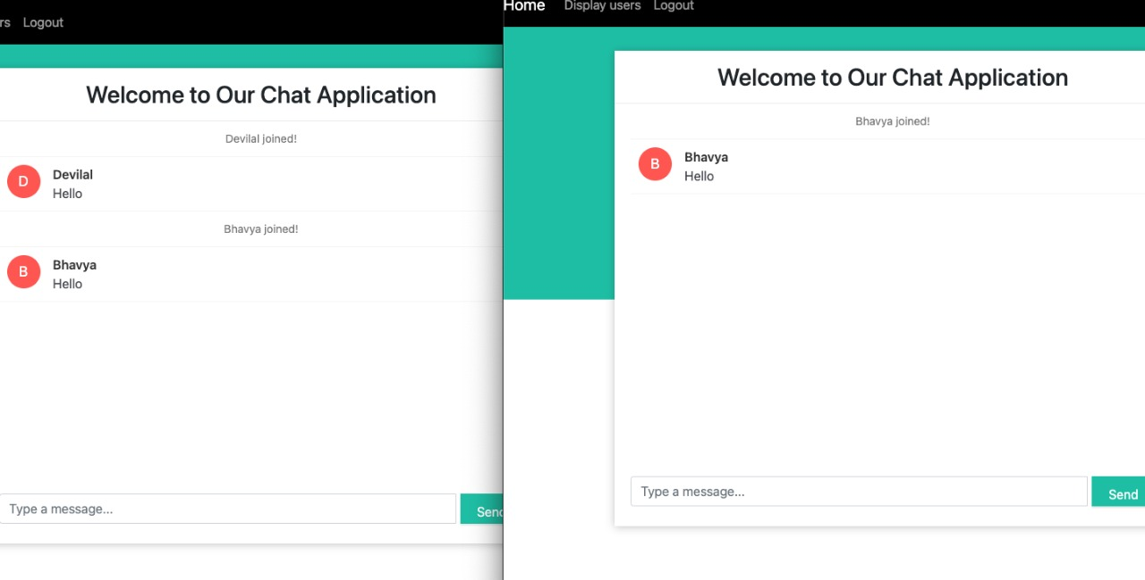

Slide 18
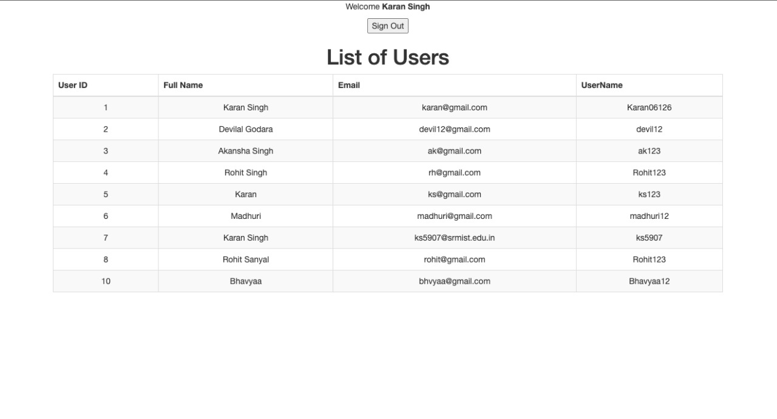

Slide 19
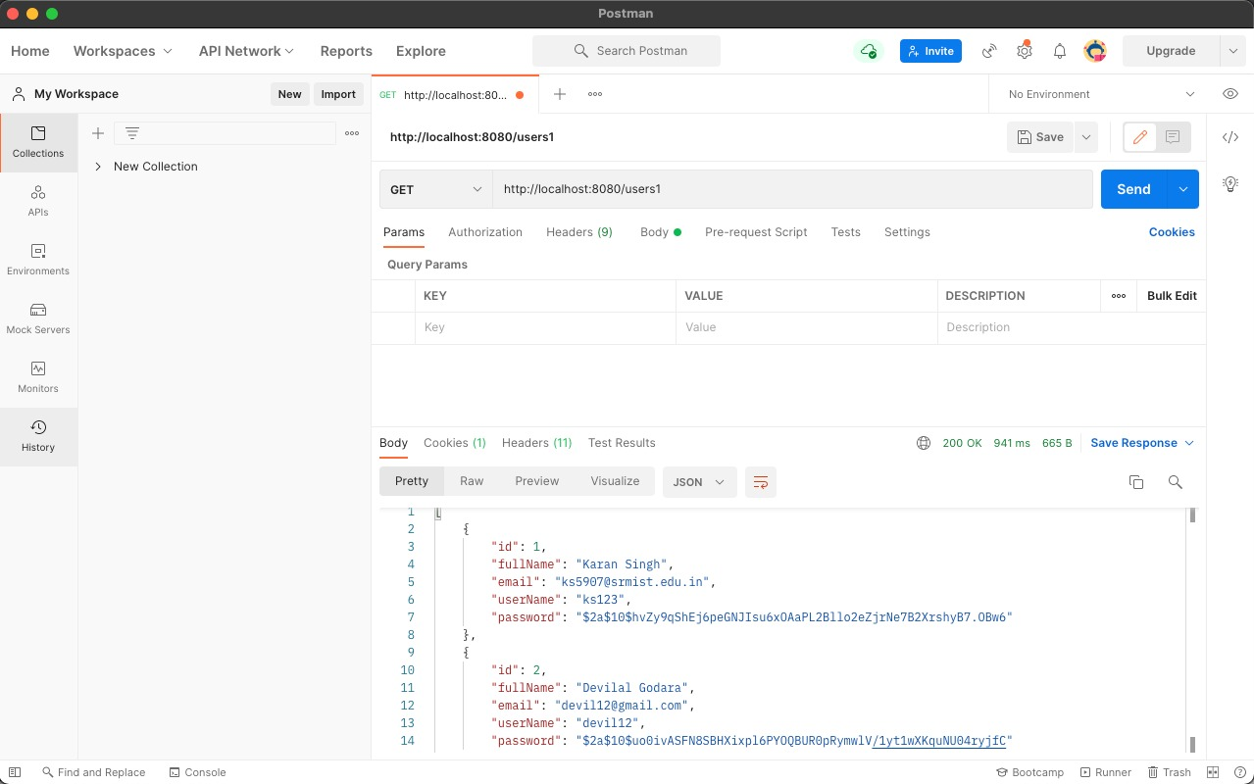

Slide 20
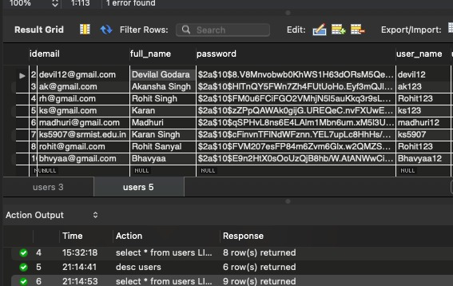

Slide 21


