Slide 1

Welcome to Shopsphere: Your one Stop Digital place
At Shopsphere, shopping meets innovation. We bring you a seamless online shopping experience with a vast selection of high-quality products, competitive prices, and lightning-fast delivery – all within a few clicks. Whether you're hunting for the latest fashion trends, cutting-edge electronics, or everyday essentials, Shopsphere is designed to make your journey effortless and enjoyable.
Explore. Shop. Thrive.
Team - 3 Japneet Kaur(2210990433), Karan Kumar Garg(2210990478 ), Kartavya(2210990484)

Slide 2
Shopsphere: Our Vision and Mission
Vision
Core Values
To be the leading global platform for seamless online shopping experiences.
Innovation
Customer Satisfaction
Mission
Reliability
Community
Connecting buyers and sellers through innovative technology and a customer-centric approach.

Slide 3
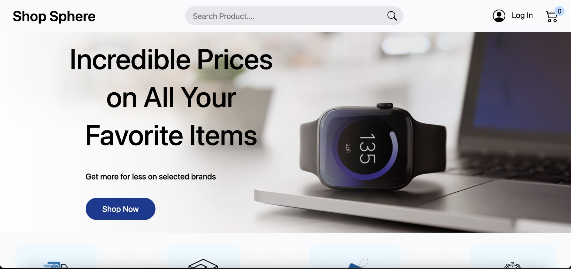

Slide 4



Target Market and Competitive Advantage
Target Audience
Gen Z and Millennials (18-40 years old).
Demographic
Urban and suburban areas with high internet penetration.
Competitive Advantages
Unique selection, superior service, community focus.

Slide 5
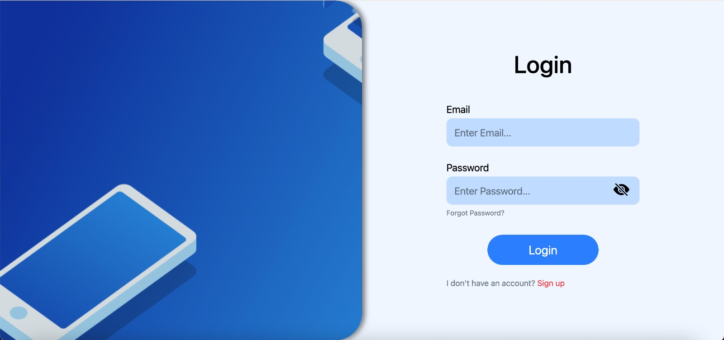

Slide 6




Key Features and Benefits
User-Friendly Interface
Personalized Experience
Boost sales by 25% with intelligent product suggestions.
Increase customer engagement by 40% through tailored shopping.
Secure Payments
Advanced Search & Filters.
Minimize transaction friction with multiple, secure payment options.
Keyword-based product search

Slide 7
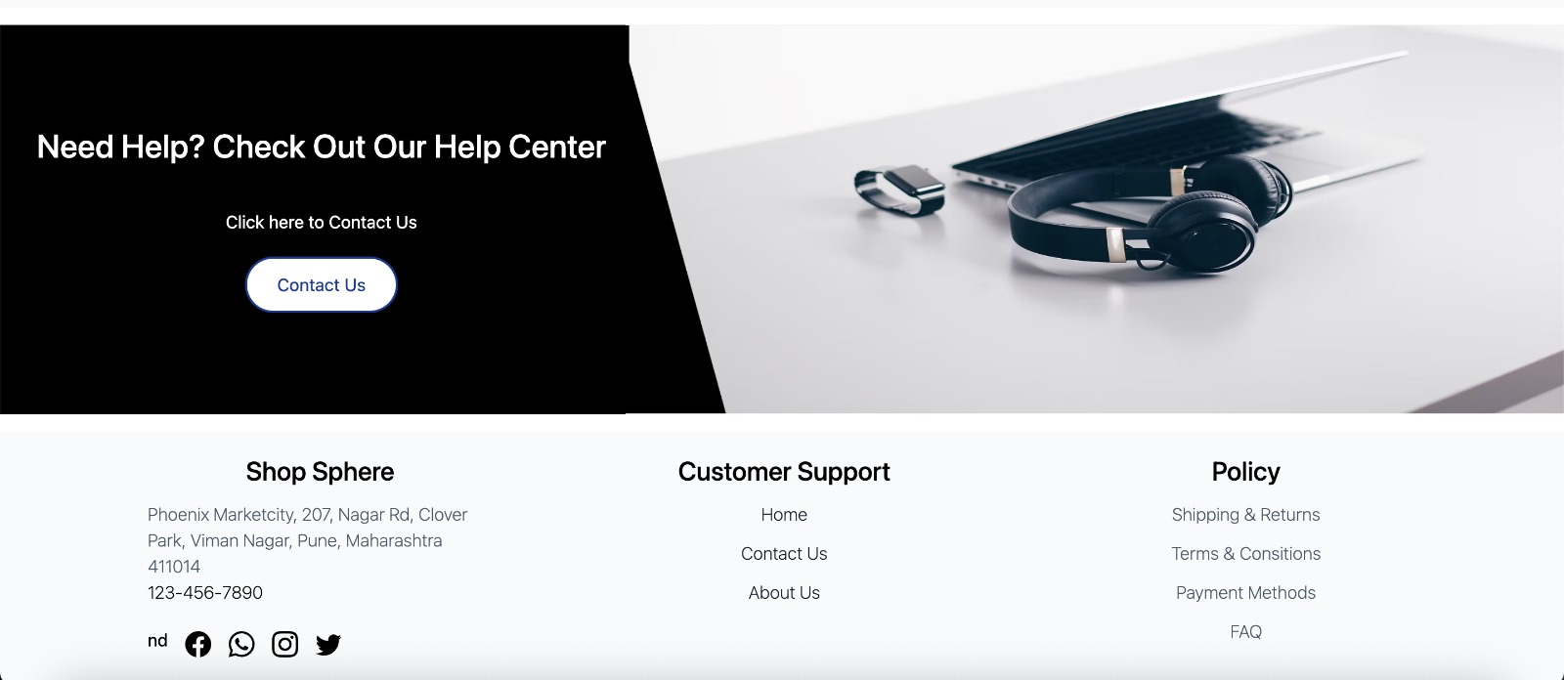

Slide 8
Technology and Infrastructure
Scalable Platform
1
Amazon Web Services (AWS).
Express.js, React.js, Node.js, SQL
2
REST APIs, CRUD operations, Web browser, VS code
JWT Authetication
3
Protecting customer data.
Shopsphere leverages a modern SERN stack. This includes React, Node.js, and PostgreSQL.

Slide 9
Call to Action: Join the Shopsphere Revolution
Explore Shopsphere
Follow us
Invest
[Website URL]
[Social Media Handles]
Invest in the Future of E-Commerce.

Slide 10


