Slide 1
COMP90024: Cluster and Cloud Computing Assignment 2: Exploring the Deadly sins Twitter analysis on Immigration in Australia: The Truth
Team 27
Maria Rashmi (1040446) Avijit Chauhan (1012820) Harshit Sethi (990198) Karan Bansal (1007845) Srijan Choudhary (1017194)

Slide 2
Scenarios
Trend Analysis:
Is immigration an issue in Australia and is overseas population travelling to Australia due to pride and/or greed?
Content Analysis:
What effects is immigration having on Australian citizens in terms of traffic, housing affordability and jobs?
Is there wrath and/or envy among the Australians towards the immigrant population.
Profile Analysis:
What is the general attitude of public, media and/or politicians towards immigration.

Slide 3
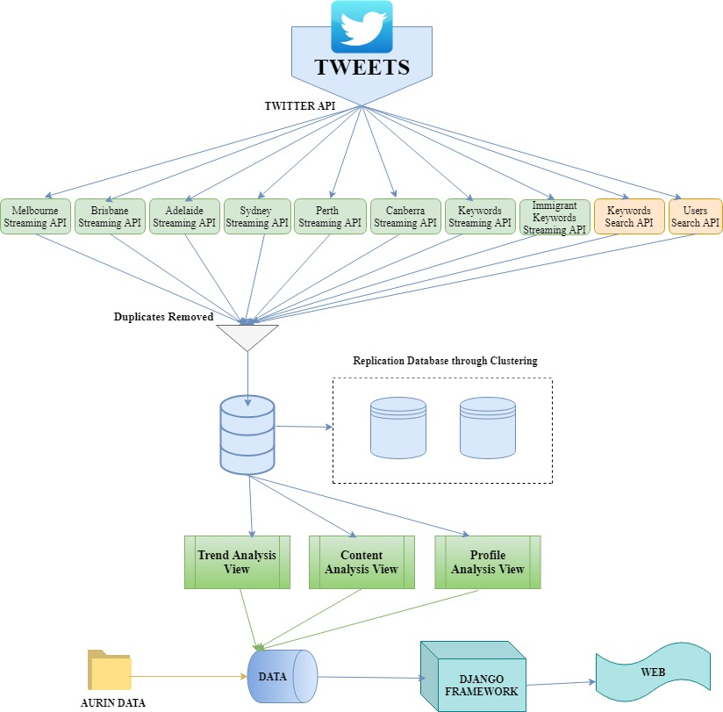
High Level Architectural diagram

Slide 4
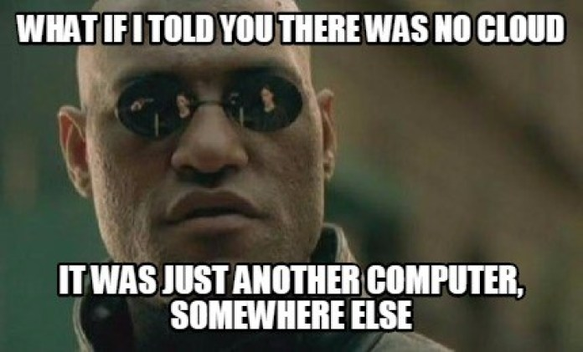
Thank You

