Slide 1
TEAM 14 • ML MINI-PROJECT
Lending Club P2P Loan
Default Prediction
Default-risk classification + profitability ranking + interactive loan analysis
Karan Varshney (PES2UG24CS903)
D Sai Karthik (PES2UG24CS141)
UE24CS352A · Problem 39
github.com/karan21v/LendingClub-P2P-Loan-Default-Prediction

Slide 2
01 / PROBLEM FRAMING
One loan application. Three useful answers.
The aim is to support decisions before funding—not merely label a historical loan.
01
02
03
CLASSIFICATION
REGRESSION
DECISION
→
→
Will this loan default?
What return could it yield?
Should this loan be selected?
Output: estimated default probability
Output: predicted Net Annualized Return
Output: INVEST / DO NOT INVEST
Two trained models supply separate signals; the validated NAR threshold creates the investment recommendation.
TEAM 14 / UE24CS352A / PROBLEM 39
2

Slide 3
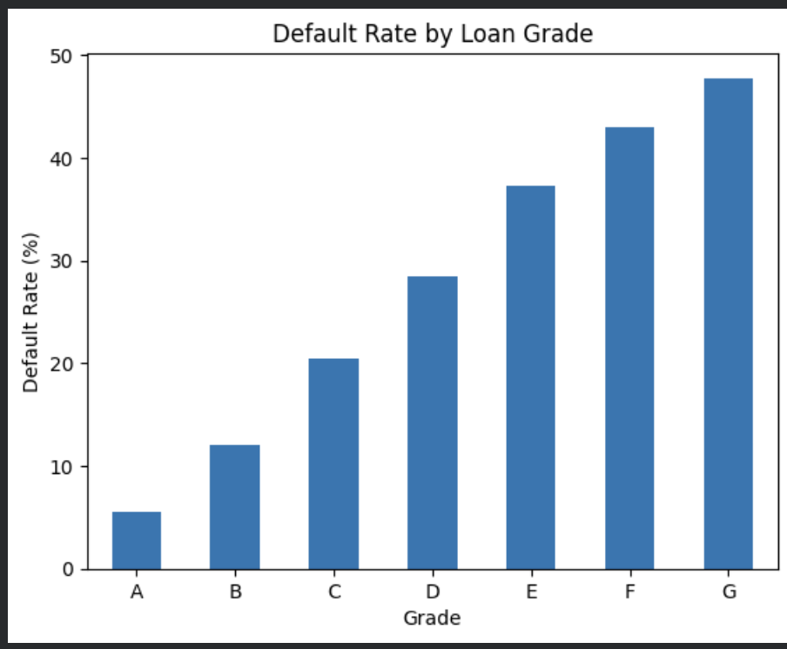
02 / DATA
A large, labelled public dataset — no synthetic outcomes
Accepted LendingClub loans; issue year 2012–2015; retain finalized Fully Paid / Charged Off / Default.
FINALIZED LOANS
786,820
OUTCOME DISTRIBUTION
81.36% Fully Paid
18.64% Default / Charged Off
33 loaded columns
21 numeric + 8 categorical
70 / 15 / 15 split
200k training sample
TEAM 14 / UE24CS352A / PROBLEM 39
3

Slide 4
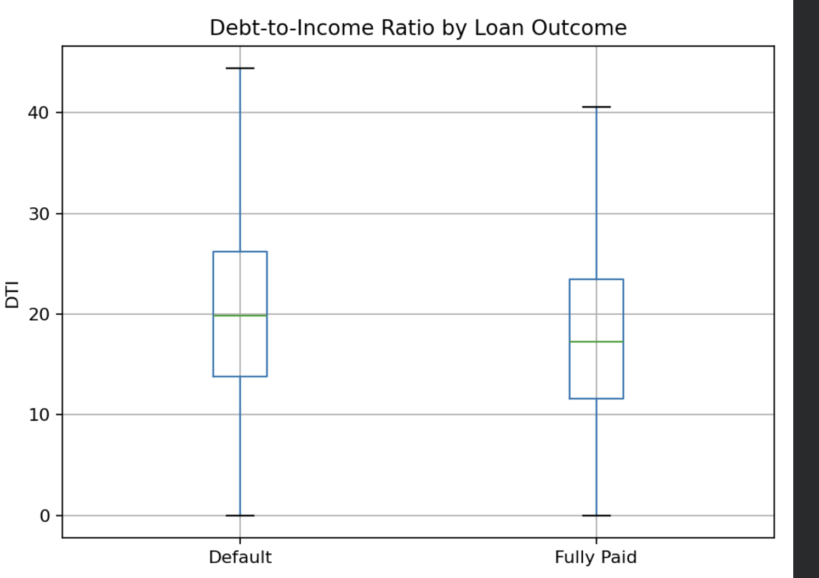
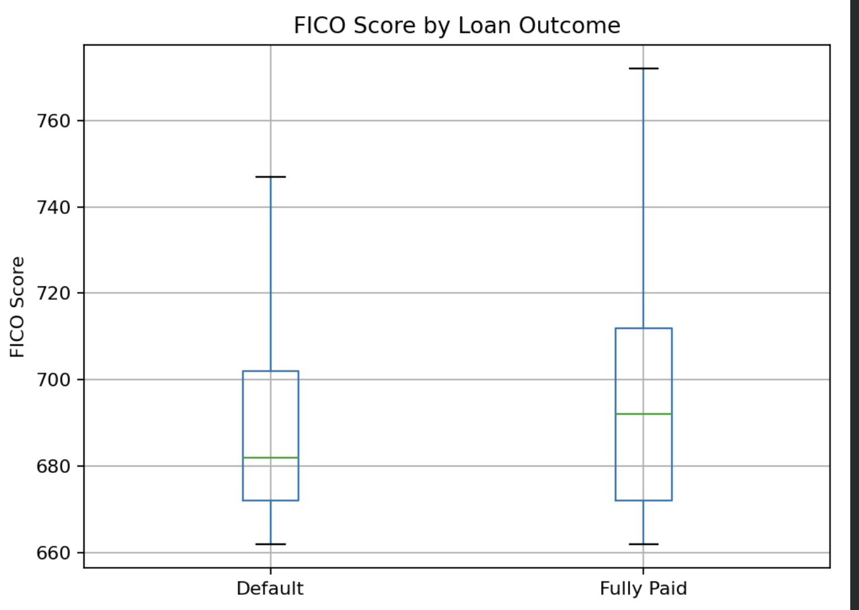
03 / EXPLORATORY ANALYSIS
Borrower-level risk signals differ by loan outcome
Defaults show somewhat higher debt burden and lower credit scores, but the distributions still overlap.
DTI BY OUTCOME
FICO SCORE BY OUTCOME
Defaulted loans have a higher median DTI, indicating greater debt burden.
Fully paid loans have a higher median FICO, consistent with stronger credit quality.
These are predictive signals with substantial overlap — neither feature alone determines the outcome.
TEAM 14 / UE24CS352A / PROBLEM 39
4

Slide 5
04 / FEATURES, PREPROCESSING & LEAKAGE
What the model sees - and what it is never allowed to see
Origination-time variables are engineered and transformed inside a pipeline fitted only on training data.
ALLOWED — KNOWN AT ORIGINATION
WITHHELD — KNOWN LATER
Loan amount · interest rate · term
Income · DTI · FICO · loan grade
Credit history · account variables
total_pymnt
last_pymnt_d
Used to construct historical NAR target only, never as model input.
FEATURE + PREPROCESSING PIPELINE
1
Feature engineering
term • FICO • credit age
→
2
Imputation
median • most-frequent
→
3
Encoding + scaling
one-hot • StandardScaler
→
4
Train-only fitting
prevents leakage
TEAM 14 / UE24CS352A / PROBLEM 39
5

Slide 6
05 / CLASSIFICATION OBJECTIVE & LOGIC
Predict default probability, then convert it into a decision
Three candidate classifiers are compared; validation default-F1 determines the winner because defaults are only 18.6%.
INPUT FEATURES
MODELS COMPARED
MODEL OUTPUT
Loan amount • rate • term
Income • DTI • FICO • grade
Credit history • account variables
→
Logistic Regression
MLP Neural Network
Random Forest
→
Default probability
Dummy baseline for reference
Decision threshold selected on validation
Selection metric: default-class F1 • chosen model = Logistic Regression
TEAM 14 / UE24CS352A / PROBLEM 39
6

Slide 7
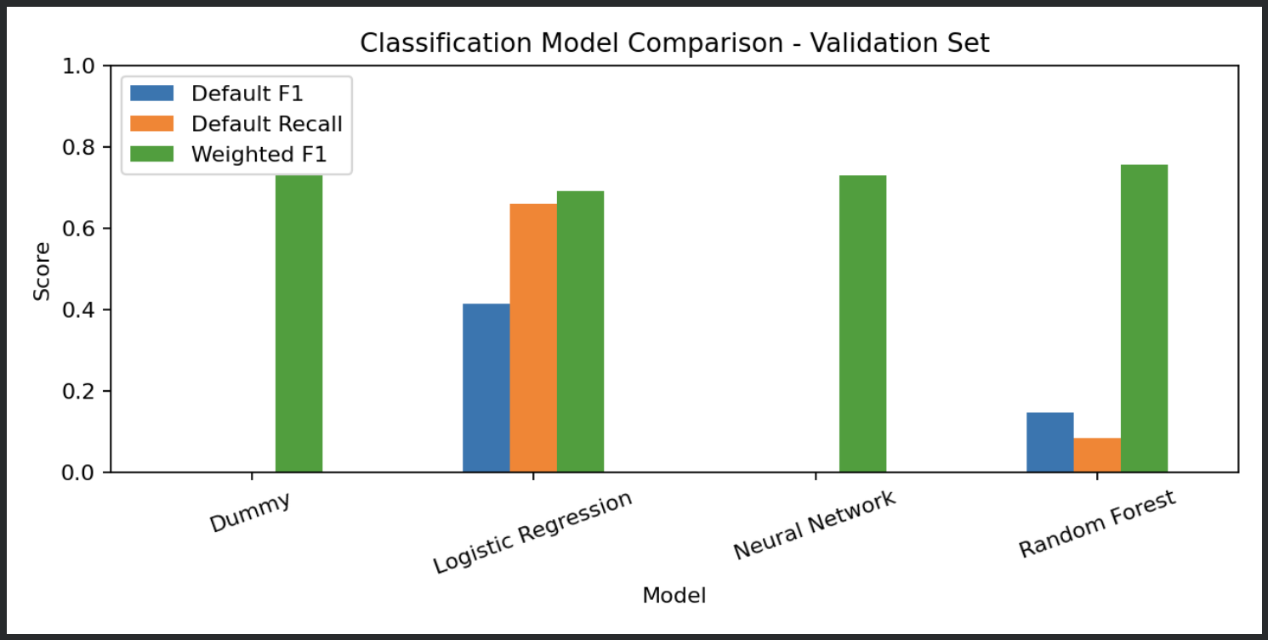
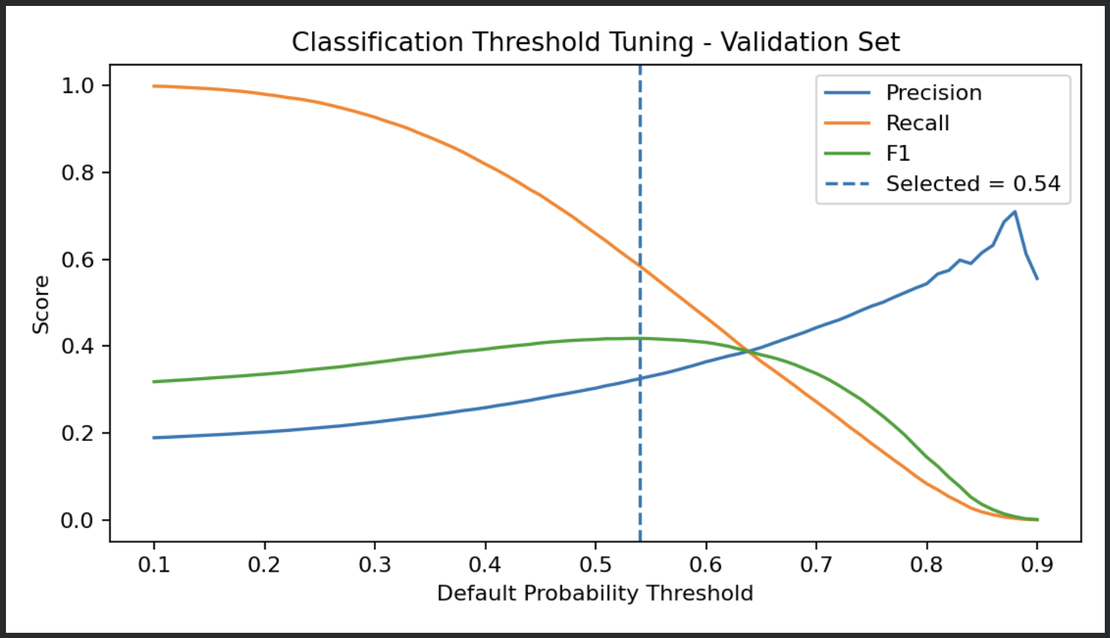
06 / CLASSIFICATION MODEL SELECTION
Validation identifies Logistic Regression as the strongest default detector
Default-class F1 is the selection metric because defaults are the minority class.
CLASSIFICATION MODEL COMPARISON — VALIDATION
Logistic Regression provides the strongest default-class F1 among the tested models; high weighted scores alone can hide poor default detection.
TEAM 14 / UE24CS352A / PROBLEM 39
7

Slide 8
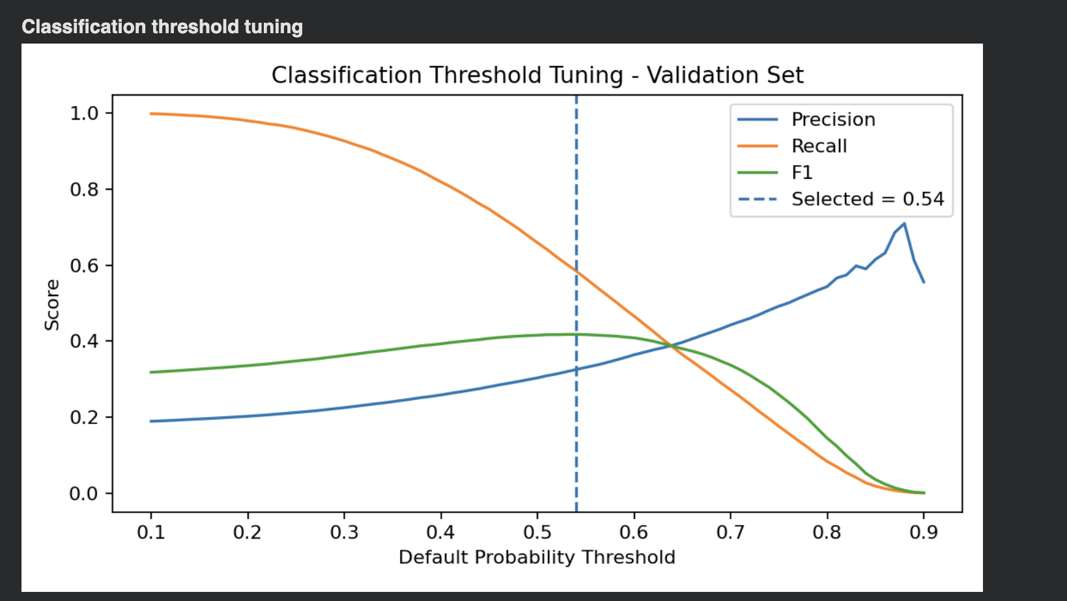
07 / CLASSIFICATION THRESHOLD
Validation selects 0.54 as the operating threshold
Raising the default-probability cutoff trades recall for precision; default-class F1 peaks near the selected point.
RECALL
SELECTED CUTOFF
PRECISION
falls as the threshold increases
0.54
rises as predictions become stricter
TEAM 14 / UE24CS352A / PROBLEM 39
8

Slide 9
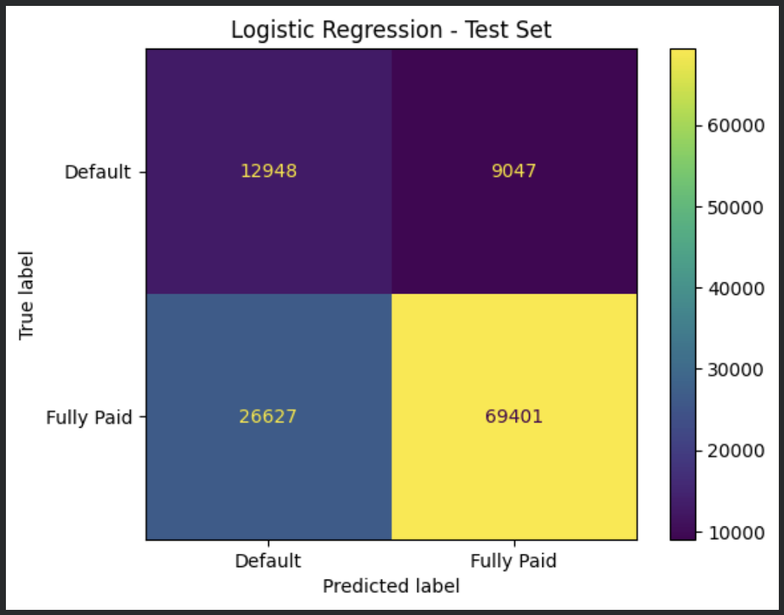
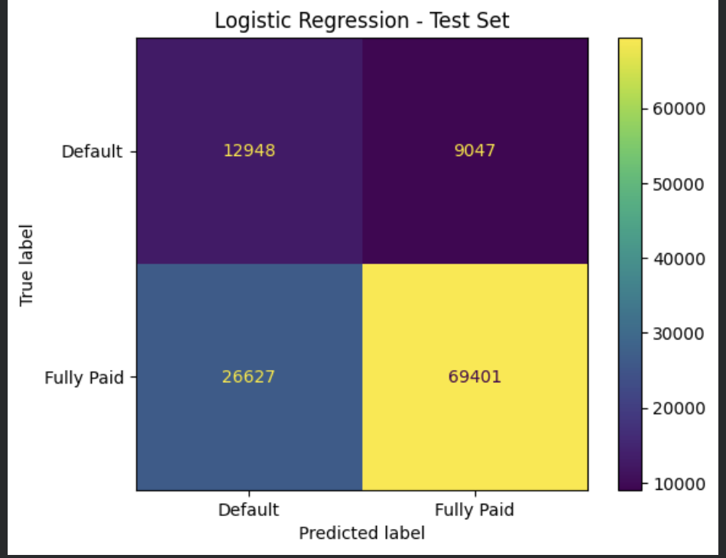
08 / FINAL CLASSIFICATION TEST
Held-out test evidence: what the selected classifier gets right and wrong
118,023 unseen loans • model and threshold already fixed from validation
DEFAULT DETECTION ON TEST
32.7%
Precision
About one in three default flags was correct
58.9%
Recall
12,948 of 21,995 defaults detected
42.1%
F1 score
Balances false alarms and missed defaults
Default threshold 0.54
Default threshold 0.54
TEAM 14 / UE24CS352A / PROBLEM 39
9

Slide 10
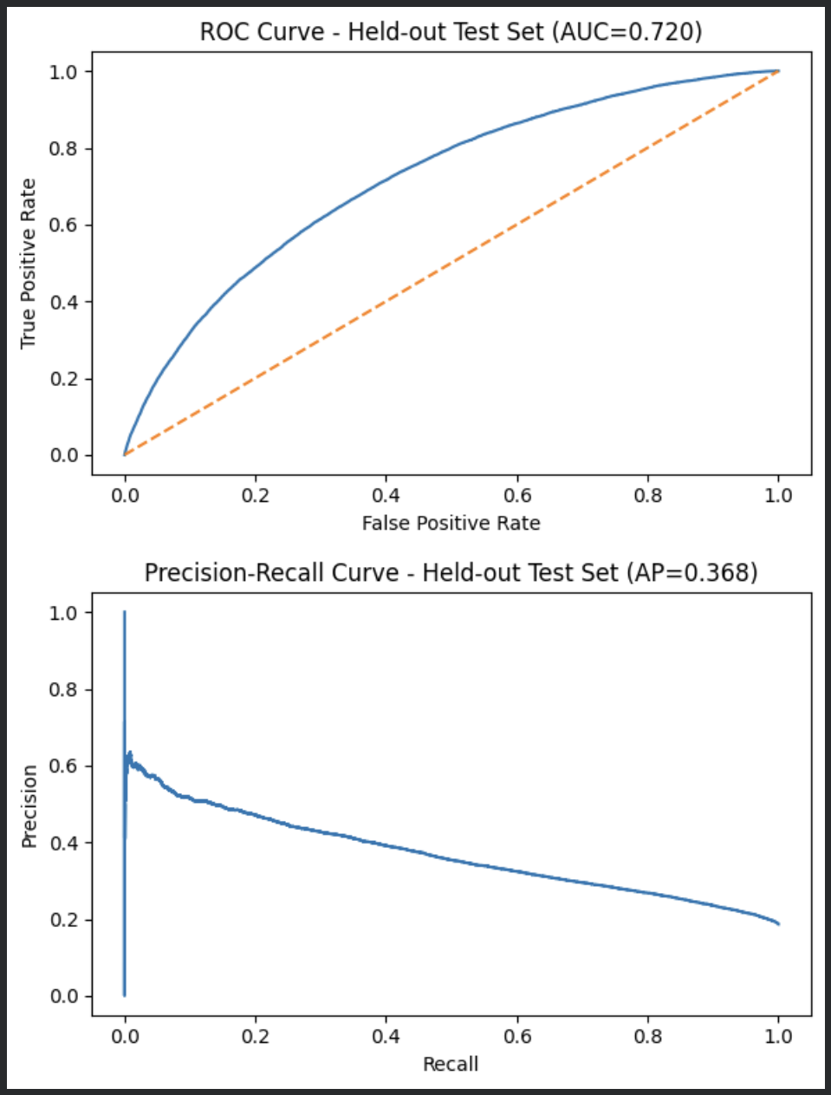
09 / FINAL CLASSIFICATION RESULTS
Final classification performance on the held-out test set
These are final test results. The model and 0.54 threshold were already fixed before TEST.
HELD-OUT TEST METRICS
ROC-AUC
0.720
PR / Average Precision
0.368
Default precision
0.327
Default recall
0.589
Default F1
0.421
ROC > random diagonal; PR is more informative for the 18.6% default minority.
TEAM 14 / UE24CS352A / PROBLEM 39
10

Slide 11
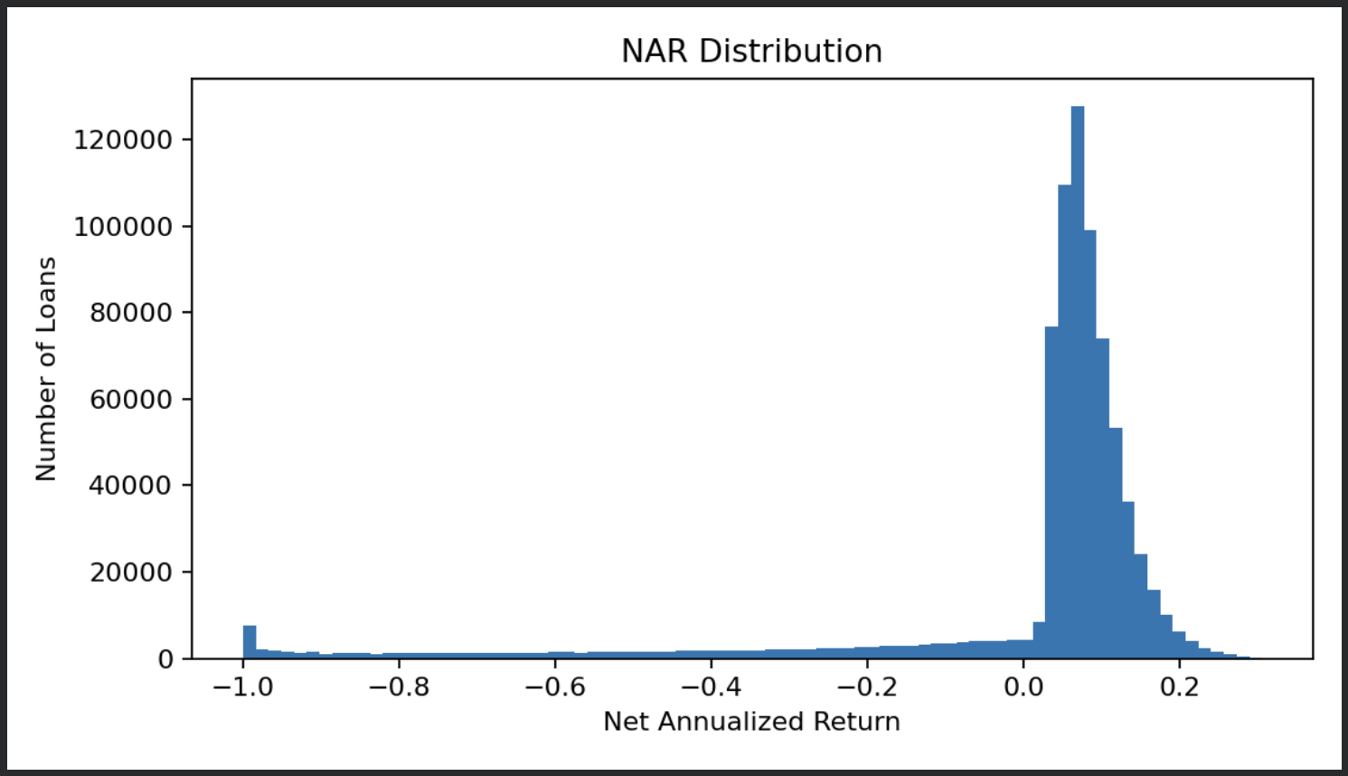
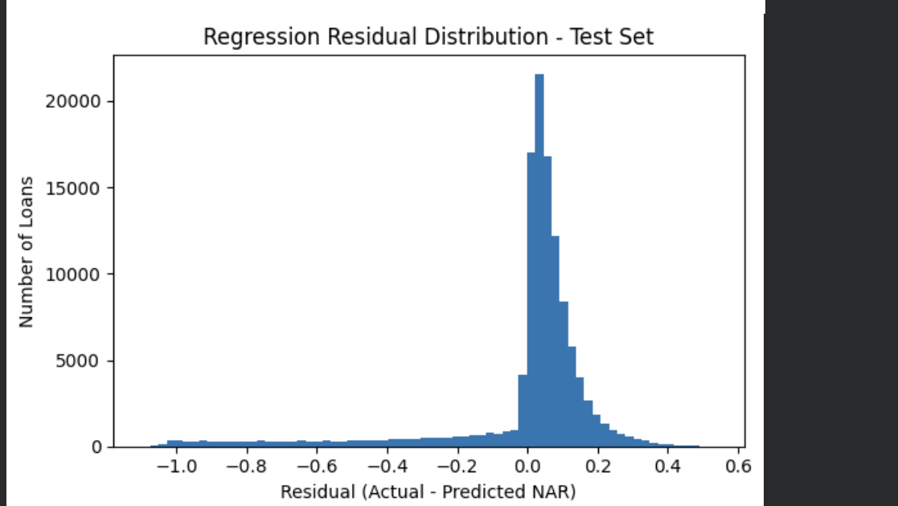
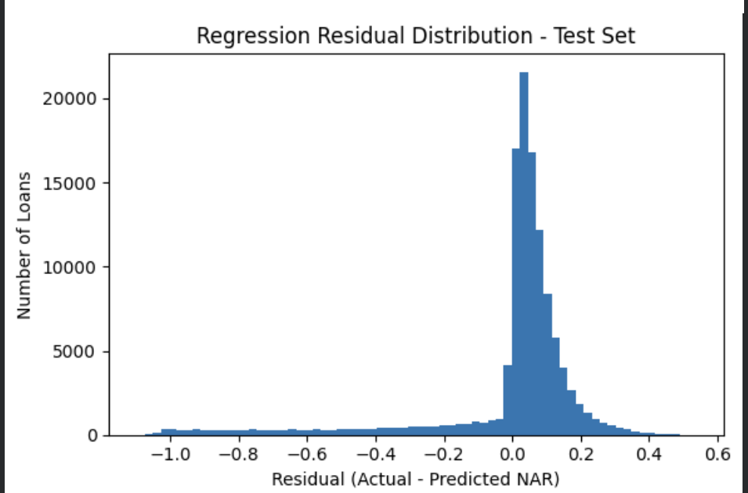
10 / NAR & PROFITABILITY
Constructing the profitability target
The second task predicts Net Annualized Return (NAR) using the same origination-time feature set.
NAR = ( total_pymnt / loan_amnt ) ^ ( 365 / days_active ) − 1
TARGET CONSTRUCTION
LEAKAGE CONTROL
WHY A SECOND MODEL?
Historical payment
+ loan amount
+ active duration
Payment/date fields create the label only.
They are not predictor inputs.
Default risk ≠ return.
A repaid loan can still offer weak profitability.
Classifier: “Will it default?” • Regressor: “What return is expected?”
TEAM 14 / UE24CS352A / PROBLEM 39
11

Slide 12
11 / NAR TARGET DISTRIBUTION
NAR is skewed with a long loss tail
Most loans cluster at modest positive returns; defaults create severe negative outcomes.
WHAT THE GRAPH SHOWS
Large mass around modest positive NAR
LOSS TAIL
Defaults push realized returns toward -1
MODELLING IMPLICATION
Exact return is noisy; ranking quality matters more
TEAM 14 / UE24CS352A / PROBLEM 39
12

Slide 13
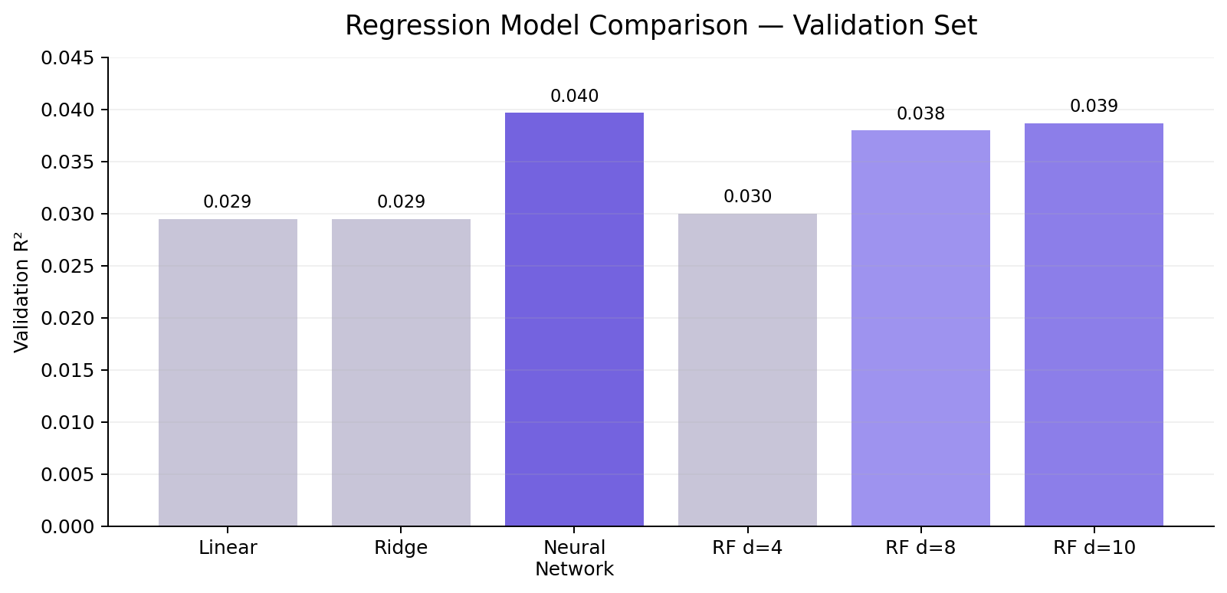
12 / REGRESSION MODEL SELECTION
Validation selects the Neural Network for NAR prediction
Exact return prediction is difficult; the best validation R² is modest, with Random Forest depth 10 close behind.
BEST VALIDATION MODEL
Neural Network
VALIDATION R²
≈ 0.040
INTERPRETATION
Use NAR primarily as a ranking signal,
not an exact return forecast.
RF depth 10 ≈ 0.039; several models are close, showing that loan-level return is intrinsically noisy.
TEAM 14 / UE24CS352A / PROBLEM 39
13

Slide 14
13 / HELD-OUT REGRESSION ERROR
Held-out residuals show concentrated errors with a long loss tail
Residual = actual NAR − predicted NAR. Zero is perfect; extreme-loss loans remain the hardest cases.
WHAT THE PLOT SHOWS
Most residuals cluster near zero
Typical loans are predicted more closely than the severe-loss cases.
Long negative tail
The regressor tends to overestimate returns for some extreme bad outcomes, which helps explain the low R².
TEAM 14 / UE24CS352A / PROBLEM 39
14

Slide 15
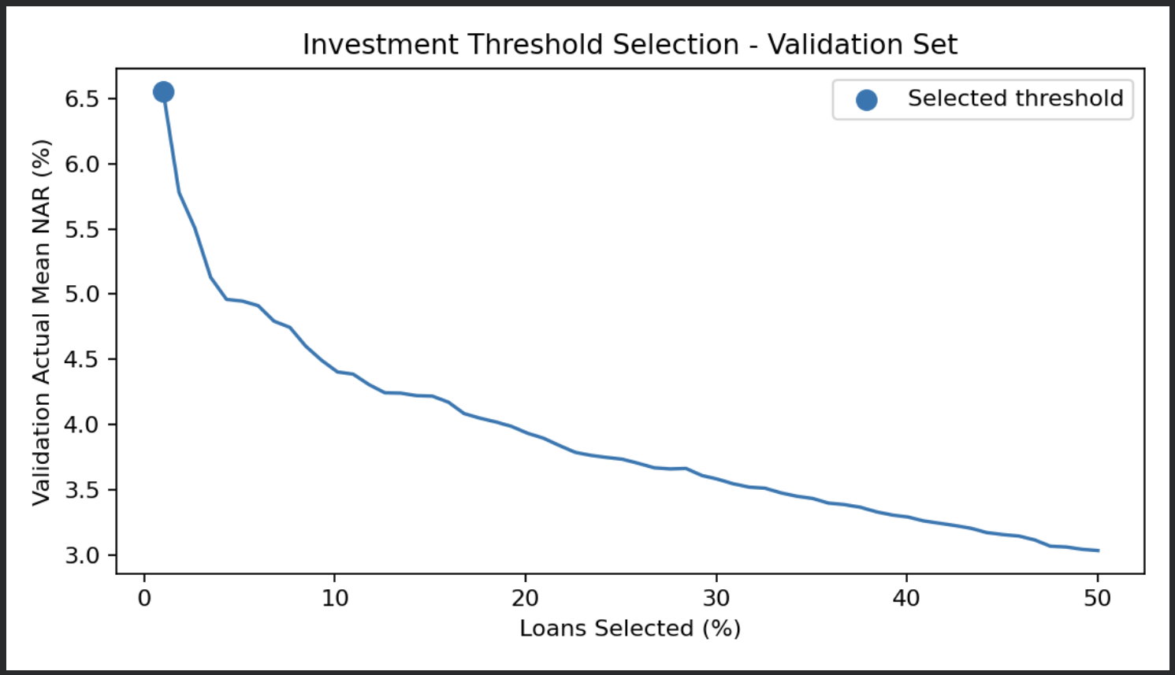
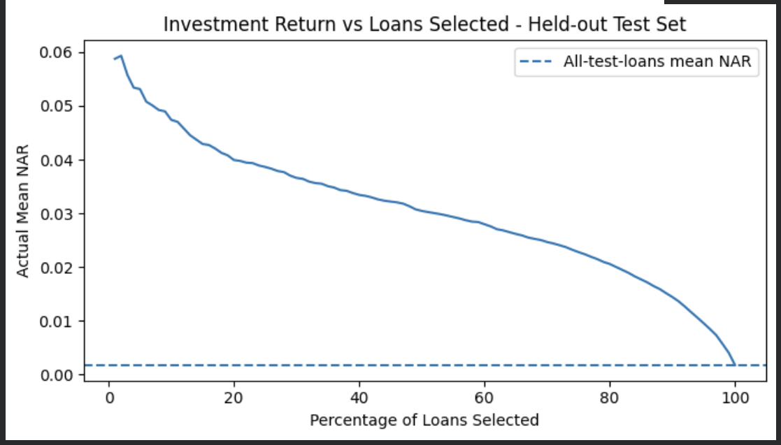
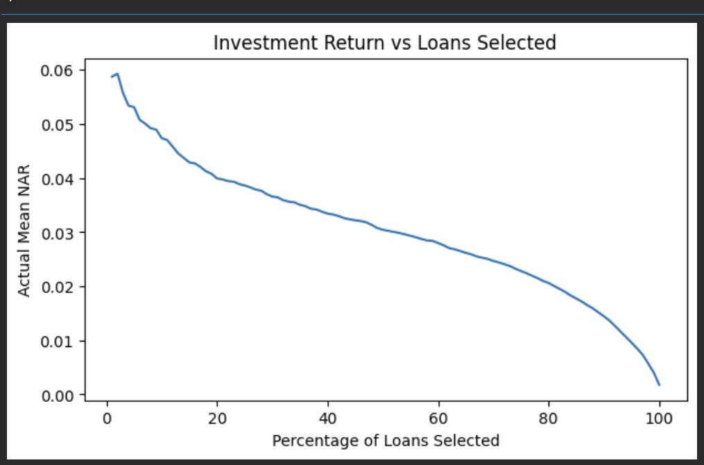
14 / INVESTMENT THRESHOLD SELECTION
Validation determines the NAR cutoff used for loan selection
The investment rule is fixed on validation data before profitability is evaluated on the test set.
VALIDATION — THRESHOLD SELECTION
TEST — RANKING BEHAVIOUR
Why validation?
• Predicted NAR is used to rank loans.
• Candidate cutoffs are compared on validation data.
• The chosen cutoff is then frozen before TEST.
• Selected investment threshold: 7.16% predicted NAR.
Top-ranked test loans start near ~5.9% realized mean NAR; return declines as more loans are included.
Selected investment threshold: 7.16% predicted NAR
7.16% predicted NAR → selected cutoff
TEAM 14 / UE24CS352A / PROBLEM 39
15

Slide 16
15 / HELD-OUT PROFITABILITY RESULTS
Higher-ranked test loans realize higher historical NAR
This is the final profitability check: the investment rule was already fixed on validation data.
TOP-RANKED FEW %
≈ 5.9% actual mean NAR
WHAT THE CURVE SHOWS
As more loans are included,
realized mean NAR falls.
MAIN RESULT
Weak exact-value regression can still
produce useful loan ranking.
TEAM 14 / UE24CS352A / PROBLEM 39
16

Slide 17
16 / DECISION LOGIC
Two model outputs answer two different questions
Risk and return are evaluated separately, then shown together in the final loan recommendation.
DEFAULT-RISK SIGNAL
PROFITABILITY SIGNAL
FINAL LOAN OUTPUT
Classifier
Default probability
0.54 decision threshold
Regressor
Predicted NAR
7.16% investment threshold
Repayment label
+ predicted return
+ INVEST / DO NOT INVEST
→
→
A loan can be Likely Fully Paid but still DO NOT INVEST if predicted NAR is below the return cutoff.
TEAM 14 / UE24CS352A / PROBLEM 39
17

Slide 18
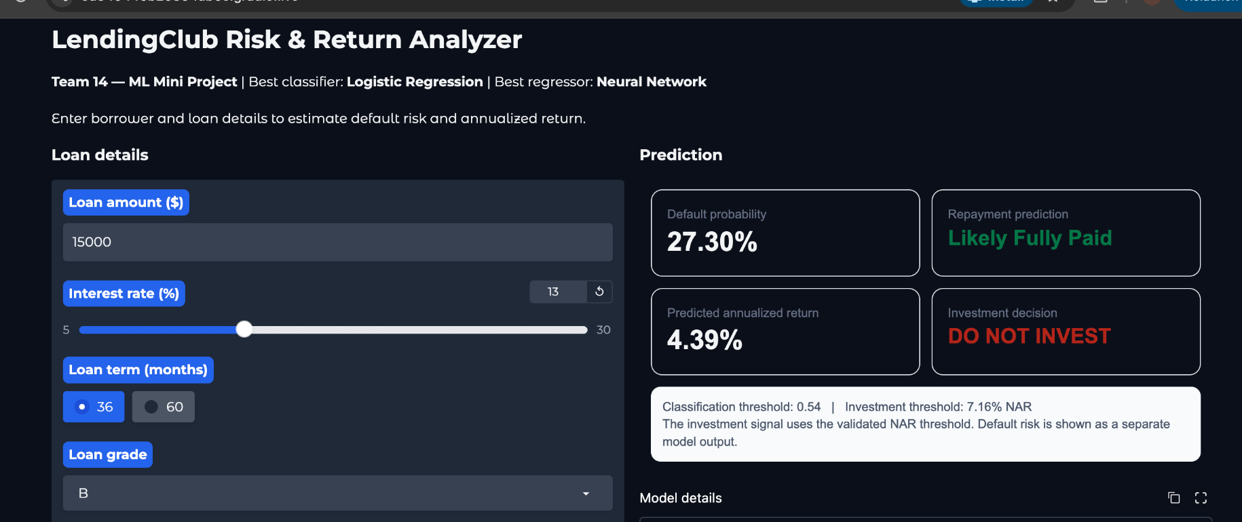
17 / GUI
Interactive Loan Risk & Return Analyzer
Enter borrower and loan details to obtain default probability, predicted NAR and an investment decision.
27.30%
4.39%
7.16%
DO NOT INVEST
Default risk
Predicted NAR
NAR threshold
Investment decision
TEAM 14 / UE24CS352A / PROBLEM 39
18

Slide 19
18 / LIMITATIONS & FUTURE SCOPE
Limitations and Future Scope
Key constraints of the current study and the most useful extensions for stronger generalization.
DATA
MODELLING
FUTURE SCOPE
LIMITATIONS
LIMITATIONS
NEXT STEPS
• 2012–2015 loans may not represent later credit cycles
• NAR regression has low explanatory power (R² ≈ 0.04)
• Evaluate on later years with a time-based split
• LendingClub grade already contains prior risk information
• Exact loan-level return prediction remains noisy
• Train on the full cohort with greater compute
• Model fitting used a 200,000-loan sample
• False positives remain substantial in default screening
• Run ablation without grade / interest rate
• Class imbalance remains important for evaluation
• Add richer borrower, text and macroeconomic features
• Improve calibration and systematic hyperparameter tuning
The main extension is stronger out-of-time validation so performance is tested across changing credit cycles.
TEAM 14 / UE24CS352A / PROBLEM 39
19

Slide 20
19 / REFERENCES
References
Primary reference paper, dataset source and project repository.
PRIMARY REFERENCE
DATASET & PROJECT
Peiqian Li & Gao Han
LendingClub accepted loans, 2007–2018Q4 (Kaggle mirror)
“LendingClub Loan Default and Profitability Prediction”
Filtered cohort used here: finalized loans issued 2012–2015
Stanford University — supplied reference for Problem No. 39
Project repository: github.com/karan21v/LendingClub-P2P-Loan-Default-Prediction
All metrics and plots shown in this presentation are outputs from our completed notebook run.
TEAM 14 / UE24CS352A / PROBLEM 39
20

