Slide 1
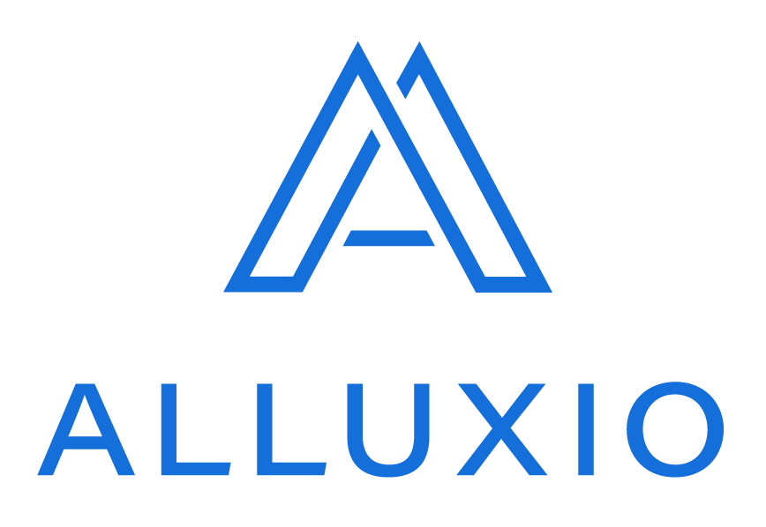

Slide 2
What’s Alluxio?
Open source data orchestration for analytics and machine learning in any cloud.
Alluxio is an open-source virtual distributed file system (VDFS).
Data Driven Applications, such as Data Analytics, Machine Learning, and AI, use APIs provided by Alluxio to interact with data from various storage systems at a fast speed.

Slide 3
What is Data Orchestration?
Data Orchestration is the automation of data-driven processes from end-to-end, including preparing data, making decisions based on that data, and taking actions based on those decisions.
It’s a process that often spans across many different systems, departments, and types of data.

Slide 4
Data orchestration challenges
S3 performance for analytics and ML workloads is inconsistent and data egress is expensive.
Making HDFS or object store data accessible to any compute in any cloud is complex.
Object storage performance, particularly for metadata operations, is unpredictable.
Orchestrating data from multiple public clouds for big data workloads is complex and expensive.

Slide 5
How Alluxio can help
LOCALITY : Accelerate big data frameworks on the public cloud.
ACCESSIBLE : Run big data workloads in hybrid cloud environments.
ELASTIC : Bring big data and AI workloads to any object store.

Slide 6
ARCHITECTURE
Alluxio’s distributed architecture is built on three core components:
Alluxio Master : Which manages file and object metadata.
Alluxio Worker : Which manages the node’s local space, as well as manages file and object blocks and interfaces with the storage systems underneath.
Alluxio Client : Which allows analytics and AI/ML applications to interface with Alluxio.

Slide 7
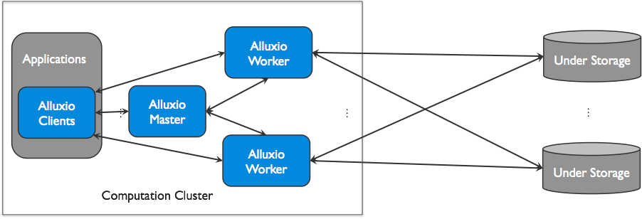
ARCHITECTURE

Slide 8
ARCHITECTURE
Master
Leading Master
Only one master process can be the leading master in an Alluxio cluster. The leading master is responsible for managing the global metadata of the system. This includes file system metadata (e.g. the file system inode tree), block metadata (e.g. block locations), and worker capacity metadata (free and used space). Alluxio clients interact with the leading master to read or modify this metadata. All workers periodically send heartbeat information to the leading master to maintain their participation in the cluster.
Standby Masters
Standby masters read journals written by the leading master to keep their own copies of the master state up-to-date. They also write journal checkpoints for faster recovery in the future. They do not process any requests from other Alluxio components.

Slide 9
ARCHITECTURE
Worker
Alluxio workers are responsible for managing user-configurable local resources allocated to Alluxio (e.g. memory, SSDs, HDDs). Alluxio workers store data as blocks and serve client requests that read or write data by reading or creating new blocks within their local resources. Workers are only responsible for managing blocks; the actual mapping from files to blocks is only stored by the master.
Workers perform data operations on the under store. This brings two important benefits:
1) The data read from the under store can be stored in the worker and be immediately available to other clients.
2) The client can be lightweight and does not depend on the under storage connectors.

Slide 10
ARCHITECTURE
Client
The Alluxio client provides users a gateway to interact with the Alluxio servers. It initiates communication with the leading master to carry out metadata operations and with workers to read and write data that is stored in Alluxio. Alluxio supports a native filesystem API in Java and bindings in multiple languages including REST, Go, and Python. Alluxio also supports APIs that are compatible with the HDFS API and the Amazon S3 API.
Alluxio clients never directly access the under storage systems. Data is transmitted through Alluxio workers.

Slide 11
Benefits
Memory-Speed I/O : Alluxio can be used as a distributed shared caching service so that compute applications talking to Alluxio can transparently cache frequently accessed data, especially from remote locations.
Simplified Cloud and Object Storage Adoption : Cloud and object storage systems use different semantics that have performance implications compared to traditional file systems.
Simplified Data Management: Alluxio provides a single point of access to multiple data sources.
Easy Application Deployment: Alluxio manages communication between applications and file or object storages, translating data access requests from applications into underlying storage interfaces.

Slide 12
USE CASES
1. Object Storage Data Acceleration
In many organizations, an increasingly popular architecture is to leverage object storage as an important source of data for data analytics applications like Spark, Presto, Hadoop, or machine learning/AI workloads such as Tensorflow etc.
Deploying Alluxio on the compute side where data is configured to persist from object stores can significantly benefit applications. Alluxio can cache data locally alongside different applications and manage its corresponding metadata to avoid particular inefficient metadata operations of object stores.

Slide 13
USE CASES
2. Satellite Compute Clusters Enabler
For reasons such as performance, security, or resource isolation, organizations maintain satellite computation clusters that are independent from their main data cluster, using dedicated resources for mission-critical applications. These satellite clusters often need to access data from the main cluster.
Alluxio can accelerate the remote data read from the main data cluster without adding extra ETL steps. When deployed on the compute nodes in the satellite cluster and configured to connect to the main data cluster, Alluxio serves as a local data proxy layer that provides the same namespace as the main data cluster.

Slide 14
USE CASES
3. A Common Data Access Layer
Users deploy Alluxio as a storage abstraction layer for common data access requests. Alluxio supports storage connectors for various storage types including public cloud, such as AWS or Azure, and on-premise storage services, such as HDFS or Ceph. As long as applications integrate with Alluxio, they are enabled to access different persistent storage systems without binary or source code changes in the application. Once connected to Alluxio, applications are automatically integrated with the most popular storage options without implementing any connectors.

Slide 15
USE CASES
4. Data Unification
Alluxio provides a mounting API that enables applications to access data across multiple sources in the same filesystem namespace. Applications do not need to individually configure connection details for each data source, such as the client library version or different security models. From the perspective of an application, it is accessing a “logical filesystem” whose data can be backed by multiple different persistent storages. This drastically simplifies the development, maintenance and management of an application.

Slide 16
Technical Innovations
Global Namespace: Alluxio serves as a single point of access to multiple independent storage systems regardless of physical location.
Intelligent Multi-tiering Caching: Alluxio clusters act as a read and write cache for data in connected storage systems. Configurable policies automatically optimize data placement for performance and reliability across both memory and disk.
Server-Side API Translation: Alluxio manages communication between applications and file or object storage, eliminating the need for complex system configuration and management.

Slide 17
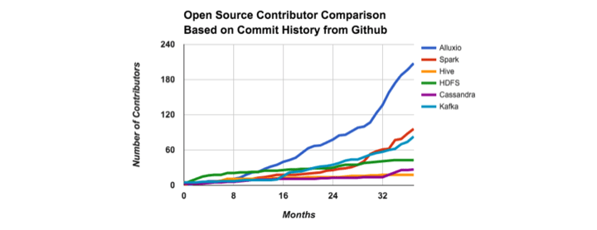
GROWING NUMBER OF CONTRIBUTORS

Slide 18
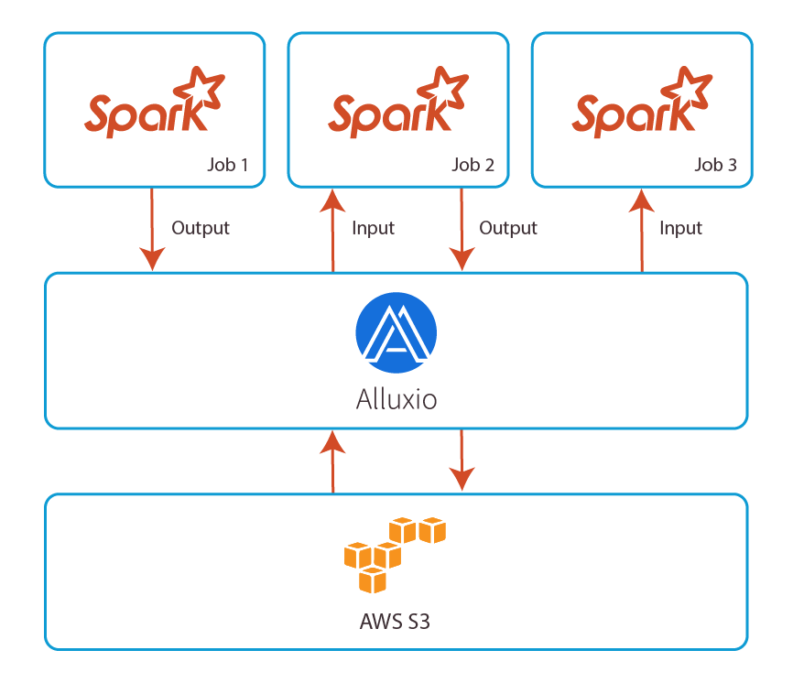
Deploying Spark on Alluxio
Data sharing between jobs : Inter-process sharing can be slowed down by network I/O. With Alluxio, storage and compute are separated, enabling inter-process sharing to happen at memory speed.

Slide 19
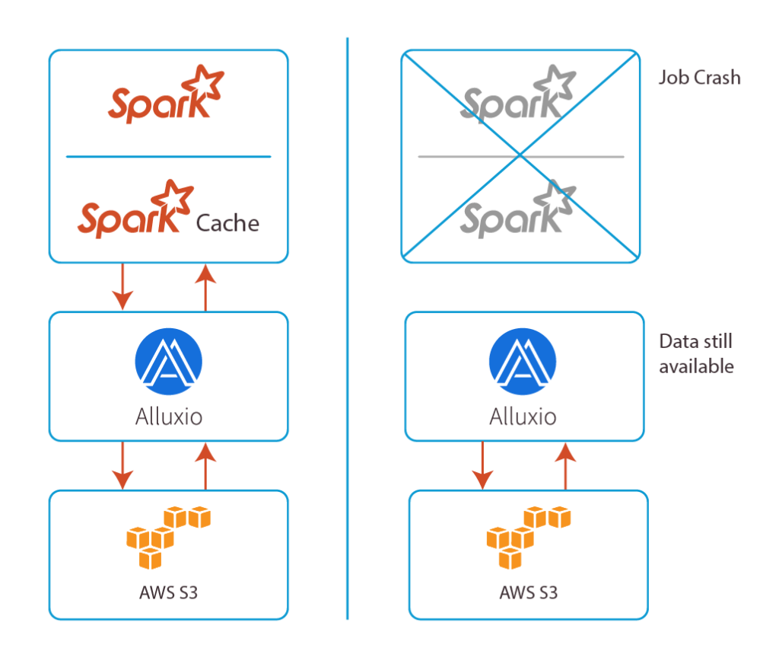
Deploying Spark on Alluxio
Data resilience during application crashes : When storage and compute are running in the same process, a process crash requires network I/O to re-read the data. With Alluxio, storage and compute are separated, so the data is still available.

Slide 20
THANK YOU !!
Deepak Chaurasia - Karan Yadav - Riya Garg

