Slide 1


Team Details
  Team name: Agentic syndicate
  Team leader name: Karan R
  Problem Statement: Intelligent Risk, Fraud & Financial Experiences (BFSI). Fraud teams drown in alerts with no evidence to act on: FraudLens AI turns a suspicious transaction into an evidence-backed, reviewable fraud case in seconds.

Slide 2
Brief about the idea
FraudLens AI · agentic fraud detection, investigation & response on Google Cloud
Banks see huge volumes of legitimate payments and a tiny share of fraud. Sending everything to an LLM is slow and expensive, fixed rules create false positives, and black-box scores give analysts nothing to act on.
FraudLens separates the problems: ML screens every transaction, Google ADK agents investigate only the alerts with verified tools, Gemini writes a summary in which every claim cites evidence, and a deterministic policy engine (not the LLM) decides the risk tier. The analyst approves or overrides, and every step is audited.
Live on Cloud Run with real Gemini. Synthetic data; all account actions simulated.
1 Screen
rules + ML on every payment · no LLM
2 Investigate
ADK orchestrator + 3 specialist agents
3 Explain
Gemini summary · every claim cites evidence
4 Decide
policy engine R1–R8 → Tier 1 · 2 · 3
5 Respond
simulated action · analyst approves · audit
ML handles scale · tools provide verified evidence · agents orchestrate · Gemini explains · policy controls the action · humans decide

Slide 3
How is it different?
• Rules engines flag anything unusual; FraudLens compares each payment with the customer's own baseline
• ML scores give a number; FraudLens gives a case with cited evidence, timeline and network
• LLM chatbots summarise and can hallucinate; FraudLens agents execute verified tools, and unsupported claims are dropped
• The LLM never acts: a deterministic, versioned policy decides
How does it solve the problem?
• Only ~0.7% of transactions reach the agents, so AI cost tracks alerts, not volume
• Agents gather behaviour, velocity, device and mule-network evidence in seconds
• Analysts open a finished investigation package instead of a blank page
• Overrides need a reason and feed agreement metrics: a built-in feedback loop
USP
• Grounded by construction: 100% evidence validity, 0 invalid citations (measured)
• Progressive autonomy (L2: AI investigates, human decides) with per-tier ceilings
• Graceful degradation: AI failure → deterministic evidence + manual review
• Regulator-ready: append-only audit, versioned model, policy and prompts in every case

Slide 4
List of features offered by the solution
Real-time screening
27 point-in-time features · rules + gradient boosting + Isolation Forest · reason codes · 0–1000 risk
Agentic investigation (ADK)
Orchestrator + Behavior, Transaction, Network agents · 11 guarded deterministic tools
Grounded Gemini summary
Structured JSON · every finding cites evidence IDs · citation validator · limitations listed
Deterministic policy engine
Rules R1–R8 → Monitor / Verify / Contain · Gemini and Laya tiers are advisory only
Human-in-the-loop governance
Autonomy ladder · override reasons · analyst ↔ policy / Gemini agreement · append-only audit
Fraud operations workspace
Dashboard KPIs · priority queue with SLA and owner · cases board · global search
Entity network graph
Shared devices and mule links · hops to confirmed fraud · interactive graph
Simulated response
Verification, escalation and restriction are simulated, logged and never touch real accounts
Graceful degradation
AI error, timeout or daily cap → deterministic tools, unavailable evidence flagged, manual review
Laya advisory triage
Open-weight decision model on private Cloud Run · runs in parallel · never sets the tier
Built-in evaluation
Script-generated metrics · golden scenarios · rules vs ML vs agentic benchmarks
Security by default
Least-privilege service accounts · no API keys · rate limits · CSP · pseudonymous data to the LLM

Slide 5
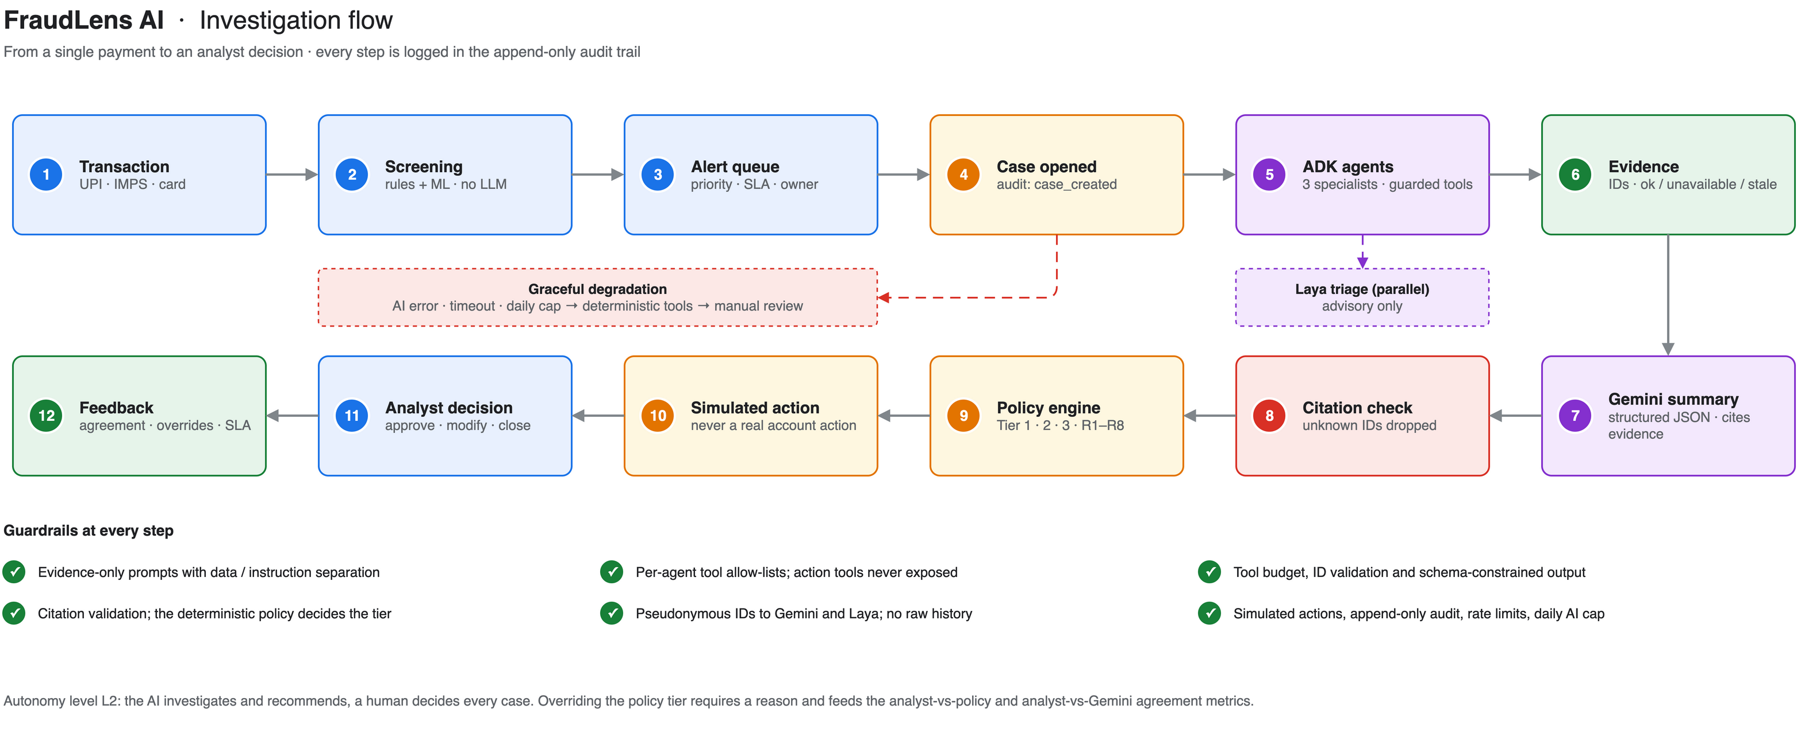
Process flow diagram or Use-case diagram
Investigation flow: payment → screening → alert → ADK agents (+ Laya in parallel) → evidence → Gemini → citation check → policy → simulated action → analyst → feedback

Slide 6
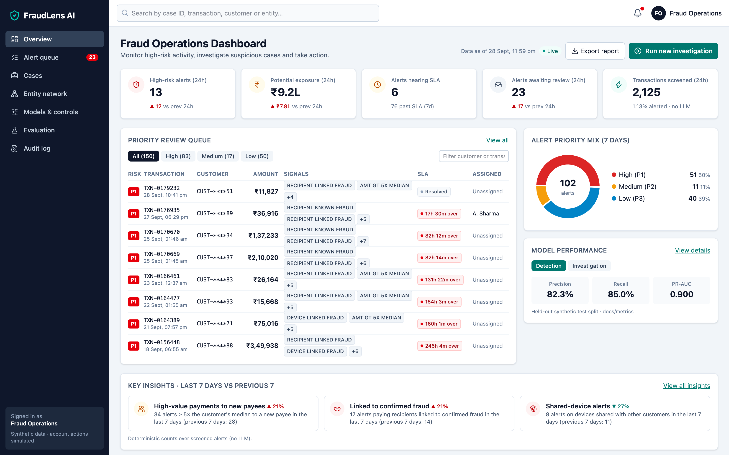
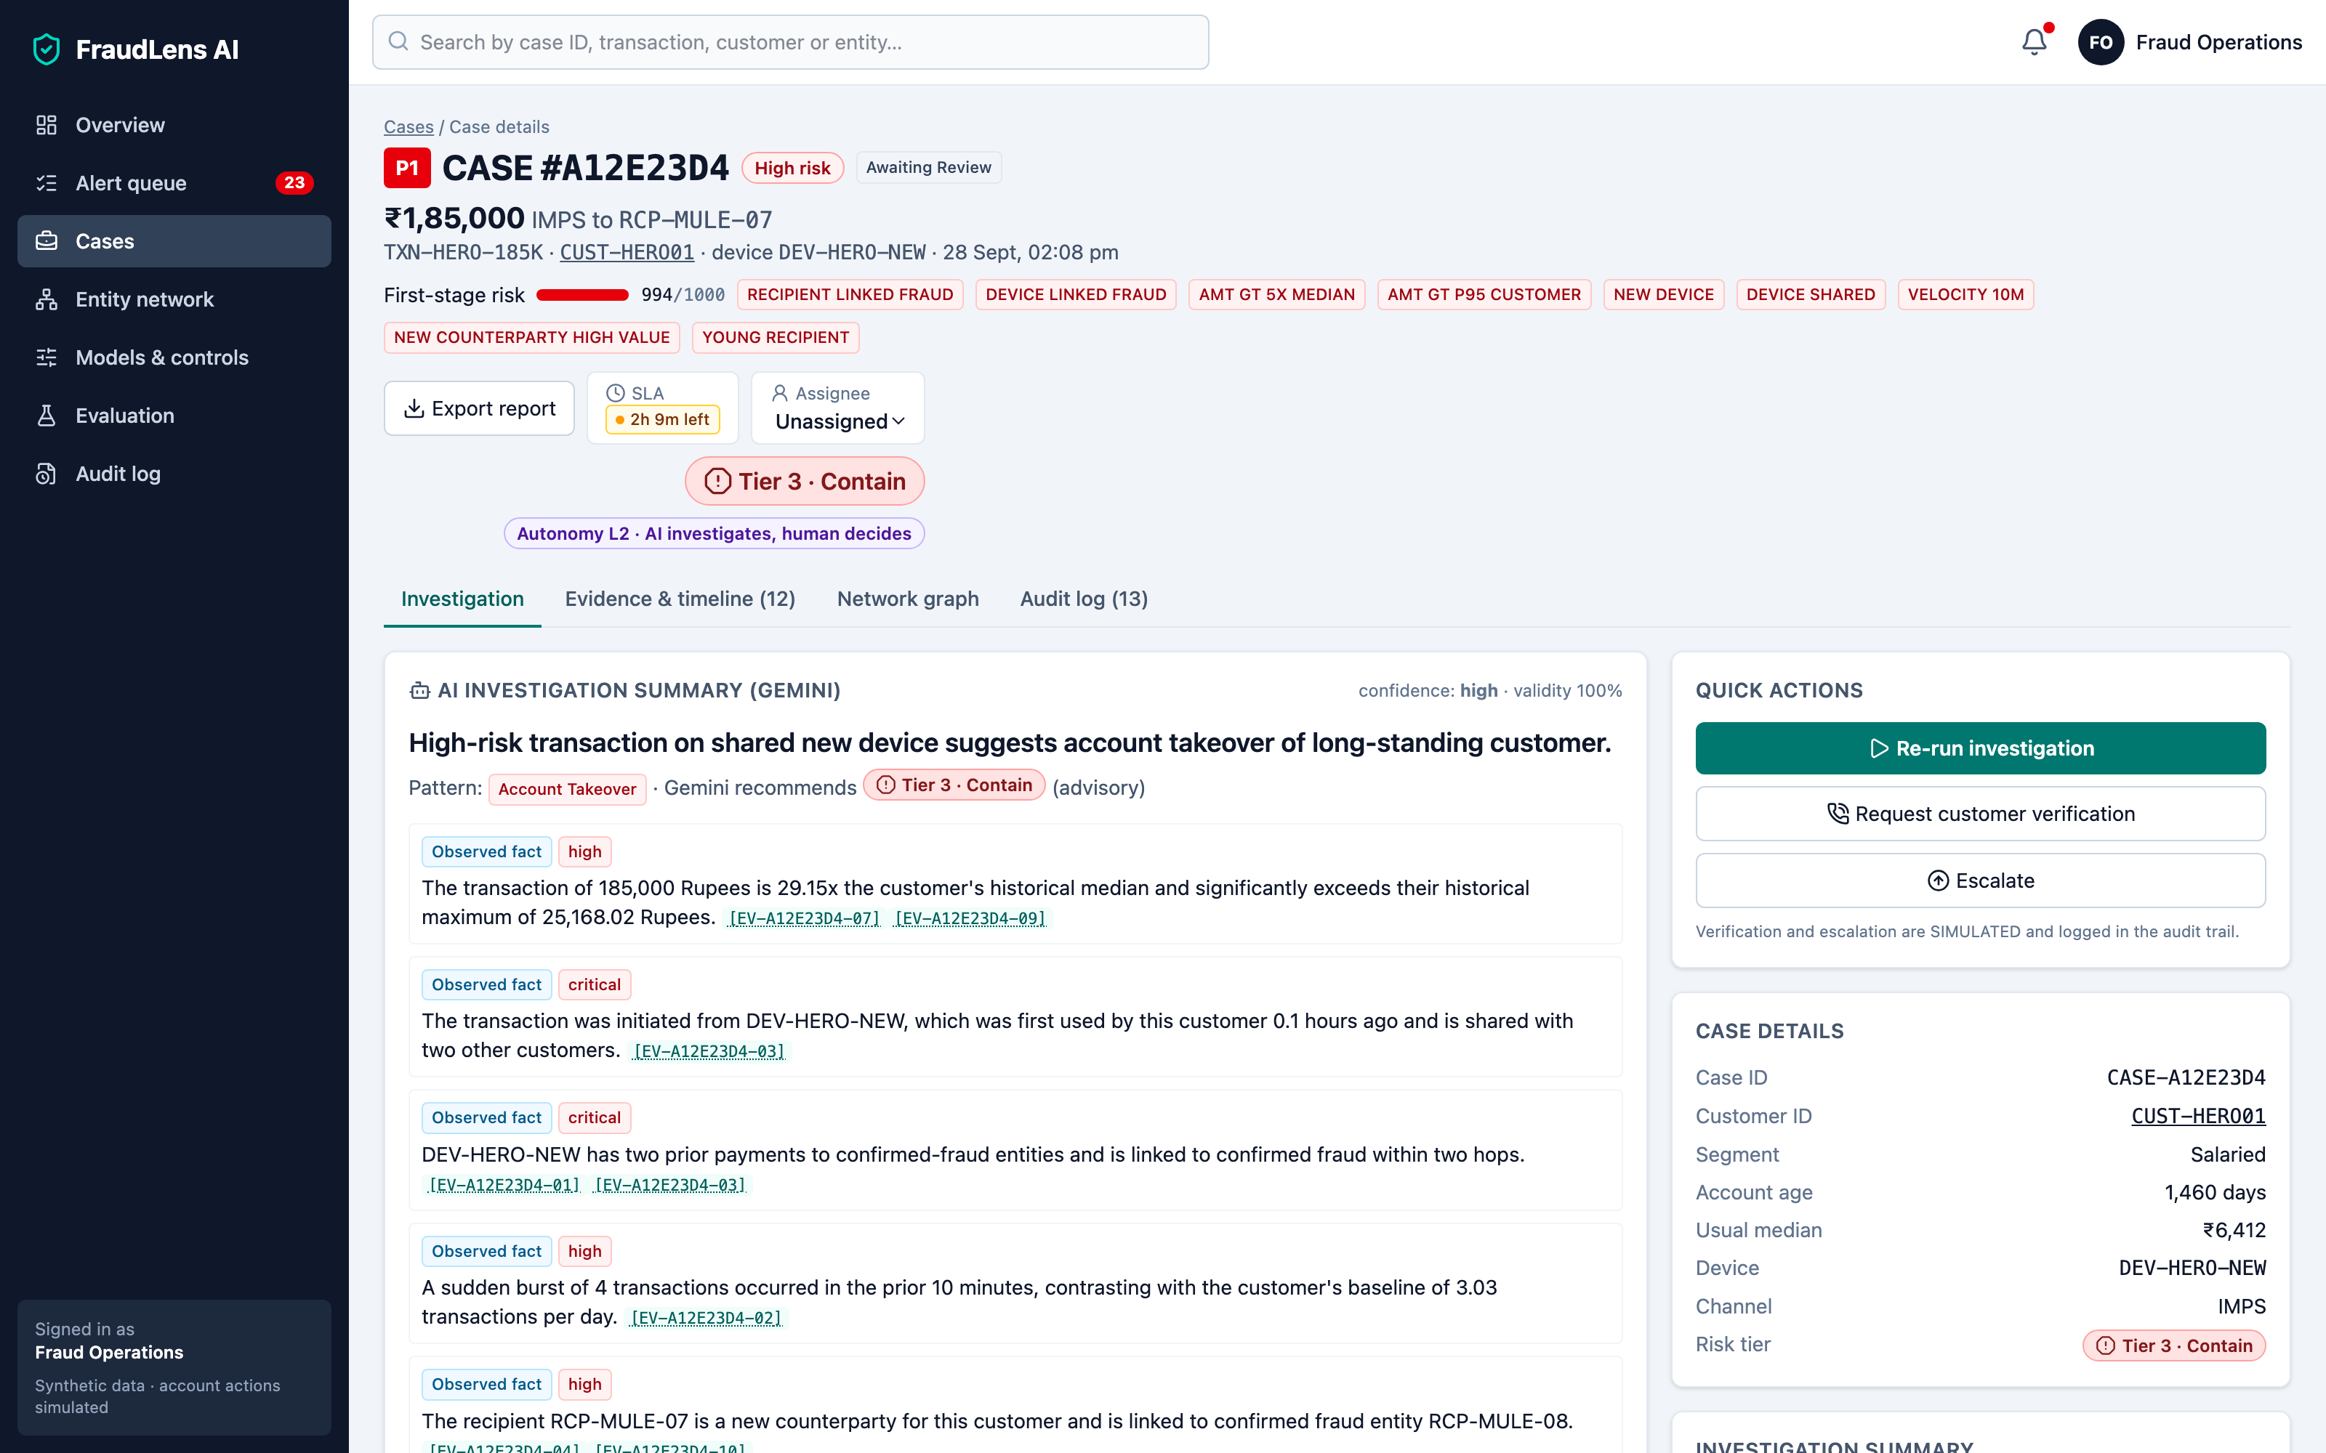
Wireframes/Mock diagrams of the proposed solution (optional)
Fraud Operations Dashboard · KPIs, priority queue, alert mix, model performance, insights
Case workspace · cited Gemini summary, policy tier, autonomy level, quick actions
Screens from the live prototype (synthetic data)

Slide 7
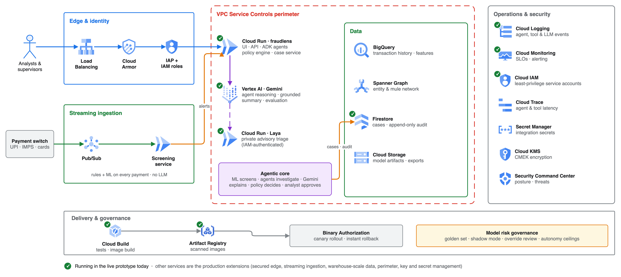
Architecture diagram of the proposed solution
Production architecture on Google Cloud · ✓ = running in the live prototype today (Cloud Run, Vertex AI Gemini, Laya, Firestore, Logging, Monitoring, IAM, Cloud Build, Artifact Registry)

Slide 8
Technologies to be used in the solution
Google AI
• Gemini 3.5 Flash on Vertex AI (Gemini Enterprise Agent Platform)
• Google Agent Development Kit (ADK) 2.12
• google-genai SDK · schema-constrained output
Google Cloud (live)
• Cloud Run (app + private Laya service)
• Firestore · Cloud Logging · Cloud Monitoring
• Cloud Build · Artifact Registry · IAM (ADC, no keys)
ML, data & graph
• scikit-learn: HistGradientBoosting + Isolation Forest
• pandas · NumPy · PyArrow (Parquet)
• NetworkX entity graph · joblib model registry
Backend
• Python 3.12 · FastAPI · Pydantic
• Deterministic policy engine and case service
• uv · pytest · ruff
Frontend
• React 19 · TypeScript · Vite
• Tailwind CSS · TanStack Query
• Recharts · Cytoscape.js · lucide icons
Decision model & production extensions
• Laya typed-decision model (open weights, PyTorch CPU)
• Pub/Sub · BigQuery · Spanner Graph · IAP · Cloud Armor
• VPC Service Controls · Cloud KMS · Secret Manager

Slide 9
Estimated implementation cost (optional)
Measured unit cost (real Gemini runs)
Gemini is called only for alerts (0.717% of transactions). Screening uses no LLM.
LLM cost at scale (derived from the measured unit cost)
Same 0.717% alert rate and token mix; excludes infrastructure.
Metric | Value
Tokens per investigated case (in / out) | 12,796 / 4,538
LLM cost per investigated case | $0.060
LLM cost per 1,000 transactions screened | $0.43
Investigation latency p50 / p95 | 18.8 s / 23.2 s
Transactions / month | Alerts investigated | Gemini cost / month
1 million | ≈ 7,170 | ≈ $430
10 million | ≈ 71,700 | ≈ $4,300
100 million | ≈ 717,000 | ≈ $43,000
Infrastructure & cost levers
• Cloud Run with request-based billing scales to zero; the prototype runs within a ₹2,000 budget alert
• Firestore, Logging and Monitoring are usage-based; Laya runs on CPU only and is optional (advisory)
• Levers: daily AI investigation cap · Gemini Flash-Lite for low-risk alerts · tune the alert threshold · batch screening jobs
Gemini 3.5 Flash list prices ($1.50 / 1M input, $9.00 / 1M output tokens; checked 17 Oct 2026, cloud.google.com/vertex-ai/generative-ai/pricing). Source: docs/metrics/agentic_eval.json

Slide 10
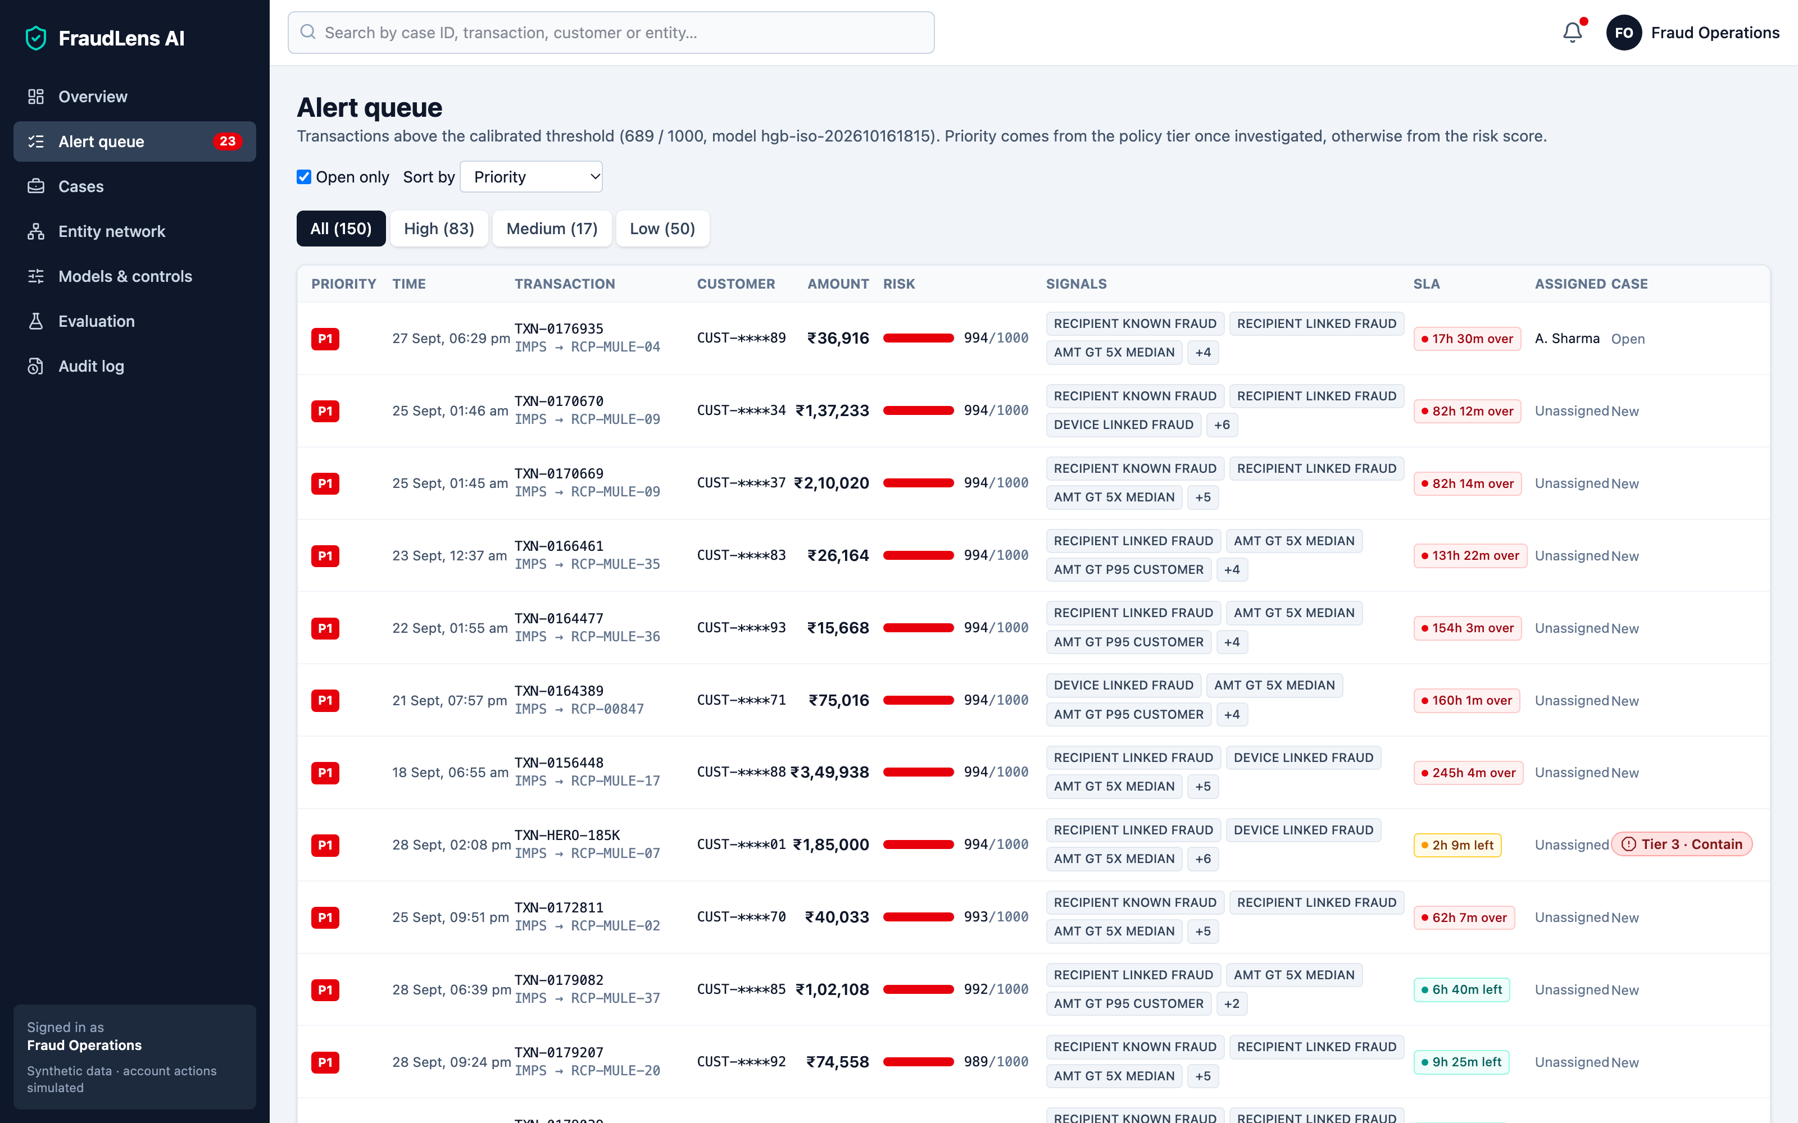
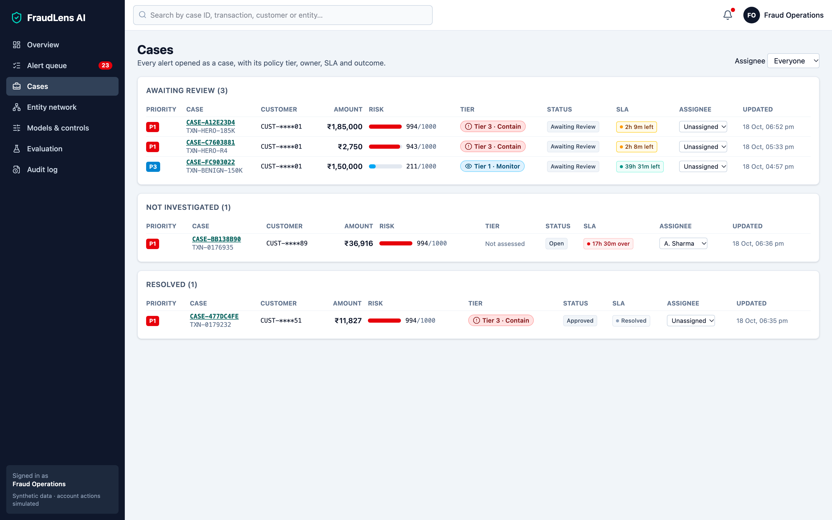
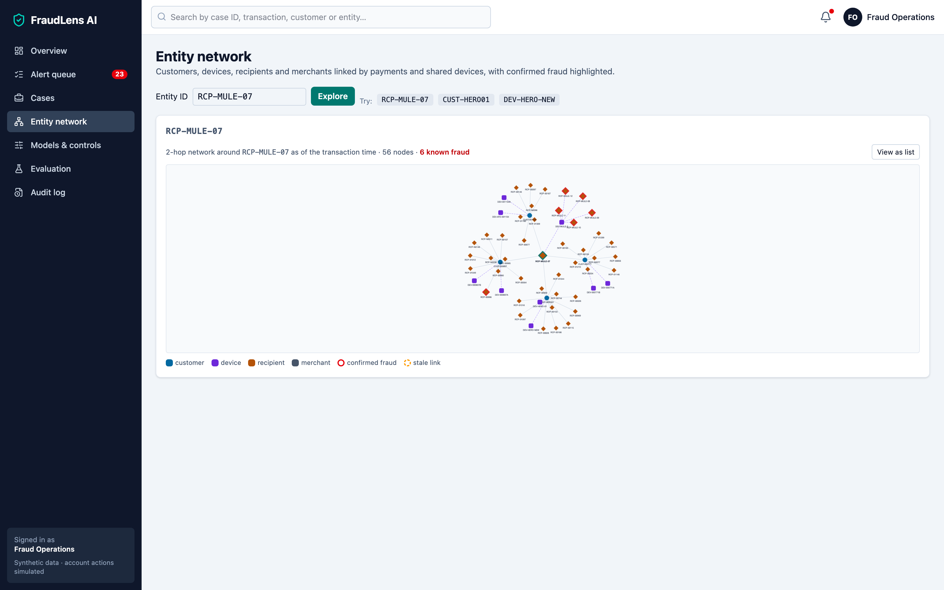
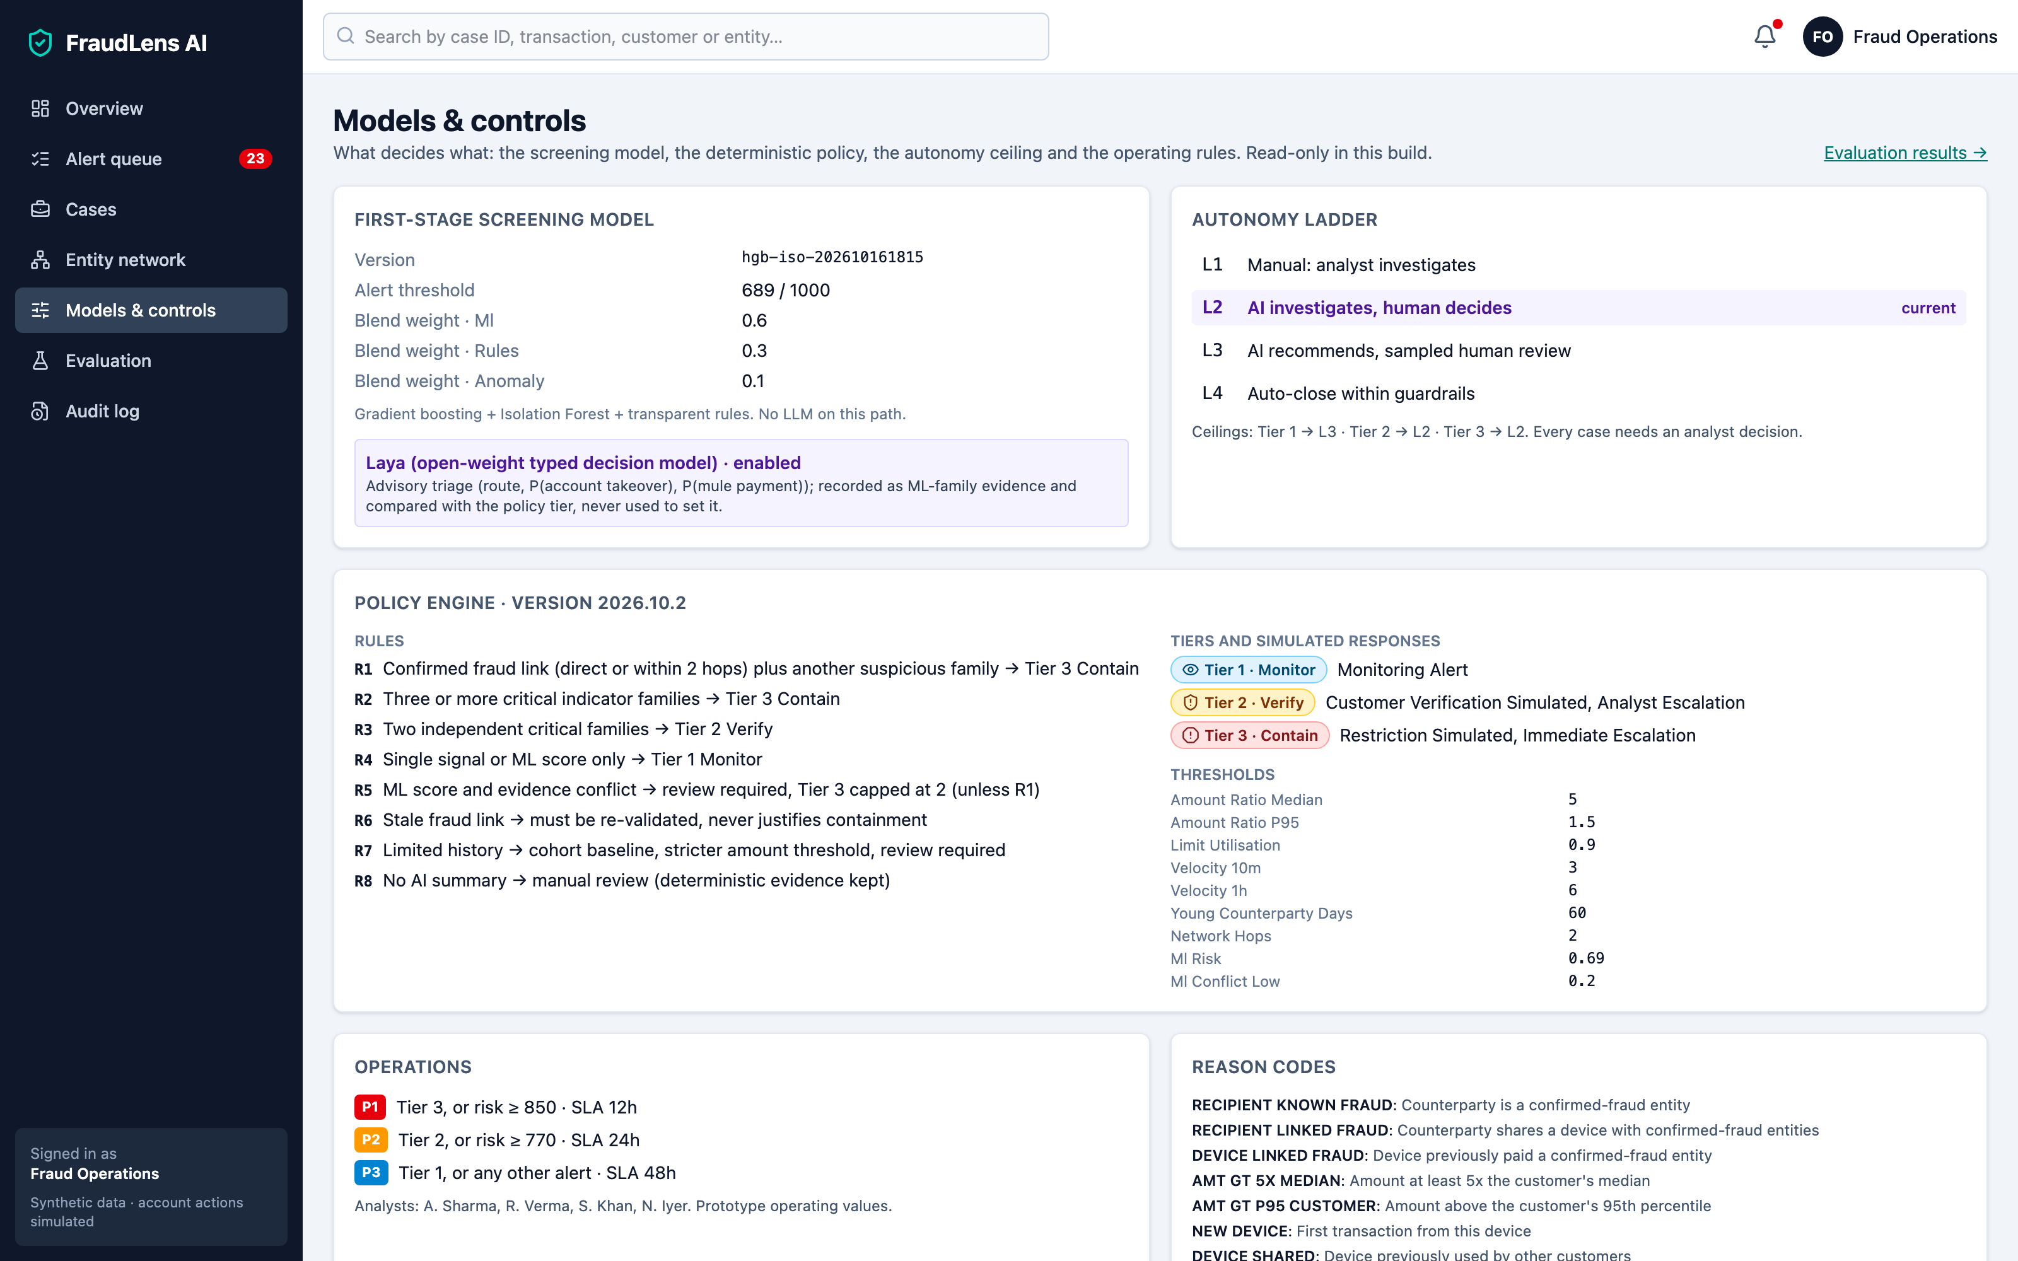
Snapshots of the prototype
Alert queue · priority, SLA, owner, masked IDs
Cases board · assignment, overrides, outcomes
Entity network · mule and shared-device links
Models & controls · policy rules, autonomy ladder
Live prototype: https://fraudlens-579191985047.us-central1.run.app

Slide 11
Prototype Performance report/Benchmarking
First-stage detection · held-out synthetic test split (days 75–89, 30,828 transactions)
Variant | Precision | Recall | PR-AUC | FP / 10k | Alert rate | Fraud value captured
A · Rules only | 0.922 | 0.659 | 0.675 | 3.89 | 0.50% | 92.4%
B · ML + anomaly + rules (deployed) | 0.824 | 0.851 | 0.900 | 12.65 | 0.72% | 73.7%
D · B + agentic Gemini investigation · 12 stratified test alerts (8 fraud, 4 legitimate) + 2 golden scenarios
Tier vs label agreement | Evidence validity | Invalid citations | Latency p50 / p95 | Tokens in / out | LLM $ / 1,000 txns
83.3% | 100% | 0 | 18.8 s / 23.2 s | 12.8k / 4.5k | $0.43
C · B + Laya open decision model (zero-shot, all 221 test alerts)
Routed to investigate | Precision / recall | Gemini escalations avoided | AUC P(ATO) / P(mule) | Laya latency p50 (CPU)
221 of 221 | 0.824 / 0.851 (= B) | 0% | 0.35 / 0.70 | 9.4 s
Takeaway: ML lifts recall from 0.66 to 0.85; agents add grounded, auditable investigations at $0.06 per case; Laya adds no lift zero-shot, so it stays advisory and off the critical path.
All numbers are produced by scripts (docs/metrics/detection_metrics.json · agentic_eval.json · laya_eval.json · benchmark.json); synthetic data, small agentic sample: treat agreement as indicative

Slide 12
Additional Details/Future Development (if any)
Production platform
• Secured edge: Load Balancing, Cloud Armor, IAP with analyst / supervisor roles
• Pub/Sub streaming, BigQuery history, Spanner Graph for entity networks
• VPC Service Controls, CMEK (Cloud KMS), Secret Manager
Smarter agents
• Detection agent: recommend rule and threshold changes from closed cases
• STR / FIU-IND narrative drafts with mandatory human sign-off
• Ask-the-case chat grounded on the evidence package
Safe autonomy
• Shadow mode on live traffic, then L3 (sampled review) for Monitor-tier cases
• Override review and challenger models before promotion
• Fairness checks across customer segments
New signals
• Scam (APP) signals: active call, remote-access tools, new payee + urgency
• Device risk and behavioural biometrics
• Privacy-preserving shared intelligence across banks

Slide 13
Provide links to your:
GitHub Public Repository: https://github.com/karan2314/AI-Code-Builder
Demo Video Link (3 Minutes): [add the public video link]
Final Product Link: https://fraudlens-579191985047.us-central1.run.app
Try it in 60 seconds
Open the live link → Overview → Run new investigation (or search TXN-HERO-185K) → watch the agents collect evidence → read the cited Gemini summary → approve the Tier 3 case or override it with a reason.
Synthetic data only · every account action is simulated · Gemini 3.5 Flash on Vertex AI · Google ADK · Cloud Run

Slide 14


