Slide 1
Variance reduction in a rough volatility model
Control variates and antithetic variates for rough Bergomi put prices
Team 9 · Jaskaran Kalra, William McDonnell
Notes:
The homework asks how much control variates and antithetic variates improve Monte Carlo prices of puts in the rough Bergomi model, separating variance reduction from computational efficiency.

Slide 2
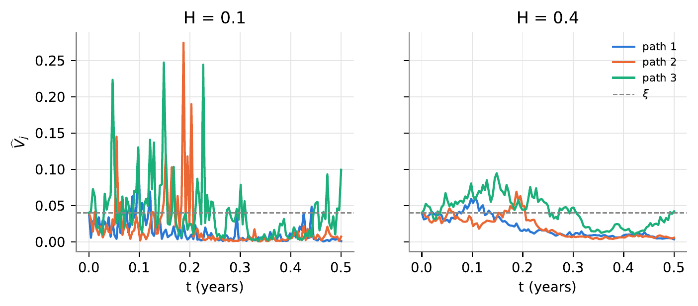
Setup and simulator checks
Rough Bergomi: H = 0.1, η = 1.5, ρ = −0.7
Put (K − S_T)+, T = 0.5, K = 90, 100, 110
Supplied hybrid scheme, n = 128 steps; Monte Carlo average over simulated paths
Three variance paths, same Gaussian inputs, H = 0.1 vs H = 0.4
Checks (Problem 1)
Mean and variance of Y, mean of V at j = 32, 64, 128 consistent with 0, q_j, ξ (within about 2 SE)
η = 0: simulated put prices consistent with Black–Scholes (6)
Notes:
Model and parameters are the assignment's baseline. Checks at n = 128: sample means of Y within 1.8 SE of zero, sample variance within 0.8% of q_j, mean of V within 2.0 SE of xi. With eta = 0 the scheme is exact Black–Scholes simulation for any n; prices match within 2.0 SE. The figure shows H = 0.1 paths are rougher than H = 0.4 paths from the same inputs.

Slide 3
Four estimators of the same price
Plain MC
Average the put payoffs over independent paths.
Control variate (CV)
Black–Scholes stock built from the same increments; its known price corrects the payoff. Coefficient fitted on a separate pilot run.
Antithetic (AV)
Each set of Gaussian inputs is used twice, as Z and −Z; the pair average is one observation.
Combined (AV+CV)
Antithetic pairs, with the control applied to the pair average. Coefficient from a pilot of pairs.
Each method: 100,000 production path evaluations; pilots of 10,000. VRF = SE² ratio vs plain; Gain also divides by run time (incl. pilot).
Notes:
These are the four estimators of Problems 2–5. The fixed budget is from Problem 5(a). VRF and Gain are defined in equation (19).

Slide 4
Baseline results, K = 100
Observations
CV: VRF 3.2. Payoff and control move together (corr 0.83); VRF ≈ 1/(1−corr²)
AV: VRF 1.4. Pair outcomes only mildly offset (corr -0.28); VRF ≈ 1/(1+corr)
Gain ranks AV+CV first (2.8): a pair needs half the random numbers, so it runs faster
All four 95% confidence intervals overlap
Notes:
K = 100 from Problem 5(a); the report has all three strikes. Prices: plain 5.061 [5.01, 5.12], CV 5.108, AV 5.095, AV+CV 5.106. VRF ranks CV first; Gain ranks AV+CV first because antithetic pairs need half the random numbers. AV+CV has the largest Gain at K = 90 and 100; at K = 110 the Gains are within timing noise.

Slide 5
Parameter sensitivity, K = 100
Observations
Smaller η or larger H: the stock behaves more like the Black–Scholes control, so corr rises (0.83 → 0.97, 0.93) and CV improves
Baseline: AV+CV is below CV. Flipping removes noise the control already explains (corr falls to 0.74 after pairing)
η = 0.5, H = 0.4: the control still fits the pair well, so AV+CV leads on VRF and Gain
Notes:
Problem 5(c). With a smaller eta or a larger H the simulated stock is closer to the Black–Scholes control, so Corr(X, C) and the CV VRF rise. At baseline, pairing removes the part of the payoff the control also explains, so the control correlates less with the pair average and the combination's VRF is slightly below CV's. Gains: eta = 0.5: CV 14.6, AV+CV 19.0; H = 0.4: CV 5.4, AV+CV 9.0.

Slide 6
Conclusions
Variance reduction (VRF): the control variate is largest at all three baseline strikes
Efficiency (Gain): AV+CV is largest at K = 90 and 100; antithetic pairs halve random-number cost
With η = 0.5 or H = 0.4, all correlations strengthen and AV+CV leads on both measures
Notes:
VRF and Gain can rank methods differently: VRF compares error for the same number of path evaluations, Gain also accounts for computation time.

