Slide 1
A/B Testing
Inspired By :
https://readmedium.com/en/https:/towardsdatascience.com/ab-testing-with-python-e5964dd66143#1.-Designing-our-experiment
Notes:
https://www.evanmiller.org/

Slide 2
Contents
Designing our experiment
Collecting and preparing the data
Visualizing the results
Testing the hypothesis
Drawing conclusions
Current State
Experiment Proposed
Experiment Goal
Experiment Design a) Hypothesis b)Metric c)Invariant Metrics d)Evaluation Metrics e) Sizing Experiment
Experiment Analysis

Slide 3
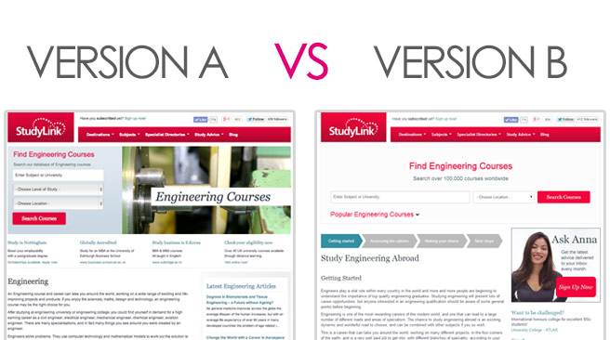
Designing our experiment(DOE)
Old page vs New page

Slide 4
Metric
Old page vs New page
CTR = Click through Rate
Old Conversion Rate = 12%
Desired Conversion Rate = 15%

Slide 5
Hypothesis and Parameters
Hypothesis
Parameters
Sample Size
Hₒ: p = pₒ
Hₐ: p ≠ pₒ
Significance Value, Alpha = 0.05
Beta = 0.20
Effect Size = Difference in conversion rates = 0.02
n = 16*sample std. deviation/ min. detectable effect between the treatment and control group.
Notes:
Power of the test (1 — β) — This represents the probability of finding a statistical difference between the groups in our test when a difference is actually present. This is usually set at 0.8 by convention (here’s more info on statistical power, if you are curious)
Alpha value (α) — The critical value we set earlier to 0.05
Effect size — How big of a difference we expect there to be between the conversion rates
Sample Size

Slide 6
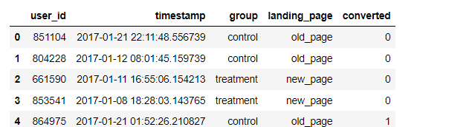
Data
User ID – Unique to every customer
Timestamp - Timestamp of visiting the page
Group – Part of either control group or treatment group.
Landing page – Old_page vs New page
Converted – 0 or 1

Slide 7
Results
Two Tailed
One Tailed
One Tailed
Control Conversion = Treatment Conversion
P value = 0.14
Cannot reject Hₒ
Control Conversion > Treatment Conversion
P value = 0.93
Cannot reject Hₒ
Control Conversion < Treatment Conversion
P value = 0.07
Cannot reject Hₒ

Slide 8
Conclusion
Our statistical tests have revealed that the new design is not doing a better job at attracting customers to become subscribers to our site than the old design.
Although the new design is not necessarily losing us customers either, business leaders may consider if they would like to revert to the old design or continue to try other solutions to attempt to attract more subscribers.

