Slide 1


Customer Shopping Behavior Analysis
Uncovering insights from 3,900 purchases to guide strategic business decisions

Slide 2
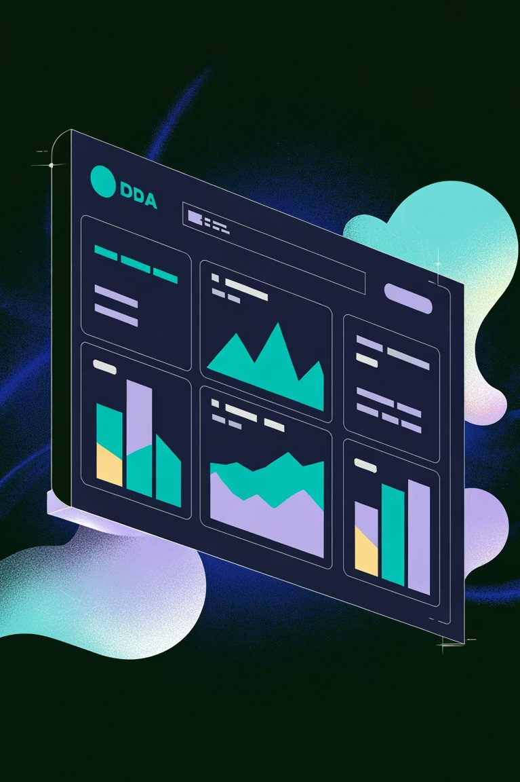
Dataset Overview
3,900 Purchases
Transactions analyzed across multiple categories
18 Features
Demographics, purchase details, behavior patterns
50 Locations
Geographic distribution of customer base
25 Products
Across 4 categories: Clothing, Footwear, Accessories, Outerwear

Slide 3

Customer Demographics
44
Average Age
Range: 18-70 years old
57%
Male Customers
2,652 male vs 1,248 female purchases
27%
Subscription Rate
1,053 subscribers vs
2,847 non-subscribers

Slide 4

Revenue Insights
Revenue by Gender
Male: $157,890
Female: $75,191
Males generate 2.1x more revenue
Revenue by Subscription
Non-Subscribers: $170,436
Subscribers: $62,645
Opportunity to convert non- subscribers

Slide 5
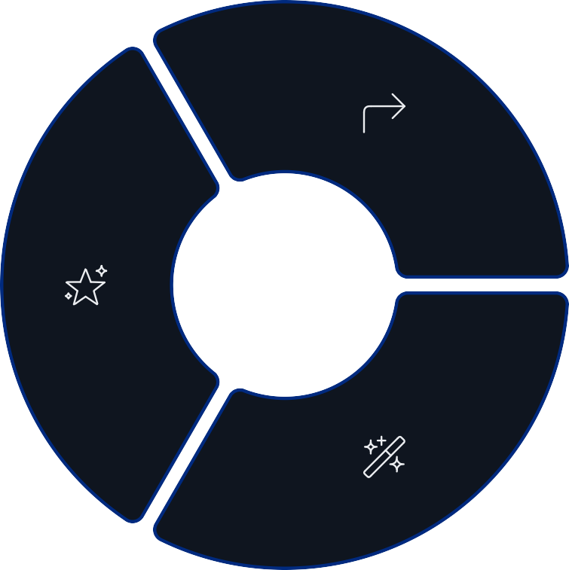
Customer Segments
Returning
701 customers (18%) Occasional repeat buyers
Loyal
3,116 customers (79.9%) Repeat purchasers with strong
engagement
New
83 customers (2.1%) First-time purchasers

Slide 6
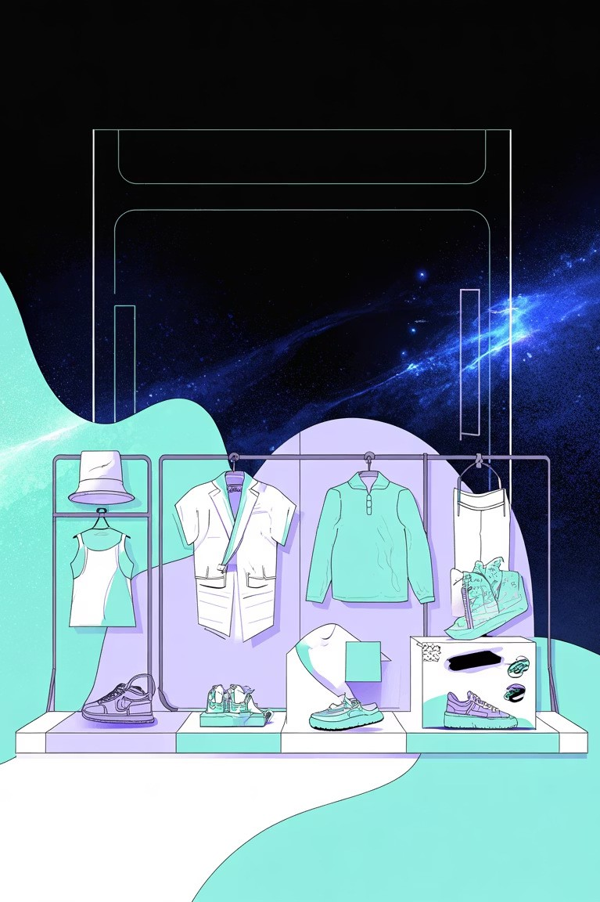
Product Performance
Top Rated
Gloves (3.86), Sandals (3.84), Boots (3.82)
1
Best Sellers
Blouse (171), Jewelry (171), Pants (171)
2
Discount Heavy
Hat (50%), Sneakers (49.7%), Coat (49.1%)
3

Slide 7

Shipping & Spending Patterns
Shipping Preference
Free Shipping: 2,223 orders (57%)
Standard: 675 orders (17%)
Express: 1,002 orders (26%)
Average Spend
Express: $60.48
Standard: $58.46
Express users spend 3.5% more

Slide 8
Discount Impact Analysis
1 2
3
High-Spending Discount Users
839 customers used discounts but spent above average ($59.76)
Discount Dependency
5 products show 47-50% discount rates, indicating margin pressure
Strategic Balance
Review discount policy to maintain profitability while driving sales

Slide 9
Age Group Revenue Contribution
$75,000.00
$50,000.00
$25,000.00
$0.00
Young Adult Middle-aged Adult
Senior
Young adults lead revenue generation with balanced contribution across all segments

Slide 10

Strategic Recommendations
Boost Subscriptions
Promote exclusive benefits to convert non-subscribers
Loyalty Programs
Reward repeat buyers to strengthen engagement
Optimize Discounts
Balance sales growth with margin protection
Targeted Marketing
Focus on high-revenue segments and express-shipping users

