Slide 1
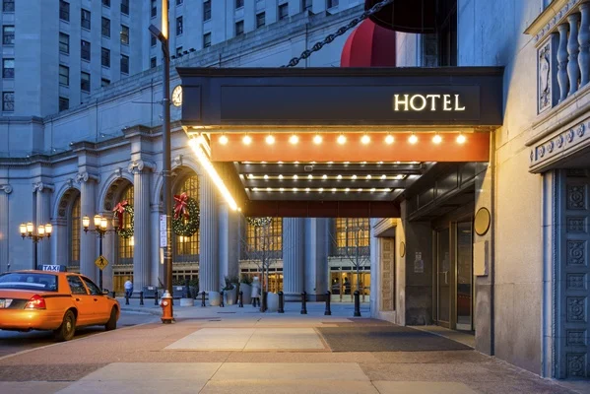

Hotel Reservation Cancellations
Develop robust machine learning models to accurately predict hotel reservation cancellations. By utilizing these models, the company aims to improve revenue management, optimize resource allocation, and potentially implement targeted retention strategies
Presented By :Karan Singh

Slide 2
AGENDA
Introduction
01
02
03
Find patterns and identify trends
04
05
06
07
Gain valuable insights from the dataset
Models and early detection bring essential benefits
Data Gathering /Data Refinement
Comprehensive Dataset Overview
Refinement and Data Preparation Steps
EXPLORATORY DATA ANALYSIS
Feature Extraction
Divide Features into X and Y
Machine Learning / Deep learning
Methodology
Algorithms or Models Used
Compare each Evaluate Algorithm
Experimental results
Visuals of Compared models
Accuracy, confusion matrix of models
Conclusion
Importance of the used approach
Suggestion for future

Slide 3

INTRODUCTION
Developed an end-to-end Machine Learning project to predict hotel reservation cancellations using Python, Pandas, NumPy, Scikit-learn, Matplotlib, and Seaborn.
Performed comprehensive Exploratory Data Analysis (EDA) to identify key factors affecting cancellations such as lead time, market segment, repeated guests, and booking timing.
Applied data preprocessing techniques including missing value handling, label encoding, feature scaling, and feature selection to improve model performance.
Built and compared multiple classification models including Logistic Regression, Decision Tree, and Random Forest to identify the best-performing algorithm for cancellation prediction.
Evaluated model performance using accuracy score, confusion matrix, classification report, and cross-validation techniques to ensure reliable predictions.
Conducted hyperparameter tuning using GridSearchCV to optimize model accuracy and improve prediction efficiency for business decision-making.

Slide 4







WORK F LOW
4. Train - Test Split
Dividing the dataset into training and testing sets to evaluate
1. Data Collection
Gathering and organizing data to train machine learning models.
5. Model Selection and Model Training
Choosing a suitable machine learning algorithm and optimizing its parameters
2. Exploratory Data Analysis
Analyzing and visualizing data patterns to understand its characteristics
6. Model Evaluation
Assessing the performance of a machine learning model using metrics
3. Preprocessing
Preparing and cleaning data to enhance its quality and suitability
7.Monitor and Update
Continuously monitor the model's performance in the real-world scenario

Slide 5

EXPLORATORY DATA ANALYSIS
Exploratory Data Analysis (EDA) helped us understand the data structure, find patterns, identify trends, and gain valuable insights from the dataset.
From EDA, we analyze the distribution of each feature, checking the correlation between the features.
Using visuals helped us see the data clearly, understand the clinical data relationship with each other, and pinpoint factors that play a vital role in the predictions of heart disease.
The datasets are clean, as there is no NULL VALUE, but we can find some DUPLICATE VALUES and OUTLIERS.
We used the univariate and bivariate analysis approach to gain insights into individual characteristics of the data and likewise how each feature relates to main goal: predicting the target variable.

Slide 6
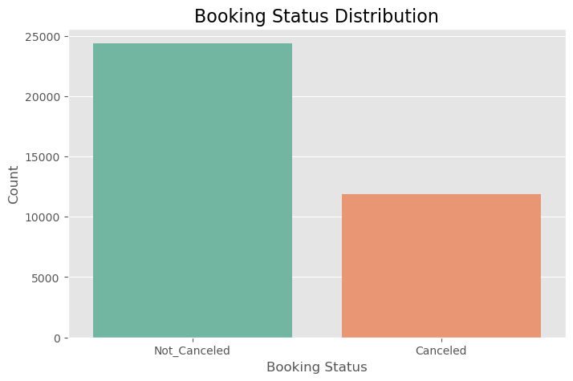
BOOKING STATUS DISTRIBUTION
The visualization shows that the number of Not_Canceled bookings is significantly higher than canceled bookings, indicating that most customers successfully complete their reservations.
Although cancellations are lower compared to successful bookings, the chart still highlights a substantial number of cancellations, which can directly impact hotel revenue and occupancy planning.
The dataset appears to have a moderate class imbalance, where the “Not_Canceled” category dominates. This insight is important while training machine learning models to avoid biased predictions.
The booking cancellation trend suggests that analyzing factors such as lead time, market segment, repeated guests, and room type could help identify why customers cancel reservations.
This distribution analysis provides a strong foundation for building predictive models that can help hotels improve revenue management, resource allocation, and customer retention strategies.

Slide 7
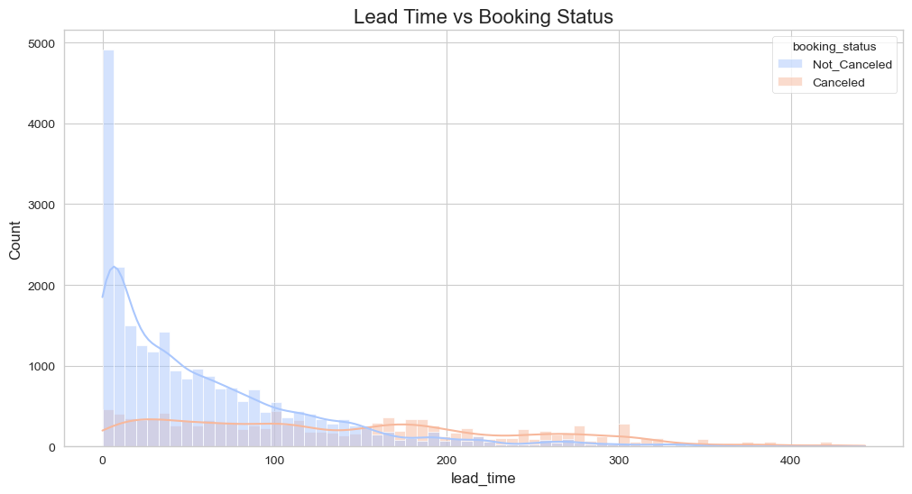
LEAD TIME VS BOOKING STATUS
The visualization shows that bookings with shorter lead times are less likely to be canceled, while cancellation probability increases as lead time increases.
Customers who book hotels far in advance tend to cancel more frequently, possibly due to changes in travel plans, pricing, or availability of better options.
The highest concentration of Not_Canceled bookings is observed at lower lead times, indicating that last-minute or near-date bookings are generally more reliable.

Slide 8
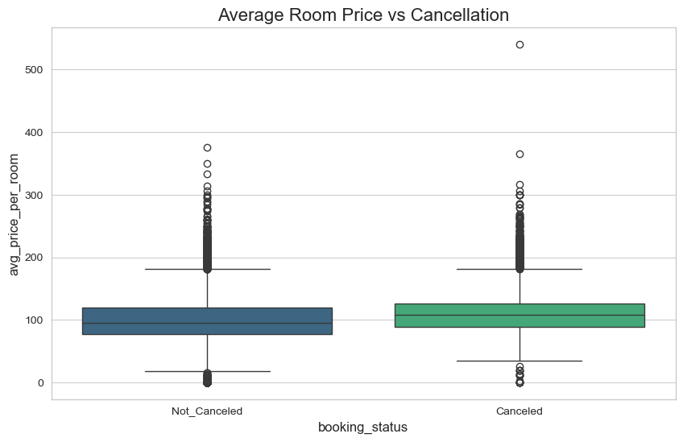
Average Room Price vs Cancellation
The boxplot shows that the average room price for canceled bookings is generally higher compared to non-canceled bookings, indicating that expensive bookings have a greater chance of cancellation.
Customers paying higher room prices may be more likely to cancel due to price sensitivity, availability of alternative options, or changes in travel plans.
The presence of several outliers in both booking categories indicates that some bookings have extremely high room prices, which can significantly influence cancellation behavior.

Slide 9

PREPROCESSSING
Irrelevant Feature Removal: All features in the dataset appear to be relevant based on EDA. We will retain all the columns, ensuring no valuable information is lost, especially given the dataset’s small size.
Missing Value Treatment: No missing value found in the dataset.
Outliers Treatment: Checked outliers using the IQR method for the continuous features, and upon identifying outliers, the nature of the algorithm, and given a small dataset size, direct removal of outliers might not be the best approach. Instead, we will apply the Box-Cox transformation to stabilize variance and make the data more normally distributed.
Feature Scaling: is imp. for the algorithms that are sensitive to the magnitude and scale of features, but not all algorithms require scaling, like Decision Trees are scale-invariant, and given our intent to use a mix-model, we’ve chosen to handle scaling.

Slide 10
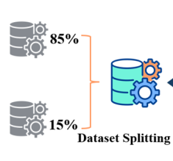


TRAIN TEST SPLIT
We divided the data into training (80%) and testing (20%) sets.
Setting a random state ensures consistent results and using stratify=y maintains a proportional distribution of the target variable in both sets.
SPLITING THE DATA INTO X & Y
We divided the dataset into two parts: X and y.
"X" typically represents the independent Variables, and "y" represents the Dependent (target variable) that we want to predict or understand.

Slide 11
MODEL SELECTION
Logistic Regression
Logistic regression is commonly used for binary classification problems. it's preferred because it provides a simple and efficient way to model the relationship between the independent variables and the probability of a certain outcome.
Random Forest
Random Forest is a robust supervised algorithm suitable for both regression and classification tasks.

Slide 12
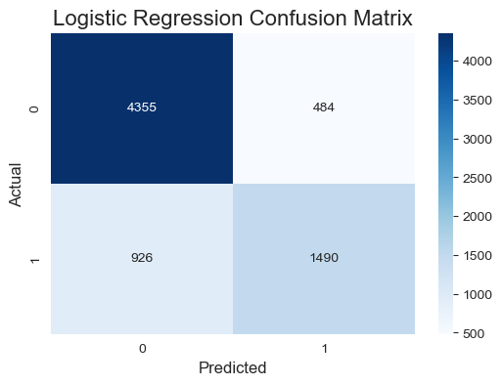
Logistic Regression Confusion Matrix

Slide 13
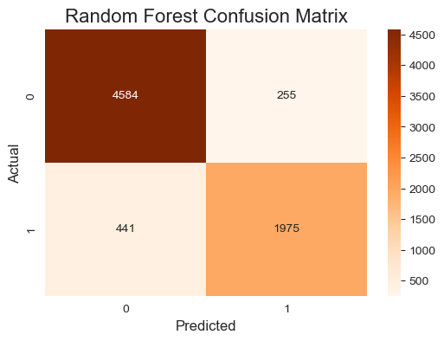
RANDOM FOREST CONFUSION MATRIX

Slide 14

Conclusion
Conclusion
This project successfully developed a Machine Learning-based hotel reservation cancellation prediction system using various booking and customer-related features. Comprehensive Exploratory Data Analysis (EDA) revealed that factors such as lead time, average room price, repeated guest status, and booking patterns significantly influence reservation cancellations.
Multiple classification algorithms including Logistic Regression, Decision Tree, and Random Forest were implemented and evaluated. Among all models, the Random Forest Classifier achieved the best performance after hyperparameter tuning using GridSearchCV, providing high prediction accuracy and reliable classification results.
Feature engineering and preprocessing techniques such as missing value handling, encoding, scaling, and feature selection improved overall model efficiency and prediction capability. The project also provided valuable business insights through visualizations and feature importance analysis.
The developed solution can help hotels improve revenue management, optimize staff and inventory planning, reduce losses from cancellations, and support strategic decision-making through predictive analytics. This project demonstrates the practical application of Machine Learning in solving real-world business problems in the hospitality industry.

Slide 15

THANK YOU

