Slide 1
Unemployment Trends Among Educated Youth in India
A Data-Driven Analysis
Karan Singh
June 2025

Slide 2
Introduction
Unemployment among educated youth is a major concern in India.
The analysis uses a dataset with 200,000 entries across multiple states.
Goal: Explore patterns and provide actionable insights.

Slide 3
Dataset Overview
Rows: 200,000 | Columns: 20
Key Features:
State, Age group, Gender, Education level
(Labour force partion rate)LFPR, Unemployment rate, Salary expectation
Training received, Internet access, Dropout reason

Slide 4
Top 10 States by Peak monthly Unemployment Rate
Bihar and Uttar Pradesh show the highest unemployment rates exceeding 30%
Maharashtra, Gujarat, and Karnataka appear on the list, emphasizing that growth does not always translate into employment.

Slide 5
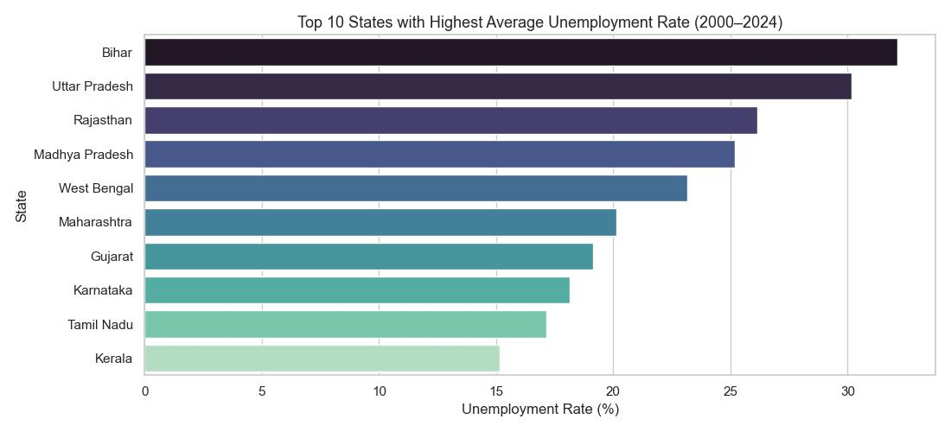
Top 10 States by Peak Monthly Unemployment Rate (2000–2024)

Slide 7
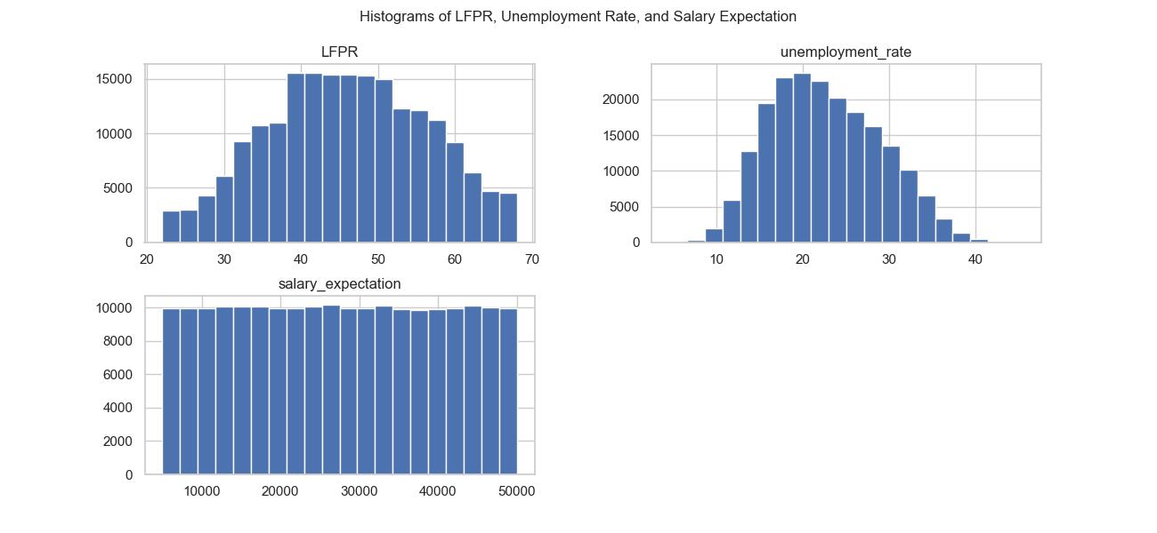

Slide 8
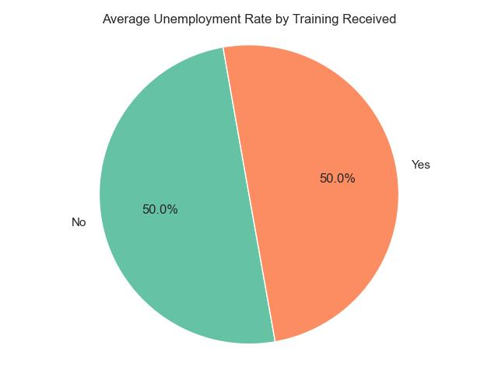
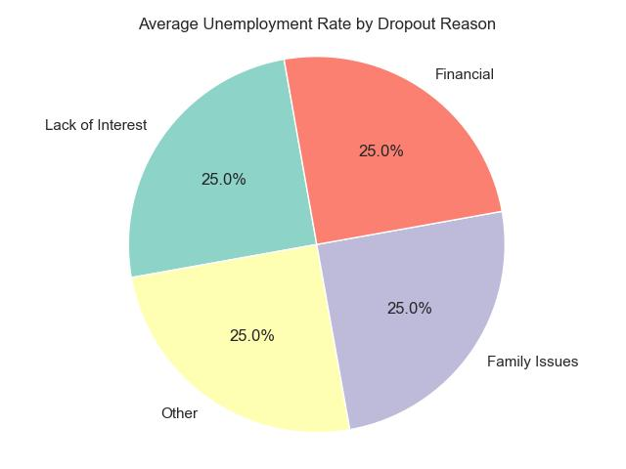
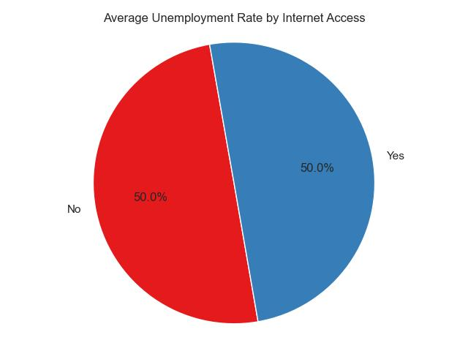

Slide 9
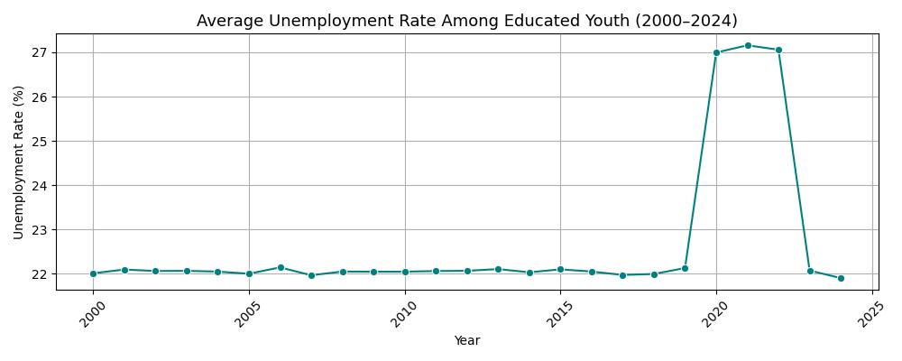
National Trends
Average Unemployment Rate Among Educated Youth (2000–2024)
Visualization: Unemployment by education level

Slide 10
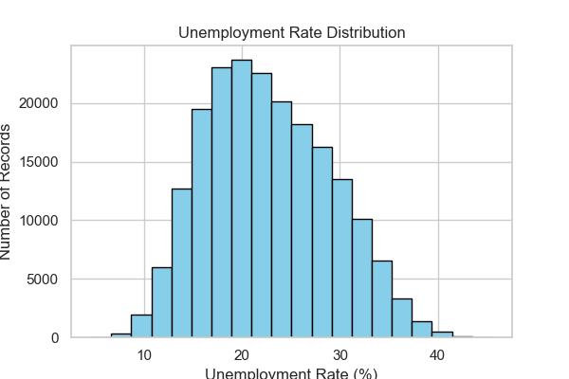
Unemployment_rate %
Year | Unemployment_rate
2020 | 26.995139
2021 | 27.157972
2022 | 27.059377
2023 | 22.072651
2024 | 21.903124
Year | Unemployment_rate
2000 | 22.011905
2001 | 22.095571
2002 | 22.062450
2003 | 22.065728
2004 | 22.048860

Slide 11
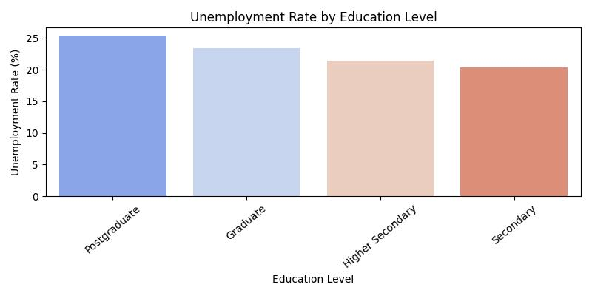
Education_level | Unemployment_rate
Postgraduate | 25.383768
Graduate | 23.403557

Slide 12
Regional Analysis
Highest unemployment in North India.
Lowest in South India.
Pie chart shows average unemployment rate by region.
Region | Unemployment rate
North | 28.170267
East | 27.638901
Central | 25.183196
West | 19.635830
South | 16.812847

Slide 14
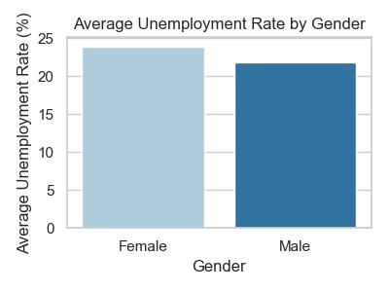
Gender and Education Level
Female youth face slightly higher unemployment than males.
Gender | Unemployment_rate
Female | 23.907426
Male | 21.816640

Slide 15
Impact Factors
Top dropout reasons: Financial issues, Family issues, Lack of interest.
Higher unemployment linked to:
No internet access
No training
High salary expectations

Slide 16
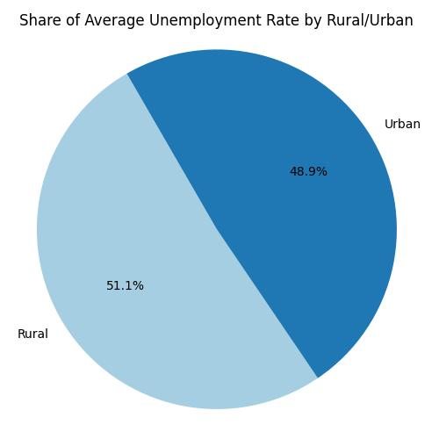
Key Insights
Rural youth have higher unemployment.
Higher education alone does not ensure jobs.
Skill development and digital access are key.

Slide 17
Conclusion
Promote vocational training and internships.
While improving internet access and digital literacy opens doors to modern employment opportunities..
A focused policy push towards rural job creation ensures inclusive and balanced development.

Slide 18
Thank’s For Watching

