Slide 1

SUMMER TRAINING PROJECT
BY KARAN YADAV

Slide 2





CT-KIDNEY IMAGE DENOISING USING AUTO-ENCODER
PROBLEM
STATEMENT

Slide 3
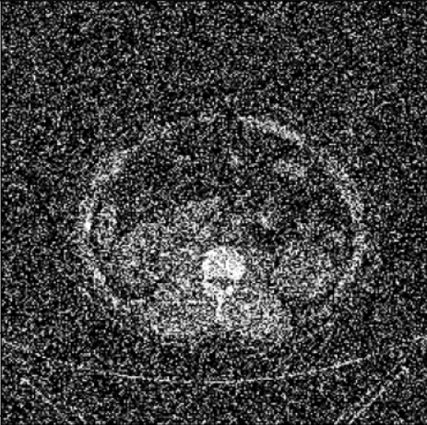
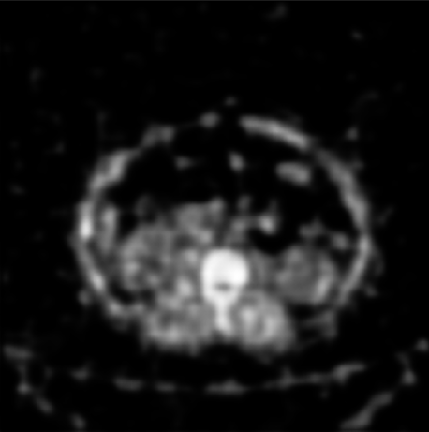
WHY DENOISING ?
Due to various reasons noise can be added in the images [ENVIRONMENTAL, MACHINERY, etc…]
So we use Denoisers to get the clear image
Not only for images, they can be used in voice denoising
NOISY IMAGE
DENOISED IMAGE

Slide 4
HOW NOISE IS ADDED TO OUR DATASET ?
Using custom function
def add_noise(data_set, noise_factor=0.5):
MU = 0.0
SIGMA = 1.0
GAUSS = np.random.normal(MU, SIGMA, size=data_set.shape)
data_set = data_set + noise_factor * GAUSS
return np.clip(data_set, 0.0, 1.0) # limiting the values between 0 and 1

Slide 5
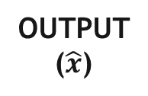



??? AUTO-ENCODERS ???
Convolutional
Auto-Encoders
OPTIMIZATION
INPUT
(x)
$$μ$$
$$\tilde{x}$$
LATENT SPACE
compressed data
OUTPUT
($\hat{x}$)
Compress data
Reconstructs
ENCODER
DECODER
$$σ$$
NOISE

Slide 6
MODEL
ENCODER
Compressed
Conv2D
MaxPool2D
Conv2D
MaxPool2D
Conv2D
Conv2D
Conv2D
Conv2DTranspose
Conv2D
Conv2DTranspose
Output
DECODER
We want to train a deep learning model which can regenerate the image from noisy images
AUTO MATICALLY

Slide 7
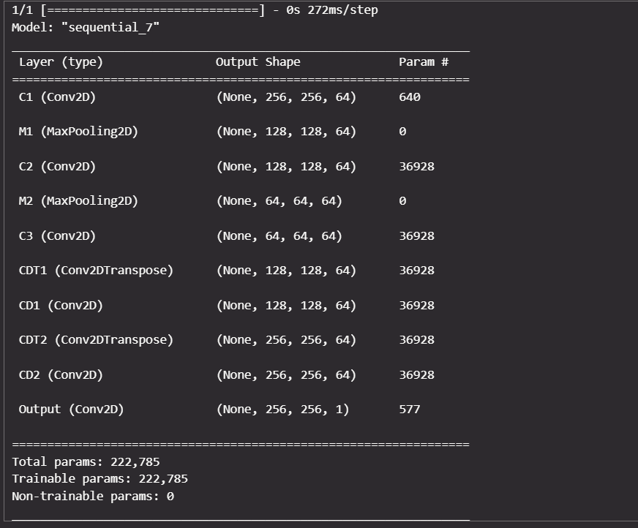
SUMMARY
def build_model():
model = tf.keras.Sequential([
# Encoder
tf.keras.layers.Conv2D(filters=64, kernel_size=(
3, 3), padding="same", activation="relu", use_bias=True, name="C1"),
tf.keras.layers.MaxPool2D(pool_size=(2, 2), padding="same", name="M1"),
tf.keras.layers.Conv2D(filters=64, kernel_size=(
3, 3), padding="same", activation="relu", use_bias=True, name="C2"),
tf.keras.layers.MaxPool2D(pool_size=(2, 2), padding="same", name="M2"),
tf.keras.layers.Conv2D(filters=64, kernel_size=(
3, 3), padding="same", activation="relu", use_bias=True, name="C3"),
# Decoder
tf.keras.layers.Conv2DTranspose(filters=64, kernel_size=(
3, 3), strides=2, padding="same", activation="relu", name="CDT1"),
tf.keras.layers.Conv2D(filters=64, kernel_size=(
3, 3), padding="same", activation="relu", use_bias=True, name="CD1"),
tf.keras.layers.Conv2DTranspose(filters=64, kernel_size=(
3, 3), strides=2, padding="same", activation="relu", name="CDT2"),
tf.keras.layers.Conv2D(filters=64, kernel_size=(
3, 3), padding="same", activation="relu", use_bias=True, name="CD2"),
# Output
tf.keras.layers.Conv2D(filters=1, kernel_size=(
3, 3), padding="same", activation="sigmoid", name="Output")
])
return model

Slide 8
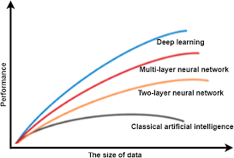
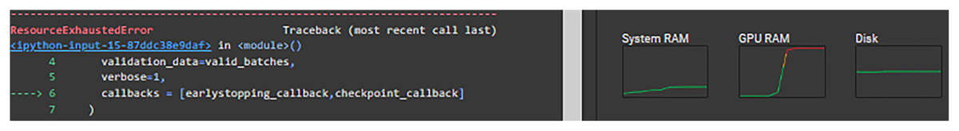
DATA MATTERS
As DATA increases,
the performance of our DEEP LEARNING MODEL increases
BUT…

Slide 9
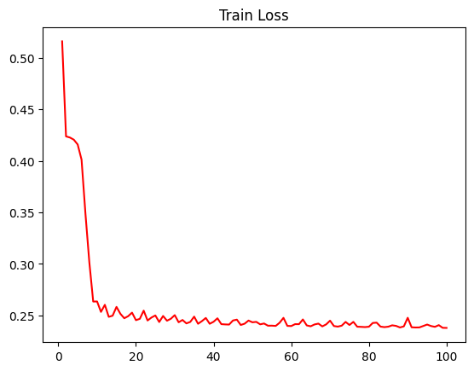
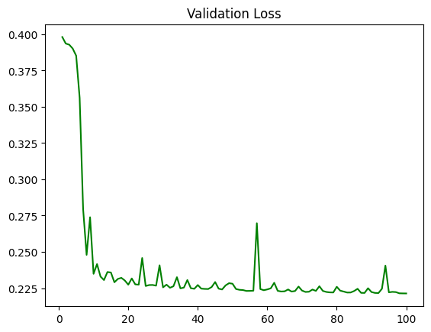
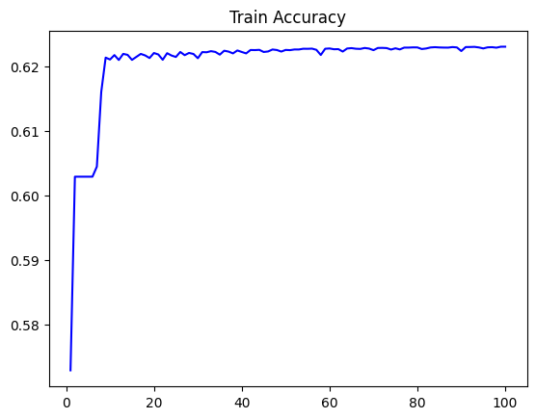
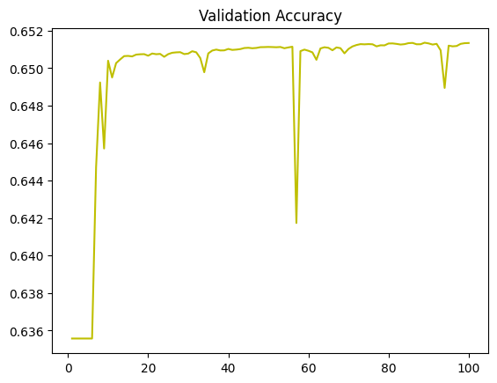
PLOTS
LEARNING_RATE = 1e-1
OPTIMIZER = tf.optimizers.SGD(learning_rate=LEARNING_RATE)
LOSS = tf.losses.binary_crossentropy
METRICS = ['accuracy']
model.compile(optimizer=OPTIMIZER, loss=LOSS, metrics=METRICS)
print("[+] Compiled")
BATCH_SIZE = 10
EPOCHS = 100
HISTORY = model.fit(x=noisy_train_images,
y=train_images,
batch_size=BATCH_SIZE,
epochs=EPOCHS,
shuffle=True,
validation_data=
(noisy_test_images, test_images))

Slide 10
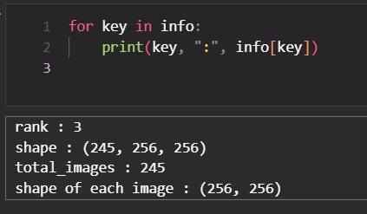
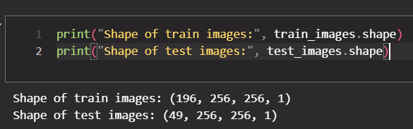
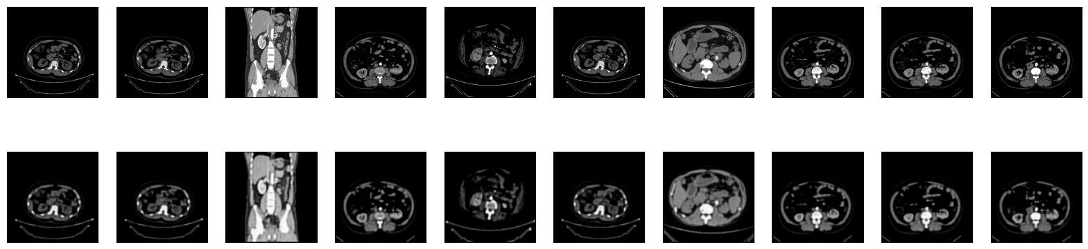
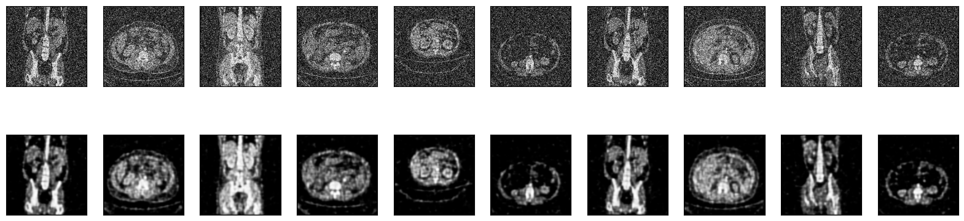
RESULTS
About Dataset
Test Images
To check regeneration power
Predicted Images
Noisy Test Images
Predicted Images

Slide 11
SOURCES
1. Paper on image denoising using CAE
2. Dataset: Kaggle
3. Google Colab for running code
4. All customs functions in code are made by me

