Slide 1

UNIVERSITY INSTITUTEOF ENGINEERING
Bachelor of Engineering (Computer Science & Engineering)
Operating System (20CST/ITT-313)
Subject Coordinator: Er. Puneet kaur (E6913)
Introduction to Operating System
DISCOVER . LEARN . EMPOWER
Font size 24

Slide 2
Distributed and Network Operating Systems
.

Slide 3
Communication Structure
The design of a communication network must address four basic issues:
Naming and name resolution - How do two processes locate each other to communicate?
Routing Strategies - How are messages sent through the network?
Connection Strategies - How do two processes send a sequence of messages?
Contention - The network is a shared resource, so how do we resolve conflicting demands for its use?

Slide 4
Naming and Name Resolution
Name systems in the network
Address messages with the process-id
Identify processes on remote systems by
<host-name, identifier> pair
Domain name service (DNS) – specifies the naming structure of the hosts, as well as name to address resolution (Internet)

Slide 5
Routing Strategies
Fixed routing - A path from A to B is specified in advance; path changes only if a hardware failure disables it
Since the shortest path is usually chosen, communication costs are minimized
Fixed routing cannot adapt to load changes
Ensures that messages will be delivered in the order in which they were sent
Virtual circuit - A path from A to B is fixed for the duration of one session. Different sessions involving messages from A to B may have different paths
Partial remedy to adapting to load changes
Ensures that messages will be delivered in the order in which they were sent

Slide 6
Routing Strategies (Cont.)
Dynamic routing - The path used to send a message form site A to site B is chosen only when a message is sent
Usually a site sends a message to another site on the link least used at that particular time
Adapts to load changes by avoiding routing messages on heavily used path
Messages may arrive out of order
This problem can be remedied by appending a sequence number to each message

Slide 7
Connection Strategies
Circuit switching - A permanent physical link is established for the duration of the communication (i.e., telephone system)
Message switching - A temporary link is established for the duration of one message transfer (i.e., post-office mailing system)
Packet switching - Messages of variable length are divided into fixed-length packets which are sent to the destination
Each packet may take a different path through the network
The packets must be reassembled into messages as they arrive
Circuit switching requires setup time, but incurs less overhead for shipping each message, and may waste network bandwidth
Message and packet switching require less setup time, but incur more overhead per message

Slide 8
Contention
Several sites may want to transmit information over a link
simultaneously. Techniques to avoid repeated collisions include:
CSMA/CD - Carrier sense with multiple access (CSMA); collision detection (CD)
A site determines whether another message is currently being transmitted over that link. If two or more sites begin transmitting at exactly the same time, then they will register a CD and will stop transmitting
When the system is very busy, many collisions may occur, and thus performance may be degraded
CSMA/CD is used successfully in the Ethernet system, the most common network system

Slide 9
Contention (Cont.)
Token passing - A unique message type, known as a token, continuously circulates in the system (usually a ring structure)
A site that wants to transmit information must wait until the token arrives
When the site completes its round of message passing, it retransmits the token
A token-passing scheme is used by some IBM and HP/Apollo systems
Message slots - A number of fixed-length message slots continuously circulate in the system (usually a ring structure)
Since a slot can contain only fixed-sized messages, a single logical message may have to be broken down into a number of smaller packets, each of which is sent in a separate slot
This scheme has been adopted in the experimental Cambridge Digital Communication Ring

Slide 10
Communication Protocol: OSI Reference Model
The communication network is partitioned into the following multiple layers:
Physical layer – handles the mechanical and electrical details of the physical transmission of a bit stream
Data-link layer – handles the frames, or fixed-length parts of packets, including any error detection and recovery that occurred in the physical layer(P2P)
Network layer – provides connections and routes packets in the communication network, including handling the address of outgoing packets, decoding the address of incoming packets, and maintaining routing information for proper response to changing load levels(S2D)

Slide 11
Communication Protocol (Cont.)
Transport layer – responsible for low-level network access and for message transfer between clients, including partitioning messages into packets, maintaining packet order, controlling flow, and generating physical addresses
Session layer – implements sessions, or process-to-process communications protocols
Presentation layer – resolves the differences in formats among the various sites in the network, including character conversions, and half duplex/full duplex (echoing)
Application layer – interacts directly with the users’ deals with file transfer, remote-login protocols and electronic mail, as well as schemas for distributed databases

Slide 12
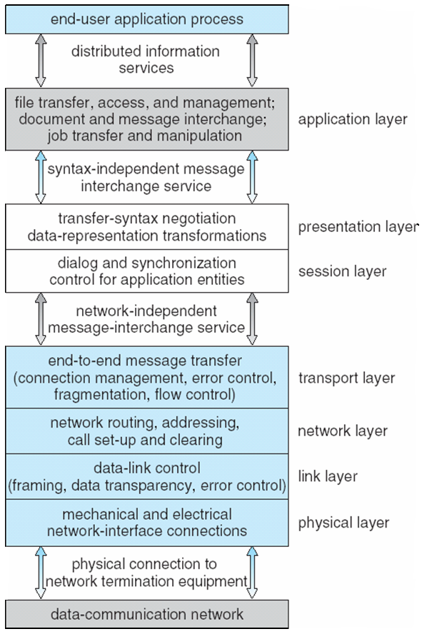
The ISO Protocol Layer

Slide 13
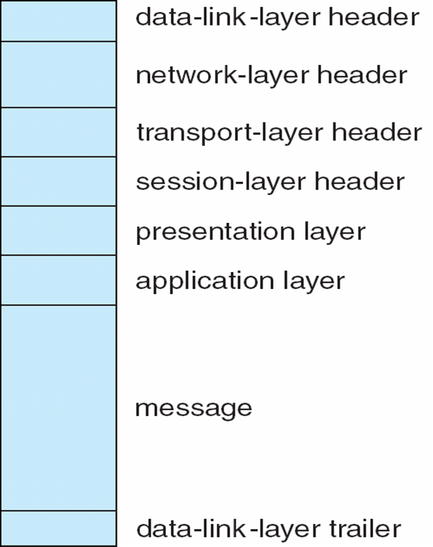
The OSI Network Message

Slide 14
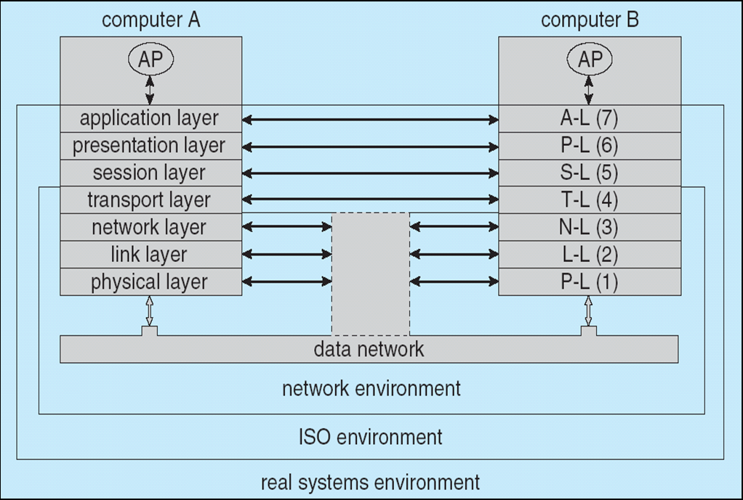
Communication Via ISO Network Model

Slide 15
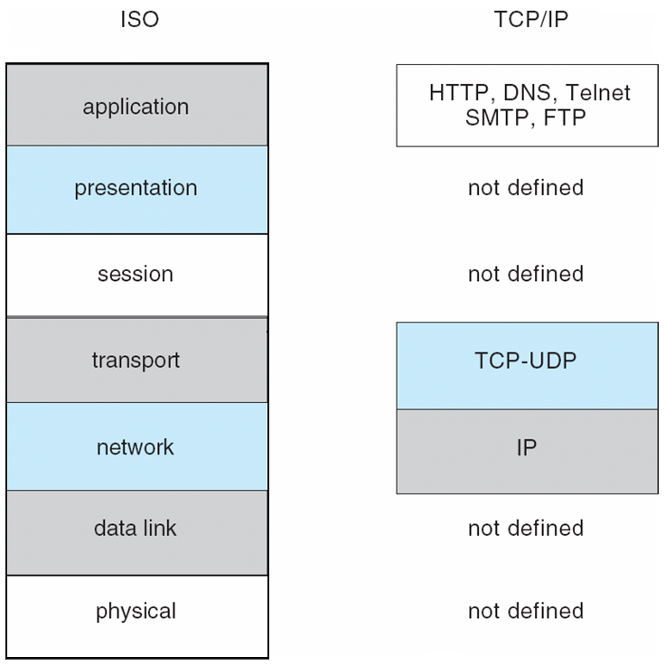
The TCP/IP Protocol Layers

Slide 16
Video Links
https://www.youtube.com/watch?v=yfDON5jjcG4 https://www.youtube.com/watch?v=RCs5aHsxUg4 https://www.youtube.com/watch?v=i9RL5jD9cTI

Slide 17
References
https://www.unf.edu/public/cop4610/ree/Notes/PPT/PPT8E/CH15-OS8e.pdf
https://www.tutorialspoint.com/operating_system/os_security.htm
https://www.coursehero.com/file/19323929/Operating-System-Threats-and-Vulnerabilities/
https://www.cs.uic.edu/~jbell/CourseNotes/OperatingSystems/15_Security.html
https://devqa.io/security-threats-attack-vectors/
https://www.geeksforgeeks.org/system-security/
https://www.javatpoint.com/os-security-management

