Slide 1
Homography Estimation

Slide 2
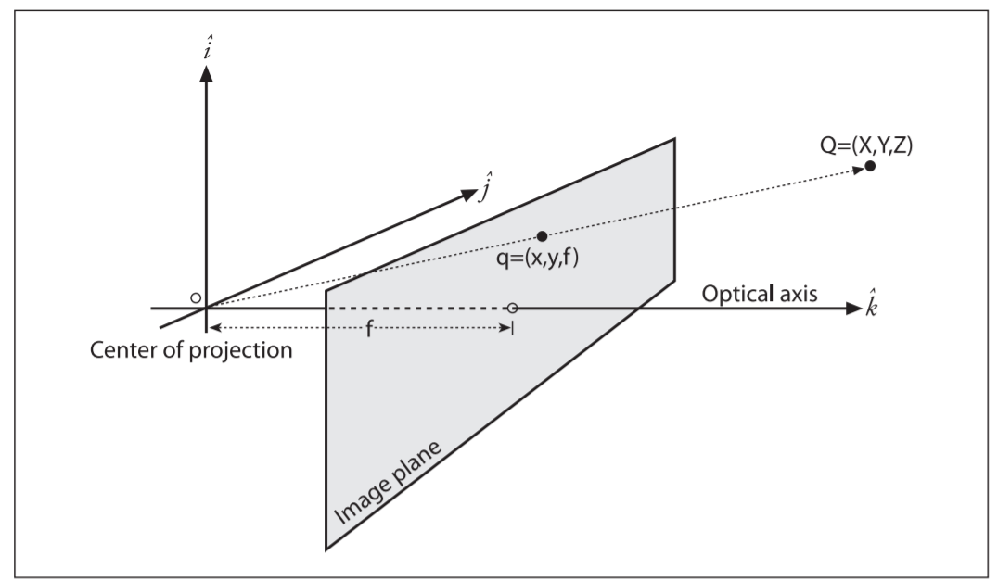
Projection
[Bradski and Kaehler]

Slide 3
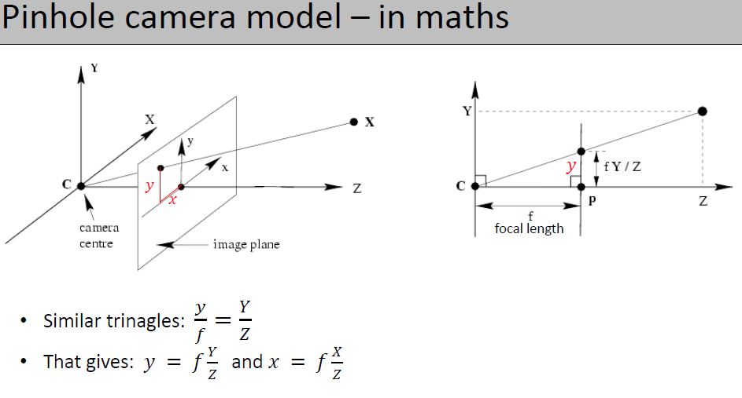
How to write this in a matrix format?

Slide 4
Homogeneous coordinates
The homogeneous coordinates associated with a point in a projective space of dimension n are expressed as an (n + 1), with the additional restriction that any two points whose values are proportional are equivalent
In our case, the image plane is the projective space, and it has two dimensions, so we will represent points on that plane as three-dimensional vectors q = (q1, q2, q3)
Recalling that all points having proportional values in the projective space are equivalent, we can recover the actual pixel coordinates by dividing through by q3
Notes:
The relation that maps the points Qi in the physical world with coordinates (Xi, Yi, Zi) to the points on the projection screen with coordinates (xi, yi) is called a projective transform.
When working with such transforms, it is convenient to use what are known as homogeneous coordinates.

Slide 5
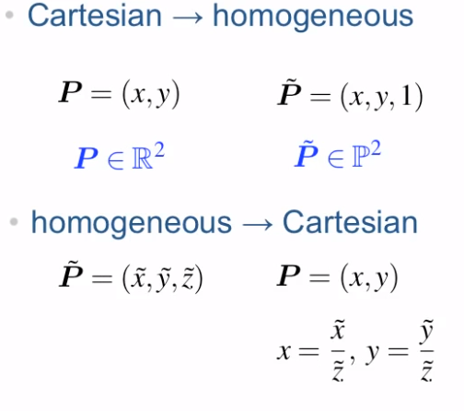
Homogenous Coordinates
Or just (a)
[Peter Corke]

Slide 6
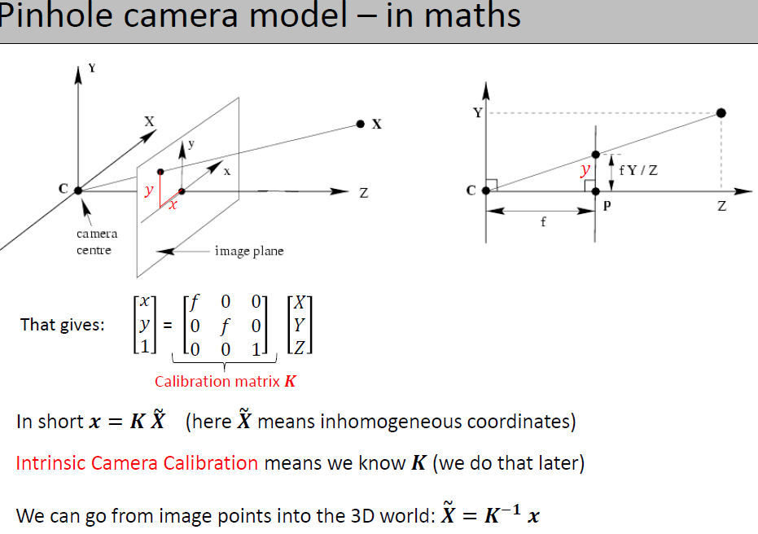
Notes:
Is it possible to recover the 3D points by knowing x, y?

Slide 7
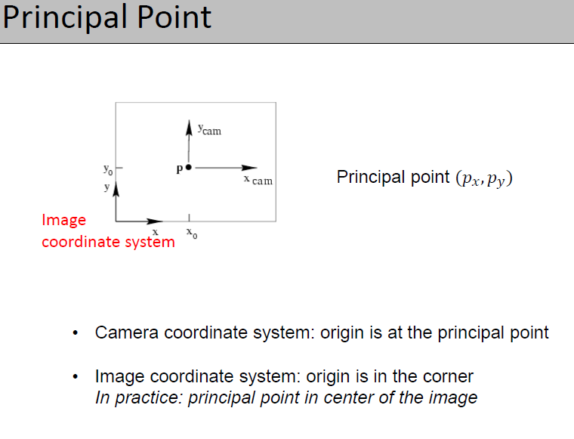

Slide 8
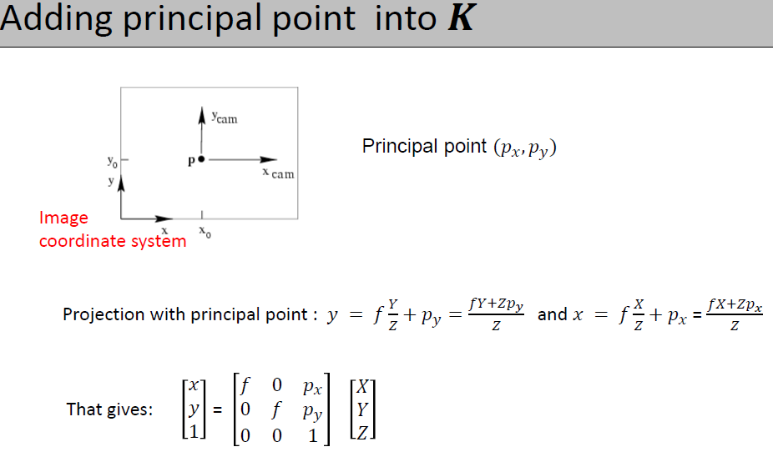

Slide 9
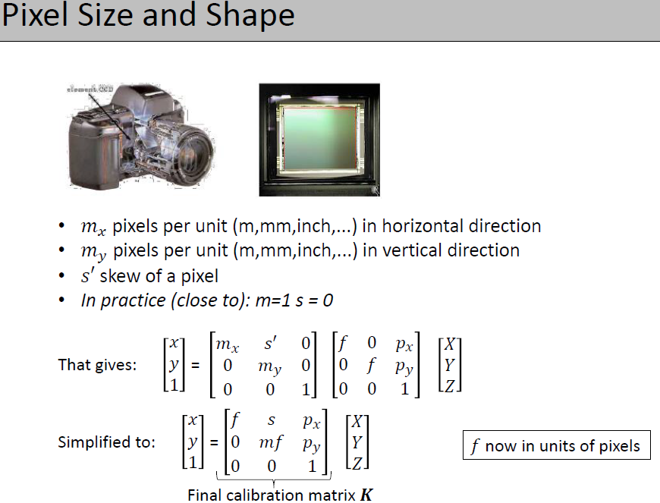
pixel magnification factors along the x and y axes respectively
Notes:
s — Skew coefficient, which is non-zero if the image axes are not perpendicular.
s=fx*tanα

Slide 10
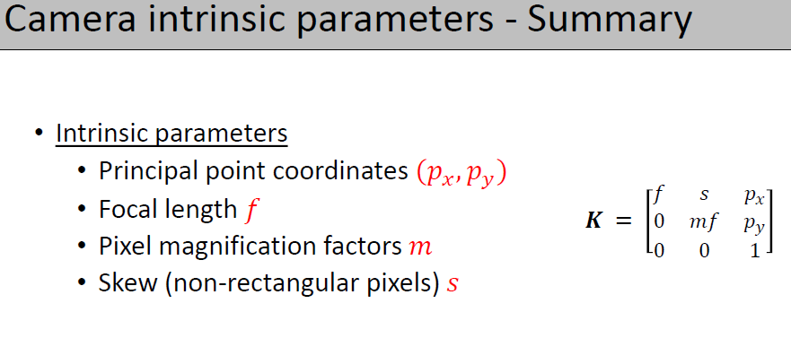

Slide 11
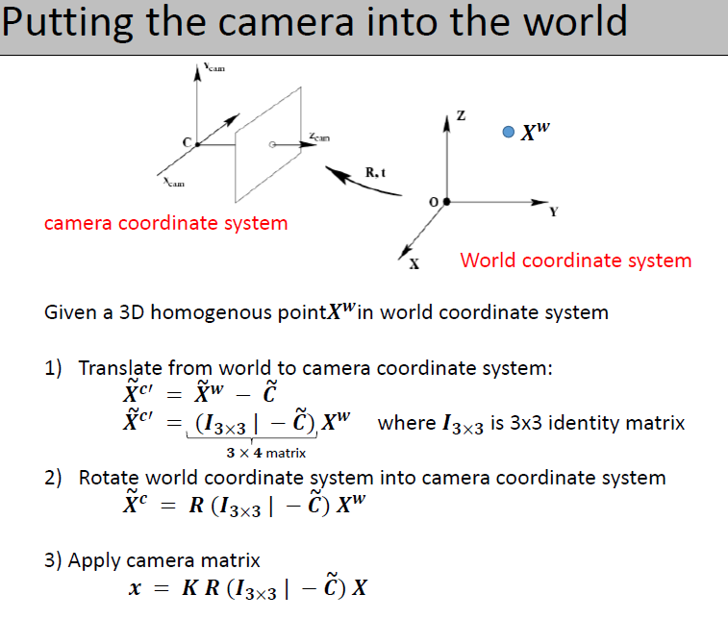
Last column is translation
Tilda means inhomogeneous vector
Notes:
This is extremely important for stereo vision. Or any two sensors that we want to project to. Moving the coordinates of one camera to another camera. Or in general if you have a global coordinate system that you want to project all the measurement to it.
World coordinates can be any other system that we are trying to use along with our camera systems. Imagine if you have two stereo vision systems, and are in different camera coordinates

Slide 12
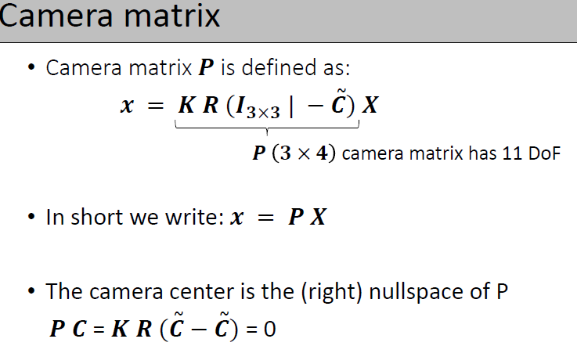

Slide 13
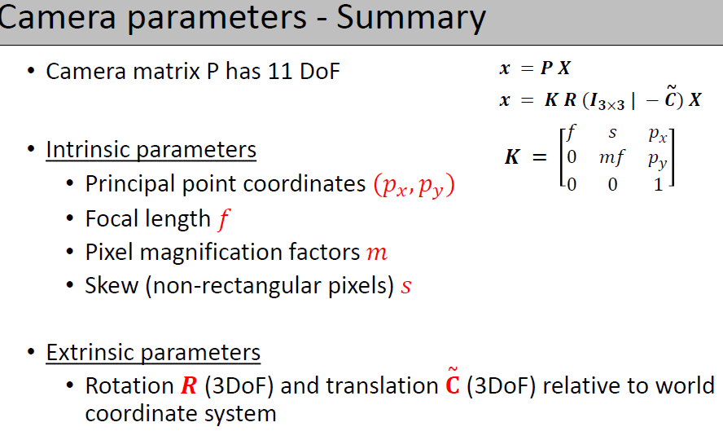

Slide 14
2D Homography (Projective Transformation)
Definition:
Line preserving
A 2D homography is an invertible mapping h from P² to itself such that three points x₁,x₂,x₃ lie on the same line if and only if h(x₁),h(x₂),h(x₃) do.
Theorem:
A mapping h: P²→P² is a homography if and only if there exist a non‐singular 3x3 matrix H such that for any point in P² represented by a vector x it is true that h(x)=Hx
Definition: Homography
⎛ x'₁ ⎞
^{h}12 ^{h}13 ⎤⎛ ^{x}1 ⎞
22
3 31 ^{h}32 33 3
⎡^{h}11
⎥⎜ _{x} ⎟
⎜ ⎟ ⎢
x' = h h
⎜ 2 ⎟
⎢
h
⎥
⎜ 2 ⎟
or
x'= H x
8DOF
⎜ ⎟
21
23
⎜ ⎟
x'
⎢
h
⎥
h x
⎝ ⎠ ⎣ ⎦⎝ ⎠
Homography=projective transformation=projectivity=collineation
14

Slide 15
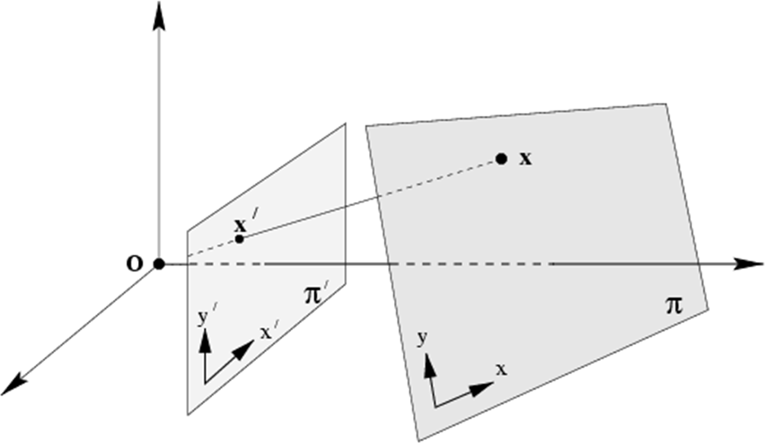
General Homography
Homographies are not restricted to P²
General definition:
A homography is a non‐singular, line preserving, projective mapping h: P^{n} → P^{n}.
It is represented by a square (n + 1)‐dim matrix
with (n + 1)²‐1 DOF
Now back to the 2D case…
Mapping between planes
15

Slide 16
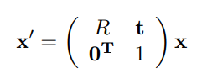
Other Geometrical Transformations - Isometry
An isometry is a transformation that preserves Euclidian distance
The same goes for the angles between lines and areas
Isometries are made up of only 2D rotations and 2D translations and therefore have only 3 degrees of freedom

Slide 17

Similarity transformation
A similarity transform is similar to an isometry except it also contains isotropic scaling
The scale adds an additional degree of freedom, so a similarity transform contains 4 degrees of freedom overall
The distance between points are no longer invariant, but the ratio of distances is preserved
Notes:
Isotropic means that the scaling is invariant with respect to direction.
There is also the so-called Affine transformation which does not preserve the distance or angles however parallel lines are still parallel

Slide 18
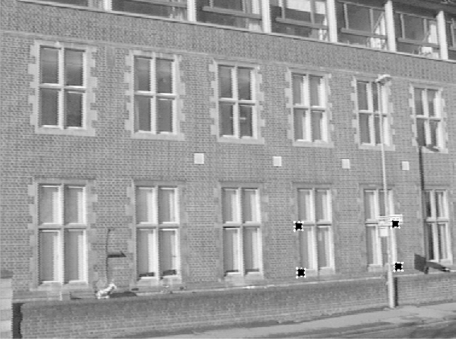
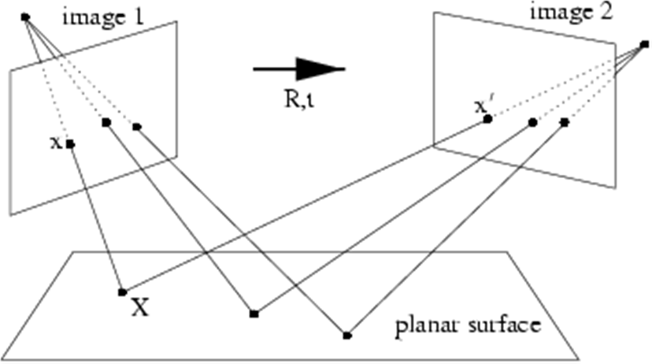
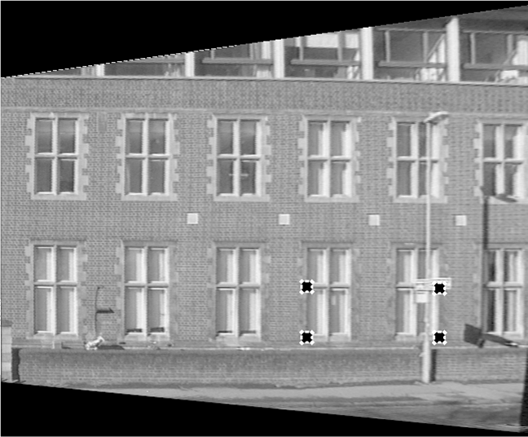
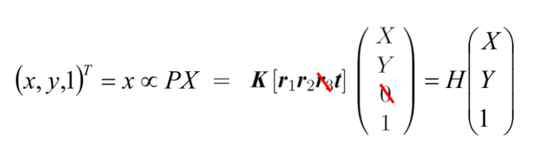
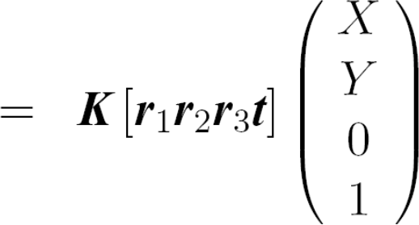
Homographies in Computer Vision
Rotating/translating camera, planar world
H
H
H
⎛ X ⎞
(x, y,1) = x ∝ PX
⎜ ⎟
T
= H ⎜Y ⎟
⎜₁ ⎟
⎝ ⎠
What happens to the P‐matrix, if Z is assumed zero?
10

Slide 19
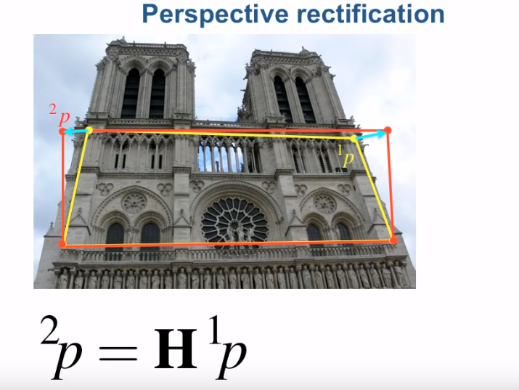
Example rectification
[Peter Corke]

Slide 20
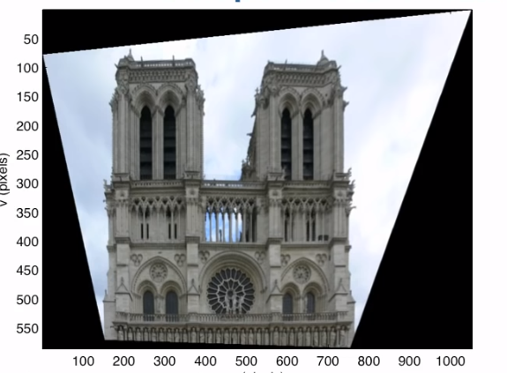
unwarping
[Peter Corke]

Slide 21
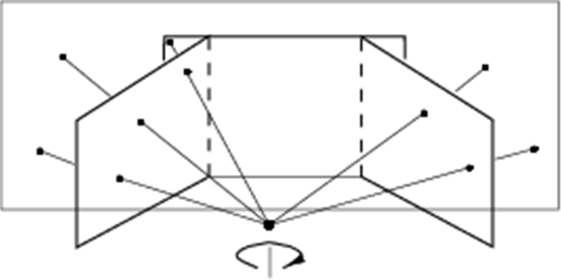
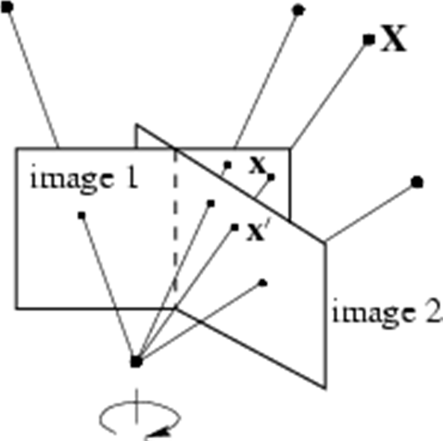
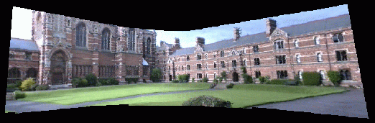
Homographies in Computer Vision
Rotating camera, arbitrary world
Stitching images with only rotation no translation
⎛ X ⎞
⎜ ⎟
Y
(x, y,1)^{T} = x ∝ PX = K (r r r t )
⎜ ⎟
∝ KRK ⁻¹ x' = Hx'
1 2 3
⎜ _{Z} ⎟
⎜ ⎟
1
We introduced last column because of translation
⎝ ⎠
What happens to the P‐matrix, if t is assumed zero?

Slide 22
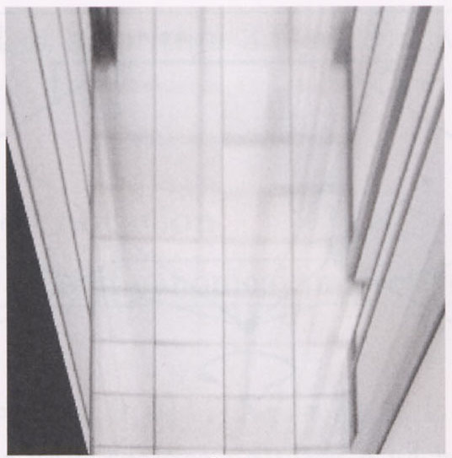
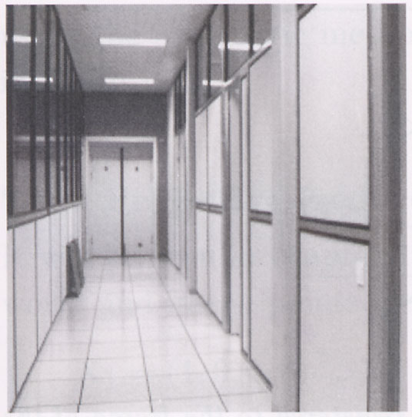
Find Homography Between Two Scenes
p’
p
To unwarp (rectify) an image
solve for homography H given p and p’
solve equations of the form: wp’ = Hp
linear in unknowns: w and coefficients of H
H is defined up to an arbitrary scale factor
how many points are necessary to solve for H?

Slide 23
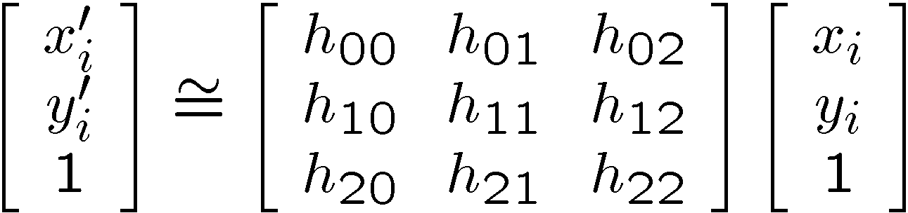
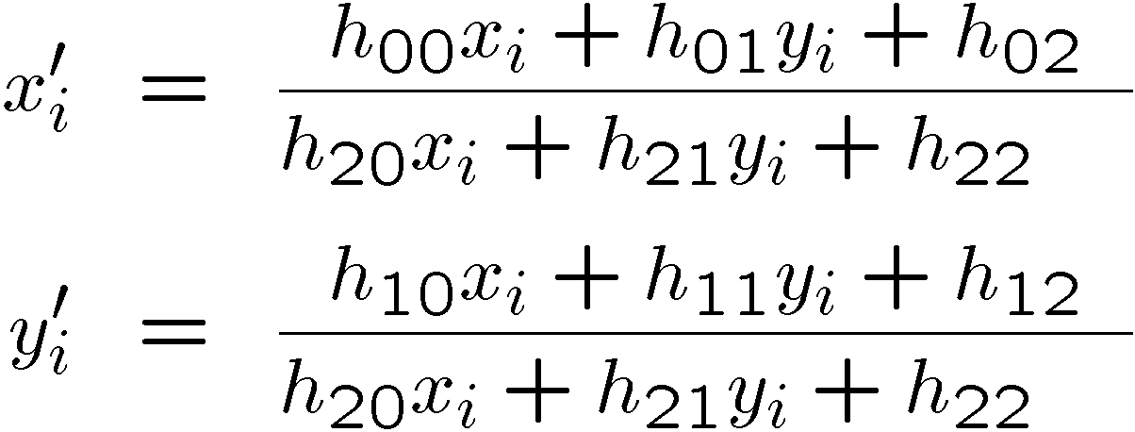
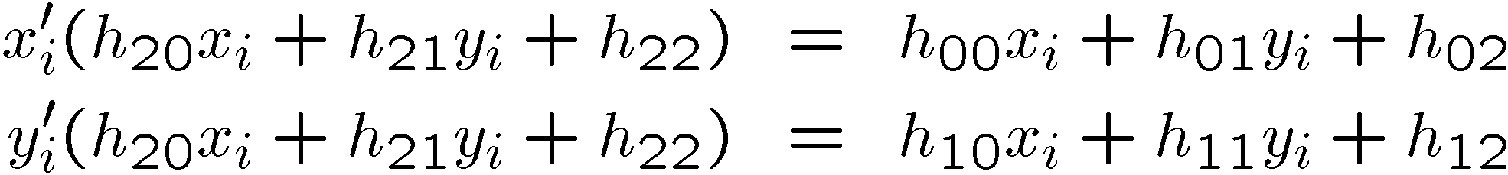
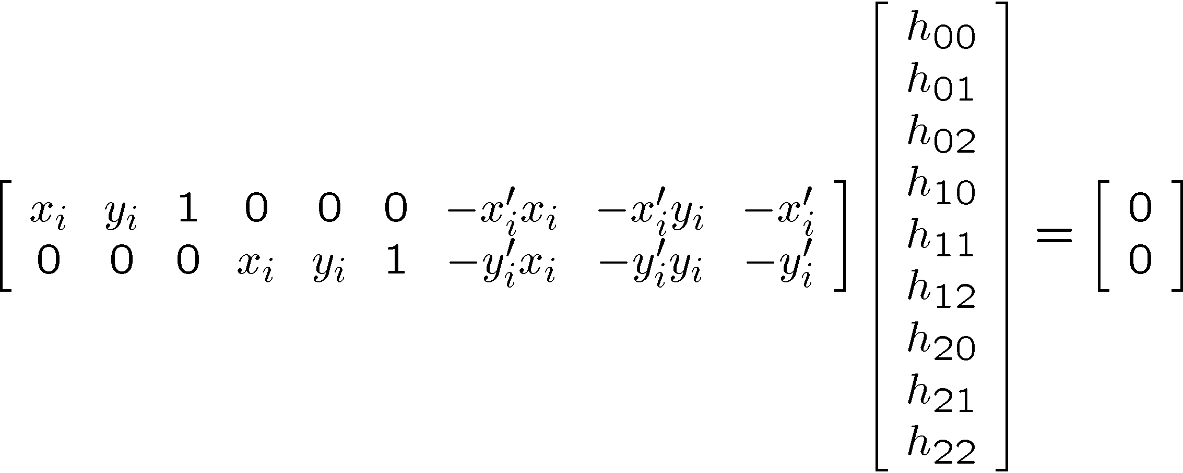
Solving for Homographies
Camera coordinates

Slide 24
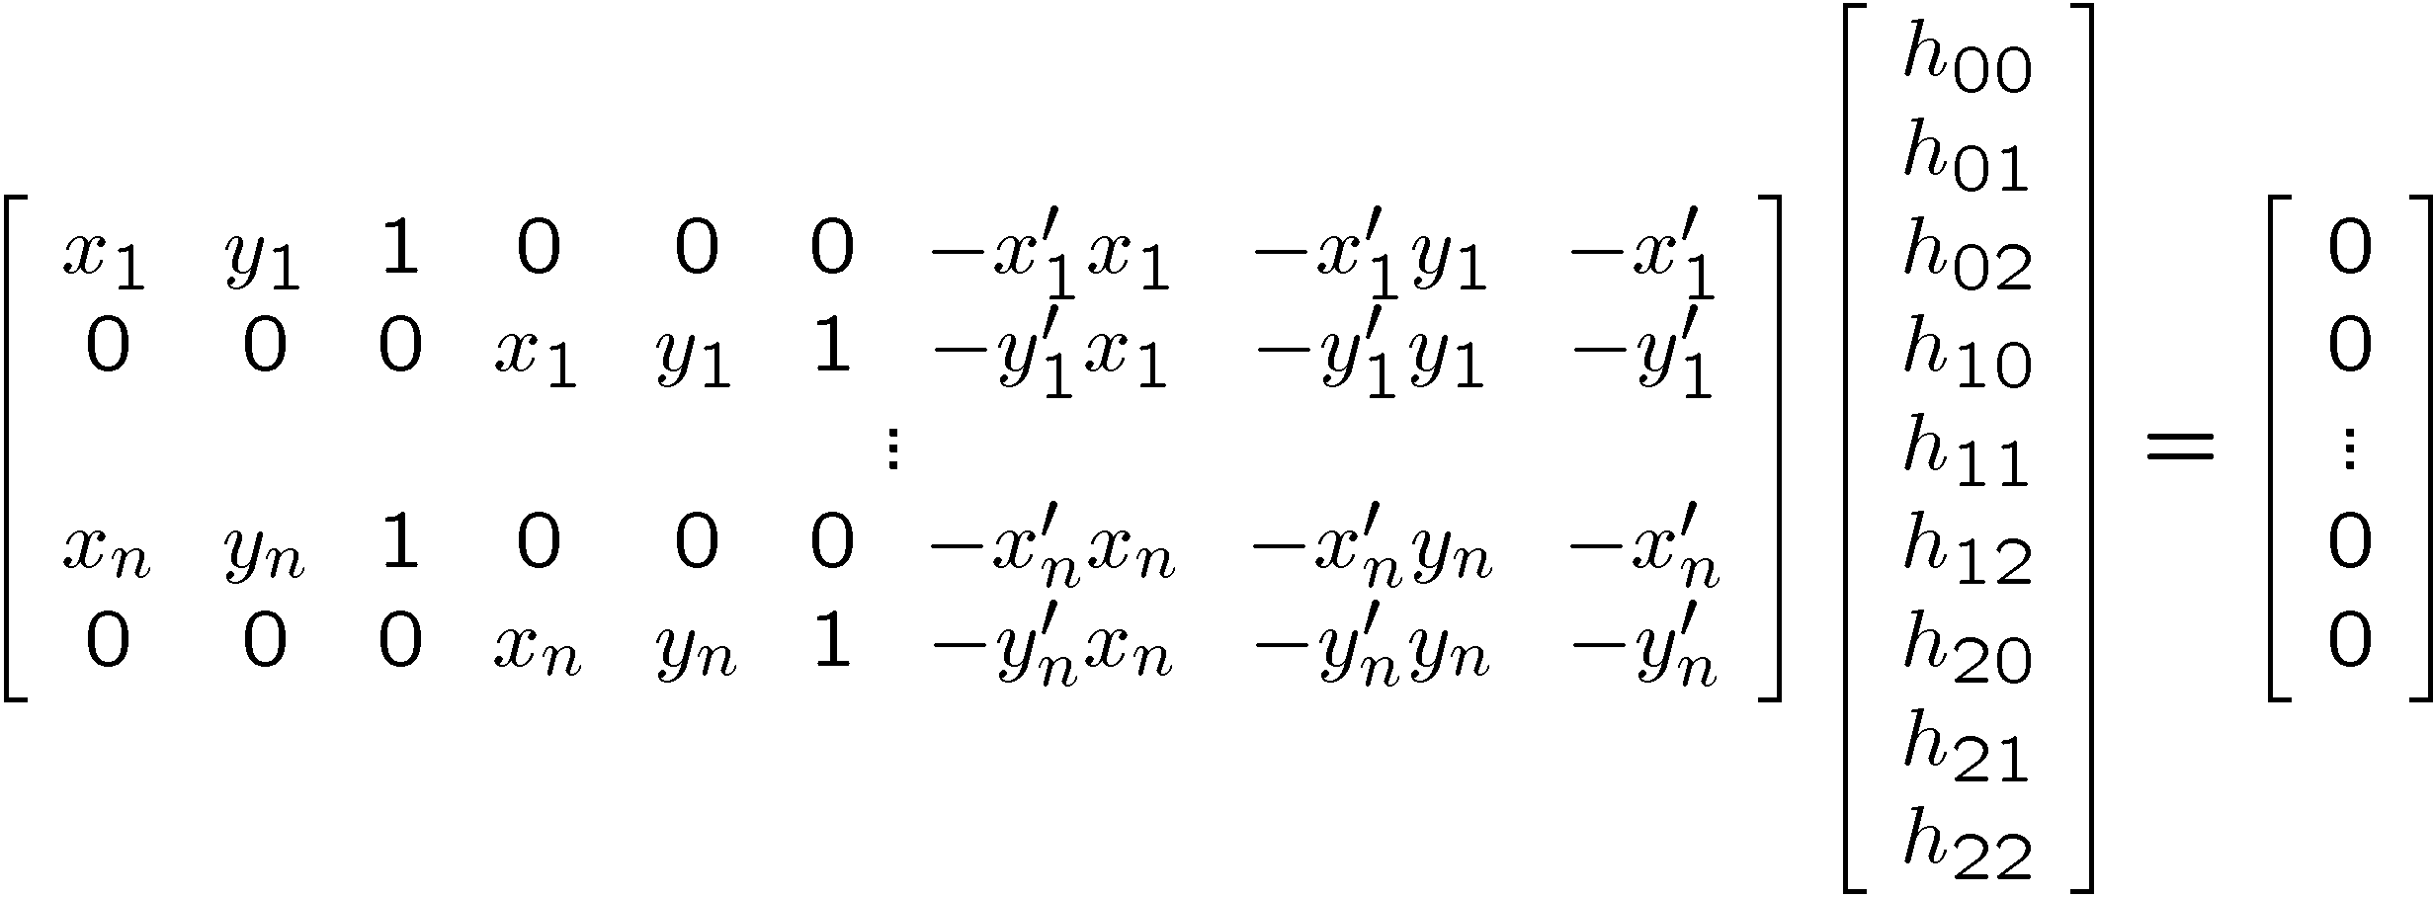

Solving For Homographies
A
h
0
2n × 9
9
2n
Linear least squares
Since h is only defined up to scale, solve for unit vector ĥ
Minimize
Solution: ĥ = eigenvector of A^{T}A with smallest eigenvalue
Works with 4 or more points
The more points the better for accuracy
Can you use RANSAC?

Slide 25
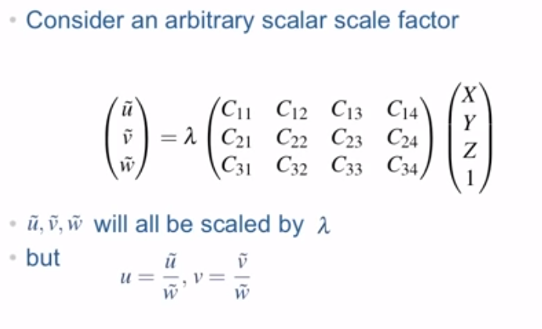
Scale invariant
We choose the scale factor such that C34 is 1
[Peter Corke]

Slide 26

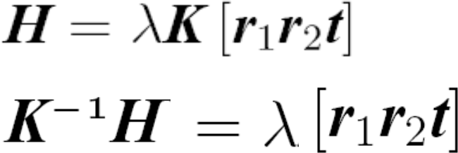
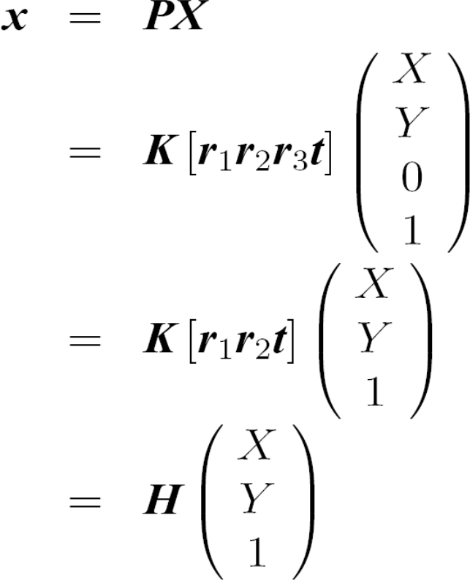
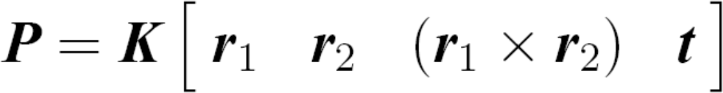
Camera pose estimation
Assume all points lie in one plane with Z=0:
–r₁ and r₂ are unit vectors ⇨ find lambda
–Use this to compute t
–Rotation matrices are orthogonal ⇨ find r3
Notes:
r are the columns of the rotation matrix, equate this to the columns on the other side

