Slide 1
Project Title Weather Prediction Application (Using Flask and OpenWeatherMap API)
Technology Stack:
Python
Flask
HTML & CSS
OpenWeatherMap API
GitHub & Render
Objective
To provide real-time weather information for locations worldwide through a simple web-based application.

Slide 2
Problem Statement
Problem Statement
People often need accurate weather information for planning travel, agriculture, outdoor activities, and daily routines.
Challenges
Difficulty accessing real-time weather updates.
Need for a simple and user-friendly weather application.
Requirement for weather information from different locations worldwide.
Proposed Solution
Develop a web application that fetches and displays real-time weather data using weather APIs.
.

Slide 3
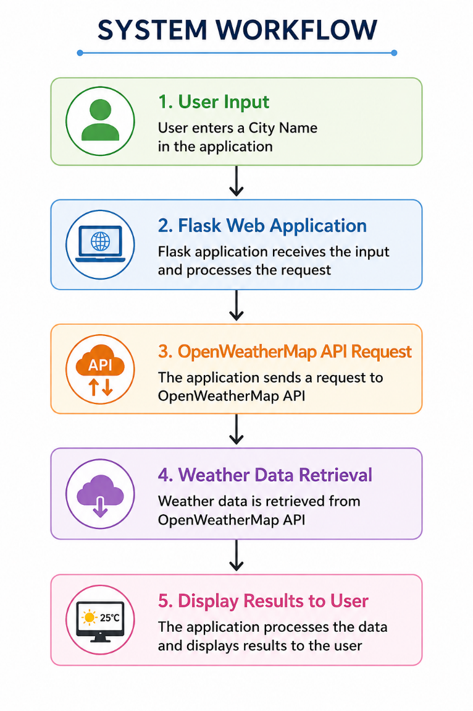
System Workflow and Implementation Steps
Implementation Steps
User enters a city name.
Flask sends a request to OpenWeatherMap API.
API returns weather information.
Application processes the data.
Weather details are displayed on the webpage.

Slide 4
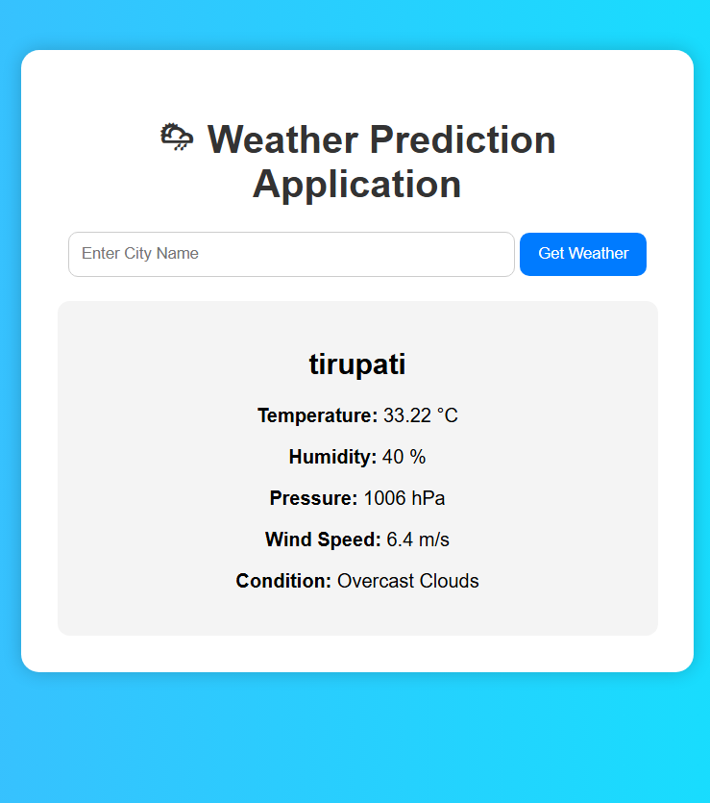
Results / Outcome
Successfully Implemented Features
Real-time weather retrieval
City-wise weather search
Temperature display
Humidity monitoring
Wind speed information
Atmospheric pressure details
Cloud deployment using Render
Outcome
The application successfully provides accurate weather information through an interactive web interface accessible from any browser.

Slide 5
Conclusion
Summary
The Weather Prediction Application is a web-based solution that provides real-time weather information using Flask and OpenWeatherMap API.
Benefits
Easy to use
Fast weather retrieval
Accessible worldwide
Demonstrates API integration and web development skills
Future Enhancements
GPS-based location detection
5-Day weather forecasting
Weather alert notifications
Interactive charts and graphs
Mobile application support

Slide 6


Slide 7


Slide 8


