Slide 1
DHCP Reservation Application
AD Team Automation
About this deck
This is all about features, Value-added, Benefits of using DHCP Reservation application.

Slide 2
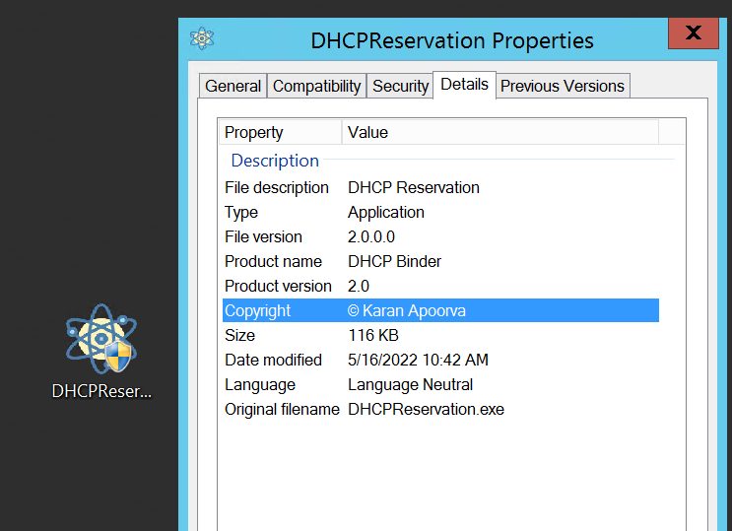
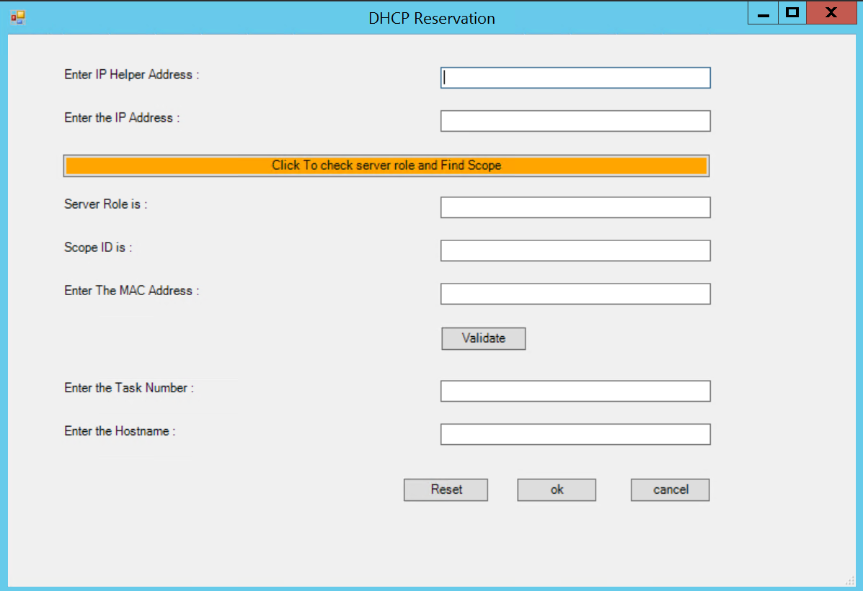

Menus
Icon and Details
DHCP Reservation App Menu

Slide 3
DHCP Reservation App Menu
Clicking it will update Server Role and Scope ID field automatically
DHCP Server Ip Address
Enter IP Address to be reserved
Provide FQDN and Role of DHCP Server
Provide the Scope ID for the mentioned IP
Enter the MAC address to be reserved
Click this to validate if IP and MAC are available for reservation or not
Enter the data to be updated in description field
Enter the Hostname/Device Name
Will Reset all fields for fresh use
Click to Reserve IP
Click to Cancel Anytime

Slide 4
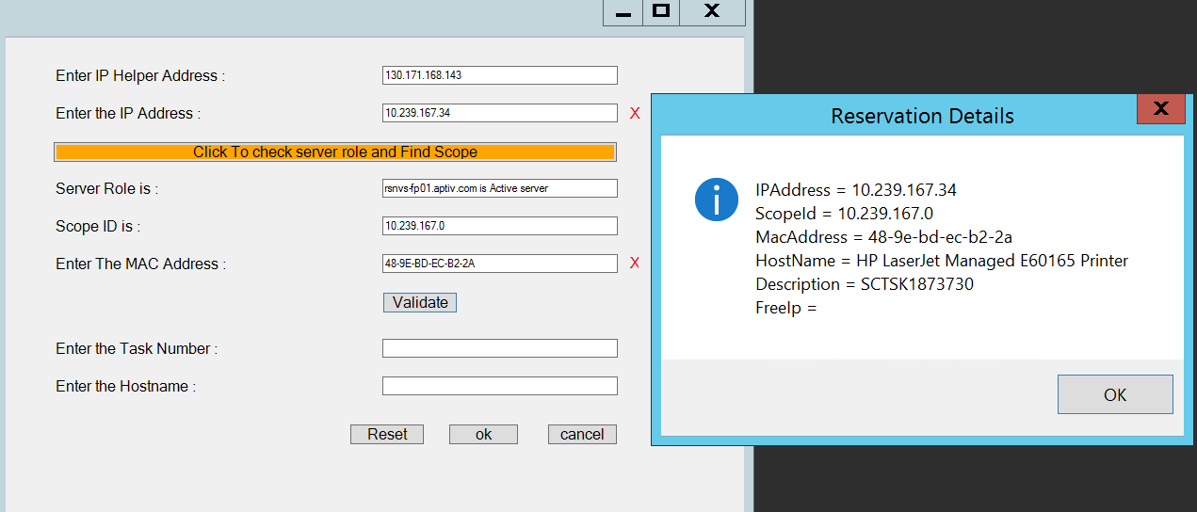
Main Menu Features
This shows that Both IP and Mac Address are already reserved. In Such cases It will automatically Provide the reservation details for both separately and also provide free IP address which can be used to reserve further.

Slide 5
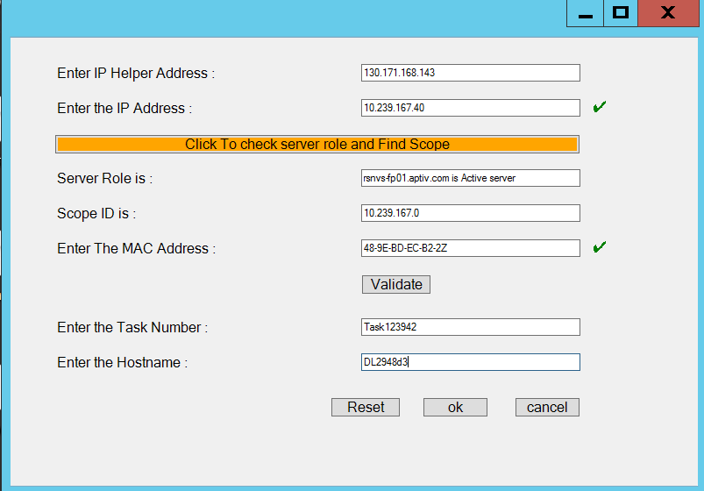
Main Menu Features
If Both IP address and MAC Address is available, then we can continue with reservation.

Slide 6
Power Shelling
Graphic User Interfacing the script Load Forms Assembly Define Form properties Define Label Boxes, Text Boxes, Buttons
Logic Part Logic for Feeding Server Role and Scope ID on click of Button Logic for Validate Button to validate if IP and MAC are available for binding Logic for OK Button to perform reservation and replicate Scope in partner Server Logic for Cancel Button Logic for Reset Button

Slide 7
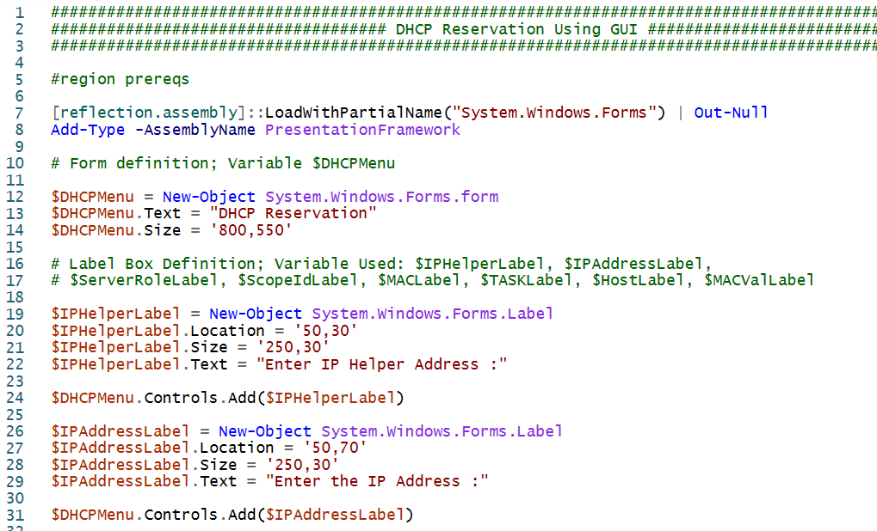
Explore without leaving your slides

Slide 8

Thank You !!

