Slide 1
GNN for Chart Analysis
Task 3 of ICPR ChartInfo-2020 challenge

Slide 2
Datasets
UB PMC Dataset: Contain real scanned charts images
Adobe Synth Dataset: Contain synthetic (i.e. virtual) chart images.

Slide 3
Task 3 of ICPR ChartInfo-2020 Challenge
Description: Task is to identify “Semantic role” of the given/detected chart component. Thus, for the task we’ve to “Classify” given/detected bounding boxes into one of the following categories:
Chart Title
Axis Title
Tick Label (x and y axes values)
Tick Grouping (x and y axes)
Legend Title
Legend Label
Value Label
Data Marker Label
Other
*For Adobe Synth Datasets, only a subset of these classes are used.
Input: Chart Image, Output from Task 1 & 2
Output: List of Text Blocks (ID’s & semantic classification)

Slide 4
Exp.-1: Train GCN on plain bounding box parameters
Idea is to identify & classify the Tick labels at first.
The hypothesis is that most of times Tick labels have a solid underneath pattern to it.
Most of times the are stacked horizontally & vertically in chart relative to the “origin point”.
The most important point in the chart is the “Origin”. Ideally, I'd like to get the “origin’s” coordinates in the chart image as an input to task. However, given that we don’t know origin’s coordinates, for the time being we can skip that part.
Using JSON annotations of UB PMC dataset, I collated a “CSV” file dataset, in which i have extracted all the bounding boxes coordinates for a given chart image.

Slide 5
Exp.-1 continued..
After that I uses “Deep Graph Library”(DGL) to convert the CSV dataset into a Graphical dataset.
I uses DataLoader, Graph convolution network(GCN) & different API’s of DGL to train a GCN on newly formed DGL Graph dataset.
The prediction labels for each node is binary (i.e. either the node’s a “Tick-lable” or not)
Result: Results were not as expected. The loss didn’t reduced while training.

Slide 6
Exp.-2: Train GCN on Delaunay Triangulation of “B-boxes”
After not achieving satisfactory results in Exp.-1, The idea was to perform another similar experiment which uses a “Delaunay Triangulation of Bounding Boxes parameters”.
The rest of setup was similar to earlier experiment.

Slide 7
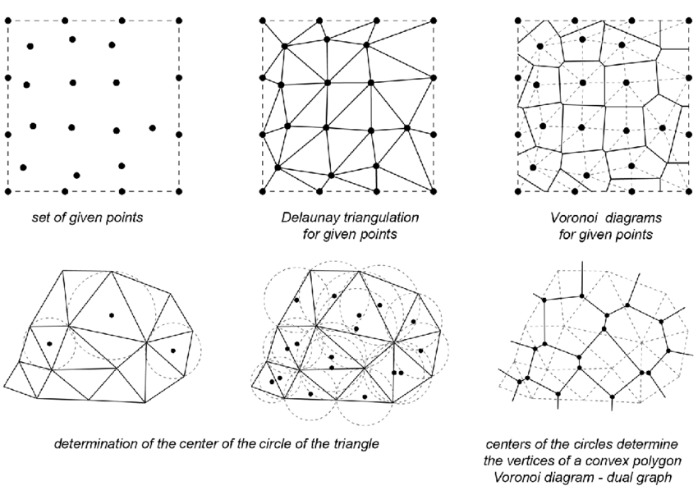
Delaunay Triangulation/Tessalation
Connect 2 nearest points to the point to form a triangle.

Slide 8
Results for Exp.2
Average F1 Score : 0.9216835713996757
Average F1 Score for class horizontal bar: 0.8271082006022984
Average F1 Score for class line: 0.9444133232086483
Average F1 Score for class scatter: 0.9511421698447455
Average F1 Score for class vertical bar: 0.9197010183912389
Average F1 Score for class vertical box: 0.8986089858174345

Slide 9
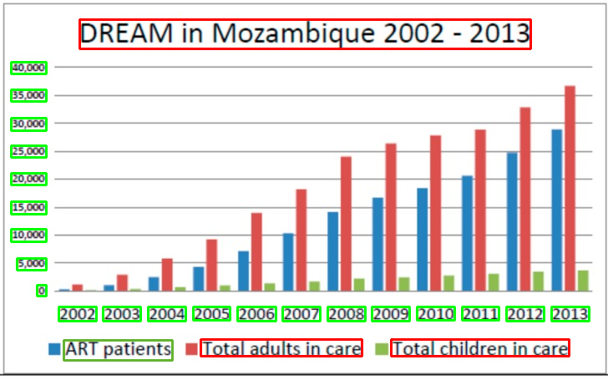
Some samples with colored bounding boxes (TP, FP, TN, FN)

Slide 10
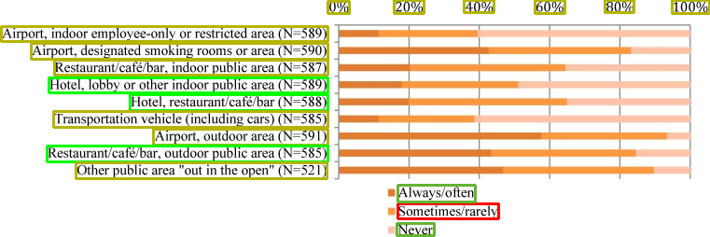

Slide 11
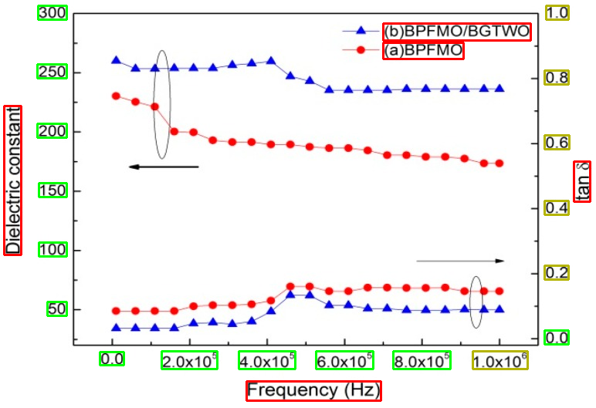

Slide 12
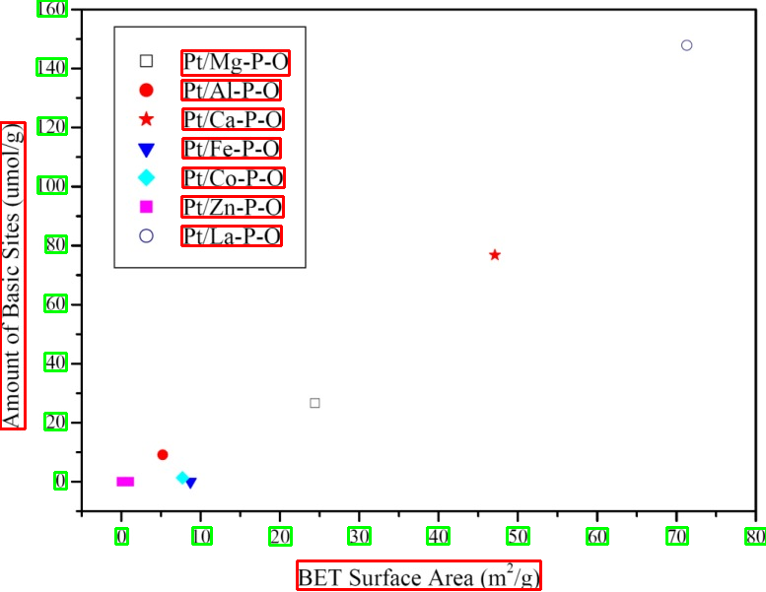

Slide 13
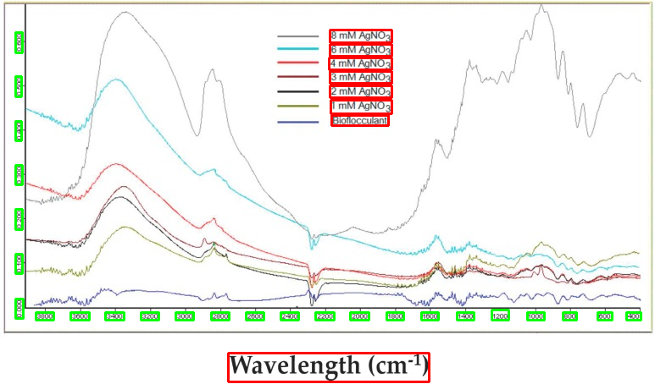

Slide 14
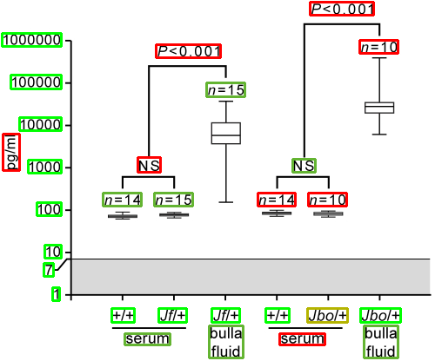

Slide 15
Logic behind the experiment
Charts have an underlying semantic, similar to a UI in a web/mobile app.
i.e. All charts follow some convention, unique to their representation.
Hence we’ll need some rules based processing.
Most common charts are like line charts with straight horizontal/vertical axis.
Hence taking idea from Binary tree & Mutual Information, i decided to precisely detect correct “Tick labels”, as “Tick labels” happens to be most important points in a chart after “Origin”.
Detecting correct tick labels will get help me to filter out chart into 4 zones.
One of the zone will be a plot area that contains data labels, value labels & legends specific boxes.

Slide 16
Logic behind the experiment
Detecting correct tick labels will get help me to filter out chart into 4 zones.
One of the zone will be a plot area that contains data labels, value labels & legends specific boxes.
The rest 3 zones contains Axis title, chart title.

Slide 17
Next steps
I’ll try to detect chart title and axis title using similar approach.
That will leave“Plot Area” specific nodes, which will require some Computer Vision approach.

