Slide 1
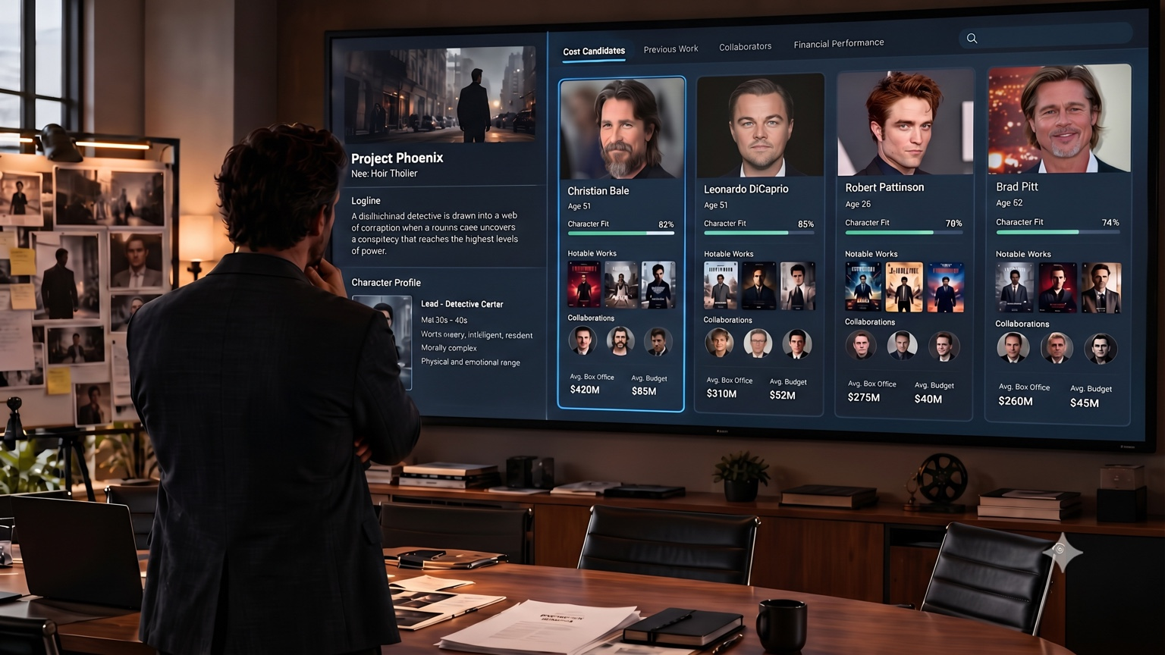
ProduCast: An Interoperable Knowledge Representation for Film Casting and Production Networks
University of Victoria
• Moksh Patel • Karan Brahmbhatt

