Slide 1

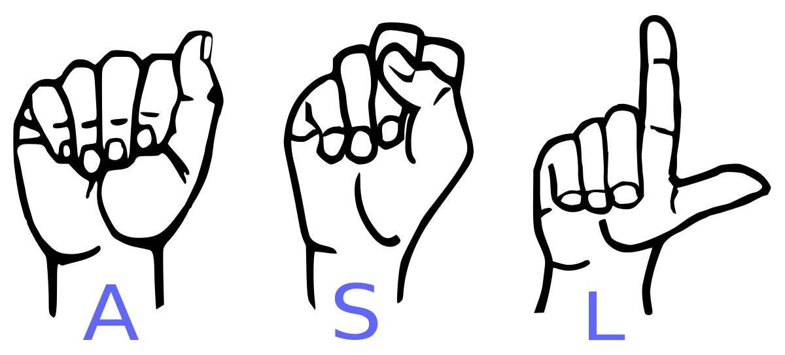
Conversion of Sign Language to Text
For Dumb and Deaf

Slide 2

Abstract
Our project aims to train a model which when shown a real time video of hand gestures of American Sign Language shows the output for that particular sign in
text format on the screen.

Slide 3

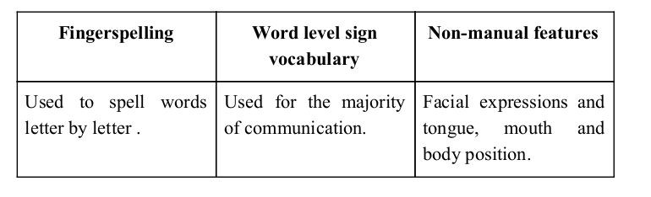
Sign language is a visual language and consists of 3 major components:

Slide 4
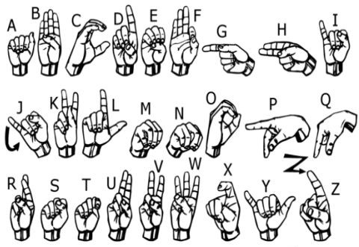
We implemented 27 symbols(All alphabets ( leaving J and Z) , delete, space and nothing) of ASL in our project.

Slide 5
Methodology

Slide 6
How we generated data set and did Data Preprocessing ?
We used OpenCV library in order to produce our dataset. We captured around 1000 - 1500 images of each of the symbols in ASL. We captured each frame shown by the webcam of our machine or mobile camera. While capturing images from the webcam ,in each frame we defined a region of interest (ROI) and showed the hand inside the ROI.
As these images were of different size, all the images were reshaped to (64, 64, 3) for training. Further these images were converted into grayscale images as colour doesn't play any importance in hand gesture classification. So the final image shape used for training was (64, 64, 1).

Slide 7
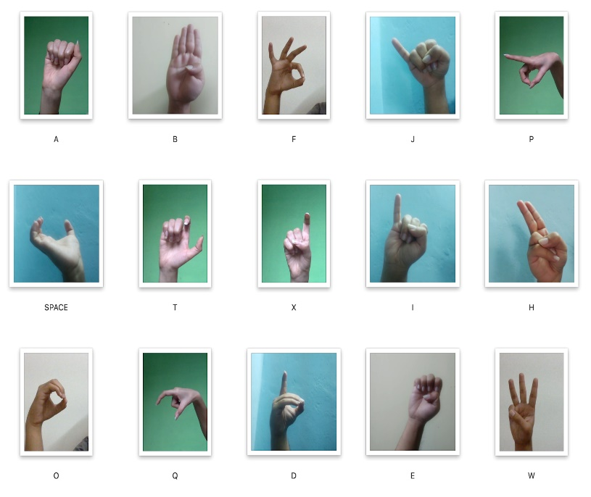
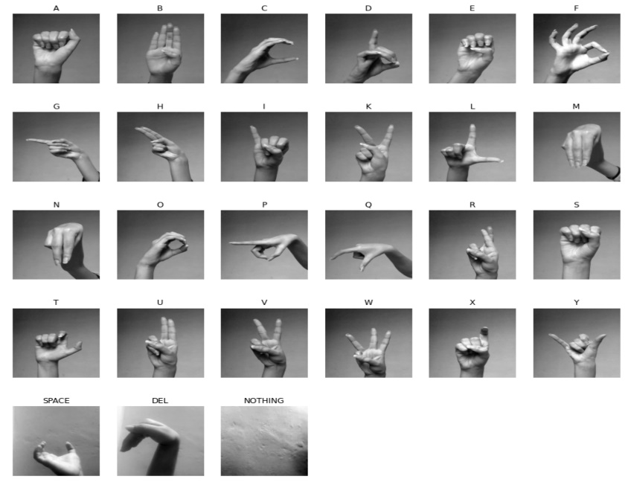
Capturing Raw Image
Gray Scale Image

Slide 8
Why we Created our own Dataset ?

Slide 9
➔ For the project we tried to find already made datasets but we couldn’t find dataset in the form of raw images that matched our requirements.
➔ Also we tried preprocessing the existing datasets but we received a
poor accuracy.
➔ Hence we decided to create our own data set.

Slide 10
Gesture Classification

Slide 11
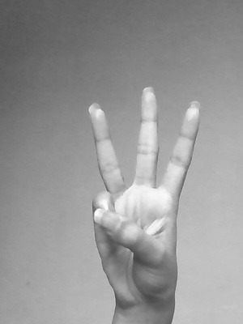
Model
Classify between 27 Symbols

Slide 12
Algorithm Layer :
Apply grayscale filter to the frame taken with opencv to get the processed image after feature extraction.
This processed image is passed to the CNN model for prediction and if a letter is detected for the majority of times based on a threshold value then the letter is printed and taken into consideration for forming the word, i.e. added to the resultant string.
If the predicted label is ‘Space’, a space is added to the resultant string. If the predicted label is ‘Del’ and the resultant string contains at least one character, the last letter of the resultant string is removed.

Slide 13
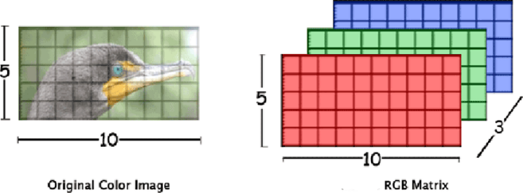
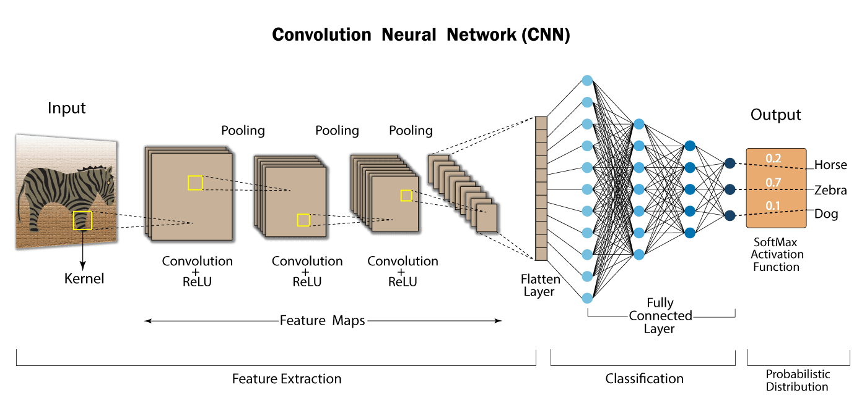
Convolutional Neural Networks
CNNs consist of multiple convolutional layers each layer containing numerous “filters” which perform feature extraction.
Initially these “filters” are random and by training, the feature extraction gets better by better.
It’s primarily used for image classification.

Slide 14
Our CNN Classifier Model

Slide 15
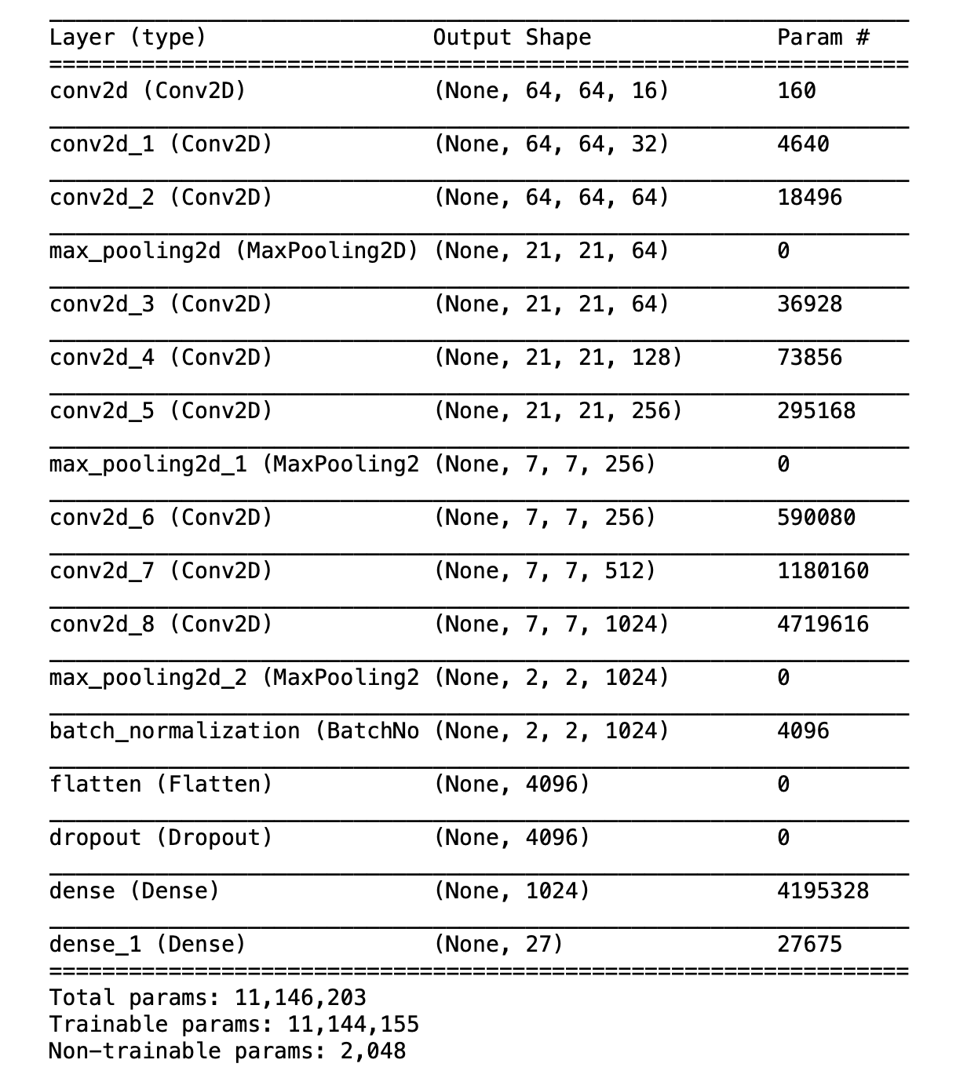

Slide 16
Finger Spelling Sentence Formation

Slide 17
Implementation
1. We maintain a dictionary with letters as key and their respective frequencies as the value.
2. After taking a frame from the webcam and getting a predicted letter, we add unity to the frequency of that letter.
3. If the predicted letter is ‘Nothing’, we again initialise the dictionary with all values as zero and continue with the next frame from the webcam.
4. If the sum of frequencies of all the letters is less than 60, we don’t add anything to the resultant string. This acts as a threshold check for the letter prediction.

Slide 18
5. After the sum of frequencies of all the letters exceeds 60, we keep checking if a letter attains majority frequency.
6. We define a letter to have attained majority if its frequency is more than or equal to half of the sum of frequencies of all the letters.
7. If a letter attains majority, we add it to the resultant string and initialise the dictionary with all values as zero.
8. If the predicted majority letter is ‘Del’ and there is at least one letter in the resultant string, we remove the last letter of the resultant string.

Slide 19
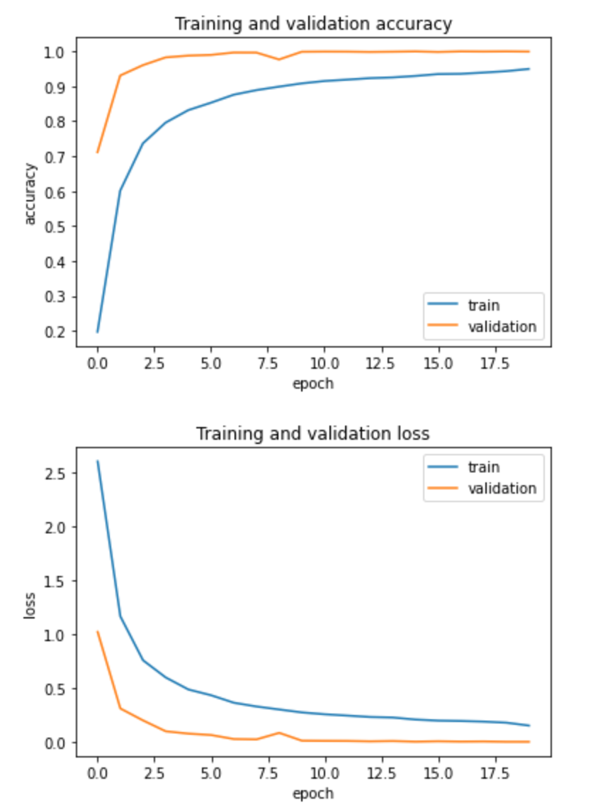
Results

Slide 20
Software Requirements
Python 3.6.6
Tensorflow 1.11.0
OpenCV 3.4.3.18
NumPy 1.15.3
Matplotlib 3.0.0
Keras 2.2.1
PySimpleGUI 2.7..0

Slide 21
Challenges Faced
We couldn’t find a dataset with raw images of all the asl characters so we made our own dataset.
Issues were faced relating to the accuracy of the model we trained in earlier phases which we eventually improved by increasing the input image size and other hyperparameter tuning and also by improving the dataset.
Doing the project in the online semester is another challenge as communication and reachability with team members has been reduced.

Slide 22
Limitations of our model
The model works well only in good lighting conditions.
Plain background is needed for the model to detect with accuracy.

Slide 23
Future Scope
We are planning to achieve higher accuracy even in case of complex backgrounds by trying out various background subtraction algorithms.
We are also thinking of improving the preprocessing to predict gestures in low light conditions with a higher accuracy.
We are planning to use some object localization algorithm ( like YOLO) to localize the hand gesture instead of using an already defined ROI.

Slide 24
Conclusion
In this report, a functional real time vision based american sign language recognition for D&M people have been developed for asl alphabets.
We achieved an accuracy of 99.86% on our dataset.
This way we can detect almost all the symbols if they are shown properly, given there is no noise in the background and lighting is adequate.

Slide 25
Efforts by
Project Under Supervision of
Dr. Shobhita Meher
Ayush Raj - 19085018
Karan Aditya Singh Bishnoi - 19085046
Aanchal Jain - 19085002

Slide 26
Thank You !

