Slide 1
All about Docker

Slide 2
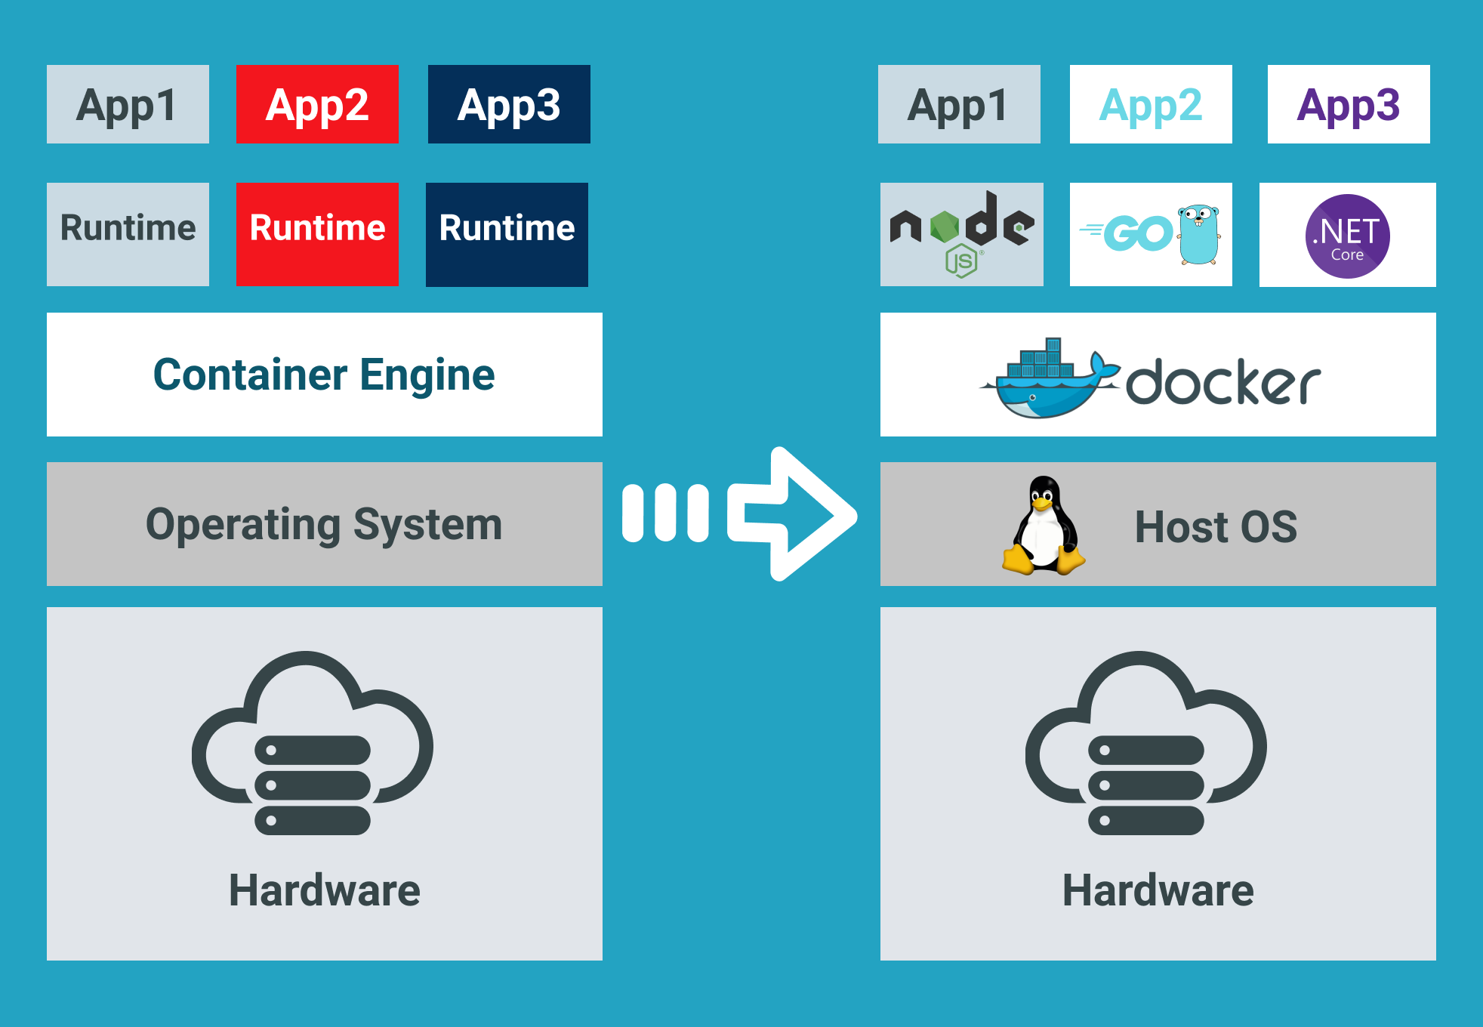
Docker Overview.
Docker is an open-source platform that automates the deployment and management of applications within software containers.
It allows developers to package an application with all of its dependencies into a standardized unit for software development.
Notes:
Image source: https://dzone.com/articles/how-to-build-docker-images-for-windows-desktop-app

Slide 3
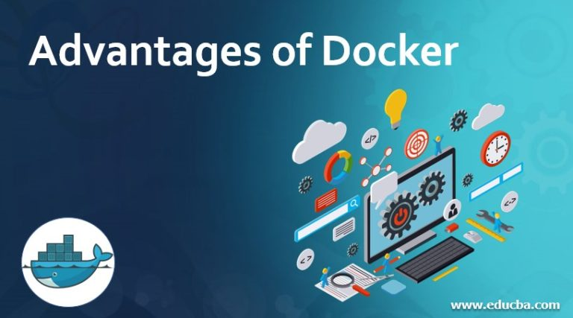
Benefits of Docker.
Docker provides consistency across different environments, making it easier to deploy applications.
It improves efficiency by enabling rapid deployment, scaling, and testing of applications.
Notes:
Image source: https://www.educba.com/advantages-of-docker/

Slide 4
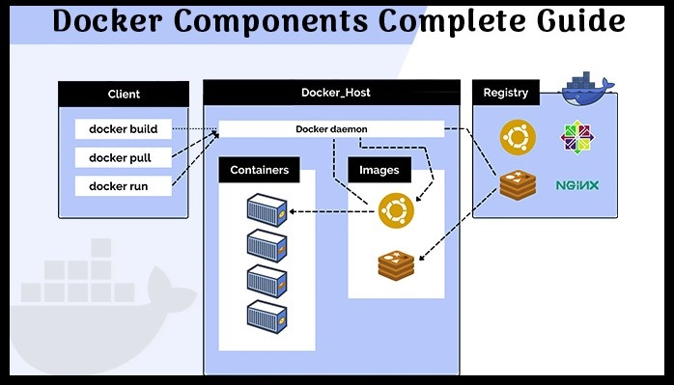
Docker Components.
Docker Engine is the core component that creates and runs containers.
Docker Hub is a cloud-based repository where users can store and share container images.
Notes:
Image source: https://thinksys.com/devops/docker-components/

Slide 5
Docker Images.
Images are read-only templates used to create containers.
They contain the application code, runtime, libraries, and dependencies needed to run the application.
Notes:
Image source: https://dzone.com/articles/how-to-build-docker-images-for-windows-desktop-app

Slide 6
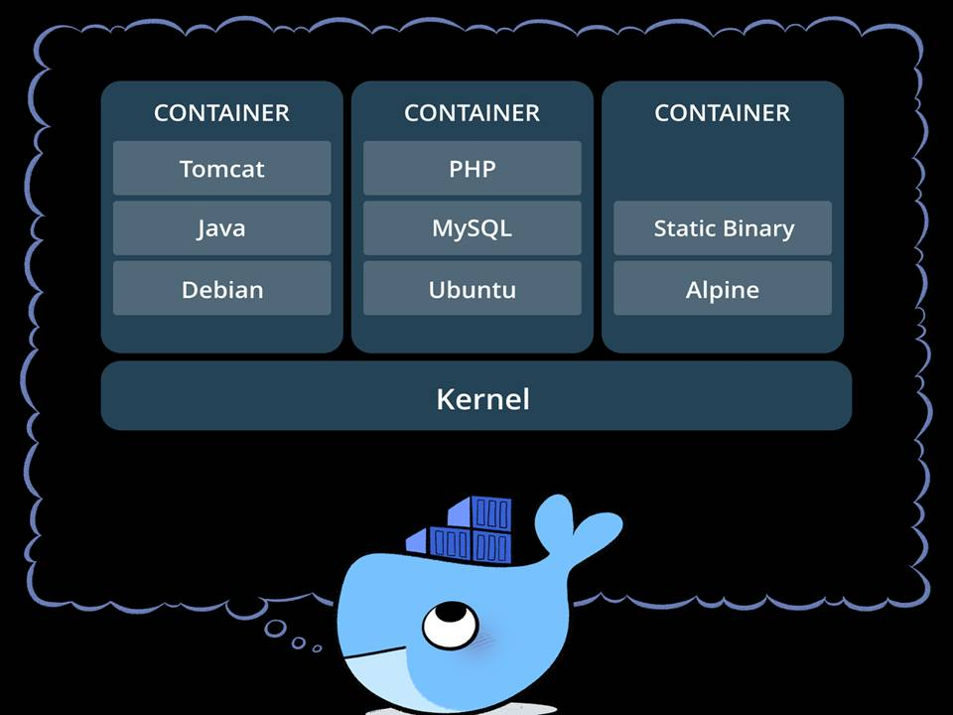
Docker Containers.
Containers are lightweight, standalone, and executable packages that include everything needed to run a piece of software.
Each container runs as an isolated process on the host machine, sharing the kernel with other containers.
Notes:
Image source: https://mindmajix.com/docker-architecture

Slide 7
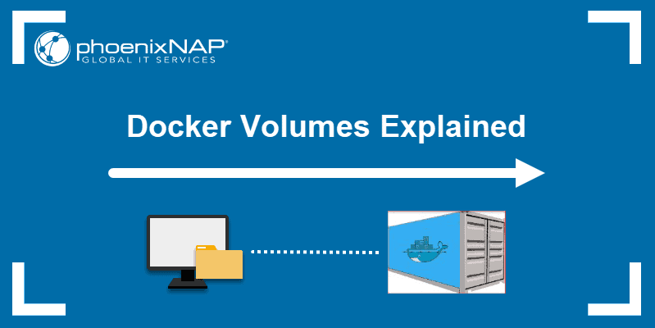
Docker Volumes.
Volumes are used to persist data generated by and used by Docker containers.
They provide a way to share data between a host machine and a container.
Notes:
Image source: https://phoenixnap.com/kb/docker-volumes

Slide 8
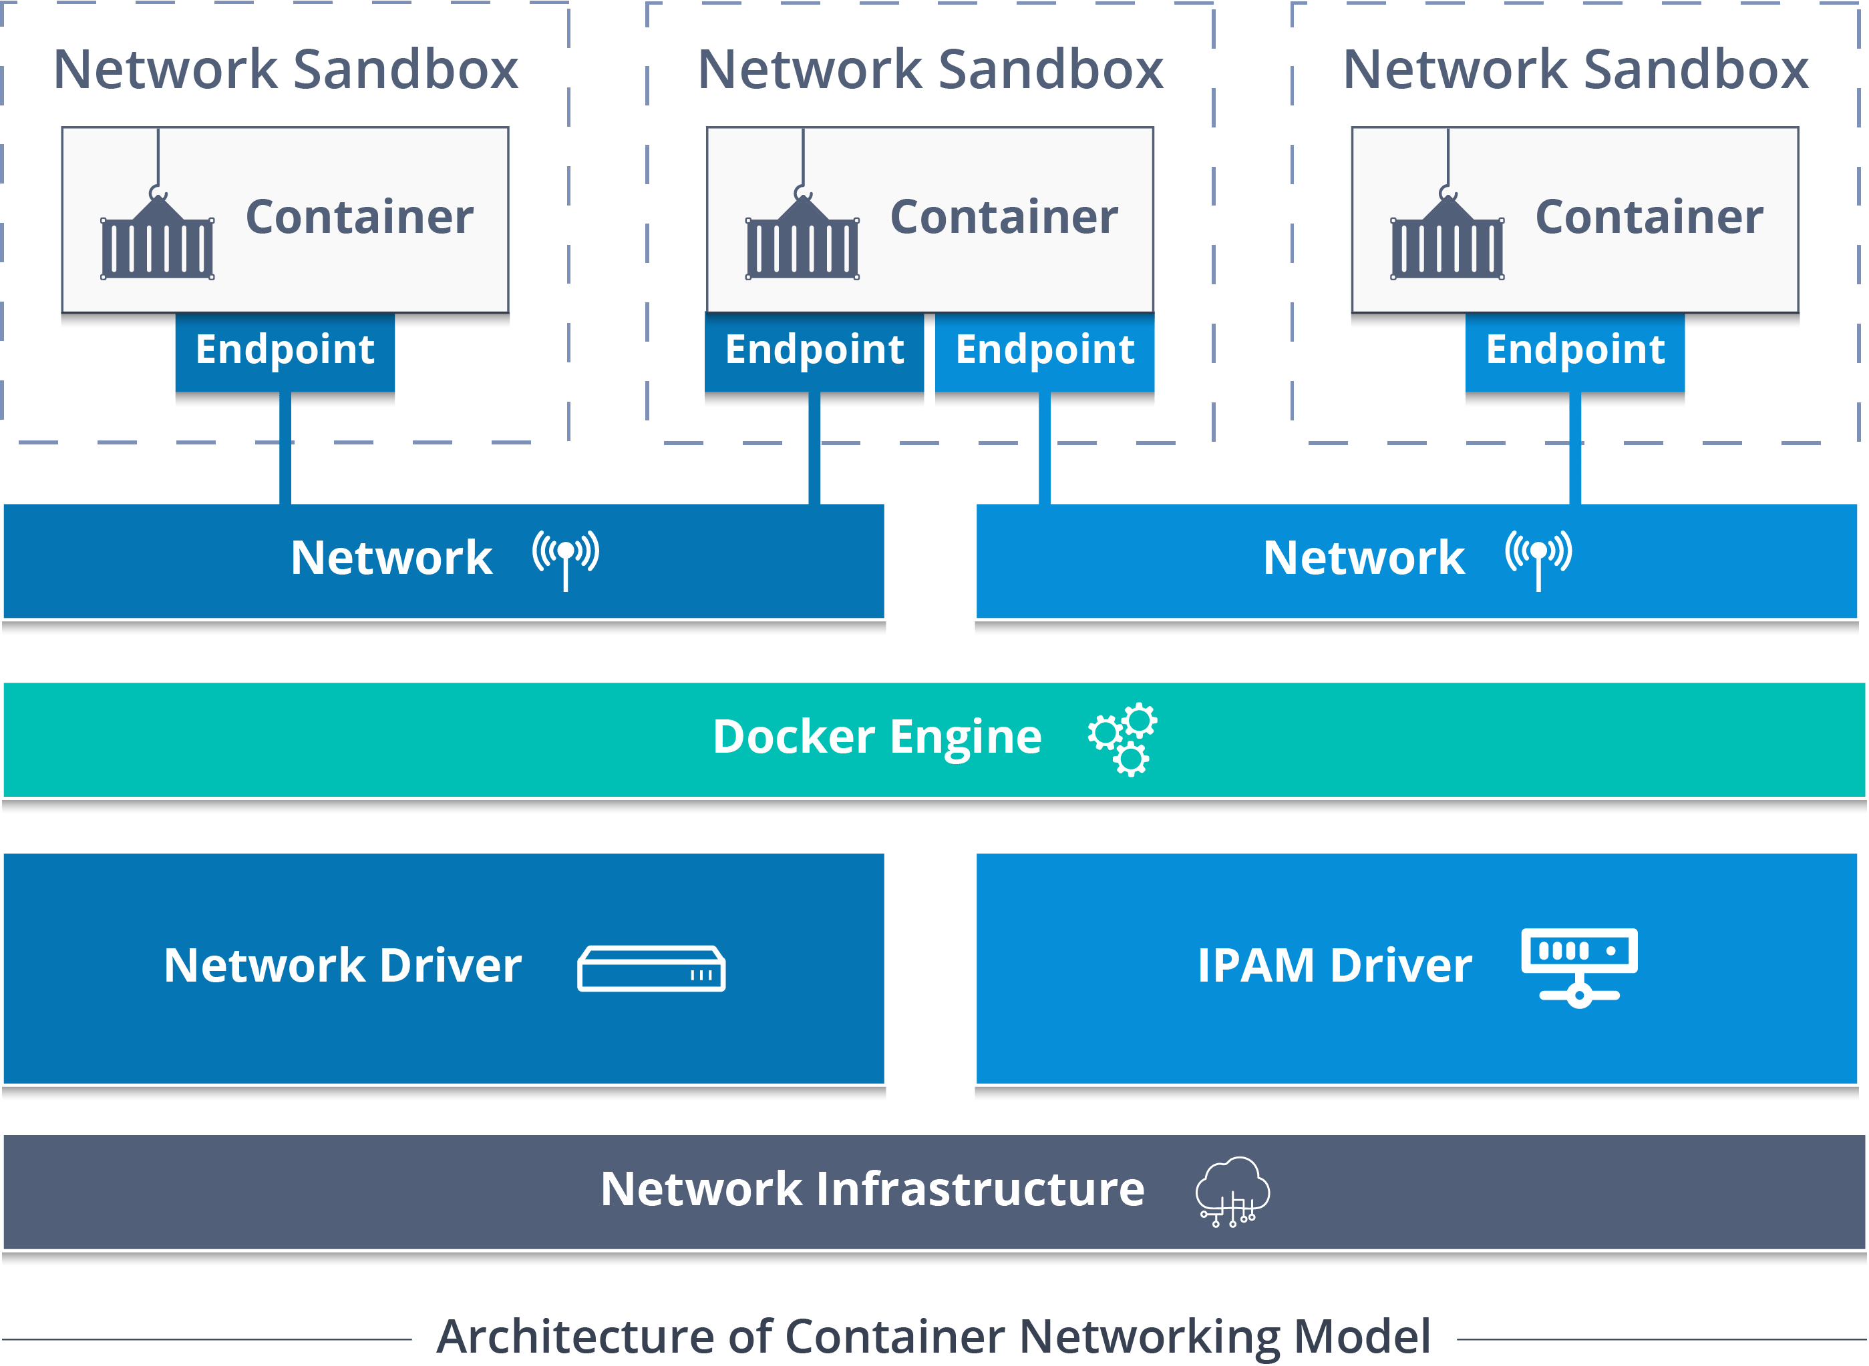
Docker Networking.
Docker provides networking capabilities that allow containers to communicate with each other and with external networks.
Containers can be connected to different types of networks, such as bridge, host, overlay, and macvlan networks.
Notes:
Image source: https://www.edureka.co/blog/docker-networking/

Slide 9
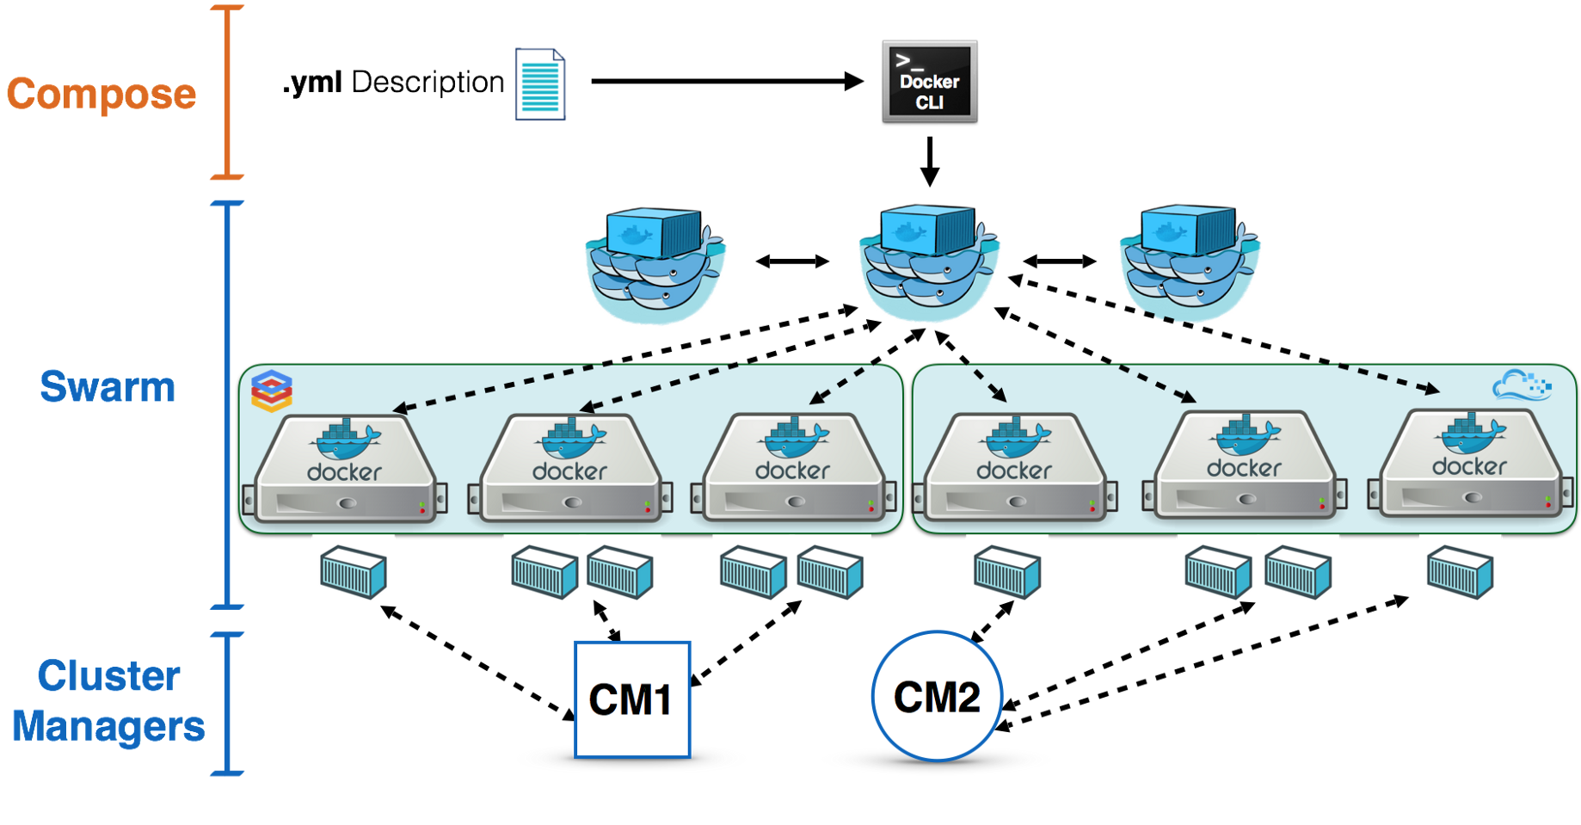
Docker Swarm.
Docker Swarm is a native clustering and orchestration tool for Docker containers.
It allows users to create and manage a cluster of Docker nodes, known as a swarm.
Notes:
Image source: https://dockertips.readthedocs.io/en/latest/docker-swarm/swarm-intro.html

Slide 10
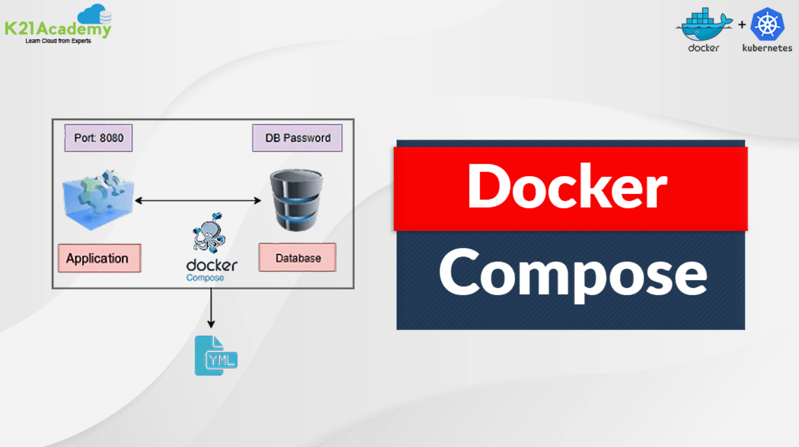
Docker Compose.
Docker Compose is a tool for defining and running multi-container Docker applications.
It uses a YAML file to configure the services, networks, and volumes of the application.
Notes:
Image source: https://fity.club/lists/d/docker-compose-tutorial-docker-in-practice-docker/

Slide 11
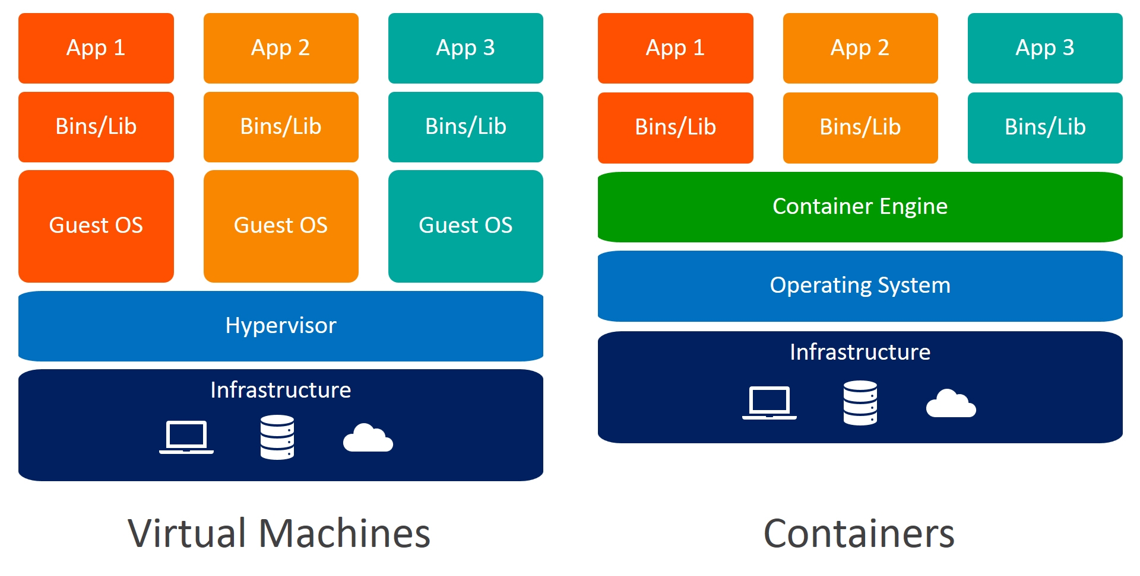
Docker Security.
Docker provides multiple layers of security, including container isolation, resource constraints, and user namespace mapping.
Users can apply security best practices such as using minimal base images, scanning images for vulnerabilities, and restricting container capabilities.
Notes:
Image source: http://fity.club/lists/suggestions/opensearch-docker/

Slide 12
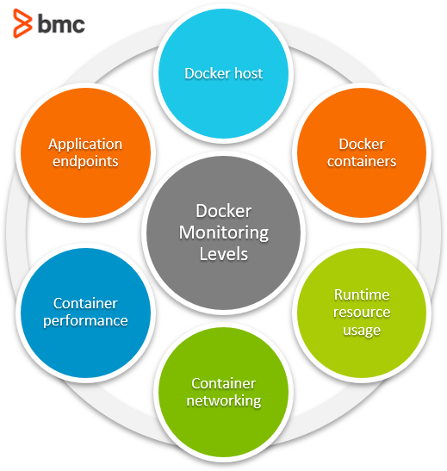
Docker Monitoring and Logging.
Docker provides built-in monitoring and logging capabilities through tools like Docker Stats, Docker Events, and Docker Logging Drivers.
Users can monitor container resource usage, inspect container events, and manage container logs.
Notes:
Image source: https://www.priezor.com/docker-network-monitoring/

Slide 13
Docker Registry.
Docker Registry is a server-side application that stores and distributes Docker images.
Users can run their private Docker Registry or use Docker Hub, a public registry provided by Docker.
Notes:
Image source: https://www.educba.com/docker-registry/?source=leftnav

Slide 14
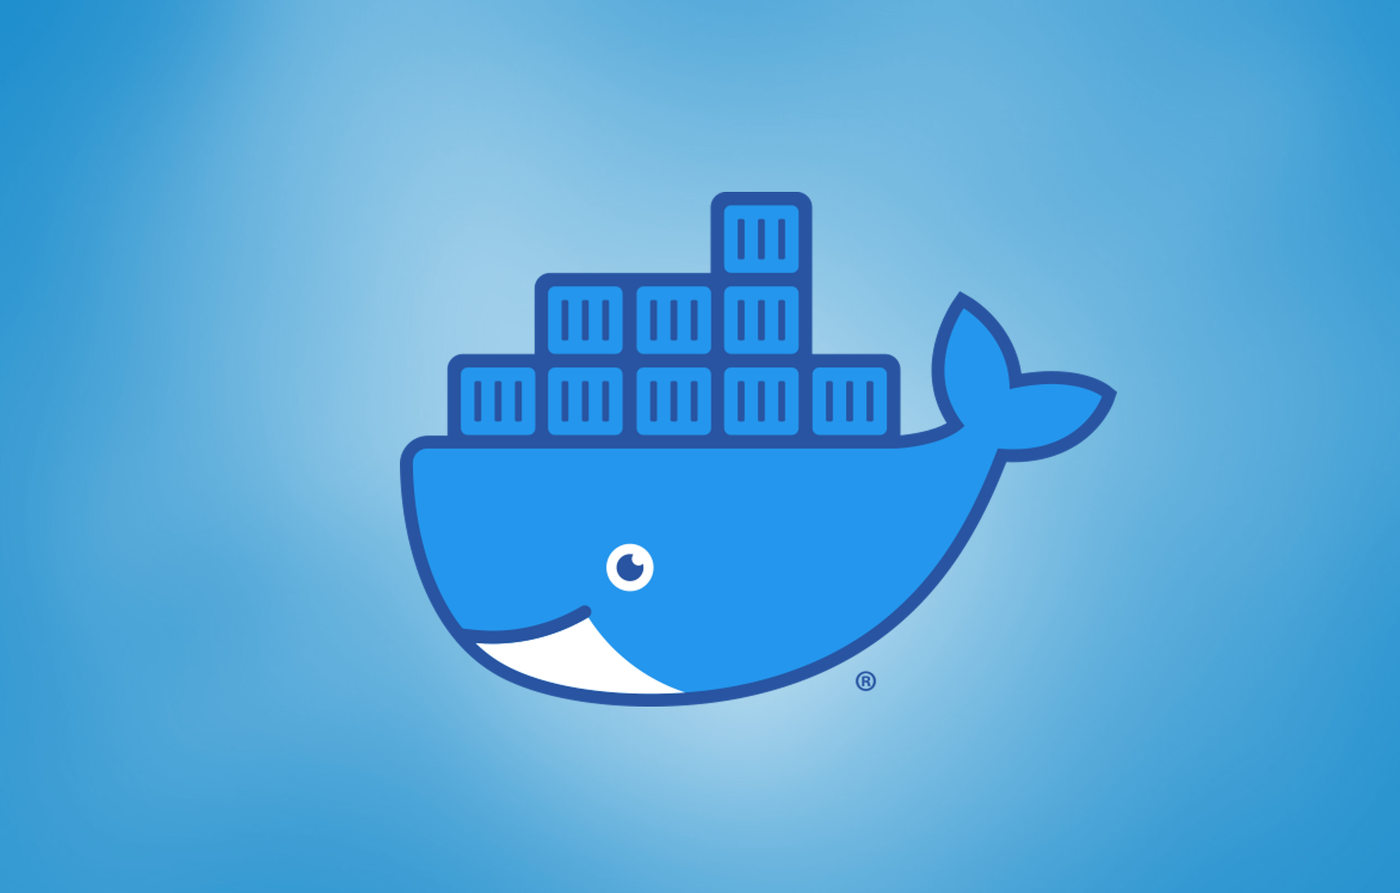
Docker Best Practices.
Use lightweight base images to reduce image size and improve performance.
Implement a microservices architecture to break down applications into smaller, more manageable components.
Notes:
Image source: https://www.datree.io/resources/docker-best-practices

Slide 15
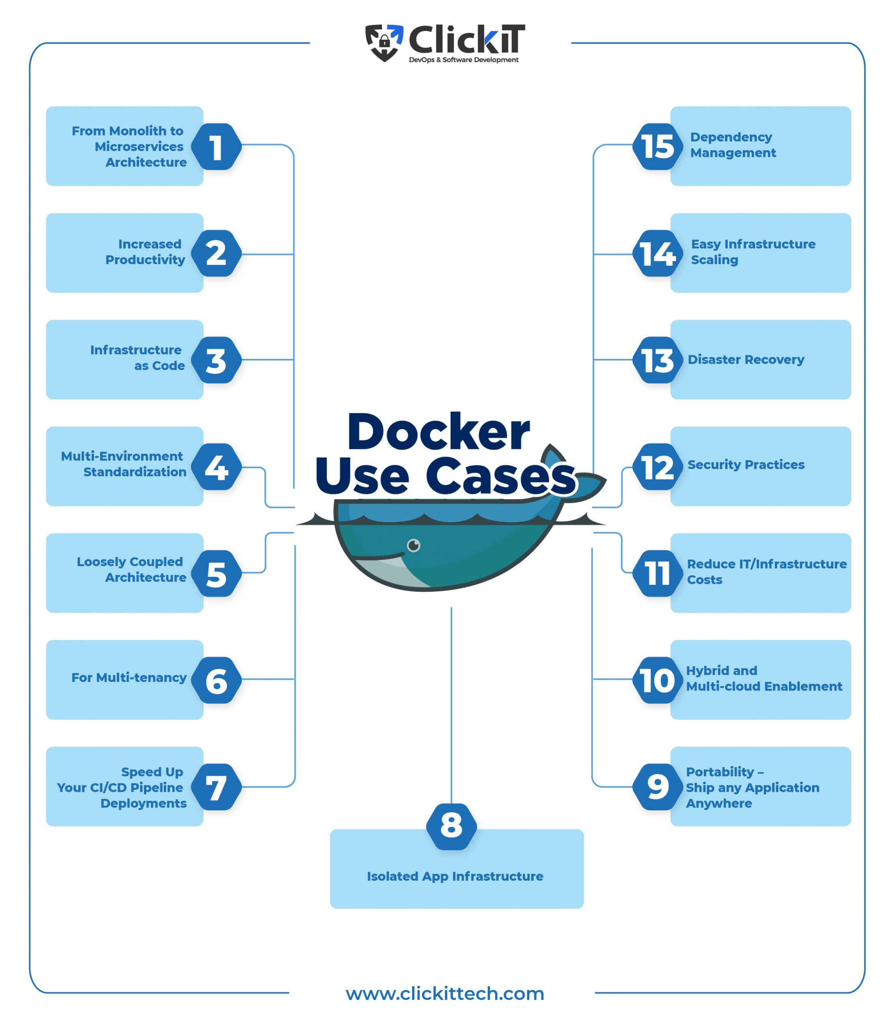
Docker Use Cases.
Docker is commonly used for application deployment, continuous integration, and continuous delivery.
It is also used for creating development and testing environments, enabling developers to work in consistent and isolated environments.
Notes:
Image source: https://www.clickittech.com/devops/docker-use-cases/

Slide 16
Docker vs. Virtual Machines.
Docker containers are lightweight and share the host system's kernel, making them more efficient than virtual machines.
Containers start up faster and consume fewer resources compared to virtual machines.
Notes:
Image source: https://www.weave.works/blog/a-practical-guide-to-choosing-between-docker-containers-and-vms

Slide 17
Docker Use in DevOps.
Docker is a fundamental tool in DevOps practices such as continuous integration, continuous delivery, and infrastructure as code.
It enables developers and operations teams to work together seamlessly by providing a standardized environment for deploying applications.
Notes:
Image source: https://www.clickittech.com/devops/docker-use-cases/

Slide 18
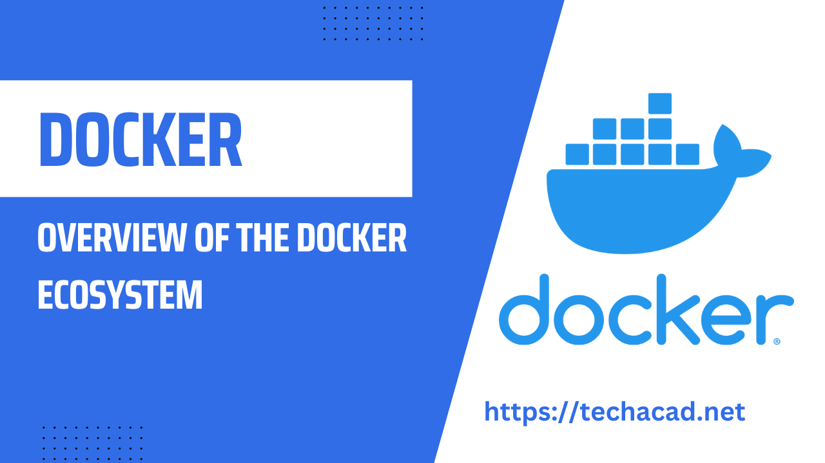
Docker Community and Ecosystem.
Docker has a vibrant community of developers, contributors, and users who actively contribute to the platform.
The Docker ecosystem includes a wide range of tools, plugins, and integrations that enhance Docker's capabilities.
Notes:
Image source: https://techacad.net/overview-of-the-docker-ecosystem-a-comprehensive-guide/

Slide 19
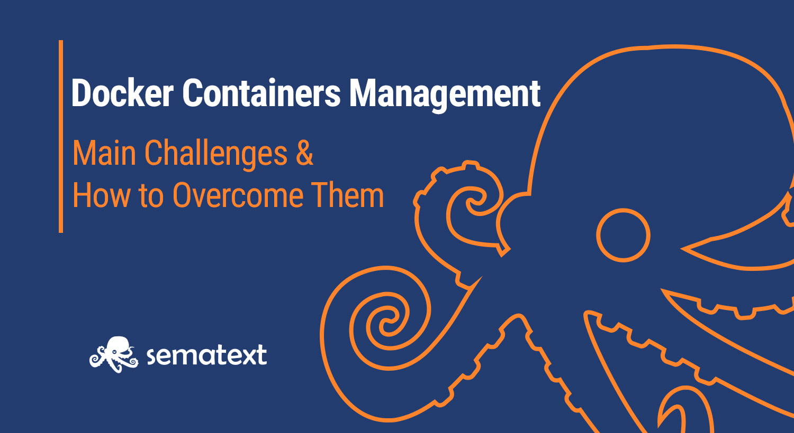
Docker Challenges.
Managing container orchestration and scaling can be complex, especially in large-scale deployments.
Security concerns such as container vulnerabilities and access control require careful consideration.
Notes:
Image source: https://sematext.com/blog/docker-container-management/

Slide 20
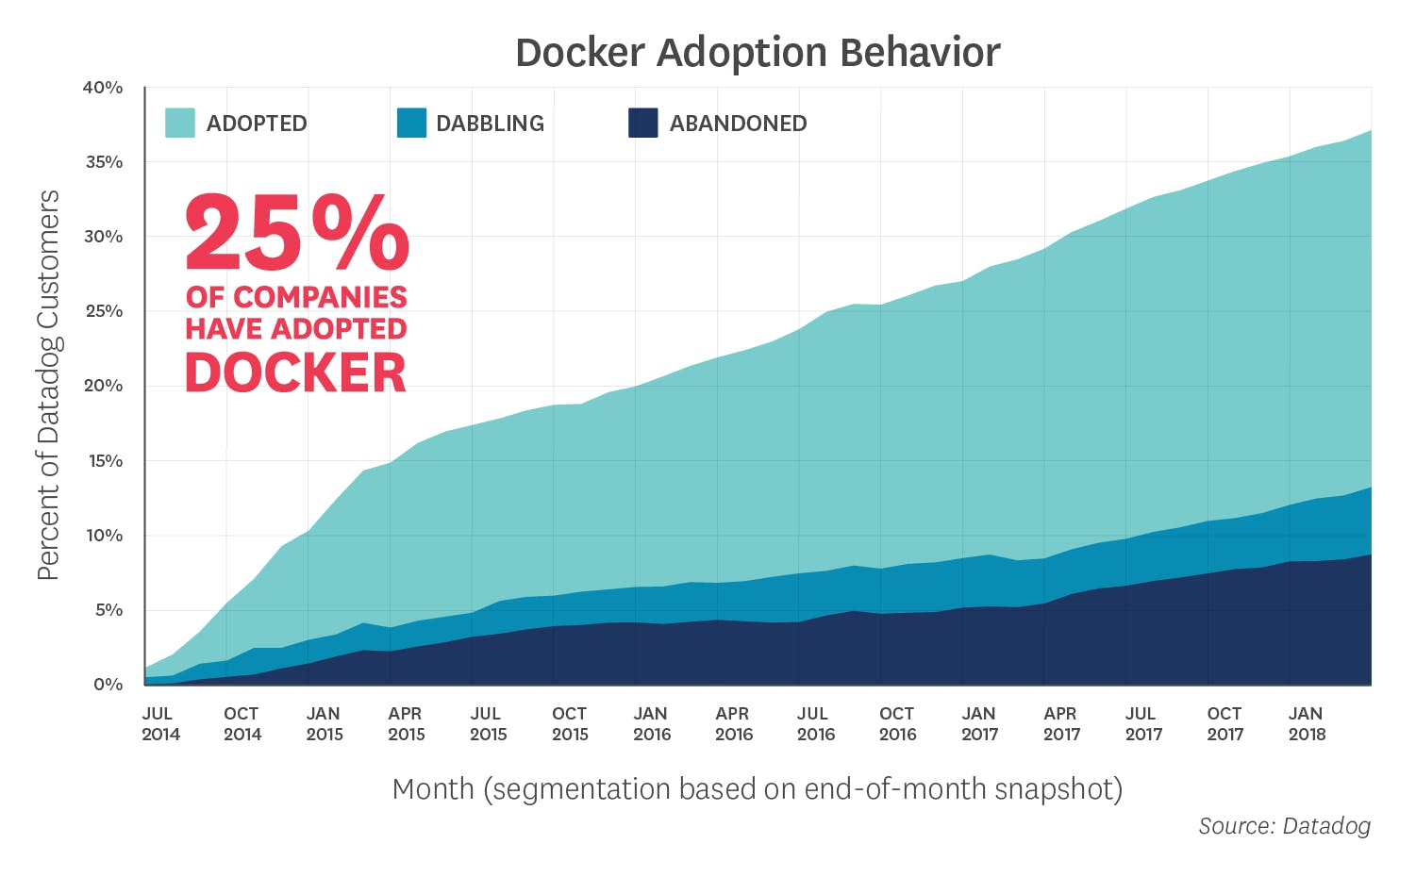
Docker Future Trends.
Continued growth in container adoption, driven by the need for agility, scalability, and efficiency in application development.
Increased focus on container security, compliance, and governance to address evolving threats and regulatory requirements.
Notes:
Image source: https://www.datadoghq.com/docker-adoption/

Slide 21
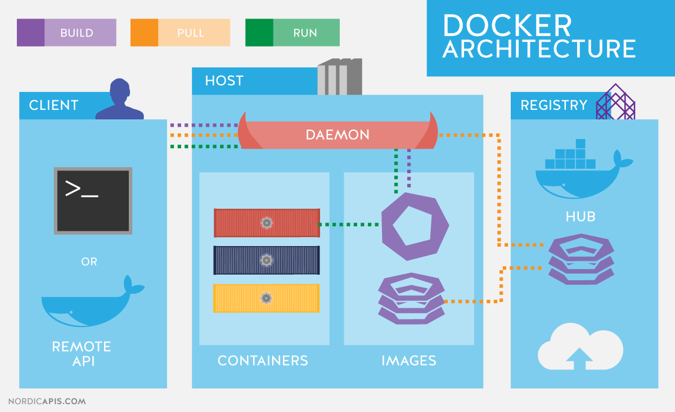
Summary.
Docker is a powerful platform for building, packaging, and deploying applications in lightweight, portable containers.
It offers numerous benefits such as consistency, efficiency, and collaboration for developers and operations teams.
Notes:
Image source: https://devopedia.org/docker

Slide 22
References
Docker Documentation. (https://docs.docker.com/)
Docker Hub. (https://hub.docker.com/)
Docker Swarm Documentation. (https://docs.docker.com/engine/swarm/)

