Slide 1
All about GitHub Action

Slide 2
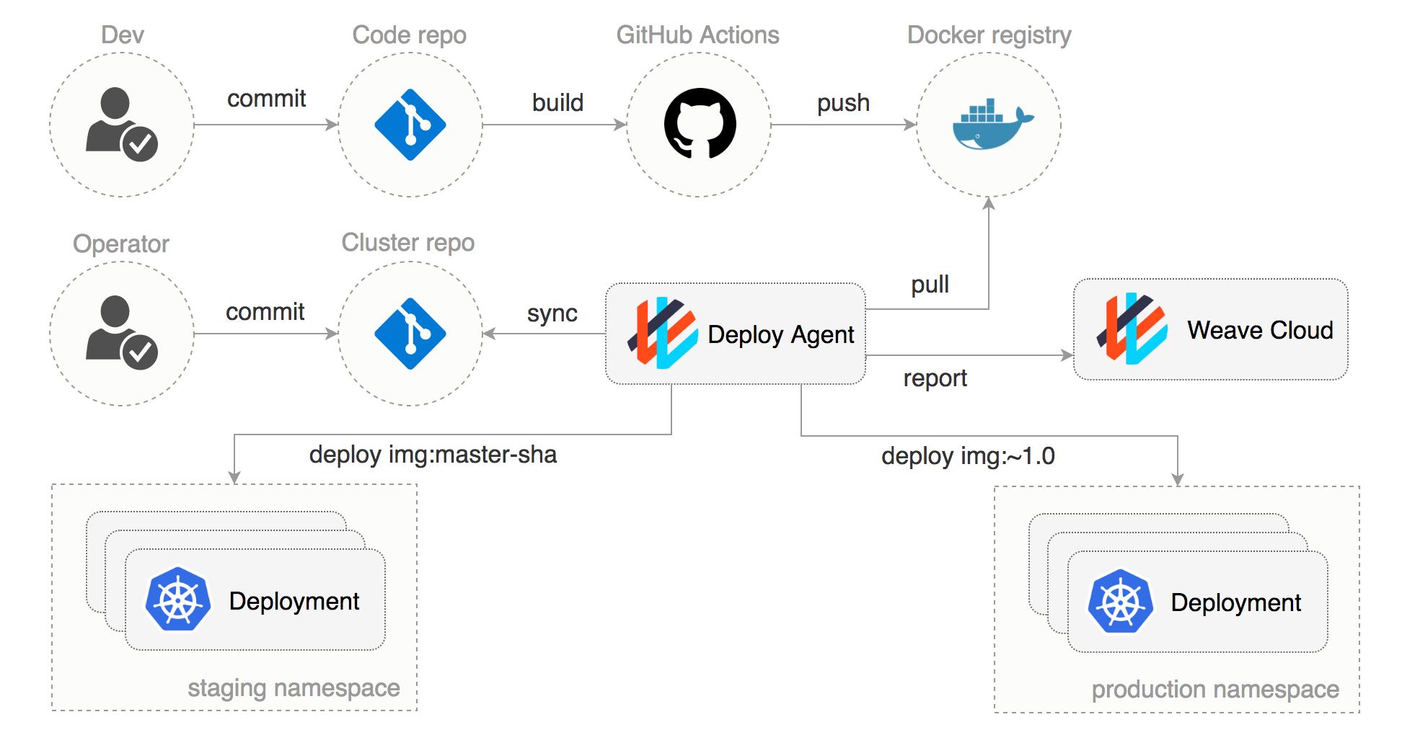
Introduction to GitHub Action
GitHub Actions is an automation tool provided by GitHub.
It allows developers to automate workflows for their repositories.
With GitHub Actions, you can build, test, and deploy your code directly from your repository.
Notes:
Image source: https://gnaganjaneyulu.blogspot.com/2023/06/github-actions-comprehensive-guide-to.html

Slide 3
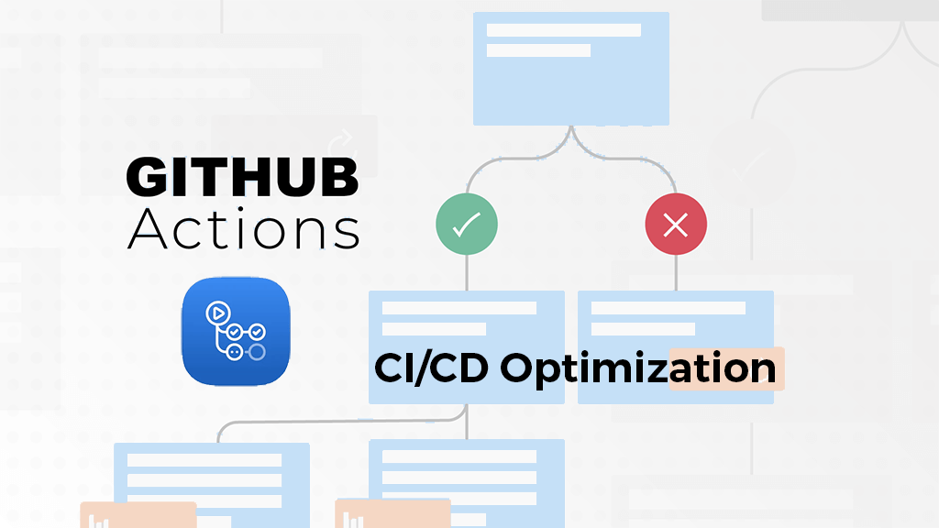
Benefits of Using GitHub Actions
Streamlines the software development process by automating repetitive tasks.
Enables continuous integration and deployment (CI/CD) pipelines.
Helps teams collaborate more efficiently by automating code reviews, testing, and deployment.
Notes:
Image source: https://www.activestate.com/blog/optimizing-ci-cd-pipelines-in-github-actions/

Slide 4
Getting Started with GitHub Actions
Actions are defined in YAML files within a .github/workflows directory in your repository.
You can create custom actions or use pre-built actions from the GitHub Marketplace.
GitHub Actions supports various programming languages and environments.
Notes:
Image source: https://itnext.io/getting-started-with-github-actions-fe94167dbc6d

Slide 5
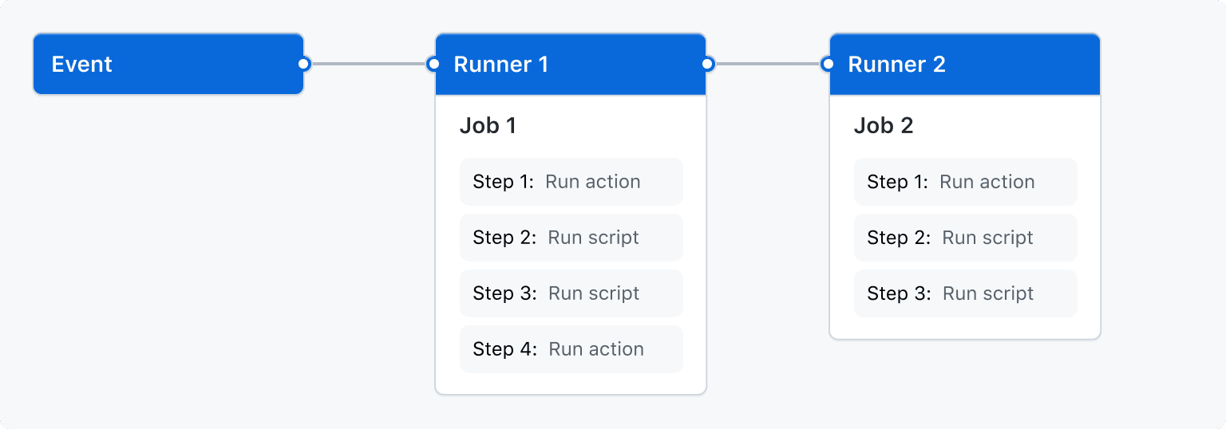
Workflow Triggers in GitHub Actions
Workflows can be triggered by events such as pushes, pull requests, or scheduled runs.
You can define custom triggers based on specific conditions or events.
Workflows can be triggered on specific branches or tags.
Notes:
Image source: https://codefresh.io/learn/github-actions/github-actions-workflows-basics-examples-and-a-quick-tutorial/

Slide 6
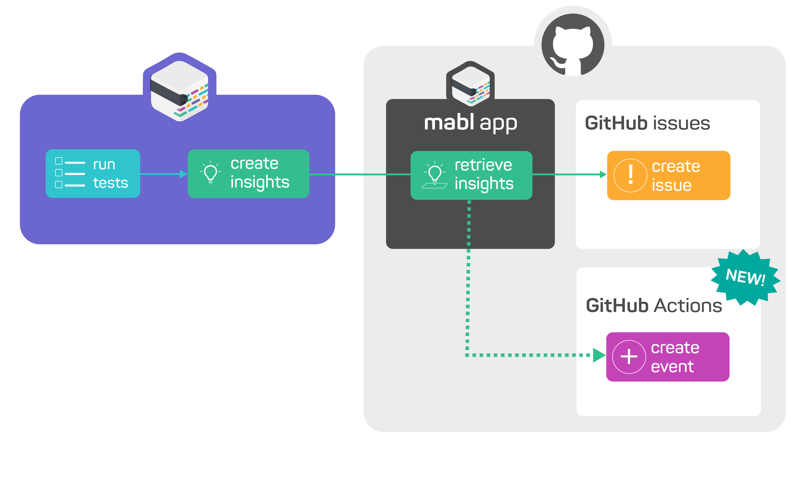
Creating Actions in GitHub
Actions are reusable units of code that can be combined to create custom workflows.
You can create actions using JavaScript, Docker containers, or any executable file.
Actions can be triggered by events and perform tasks such as building, testing, or deploying code.
Notes:
Image source: https://help.mabl.com/changelog/github-actions-custom-event-support

Slide 7
Using GitHub Actions for Continuous Integration
GitHub Actions can be used to automate the process of running tests and checks on your code.
You can set up workflows to run on each commit or pull request to ensure code quality.
Integration with popular testing frameworks allows for seamless testing within your workflow.
Notes:
Image source: https://github.com/tushar0305/CI-CD-Pipeline

Slide 8
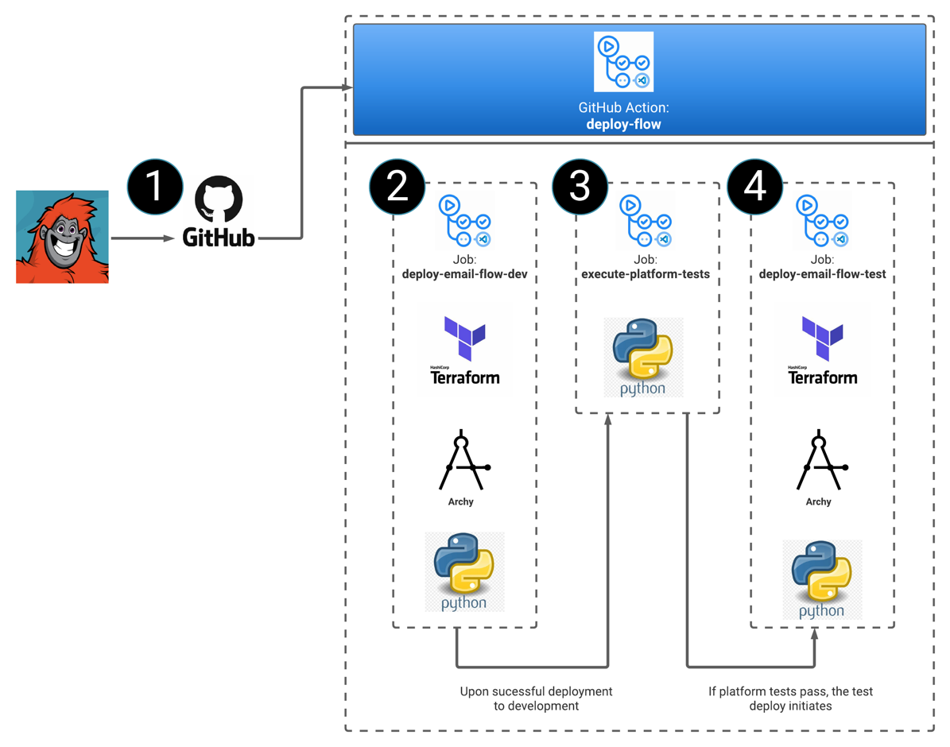
GitHub Actions for Continuous Deployment
Automate the deployment of your code to various environments using GitHub Actions.
Define deployment workflows that trigger on specific conditions such as successful tests.
Integrate with deployment tools to deploy to servers, containers, or cloud platforms.
Notes:
Image source: https://developer.genesys.cloud/blueprints/cx-as-code-cicd-gitactions-blueprint/

Slide 9
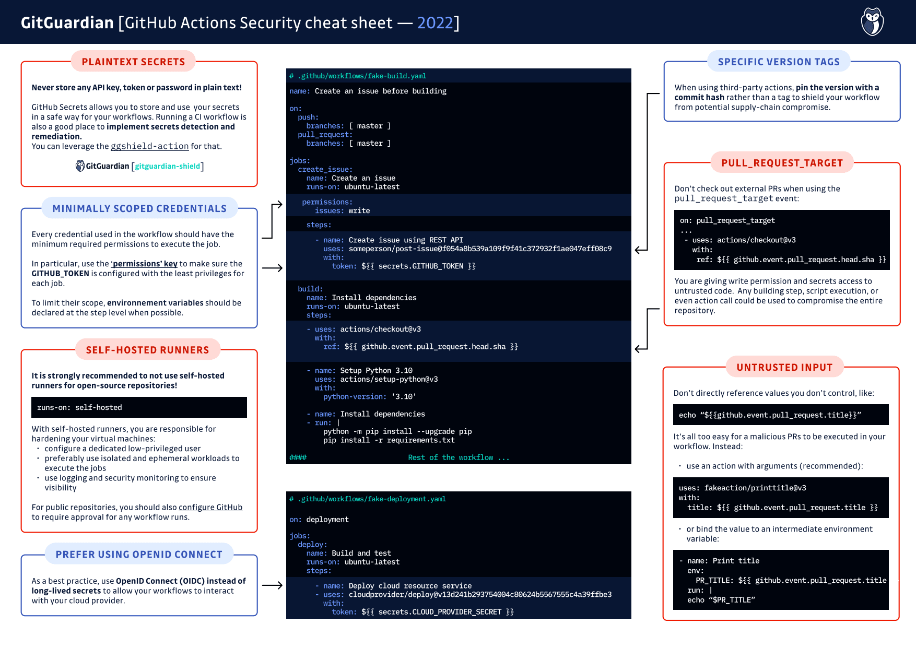
GitHub Actions Security Best Practices
Use secrets to securely store sensitive information such as API keys and credentials.
Limit access to workflows and actions to authorized users or teams.
Regularly review and audit your workflows for potential security vulnerabilities.
Notes:
Image source: https://blog.gitguardian.com/github-actions-security-cheat-sheet/

Slide 10
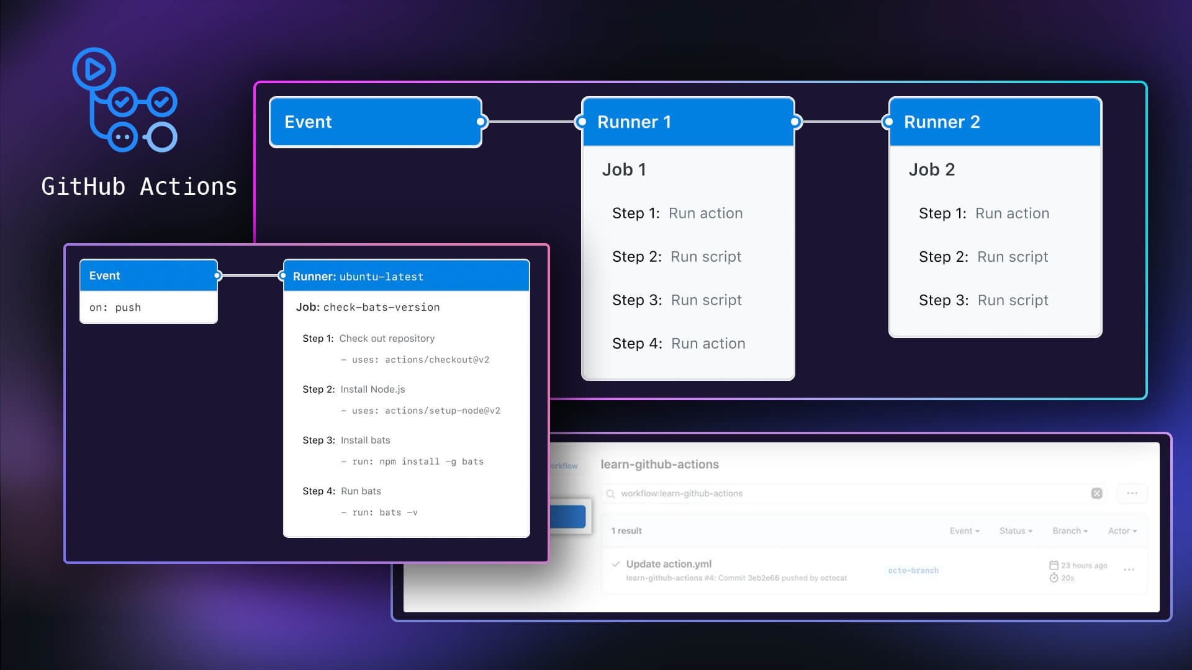
Monitoring and Troubleshooting with GitHub Actions
Monitor the status and output of your workflows using the GitHub Actions interface.
Debug and troubleshoot failed workflows by examining logs and error messages.
Use actions such as notifications to alert team members of workflow failures.
Notes:
Image source: https://www.liatrio.com/blog/github-actions-workflows

Slide 11
GitHub Actions Community and Marketplace
Join the GitHub Actions community to share workflows, actions, and best practices.
Discover pre-built actions and workflows in the GitHub Marketplace.
Contribute your own actions to the community for others to use.
Notes:
Image source: https://www.liatrio.com/blog/github-actions-workflows

Slide 12
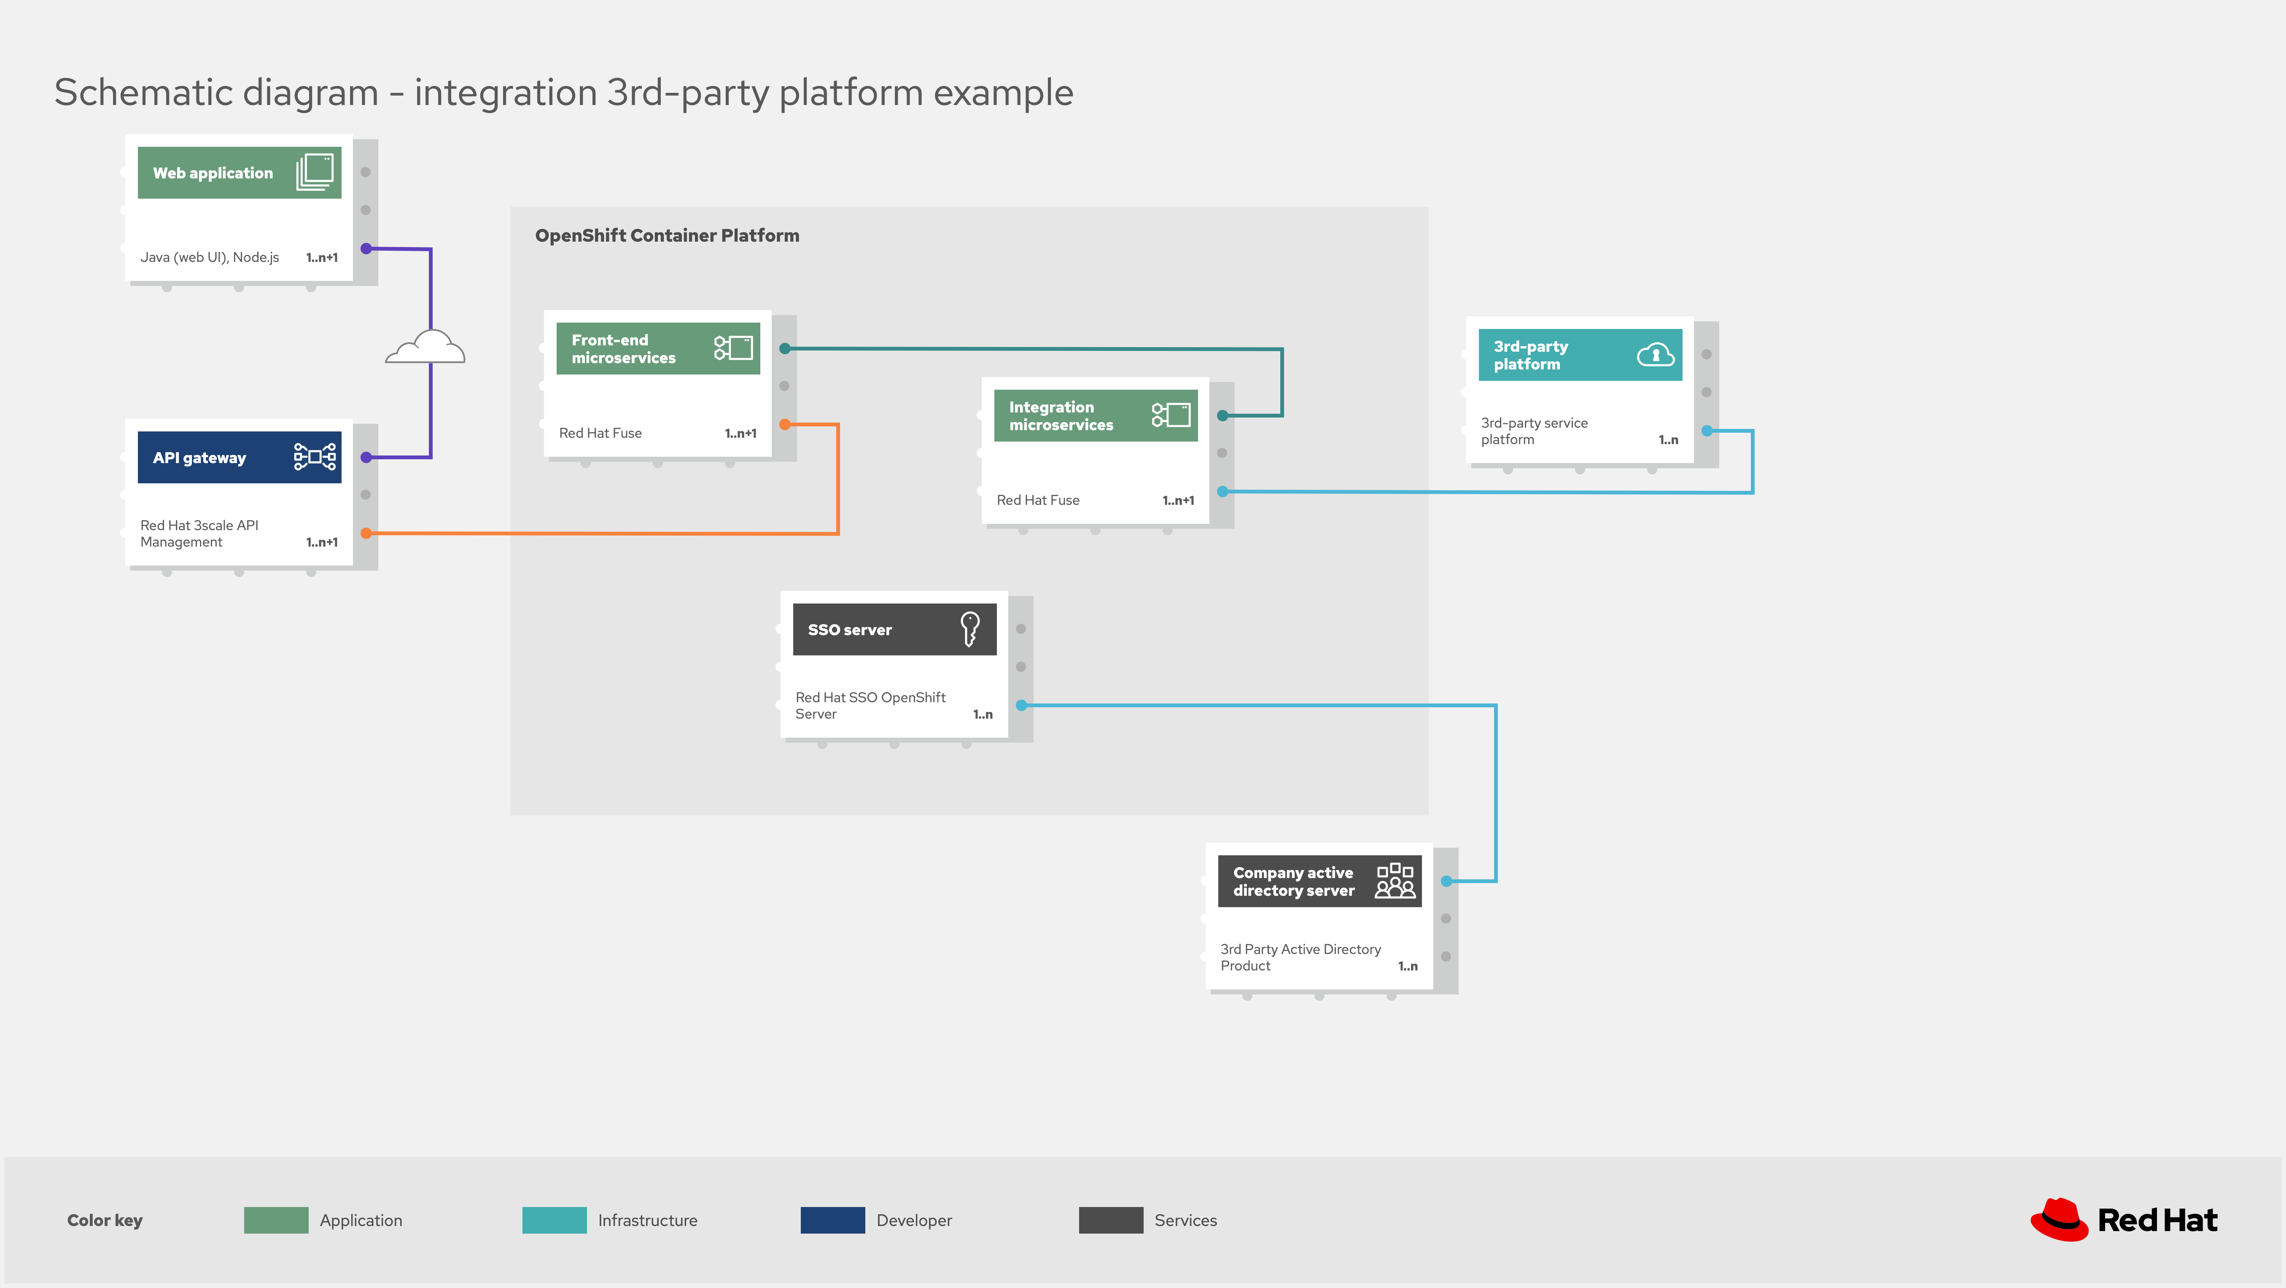
Integrating Third-Party Tools with GitHub Actions
GitHub Actions integrates with a wide range of third-party tools and services.
Use actions from partners such as AWS, Azure, and Slack to extend the functionality of your workflows.
Leverage GitHub's API to create custom integrations with external services.
Notes:
Image source: https://dzone.com/articles/integrating-with-saas-applications-example-3rd-par

Slide 13
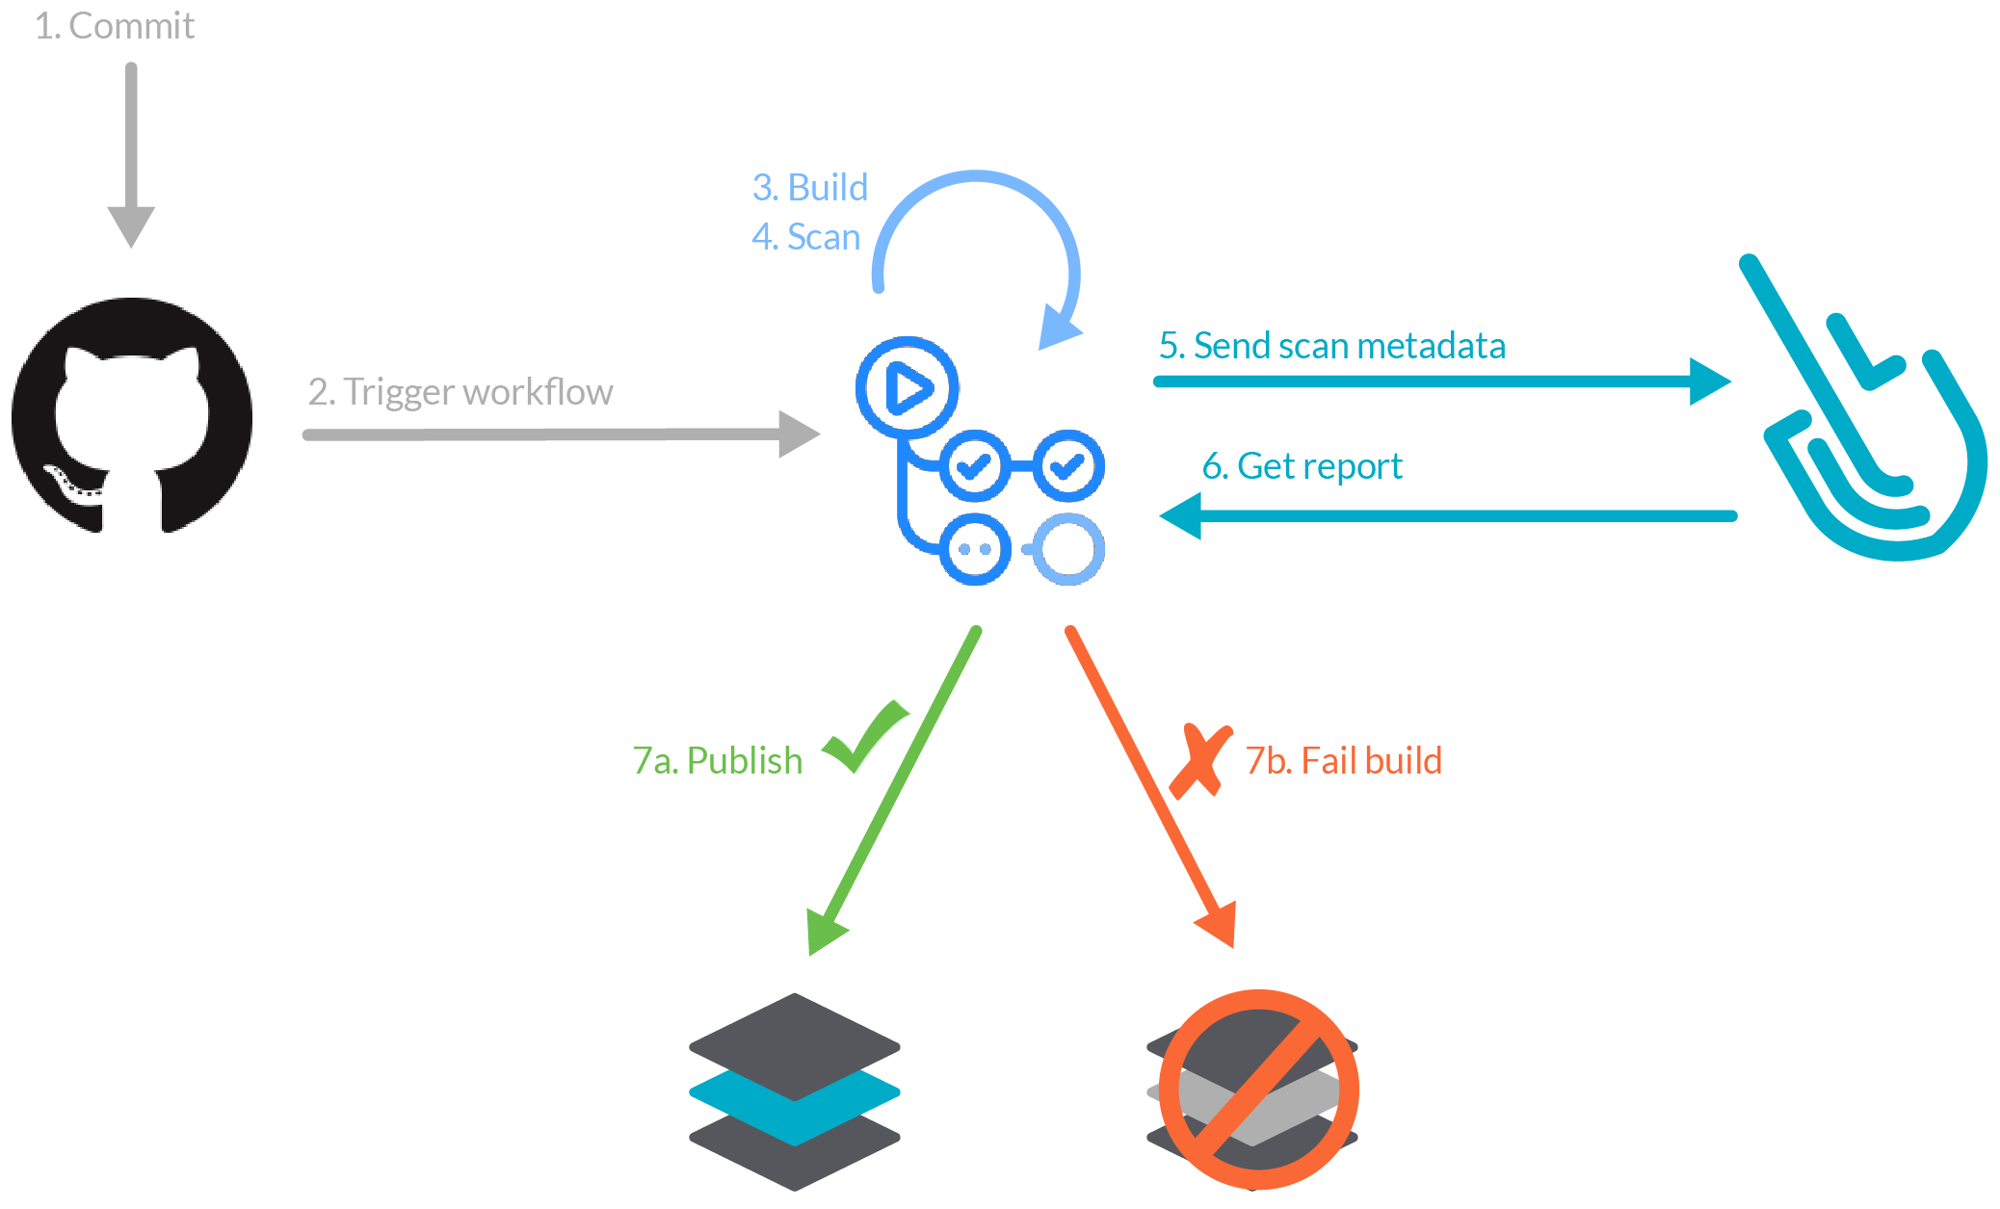
Cost and Limitations of GitHub Actions
GitHub Actions offers free tier usage for public repositories.
Private repositories may incur charges based on usage.
Be mindful of usage limits and constraints when designing workflows.
Notes:
Image source: https://manuallistmetzger.z19.web.core.windows.net/github-actions-manual.html

Slide 14
Advanced Features of GitHub Actions
Conditional expressions allow you to define logic within your workflows.
Matrix builds enable parallel testing across multiple configurations.
Secrets management allows for secure storage and retrieval of sensitive information.
Notes:
Image source: https://itnext.io/getting-started-with-github-actions-fe94167dbc6d

Slide 15
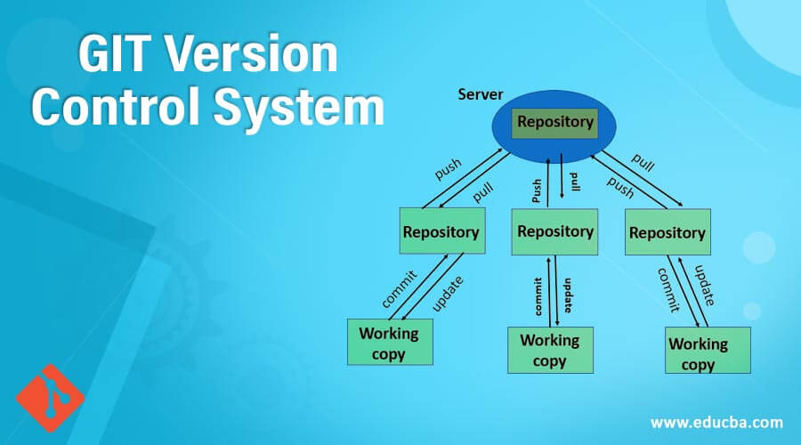
Versioning and Collaboration with GitHub Actions
Use version control to track changes to your workflows over time.
Collaborate with team members by creating shared workflows and actions.
Implement code review processes to ensure the quality of your workflows.
Notes:
Image source: https://tutorialzxy.blogspot.com/2022/12/git-version-control-tutorial.html

Slide 16
Scaling Workflows with GitHub Actions
GitHub Actions supports scaling workflows to accommodate growing projects.
Utilize caching to speed up workflow execution and reduce resource consumption.
Leverage workflow templates and reusable actions to streamline development processes.
Notes:
Image source: https://www.liatrio.com/blog/github-actions-workflows

Slide 17
Best Practices for GitHub Actions Usage
Define clear naming conventions for workflows and actions to improve readability.
Document your workflows and actions to facilitate collaboration and knowledge sharing.
Regularly review and optimize your workflows for performance and efficiency.
Notes:
Image source: https://sumanprasad.hashnode.dev/github-action-best-practices-how-to-tweak-your-workflow

Slide 18

Future Developments and Trends in GitHub Actions
GitHub continues to invest in expanding the capabilities of GitHub Actions.
Look out for updates and new features to enhance your automation workflows.
Stay informed about industry trends and best practices in CI/CD and automation.
Notes:
Image source: http://appfleet.com/blog/github-actions-testing-building-and-notifying/

Slide 19
Use Cases and Examples of GitHub Actions
Explore use cases such as automating code deployment, scheduled tasks, and notifications.
Check out examples from the GitHub Actions community for inspiration and learning.
Tailor workflows to your specific needs and requirements for maximum efficiency.
Notes:
Image source: https://github.com/tushar0305/CI-CD-Pipeline

Slide 20
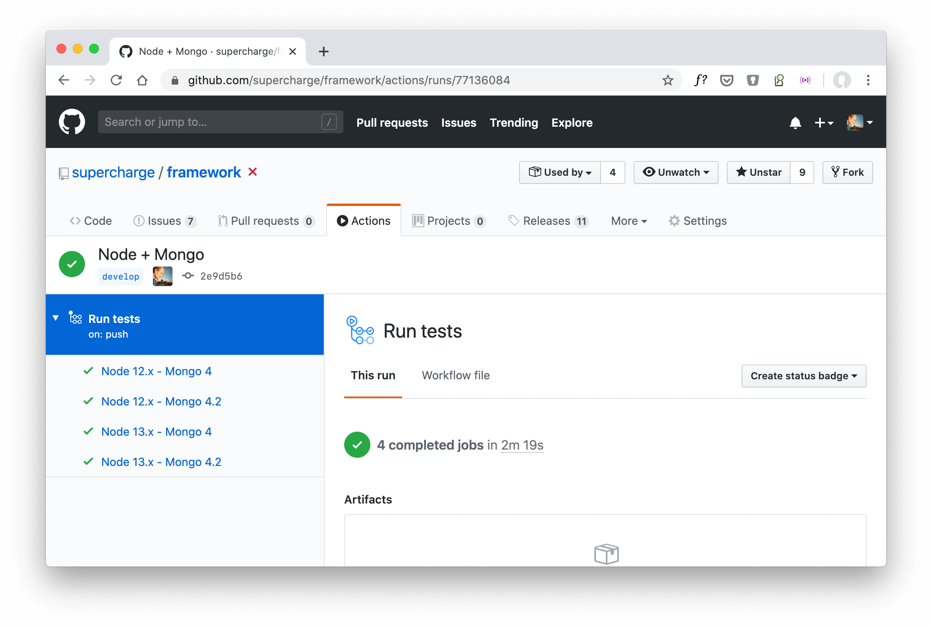
GitHub Actions for Open Source Projects
GitHub Actions is well-suited for automating tasks in open source projects.
Encourage community contributions by creating transparent and automated workflows.
Showcase your project's automation processes to attract and retain contributors.
Notes:
Image source: https://futurestud.io/tutorials/github-actions-customize-the-job-name

Slide 21

Conclusion
GitHub Actions revolutionizes the way developers automate workflows and streamline software development.
Embrace the power of automation with GitHub Actions to enhance productivity and collaboration.
Start leveraging GitHub Actions today to build, test, and deploy code more efficiently.
Notes:
Image source: https://www.desertcart.ae/products/403516823-automating-workflows-with-git-hub-actions-automate-software-development-workflows-and-seamlessly-deploy-your-applications-using-git-hub-actions

Slide 22
References
GitHub Actions Documentation: https://docs.github.com/en/actions
GitHub Actions Marketplace: https://github.com/marketplace?type=actions
GitHub Actions Community: https://github.community/c/github-actions/31

