Slide 1
All about Jenkins

Slide 2
Introduction to Jenkins
Jenkins is an open-source automation platform for operations related to continuous integration and delivery (CI/CD). It enables software developers to automate the processes of developing, testing, and deploying their applications. Jenkins accelerates the development cycle, lowers manual error rates, and increases productivity.
1
Notes:
Image source: https://k21academy.com/devops-foundation/jenkins-overview-installation-pre-requisites-concepts/

Slide 3
Key Features of Jenkins
Jenkins facilitates the integration of SVN, Mercurial, and Git version control systems. It offers an intuitive web-based user interface for configuring and tracking automation jobs. To increase its functionality and connect it with other tools in the DevOps pipeline, Jenkins provides an extensive library of plugins.
2
Notes:
Image source: https://www.toolsqa.com/jenkins/what-is-jenkins/

Slide 4
Jenkins Architecture
Jenkins follows a master-slave architecture where the master node manages the configuration and distributes tasks to multiple slave nodes. The master node handles job scheduling, monitoring, and distributing build jobs to the slave nodes.
Slave nodes execute the build jobs and report back to the master node with the results.
3
Notes:
Image source: https://subscription.packtpub.com/book/programming/9781784390891/2/ch02lvl1sec15/understanding-the-master-and-slave-architecture

Slide 5
Installation of Jenkins
The master node handles job scheduling, monitoring, and distributing build jobs to the slave nodes. Slave nodes execute the build jobs and report back to the master node with the results. Linux, macOS, and Windows are just a few of the operating platforms on which Jenkins can be installed.
4
Notes:
Image source: https://benisnous.com/jenkins-installation-step-by-step-how-to-install-jenkins-on-ubuntu-18-04-jenkins-tutorial-part-1/

Slide 6
Creating Jenkins Jobs
Jenkins jobs specify the automation tasks that need to be carried out, including the development, testing, and deployment of applications. Through the Jenkins web interface, jobs may be built by setting up variables such as build triggers, post-build actions, and source code repository. Pipelines are a useful tool for organizing Jenkins activities into more intricate automation workflows.
5
Notes:
Image source: https://www.fiverr.com/chathuranga50/jenkins-automation-to-completed-any-tasks

Slide 7
Jenkins Plugins
Jenkins plugins increase the capability of Jenkins by integrating it with additional tools and by introducing new features. The Jenkins plugin library has thousands of plugins for a variety of use cases, including deployment, testing, and version control. Using the Jenkins web interface, installing and configuring plugins is simple.
6
Notes:
Image source: https://www.educba.com/jenkins-plugins/

Slide 8
Jenkins Pipelines
Jenkins pipelines enable users to utilize a Jenkinsfile to define intricate automation procedures like code. Stages, phases, parallel execution, and error handling are all supported by pipelines, which facilitate the visualisation and management of the complete CI/CD process. Version control systems can be used to store Jenkins pipelines, facilitating improved teamwork and traceability.
7
Notes:
Image source: https://faun.pub/jenkins-pipeline-tutorial-first-step-guide-to-continuous-delivery-87f74d322ab7

Slide 9
Jenkins Security
Role-based access control, authorization, and user authentication are just a few of the security capabilities that Jenkins offers. Jenkins's user database or third-party authentication providers like LDAP and Active Directory can be used to authenticate users. It is possible to modify Jenkins security settings to limit access to resources and sensitive data inside the Jenkins environment.
8
Notes:
Image source: https://nmapcheatsheet.my.to/jenkins-security-tutorial/

Slide 10
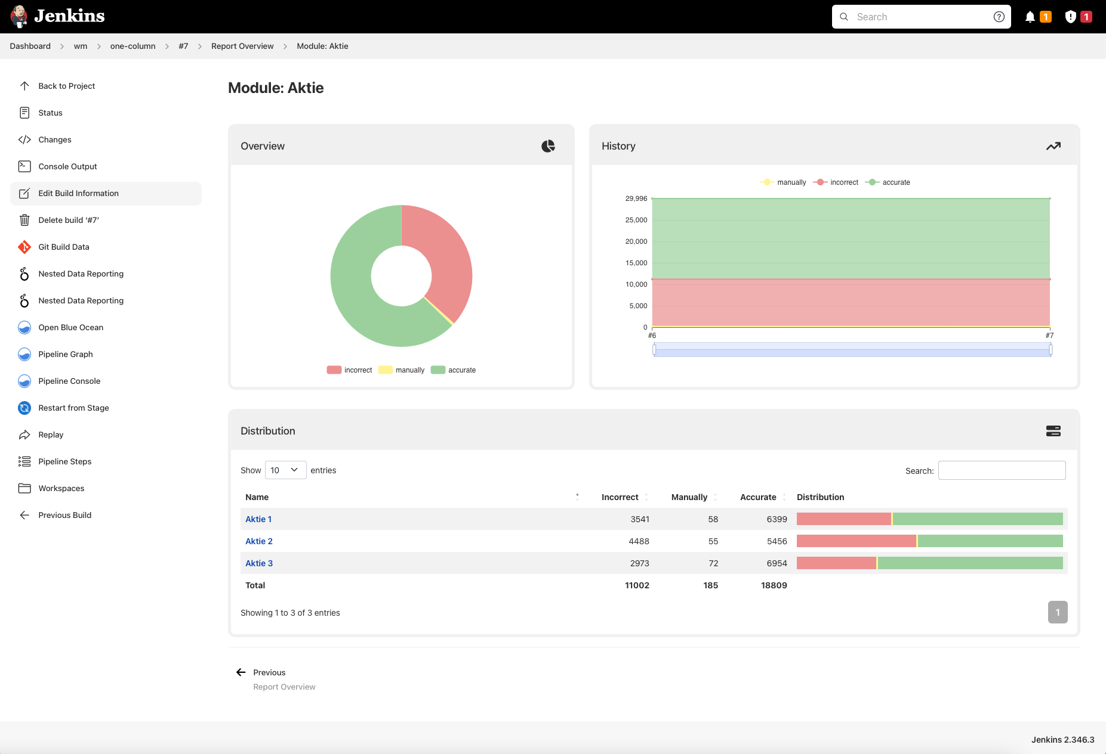
Jenkins Monitoring and Reporting
Jenkins comes with built-in features for real-time build, task, and node status tracking. Jenkins's monitoring tools allow users to access comprehensive build logs, performance metrics, and historical trends. Blue Ocean and other Jenkins plugins offer an easier-to-use interface for pipeline visualization and build progress tracking.
9
Notes:
Image source: https://plugins.jenkins.io/nested-data-reporting

Slide 11
Jenkins Scalability
Jenkins may be set up to manage numerous concurrent builds and dispersed workloads, and it is very scalable. Jenkins facilitates the configuration of a master-slave architecture to better spread build jobs among several nodes. By increasing the hardware's scalability or implementing Jenkins in a cloud environment, users can expand Jenkins' capabilities.
10
Notes:
Image source: https://digitalvarys.com/how-to-create-dynamically-scalable-jenkins-slaves-with-docker-and-kubernetes/

Slide 12
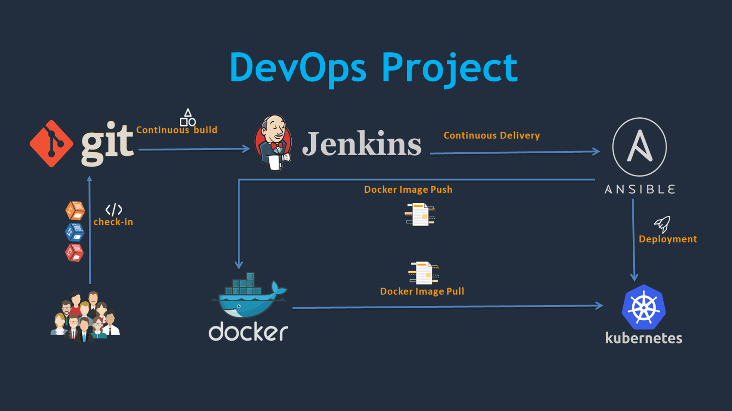
Jenkins Integration with Other Tools
Ansible, Docker, Kubernetes, Jira, and other DevOps tools may all be linked with Jenkins to automate the software delivery process from start to finish. Jenkins can automatically start builds whenever updates are pushed to the repository thanks to integration with version control systems. Jenkins can also be integrated with testing technologies such as JUnit and Selenium to perform automated application testing.
11
Notes:
Image source: https://www.eduonix.com/devops-project-ci-cd-with-git-jenkins-ansible-docker-kubernetes

Slide 13
Jenkins Best Practices
For improved reproducibility and versioning, define automation processes in a Jenkins file using the "Pipeline as Code" concept. Make use of Jenkins' integrated security capabilities to protect private data, such as API keys and credentials. Update Jenkins and its plugins frequently to take advantage of security patches, bug fixes, and new features.
12
Notes:
Image source: https://laptrinhx.com/setting-up-a-ci-cd-pipeline-by-integrating-jenkins-with-aws-codebuild-and-aws-codedeploy-2389954695/

Slide 14
Jenkins Use Cases
Software development companies frequently utilize Jenkins to automate the build, test, and deployment processes. It speeds up the software delivery cycle in pipelines for continuous integration and delivery. Jenkins is also utilized in configuration management and infrastructure automation for server environment provisioning and administration.
13
Notes:
Image source: https://reverasite.com/build-jenkins-cicd-pipeline-to-build-and-deploy-docker-container

Slide 15
Jenkins Community Support
Jenkins has a sizable and vibrant user base, developers, and contributors that offer documentation, plugins, and support. Users can ask for assistance, exchange information, and support the Jenkins ecosystem by taking part in forums, mailing lists, and meetups. To bring together users and professionals from around the world, the Jenkins community routinely organizes events like Jenkins World.
14
Notes:
Image source: https://community.arm.com/developer/tools-software/tools/b/tools-software-ides-blog/posts/jenkins-community-support-for-arm-architecture

Slide 16
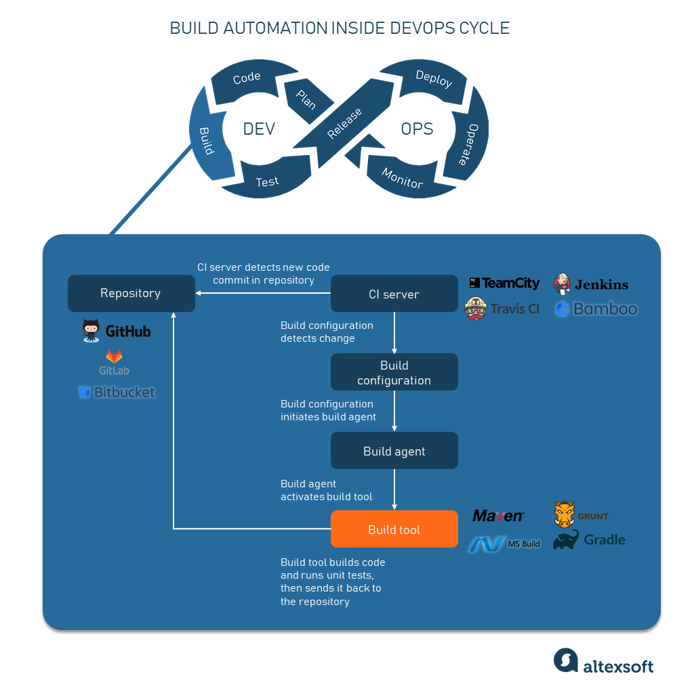
Jenkins Alternatives
Jenkins has a number of competitors on the market, including GitLab CI/CD, Travis CI, CircleCI, and Bamboo. Every option has distinct features, varying pricing structures, and integrations to meet various needs and tastes. Based on attributes like scalability, user-friendliness, and compatibility with current tools in their DevOps stack, users can compare and contrast various CI/CD technologies.
15
Notes:
Image source: https://www.altexsoft.com/blog/engineering/cicd-tools-comparison/

Slide 17
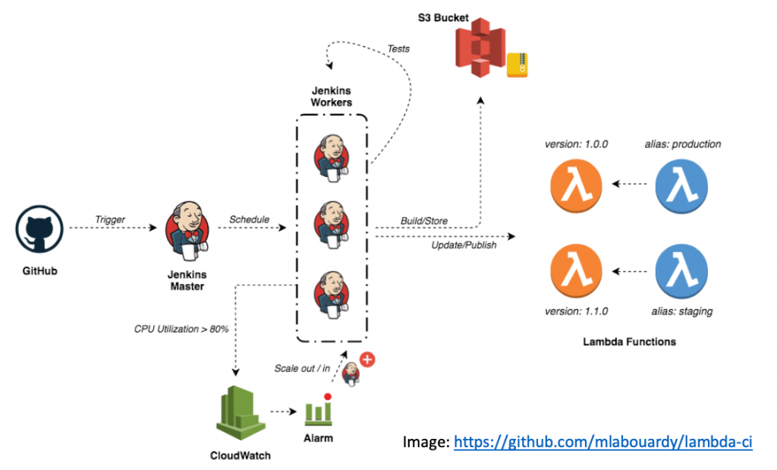
Jenkins Future Trends
Jenkins is always changing to keep up with the ways that software development methods and DevOps are evolving. Improved security features, increased support for cloud-native technologies, and interaction with new tools and platforms are some of the future developments for Jenkins. Jenkins is anticipated to continue being a well-liked option for DevOps pipeline automation because of its adaptability, extensibility, and robust community support.
16
Notes:
Image source: https://aws.amazon.com/blogs/opensource/why-jenkins-still-continuously-serves-developers/

Slide 18
Jenkins Cost and Licensing
Jenkins is an open-source program that can be used, altered, and shared without restriction thanks to the MIT license. Jenkins is an affordable automation solution because users may download and install it for free without having to pay any license costs. Nevertheless, Jenkins hosting on cloud platforms, infrastructure management, and the acquisition of premium plugins or support services may come at a cost to customers.
17
Notes:
Image source: https://www.youtube.com/watch?v=d_dvANdV6J4

Slide 19

Jenkins Training and Certification
To study Jenkins and become an automation expert, there are numerous online tutorials, courses, and certifications accessible. Jenkins administration, troubleshooting, and best practices are validated by official certificates such as Certified Jenkins Engineer (CJE). Accredited suppliers of training programs assist users in developing their Jenkins abilities and advancing their DevOps and automation careers.
18
Notes:
Image source: https://www.educationplans.us/online-education/is-online-training-mandatory-for-the-worksite.html

Slide 20
Jenkins Success Stories
Numerous establishments have effectively integrated Jenkins into their DevOps processes to get expedited delivery, enhanced quality, and decreased labor intensity. Jenkins is used by businesses like Google, Netflix, and eBay to automate software development processes and guarantee continuous integration and deployment.
19
Notes:
Image source: https://www.aiophotoz.com/photos/cicd-series-part-1-how-to-build-a-cicd-pipeline-using-jenkins.html

Slide 21
Conclusion
Jenkins is an extremely useful automation tool that is essential for expediting software delivery and optimizing DevOps procedures. Organizations of all sizes use it because of its strong community support, extensibility, and broad feature set. Teams may accelerate the time-to-market for their apps, boost productivity, and automate tedious operations by utilizing Jenkins.
20
Notes:
Image source: https://cloudify.co/blog/jenkins-ci-server-automation-cloud-cd-continuous-integration-delivery/

Slide 22
References
Jenkins Official Website. https://www.jenkins.io/
Jenkins Documentation. https://www.jenkins.io/doc/
Jenkins Plugin Repository. https://plugins.jenkins.io/
21

