Slide 1
Global Airfoil Shape Optimization with Swarm Intelligence
Karan Chawla
AE-416

Slide 2
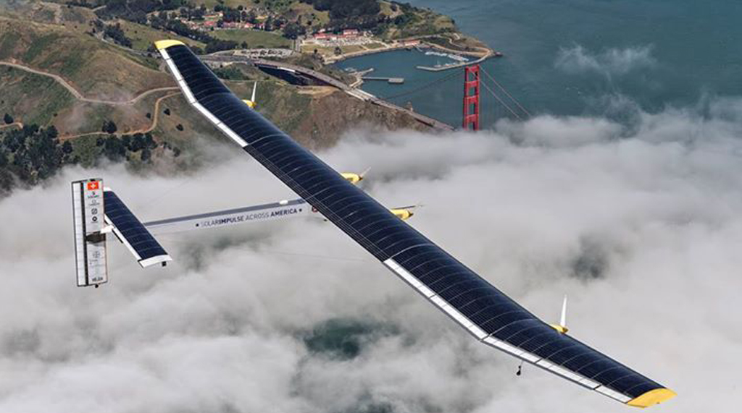
Why Optimization?
Highly optimized designs
Fuel Efficiency
Other design/system level goals
Solar Impulse

Slide 3
Airfoil Parametrization
Why do it?
Curse of dimensions
Parameters that define global shape
Interpolate with an nth order polynomial

Slide 4
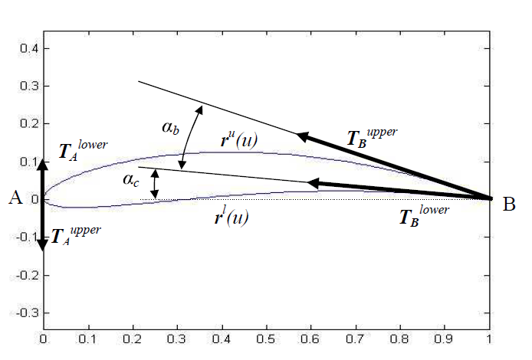
Ferguson Splines

Slide 5
Particle Swarm Optimization (PSO)
Inspired from nature: bird flocking, ant colony behaviour etc.
Combination of every member’s experience and swarm’s experience as a whole – “swarm intelligence”

Slide 6
Particle Swarm Optimization
Each particle consists of:
Data representing a possible solution
Velocity value
Particle Best

Slide 7

Particle Swarm Optimization
Consists of 3 main steps:
Generating the position and velocity of each particle
Updating the velocity
Changing the position

Slide 8
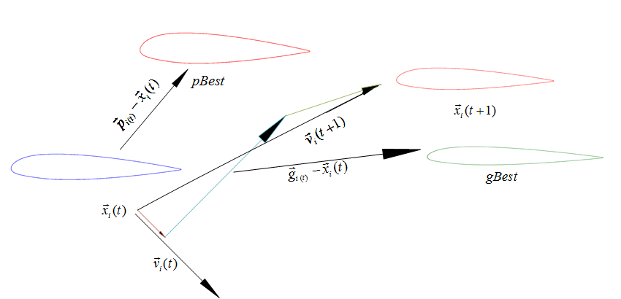
Shape Optimization Process

Slide 9
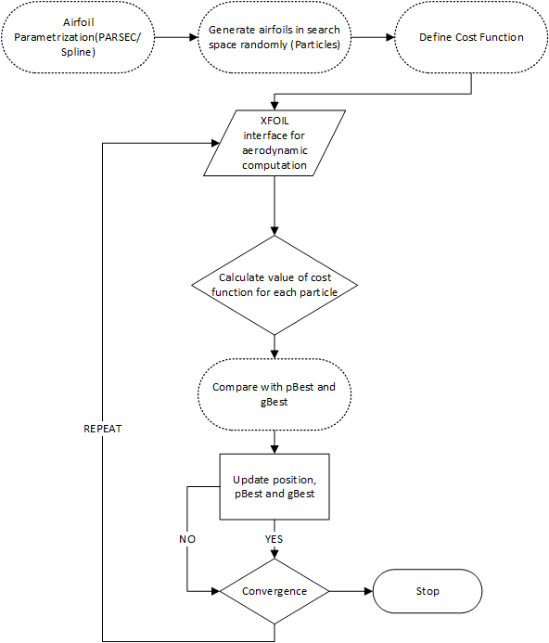
Architecture

Slide 10
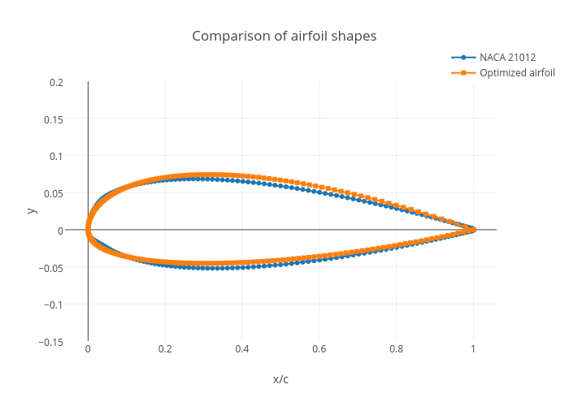
Case Study
Cost Function: max(Cl/Cd)
Reynolds Number: 1E6
Angle of attack: 4 deg
Starting Airfoil: NACA 21012

Slide 11
Simulation

Slide 12
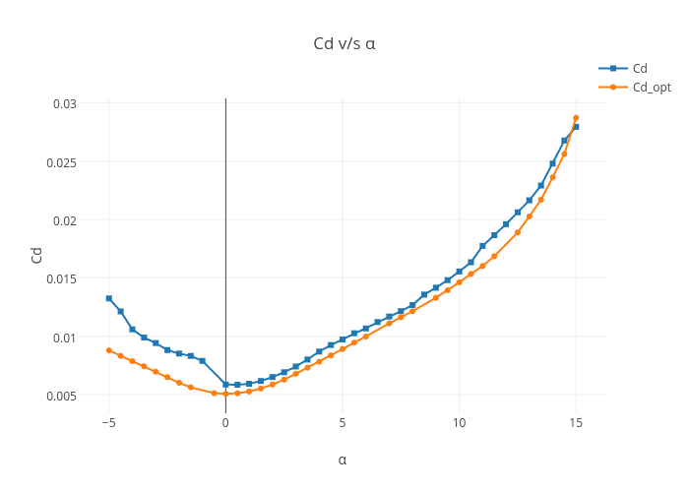
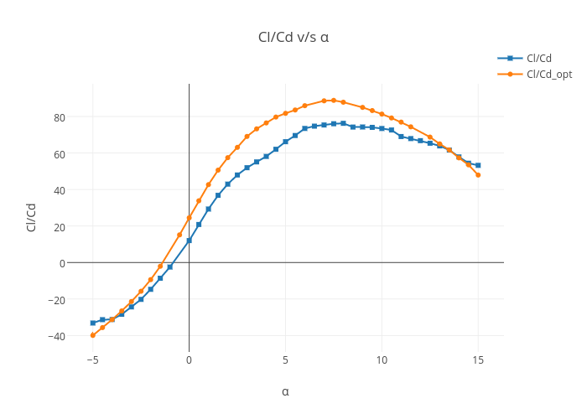
Reduced Drag
Improved Cl/Cd

Slide 13
Thank you

