Slide 1
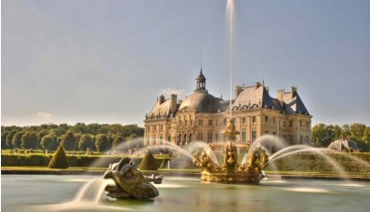
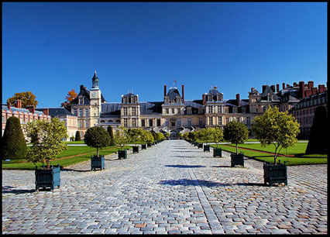
Palace of Fontainebleau
The earliest record of a fortified castle at Fontainebleau dates to 1137.
It became a favorite residence and hunting lodge of the Kings of France because of the abundant game and many springs in the surrounding forest.
It took its name from one of the springs, the fountain de Bliaud, located now in the English garden, next to the wing of Louis XV.
It was used by King Louis VII, for whom Thomas Becket consecrated the chapel in 1169; by Philip Augustus; by Louis IX, or Saint Louis, who built a hospital and a convent, the Couvent des Trinitaires, next to the castle; and by Philippe le Bel, who was born and died in the castle.
Architect:
Philibert de l'Orme
Sebastiano Serlio
Gilles Le Breton
Jean Bullant

Slide 2
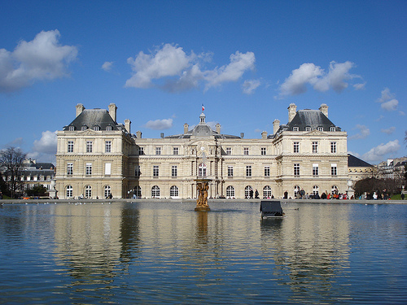
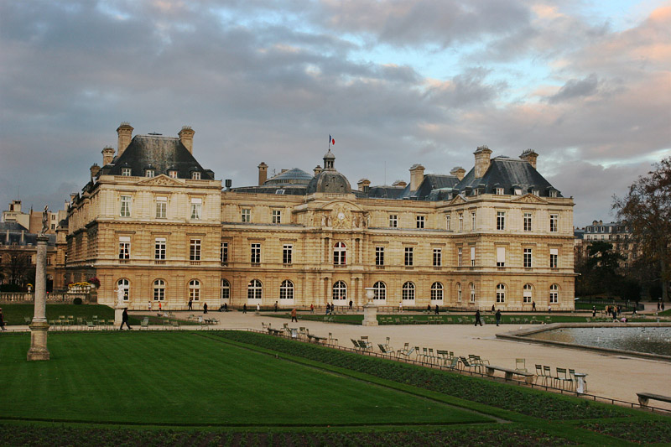
Luxembourg Palace
The Luxembourg Palace is located at 15 rue de Vaugirard in the 6th arrondissement of Paris.
It was originally built (1615–1645) to the designs of the French architect Salomon de Brosse to be the royal residence of the regent Marie de' Medici, mother of Louis XIII of France.
After the Revolution it was refashioned (1799–1805) by Jean Chalgrin into a legislative building and subsequently greatly enlarged and remodeled (1835–1856) by Alphonse de Gisors.
Since 1958 it has been the seat of the French Senate of the Fifth Republic.
Immediately west of the palace on the rue de Vaugirard is the Petit Luxembourg, now the residence of the Senate President; and slightly further west, the Musée du Luxembourg, in the former orangery.
On the south side of the palace, the formal Luxembourg Garden presents a 25-hectare green parterre of gravel and lawn populated with statues and large basins of water where children sail model boats.
Architect: Salomon_de_Brosse

