Slide 1
HTML5 LocalStorage Security : A Survey
Karan Desai

Slide 2
Topics to be covered
HTML5 LocalStorage Introduction
Possible applications
Comparison to similar implementations
Security Issues
Possible solutions
Implementation
JavaScript cryptography

Slide 3
Why HTML5
First, what is HTML5? – CSS+JavaScript+HTML
The New HTML Standard
Life without plugins
It is also cross-platform
Still work in progress

Slide 4
What is LocalStorage?
Standardized way of providing larger amounts of client-side storage
Two types of HTML5 Client Side storage
1. Local Storage
2. Session Storage
Without HTML5, client-side storage for web applications is limited to the tiny storage provided by cookies

Slide 5
Browser Support
All major browsers on all kinds of devices support HTML5 LocalStorage
IE | FIREFOX | SAFARI | CHROME | OPERA | IPHONE | ANDROID
8.0+ | 3.5+ | 4.0+ | 4.0+ | 10.5+ | 2.0+ | 2.0+

Slide 6
Difference
Storage Type | Max Size | Persistence | Availability to other Windows/tabs | Data Type Supported
LocalStorage | 5MB per app per browser ( browsers decide the standard ) | On disk until deleted by user (delete cache) or by the app | Shared across every window and tab of one browser running same web app | String only, as key-value pairs
SessionStorage | Limited only by system memory | Survives only as long as its originating window or tab | Accessible only within the window or tab that created it | String only, as key-value pairs

Slide 7
Similar Ideas
IndexedDB
WebSQL
Flash Client side storage

Slide 8
Why LocalStorage
It is very easy to implement.
It uses strings for storage instead of complex databases (and you can store more complex data using JSON encoding)
It is well supported by browsers (desktop and mobile) and endorsed by companies
A lot of storage space (5 MB, much more than cookies)
On the client side, which means significantly speed up display times and less network traffic
Persists beyond a page refresh, browser restart and even system restart
No transition to the server helps security
Think of LocalStorage as “cookies on steroids”
(Cookies are so 1994)

Slide 9
Are any websites actually using it?
Web Privacy Census by Berkeley Law - A study about privacy and tracking
Most Popular 100 Sites – 38 were using it
Conclusion
“In this first update to our original June 2012 Web Privacy Census, we observed statistically significant increases in the amount of tracking on all three of our samples--the top 100, 1,000, and top 25,000 websites. Flash cookies use is declining among the most popular websites, and HTML5 local storage is rising across all three groups”
Chris Jay Hoofnagle & Nathan Good, The Web Privacy Census , October 2012, available at http://law.berkeley.edu/privacycensus.htm

Slide 10
What do websites use it for?
Consider this from YouTube's local storage
{"data":"{\"clickindex\":0,\"items\":[{\"type\":\"video\",\"id\":\"ZsupViGHy_0\",\"time\":\"0:59\",\"title\":\"Auburn defeats Alabama - Chris Davis returns missed field goal 100+ yards for winning TD - Iron Bowl\",\"user\":\"Sports Entertainment Network\",\"views\":\"1,985,273 views\"},{\"type\":\"video\",\"id\":\"Dd7dQh8u4Hc\",\"time\":\"10:46\",\"title\":\"Why Are Bad Words Bad?\",\"user\":\"Vsauce\",\"views\":\"4,003,527 views\"},{\"type\":\"video\",\"id\":\"_VrzqHqwp5E\",\"time\":\"1:13\",\"title\":\"Turkey Bomb Prank!!\",\"user\":\"RomanAtwood\",\"views\":\"4,451,700 views\"},{\"type\":\"video\",\"id\":\"wvBOUy9E5Qw\",\"time\":\"3:04\",\"title\":\"Shredding Broken Laptops and Computer Parts for Gold Recycling with a Mitts & Merrill Shredder\",\"user\":\"Recycling Equipment\",\"views\":\"753,123 views\"},{\"type\":\"video\",\"id\":\"8GKmkD1pUG0\",\"time\":\"1:12\",\"title\":\"#Auburn's Final Play in Iron Bowl: Chris Davis Return for TD\",\"user\":\"Auburn Athletics\",\"views\":\"416,482 views\"}

Slide 11
General Uses
Current Web Sites generally use it for
Tracking
Preferences
Recent Clicks
Ads
Easy IP Visit counts
Sessions (Yes, Sessions)

Slide 12
Example

Slide 13
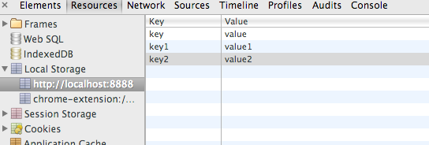
Developer Console

Slide 14
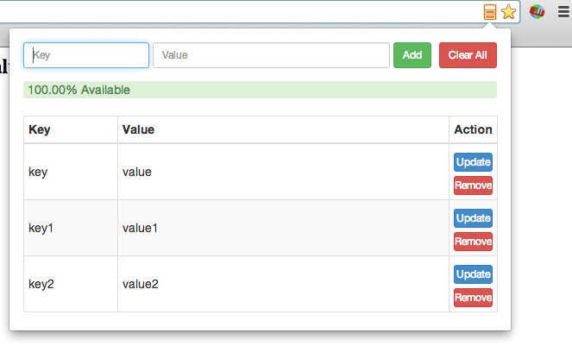
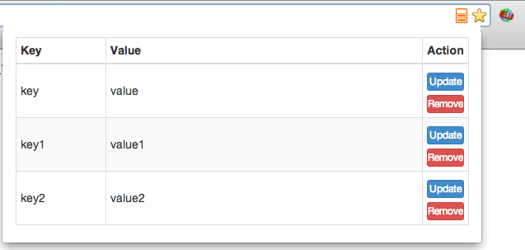
Extension

Slide 15
Security

Slide 16
LocalStorage is Not Secure Storage
It was not meant to be secure as per the definition
HTML5 local storage saves data unencrypted in string form in the regular browser cache.
It should not be used for sensitive data, such as social security numbers, credit card numbers, logon credentials, and so forth.

Slide 17
Lets see how it is secured
The only security it has it the browser’s SOP ( Same Origin Policy )

Slide 18
So why are talking about its security??
It should not be storing information in plain text
As it stands it can be a threat if your web application is vulnerable to attacks to Cross Site Scripting (XSS) and others
Privacy issue
That’s it? – Mostly
We are trying to secure it because if we can, we can do much more with it
(More in applications)

Slide 19
Sample XSS
Inject a script like
for (i=0; i<localStorage.length; i++)
{
key = localStorage.key(i);
pairs += "key:"+key+" value:"+localStorage.getItem(key);
}
alert(pairs);
//Instead of alert you can send it somewhere
How – via Form fields, URLs , get user to click your ad , etc

Slide 20
How big is XSS?
XSS still remains a top security vulnerability
WhiteHat’s report in May 2013 states 43% vulnerabilities discovered are still XSS (followed by information leak)
In the OWASP Top 10 XSS makes it to top 3 every time
Facebook's XSS issues weren't resolved until 2008, and Twitter's weren't resolved until 2010
With constant website evolution you can never guarantee anything

Slide 21
Securing Local Storage
Encrypted text instead of plain text
Encryption key on client side is very important
Defense against editing or removing entries

Slide 22
Solution 1 Intelligent Server

Slide 23
Steps
Server Encrypts all local Storage data before sending it
Hash it for authenticity checks later
Encrypt with user’s password for your website. Not just password but something like PBKDF2 (Password-Based Key Derivation Function 2)
Client decrypts by making user enter his password

Slide 24
How good is this?
It is actually quite secure
Local Storage has now become a glorified cookie
Whatever happens, your data is secured
But do you really want the user to enter the password to decrypt? Or store password? -NO
Alternative – use SSL to transfer passwords
Problem – Server involvement

Slide 25
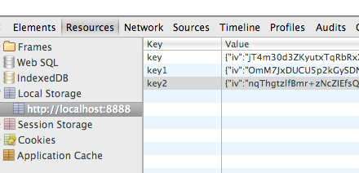
Console after Encryption

Slide 26
Solution 2
Browser Extension

Slide 27
Steps
A chrome extension now replaces the inbuilt function on the client side to perform localstorage.getItem/localstorage.setItem
(can an extension do that?)
These functions perform the encryption-decryption as well with normal read-write
It also does the same type of hashing
The cookie is used as the password
It uses sjcl.js as a cryptographic library

Slide 28
How good is this?
It is completely independent of implementation
Is it more secure than solution 1? –NO
Prevents editing/deletion
It depends on the cookie and how good is your website in protecting the cookie
Using the HttpOnly flag for cookies will prevent most XSS attacks
It is actually useless under a high threat scenario

Slide 29
YouTube’s LocalStorage

Slide 30
Is it all good now?
No, we need something better

Slide 31
Related work
“Privilege Separation in HTML5 Applications“
Devdatta Akhawe, Prateek Saxena, Dawn Song University of California, Berkeley
A very good idea about separating parts of the application into parent/children and the children are unprivileged
Everything goes through the parent which decides whether to allow action based on security policy
So would it work for our case? – Yes, it could work. But requires quite a lot of changes to the code and solution 1 seems better and simpler

Slide 32
Enhancement
Fake Privilege separation
The chrome extension that we built injects the new functions in way that confuses JavaScript scope of getItem. All writes to local storage get encrypted but not all reads are decrypted.
Most XSS attacks occur by appending <scripts> to the HTML
It gives the encrypted form only in this case
Even the console or the extension will not show decrypted text

Slide 33
Final Remarks on its Security
It’s a chicken-egg problem
The browser has to do encryption-decryption
You cannot trust JavaScript for cryptographic purposes
You need proper entropy
Google deprecated the use of native code in extensions – otherwise one could use it for proper cryptography

Slide 34
Applications
Permanently bound sessions
Store sensitive information
Would you trust Amazon to store your details or your device?
Detailed user history
Less ads and spam
Client customized page
Wishlists/Shopping carts
It has 5MB of available space ( can be hacked to extend, proven for chrome )

Slide 35
Questions? Thank you

