Slide 1
Attrition Prediction
Factors affecting attrition and predicting whether employees will leave the company or not.

Slide 2
Problem
Following attributes are available for every employee.
Satisfaction Level
Last evaluation
Number of projects
Average monthly hours
Time spent at the company
Whether they have had a work accident
Whether they have had a promotion in the last 5 years
Departments (column sales)
Salary
Objective
What type of employees are leaving? Determine which employees are prone to leave next.

Slide 3
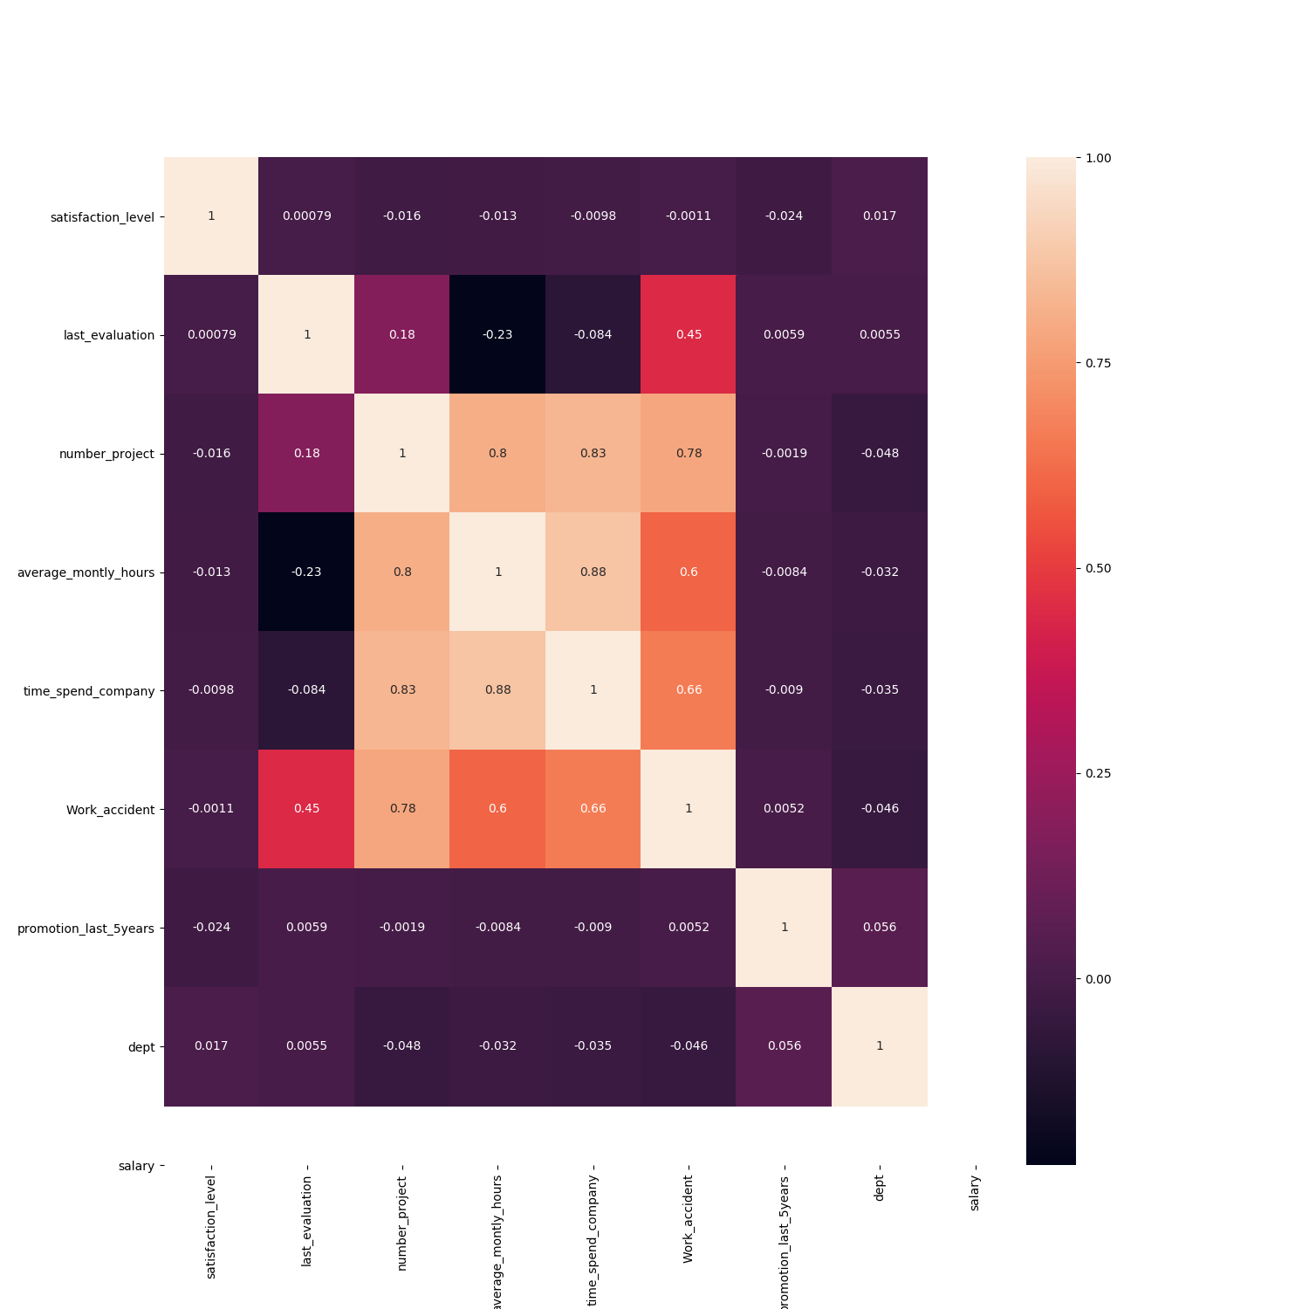
Observations
Heatmap of all the features which
helps in analysing which features are the
most important in predicting attrition.
As we can see Number of projects,
average monthly hours spend in
office and time spend in the company
are the crucial factors which help in
determining whether the employee will
leave the company or not.

Slide 4
Proposed Solution
After researching about various algorithms, the best one to use here was One Class SVM because the data provided didn’t have the final classes and hence was difficult to train normally.

Slide 5
Solution
One Class SVM
Accuracy on test cases (calculated on Employees that left) : 60% (0.608938547486)
Percentage of employees that can leave the company (calculated on existing employees sheet) : 3% (3.82394119706)

Slide 6
Thank you

