Slide 1




Apache ZooKeeper Assignment 2 Distributed Systems - CS7NS6 Group 9 Submitted by: Anastasiia Khomenko (22304231) Charbel Nebo (18324228) Karan Dua (21331391) Shauna Gurhy (18324848)

Slide 2
Introduction:
What is Apache ZooKeeper?
“ZooKeeper is a centralized service for maintaining configuration information, naming, providing distributed synchronization, and providing group services.”
Provides a simple set of primitives which can be built on by individual applications
Created at Yahoo!
Hunt, P., Konar, M., Junqueira, F.P. and Reed, B., 2010, June. ZooKeeper: wait-free coordination for internet-scale systems. In USENIX annual technical conference (Vol. 8, No. 9).
What it is not
Not purely a data storage/management system
Only configuration data is stored
Replication is not costly because there is only a small amount of configuration data
Expected Usage Patterns
As a configuration service, it is quite read dominant
High performance and throughput
General
Reusable in many different applications
Notes:
https://zookeeper.apache.org/
Replication → Reliability
Every write provokes many processes to read and update configuration data

Slide 3
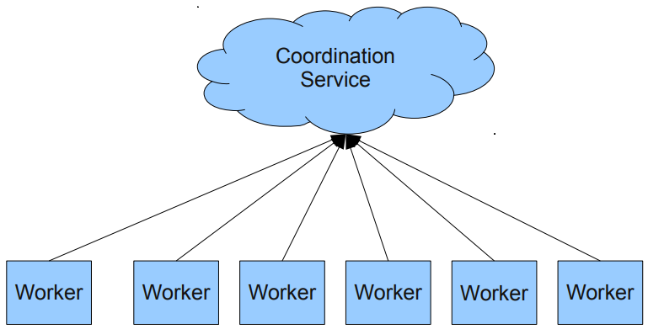
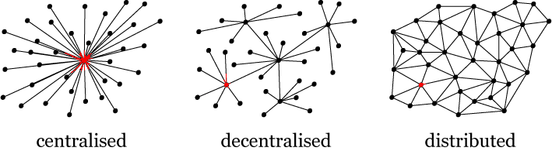
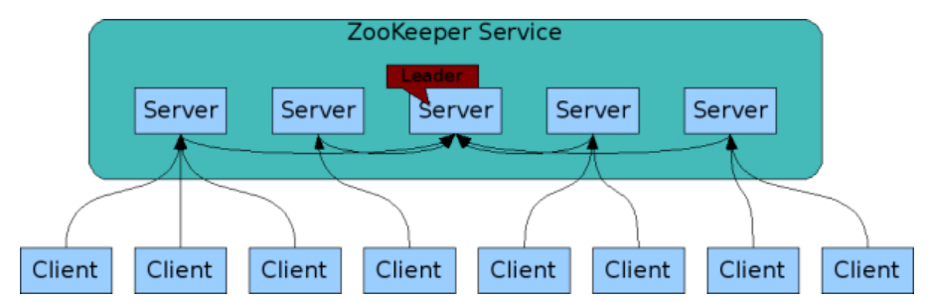
Apache ZooKeeper:
Centralised or Distributed System?
Centralised or Distributed?
Control vs Structure
Centralised
Central repository of configuration information
Distributed
Ensemble of servers used to attain high availability
It is both centralised and distributed
Image Source: Google

Slide 4
Introduction:
Why should ZooKeeper be used?
Fully functioning distributed systems are notoriously challenging to implement correctly
Synchronisation, resource management etc.
As a coordination service, Zookeeper speeds up and eases the process of developing distributed systems
Application programmers can focus on application
No need to create coordination service from scratch
Ubiquitous in industry
Open source
Acts as an API to a centralised coordination service
Written in Java
Also has an official C library
Widely used in industry
Relieves complexity in managing the coordination service
General
Tackles the fundamental problems in distributed systems
Flexible
Notes:
Problems with DS as seen in lectures →Race conditions, deadlocks, inconsistency
General → Most systems deal with the same issues
flexible?

Slide 5
“Primitive” Operations in a Distributed System
Master Election
- One node registers itself as master and holds that lock. No other node can become “Master” till that lock is held.
- Only one node can hold that lock
Crash Detection
- Identify when a node has crashed when it has disconnected or failed to refresh itself after some time-out period
Group Management
- List of worker available in pool
ZooKeeper provides a more general purpose system that makes it easy
for application to implement them

Slide 6
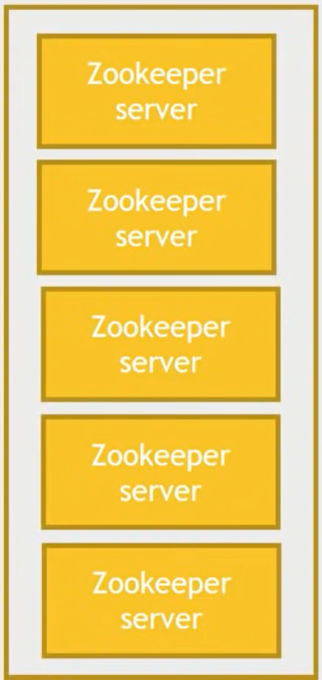
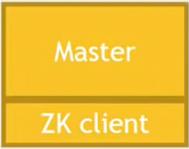
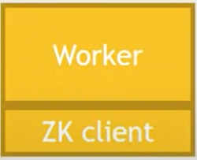
The Architecture
ZooKeeper Ensemble
Key Components:
Application
ZooKeeper Ensemble
- Cluster of ZooKeeper server
- Minimum nodes required to
form ensemble is 3
ZooKeeper Server
- Provides all services to ZK
Clients
- Gives acknowledgment to ZK
Clients
ZooKeeper Client
- A Node in distributed
application cluster
- Access information from the
server

Slide 7
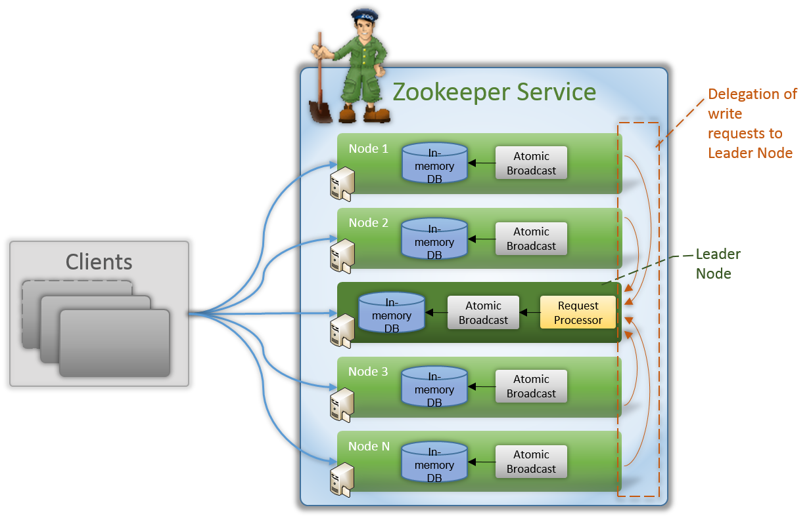
The Architecture
Leader Node
- Responsible for coordinating and managing the distributed
state of the cluster.
- Handle client requests, maintain the consistency of the
data stored in the ensemble, and managing the
replication of data across the nodes in the ensemble.
- Also responsible for detecting and handling failures in
the ensemble, including detecting when a node has
Gone offline or has become unresponsive.
Follower Node
- Responsible for handling the read requests.
- Delegate all write requests to Leader node.
- Replicate the data stored in the leader node.
- Ensure that the system remains highly available, reliable, and
consistent even in the face of node failures or other types of
disruptions.
How does it work
- Leader is not set while setting up the ZooKeeper
- All nodes participate in Leader Election process using
Leader Election Protocol (Concept of Majority).
- Followers elect new Leader if existing Leader goes down.
Image Source: Google

Slide 8
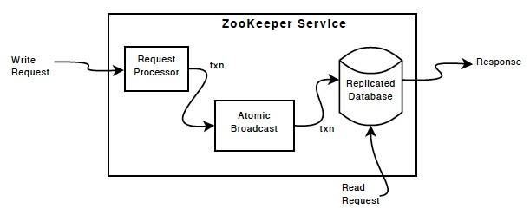
The Architecture
Request Processor
- Active only on Leader node.
- Responsible for processing Write request from Client or Follower node.
- After processing, it broadcasts changes to follower nodes to update their state
accordingly.
Atomic Broadcast
- Present in both Leader node and Follower node.
- Responsible for sending updates to client.
- Also responsible for receiving changes from Leader node to Follower node
(Internal Updates).
Replicated Database
- It is an In-Memory Database responsible for storing data.
- Every node has its own DB to serve read requests.
- It is a small database which can be used to store configuration related data.
Image Source: Google

Slide 9
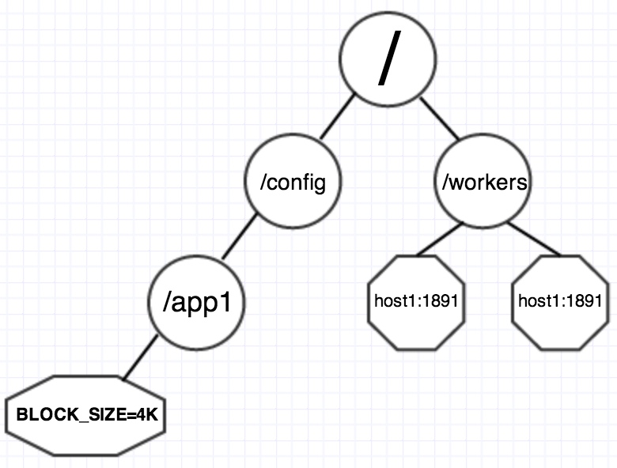
The Architecture
The ZooKeeper Data Model
- Namespace provided by ZooKeeper is like standard OS file system.
- Root folder starts with /.
- Every node in ZooKeeper starts with / followed by its name.
- Every node in ZooKeeper is identified using path and referred as Znode.
- The data model works on absolute path and not on relative path.
Types of ZNodes
Persistence ZNodes or Regular nodes
- These nodes remain alive until these are explicitly deleted.
- These are the most common type of znodes and are used to store data in ZooKeeper.
- Regular znodes can have child nodes, and each node can store up to 1 MB of data.
Ephemeral ZNodes
- These are created by a client and exist only as long as the client's session is active.
- These are useful for implementing distributed locks and managing cluster membership.
Container ZNodes
- These are a special type of ZNode that can store large amounts of data (up to 1 GB).
- These are useful for storing large files and other types of data that cannot be easily split into
smaller pieces.
Overall, the different types of ZNodes in ZooKeeper provide a flexible and powerful mechanism for storing and managing data in a distributed system. By choosing the appropriate type of ZNode for each use case, developers can build highly scalable and reliable distributed applications using ZooKeeper.
Image Source: Google

Slide 10

The Architecture
Notifications/Watches – The most important feature
- It is a mechanism for clients can for notifications on a ZNode about the
changes in ZooKeeper.
- Avoids continuous polling
- Client can set watches while reading a particular ZNode.
- ZNode sends notifications to watchers if there are any changes in the data
associated with ZNode or changes in ZNode Children.
- Watches are triggered only once.
Image Source: Google

Slide 11
Design Goals
ZooKeeper is simple:
ZK allows distributed processes to coordinate with each other through a shared hierarchical namespace which is organized similarly to a standard file system.
The ZK implementation puts a premium on high performance, highly available, strictly ordered access. The performance aspects of ZK means it can be used in large, distributed systems. The reliability aspects keep it from being a single point of failure. The strict ordering means that sophisticated synchronization primitives can be implemented at the client.
ZooKeeper is replicated:
Replicated over a set of hosts called an ensemble. The servers maintain an in-memory image of state, along with a transaction logs and snapshots in a persistent store.
ZooKeeper is ordered:
ZK stamps each update with a number that reflects the order of all ZK transactions. Subsequent operations can use the order to implement higher-level abstractions, such as synchronization primitives.
ZooKeeper is fast:
It is especially fast in "read-dominant" workloads. ZK applications run on thousands of machines, and it performs best where reads are more common than writes, at ratios of around 10:1.

Slide 12
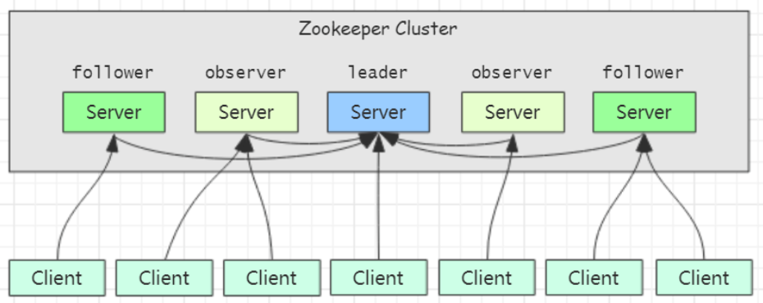
Design Choices: Scalability
Scalability is an important aspect of any distributed system, as it allows the system to grow and adapt to changing demands.
Clients can connect to any servers that make up ZK. When a ZK server receives a “read” request it is serviced from a local copy of the system state. “Write” requests are forwarded to the leader. This gives nice scalability on the reads and linearisability on the writes.
ZK performs very well having clients connect directly to voting members of the ensemble, however, this architecture makes it hard to scale out to huge numbers of clients. The problem is that as more voting members are added, the write performance drops. This is because a write operation requires the agreement of at least half the nodes in an ensemble and therefore the cost of a vote can increase significantly as more voters are added.
Observers: Scaling ZooKeeper Without Hurting Write Performance
A new type of ZK node called an Observer is introduced to address this problem and improve ZK’s scalability.
Observers are non-voting members of an ensemble which only hear the results of votes, not the agreement protocol that leads up to them. Other than this, Observers function exactly the same as Followers
Advantage: Observers are not a critical part of the ZK ensemble as they don’t vote. They can fail, or be disconnected from the cluster, without harming the availability of the ZK service.
Image Source: Google
Notes:
The motivation behind the development of ZooKeeper was to address the need for a scalable and reliable coordination service for distributed systems. With its simple, unified interface and robust feature set, ZooKeeper has become an indispensable tool for building and maintaining distributed systems at scale.
Scalability is an important aspect of any distributed system, as it allows the system to grow and adapt to changing demands.
A new type of ZK node called an Observer is introduced to address this problem and improve ZK’s scalability.
Observers are non-voting members of an ensemble which only hear the results of votes, not the agreement protocol that leads up to them. Other than this, Observers function exactly the same as Followers - clients may connect to them and send read and write requests to them. Observers forward these requests to the Leader like Followers do, but they then simply wait to hear the result of the vote. Because of this, the number of Observers can be increases as much as needed without harming the performance of votes.
Advantage: Observers are not a critical part of the ZK ensemble as they don’t vote. They can fail, or be disconnected from the cluster, without harming the availability of the ZK service. The benefit to the user is that Observers may connect over less reliable network links than Followers. Observers may be used to talk to a ZK server from another data center. Clients of the Observer will see fast reads, as all reads are served locally, and writes result in minimal network traffic as the number of messages required in the absence of the vote protocol is smaller.
https://zookeeper.apache.org/doc/r3.5.10/zookeeperObservers.html

Slide 13
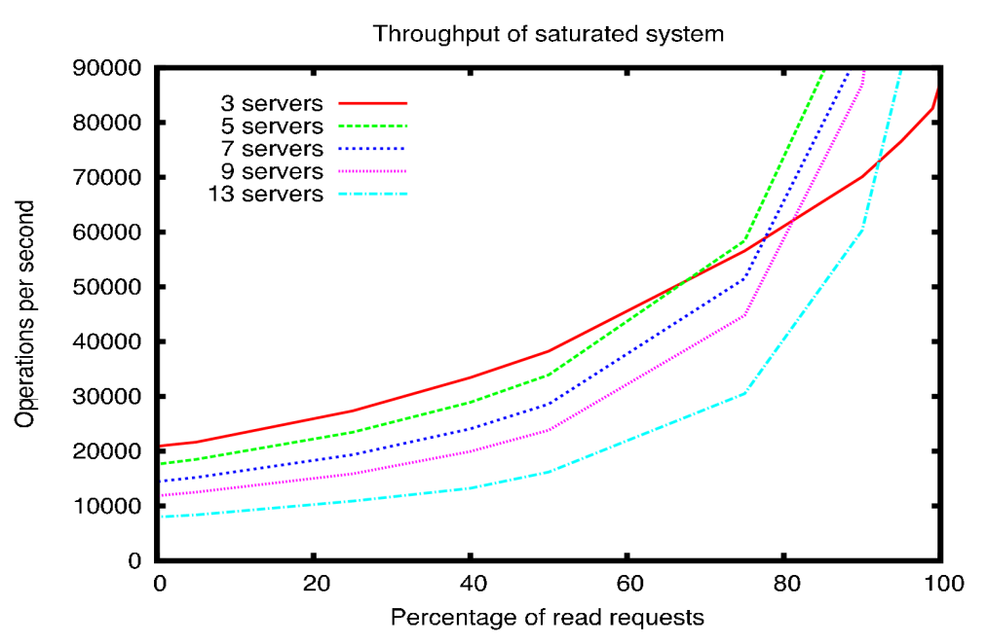
Design Choices: Performance
ZooKeeper is designed to be high performance.
It is especially high performance in applications where reads outnumber writes, since writes involve synchronizing the state of all servers. (Reads outnumbering writes is typically the case for a coordination service.)
Performance is great!
Target workload is really 90% and above, in the figure we can see for that workload, performance is very high, even considered higher than the applications needs according to Yahoo!
Figure shows Operations per second VS Percentage of reads to writes requests
Image Source: Google
Notes:
The ZK Throughput as the Read-Write Ratio Varies graph is a throughput graph of ZooKeeper release 3.2 running on servers with dual 2Ghz Xeon and two SATA 15K RPM drives. One drive was used as a dedicated ZooKeeper log device. The snapshots were written to the OS drive. Write requests were 1K writes and the reads were 1K reads. "Servers" indicate the size of the ZooKeeper ensemble, the number of servers that make up the service. Approximately 30 other servers were used to simulate the clients. The ZooKeeper ensemble was configured such that leaders do not allow connections from clients.

Slide 14
Design Choices: Availability
The ZK service comprises an ensemble of servers that use replication to achieve high availability and performance.
ZK uses a replication, where multiple servers work together to maintain a consistent view of the system's state. In the event of a failure, ZK is able to automatically elect a new leader and continue providing service without interruption.
The servers must all know about each other. They maintain an in-memory image of state, along with a transaction logs and snapshots in a persistent store. As long as a majority of the servers are available, the ZooKeeper service will be available.
Image Source: Google
Notes:
ZooKeeper is designed to be highly available, meaning that it is able to provide a consistent service even in the face of failures or network partitions. To achieve this, ZooKeeper uses a replicated state machine approach, where multiple servers work together to maintain a consistent view of the system's state. In the event of a failure, ZooKeeper is able to automatically elect a new leader and continue providing service without interruption.

Slide 15
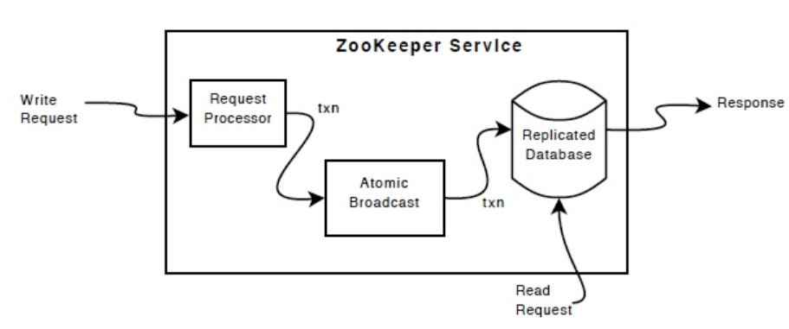
Design Choices: Reliability
ZK has a small set of Guarantees, one of which is Reliability - Once an update has been applied, it will persist from that time forward until a client overwrites the update.
ZK Achieves reliability through:
Replication: Replicates data over ensemble. Ensures that the system can continue to operate even if one or more nodes fail
ZAB (ZooKeeper Atomic broadcast): Updates are delivered to all nodes in the cluster in the same order. (consistent state)
Write-ahead log: A replay log of committed operations is kept and periodic snapshots of the in-memory database are generated.
Each of the servers that make up the ZK service replicates its own copy of each of the components (exception: the request processor).
Image Source: Google
Notes:
Like the distributed processes it coordinates, ZooKeeper itself is intended to be replicated over a set of hosts called an ensemble.
ZooKeeper achieves reliability through several mechanisms, including:
Replication: ZooKeeper replicates data over a set of hosts called an ensemble to ensure that there are multiple copies of the data available. This ensures that the system can continue to operate even if one or more nodes fail. The replicated database is an in-memory database containing the entire data tree.
Atomic broadcast: ZooKeeper uses an atomic broadcast protocol to ensure that updates are delivered to all nodes in the cluster in the same order. This helps to ensure that the state of the system remains consistent across all nodes.
Write-ahead log: ZooKeeper uses a write-ahead log to ensure that updates are durable and recoverable in the event of a failure. The write-ahead log is stored on disk, and updates are only considered complete once they have been written to the log.

Slide 16
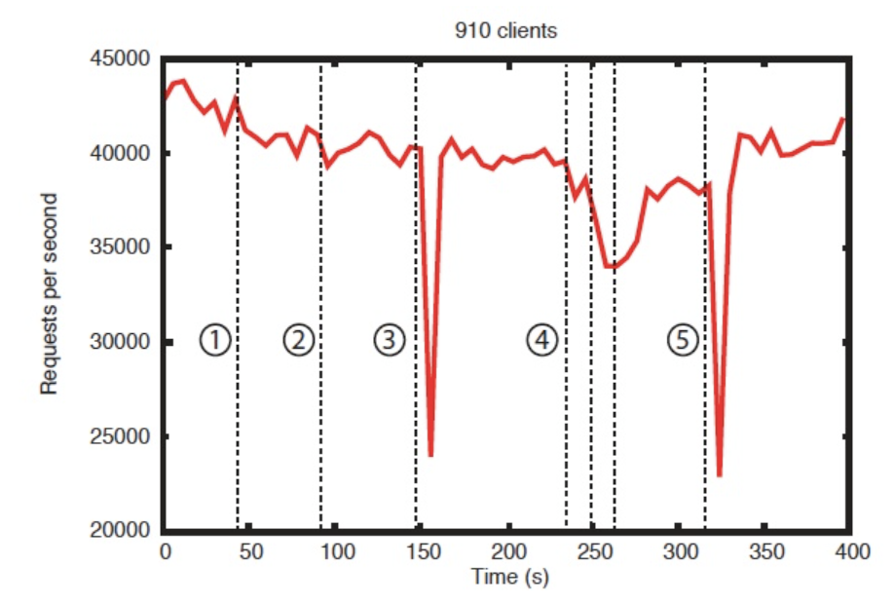
Design Choices: Reliability
Reliability in the Presence of Errors shows how a deployment responds to various failures. The events marked in the figure are the following:
Failure and recovery of a follower
Failure and recovery of a different follower
Failure of the leader
Failure and recovery of two followers
Failure of another leader
Important observations from this graph:
If followers fail and recover quickly, then ZK is able to sustain a high throughput despite the failure.
The leader election algorithm allows for the system to recover fast enough to prevent throughput from dropping substantially. (ZK takes less than 200ms to elect a new leader. )
As followers recover, ZK is able to raise throughput again once they start processing requests.
Image Source: Google

Slide 17
Design Choices: Consistency
ZK is very fast and very simple. Since its goal, is to be a basis for the construction of more complicated services, such as synchronisation, it provides a set of guarantees. One of these guarantees is Sequential Consistency - Updates from a client will be applied in the order that they were sent.
ZK stamps each update with a number that reflects the order of all ZK transactions. Subsequent operations can use the order to implement higher-level abstractions, such as synchronization primitives.
Strong consistency guarantees, mean that all clients see the same view of the system's state at all times. This is achieved through the use of a write-ahead log and a consensus protocol ZAB (ZooKeeper Atomic Broadcast), which ensures that all updates to the system are ordered and processed in the same order by all servers.

Slide 18







Major Platforms Using ZooKeeper
Image Source: Google

Slide 19
ZooKeeper Use Cases at Twitter
Manhattan, Twitter’s in-house key-value database, stores its cluster topology information in ZooKeeper.
EventBus, Twitter’s pub-sub messaging system, stores critical metadata in ZooKeeper and uses ZooKeeper for leader election.
Mesos, Twitter’s compute platform, uses ZooKeeper for leader election.
ZooKeeper is used to store service registry, which is used by Twitter’s naming service for service discovery.

Slide 20
ZooKeeper Use Cases at Netflix
Ensuring the generation of unique values in various sequence ID generators.
Cassandra backups.
Implementing the TrackID service.
Performing leader election with ZooKeeper for various distributed tasks.
Implementing a distributed semaphore for concurrent jobs.
Distributed caching.

Slide 21
ZooKeeper at Meta
Incremental scaling with minuscule failures.
Easy upgrading of hardware and software.
Failures affect only the cell boundary, which affects limited users.
Hosting cells in distributed data centers avoids disasters.
Advantages
Strict ordering guarantees
Thundering herds
Large updates can saturate NICs
Disadvantages

Slide 22
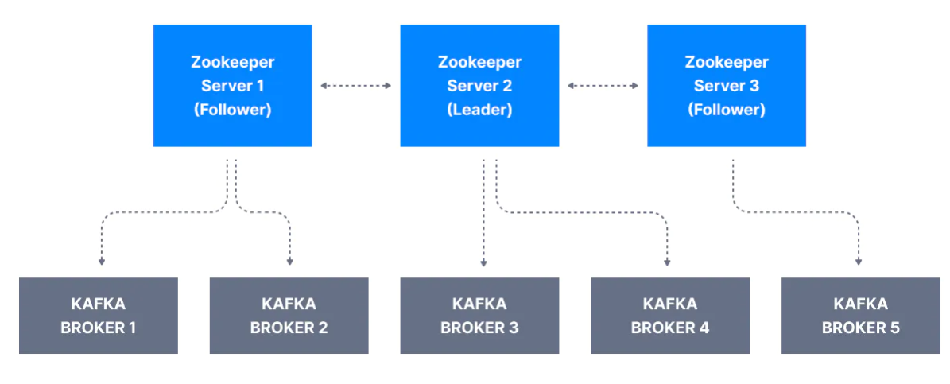
ZooKeeper in Kafka
Keeps track of which brokers are part of the Kafka cluster
Is used by Kafka brokers to determine which broker is the leader of a given partition and topic and perform leader elections
Stores configurations for topics and permissions
Sends notifications to Kafka in case of changes
1
2
3
4

Slide 23
Key Limitations of ZooKeeper
Loss of data when adding new Zookeeper Servers
No Migration
Not offer support for Rack placement and awareness
Prohibition of reducing the number of pods
Cannot switch the service to the host network without a complete reinstall if the service is deployed in a virtual network
Service doesn’t support changing volume requirements once the initial deployment is over
Loss of messages
Complex

