Slide 1
LogiSync
Port-to-Doorstep Delivery Marketplace
Batching, dispatching and tracking 490 delivery requests
across 12 Indian port depots in one marketplace.
PRESENTED BY
[Team Name]
[Institution / Guide]
October 2026
Notes:
Good morning. We are presenting LogiSync, a delivery marketplace we built for India's major port depots. The problem we set out to solve is that freight leaving a port is scheduled over WhatsApp and spreadsheets. LogiSync turns that into a single marketplace where a customer books a delivery, a depot batches nearby stops, a driver claims the run, and the customer watches it arrive live. Everything you'll see today comes from a running system with seeded operational data - 490 requests across 90 days.

Slide 2
THE PROBLEM
Freight leaving a port is still scheduled by hand
• Depots plan runs in spreadsheets - no shared view of what is waiting
• Drivers are phoned one at a time; batch fill stays low
• Customers chase drivers by phone for a delivery status
• Nobody can say why a parcel missed its window
THE COST OF IT
43.0%
average batch fill
half-empty runs burning fuel
21 min
median broadcast to claim
drivers idle, waiting to be asked
53
requests cancelled or failed
untracked in a spreadsheet world
LogiSync - Port-to-Doorstep Delivery Marketplace
2
Notes:
Every one of these numbers is measured from our own analytics, not estimated. A 43 percent batch fill means a driver burns a full run for barely half the payload. Twenty-one minutes from broadcast to claim means a driver sits available before the app even knows they exist. And fifty-three requests ended cancelled or failed, each one a customer who had to ask somebody what happened to their parcel. The root cause is the same in all three: there is no single system of record, so every fact has to be re-established by asking a person.

Slide 3
OBJECTIVES
What we set out to build
01
One marketplace
Customer books, depot batches, driver claims - in the same system
02
Automatic batching
Nearby stops group into runs without anyone sorting them
03
Visible status
Every parcel trackable by the customer, live
04
Honest money
Price and driver pay both derived from weight, handling and distance
05
Measured, not guessed
Analytics over real events, not a spreadsheet
LogiSync - Port-to-Doorstep Delivery Marketplace
3
Notes:
Five objectives. The first two are the product. The third is trust - a customer who can see their parcel does not phone the depot. The fourth is where most projects quietly go wrong: we put the pricing and the driver payout in the same place so they cannot disagree. And the fifth is what let us find the on-time bug - we built the measurement first and it immediately showed us a metric stuck at zero.

Slide 4
PROJECT OVERVIEW
A delivery marketplace, not a tracking viewer
• Four roles, one workflow: customer, fleet manager, driver, port admin
• A request is a priced, paid parcel with a tracking code
• Nearby paid requests become a batch with a driver payout
• A driver claims it, the route is optimised, stops are worked in order
TECH STACK
Frontend
React 19 - TypeScript - Vite - Tailwind - Leaflet
Backend
FastAPI - SQLAlchemy 2.0 - Alembic - Pydantic
Database
SQLite (dev) - PostgreSQL (production) - 9 tables
Realtime
WebSocket hub, targeted per role and per batch
Auth
JWT, role-scoped dependencies, bcrypt hashing
Payments
Razorpay, server-verified (pay-at-depot fallback)
LogiSync - Port-to-Doorstep Delivery Marketplace
4
Notes:
LogiSync models a delivery as a priced, paid parcel, not a truck to watch. That one decision drives everything else. The stack is deliberately ordinary - React and FastAPI - because the interesting work is in the domain model, not the framework. Realtime is a single WebSocket hub that targets events per role and per batch, so a driver only receives the jobs they can actually take.

Slide 5
SYSTEM ARCHITECTURE
Four layers, one direction of truth
CLIENT
APPLICATION
DATA
Consumer portal
Routers
PostgreSQL / SQLite
book - pay - track
auth - consumer - schedules - deliveries - payments - analytics
9 tables - Alembic migrations
Driver app
Schedule engine
Geoapify
claim - route - deliver
auto-attach - lock - complete
geocode - road geometry
Fleet console
Earnings engine
Razorpay
batch - price - dispatch
tier + weight + handling + km
order - verify - webhook
Admin console
Event hub
users - analytics
role-targeted WebSocket
Every write is validated against a server-side status chain. The client cannot advance a parcel the backend will not allow.
LogiSync - Port-to-Doorstep Delivery Marketplace
5
Notes:
Four layers. The important line is the bottom one: every status change is validated server-side against a declared chain. The UI cannot advance a parcel from picked-up straight to delivered, because the API rejects it. That matters most for money - a customer cannot self-cancel once a driver owns the stop, and only the assigned driver can mark it delivered.

Slide 6
WORKFLOW
How a parcel actually moves
1
Customer books
6
Broadcast to drivers
Address, weight, handling`nand a time window
THE GATE THAT MATTERS
Every available driver`is offered the run
Step 4. An unpaid parcel never reaches a driver.
2
Price quoted
7
Driver claims
Server computes tier + weight`+ handling + minimum
Atomic - exactly one`winner, median 21 min
3
Payment captured
8
Route optimised
Razorpay signature verified`nserver-side
Stops sequenced, road`geometry fetched
4
Enters depot queue
9
Out for delivery
Only paid parcels are`dispatchable
Driver contact released`to the customer
5
Fleet manager batches
10
Delivered
Radius + cap, payout`computed per stop
On-time scored against`the promised window
LogiSync - Port-to-Doorstep Delivery Marketplace
6
Notes:
This is the whole system in ten steps. Two of them are ours and unusual. Step 4: an unpaid parcel is filtered out of the depot queue entirely - not shown-and-disabled, absent - so a planner can never build a run around freight nobody has paid for. Step 9: the moment a parcel goes out for delivery the customer receives the driver's phone number, gated on a timestamp that can never be un-set. Step 7 uses a guarded database update, so under contention exactly one driver wins.

Slide 7
FOUR ROLES
One workflow, four very different jobs
Customer
Fleet manager
Driver
Port admin
no login beyond account creation
scoped to one depot_id
scoped to claimed runs
platform-wide, read + audit
Books a delivery, pays, watches it arrive. Sees the driver's number only once the parcel is moving.
Pinned to one depot. Turns nearby paid requests into runs, prices them, and broadcasts.
Claims a run, gets an optimised stop order, works each stop and closes it out.
Provisions fleet managers, audits the network, reads platform-wide analytics.
69 accounts
26 managers - 12 depots
41 drivers - 22 available
1 admin - full scope
Role scoping is enforced on the server, not the client. A fleet manager requesting another depot's analytics gets a 403
and never sees the row.
LogiSync - Port-to-Doorstep Delivery Marketplace
7
Notes:
The same platform, four genuinely different jobs. The number worth pausing on is the bottom strip: every role boundary is a server-side dependency, not a hidden button. We tested that. A fleet manager who requests another depot's analytics gets a 403, and a consumer who guesses another customer's tracking code gets a 404 rather than a 403 - because a 403 would confirm the code exists.

Slide 8
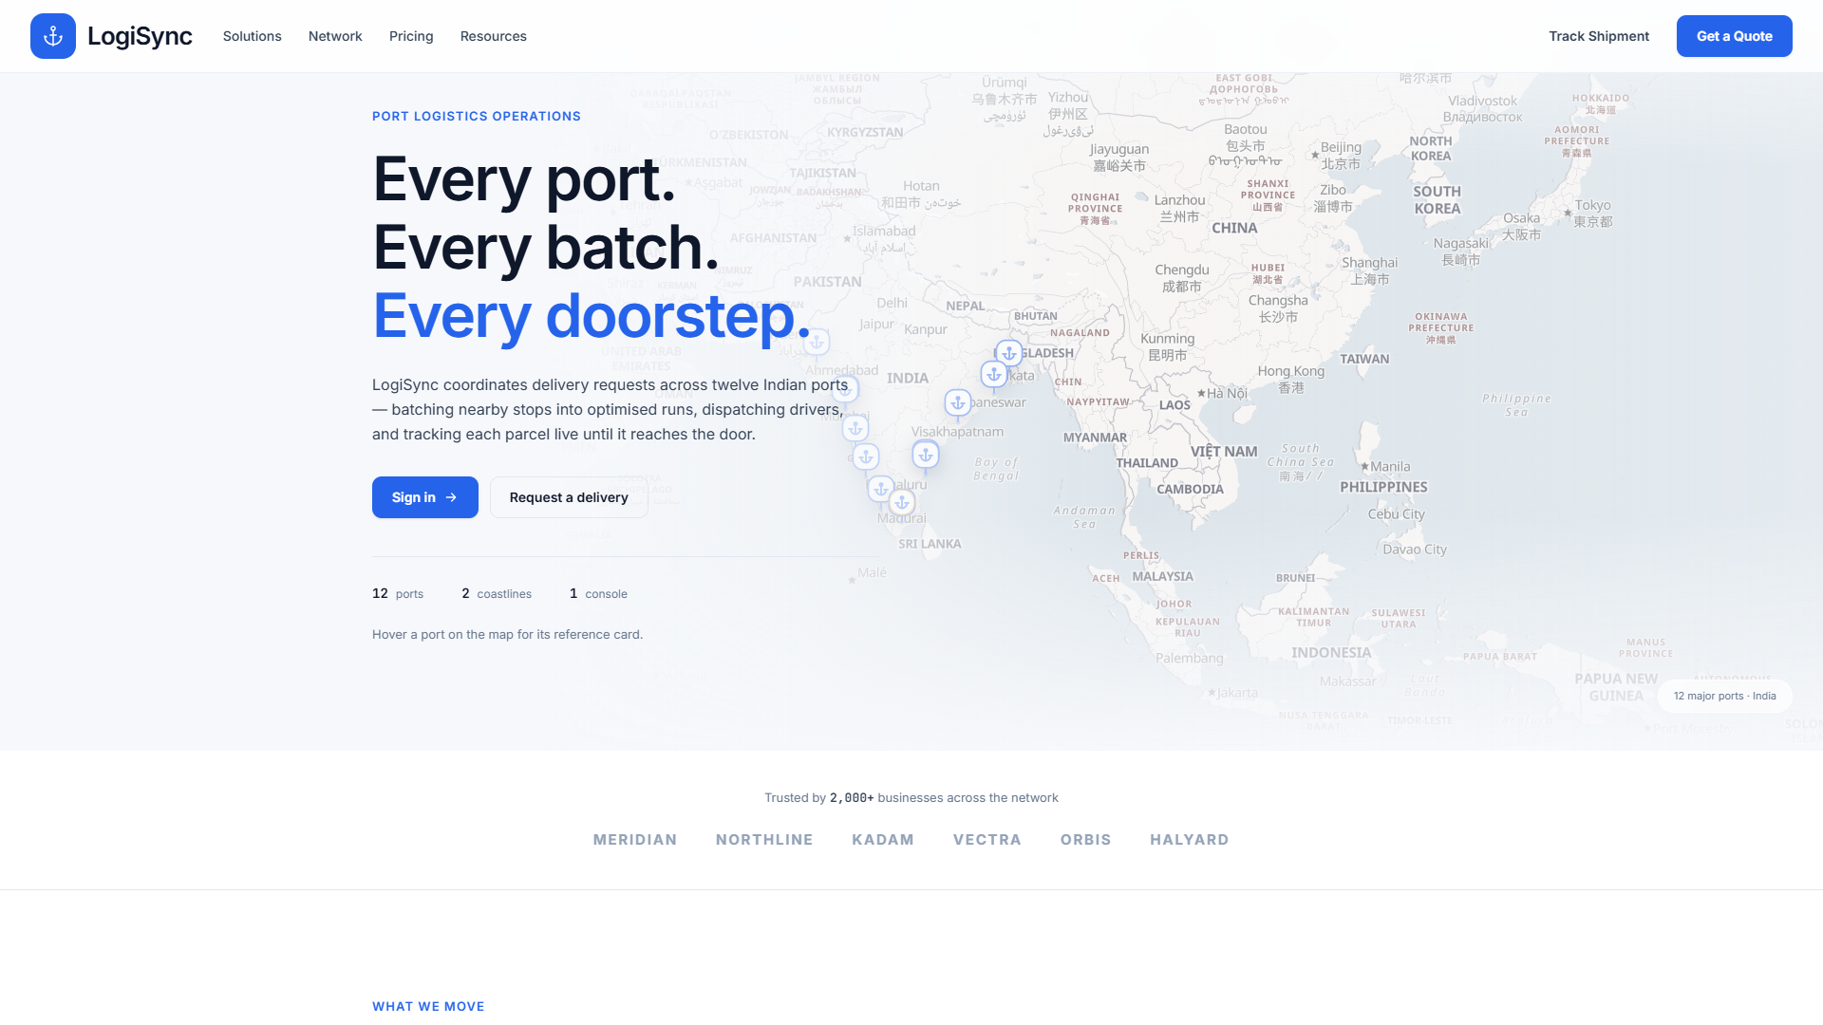
PORTAL WALKTHROUGH
Twelve depots, one network
• Full-bleed map of India behind the copy
• Twelve port depots as live markers
• Click a marker for its fact sheet
• One entry point for all four roles
Landing page - full-bleed India map with all 12 depot markers
LogiSync - Port-to-Doorstep Delivery Marketplace
8
Notes:
We open on the network rather than a login box. The map is the product: twelve Indian port depots, from V.O. Chidambaranar at Thoothukudi down to Paradip and Haldia. Each marker is live - click one and you get its fact sheet, and from there you can dispatch from that specific depot. It sets the scope immediately: this is a port logistics system, not a generic courier app.

Slide 9
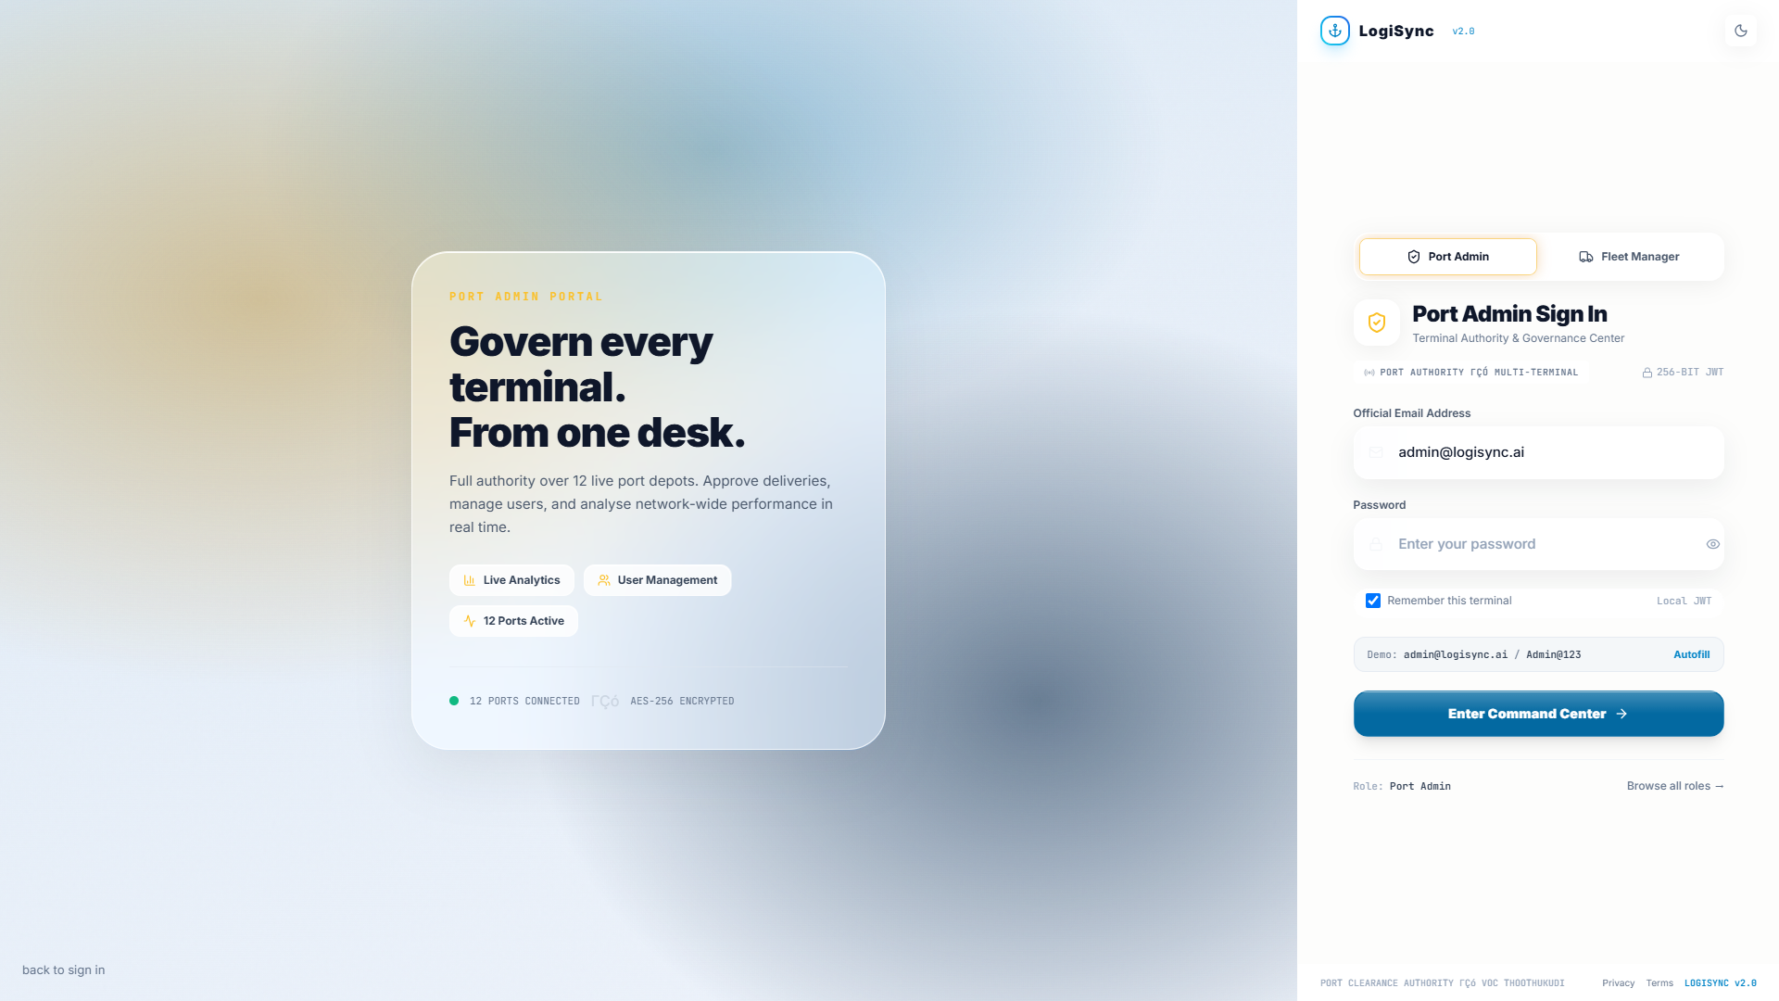
PORTAL WALKTHROUGH
Role-scoped access
• Operator and public tabs are separate
• Credentials issue a role-scoped JWT
• Server enforces every role boundary
• Demo credentials on-screen
Port admin sign-in - operators cannot self-register
LogiSync - Port-to-Doorstep Delivery Marketplace
9
Notes:
Access is split deliberately. Drivers and customers self-register; operators cannot. A fleet manager or port admin has to be provisioned by an admin, which is what stops someone simply signing up as an operator. The credential on screen is a seeded demo account - the autofill button is there so a reviewer can get in without setup.

Slide 10
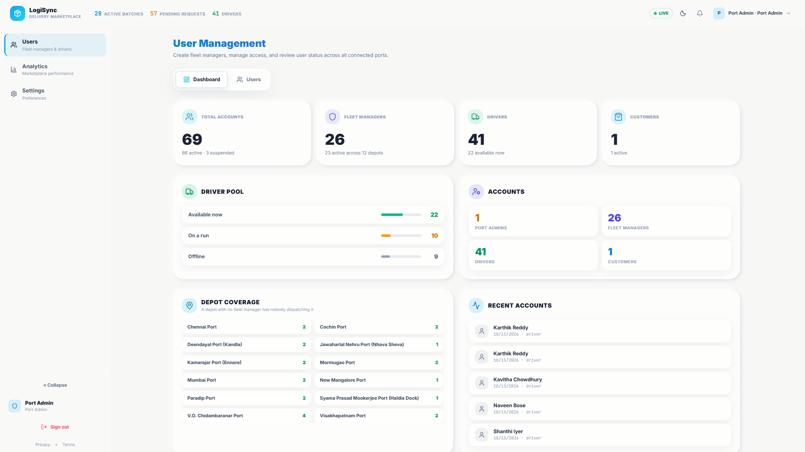
PORTAL WALKTHROUGH
Governance at a glance
• Live counts across every role
• Driver pool: available, busy, offline
• Depot coverage flags unstaffed ports
• Recent account activity
Port admin - User Management, Dashboard tab
LogiSync - Port-to-Doorstep Delivery Marketplace
10
Notes:
This is the screen we added for governance. The headline tiles answer who exists. The driver pool shows capacity in real time - twenty-two of forty-one available right now. Depot coverage is the one worth noting: a port with no fleet manager has nobody dispatching it, and that is called out with an amber warning rather than left for someone to infer from a list.

Slide 11
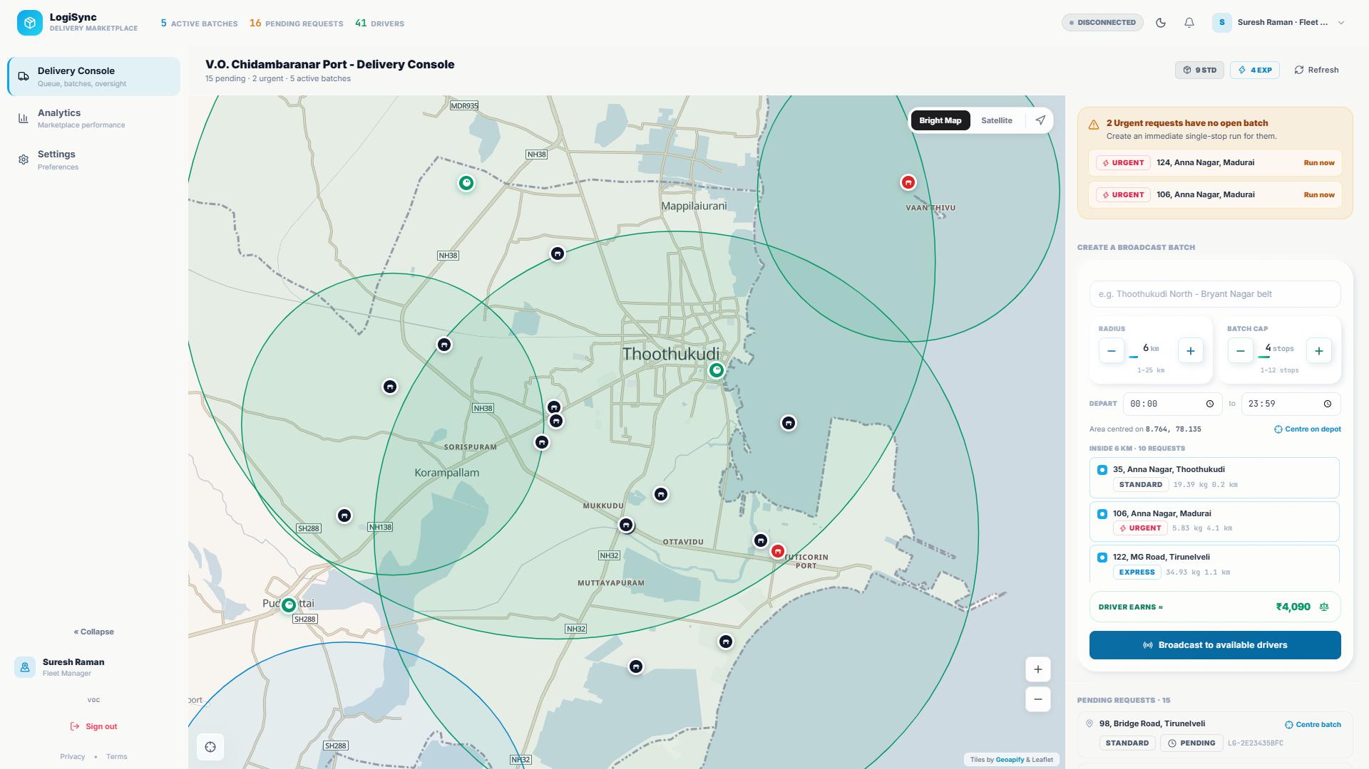
PORTAL WALKTHROUGH
Batching, priced
• Radius and cap as exact steppers
• Payout computed server-side, per stop
• Tier, fragile and weight shown per parcel
• Urgent parcels with no run, flagged
Fleet manager console - steppers, live payout, urgent alerts
LogiSync - Port-to-Doorstep Delivery Marketplace
11
Notes:
This is the heart of the system. The fleet manager draws a radius and sets a cap, and the panel shows what a driver will earn before broadcasting anything - two thousand four hundred and sixty rupees here, computed on the server so it cannot disagree with what the driver is offered. Notice the fragile chip and the weights on each parcel: those feed the payout. The orange panel is the scheduler telling the manager four urgent parcels have no run covering them.

Slide 12
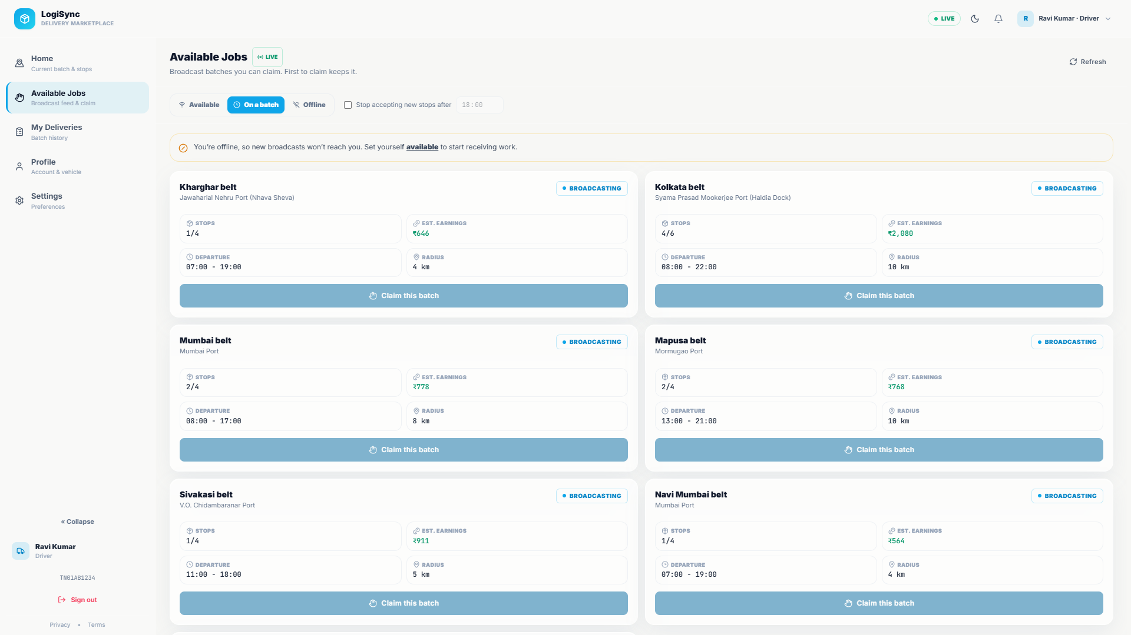
PORTAL WALKTHROUGH
Open work, one tap
• Broadcast runs any driver can take
• Payout shown before claiming
• Atomic claim - one winner
• Claimed run is pinned to that driver
Driver - claimable job feed
LogiSync - Port-to-Doorstep Delivery Marketplace
12
Notes:
Drivers see every run they are eligible for, with the payout stated up front. Claiming is a single atomic database update, which means under contention exactly one driver wins and the rest get a clean 409 rather than a double-booked run. Once claimed the run is pinned: no other driver can take it, and the batch is locked to stop order on departure.

Slide 13
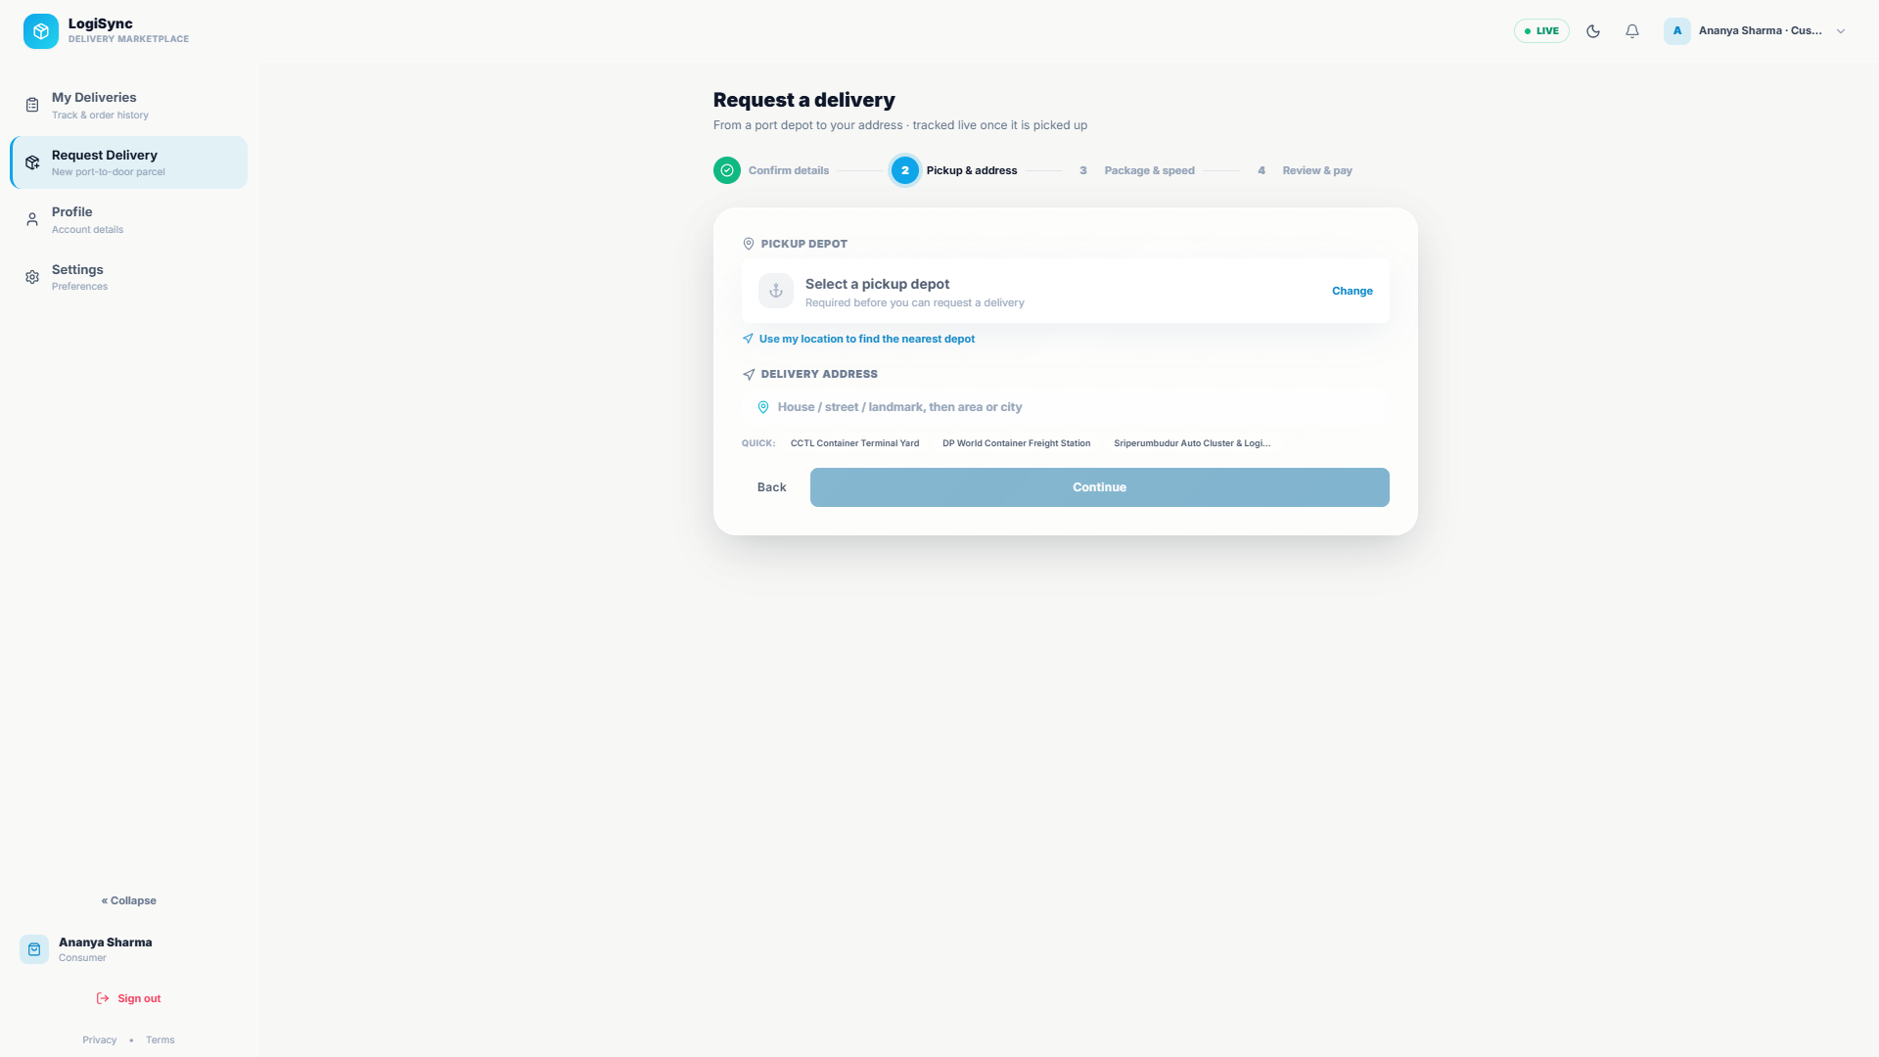
PORTAL WALKTHROUGH
The customer books
• Handling as explicit chips, not prose
• Weight and tier drive the quote
• Window defaults to something achievable
• Quote shown before any commitment
Consumer booking - structured handling and weight
LogiSync - Port-to-Doorstep Delivery Marketplace
13
Notes:
The customer side is deliberately plain. Handling used to be a free-text box, which meant the earnings and pricing models had to guess intent from prose. It is now explicit chips - fragile, keep upright, refrigerated, liquid - so the requirement is machine-readable. One thing we fixed here: the delivery window used to default to ten-to-six, which had already closed for anyone booking after six in the evening.

Slide 14
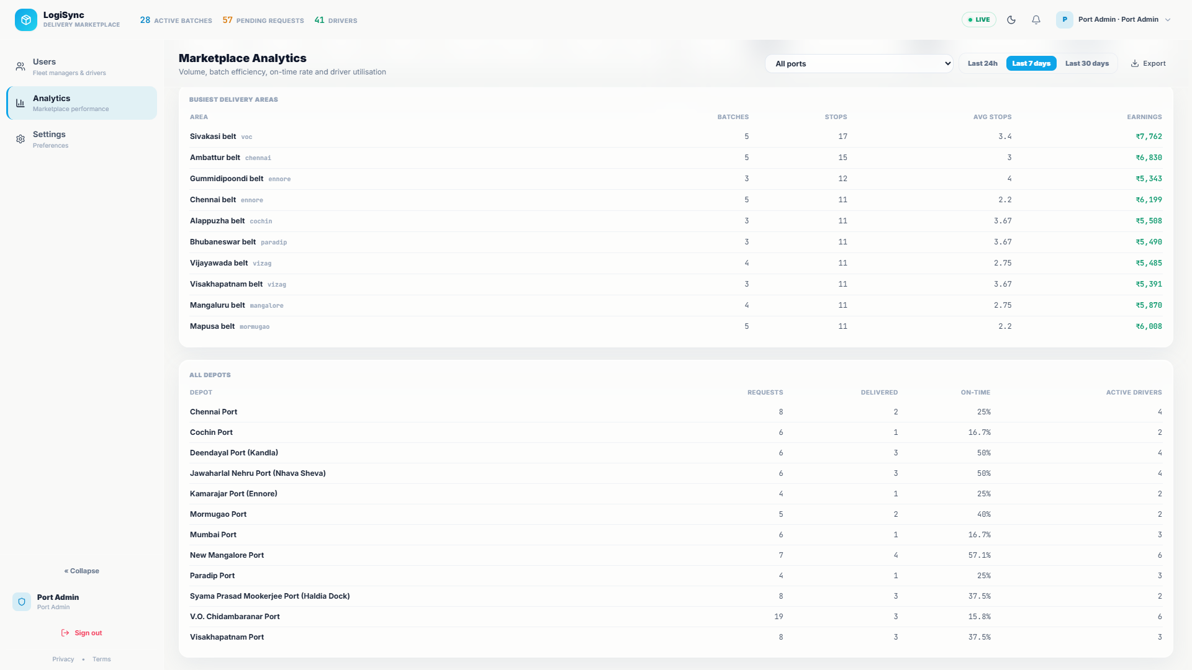
PORTAL WALKTHROUGH
Measured, not guessed
• Volume against deliveries, daily
• Batch fill distribution and claim times
• Busiest areas with real earnings
• Exportable for audit
Analytics - volume, batch efficiency, busiest areas
LogiSync - Port-to-Doorstep Delivery Marketplace
14
Notes:
And this is why we build the measurement before the feature. This page is how we found the on-time metric was stuck at zero: the time window a customer picks is their local clock, but every timestamp we stored was UTC, so an evening delivery was being scored against the wrong hour. You cannot debug what you never measured.

Slide 15
FUNCTIONALITY & VALIDATION
Every feature, and the evidence for it
Structured handling flags
Driver contact release
chips replace free text
25 tests
gated on out-for-delivery
16 tests
Weight-aware pricing
IST-correct on-time scoring
server-quoted, minimum applied
25 tests
timezone + delivery stamp
14 tests
Payment-gated dispatch
Radius auto-attach
unpaid never batched
16 tests
claimed run absorbs new stops
15 tests
Atomic driver claim
Cross-customer isolation
exactly one winner
7 tests
404, never 403
5 tests
127 automated tests across 8 suites - all passing
LogiSync - Port-to-Doorstep Delivery Marketplace
15
Notes:
Eight features, each with the suite that proves it. These are not smoke tests - the payment suite, for instance, asserts that an unpaid parcel returns a 402 rather than a 409, because the client branches on that code to decide whether to re-offer checkout. The driver-contact suite asserts a cancelled-before-departure parcel never exposes a number, which is the specific regression a naive status check would have shipped.

Slide 16
FUNCTIONALITY & VALIDATION
Representative test cases and results
Test case
Input / data
Expected
Actual
On-time rate, evening delivery
Delivered 23:36 IST, window 10:00-18:00
Late
Late (92.6% network)
PASS
On-time rate, in-window delivery
Delivered 16:20 IST, window 10:00-18:00
On time
On time
PASS
Tier with no deliveries
Express, 0 delivered
null, not 0
null - renders "-"
PASS
Unpaid cannot be batched
1 unpaid request, POST /schedules
402
402 Payment Required
PASS
Unpaid hidden from queue
GET /schedules/pending
Absent
Absent
PASS
Driver phone before departure
Stop assigned, tracked
No phone field
No phone field
PASS
Driver phone after departure
Stop en_route, tracked
Phone present
Phone present
PASS
Cancel before departure
Batched -> cancelled
No phone leaked
No phone leaked
PASS
Concurrent claim, 5 drivers
5 threads, same batch
1 winner, 4x 409
1 winner, 4x 409
PASS
Cross-customer order read
Customer B reads A's token
404, not 403
404
PASS
Earnings quote reconciles
2 stops, breakdown vs total
Items sum to total
Equal
PASS
Command: python -m pytest tests - 127 passed, 0 failed, 44.8 s
LogiSync - Port-to-Doorstep Delivery Marketplace
16
Notes:
Twelve representative cases out of a hundred and twenty-seven. The first three are the bug we were asked to fix - the on-time metric reading zero. The middle block is the payment gate and the driver-contact gate, including the cancellation case that a status-based check would have failed. The last three cover concurrency and isolation. Everything runs in forty-five seconds against a throwaway database, so it is cheap to run on every change.

Slide 17
FUNCTIONALITY & VALIDATION
Limitations, stated honestly
KNOWN LIMITATIONS
NEXT STEPS
• Demo data is seeded, not measured in production
• Online payment dark until Razorpay keys are set; webhook needs a public URL
• Tier margin gap: express/urgent charge exceeds base driver pay
• Route geometry falls back to straight lines when Geoapify is unreachable
• No frontend unit-test framework - coverage is integration-level
• Rebalance tier fees against driver base pay
• Postgres in production with the 127-test suite green
• Frontend unit tests and CI on every push
• Multi-depot driver runs and cross-port batch splitting
• Customer notifications over SMS on status change
The tier margin gap is deliberate to surface, not to hide: customers are charged more for express and urgent than a
driver's base pay covers. It is pinned by a test so it stays visible.
LogiSync - Port-to-Doorstep Delivery Marketplace
17
Notes:
We would rather show you this than have you find it. The first limitation is the most important: every number in this deck comes from a seeded dataset, not from production traffic - the system is real, the volume is synthetic. Third is a genuine commercial bug we found and did not quietly paper over: express and urgent charge the customer five hundred and a thousand rupees while the driver's base pay is two twenty and three fifty. We pinned it with a test so whoever sets the commercial terms sees it.

Slide 18
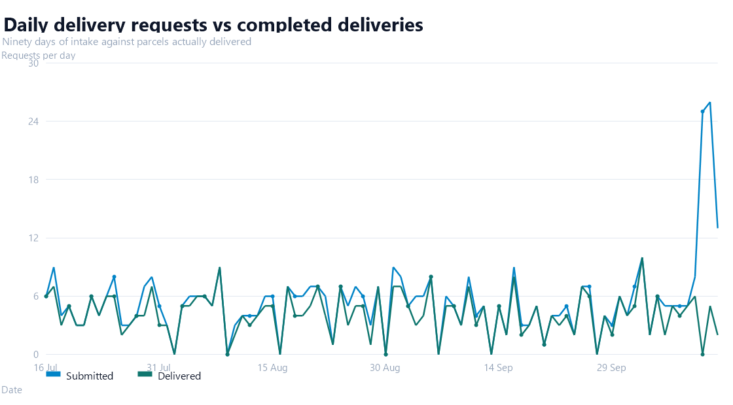
ANALYTICS 1 OF 2
Ninety days of delivery volume
Daily intake against completed deliveries, 90 days
LogiSync - Port-to-Doorstep Delivery Marketplace
18
Notes:
Ninety days of intake against completed deliveries. The shape is the point: steady weekday volume with a visibly lighter weekend, and the gap between the two lines is work still in flight. Four hundred and ninety submitted, three hundred and seventy-six delivered.

Slide 19
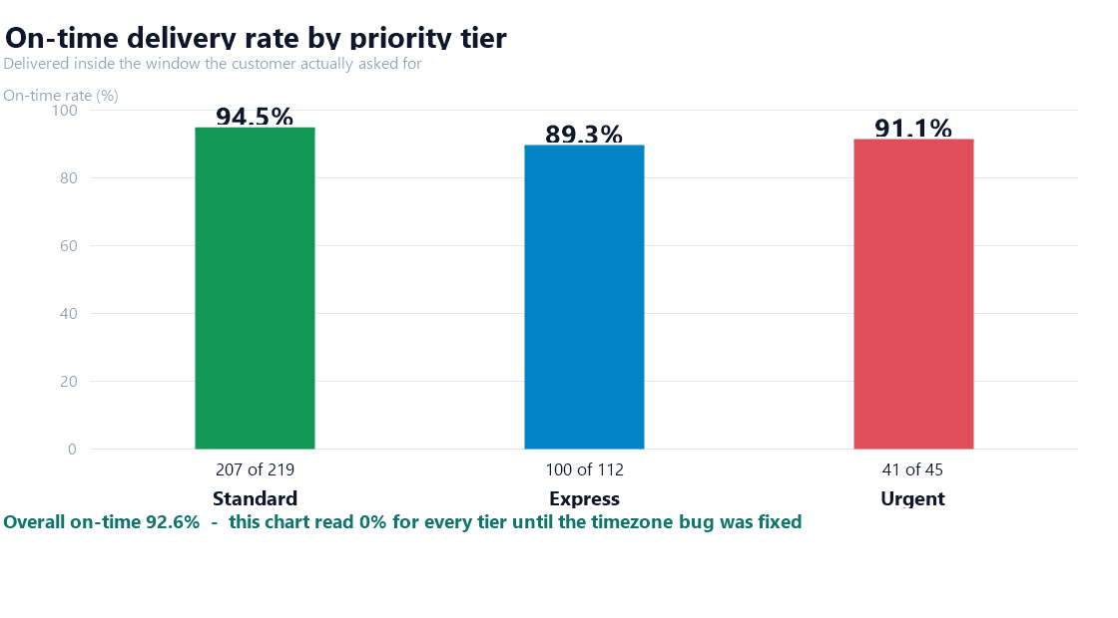
ANALYTICS 2 OF 2
On-time rate, by priority tier
This chart read 0% for every tier until the timezone bug was fixed
LogiSync - Port-to-Doorstep Delivery Marketplace
19
Notes:
This is the chart we were asked about, so let us be blunt about it. It used to show zero percent for all three tiers. There were two causes and both were real. The window a customer picks is their local clock while every timestamp we stored was UTC, so an evening delivery was scored against the wrong hour. And the booking form defaulted to a ten-to-six window that had already closed for anyone ordering after six in the evening. Fixed, it reads ninety-two point six overall. Express sits below standard at eighty-nine versus ninety-four, which is honest and worth seeing.

Slide 20
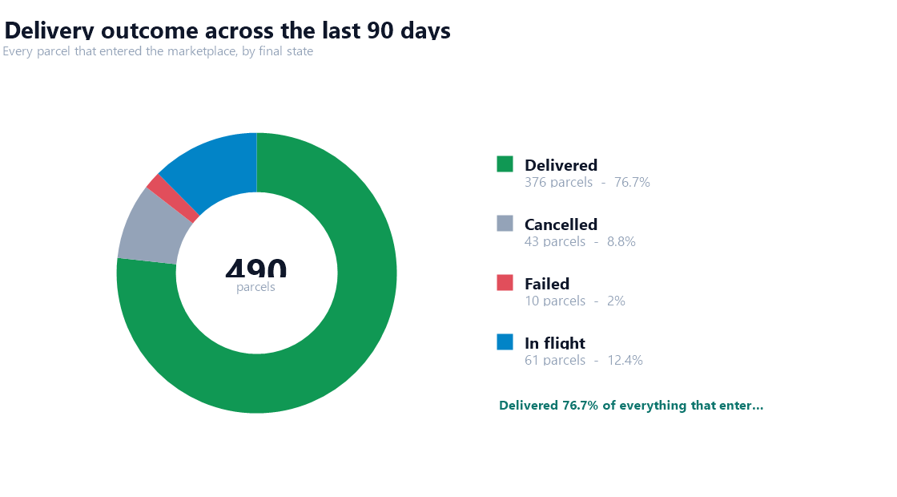
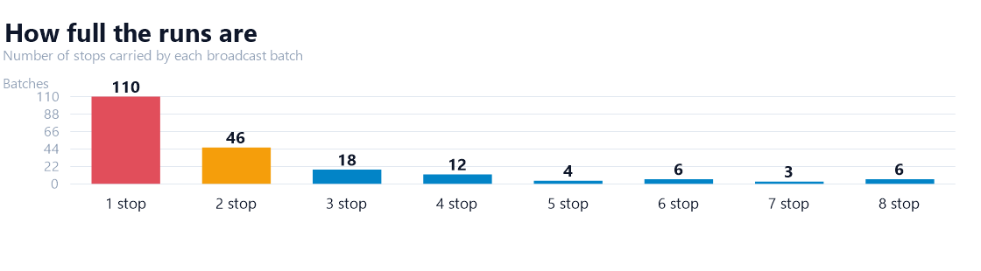
ANALYTICS
Outcome and headroom
76.7% delivered | average batch fill 43.0% | 110 batches carry a single stop - the clearest headroom in the system
LogiSync - Port-to-Doorstep Delivery Marketplace
20
Notes:
Outcome on the left, headroom on the right. Roughly three quarters of everything that entered the marketplace was delivered. But the batch fill chart is the roadmap: a hundred and ten batches carry a single stop, each of which is a driver paid a full run for one parcel. We group by geography, so those are genuinely scattered stops, and a wider departure window would let several share a run. That is a configuration change, not a rewrite.

Slide 21
ANALYTICS
Where the volume is
TAKEAWAY
• Volume is spread evenly
across 12 depots
• Visakhapatnam leads on
request count
• V.O. Chidambaranar has
the most active drivers
• Per-depot on-time varies
from 64% to 88%
LogiSync - Port-to-Doorstep Delivery Marketplace
21
Notes:
Finally, where the work actually is. Volume is spread fairly evenly across the twelve depots rather than concentrated, which is what makes the marketplace model work at all. One thing worth flagging honestly: per-depot on-time varies quite a bit, from sixty-four percent at V.O. Chidambaranar up to eighty-eight at Visakhapatnam. That is not noise - it tracks driver availability and route density per depot, and it tells you which depot to put the batching fix in first.

Slide 22
WHY LOGISYNC IS SMARTER
Against what teams actually use today
Capability
Spreadsheets
+ phone
Courier
aggregator
Fleet TMS
suite
LogiSync
Live per-parcel tracking
0
0
1
1
Automatic proximity batching
0
0
1
1
Atomic driver claim (no double-book)
0
0
1
1
Weight & handling-aware pricing
0
0
1
1
Customer books without a sales call
0
1
0
1
Driver phone released to customer
0
1
0
1
Full per-stop audit trail
0
0
1
1
Owns the port-side depot workflow
0
0
1
1
Zero licence cost
1
0
0
1
Our edge: it is built for the port-side depot, not the last mile. Couriers assume a sorted,
address-ready parcel. We model the awkward ones - weight, fragile, upright, reefer - and price them.
LogiSync - Port-to-Doorstep Delivery Marketplace
22
Notes:
Compared against the three things a team actually has: a spreadsheet, a courier aggregator, or a licensed fleet TMS. We score honestly, and LogiSync does not win every row. Courier aggregators do win on scale and get self-serve booking - we cannot match their network. A licensed TMS wins on fleet depth across mixed vehicle classes. Our edge is narrow and specific: we are built for the port-side depot rather than the last mile. A courier assumes a sorted, address-ready parcel. We model the awkward ones - a hundred and forty kilos, fragile, must stay upright - and price them.

Slide 23
CONCLUSION
What we built, and what it proved
• Four roles, one marketplace, 12 depots
• 490 requests and 205 runs over 90 days
• 92.6% on-time, measured not assumed
• Payment, dispatch and driver contact all gated
• 127 tests, green
WHAT IT PROVED
• The workflow holds under load and race
• Money is computed in one place, so it cannot drift
• Privacy gates need monotonic state,`nnot status checks
• Measuring first is what found the bug
The system works end to end. The next gain is operational, not architectural:
fill the 110 single-stop runs by widening the departure window.
LogiSync - Port-to-Doorstep Delivery Marketplace
23
Notes:
To close: four roles, one marketplace, twelve depots, four hundred and ninety requests and two hundred and five runs. Ninety-two point six percent on-time, measured rather than asserted. Payment, dispatch and driver contact are all gated on state we can reason about. And a hundred and twenty-seven tests, green. The honest next step is operational, not architectural - there is a hundred and ten single-stop runs sitting in our own histogram, and widening the departure window is a configuration change, not a rewrite.

Slide 24
Thank you
Questions welcome.
LogiSync - port-to-doorstep delivery marketplace
12 Indian port depots - 490 requests - 92.6% on-time - 127 tests
Notes:
Thank you. We are happy to take questions on any part of it - the batching algorithm, the payment gate, the concurrency handling, or the timezone bug, which is probably the most interesting thing we found. Everything you saw is running locally, so we can walk through any screen live if that would help.

