Slide 1
Machine Learning
How it works
(people going, not again ☹)

Slide 2
2 Main Methods
Gradient Descent
Test for Audience
How it works
Find out house prices
Cool animation
Decision Tree
Test for Audience
How it works
Solve cancer
Cool Graphics

Slide 3
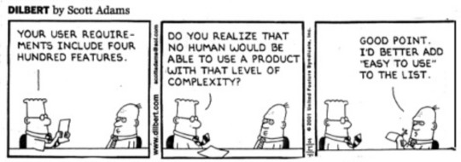
COMIC RELIEF ☺ Before Serious Stuff

Slide 4
TEST For You
Temperature | Humidity | Wind | Go Outside
Hot | High | Weak | No
Hot | High | Strong | No
Mild | High | Weak | No
Cold | Low | Weak | No
Mild | Low | Strong | Yes
If Humidity == ‘High’
Go_outside = ‘No’
Elseif Temperature == ‘Cold’
Go_outside = ‘No’
Else
Go_outside= ‘Yes’

Slide 5
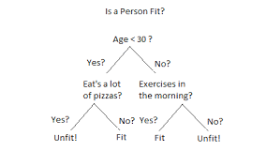
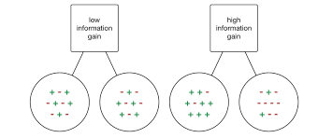
1. Divide Based on Available Variables.
2. Which Variables to choose

Slide 6
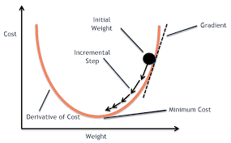
How Gradient Descent Work

