Slide 1
Software Engineering Project
Testing Report CS330
Professor – Dr. Angshuman Jana
Group9
By-Bhaskar Mishra , Harmanjeet Singh, Jadi Pujita , Karan Gupta

Slide 2
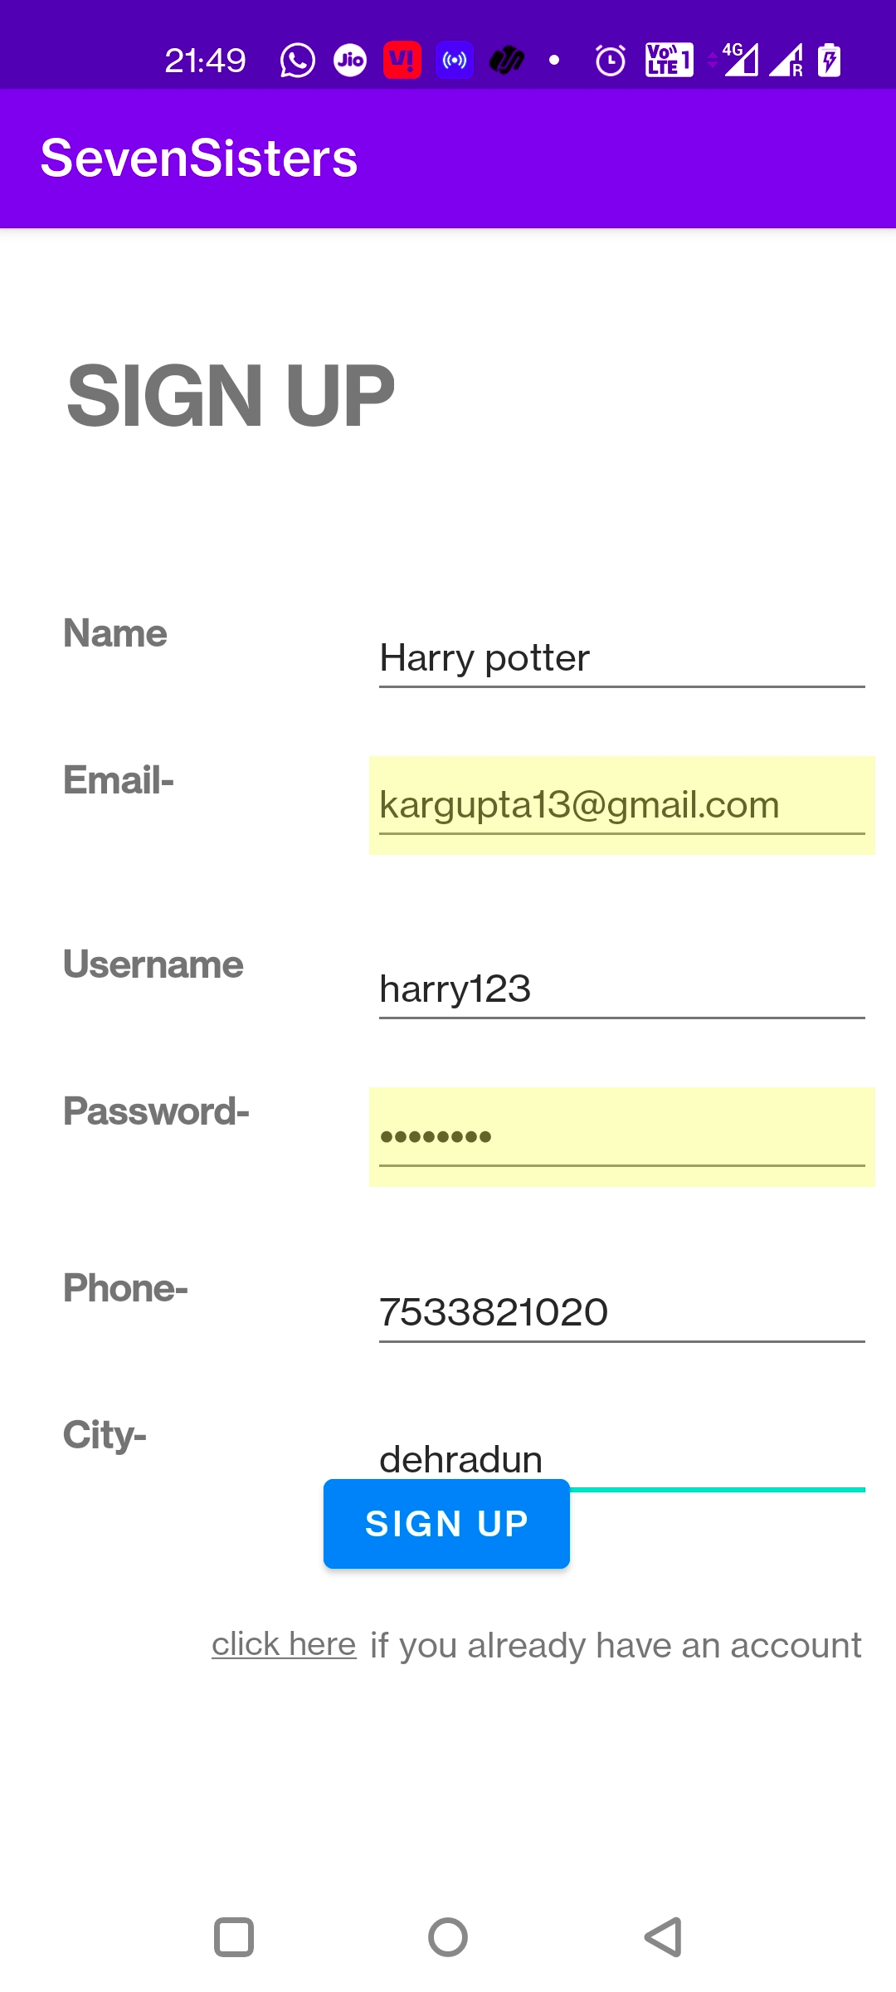
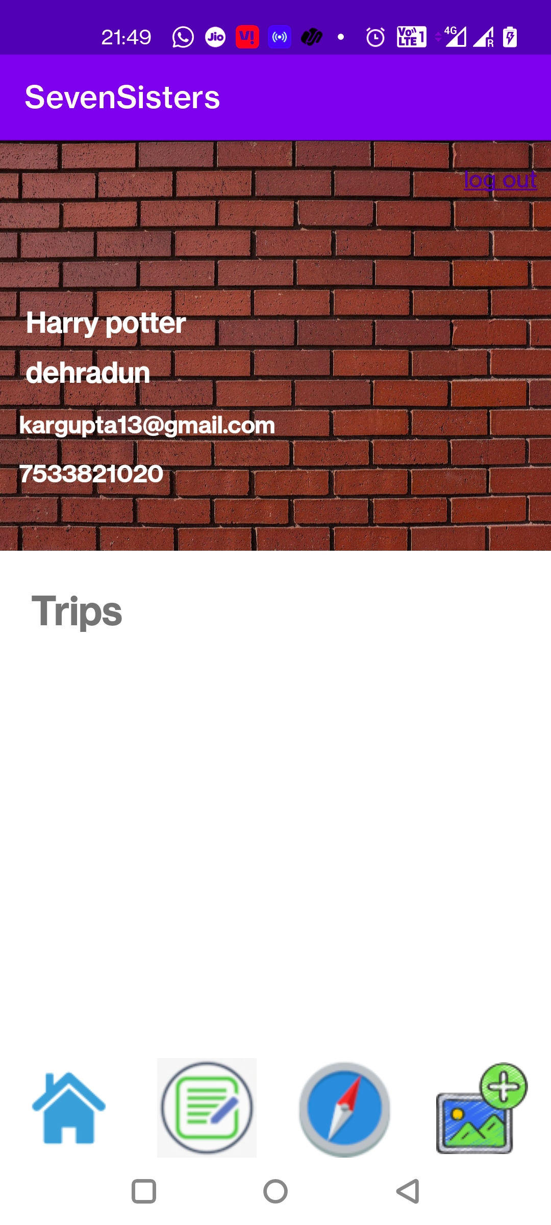
Unit Testing
1.Input – Enter user credetials in registration activity, click on sign up
Output – Reflects on Profile Screen

Slide 3
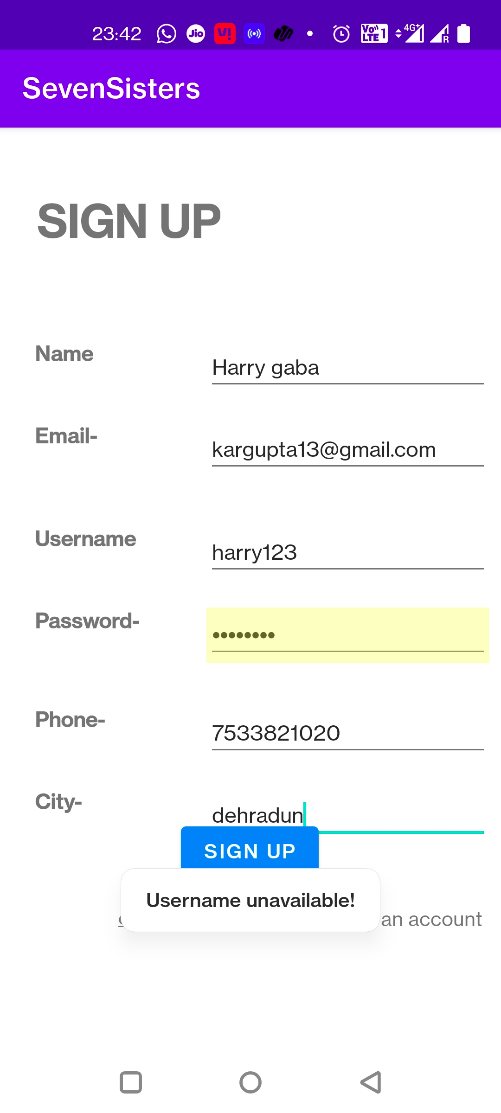
2.Input - Sign up with previously registered username.
Output – Message pops up and registration denied.

Slide 4
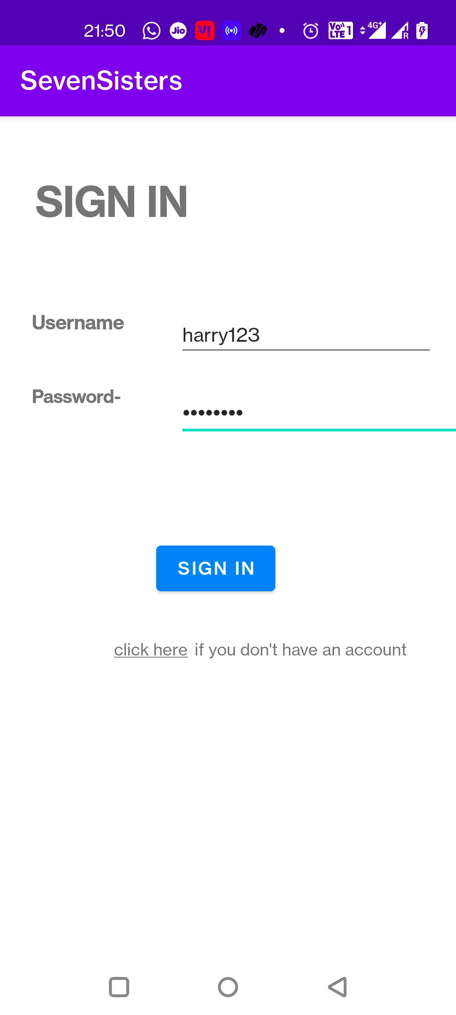
3. Input – Correct username and password in sign in activity
Output- Signed in with credentials displayed on profile screen.

Slide 5

4. Input – Enter incorrect username/password credentials in signin acticity
Output – Message popup and login denied

Slide 6
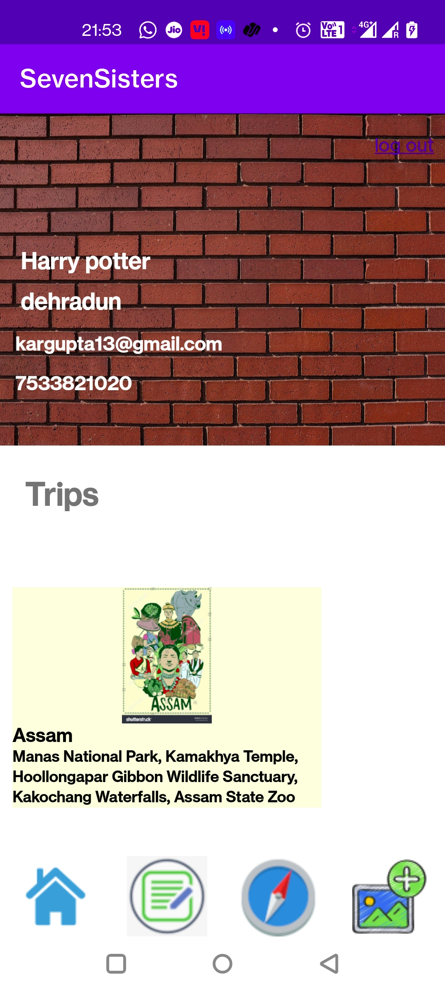
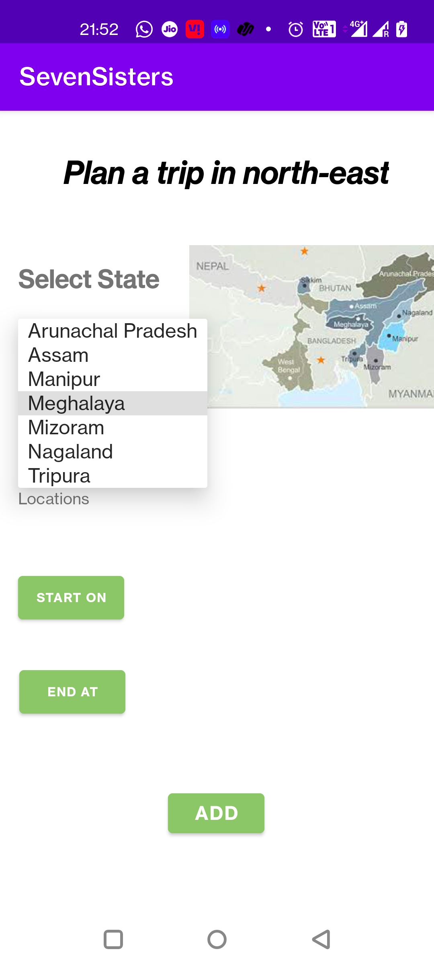
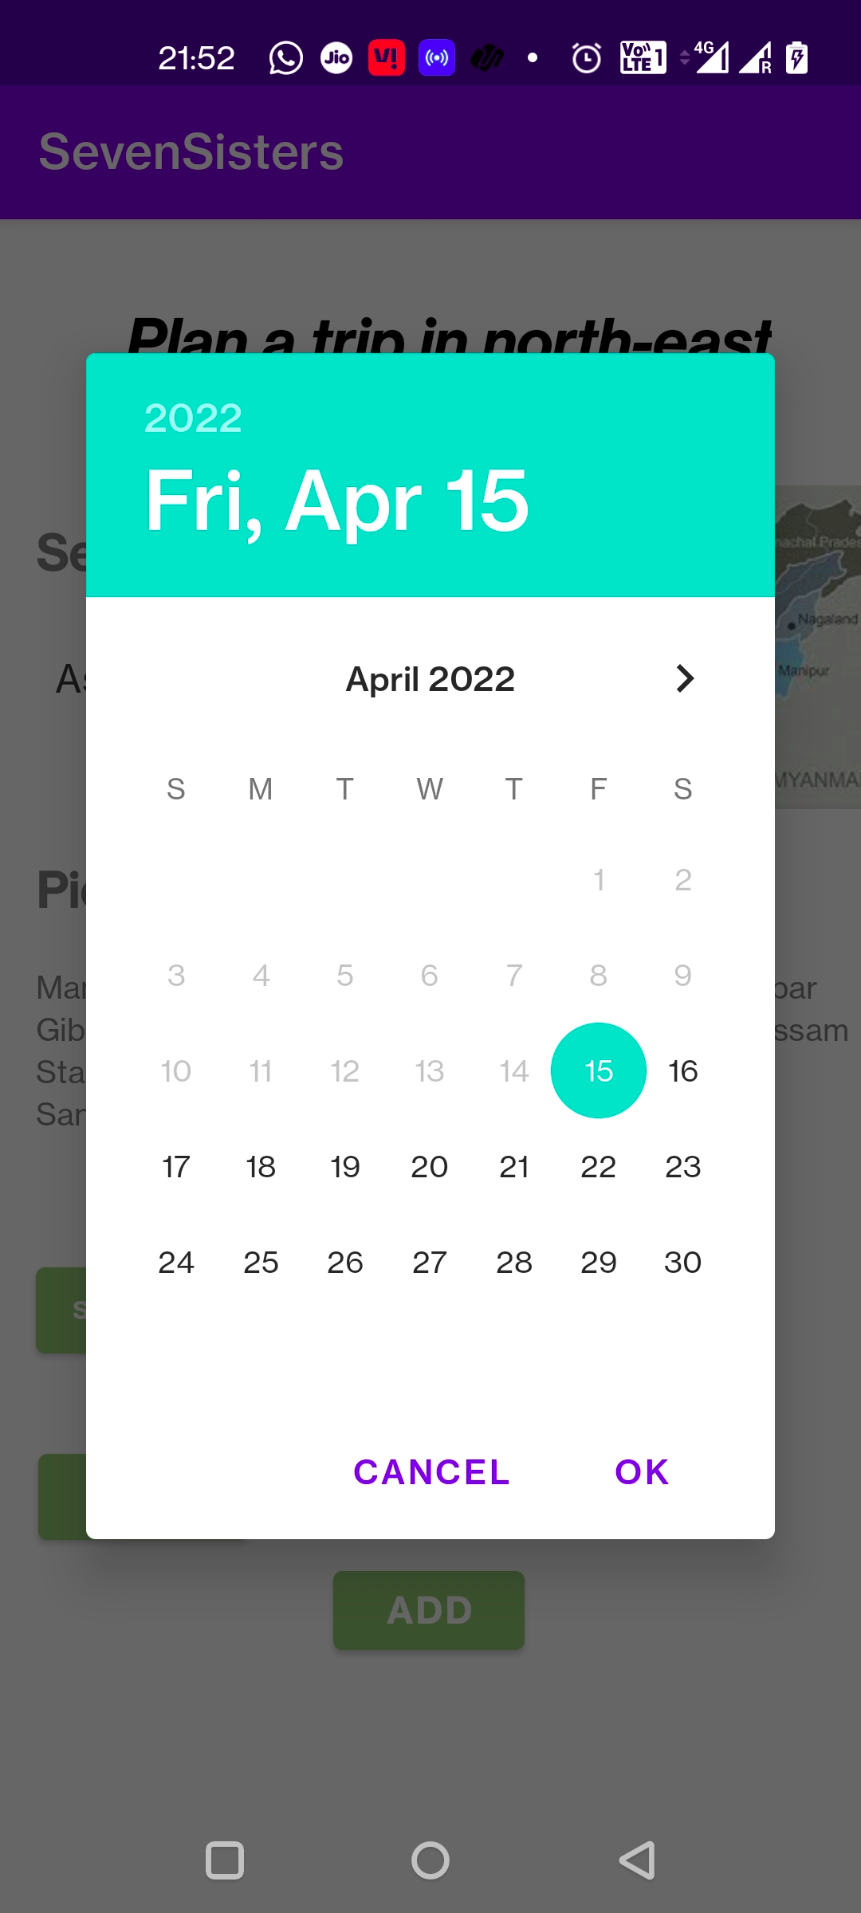
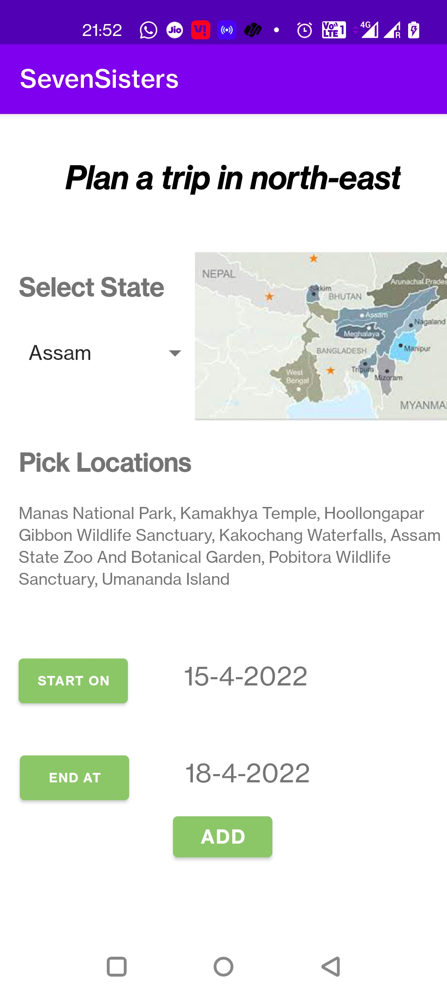
5.Input - Enter Trip details in add trip activity and click on add
Output – Trip visible on profile activity

Slide 7
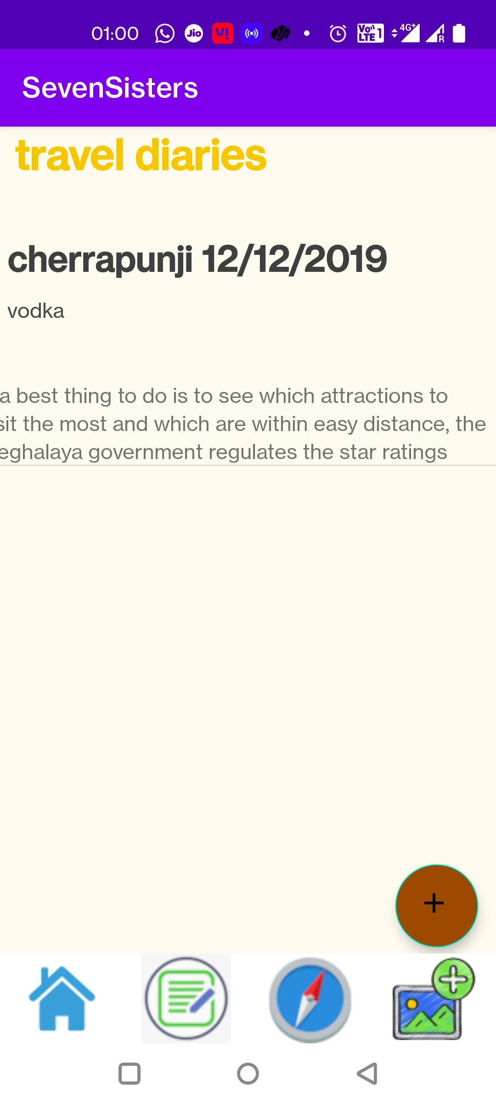
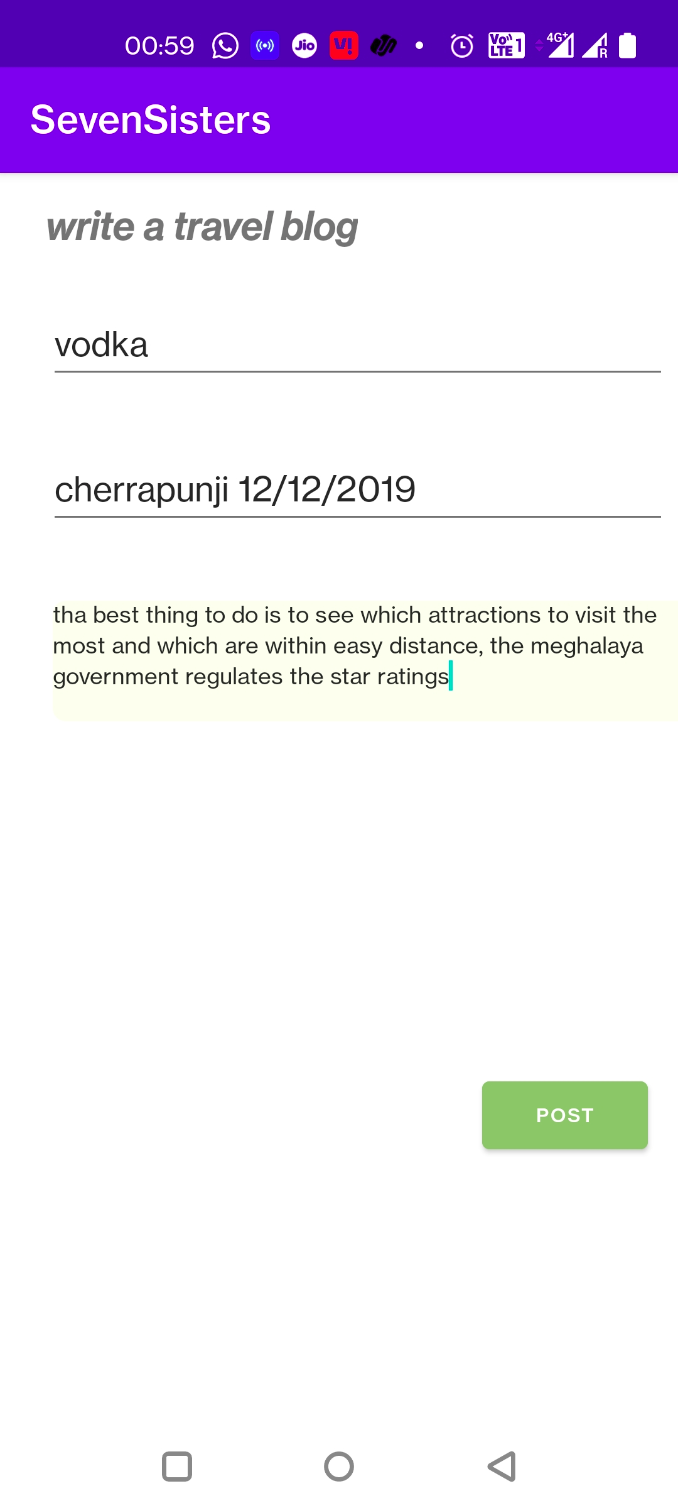
6.Input – Enter blog details in create blog wizard and click on post .
Output – See it getting published online

