Slide 1
Wigderson Algorithm For 3-colorable Graphs
Mini Project MA252
Mathematics and Computing
IIT Guwahati
Course Instructor : Prof. K.V. Krishna

Slide 2
Main Points of Focus
Understanding the Graph Coloring Problem
Understanding the NP Completeness of the above Problem
To explore the Wigderson Algorithm, an algorithm that has been devised to properly color 3-colorable graphs.
We will look into this algorithm in detail, analysing the time complexity correctness, and the performance of this algorithm.
To slightly improve the performance of this algorithm

Slide 3
The Graph Coloring Problem
This presentation mainly revolves around the graph coloring problem.
The Problem is as follows:
‘Given a set of m distinct colors, find a way of the coloring all the vertices of a Graph in a such a way that no two adjacent vertices share the same color, or report if it impossible to do so with m colors.’
Such a coloring is called proper (or legal) coloring of a Graph.

Slide 4
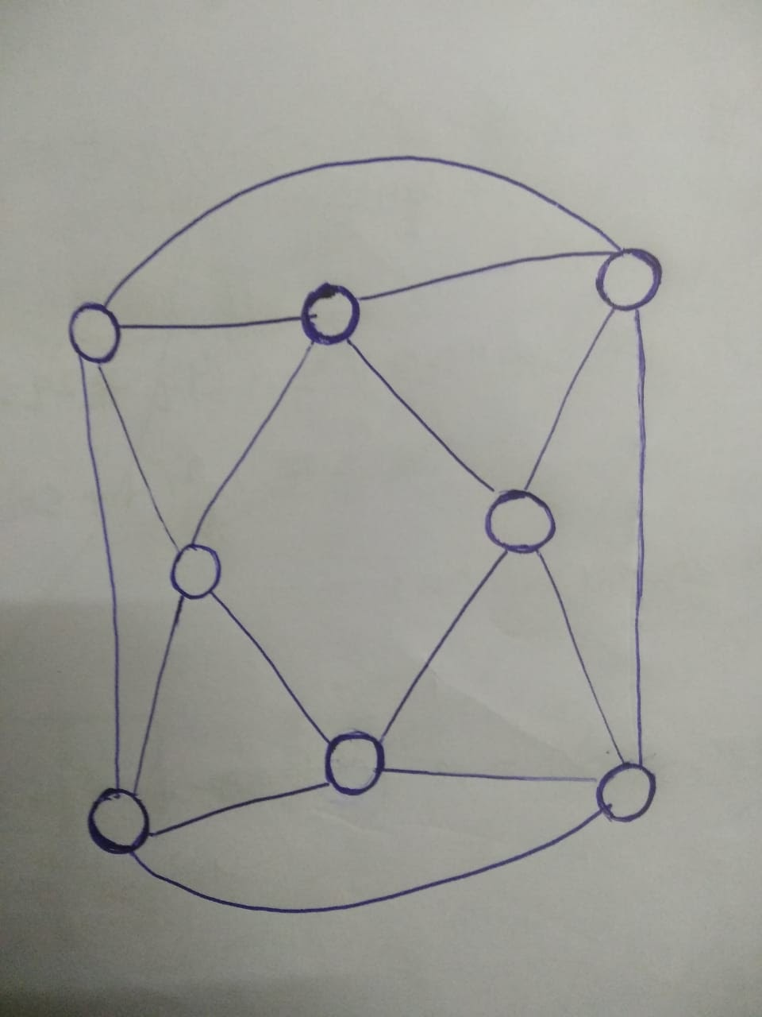
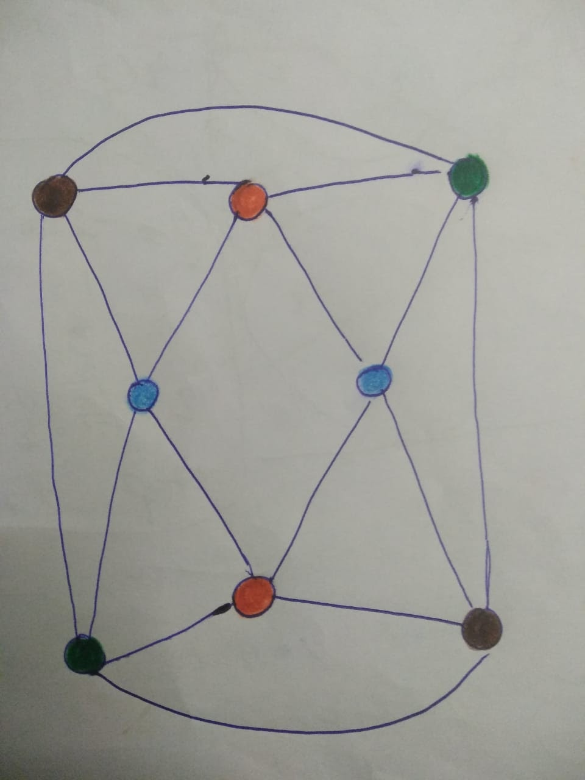
Example 1
Consider this graph with m = 4
The image to the right gives a proper 4-coloring of the graph.

Slide 5
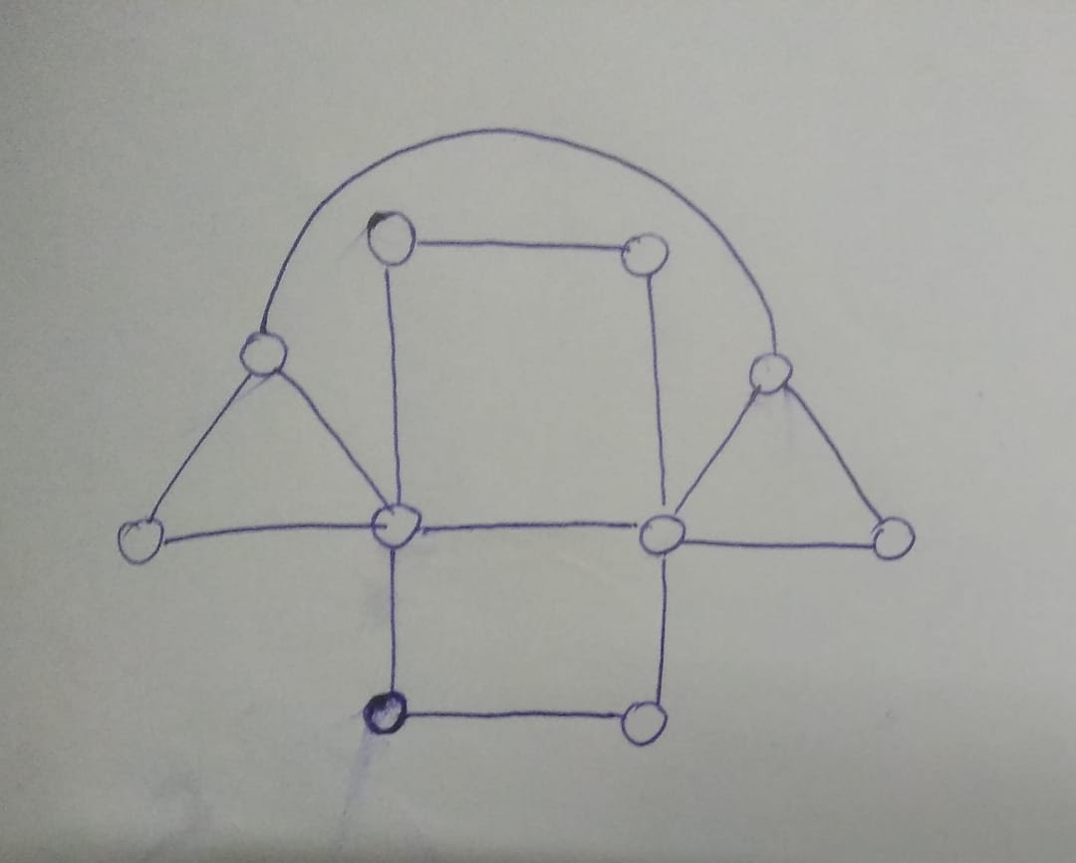
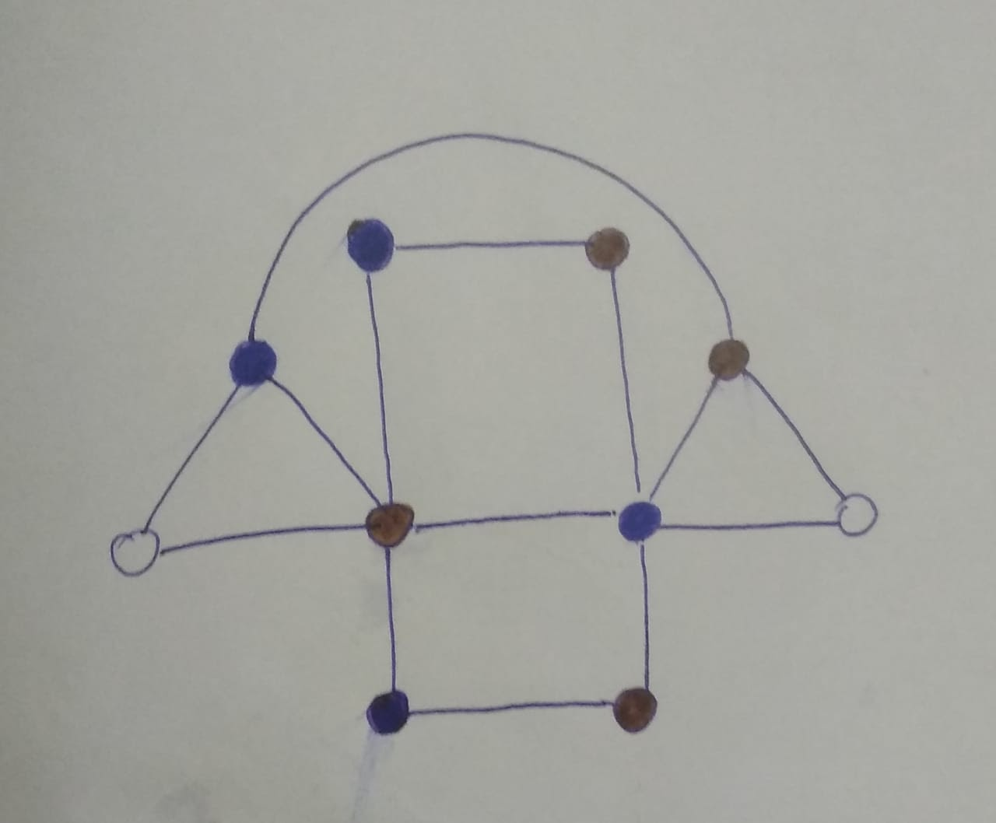
Example 2
Consider the graph to the left. Suppose m = 2.
We attempt to provide a proper 2-colring for the graph. It could be seen that the 2 uncolored vertices can neither be blue nor brown because they already have an adjacent vertex of both those colors.
It can be observed no proper coloring is possible for this graph using 2 colors.

Slide 6
Some Definitions
The minimum number of colors required to color the vertices of a graph such that no two adjacent vertices share the same color is called the chromatic number of a Graph.
For e.g., chromatic number of any tree (excluding single vertex trees) is 2.

Slide 7
Some Definitions
If a graph could be colored with exactly k colors such that no two adjacent vertices share a common color, then the graph is called k-colorable.
So our main problem( Graph Coloring Problem) can be restated as:
‘Given a Graph and an integer k (> 3), is the Graph k-colorable?’

Slide 8
NP-Completeness
The 3-colarable Graph Problem (whether it is possible to color a graph with exactly 3-colors) was shown to be NP-Complete by Karp and Cook in 1972
A polynomial time reduction from 3-SAT to 3-colarable Graph Problem (whether it is possible to color a graph with exactly 3-colors) was proposed by Karp and Cook.
Hence, it was subsequently shown that determining a proper colouring for a 3-colorable graph is also NP-Complete.

Slide 9
Approximate Algorithms
Coloring a graph G with the minimum number of colors(Chromatic Number) is NP-hard so the focus shifts to efficiently coloring a graph in polynomial time with as approximately optimal number of colors.
We shall now explore certain algorithms to efficiently color 3-colorable graphs in polynomial time.

Slide 10
Greedy Algorithm
The Algorithm is as follows:
i) Color the first vertex with color 1
ii) For all the other vertices:
a) We initially color the current vertex with the lowest color that has not been used on the vertices adjacent to it (that have already been colored). Then, we repeat step (a) until all vertices have been colored.

Slide 11
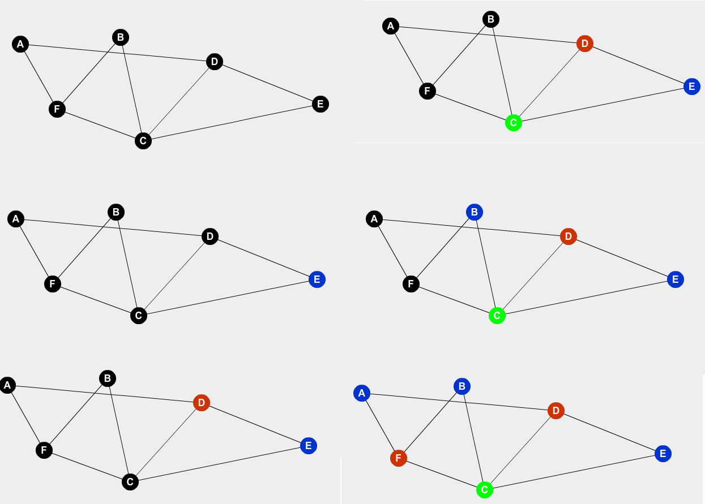
Greedy Algorithm
Step 1
Step 4
Here is an example:
Order of vertices is as follows.
E,D,C,B,F,A
Order of colors is as follows:
Blue, Red, Green
First we color E with blue, then D with next available color(red), C with next available color(red), then B with blue(first available color), and so on.
** The above figure is a self created figure(not from the internet)
Step 2
Step 5
Step 6
Step 3

Slide 12
Analysis of the Greedy Algorithm
This Algorithm can properly color any graph in O(n + m) time where n is the number of vertices and m is the number of edges of the graph.
However, the algorithm does not necessarily provide the optimal solution.
Let max degree of the Graph be d. Since any vertex is connected to at most d vertices, hence the color chosen for this vertex has to be less than or equal to d+1. So, this does not provide the optimal coloring and hence is an approximate algorithm.
Hence the maximum number of colors this algorithm uses is max_degree+1.

Slide 13
Backtracking Solution for 3-colorable graphs
Here, we discuss about an exact algorithm(which gives the optimal solution) for 3-colorable graphs :
1.We create a recursive function that returns a possible proper optimal coloring, which takes in the current vertex as an input.
2.We first check the number of vertices that already have been assigned a color.
If the number is n, we return true. If the number is not n, we continue to the next step.
(n is the number of vertices)
3. Assign all the colors one by one to the current vertex (from colors 1 to 3). And then, we recursively call the function, moving to the next vertex.
4. For each color, we check if each assignment does not violate the proper coloring property.
5. If for every color, we get a false result, we return false, else we return true.

Slide 14
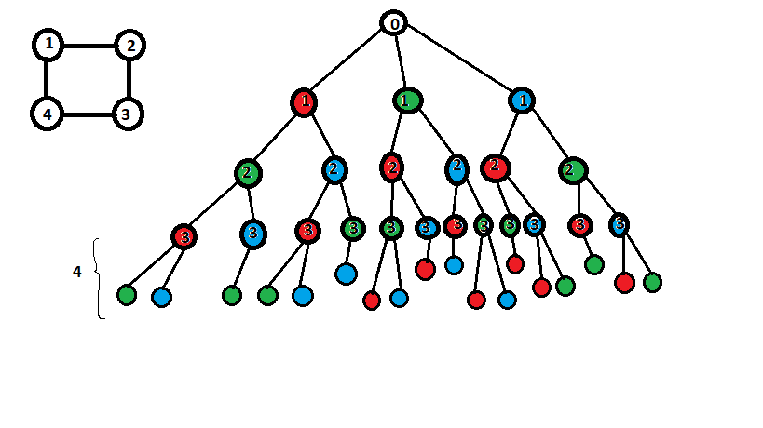
Analysis of the Backtracking Solution
The most basic implementation of this algorithm has a O(3^n) time complexity.
This is because the algorithm checks for all possible colors for a vertex, and hence goes through all possible colorings of the graph.
This Algorithm gives an optimal coloring, using only 3-colors for a 3-colorable graph.
An example of the backtracking solution
** This image has been taken from ResearchGate Website

Slide 15
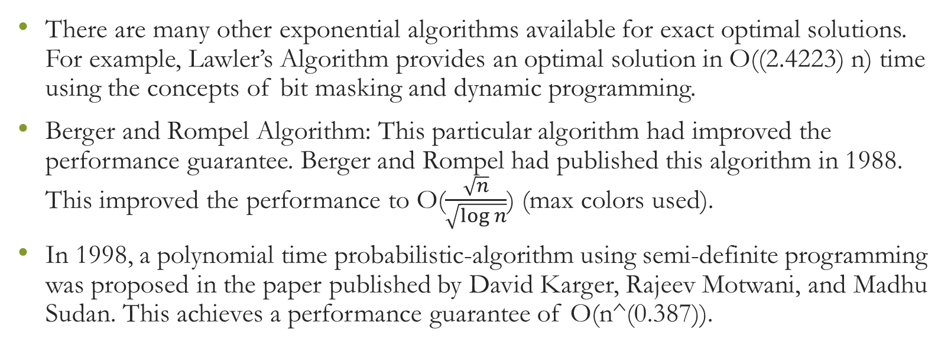
Other Algorithms
There are many other exponential algorithms available for exact optimal solutions. For example, Lawler’s Algorithm provides an optimal solution in O((2.4223) n) time using the concepts of bit masking and dynamic programming.
Berger and Rompel Algorithm: This particular algorithm had improved the performance guarantee. Berger and Rompel had published this algorithm in 1988. This improved the performance to O($\frac{\sqrt{n}}{\sqrt{\log{n}}}$) (max colors used).
In 1998, a polynomial time probabilistic-algorithm using semi-definite programming was proposed in the paper published by David Karger, Rajeev Motwani, and Madhu Sudan. This achieves a performance guarantee of O(n^(0.387)).

Slide 16
Wigderson Algorithm
We have now reached an our main topic of focus.
A brief Overview:
This Algorithm was proposed in 1983, by Avi Wigderson. This algorithm provides an O(n + m) solution for finding a proper coloring for 3-colorable graphs with a performance guarantee of O(√n). Here performance guarantee means the upper bound on the number of colors used for the particular coloring.

Slide 17
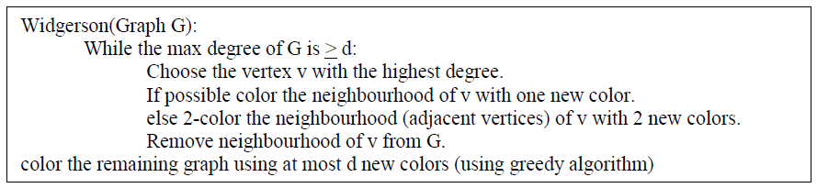
Wigderson Algorithm
A pseudo-code of the algorithm is as follows:

Slide 18
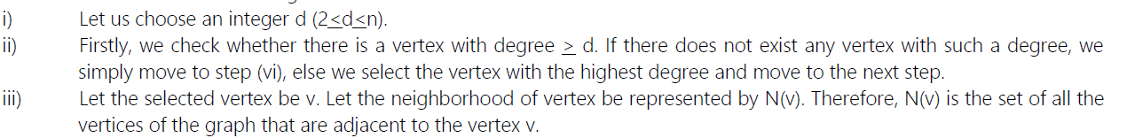
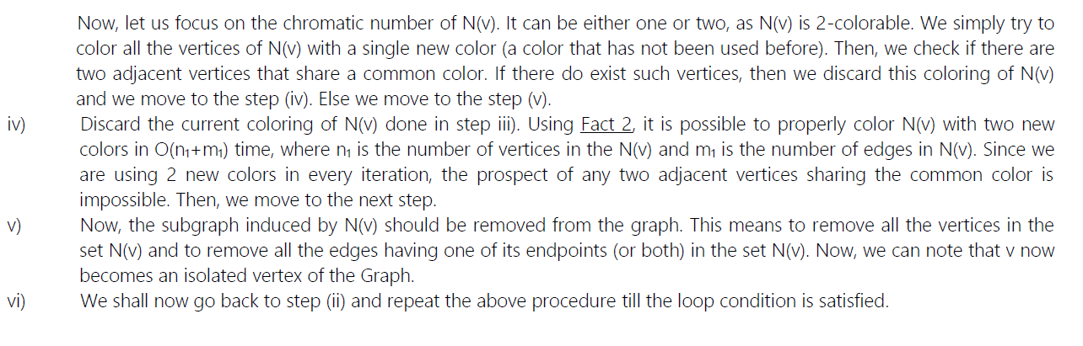
Explanation of the Algorithm
Refer to Report for proof

Slide 19
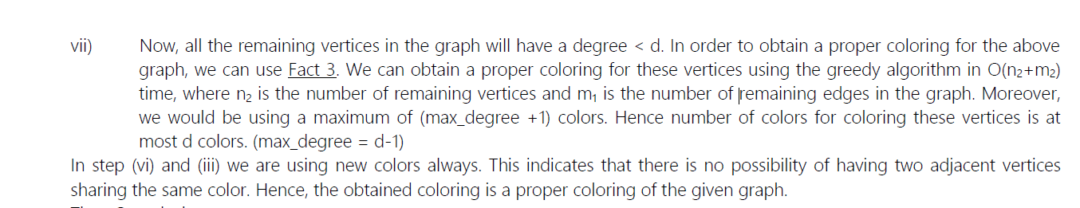
Algorithm Continued
**Algorithm taken from report
**Wigderson Algorithm chooses the value of d as ceil(root(n))

Slide 20
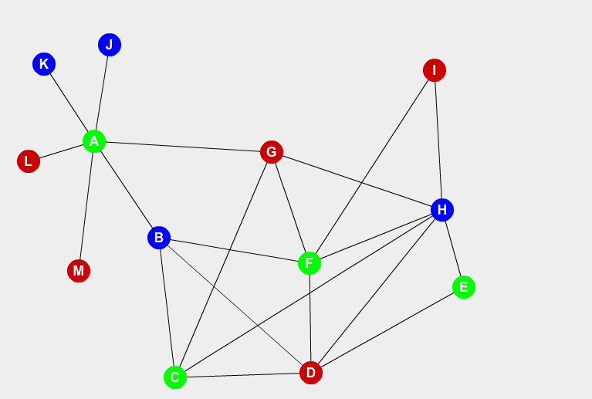
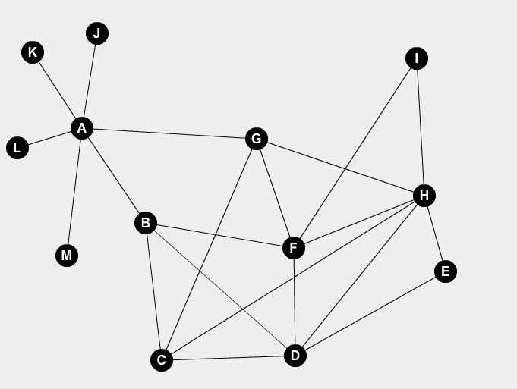
An example for the Wigderson Algorithm
Consider the following graph.
This graph is 3-colorable, as it has been colored with the help of 3-colors as shown in the Figure 1.
At step 0, the graph looks like as shown in Figure 2.
** The above figure is a self created figure(not from the internet)
Figure 1
Figure 2

Slide 21
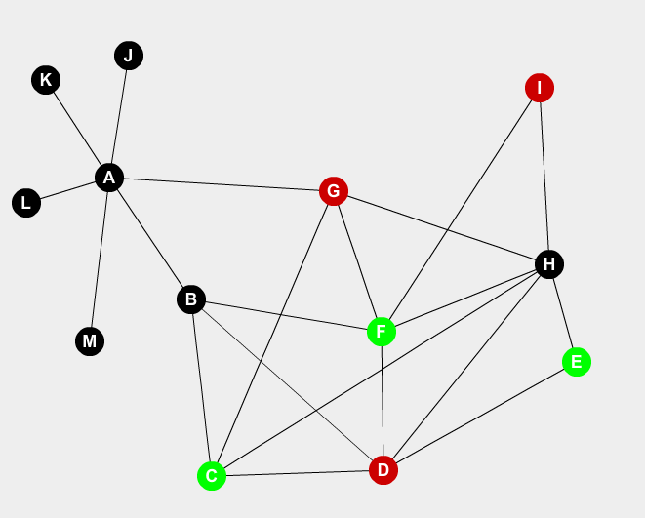
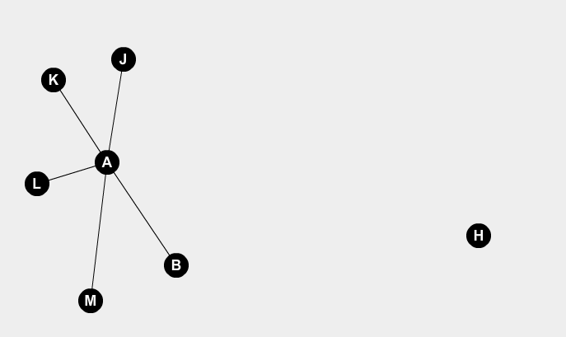
Example continued
After 2-coloring N(H)
So, in the graph, we can see that number of vertices is 13. So, d = ceil(√13) = 4.
We choose the vertex with the highest degree, i.e. H. We color its neighborhood (represented as N(H)) with 2 colors, since coloring with one color is not proper.
We then remove N(H) from the graph.
After deleting N(H) and all edges associated with it

Slide 22
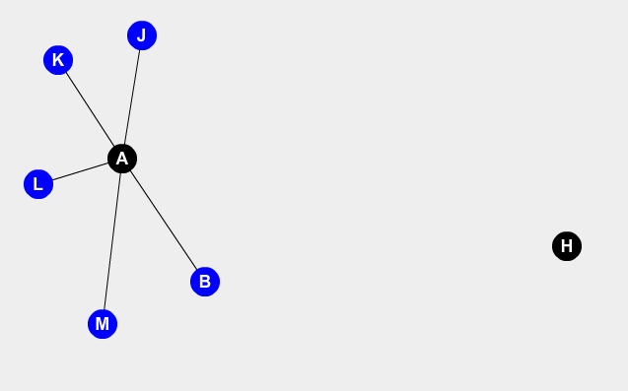
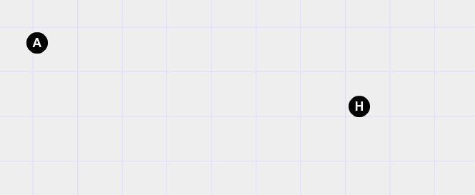
Example Continued
Now, we choose the vertex A, since it has a degree > 4.
We now try to color N(A) with a single color. We can see coloring of N(A) can be done with a single (new) color. We now proceed to the next step.
We now delete N(A) and all the associated edges.
1-coloring the N(A)
After removing N(A)

Slide 23
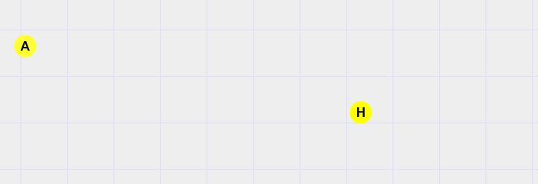
Example Continued
We now see that no vertex with degree > 4 remains.
Now, we color the remaining graph with the help of greedy algorithm using new colors.
After coloring the remaining graph using greedy Algorithm

Slide 24
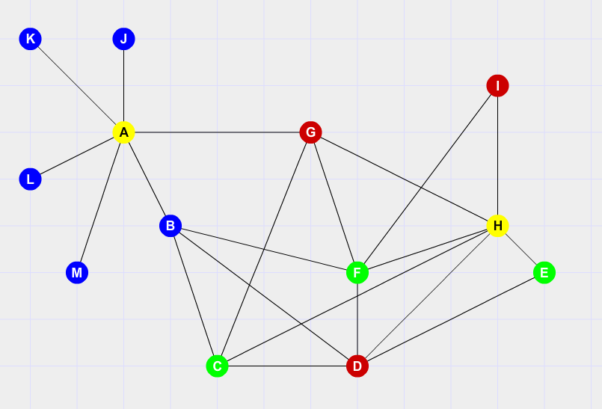
End Result
We have obtained a proper coloring of the given graph.
We can see the number of colors used is 4.

Slide 25
Time Complexity
We can observe that each vertex is visited at most twice by the algorithm. Once a vertex is colored, we would recolor it again at most once (Step iv).
All the edges are visited at most twice. So, the time complexity of the above algorithm is O(n + m), where n is the number of vertices and m is the number of the edges.
Hence, this is a polynomial time Algorithm.

Slide 26
Performance Guarantee
The Widgerson Algorithm chooses the value of d as ⌈√n⌉. (where ⌈x⌉ represents the least integer > x)
In each iteration of the loop, at least ⌈√n⌉ vertices are deleted. So, the loop runs at most n/⌈√n⌉ ≤ √n times. So, the maximum number of colors used in the loop is 2∗√n as in each iteration of the while loop at most 2 new colors are used.
And, in the last step, at most ⌈√n⌉ new colors are used. This is because the maximum degree of the remaining graph in the last step is ⌈√n⌉-1. So, by using greedy algorithm, proper coloring can be provided for the remaining graph using at most ⌈√n⌉ colors.
So, this the total number of colors used by this algorithm is at most 2∗√n + ⌈√n⌉ < 3*⌈√n⌉.
So, the upper bound for the number of colors used is in this particular algorithm is 3*⌈√n⌉.
Hence, we can say that the performance guarantee of the Wigderson Algorithm is O(√n) colors, or 3*⌈√n⌉ to be exact.

Slide 27
New Proposition
Proposition:
The upper bound for the performance guarantee of Wigderson Algorithm can be improved from 3⌈√n⌉ to 2⌈√(2n)⌉.
This could be realized by changing the value of d.

Slide 28
Suggested Method
In the above Wigderson algorithm, we have chosen d as ⌈√n⌉. But here, let us consider the value of d as ⌈√(2n)⌉. Now, in the algorithm, each iteration of the above loop will eliminate at least ⌈√(2n)⌉ vertices. So, the number of iterations of the while loop is at most (n)/(⌈√(2n)⌉) times. Since each iteration uses at most two new colors, number of colors used by the while loop is at most (2*n)/(⌈√(2n)⌉). Now, the final step of the algorithm (greedy algorithm) uses at most ⌈√(2n)⌉ new colors. So, the total number of colors used by the algorithm is:
(2*n)/(⌈√(2n)⌉) + ⌈√(2n)⌉ < 2⌈√(2n)⌉
Hence, the upper bound for the number of colors used is at most 2√(2n).
Hence, the upper bound has been improved.

Slide 29
Example
Example:
Consider a 3-colorable Graph with 100000 vertices.
The original algorithm uses at most 951 colors.
With change in the value of d, the algorithm uses at most 896 colors, an improvement of 55 colors.

Slide 30
Conclusions
So, we have studied about the Wigderson Algorithm which finds a proper Graph Coloring for 3-colorable graphs with a performance guarantee of O(√n) in O(n + m) time. The upper bound for the total number of colors used is 3⌈√n⌉, which was improved to 2⌈√(2n)⌉ in this document. The Wigderson Algorithm can be extended to other k-colorable Graphs as well, with a performance Guarantee of O(n^(k-1)/k). Approximate Graph Coloring methods can be applied to solve many problems, like making time tables, finding solutions for sudoku, map colorings, register allocation in compiler optimization, etc.

Slide 31
REFERENCES
[1]. [Wig83] Avi Wigderson. Improving the performance guarantee for approximate graph coloring. J. ACM, 30(4):729–735, October 1983.
[2] Wikipedia Website
https://en.wikipedia.org/wiki/Graph_coloring
https://en.wikipedia.org/wiki/Greedy_coloring
[3] Geeks for Geeks Website
https://www.geeksforgeeks.org/graph-coloring-set-2-greedy-algorithm/
https://www.geeksforgeeks.org/m-coloring-problem-backtracking-5/
[4] Colouring 3-Colorable Graphs. Charles Jin (2015)

Slide 32
REFERENCES CONTINUED
[5]. *B. Berger and J. Rompel. A better performance guarantee for approximate graph coloring. Algorithmica, 5(3):459–466, 1990.
[6] Open Genus Website
https://iq.opengenus.org/wigderson-algorithm/
[7] Introduction to Algorithms, Second Edition, Thomas H. Cormen, Charles E. Leiserson, Ronald L. Rivest
34-3: Graph Colouring Problem
34: NP Complete Problems
[8] *Exact Algorithms for the Graph Coloring Problem Algoritmos Exatos para o Problema da Coloração de Grafos Alane Marie de Lima1 *, Renato Carmo2
[9] *Approximate Coloring -Advanced Algorithms -Lecture Notes, Islamic University of Science & Technology
*minor references

Slide 33
Thank You
Presenters:
Udandarao Sai Sandeep 180123063
Karan Gupta 180123064

