Slide 1


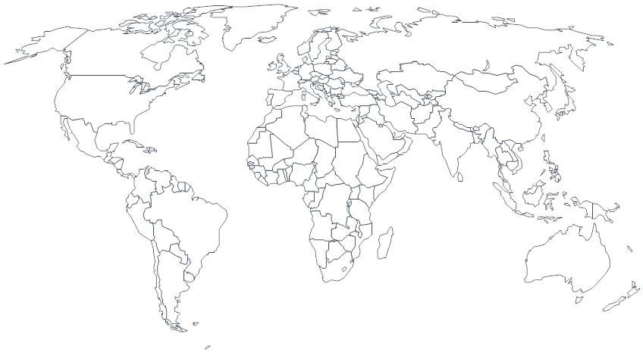


going global with i18n4go
dr.max @maximilien
ibm cloud labs
maximilien.org
v0.4.1
April 23rd, 2015

Slide 2

Agenda
motivations
what? how? and when?
goals and design points
overview of approach
demo
technical details and contributing
what next? and future work

Slide 3
motivations
IBM Bluemix (based on CloudFoundry) is worldwide PaaS
CloudFoundry CLI is written in Golang & is main entry to CF
Golang support for internationalization (i18n) is minimal
existing i18n for Golang mainly runtime libraries
how to convert existing and green field Golang code to i18n?
supporting i18n requires lifecycle tooling:
code, test, continuous integration (CI)
deployment and maintenance

Slide 4
what? how? and when?
what?
internationalization (i18n) tooling for the Golang: github.com/maximilien/i18n4go
supports lifecycle i18n workflows for both existing and green field Golang programs
how?
written entirely in Golang
makes heavy use of Go’s AST package to manipulate program source code
when?
created by IBM and Pivotal in July 2014 and in used since by CloudFoundry CLI
available under Apache 2.0 OSS license; email: i18n4go at the Gmail domain

Slide 5
seven goals or design points
automate as much as possible
support both: pre- and post-facto i18n use cases
maintain Golang’s static compile-time checks
keep code readable (as much as possible)
minimal external dependencies
JSON and PO resource file types
implement in Golang

Slide 6
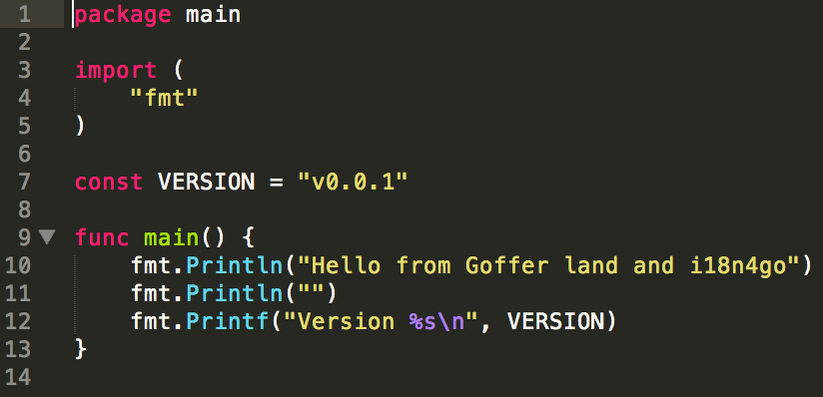
hello world - original

Slide 7
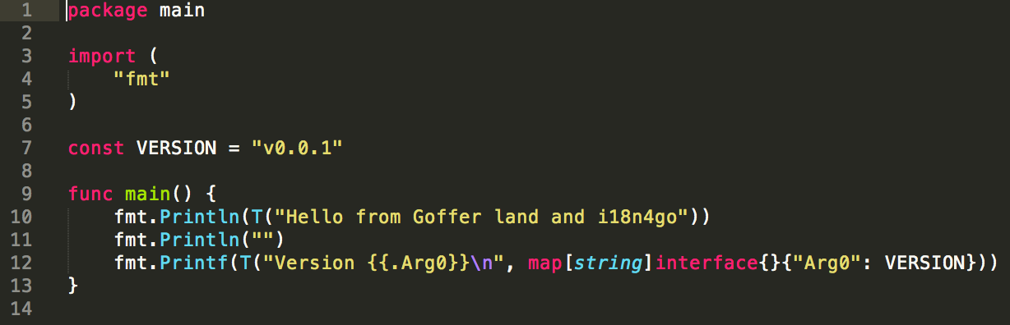
hello world - desiderata

Slide 8
overview of approach
use @NickSnyder’s go-i18n project on Github for runtime
created tooling for
extracting and merging strings from Golang programs
rewriting Golang code to enable i18n translations
verify strings and different i18n resources
initialize locale by auto discovery (depends on OS)
i18n4go enables all of the above and more

Slide 9
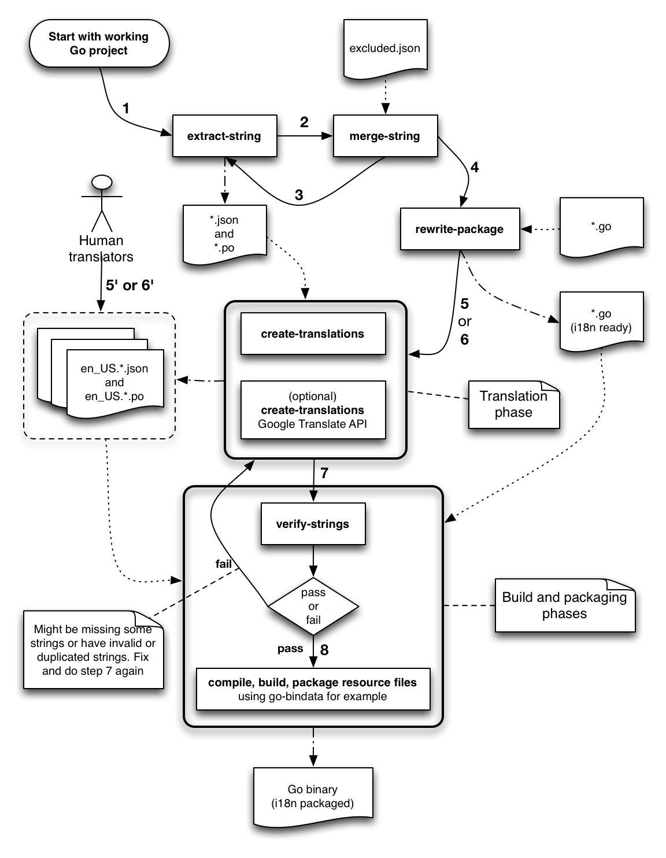

overview of approach (cont.)

Slide 10
hello world - initial program
package main
import (
"fmt"
)
const VERSION = "v0.0.1"
func main() {
fmt.Println("Hello from Goffer land and i18n4go")
fmt.Println("")
fmt.Printf("Version %s\n", VERSION)
}

Slide 11
hello world - extracted strings (en_US)
[
{
"id": "Hello from Goffer land and i18n4go",
"translation": "Hello from Goffer land and i18n4go",
"modified": false
},
{
"id": "Version {{.Arg0}}\n",
"translation": "Version {{.Arg0}}\n",
"modified": false
}
]

Slide 12
hello world - rewritten code
package main
import (
"fmt"
)
const VERSION = "v0.0.1"
func main() {
fmt.Println(T("Hello from Goffer land and i18n4go"))
fmt.Println("")
fmt.Printf(T("Version {{.Arg0}}\n",
map[string]interface{}{"Arg0": VERSION}))
}

Slide 13
hello world - i18n init code (partial)
…
func Init(detector Detector) goi18n.TranslateFunc {
var T goi18n.TranslateFunc
var err error
var userLocale string
userLocale, err = initWithUserLocale(detector)
if err != nil {
userLocale = mustLoadDefaultLocale()
}
T, err = goi18n.Tfunc(userLocale, DEFAULT_LOCALE)
if err != nil {
panic(err)
}
return T
}
…

Slide 14
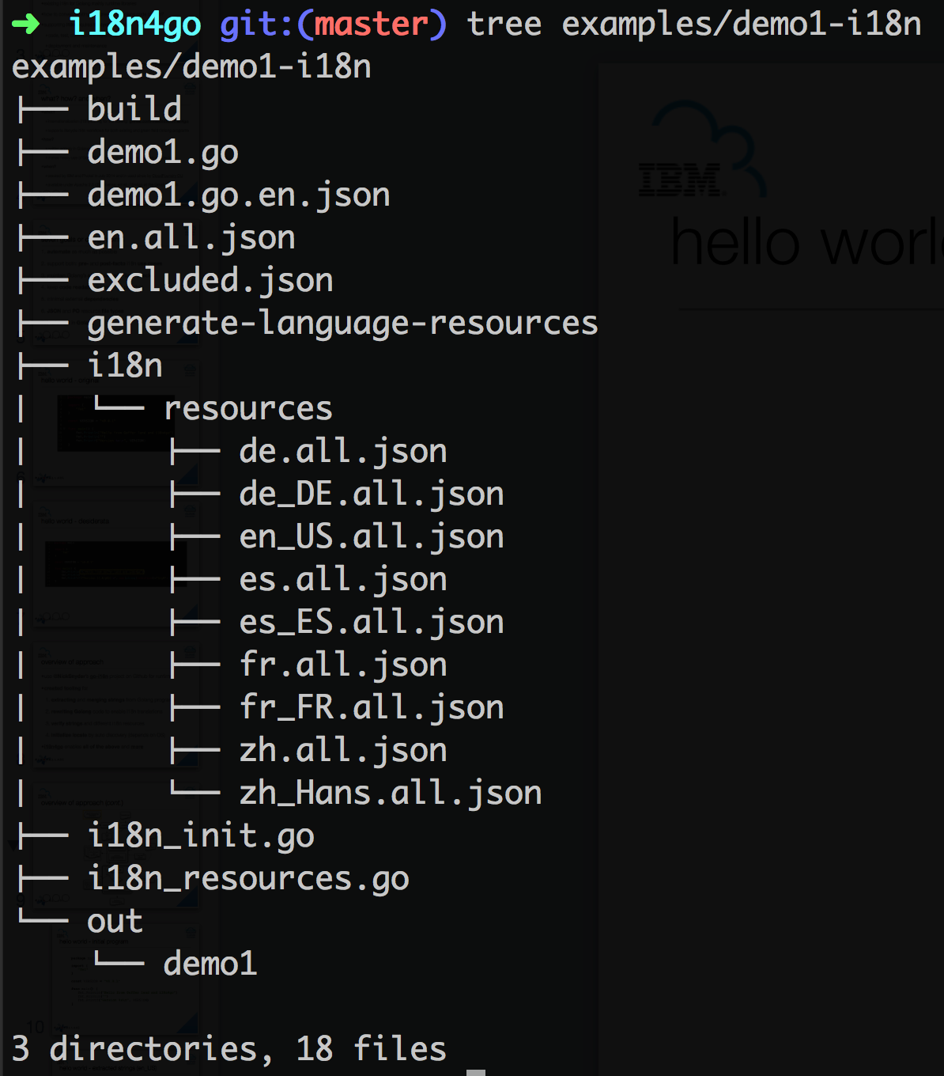
hello world - resulting code structure

Slide 15
demo
live demo
https://github.com/maximilien/i18n4go/tree/master/examples/demo1

Slide 16
technical details
heavy use of golang.org/pkg/go/ast package
extract-strings and rewrite-package
go-fmt to reformat code (uses AST as well)
auto create-translations is OK but humans way better
need to package i18n JSON as binary, e.g., go-bindata
verify-strings and checkup and fixup for maintenance

Slide 17
what next?
being used for about one year now in CF CLI
can we simplify basic workflow even more?
other auto-translators? e.g., IBM Watson, Bing
support strings with localized dates, currency, numbers
socialize to Golang communities, e.g., GoSF
we welcome contributors…

Slide 18

credit: http://knowyourmeme.com/photos/522333-language

Slide 19

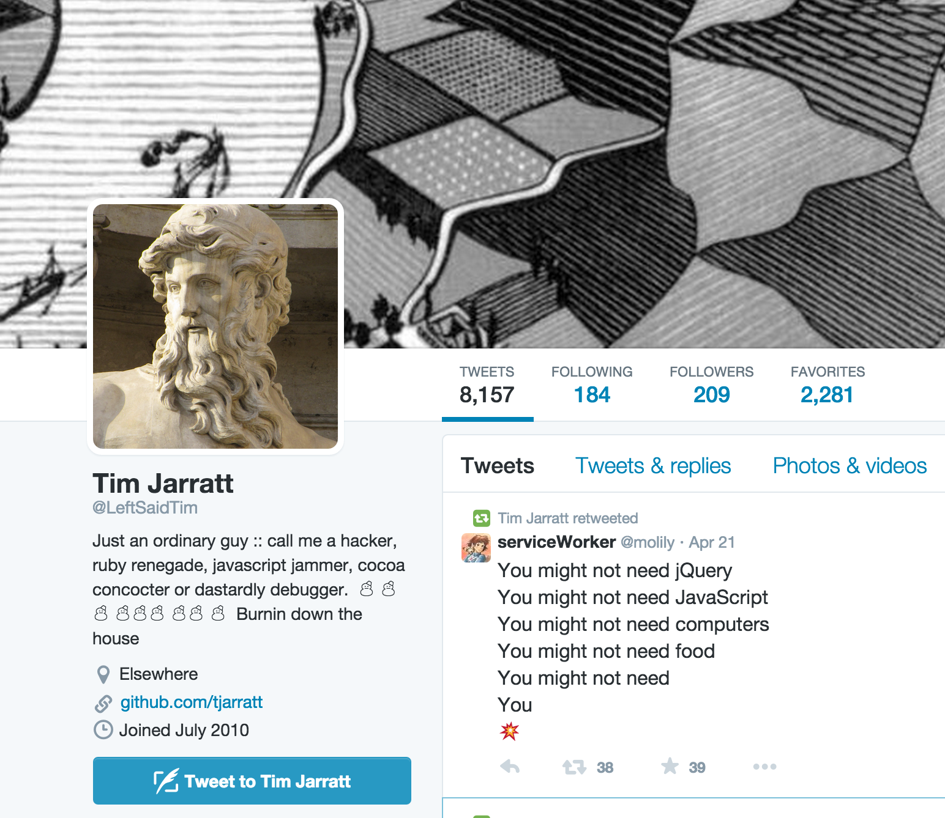


@maximilien
Various
at
Pivotal
@UsedRecently
@LeftSaidTim
@jberkhahn
Simon Leung
Dan Lavine

