Slide 1



cf-swagger
giving CF APIs their swagger back!
Mohamed Mohamed (IBM Research) and Michael Maximilien (IBM)
v0.7.0
September 16th, 2015

Slide 2
agenda
what is swagger?
what part of CF could use swagger?
CF Service Broker APIs
docs,
server, clients,
tests and TCK
value of TCK survey results
what next?
Notes:
quickly introduce swagger
Max

Slide 3






what is swagger?
OSS API description language and tools
describe REST APIs (in JSON/YAML)
Use OSS tooling to generate
API docs
code artifacts, e.g., client and server stubs
Flexible, customizable, and OSS
growing number of companies using
Notes:
Give some details on swagger description

Slide 4
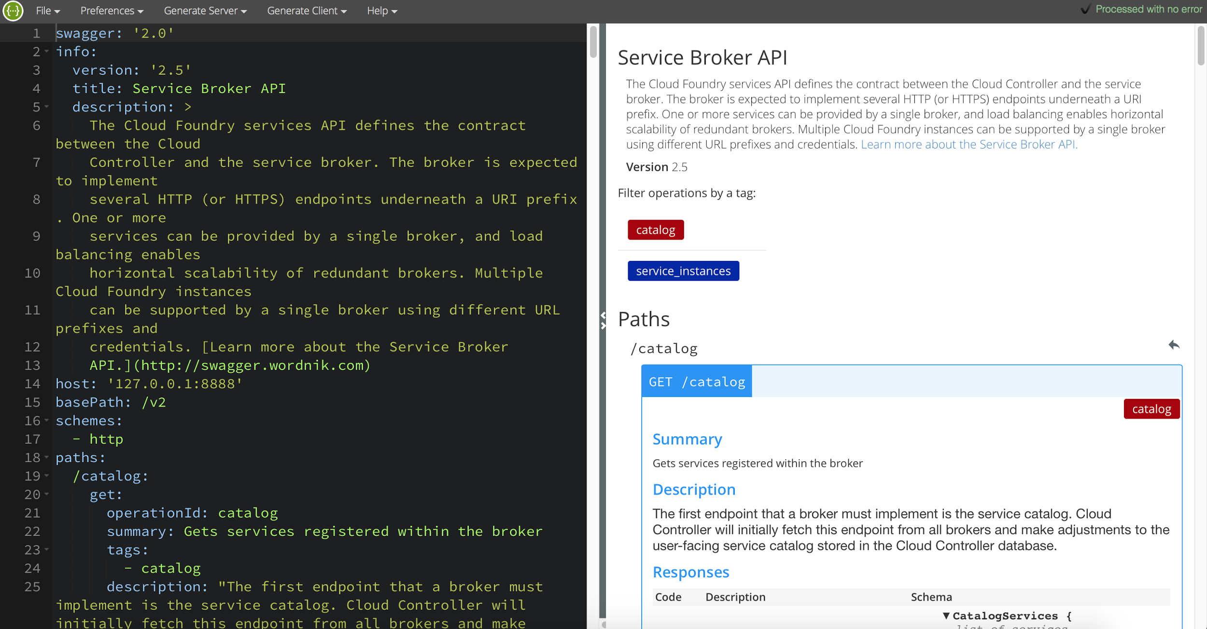
what is swagger?: interactive editor

Slide 5
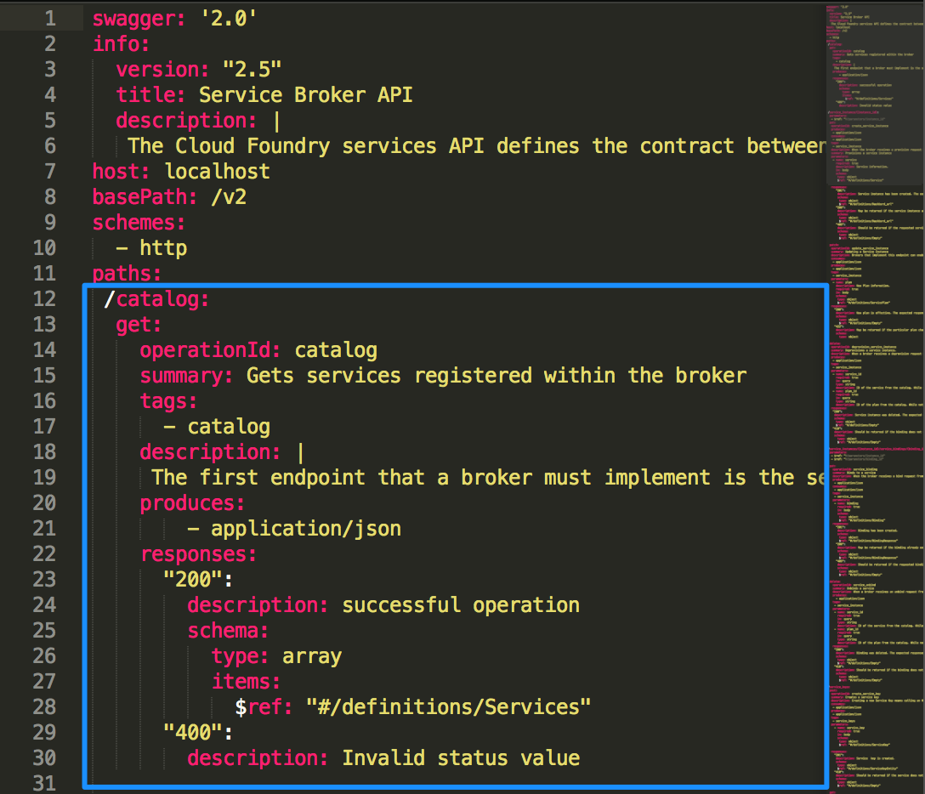
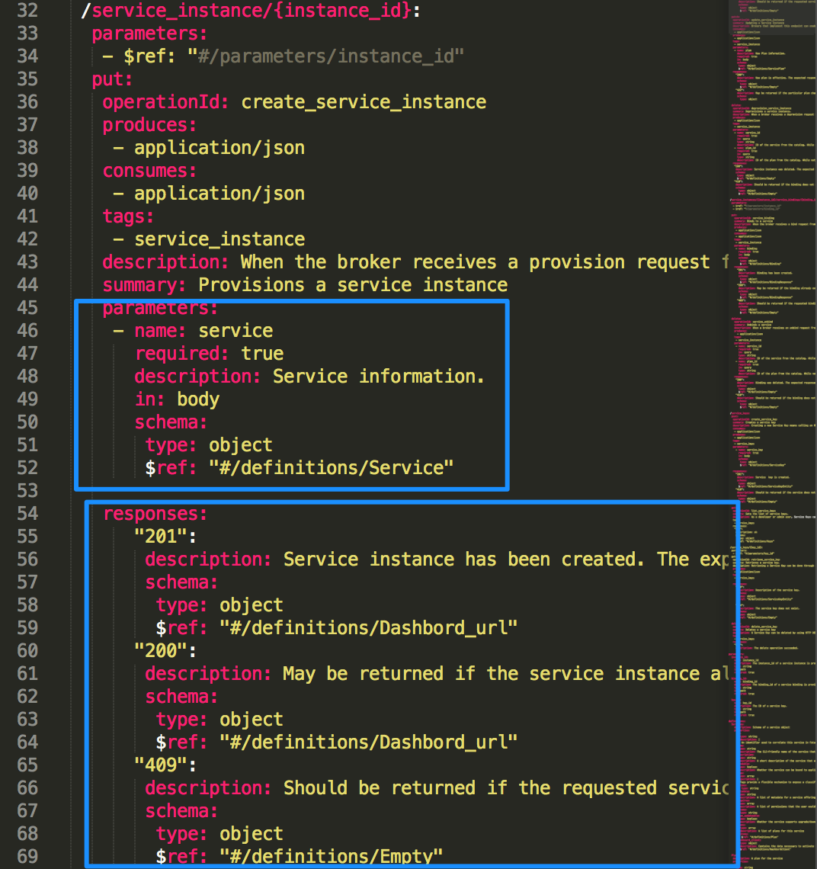
what is swagger?: spec details
Notes:
move onto the demo

Slide 6
what is swagger? (cont.)
Demo 1
swagger editor
swagger description for CF service brokers
generated API docs

Slide 7
cf-swagger
describe all CF APIs (eventually)
CF services: broker APIs
CF Cloud Controller: v3
UAA APIs
generate API docs
generate API client and servers (stubs)
generate test suites for API servers
generate Test Compatibility Kits
Notes:
Introduce swagger CF and Go to services

Slide 8
cf-swagger: service broker APIs
API docs
server generation
extending the swagger spec
prototypes for
unit and integration tests generation
Test Compliance Kit (TCK) generation

Slide 9
cf-swagger: why a TCK?
some CF APIs are “plugins” or “extensions”
designed to allow many (1K+) providers
heterogeneous supporting lots of versions
tests are templatized-able and tedious
TCK is meant for
verifying compliance level of broker
tell you what part of spec is not supported

Slide 10
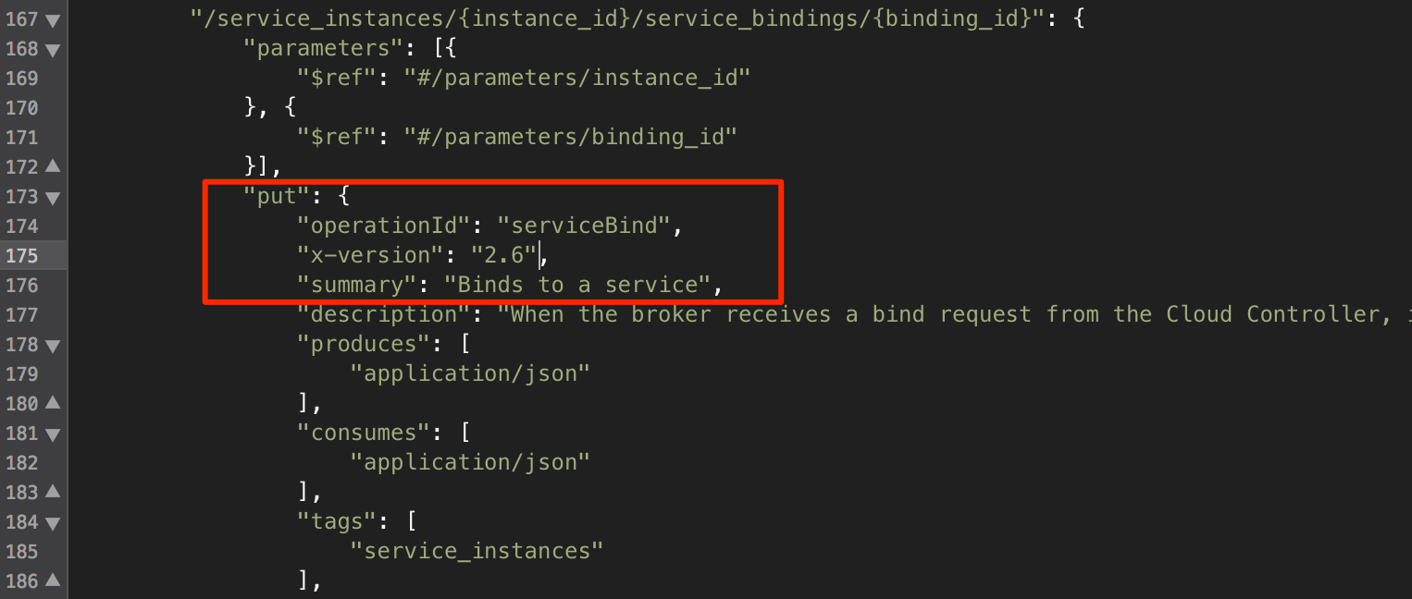
cf-swagger: spec extensions

Slide 11
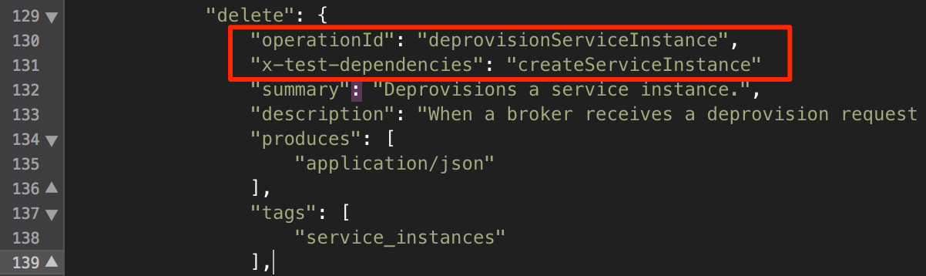
cf-swagger: spec extensions (cont.)

Slide 12
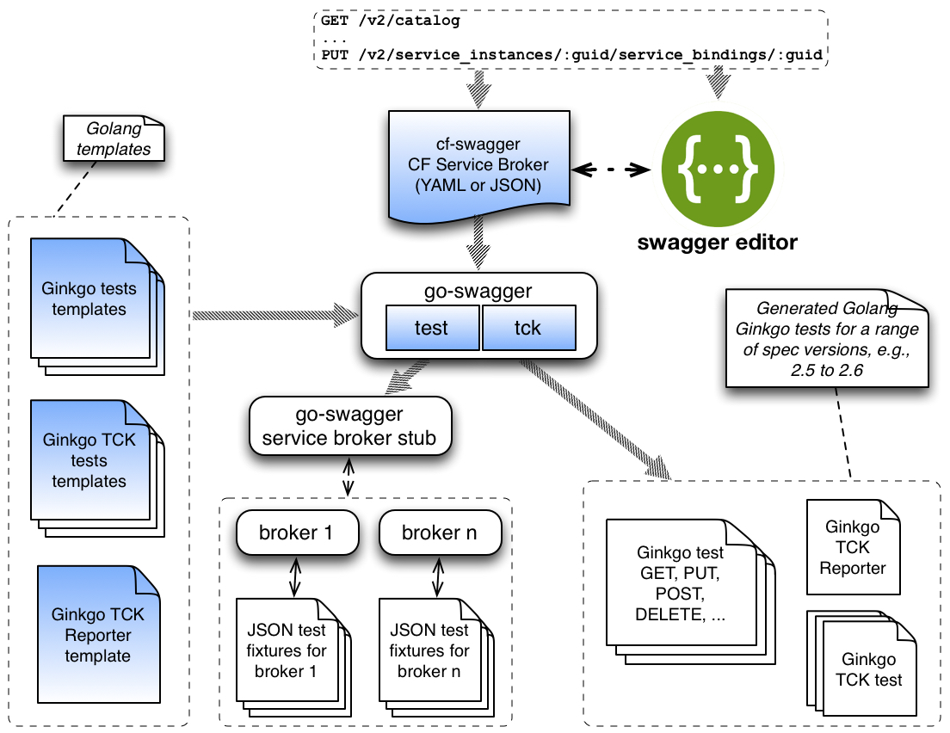
cf-swagger: high-level overview

Slide 13
cf-swagger (cont.)
Demo 2
swagger spec extension for test and TCK
go-swagger test command
go-swagger tck command
running tests with real broker

Slide 14
existing solutions?
Bluemix: servicebrokertest
manually created
stuck at v2.3 of spec
Others?
CATs services tests
manual, indirectly with CF CLI

Slide 15
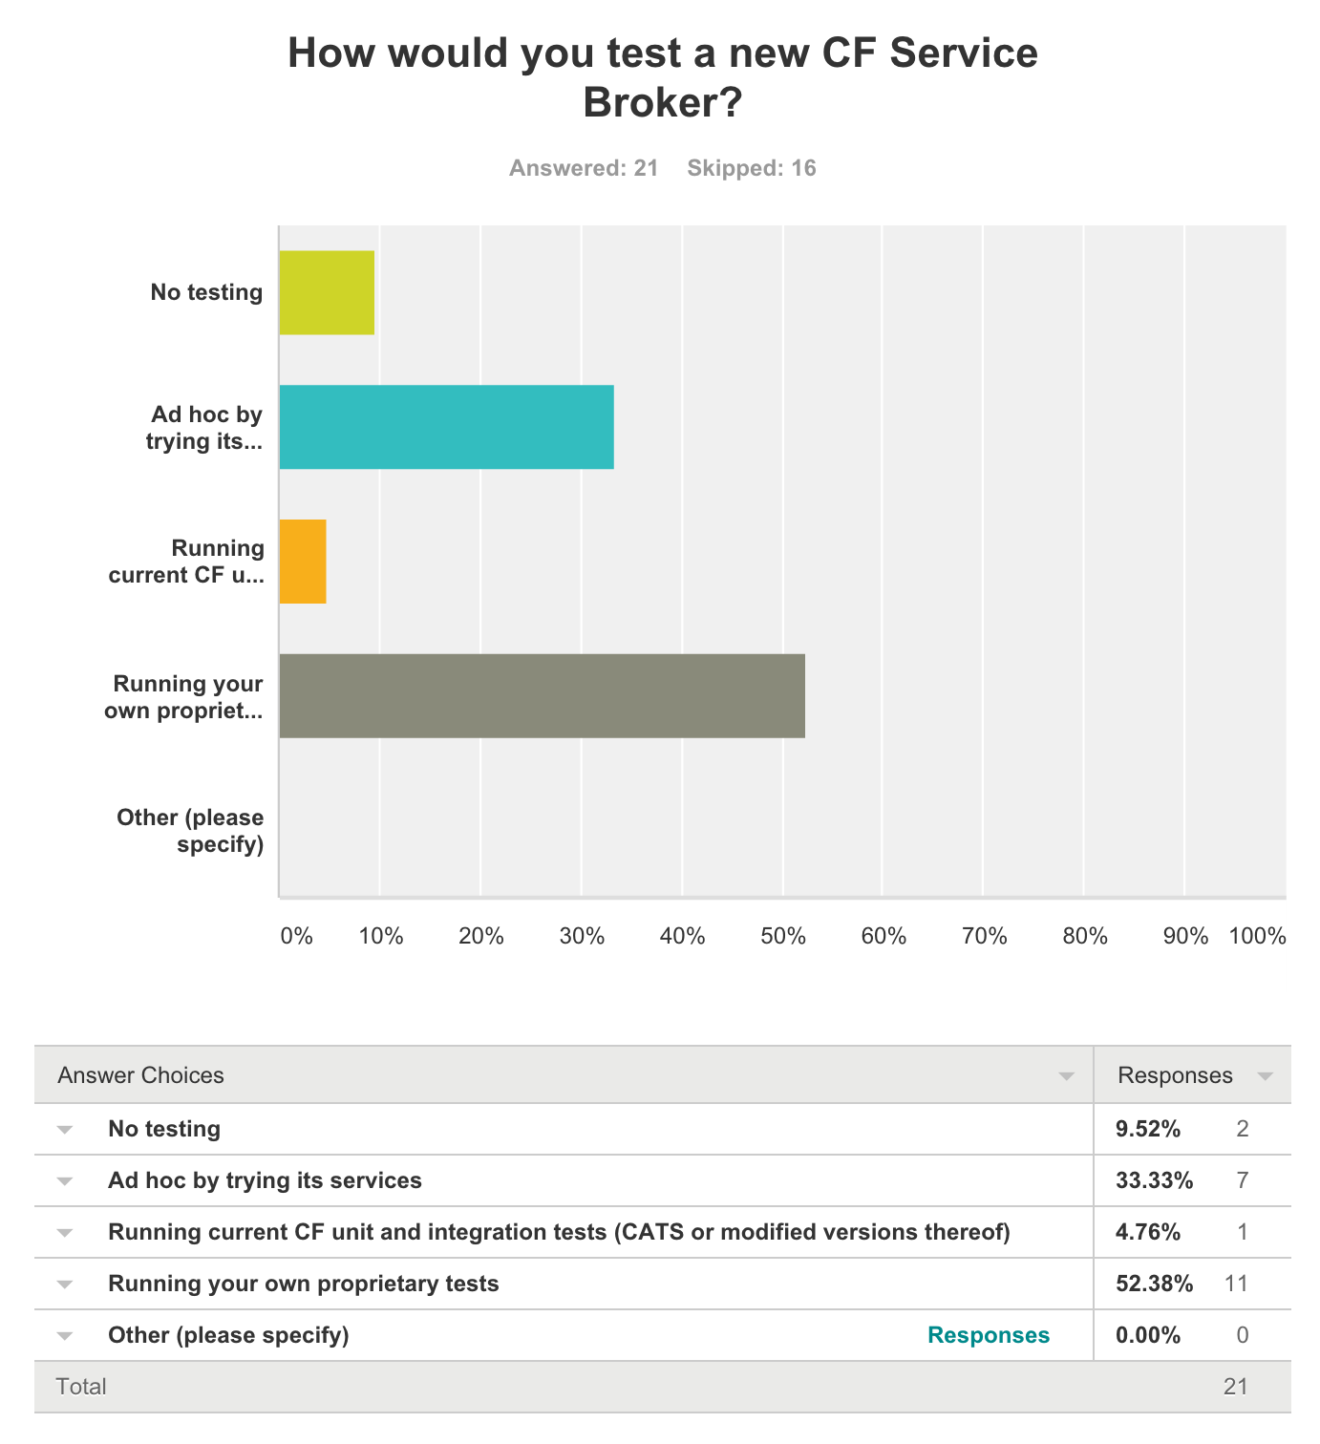
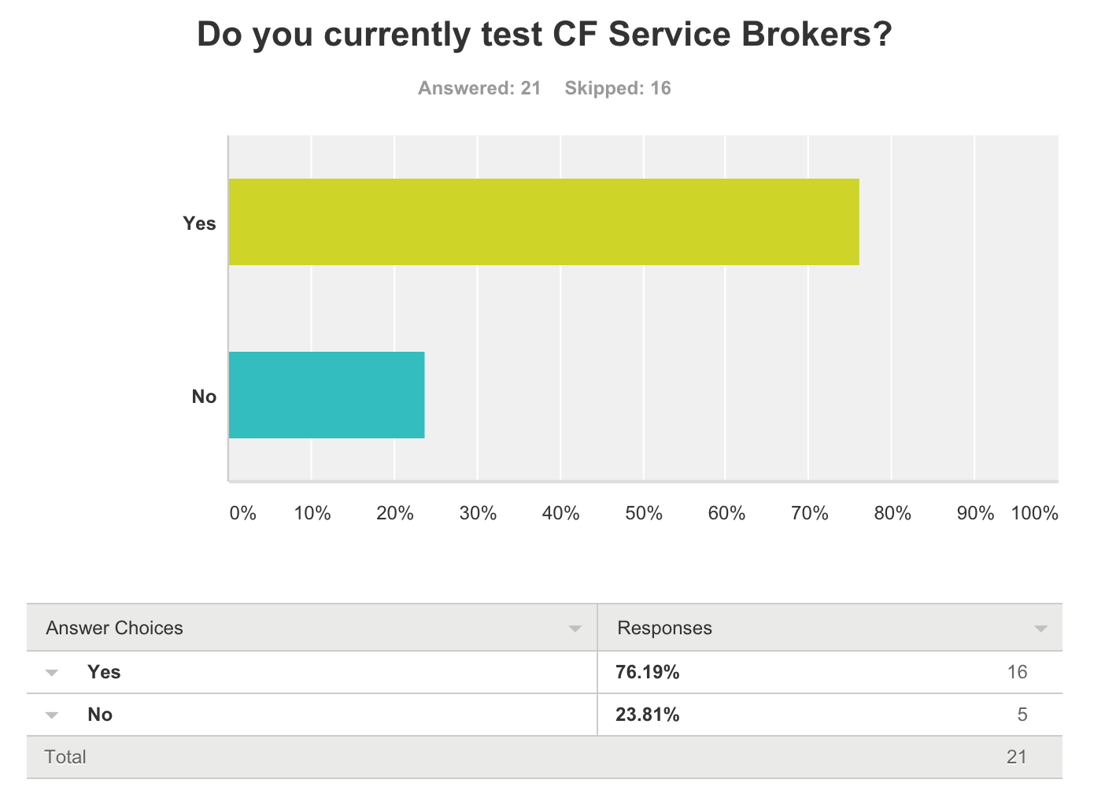
survey results: test strategy

Slide 16
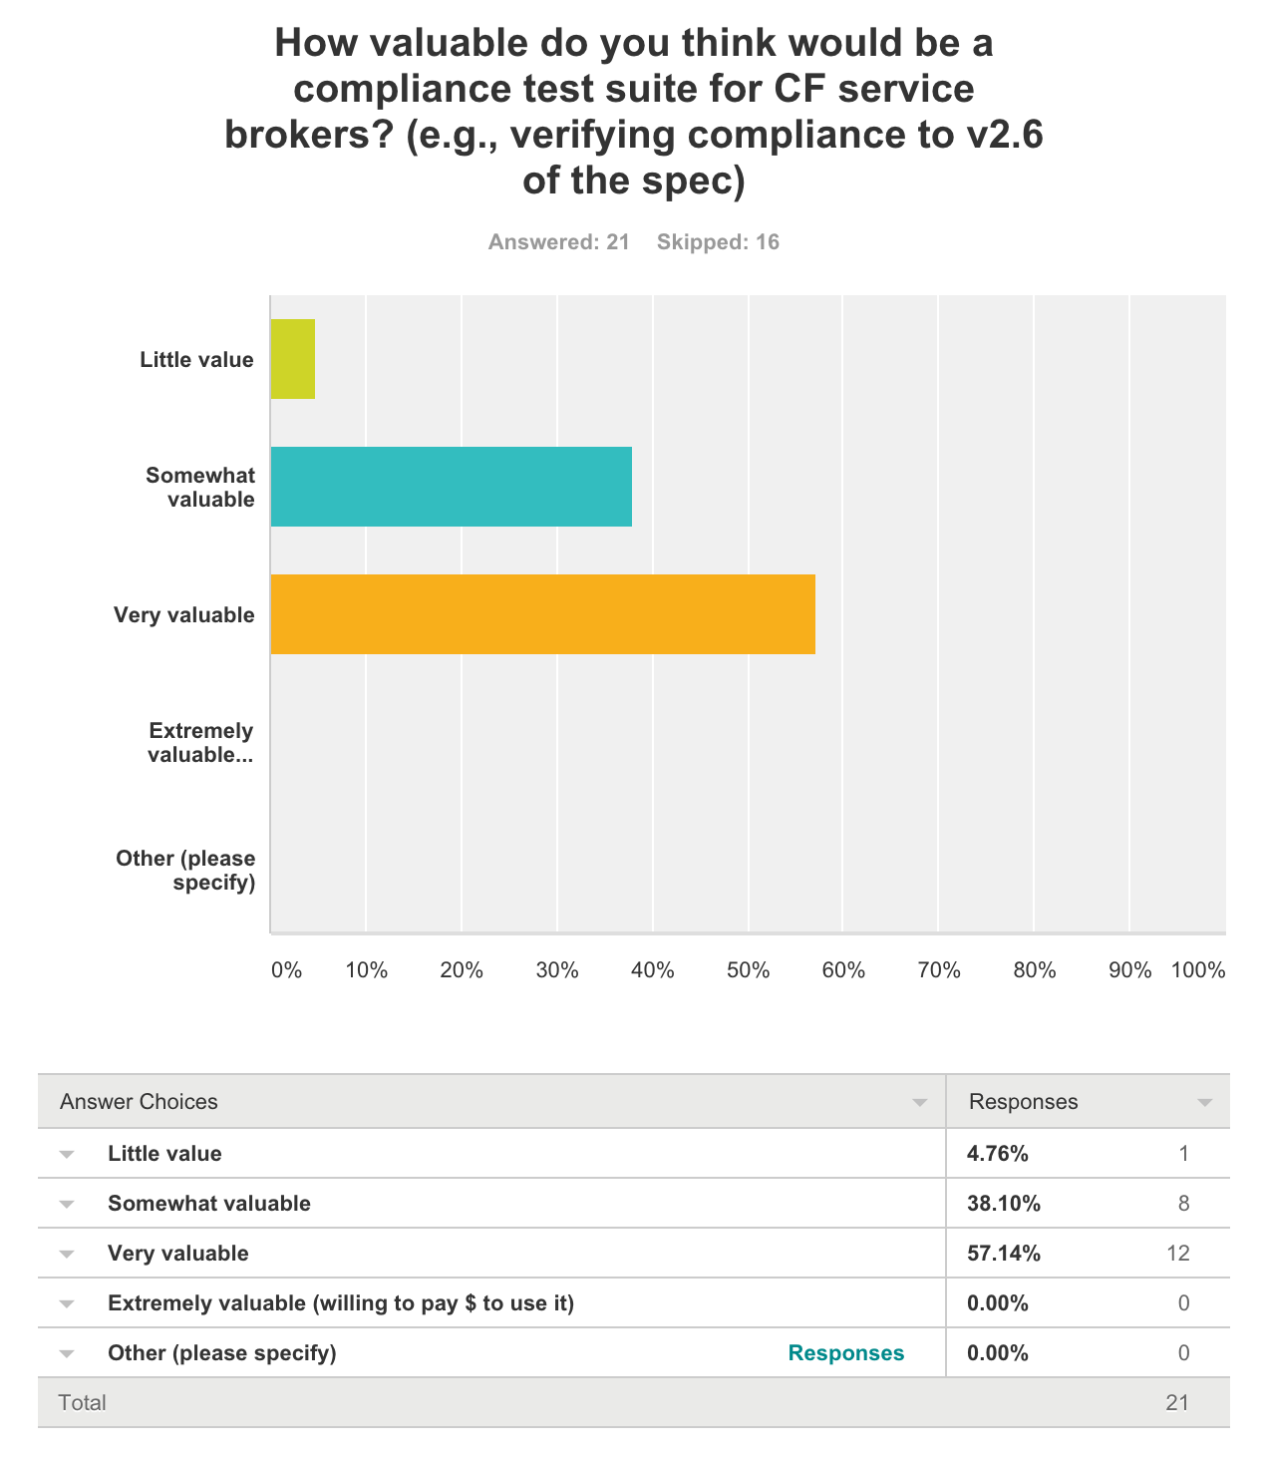
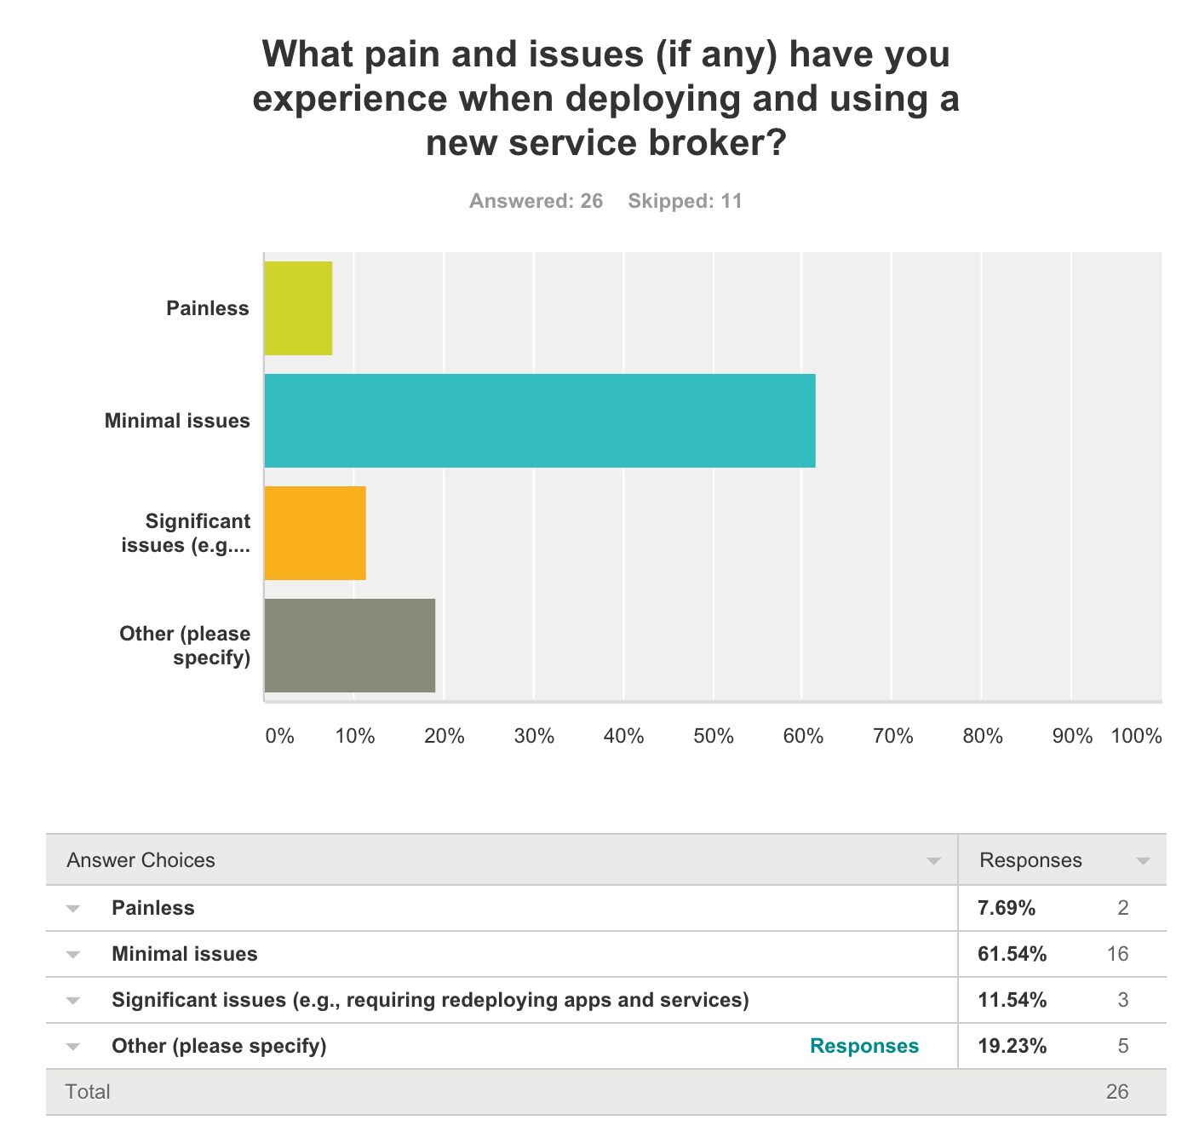
survey results: pain & TCK value

Slide 17
what next?
TCK
complete and harden the code generation
submit code-generation changes to go-swagger
explore describing other CF APIs
CC v3 (?)
UAA, CF-Abacus
socialize with CF community: dW Open and cf-swagger incubators?

Slide 18
thank you
QAs

Slide 19
https://github.com/maximilien/cf-swagger

Slide 20
backup

Slide 21
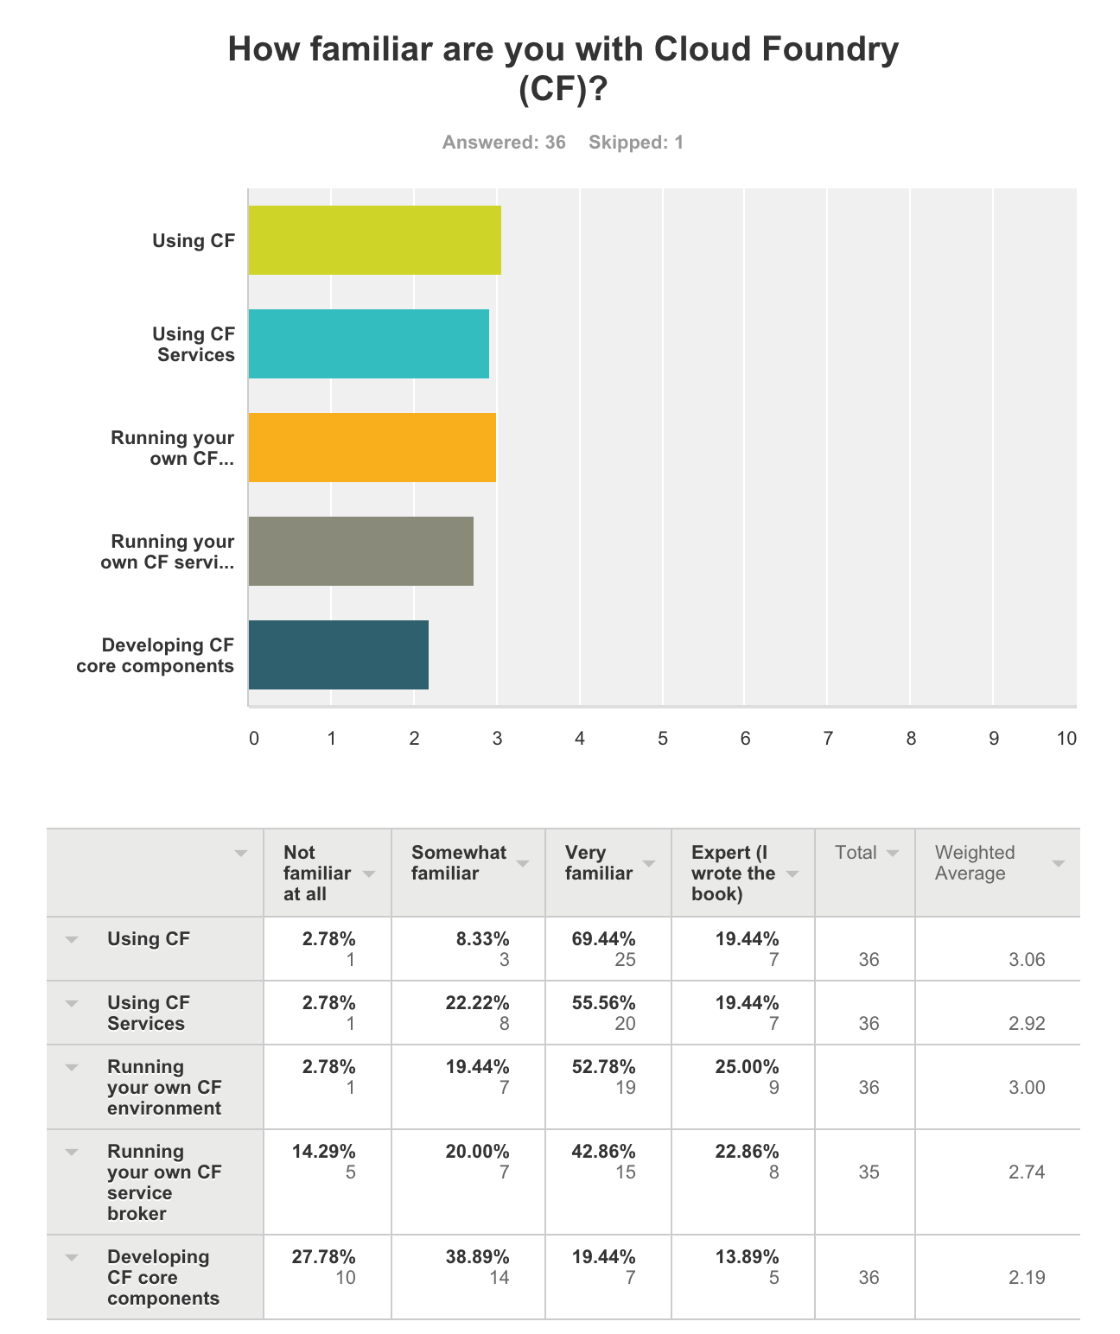
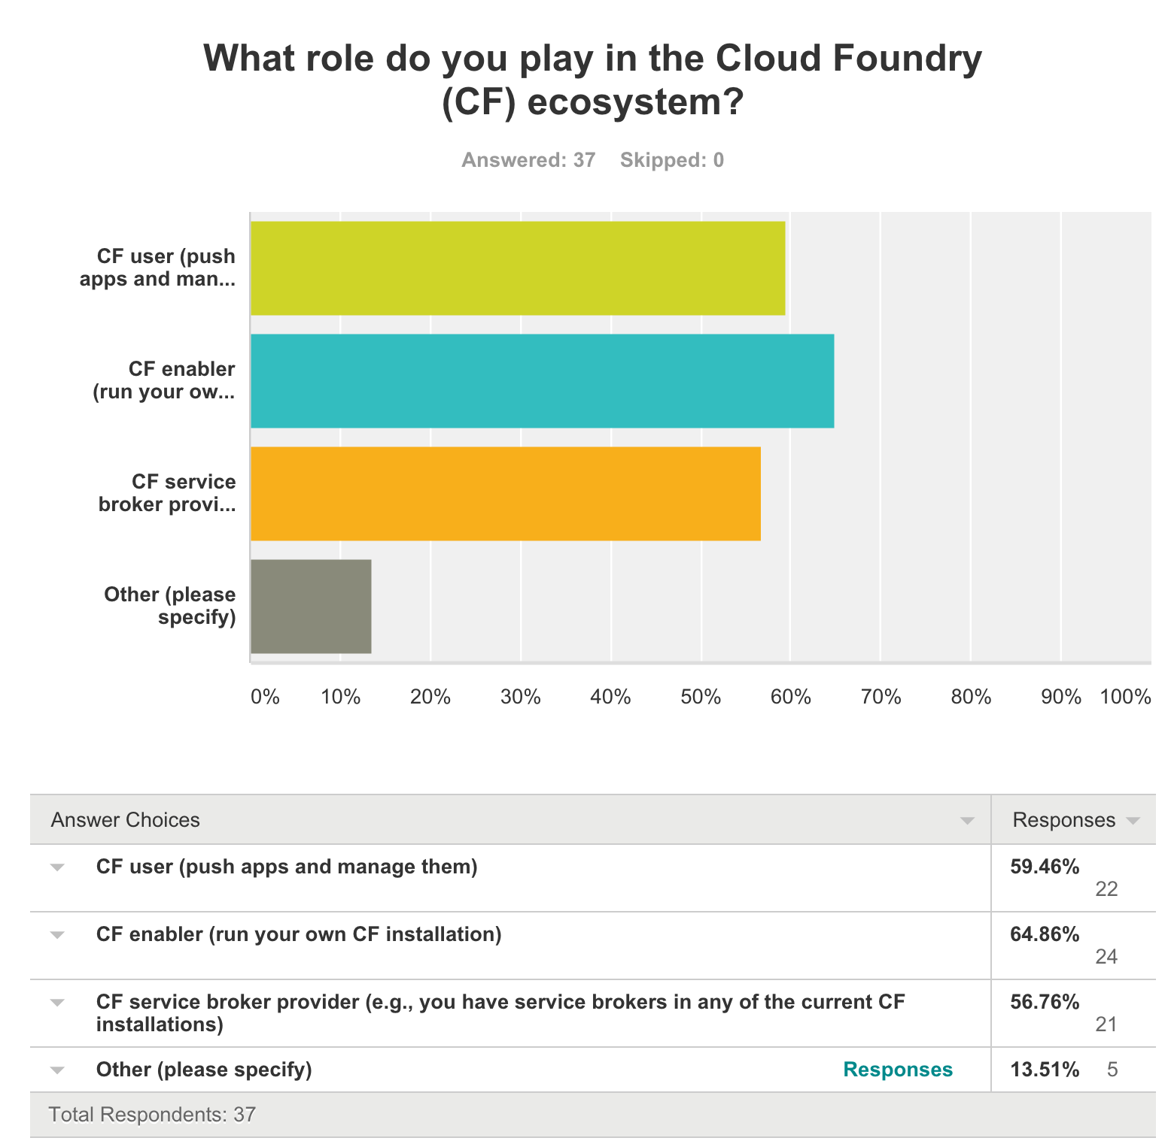
survey results: CF role & familiarity

Slide 22
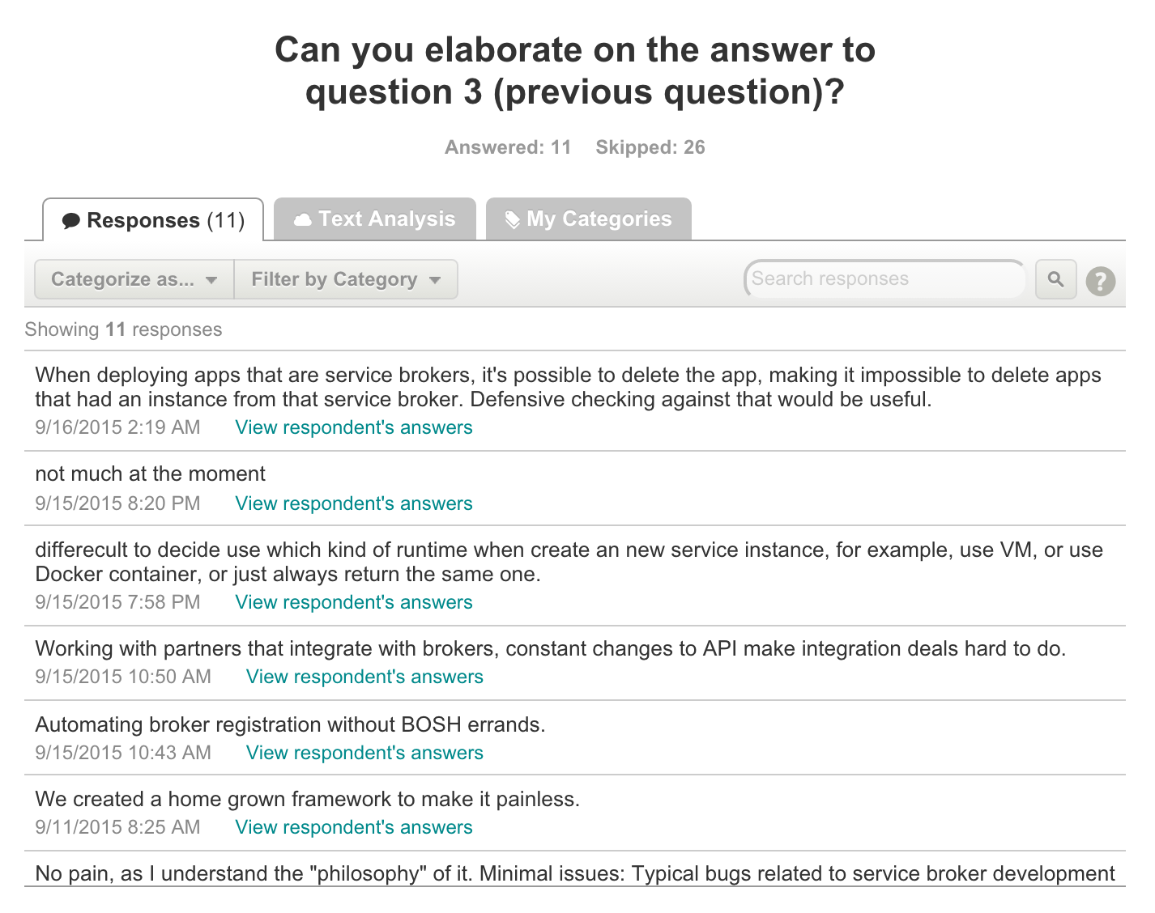
survey results: detail on pain

