Slide 1
Data-driven insights from aviation accident data (1962–2023)
Notes:
An Analysis of Aviation Accident Data (1962–2023)

Slide 2
Business Understanding
Problem Statement :
The Cozzy Airlines company is set to expand and wants to acquire aircrafts.
Key Business Question:
Which aircraft types present the lowest operational risk for initial investment?

Slide 3

Data Understanding
Data Source
The National Transportation Safety Board (NTSB)
Aviation accidents and incidents (1962–2023)
Extracted from Kaggle
Data Description
With over 90,000 accident records
Has 30+ variables including:
- Aircraft category
- Engine type
- Fatalities(minor , serious , fatal )
- Event and publication dates
- Weather conditions

Slide 4
Data Preparation
Filling Null Values and Removing almost null values
Changing Data types
Removing Duplicate Data
Steps to Clean the data

Slide 5
DATA ANALYSIS & VISUALIZATION
Visualization was done using matplotlib in python and also using tableau

Slide 6
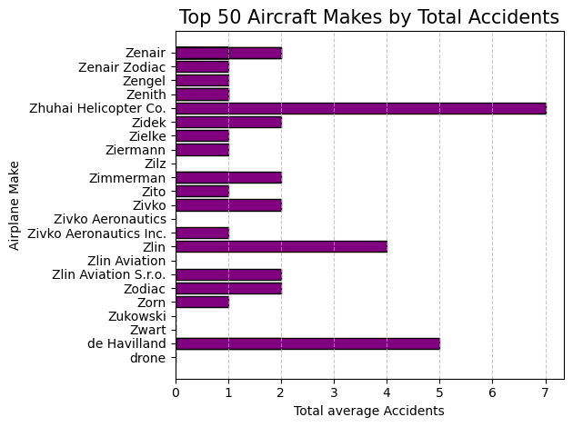
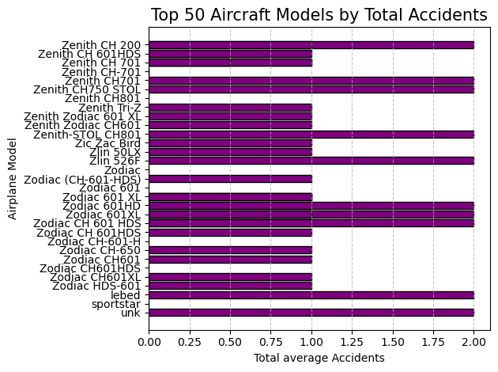
Top 50 Aircraft Makes by Total Accidents
Top 50 Aircraft Models by Total Accidents
Top 50 Aircraft Makes and Models VS Total accidents

Slide 7
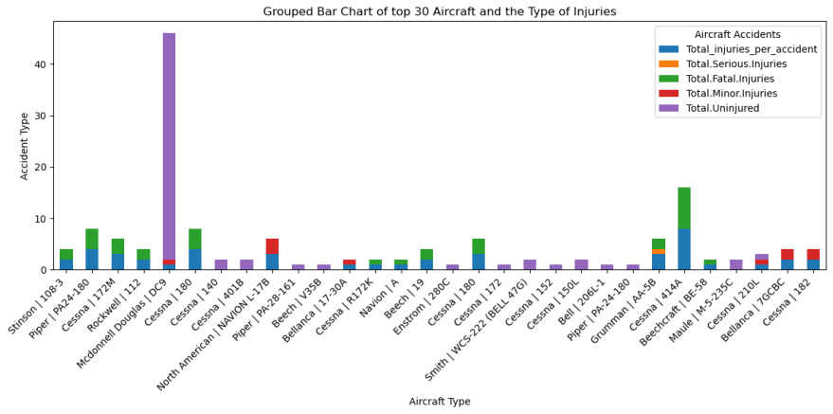
Aircraft Type vs Injuries fatalities

Slide 8
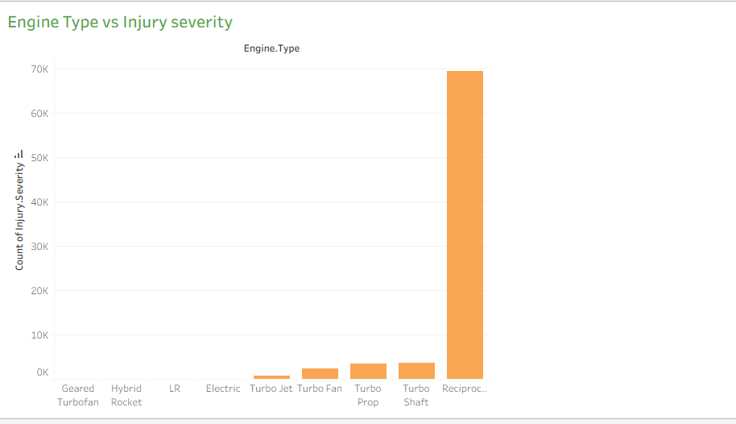
Engine Make vs Injury Severity

Slide 9
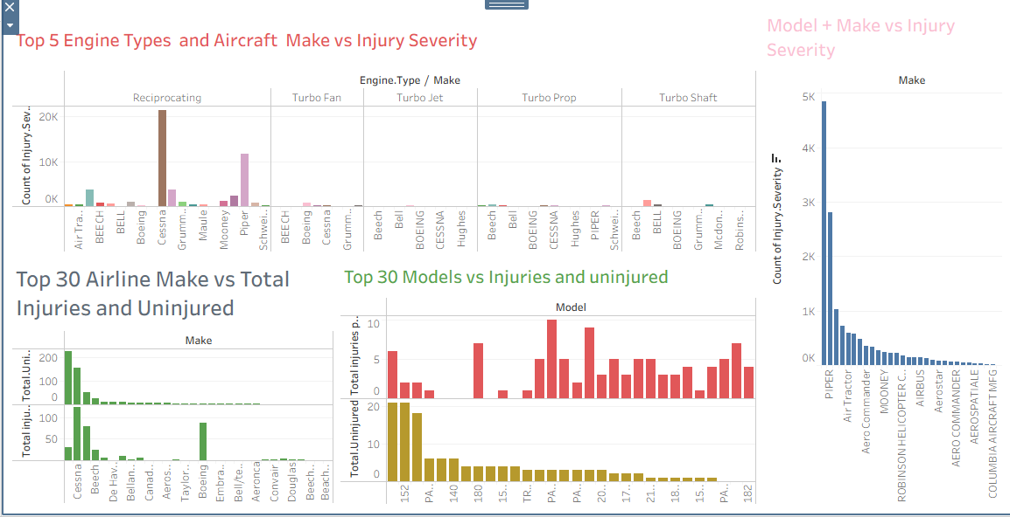
Interactive Dashboard

Slide 10
BUSINESS RECOMMENDATIONS
Top Aircraft Makes
Zenith CH-701
Top Aircraft Models
Zilz
Top Aircraft Engines
Geared TurboFan
zodiac
Zodiac CH-601-H
Zodiac CH601XL
Sportstar
Zwart
drone
Zlin Aviation
Hybrid Rocket
LR
Electric
Zukowaski
Modern Aircraft makes and models with newer engine make technologies are associated with reduced accident severity.
Pilot decisions and experience contribute to most accidents.
Commercial aviation frameworks provide safer operational environments.

Slide 11

THANKYOU ☺
Any Questions ?
Feel Free to ask
Check me out on linked in @SenseiKarani

