Slide 1
ISCG6420 Internet & Website Development: Assignment B
Presented by Kyung Min Kim & Anna McColl
8th June 2021

Slide 2
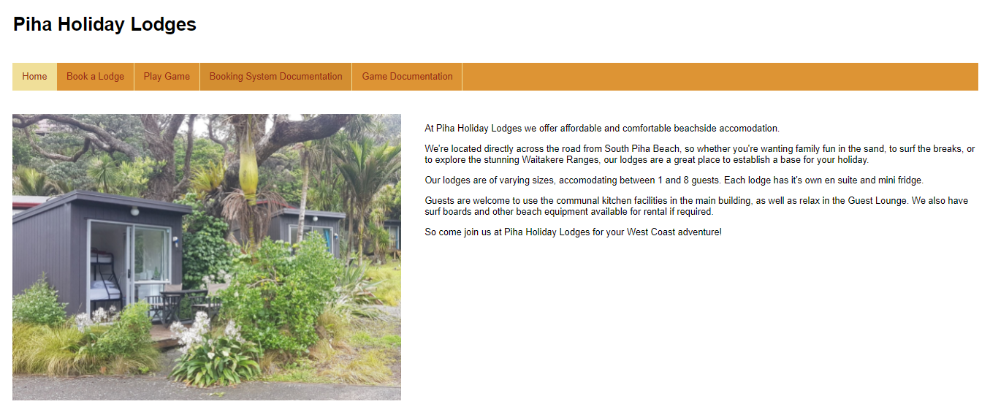
Landing Page

Slide 3
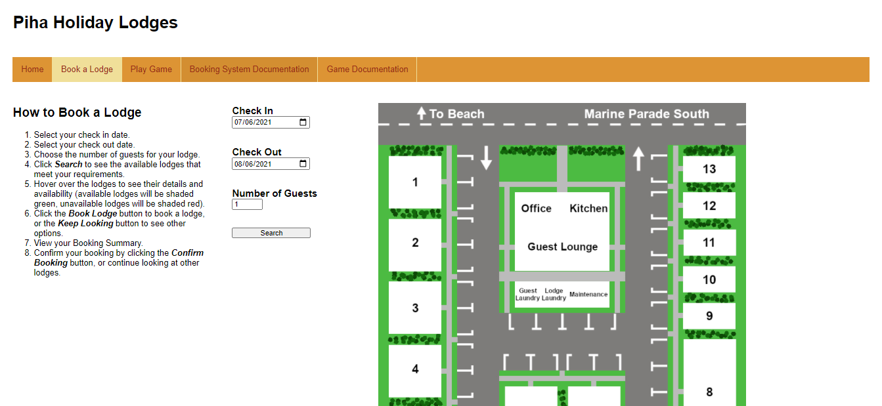
Online Booking System
Data Dictionaries and XML Documents
Lodge Information
Current Bookings
Booking System Features
Date Pickers
Number Pickers

Slide 4
Online Booking System
Data Dictionaries and XML Documents
Lodge Information
Current Bookings
Booking System Features
Date Pickers
Number Picker
Canvas
Modals

Slide 5
Lodge Information – Data Dictionary
Field Name | Data Type | Description
Name | Number | The Lodge Number, the Primary Key.
MaxCapacity | Number | The maximum number of guests the lodge can accommodate.
NightlyRate | Number | The amount of money charged per night for the lodge.
CheckInTime | Text | The earliest the lodge is available for guests to check in.
CheckOutTime | Text | The latest guests are allowed to check out of the lodge.
Image | Text | The file name for an image containing an interior view of the lodge.
ImageX | Number | The X co-ordinate (in pixels) of the lodge’s left-most point on the map of Piha Holiday Lodges.
ImageY | Number | The Y co-ordinate (in pixels) of the lodge’s top-most point on the map of Piha Holiday Lodges.
ImageWidth | Number | The width (in pixels) that the lodge takes up on the map of Piha Holiday Lodges.
ImageHeight | Number | The height (in pixels) that the lodge takes up on the map of Piha Holiday Lodges.

Slide 6
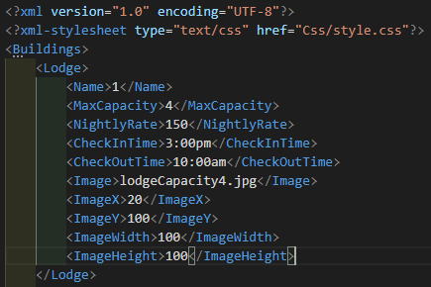
Lodge Information – XML Document

Slide 7
Current Bookings – Data Dictionary
Field Name | Data Type | Description
Reference | Text | The booking’s Reference Number, the Primary Key. It is made up of the Lodge Number and the Check In Date in L-YYYY-MM-DD format (L represents the Lodge Number).
LodgeNumber | Number | The number of the lodge booked.
CheckInDate | Text | The date that the booking’s guests will check in (in full string format).
CheckOutDate | Text | The date that the booking’s guests will check out (in full string format).
AgreedNightlyRate | Number | The Nightly Rate at the time of booking.
TotalCost | Number | The total cost of the Booking.
NumberOfGuests | Number | The number of guests who have applied to stay in the lodge.

Slide 8
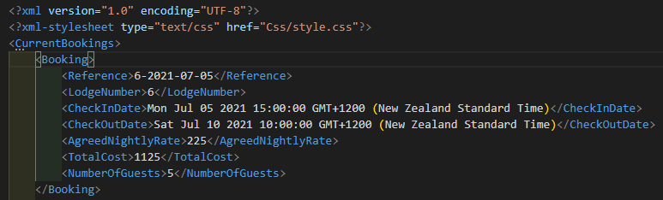
Current Bookings – XML Document

Slide 9
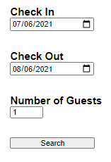
Date Pickers
Onload to today’s date
Automatic Update to Check Out picker
Prohibits picking past dates

Slide 10
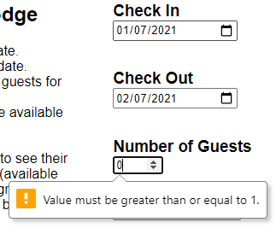
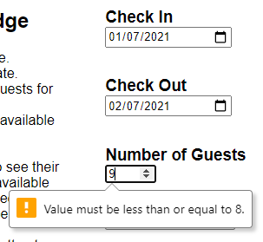
Number Picker
Minimum Number of Guests
Maximum Number of Guests

Slide 11
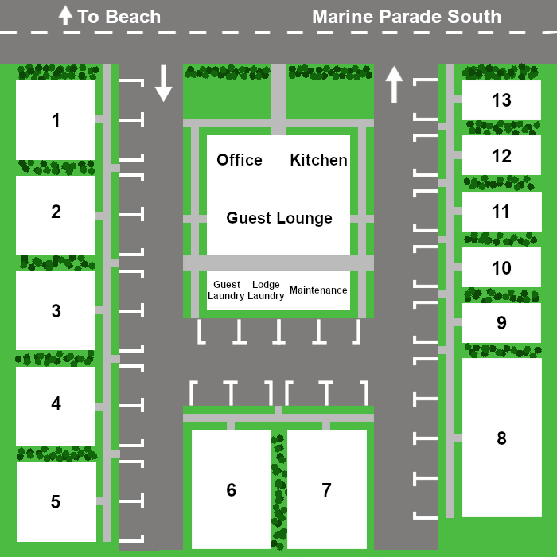
Canvas
Colour Changes
Available Lodges: Green
Unavailable Lodges: Red

Slide 12
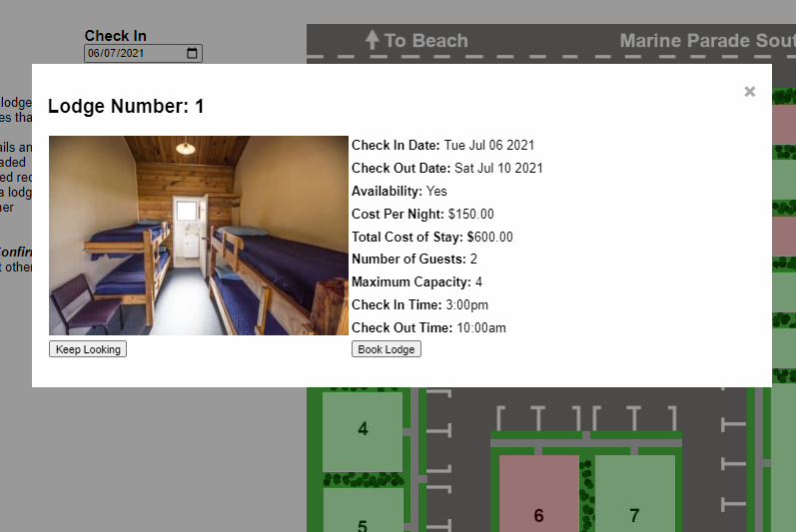
Modals
Modal Features
Clicking outside the Modal
Lodge Details
Booking Summary
Confirmation Screen

Slide 13






Thank you very much.
Does anyone have any questions?

