Slide 1








Pitch
Desk

Slide 2
Group Members
KARAN INDER SINGH -- U101116FCS057
RISHABH GAUR -- U101116FCS100
RAHUL SAHA -- U101116FCS241
RAJAT SRIVASTAVA -- U101116FCS098

Slide 3
Problems
◆ Slow service is an important issue which costumers face while booking any service for home.
◆ Security is a major concern when a
service provider visits your home.
◆ No easy way exists to book a service provider, nearest to you online.

Slide 4
Solutions
✓ A web platform where users can find out
the best suitable nearest service provider.
✓ The service provider will reach the destination
within an hour of booking.
✓ Check-in, Check-out call details and police verification of the service provider will solve the security issues.

Slide 5
Future
Plan
Making a chain of other service providers
like plumbers, carpenters, tutors, beauticians, etc.

Slide 6
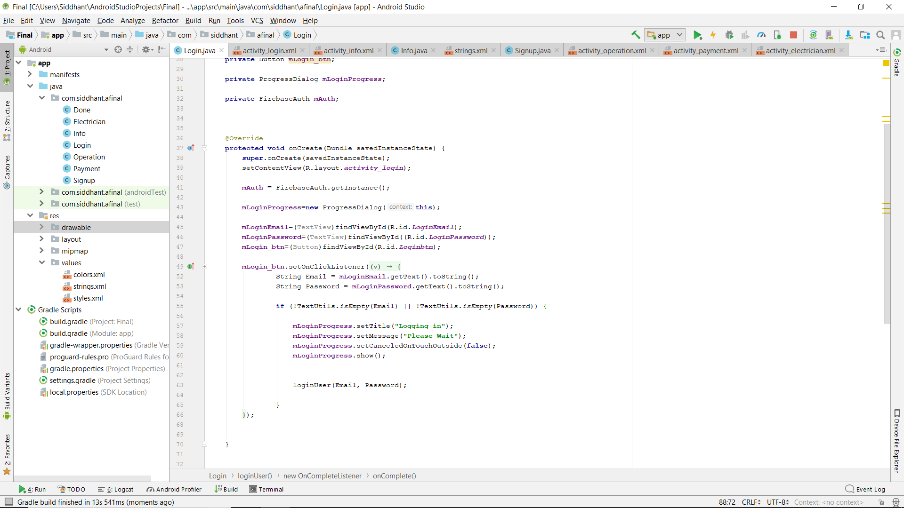
Login page setup
Here a login page is created using Android studio that acts
as the starting page of the app

Slide 7
Problems faced in App
Lack of knowledge
Firebase connection
Typical SHA-1 PROBLEM
Creation of database
Final execution and complete app

Slide 8
Solutions
YouTube videos for getting information and application
Typical problems of SHA-1 Solved with reasearch and work
Firebase account and tutorials for connecting with firebase
Google firebase for creating database
Signing in encryption and authentication using google firebase

Slide 9
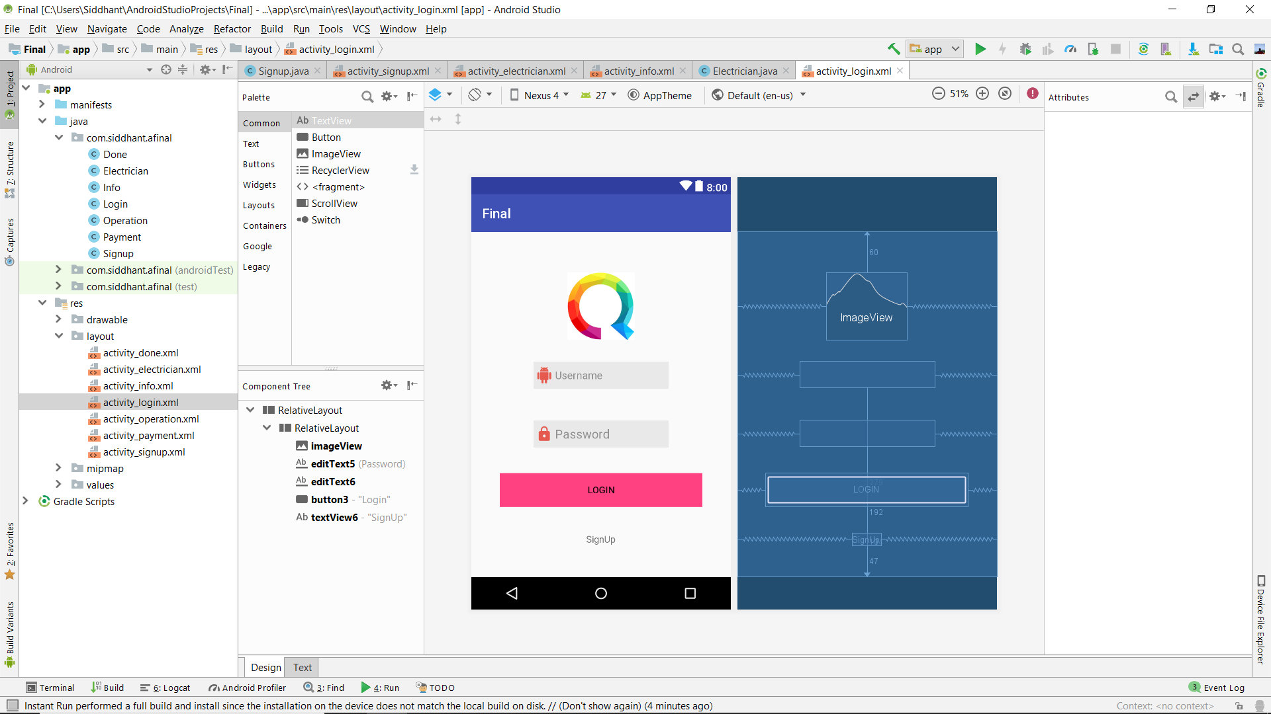
The Login page
Front page and layout

Slide 10
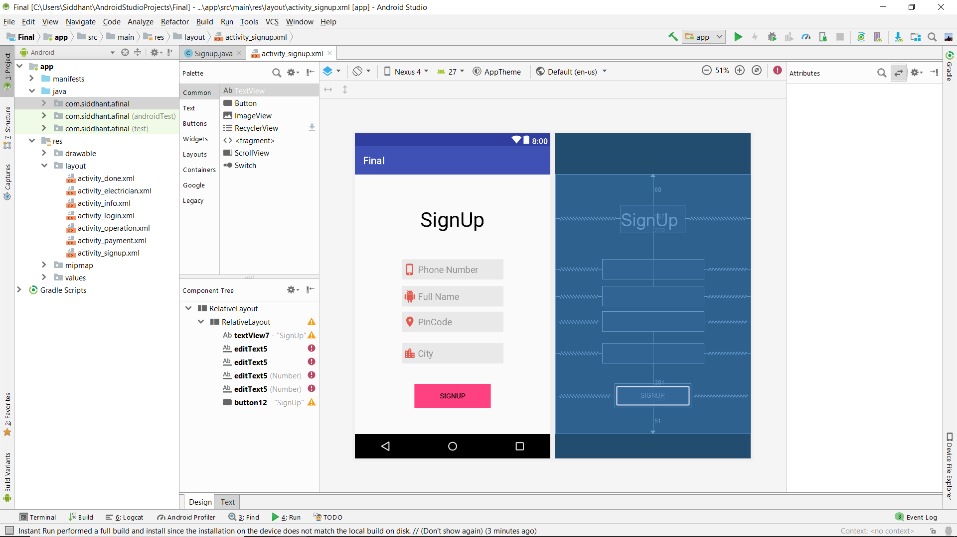
The Signup page of the app
This works under the conditions that user is signing up for first time

Slide 11
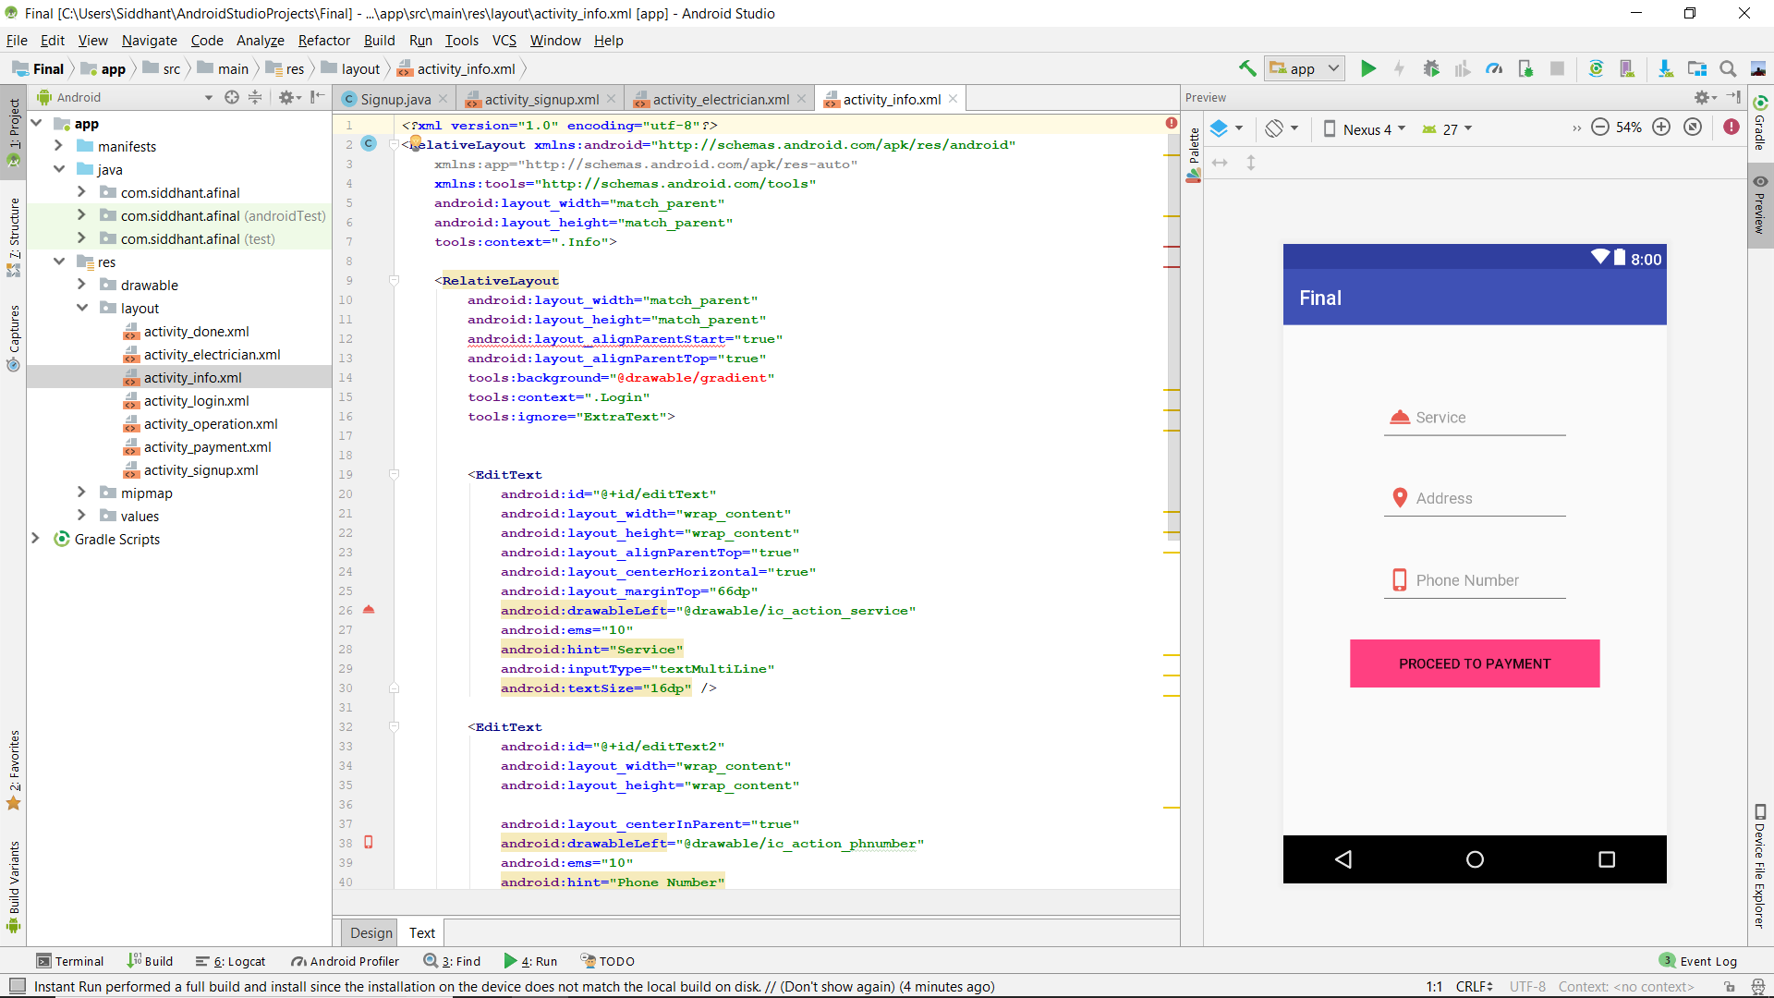
The code
The code used to generate activity

Slide 12
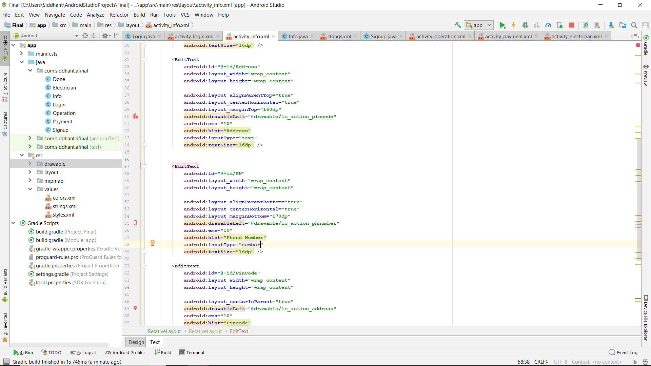
Continuation of the code
Linking of pages is done here

Slide 13
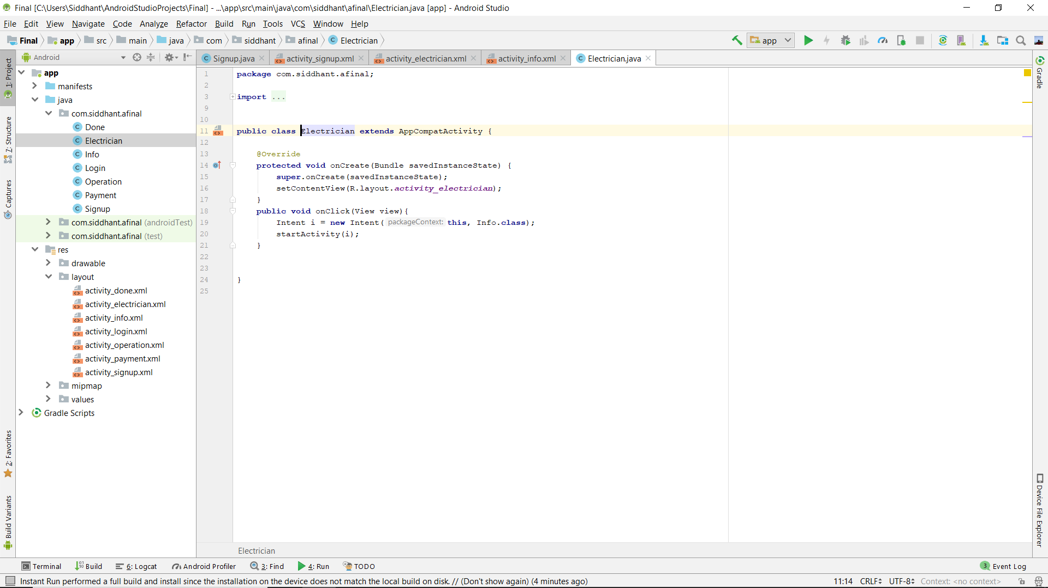
Work on Electrician classifield
Here, the classified and database link of electrician is created

Slide 14
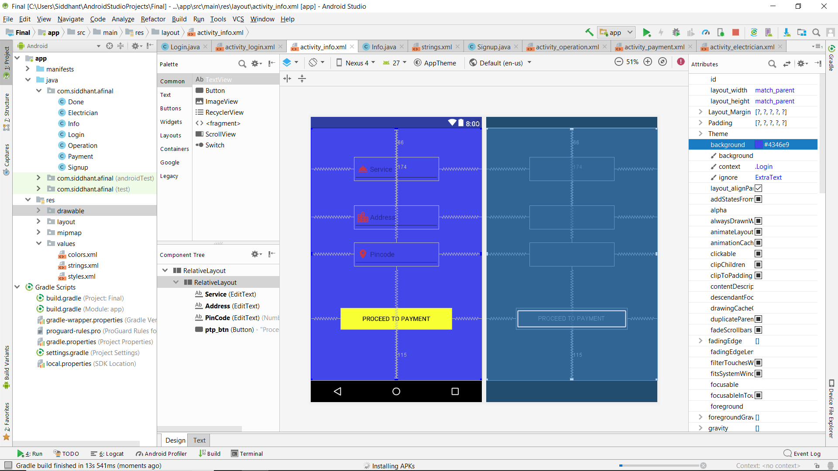
Designing pages

Slide 15

Firebox--the key to app database

Slide 16
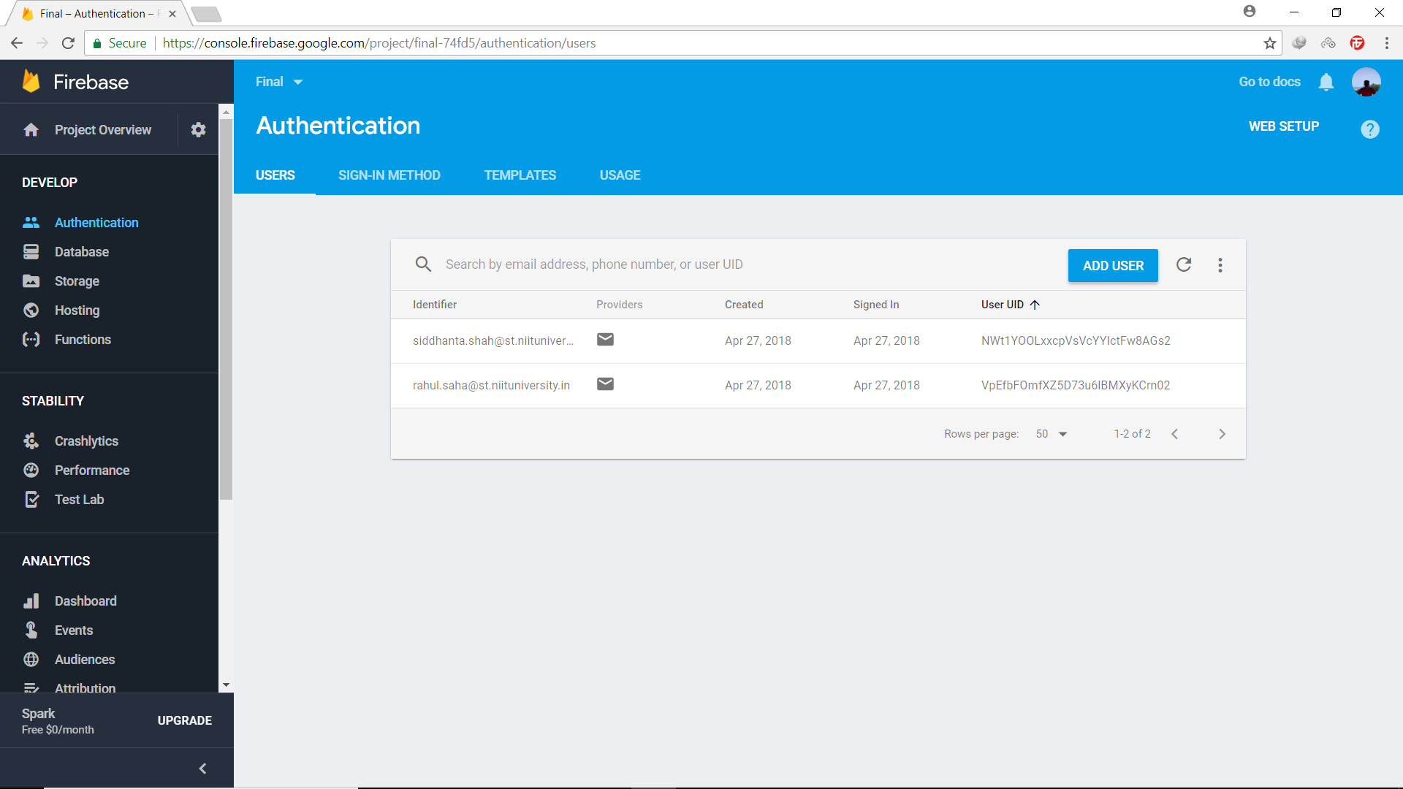
Firebase
The app is linked with the firebase account and authentication is done

Slide 17
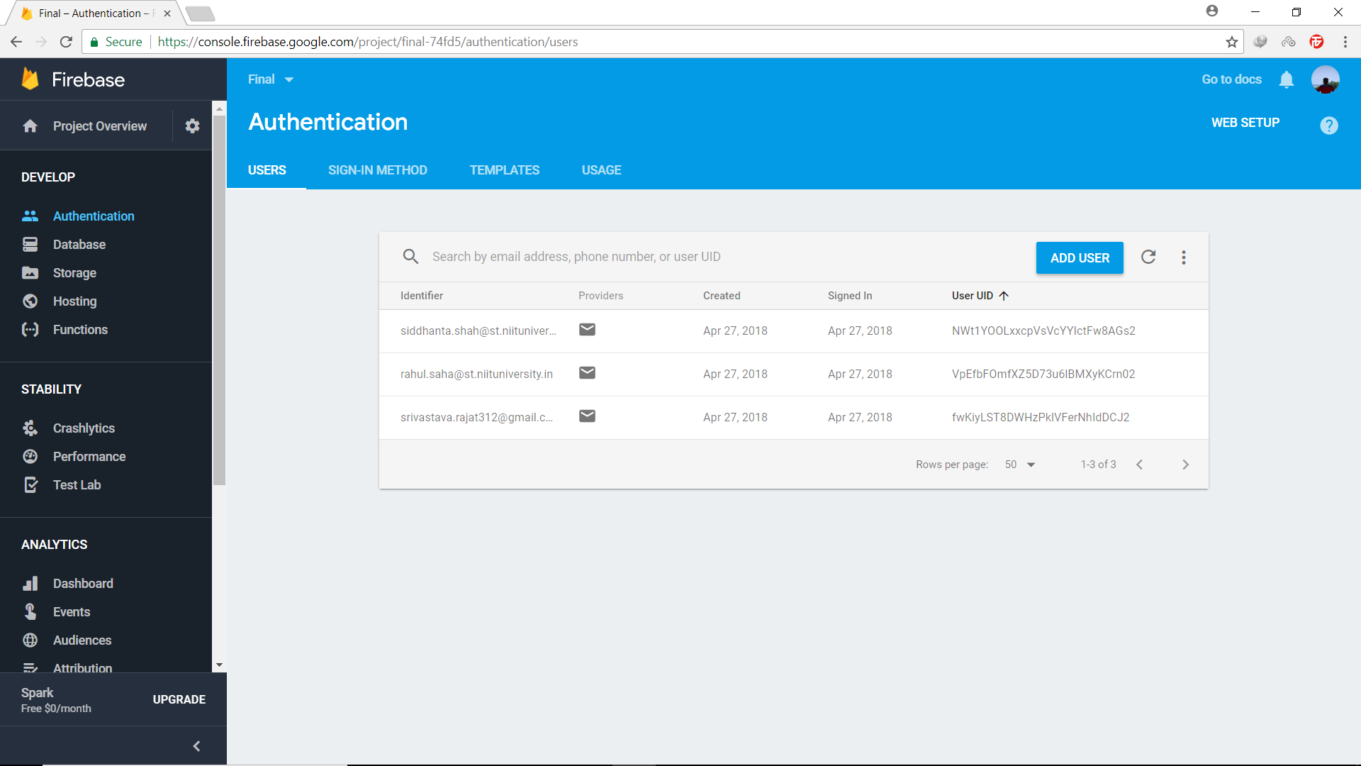
Authentication
The emails and entries are visible here

Slide 18
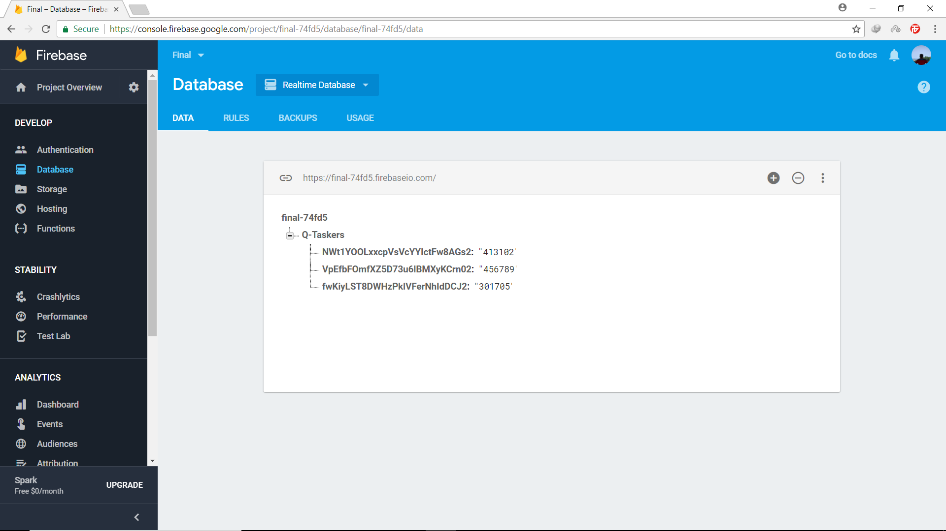
Finally……Database Entries
The database of the app can be accessed using this feature on FIREBASE

