Slide 1

By Brian Kemboi
Flexbox

Slide 2

Flexbox
What is Flexbox?
The Flexbox Layout (Flexible Box) module (a W3C Candidate Recommendation as of October 2017) aims at providing a more efficient way to lay out, align and distribute space among items in a container, even when their size is unknown and/or dynamic (thus the word “flex”)

Slide 3
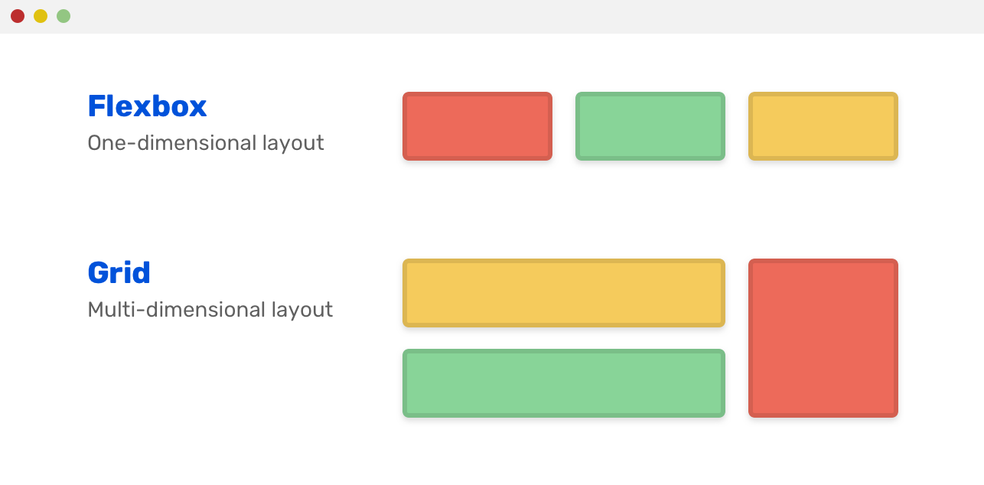
Flexbox vs Grid

Slide 4
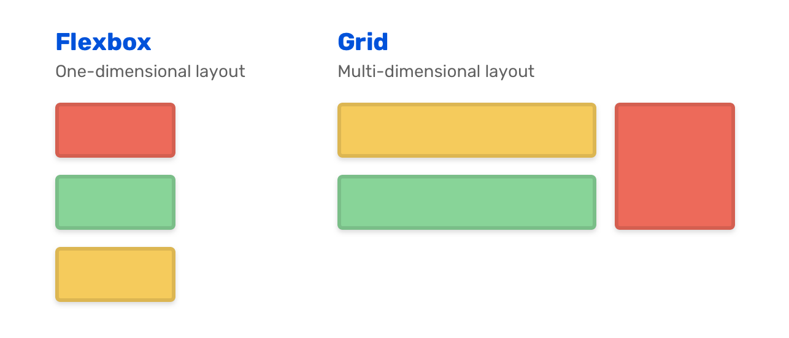
Flexbox vs Grid

Slide 5
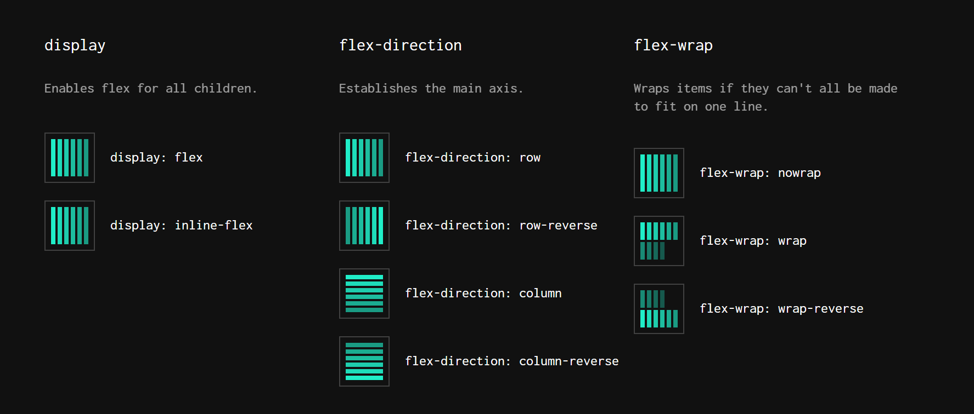
Container

Slide 6
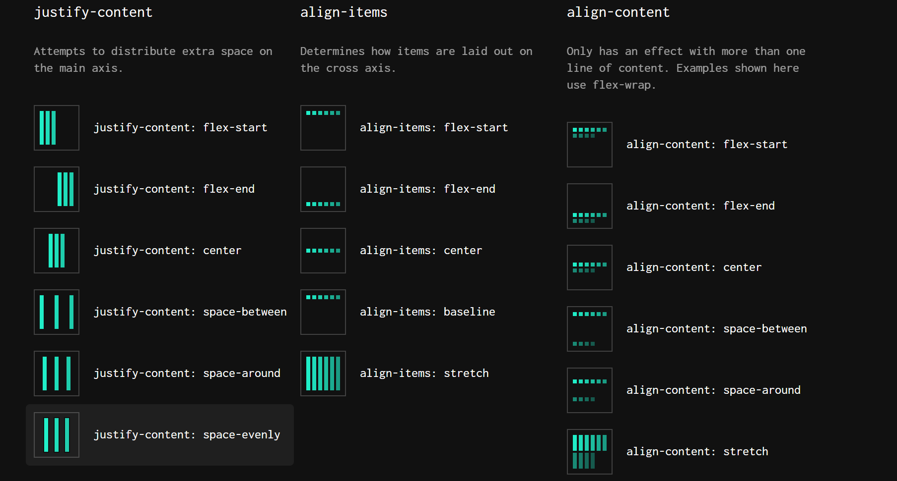
Container

Slide 7
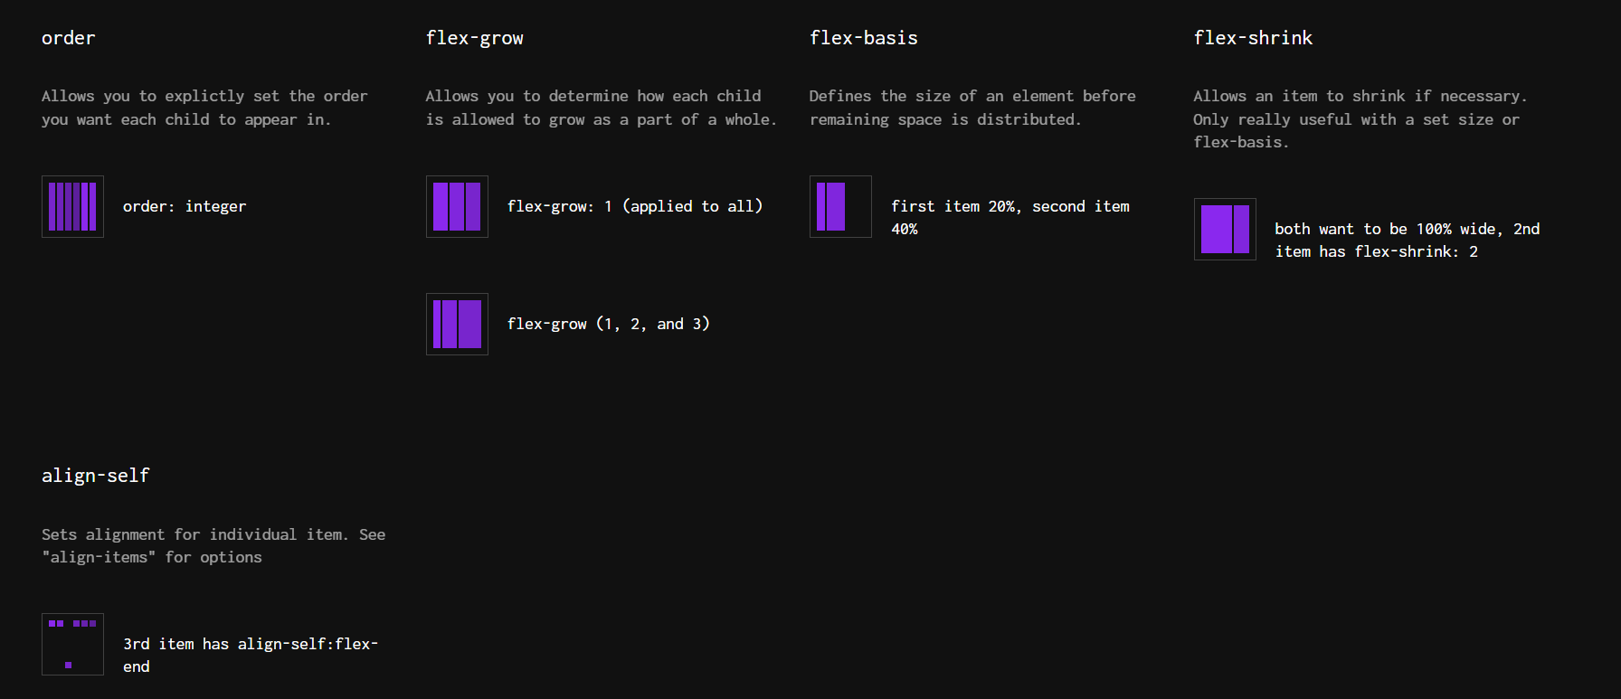
Children

Slide 8
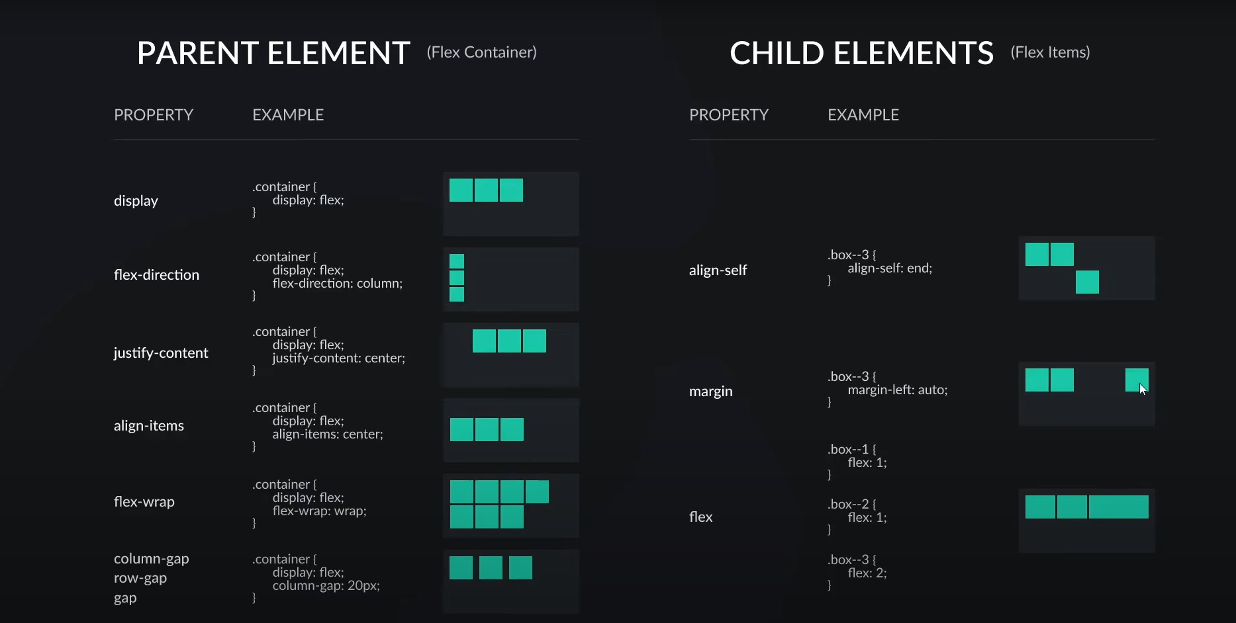
Flexbox Cheat sheet

Slide 9
Resources
https://flexbox.malven.co/
https://yoksel.github.io/flex-cheatsheet/#section-flex-grow
https://css-tricks.com/snippets/css/a-guide-to-flexbox/
https://css-tricks.com/wp-content/uploads/2022/02/css-flexbox-poster.png
https://flexboxfroggy.com/

