Slide 1

By: Brian Kemboi
Grid Layout

Slide 2

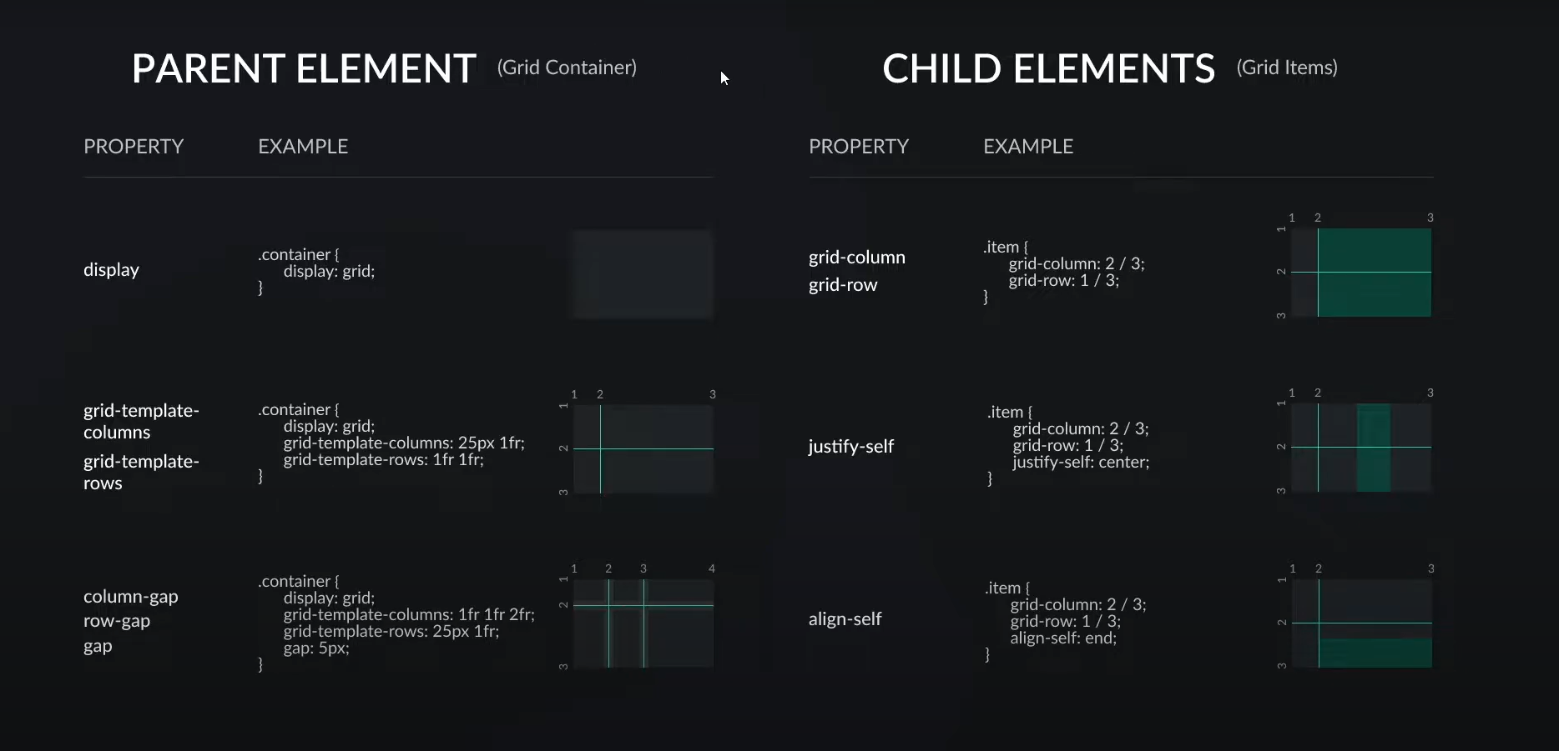
Grid Cheat sheet

Slide 3
Grid
What is Grid Layout?
The CSS Grid Layout Module offers a grid-based layout system, with rows and columns, making it easier to design web pages without having to use floats and positioning.

Slide 4
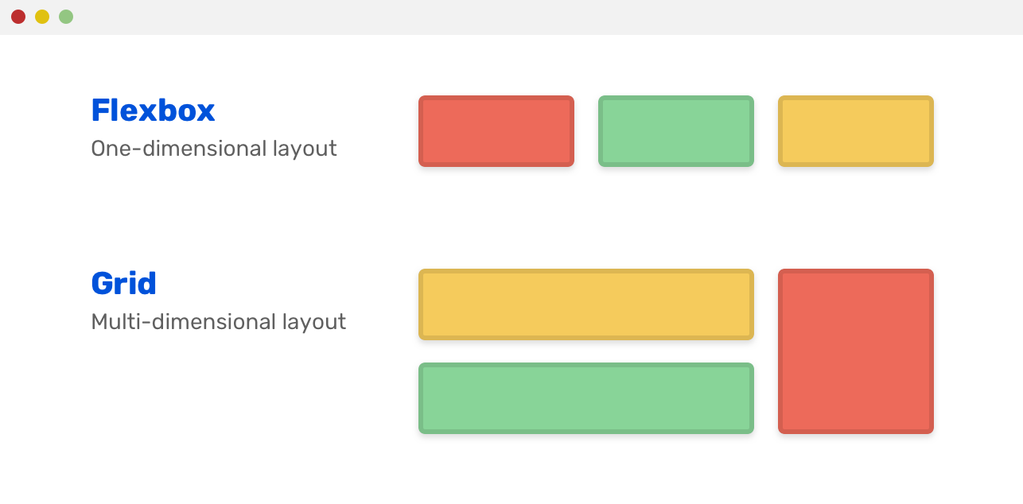
Flexbox vs Grid

Slide 5
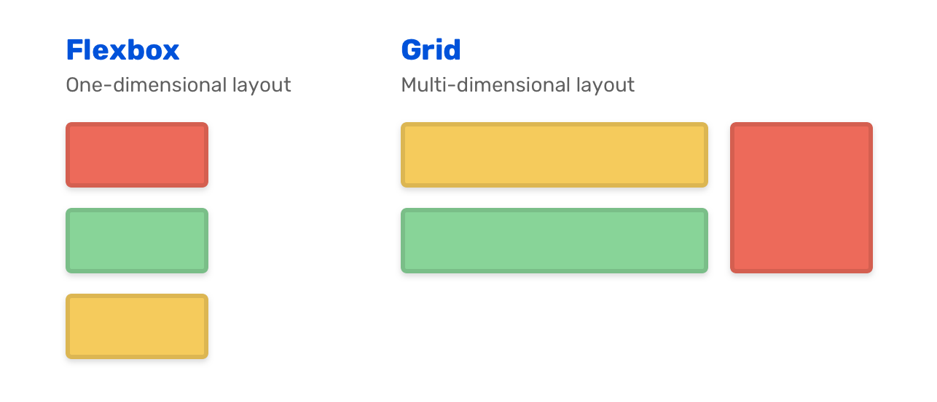
Flexbox vs Grid

Slide 6
Grid Container
To make an HTML element behave as a grid container, you have to set the display property to grid or inline-grid.
Grid containers consist of grid items, placed inside columns and rows.
grid-template-columns Property
property defines the number of columns in your grid layout, and it can define the width of each column.
The value is a space-separated-list, where each value defines the width of the respective column.
If you want your grid layout to contain 4 columns, specify the width of the 4 columns, or "auto" if all columns should have the same width.

Slide 7
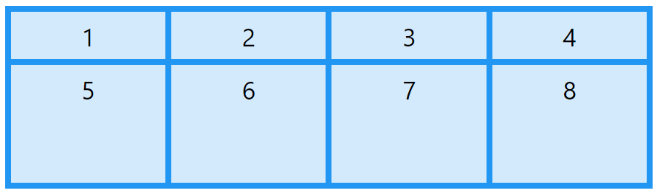

grid-template-rows Property
property defines the height of each row.

Slide 8
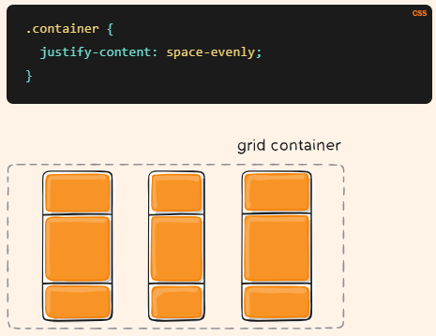
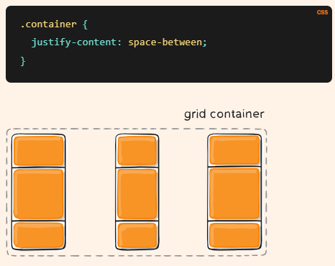
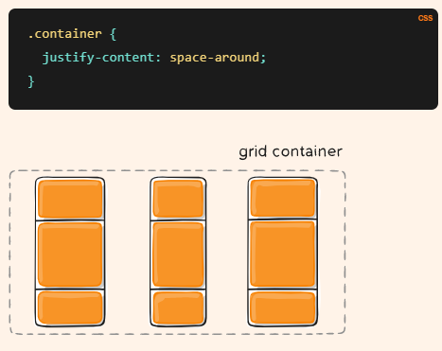
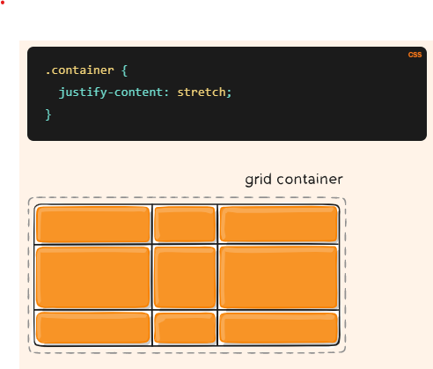
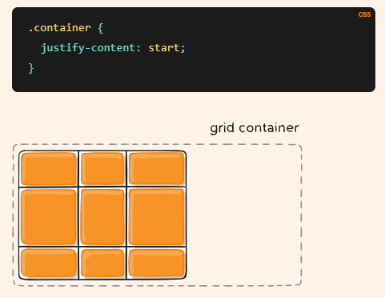
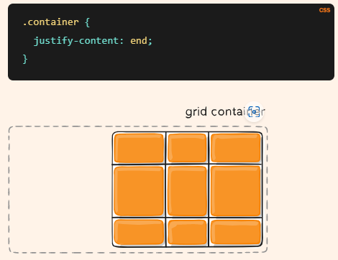
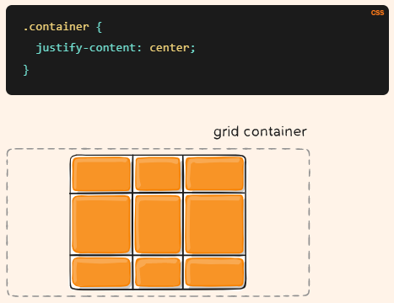
Grid Container Properties
justify-content : property is used to align the whole grid inside the container.

Slide 9
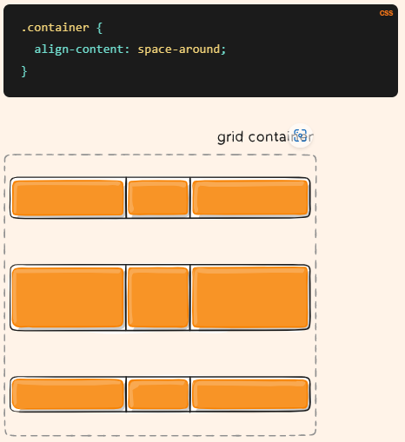
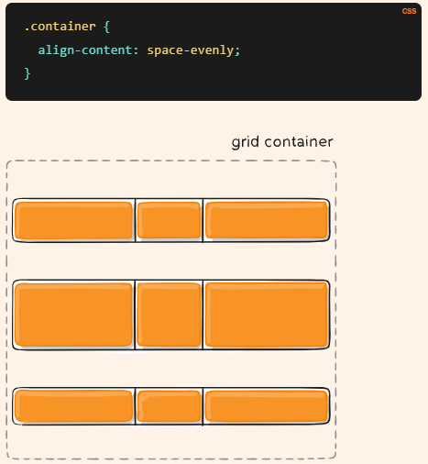
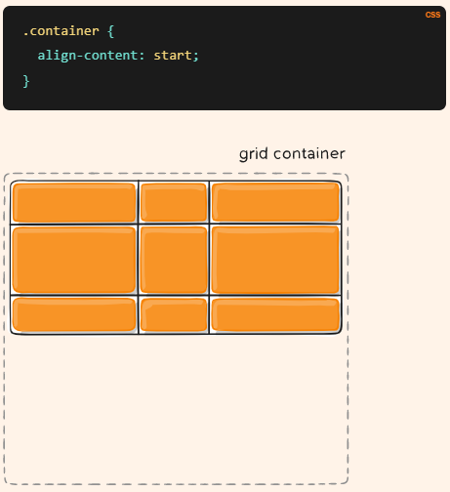
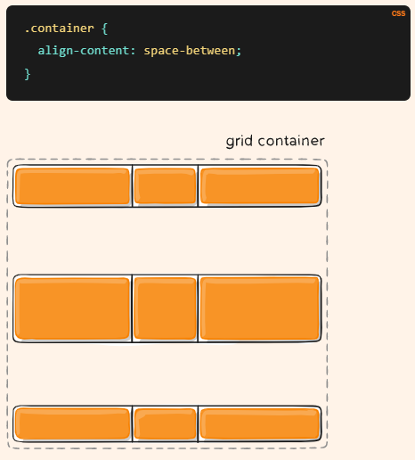
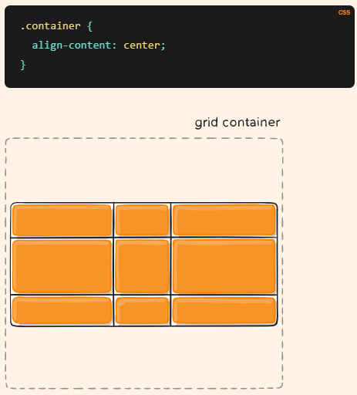
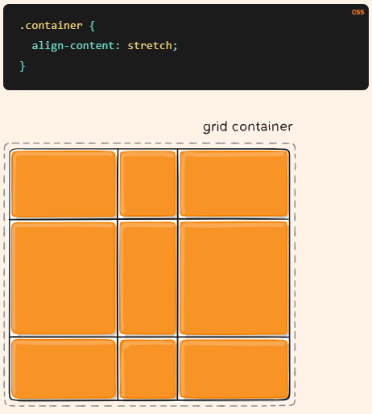
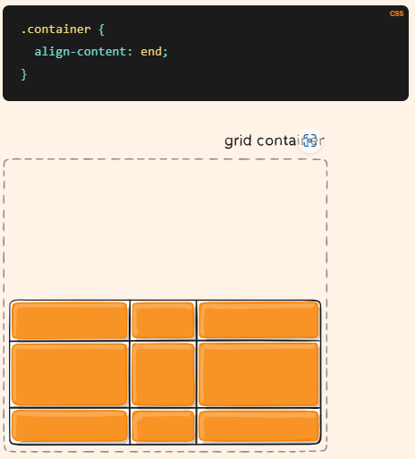
Grid Container Properties
align-content : used to vertically align the whole grid inside the container.

Slide 10
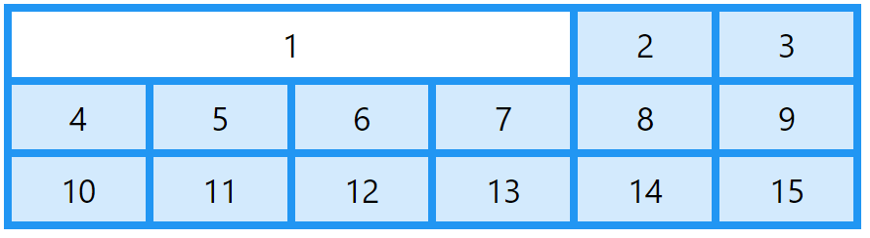
Grid Item
A grid container contains grid items. By default, a container has one grid item for each column, in each row, but you can style the grid items so that they will span multiple columns and/or rows.
The grid-column Property:
A grid container contains grid items. By default, a container has one grid item for each column, in each row, but you can style the grid items so that they will span multiple columns and/or rows.
The grid-column property is a shorthand property for the grid-column-start and the grid-column-end properties.

Slide 11
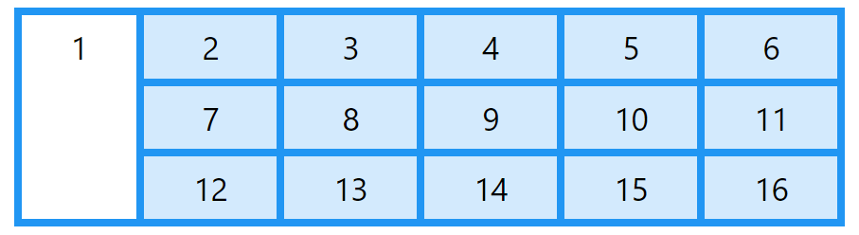
The grid-row Property:
A grid-row property defines on which row to place an item.
You define where the item will start, and where the item will end.
The grid-row property is a shorthand property for the grid-row-start and the grid-row-end properties.

Slide 12
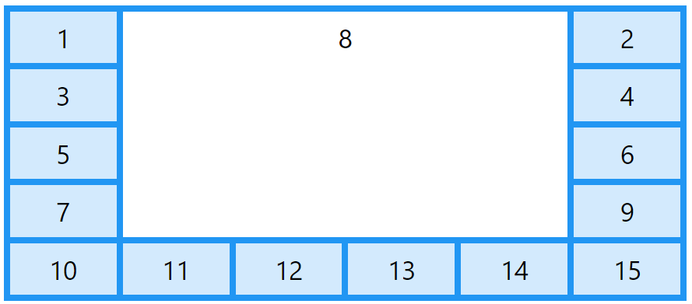
The grid-area Property:
The grid-area property can be used as a shorthand property for the grid-row-start, grid-column-start, grid-row-end and the grid-column-end properties.
The syntax is:
grid-row-start / grid-column-start / grid-row-end / grid-column-end.

Slide 13
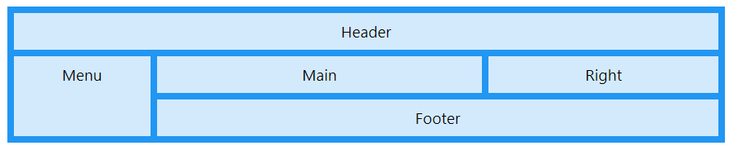
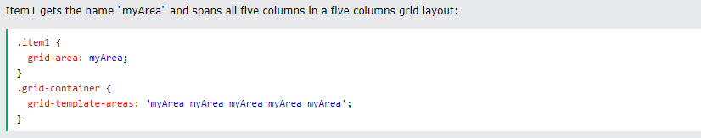
Naming Grid Items
The grid-area property can also be used to assign names to grid items.
Named grid items can be referred to by the grid-template-areas property of the grid container.

Slide 14
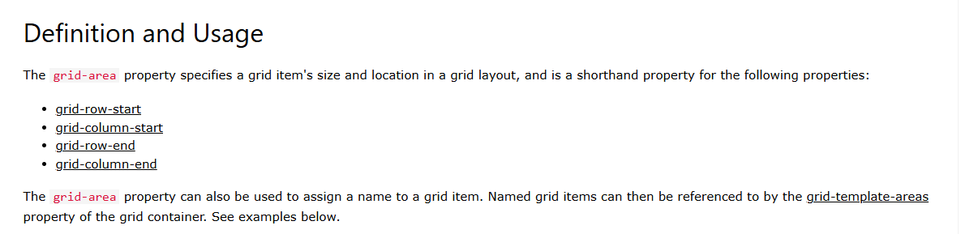

Slide 15
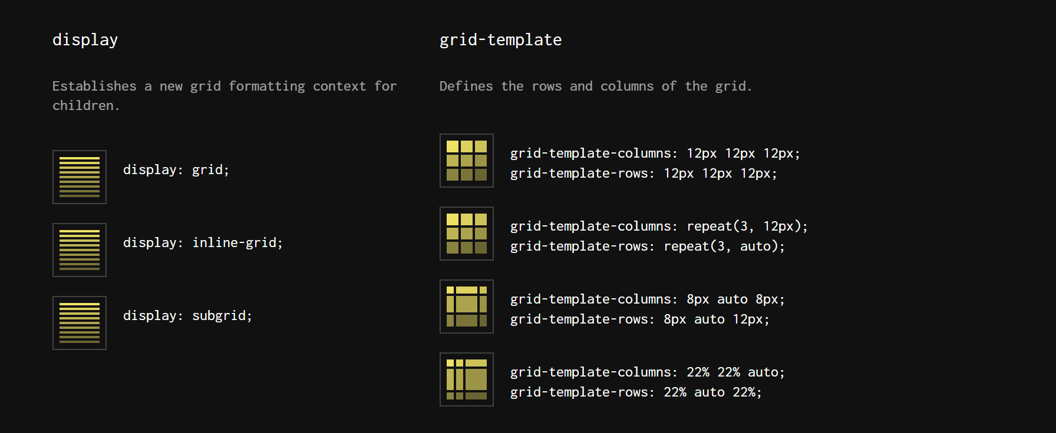
Container

Slide 16
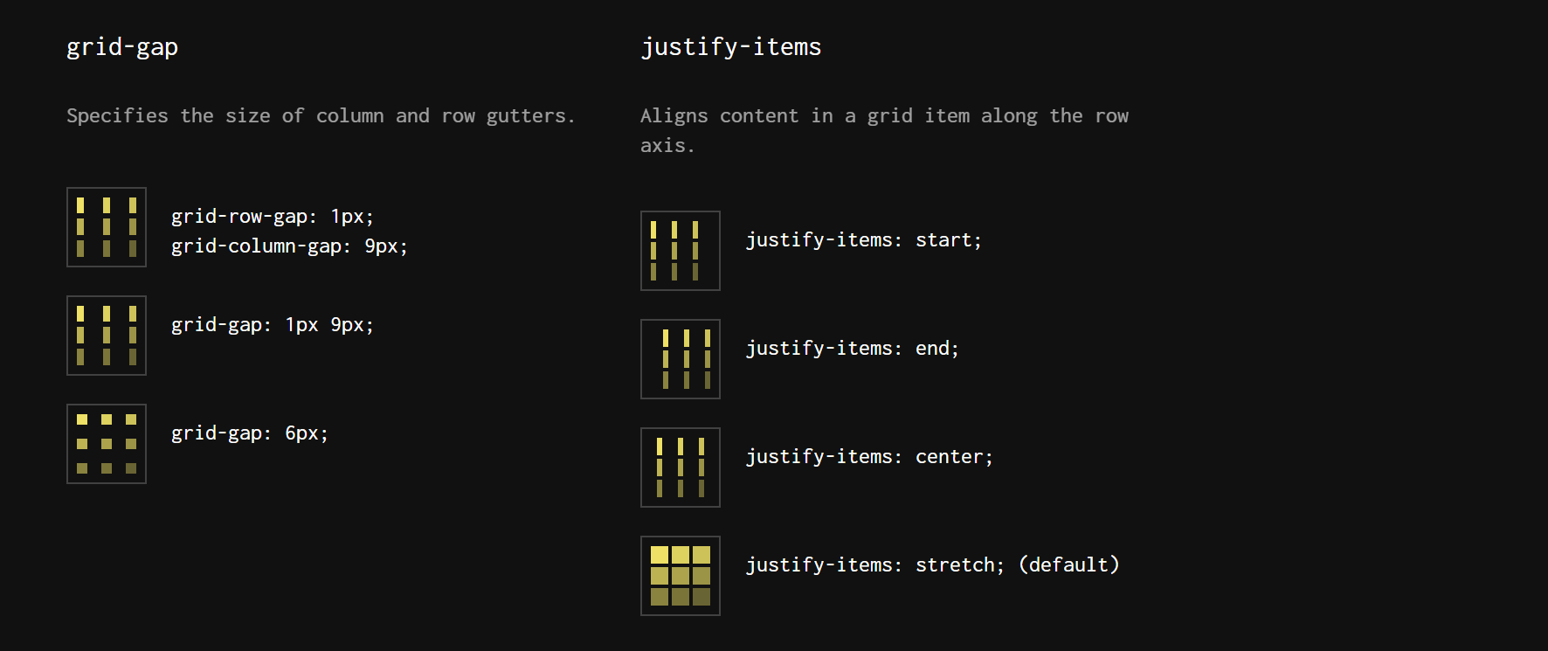
Container

Slide 17
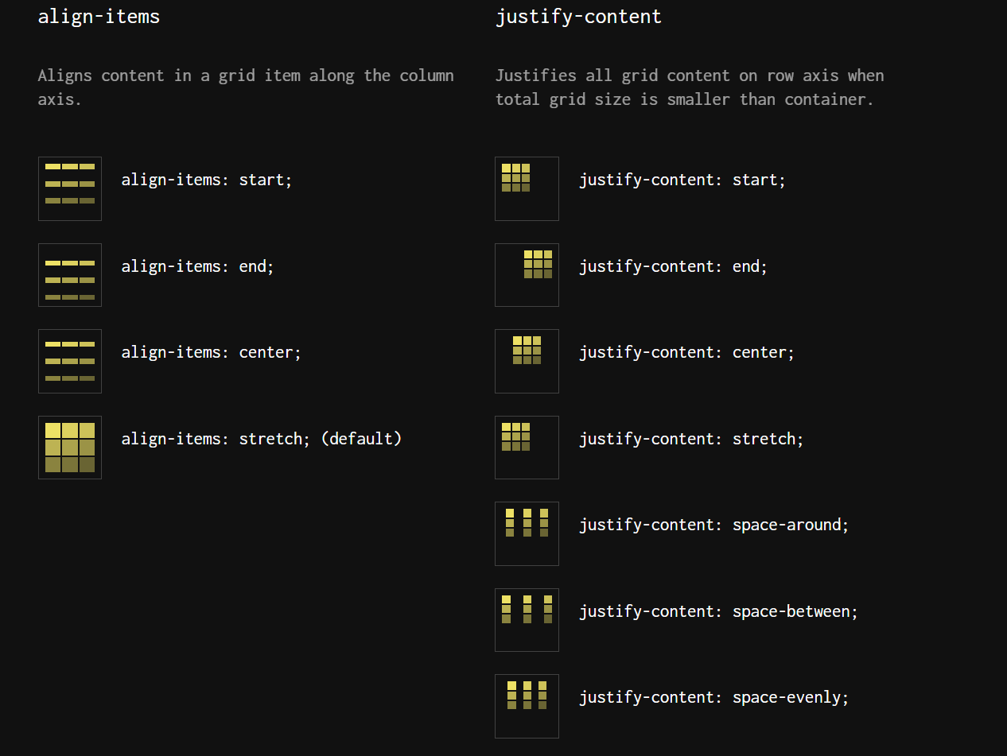
Container

Slide 18
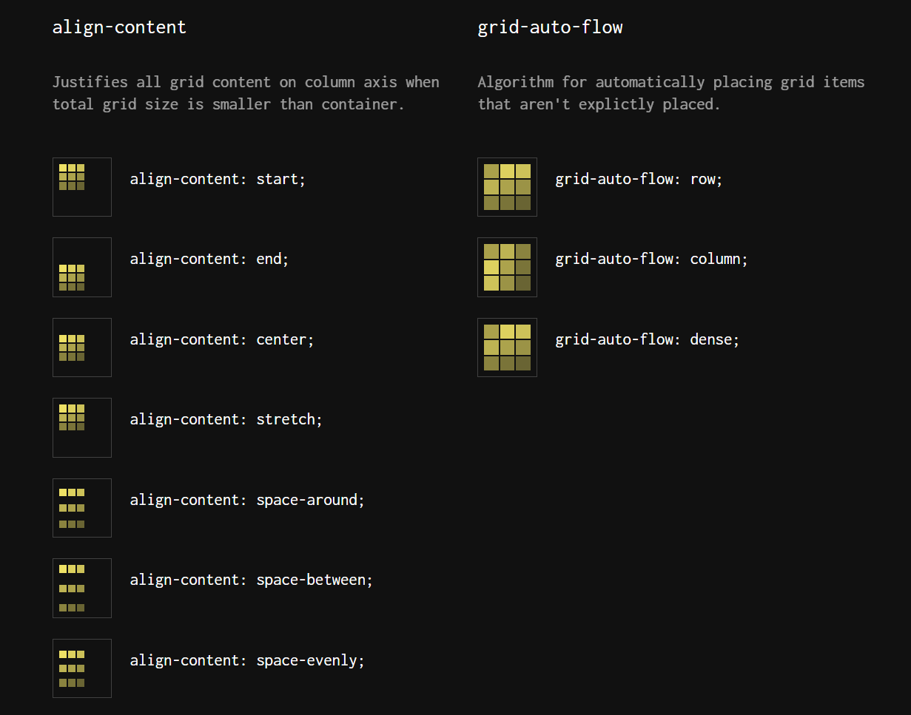
Container

Slide 19
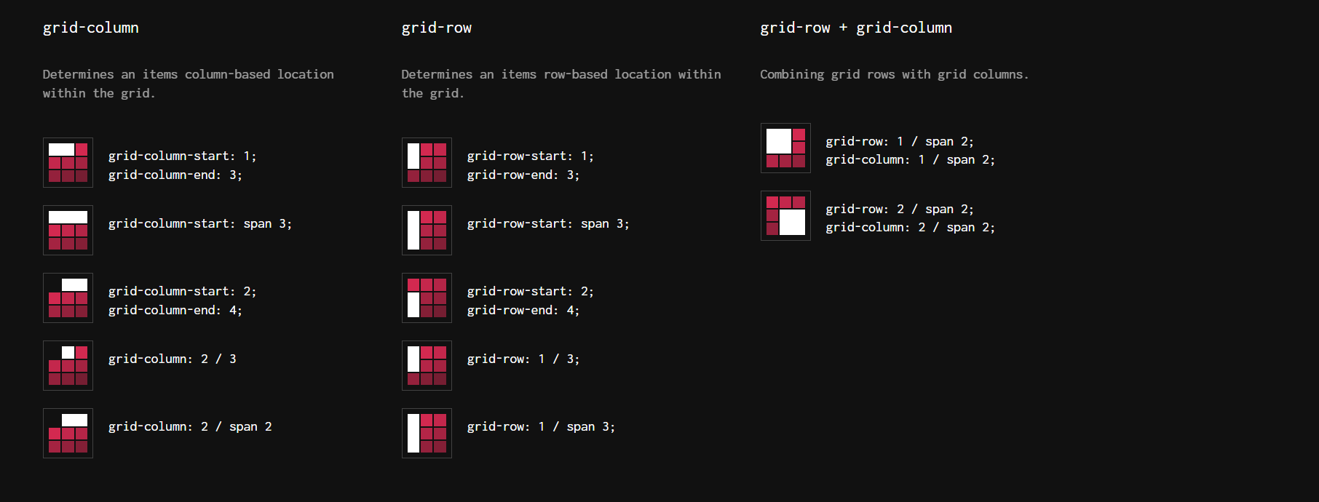
Children

Slide 20
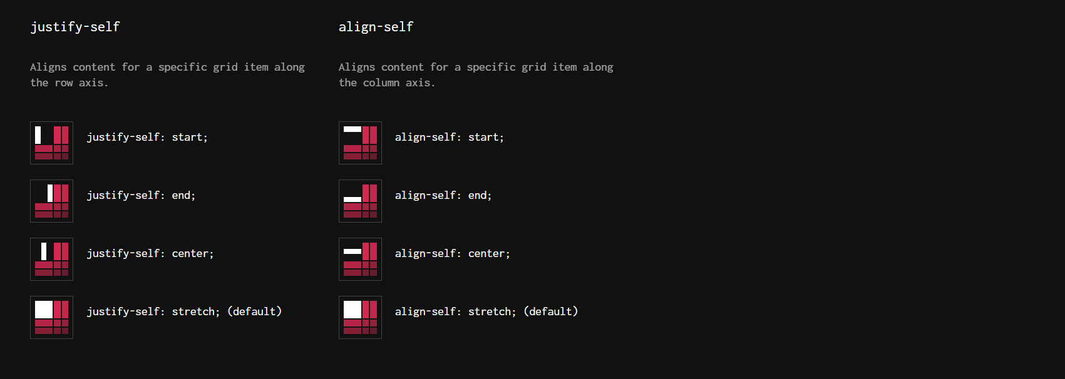
Children

Slide 21
Grid Resources
https://grid.malven.co/
https://css-tricks.com/snippets/css/complete-guide-grid/
https://css-tricks.com/a-complete-guide-to-css-media-queries/
https://cssgridgarden.com/

