Slide 1


By: Brian Kemboi
Introduction to HTML?

Slide 2
HTML
What is HTML?
HTML stands for Hyper Text Markup Language
HTML is the standard markup language for creating Web pages
HTML elements tell the browser how to display the content

Slide 3
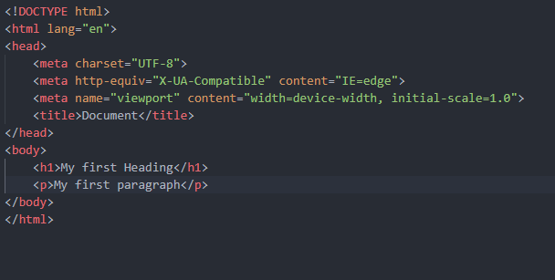
HTML
A Simple HTML Document
<body> element defines the document's body, and is a container for all the visible contents ie headings,images,tables.
<h1> element defines a large heading
<p> element defines a paragraph
The <!DOCTYPE html> defines the document is HTML5
<html> element is the root element of an HTML page
<head> element contains meta information about the HTML page
<title> element specifies a title for the HTML page

Slide 4
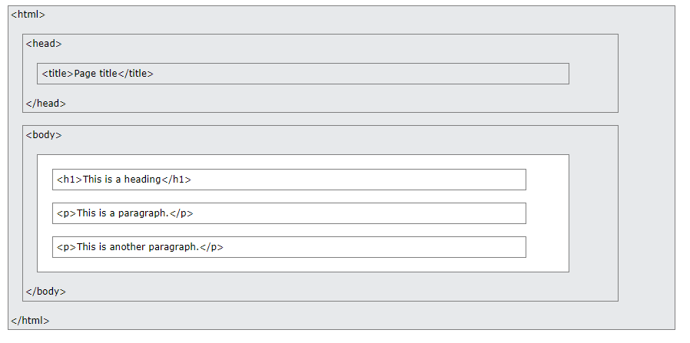
HTML
HTML Page Structure?
visualization of an HTML page structure:

Slide 5
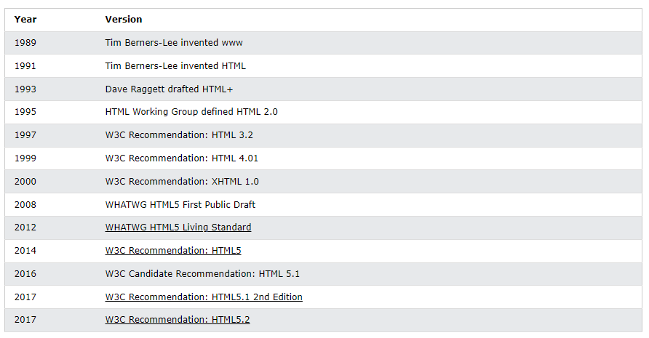
HTML
HTML History?
Since the early days of the World Wide Web, there have been many versions of HTML:

Slide 6
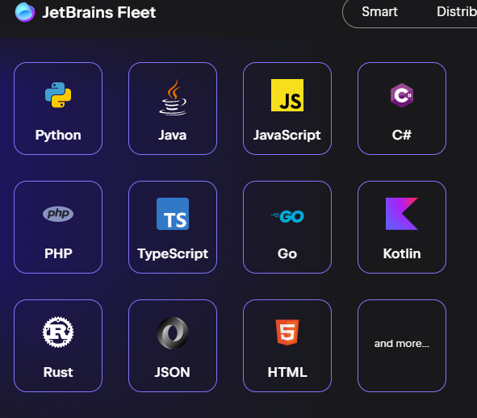
HTML
HTML Editors?
A simple text editor is all you need to learn HTML. Web pages can be created and modified by using professional HTML editors.
However, for learning HTML we recommend a simple text editor like Notepad (PC) or TextEdit (Mac).Other include
Vs Code
Sublime Text
Espresso
Brackets
Notepad++
Vim
Bbedit
jetBrains Fleet
IDES ie Visual studio code, Jetbrains IDES

Slide 7
HTML
What is an HTML Element?
An HTML element is defined by a start tag, some content, and an end tag:
<tagname> Content goes here... </tagname>
Start tag | Element content | End tag
<h1> | My first heading | </h1>
<p> | My first paragraph | <p/>
<br> | none | none
Note: Some HTML elements have no content (like the <br> element). These elements are called empty elements. Empty elements do not have an end tag!

Slide 8
HTML
What is an HTML Attribute?
HTML attributes provide additional information about HTML elements.
All HTML elements can have attributes
Attributes provide additional information about elements
Attributes are always specified in the start tag
Attributes usually come in name/value pairs like: name="value"
Examples?
The href attribute of <a> specifies the URL of the page the link goes to
The src attribute of <img> specifies the path to the image to be displayed
The width and height attributes of <img> provide size information for images
The alt attribute of <img> provides an alternate text for an image
The style attribute is used to add styles to an element, such as color, font, size, and more
The lang attribute of the <html> tag declares the language of the Web page
The title attribute defines some extra information about an element

Slide 9

HTML Elements?
HTML Headings?
HTML headings are defined with the <h1> to <h6> tags.
<h1> defines the most important heading. <h6> defines the least important heading:
HTML Links?
HTML links are defined with the <a> tag:
HTML Images?
HTML images are defined with the <img> tag.
The source file (src), alternative text (alt), width, and height are provided as attributes:

Slide 10
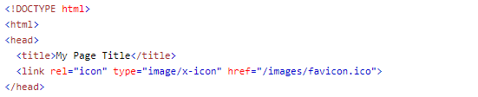
HTML Elements?
HTML Styles?
The HTML style attribute is used to add styles to an element, such as color, font, size, and more.
Favicon in HTML
You can use any image you like as your favicon. You can also create your own favicon on sites like https://www.favicon.cc.
HTML Paragraphs
A paragraph always starts on a new line, and is usually a block of text.
<p>My first paragraph</p>

Slide 11
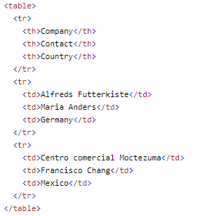
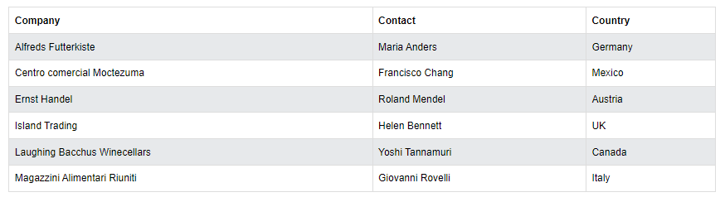
HTML Elements?
HTML Tables?
HTML tables allow web developers to arrange data into rows and columns.
Table Cells?
Table Headers?
Each table cell is defined by a <td> and a </td> tag.
Sometimes you want your cells to be table header cells. In those cases use the <th> tag instead of the <td> tag.
Table Rows?
Table Data?
Each table row starts with a <tr> and ends with a </tr> tag..
The <td> tag defines a standard data cell in an HTML table.

Slide 12
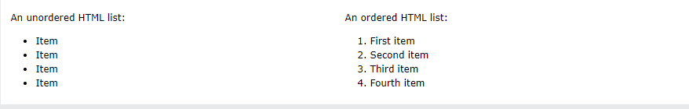


HTML Elements?
HTML Lists?
HTML lists allow web developers to group a set of related items in lists.
Unordered List
Ordered List
An unordered list starts with the <ul> tag. Each list item starts with the <li> tag.
The list items will be marked with bullets (small black circles) by default:
An ordered list starts with the <ol> tag. Each list item starts with the <li> tag.
The list items will be marked with numbers by default:

Slide 13
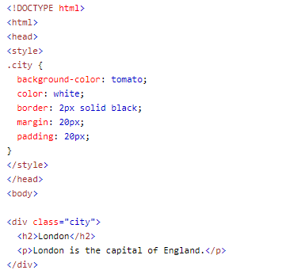
HTML Block and Inline Elements?
Block-Level Elements?
A block-level element always takes up the full width available (stretches out to the left and right as far as it can).Two commonly used block elements are: <p> and <div>.
Inline Elements?
An inline element does not start on a new line. An inline element only takes up as much width as necessary. This is a <span> element inside </span> a paragraph.
Class Attribute
The HTML class attribute is used to specify a class for an HTML element.

Slide 14
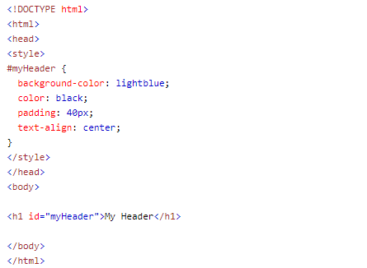
HTML Block and Inline Elements?
id Attribute?
The id attribute specifies a unique id for an HTML element. The value of the id attribute must be unique within the HTML document.
Difference Between Class and ID?
A class name can be used by multiple HTML elements, while an id name must only be used by one HTML element within the page:

Slide 15
HTML Iframes
An HTML iframe is used to display a web page within a web page.
Iframe Syntax
The HTML <iframe> tag specifies an inline frame. It is a good practice to always include a title attribute for the <iframe>. This is used by screen readers to read out what the content of the iframe is. Use the height and width attributes to specify the size of the iframe.
<iframe src="demo_iframe.htm" height="200" width="300" title="Iframe Example"></iframe>
Or you can add the style attribute and use the CSS height and width properties:
Example
<iframe src="demo_iframe.htm" style="height:200px;width:300px;" title="Iframe Example"></iframe>

Slide 16
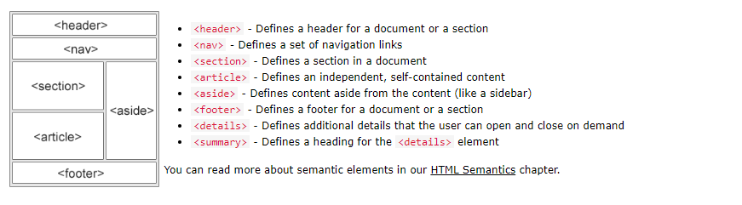
HTML - Head Element
The HTML <head> element is a container for the following elements: <title>, <style>, <meta>, <link>, <script>, and <base>.
HTML - Layout Elements
HTML has several semantic elements that define the different parts of a web page:
HTML - Layout Techniques
There are four different techniques to create multicolumn layouts. Each technique has its pros and cons:
CSS framework
CSS float property
CSS flexbox
CSS grid

Slide 17
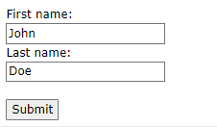
HTML Forms
An HTML form is used to collect user input. The user input is most often sent to a server for processing.
Form Elements?
The HTML <form> element can contain one or more of the following form elements:
<input>
<label>
<select>
<textarea>
<button>
<fieldset>
<legend>
<datalist>
<output>
<option>
<optgroup>
Form example

Slide 18
HTML Forms
<input> Element
The HTML <input> element is the most used form element.
An <input> element can be displayed in many ways, depending on the type attribute.
Here are some examples:
Type | Description
<input type="text"> | Displays a single-line text input field
<input type="radio"> | Displays a radio button (for selecting one of many choices)
<input type="checkbox"> | Displays a checkbox (for selecting zero or more of many choices)
<input type="submit"> | Displays a submit button (for submitting the form)
<input type="button"> | Displays a clickable button

Slide 19
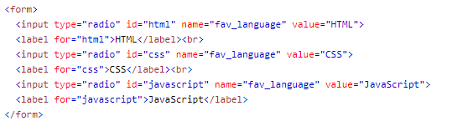
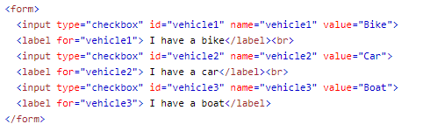
HTML Forms
<label> Element
The <label> tag defines a label for many form elements. The <label> element is useful for screen-reader users, because the screen-reader will read out loud the label when the user focuses on the input element. <label>Example Label</label>
Radio Buttons
The <input type="radio"> defines a radio button. Radio buttons let a user select ONE of a limited number of choices.
Checkboxes
The <input type="checkbox"> defines a checkbox.
Checkboxes let a user select ZERO or MORE options of a limited number of choices.
Submit Button
The <input type="submit"> defines a button for submitting the form data to a form-handler.

Slide 20

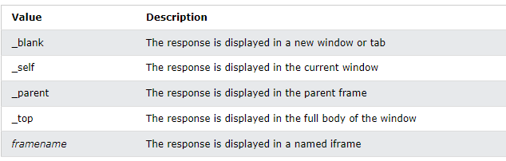
HTML Form Attributes
Action Attribute
The action attribute defines the action to be performed when the form is submitted. Usually, the form data is sent to a file on the server when the user clicks on the submit button
Target Attribute
The action attribute defines the action to be performed when the form is submitted. Usually, the form data is sent to a file on the server when the user clicks on the submit button
Method Attribute
The method attribute specifies the HTTP method to be used when submitting the form data.
The form-data can be sent as URL variables (with method="get") or as HTTP post transaction (with method="post").The default HTTP method when submitting form data is GET.
<form action="/action_page.php" method="post">

Slide 21
HTML Forms
Autocomplete Attribute
The autocomplete attribute specifies whether a form should have autocomplete on or off.
When autocomplete is on, the browser automatically complete values based on values that the user has entered before.
<form action="/action_page.php" autocomplete="on">
The Name Attribute for <input>
The novalidate attribute is a boolean attribute. When present, it specifies that the form-data (input) should not be validated when submitted.
<form action="/action_page.php" novalidate>
The Name Attribute for <input>
Notice that each input field must have a name attribute to be submitted.
If the name attribute is omitted, the value of the input field will not be sent at all.
ASSIGNMENT => Create a html page showing all the form input types, form attributes and their respective attributes ie Placeholder,pattern,multiple,min & max size, maxlength,minlength etc

Slide 22
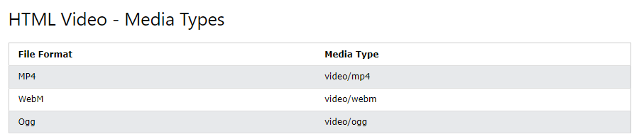
HTML Multimedia
Multimedia on the web is sound, music, videos, movies, and animations. Multimedia files have formats and different extensions like: .wav, .mp3, .mp4, .mpg, .wmv, and .avi.
HTML Video
The HTML <video> element is used to show a video on a web page. To start a video automatically, use the autoplay attribute:
<video width="320" height="240" controls autoplay > <source src="movie.mp4" type="video/mp4">
Your browser does not support the video element. </video>

Slide 23
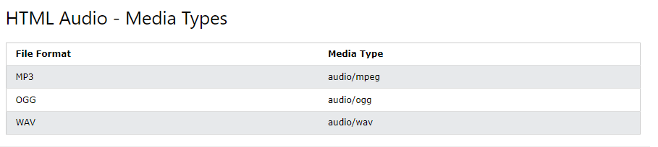
HTML Multimedia
HTML Audio
The controls attribute adds audio controls, like play, pause, and volume. The text between the <audio> and </audio> tags will only be displayed in browsers that do not support the <audio> element.
<audio width="320" height="240" > <source src=“audio.mp3" type="audio/mpeg">
Your browser does not support the audio element. </audio >

