Slide 1
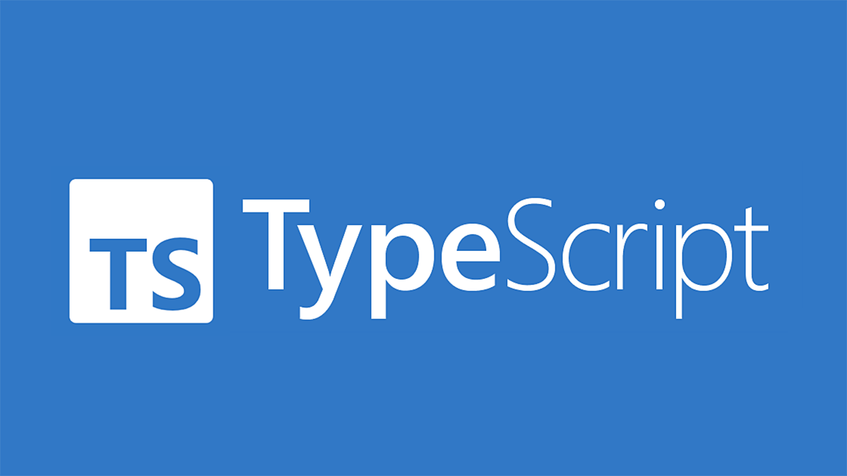

Slide 2

Our Goal
By the end, I want you to have a rock-solid mental model, that will allow you to design, discuss and understand types.

Slide 3
What is TypeScript?
TypeScript is an open source, typed syntactic superset of JavaScript
Compiles to clean, readable JS
Three parts: Language, Language Server and Compiler
Kind of like a fancy linter — helps purely at build time

Slide 4
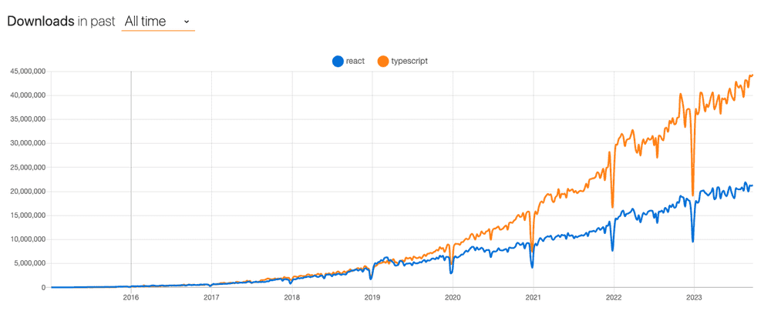
TypeScript is increasingly popular

Slide 5
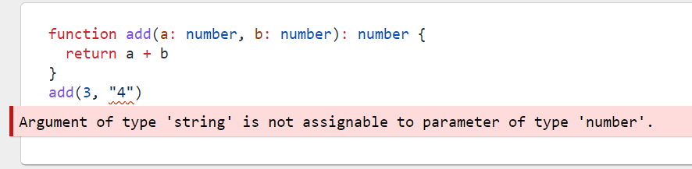
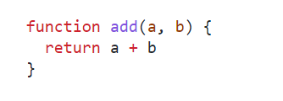
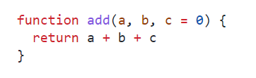
Why types are a big deal😐
It allows developers to leave more of their intent “on the page”, especially when it comes to articulating constraints.
This kind of intent is often missing from JS code. For example:
We’re headed for trouble if we decide to pass strings in for a and b!
Types make the author’s intent more clear
Is this meant to take numbers as args? strings? both?
What if someone who interpreted a and b as numbers made this “backwards-compatible change?”
This code is more readable and self-documenting, in that it’s clearer how the author of this function intends it to be used.

Slide 6
Why types are a big deal😐
TypeScript moves some kinds of common programming errors from runtime to compile time
Examples:
Potentially absent Values (null or undefined).
Incomplete refactoring.
Breakage around internal code contracts (e.g., an argument becomes required)
It serves as the foundation for a great code authoring experience

Slide 7
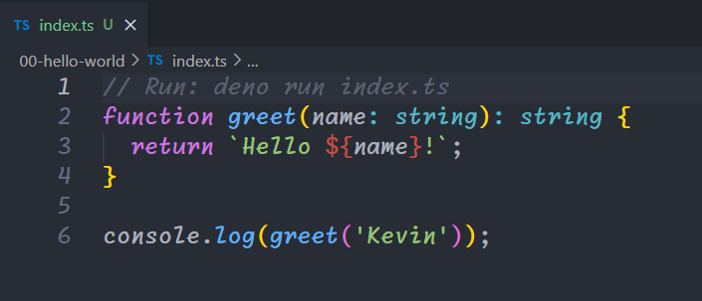
‘Hello World’ with TypeScript
TypeScript Setup using tsc
pnpm install -g typescript
Install Ts globally.
TypeScript compiler (tsc) will transpile your TypeScript code into JavaScript
Then Node index.js will run your compiled JavaScript file
pnpm install -g typescript
tsc index.ts
node index.js

Slide 8
tsc VS ts-node-dev
Tsc (TypeScript Compiler)
ts-node
Installation: Comes bundled with the TypeScript package. No need to install separately.
Purpose: The TypeScript compiler (tsc) is responsible for transpiling TypeScript files (.ts) into JavaScript files (.js). It processes all files according to your tsconfig.json configuration.
Compilation: It compiles the entire project based on the specified settings in your tsconfig.json.
Output: Produces JavaScript files that can be executed directly by Node.js.
Usage:
Typically used for production builds.
Faster than ts-node.
Generates separate .js files for each .ts file.
Installation: pnpm install -g ts-node or pnpm install ts-node --save-dev.
Purpose: Ts-node is a wrapper for Node.js’s node executable. It installs a TypeScript-enabled module loader that compiles TypeScript code on-the-fly as needed.
Interpretation: Instead of compiling all files upfront, ts-node interprets TypeScript code directly using a JavaScript interpreter.
Usage:
Commonly used for development purposes.
Ideal for running in watch mode during development.
Convenient for quick iterations and debugging.
Acts as a REPL environment for TypeScript.
Performance: Slower than tsc because it compiles TypeScript code on-the-fly.
Debugging: Easier to debug because it preserves the original TypeScript code.
Sample Usage:
ts-node-dev --respawn => ts-node-dev --transpile-only file.ts => to skip type-checking and only transpile ts code to js.
ts-node --files file.ts => to enable file watching and recompilation on file changes.

Slide 9
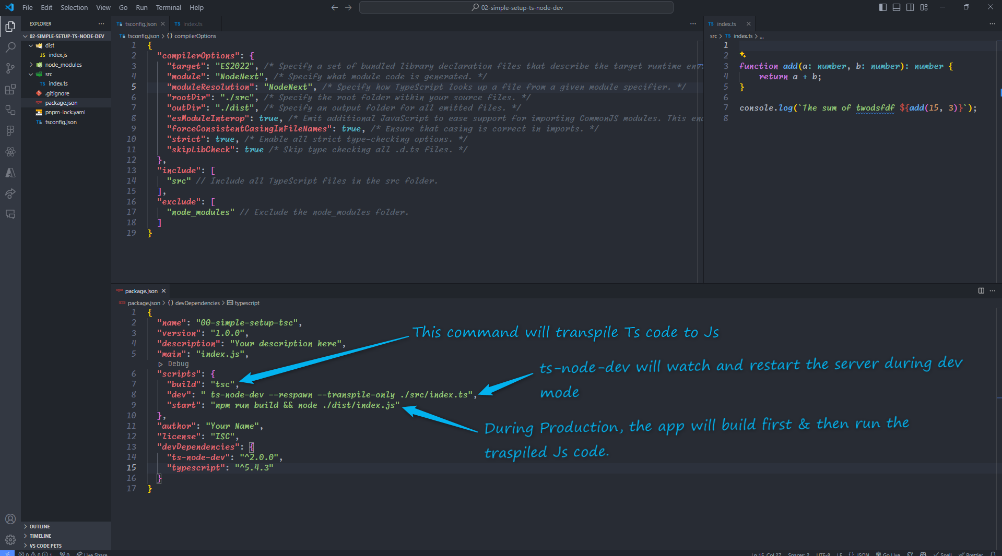

Slide 10
Variables and Values

Slide 11
Variable Declarations & Inference
Variables
A variable is a named memory location that can hold a value.
Variables can store a wide range of data types, such as numbers, strings, and arrays.
A variable is declared by specifying its name, data type, and optionally an initial value.
Once a variable is declared, it can be read and updated in other parts of the program

Slide 12
Special Types

Slide 13
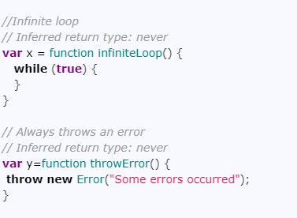
TypeScript Special Types
Never
The never type represents the value that will never happen. We use it as the return type of a function, which does not return a value(infinite loop or function that always throws an error). For example, the function that always throws an exception is shown below

Slide 14

TypeScript Special Types
Void
Void represents the absence of any return value. For example, the following function prints “hello” and returns without returning a value. Hence the return type is void.

Slide 15
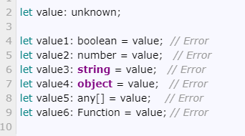
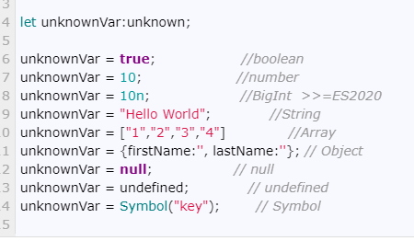
TypeScript Special Types
Unknown
But cannot assign unknown to any other types.
unknown type means that the type of variable is not known. It is the type-safe counterpart of any

Slide 16

TypeScript Special Types
Null and Undefined
JavaScript has two ways to refer to the null. They are null and undefined and are two separate data types in Typescript as well. The null and undefined are subtypes of all other types. That means you can assign null and undefined to something like a number.
Undefined : Denotes value is given to all uninitialized variables.
Null : Represents the intentional absence of object value.

Slide 17
Objects

Slide 18
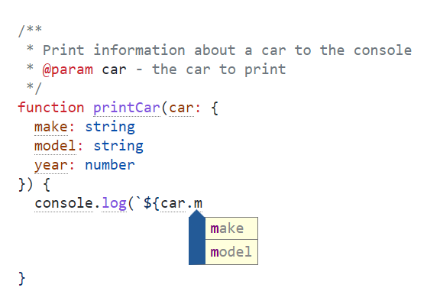
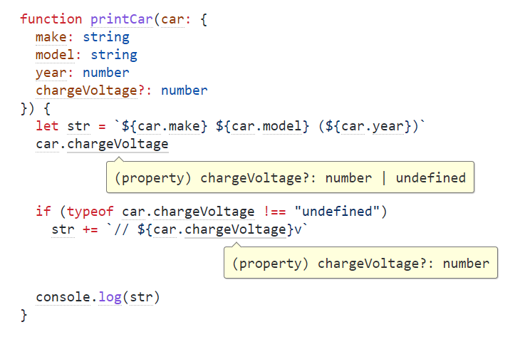
Objects
Variables
In general, object types are defined by:
The names of the properties that are (or may be) present
The types of those properties
Optional Properties
What if we take our car example a bit further by adding a fourth property that’s only present sometimes?
Note that the type of chargeVoltage is now number | undefined

Slide 19
Arrays

Slide 20
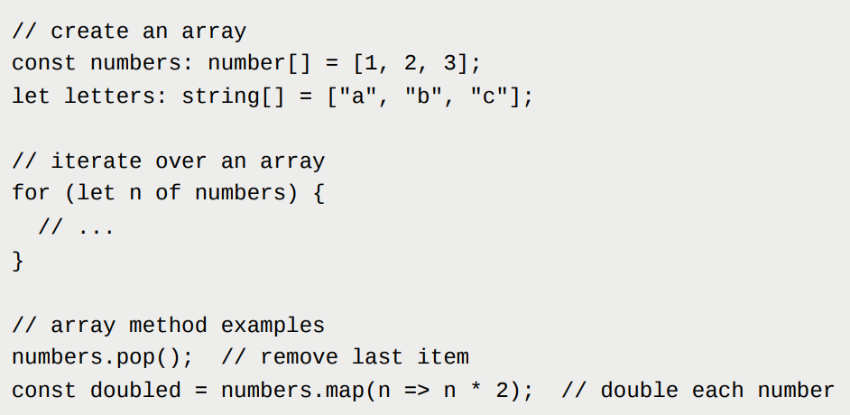
Array Types
Describing types for arrays is often as easy as adding [] to the end of the array member’s type. For example, the type for an array of strings would look like string[]. Later using various methods such as push() , splice() , and concat() . Arrays can be of a fixed length or dynamically resized as needed, and they can be used with various array methods to perform common operations like sorting, filtering, and mapping

Slide 21
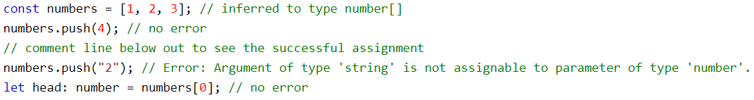
Readonly Array
The readonly keyword can prevent arrays from being changed.
Type Inference
TypeScript can infer the type of an array if it has values.

Slide 22
Tuples

Slide 23
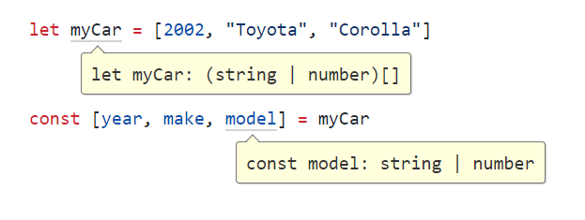
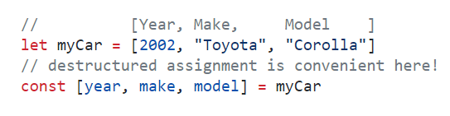
Tuples
TypeScript handles inference in this case
A tuple is a typed array with a pre-defined length and types for each index.
Let’s imagine we define a convention where we can represent the same “2002 Toyota Corolla” as
| means “OR”, so we can think of string | number means either a string or a number.
TypeScript has chosen the most specific type that describes the entire contents of the array. This is not quite what we wanted, in that:
it allows us to break our convention where the year always comes first
it doesn’t quite help us with the “finite length” aspect of tuples

Slide 24
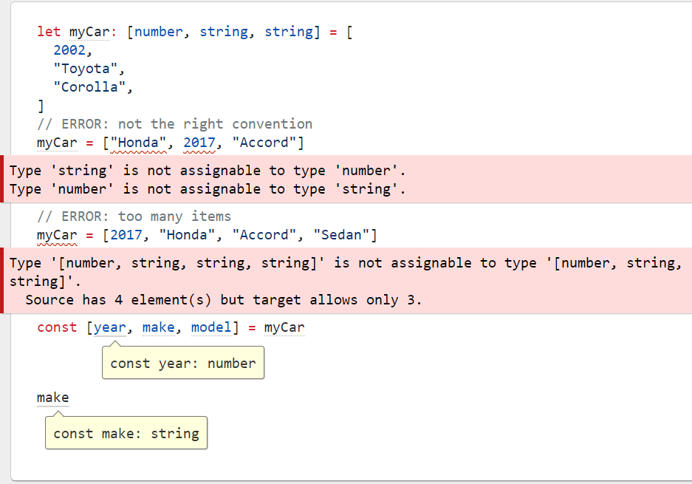
Explicitly state the type of a tuple
Now, we get errors in the places we expect, and all types work out as we hoped

Slide 25
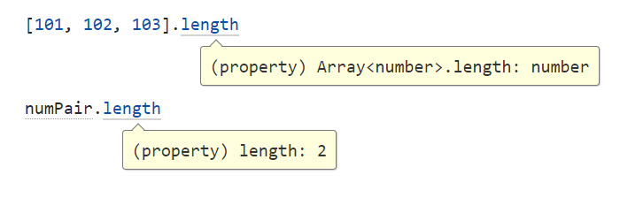

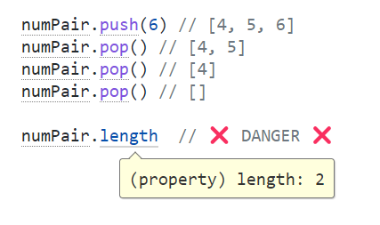
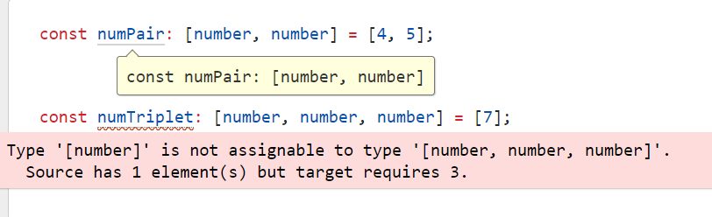
Readonly Tuples
and we see something interesting happening with .length
Tuples are just regular JS Arrays.
This imposes some degree of limitation on how tuples can be typed. For example, an Array allows new things to be .push(...)ed into them, allow .splice(...) and so on. At runtime these methods will exist on every tuple, and the types reflect that.
Typescript provides a lot of the support you’d hope for on assignment:
but we get no protection around push and pop, which effectively would change the type of the tuple

Slide 26
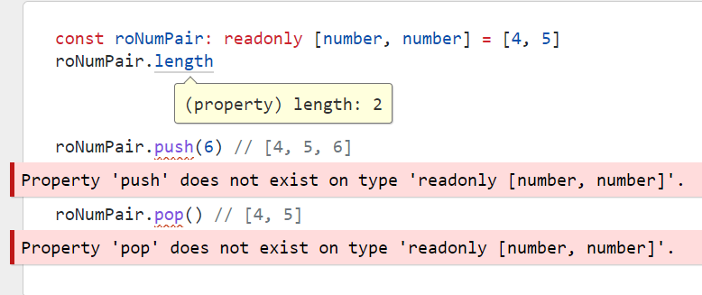
Readonly Tuples
If we are ok with treating this tuple as read-only, we can state so, and get a lot more safety around mutation.

Slide 27
Union and Intersection Types

Slide 28

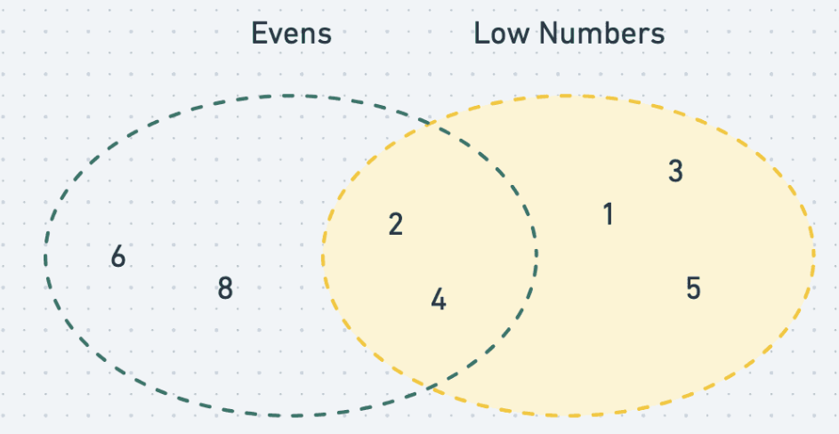
Union and Intersection Types, Conceptually
Union and intersection types can conceptually be thought of as logical boolean operators (AND, OR) as they pertain to types. Here are a couple of example sets we’ll use for this discussion

Slide 29
Union Types |
A union type can be thought of as OR, for types, and TypeScript uses the pipe (|) symbol to represent the Union type operator
Using the example above, if we wanted to find OneThroughFive | Evens we’d combine all the members of the OneThroughFive set and all of the members of the Evens set.
If you think about the assumptions we could make about a member of this set at random, we couldn’t be sure whether it’s between 1 and 5, and we couldn’t be sure whether it’s odd.

Slide 30


Intersection types &
An intersection type can be thought of as AND, for types, and TypeScript uses the ampersand (&) symbol to represent the Intersection type operator
Using the example again, if we wanted to find OneThroughFive & Evens we’d find all members that the OneThroughFive and Evens sets have in common
If you think about the assumptions we could make about a member of this set at random, we couldn’t be sure whether it’s between 1 and 5, and we couldn’t be sure whether it’s odd.

Slide 31
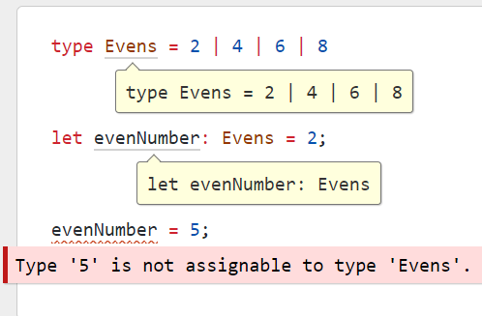
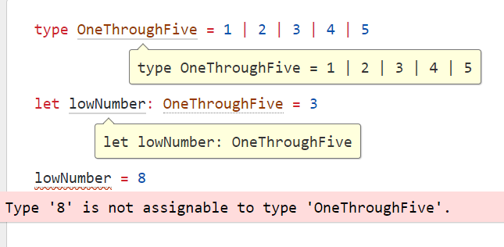
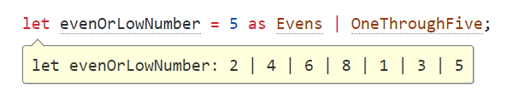
Union Types in TypeScript
and we could create another type called Evens to represent the set { 2, 4, 6, 8 }
If we wanted to create a union type that represented the set { 1, 2, 3, 4, 5 } we could do it using the | operator. We can also use the type keyword to give this type a name.
Explicitly creating the union type is now simple

Slide 32
Intersection Types in TypeScript
and we could create another type called Evens to represent the set { 2, 4, 6, 8 }
If we wanted to create a union type that represented the set { 1, 2, 3, 4, 5 } we could do it using the | operator. We can also use the type keyword to give this type a name.
Explicitly creating the union type is now simple

Slide 33
Type Aliases

Slide 34
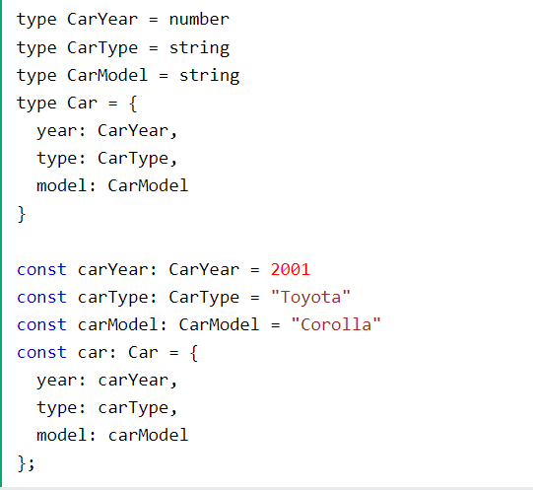
Interfaces and Type Aliases
TypeScript provides two mechanisms for centrally defining types and giving them useful and meaningful names:
Type Aliases
Type Aliases allow defining types with a custom name (an Alias). Type Aliases can be used for primitives like string or more complex types such as objects and arrays:

Slide 35
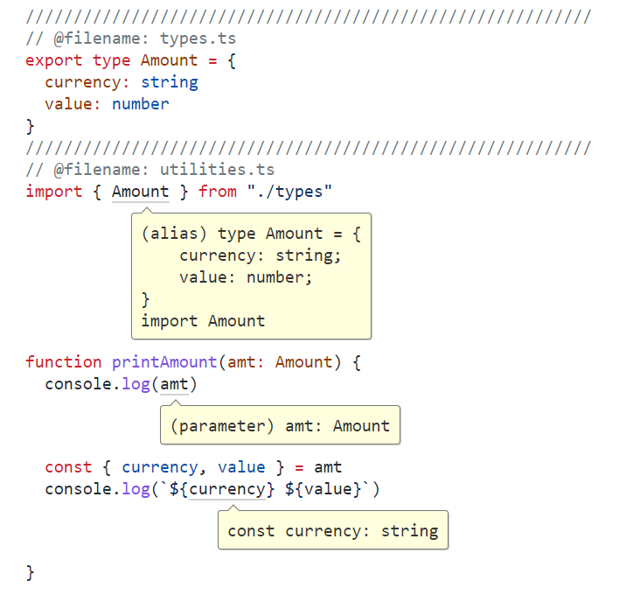
Type Aliases Benefits
Type aliases help to address this, by allowing us to:
define a more meaningful name for this type
declare the shape of the type in a single place
import and export this type from modules, the same as if it were an importable/exportable value

Slide 36
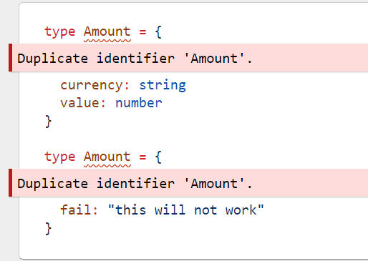
A few things to point out here:😐
This is a rare occasion where we see type information on the right-hand side of the assignment operator (=)
We’re using TitleCase to format the alias’ name. This is a common convention
As we can see below, we can only declare an alias of a given name once within a given scope. This is kind of like how a let or const variable declaration works

Slide 37
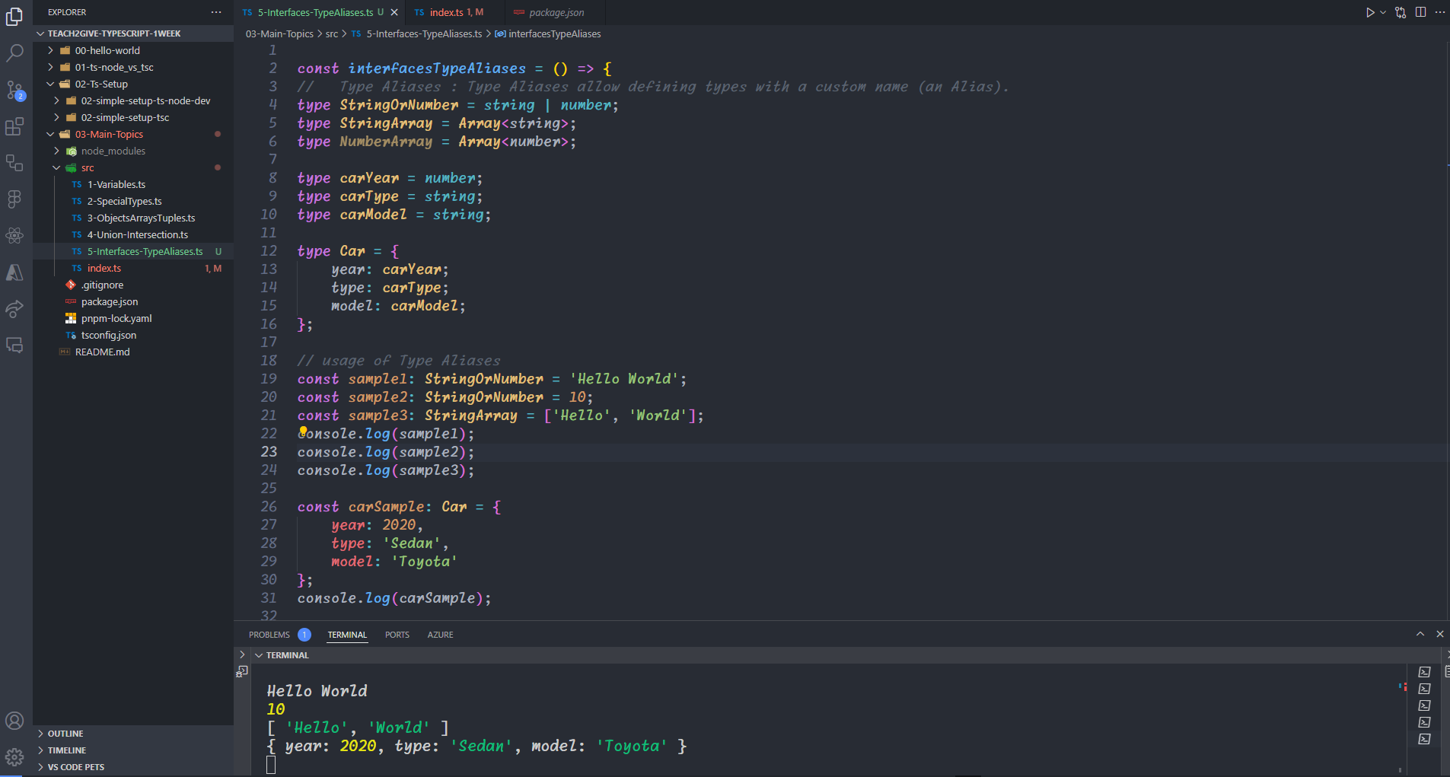

Slide 38
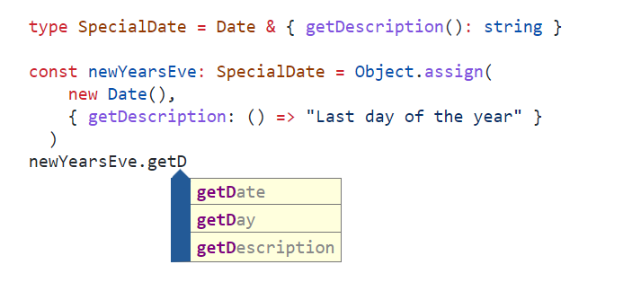
Inheritance in type aliases
You can create type aliases that combine existing types with new behavior by using Intersection (&) types.

Slide 39
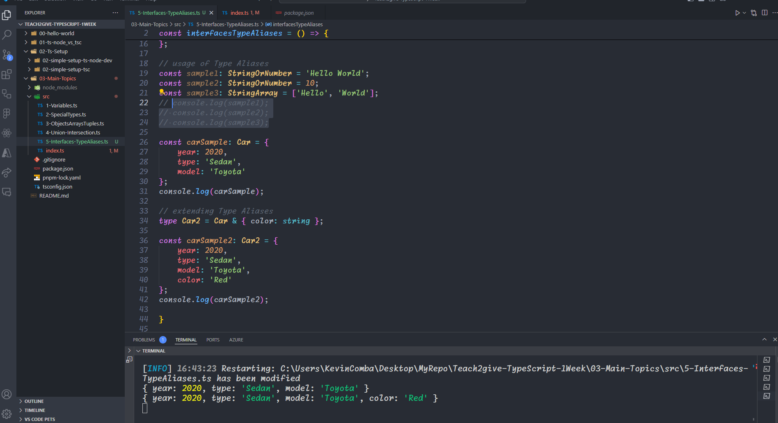

Slide 40
Interfaces

Slide 41
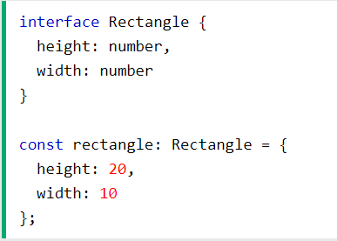
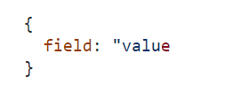
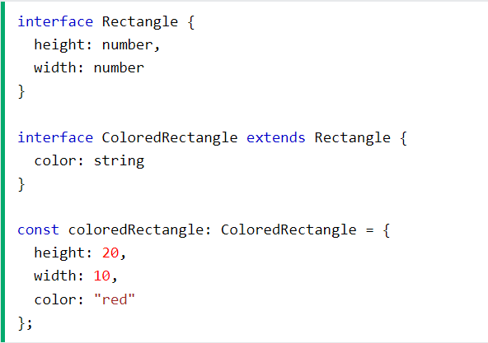
Interfaces
Interfaces are similar to type aliases; except they only apply to object types.
Extending Interfaces
Extending an interface means you are creating a new interface with the same properties as the original, plus something new.

Slide 42
Choosing whether to use type or interface
In many situations, either a type alias or an interface would be perfectly fine, however…
If you need to define something other than an object type (e.g., use of the | union type operator), you must use a type alias
If you need to define a type to use with the implement's heritage term on a class, use an interface
If you need to allow consumers of your types to augment them, you must use an interface.

Slide 43
Functions

Slide 44
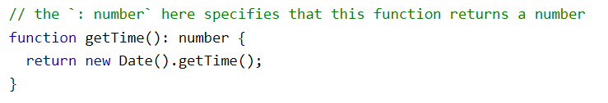
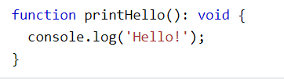

TypeScript Functions
TypeScript has a specific syntax for typing function parameters and return values.
Return Type
The type of the value returned by the function can be explicitly defined.
Void Return Type
The type void can be used to indicate a function doesn't return any value.
Parameters
unction parameters are typed with a similar syntax as variable declarations.

Slide 45
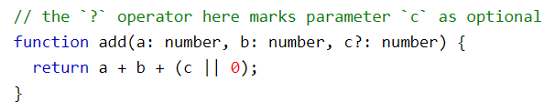

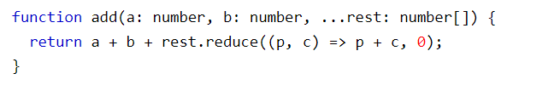
TypeScript Functions
Optional Parameters
By default TypeScript will assume all parameters are required, but they can be explicitly marked as optional.
Default Parameters
For parameters with default values, the default value goes after the type annotation:
Rest Parameters
Rest parameters can be typed like normal parameters, but the type must be an array as rest parameters are always arrays.

Slide 46
Callbacks

Slide 47

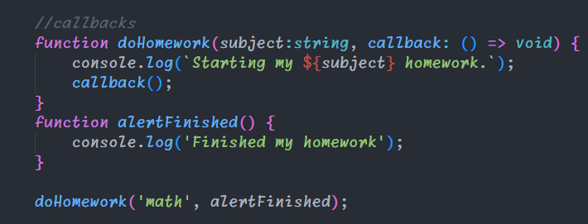
Callbacks
TypeScript, defining callback functions involves using function signatures as types. This powerful feature allows developers to create structured, type-safe callback mechanisms.
Basic Callback Type
To define a callback type, use the following syntax:
Callback Types
You can incorporate this type into your functions

Slide 48
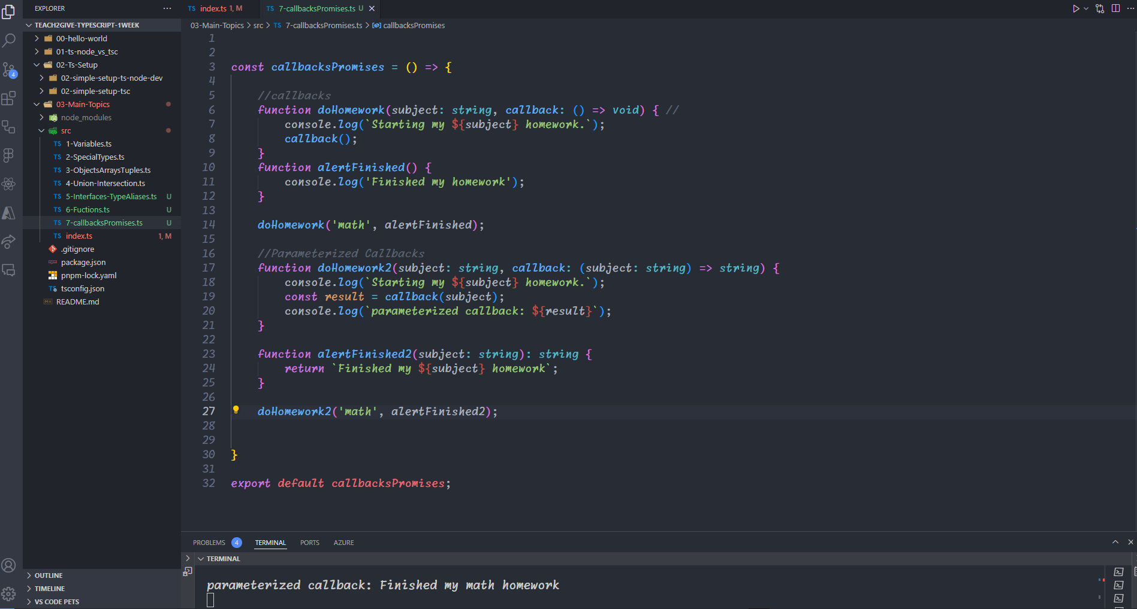
Parameterized Callbacks

Slide 49
Promises

Slide 50
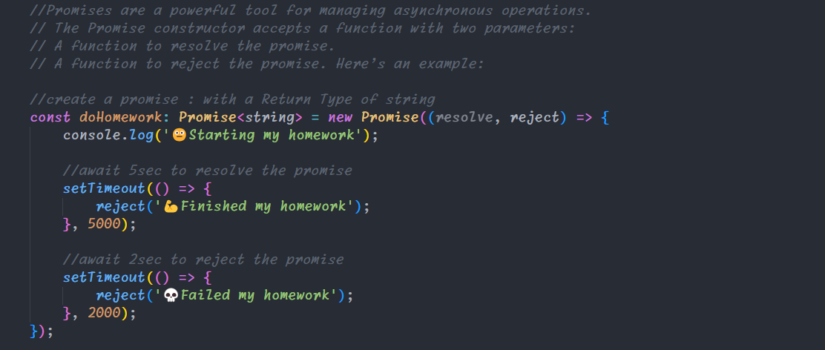
Promises
Promises are a powerful tool for managing asynchronous operations. The Promise constructor accepts a function with two parameters:
A function to resolve the promise.
A function to reject the promise.

Slide 51
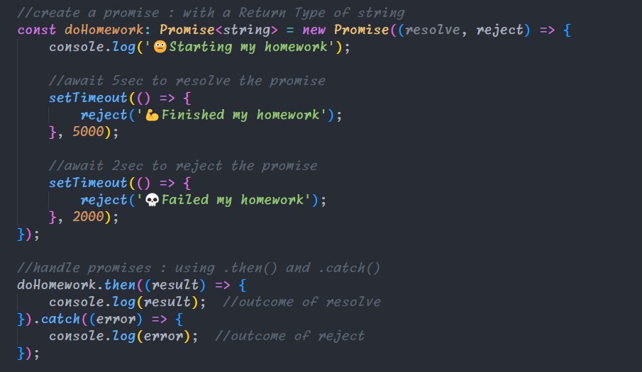
Handle Promises: .then() and .catch()
Once a promise is declared, use the .then() and .catch() methods to handle success or failure:
The .then() method is called when the promise is resolved.
The .catch() method is called when the promise is rejected

Slide 52
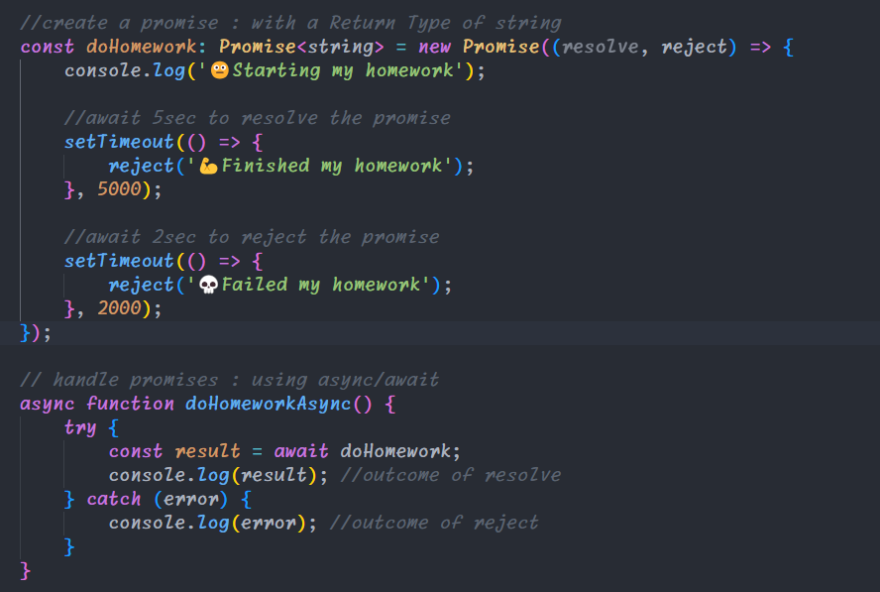
Handle Promises: Async/Await
TypeScript also supports the async/await syntax, which provides a more readable way to handle promises
The async keyword indicates that the function returns a promise.
The await keyword waits for the promise to be resolved.
The try block handles promise to be resolved.
The catch block handles rejected promises.

Slide 53
TypeScript Casting

Slide 54


TypeScript Casting
There are times when working with types when it's necessary to override the variable type, such as when a library provides incorrect types.
Casting is the process of overriding a type
Casting with as
A straightforward way to cast a variable is using the as keyword, which will directly change the type of the given variable.
Casting doesn't actually change the type of the data within the variable, for example the following code will not work as expected since the variable x is still holds a number.
Casting with <>
Using <> works the same as casting with as. This type of casting will not work with TSX, such as when working on React files.

Slide 55
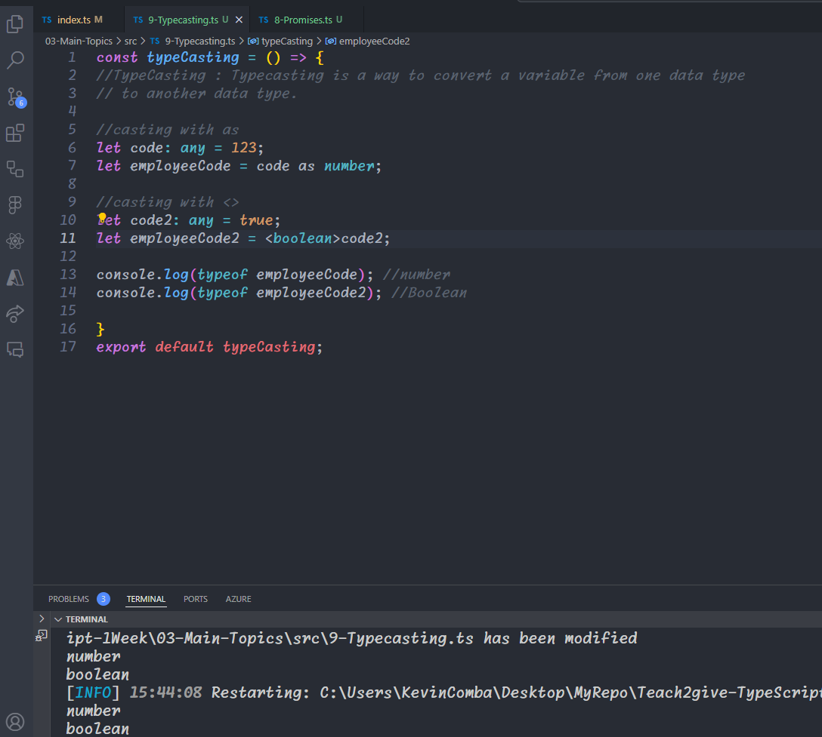
TypeScript Casting

Slide 56
Omit

Slide 57
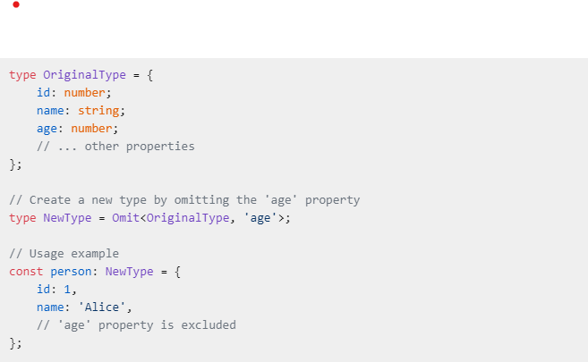
Omit
Omit utility type allows you to create a new type by picking all properties from an existing type and then removing specified keys. It’s particularly useful when you want to create a type based on another but excluding certain properties.

Slide 58
