Slide 1
PROJECT AT A GLANCE
AI Hospital Patient Management
01
Register
02
Appointments
An n8n-based workflow automation system integrating AI, OCR, Google services and structured hospital records.
03
AI Reports
04
Reminders
05
Billing
06
Analytics
n8n • OpenAI • OCR.Space • Google Sheets • Gmail • Google Calendar
01

Slide 2
PROBLEM
Why this project?
The project connects repetitive hospital tasks into traceable automated workflows.
01
Fragmented Tasks
02
Manual Follow-up
03
Limited Traceability
Registration, scheduling, reports, reminders and billing are often handled separately.
Confirmations, reminders and routine communication can be delayed or missed.
Without logs, it is harder to identify what ran, what failed and when.
PROJECT GOAL
Automate the workflow — while keeping data, communication and execution history connected.
02

Slide 3
ARCHITECTURE
How the system is organized
INPUT
Webhook / Schedule Trigger
↓
ORCHESTRATION
n8n workflows + decision logic
↓
INTELLIGENCE
OCR.Space + OpenAI
↓
SERVICES
Google Calendar + Gmail
↓
DATA
Google Sheets + Activity Log
03

Slide 4
ARCHITECTURE
End-to-end event flow
Each workflow follows the same design pattern, but performs a different hospital task.
1
2
3
4
5
6
7
→
→
→
→
→
→
Trigger
Validate
Process
Decide
Store
Notify
Log
Result: structured records + automated communication + visible execution history
04

Slide 5
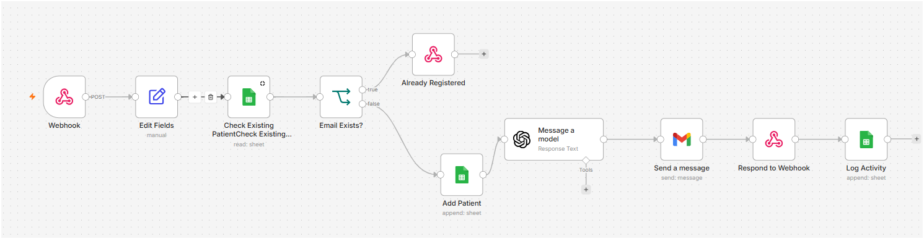
WORKFLOW 1
Patient Registration
Duplicate checking before a new patient record is created.
01
Receive
Webhook receives registration details.
02
Check
Existing email/patient is checked before append.
03
Confirm
Google Sheets + Gmail + Activity Log complete the flow.
Figure 2 — Patient Registration n8n Workflow
05

Slide 6
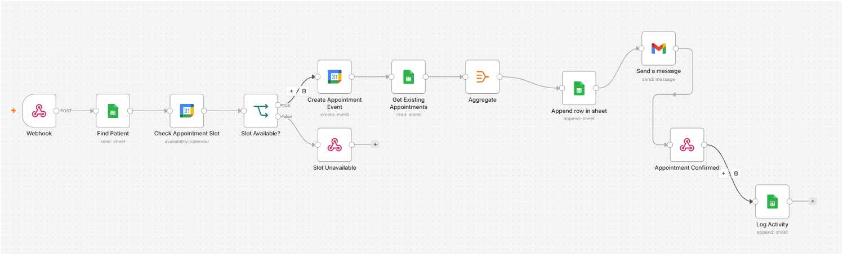
WORKFLOW 2
Appointment Booking
Availability is checked before the appointment is stored and confirmed.
01
Verify
Find Patient reads the patient record.
02
Schedule
Calendar availability and Slot Available? control routing.
03
Record
Appointment is stored, emailed and logged.
Figure 4 — Appointment Booking n8n Workflow
06

Slide 7
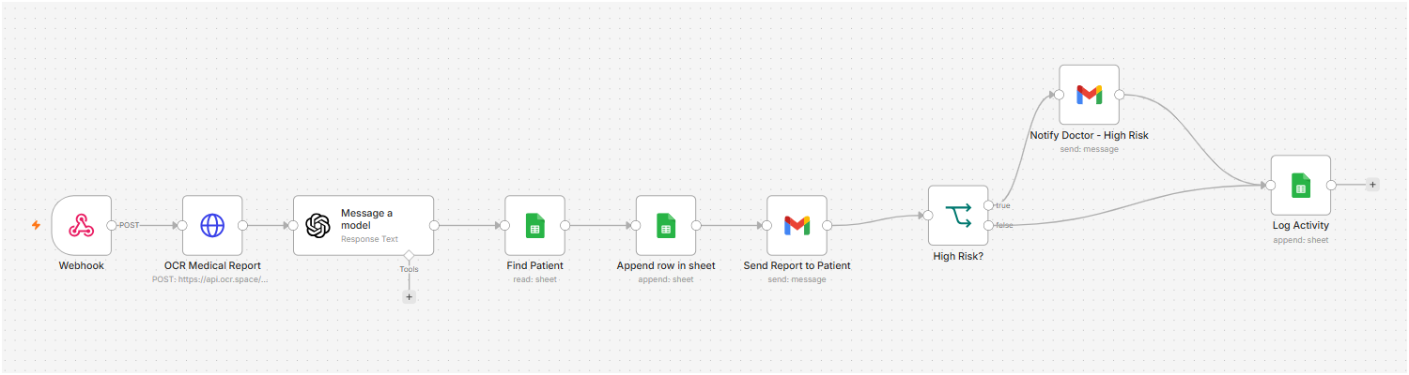
WORKFLOW 3
Medical Report → AI-Assisted Summary
The strongest AI component in the project.
REPORT
→
OCR
→
OPENAI
→
RISK CHECK
→
STORE / EMAIL
STRUCTURED OUTPUT
Disease / condition Risk level Medicines Lifestyle tips Doctor advice Summary
Clinical review remains necessary.
Figure 6 — AI Medical Report Analysis
07

Slide 8
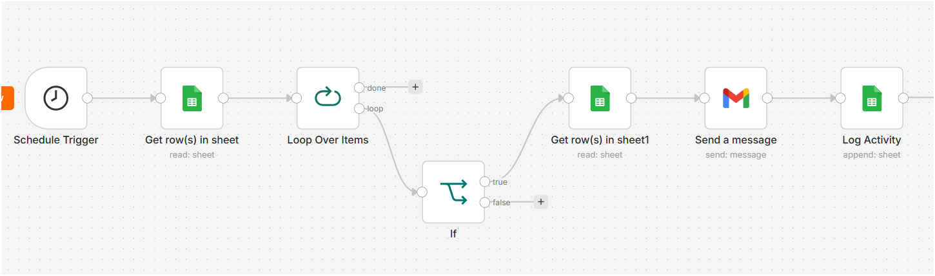
WORKFLOW 4
Medication Reminder
A scheduled workflow processes medicine records and sends due reminders.
01
Schedule
Schedule Trigger starts the workflow.
02
Loop + IF
Medicine rows are checked one by one.
03
Remind
Gmail sends the reminder; activity is logged.
Figure 8 — Medication Reminder n8n Workflow
08

Slide 9
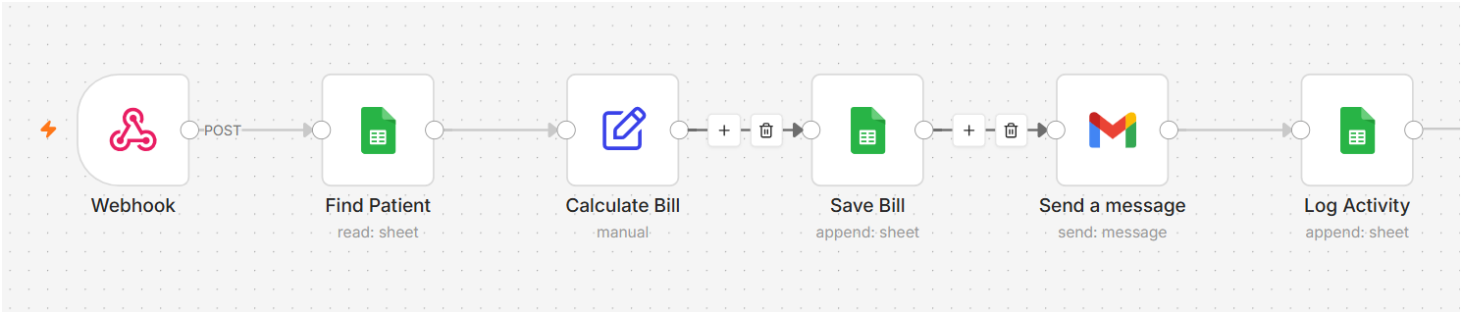
WORKFLOW 5
Billing Automation
Charges are combined into a stored billing record and patient message.
BILL COMPONENTS
1
Consultation Fee
2
Test Charges
3
Medicine Charges
4
Other Charges
5
Total Amount
Figure 10 — Automated Billing n8n Workflow
09

Slide 10
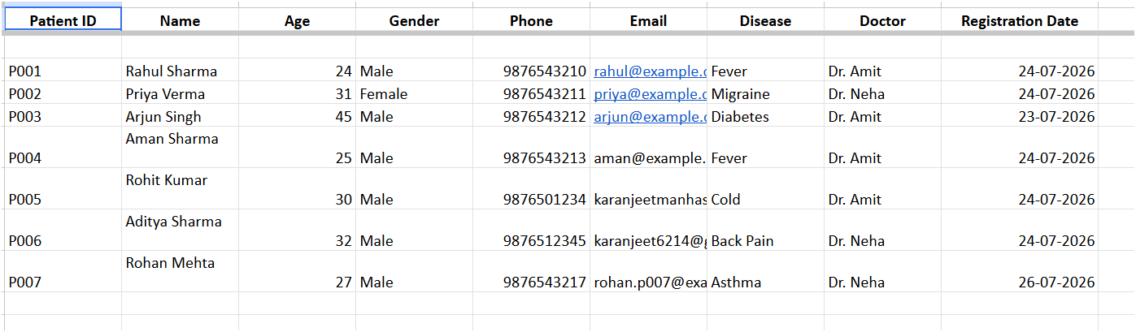
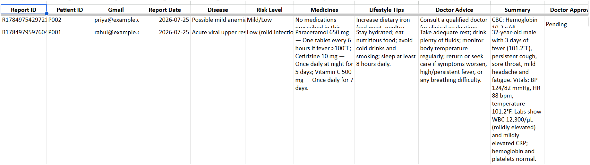
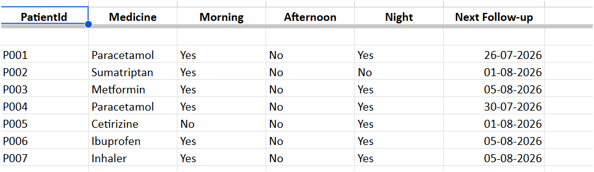
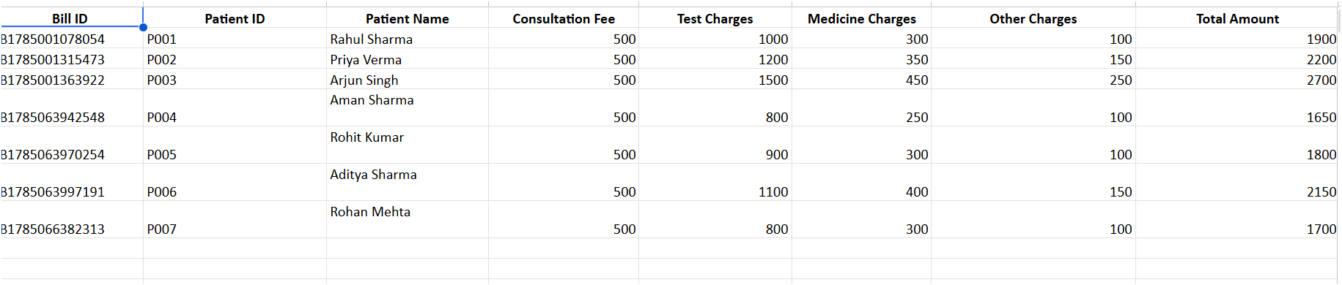
EVIDENCE
Google Sheets: project records
Use real sheets as evidence that the workflows are producing outputs.
SHEETS USED
1
Patients
2
Appointments
3
Reports
4
Medicines
5
Bills
6
Activity Logs
Tip: show more sheets during the live demo.
Figure — Google Sheets Output
10

Slide 11
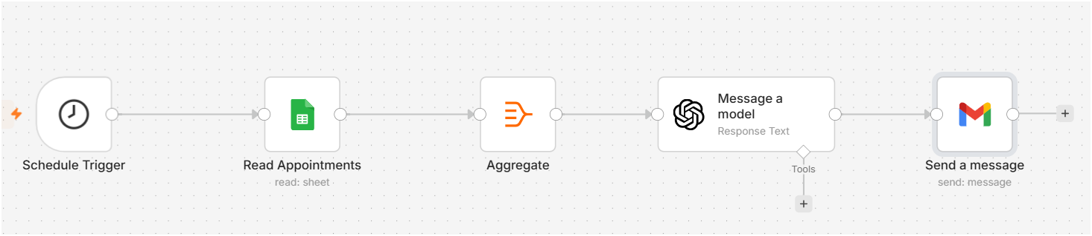
ANALYTICS
Weekly Hospital Analytics
Scheduled aggregation + AI-assisted summary.
01
Collect
Read relevant rows from Google Sheets.
02
Aggregate
Combine records for weekly reporting.
03
Summarize
OpenAI prepares readable analytics when quota is available.
Figure 12 — Hospital Weekly Analytics Workflow
11

Slide 12
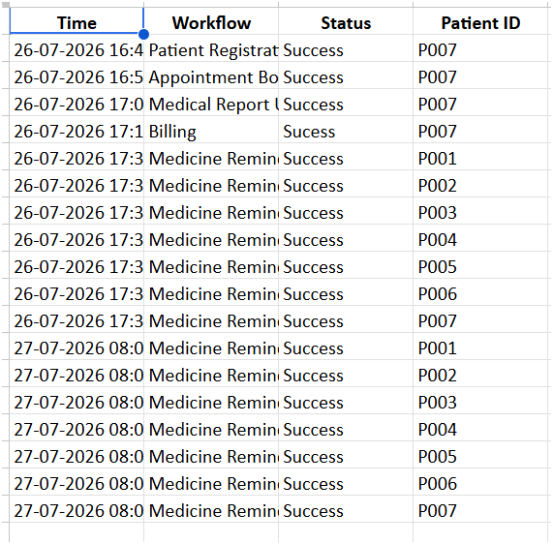
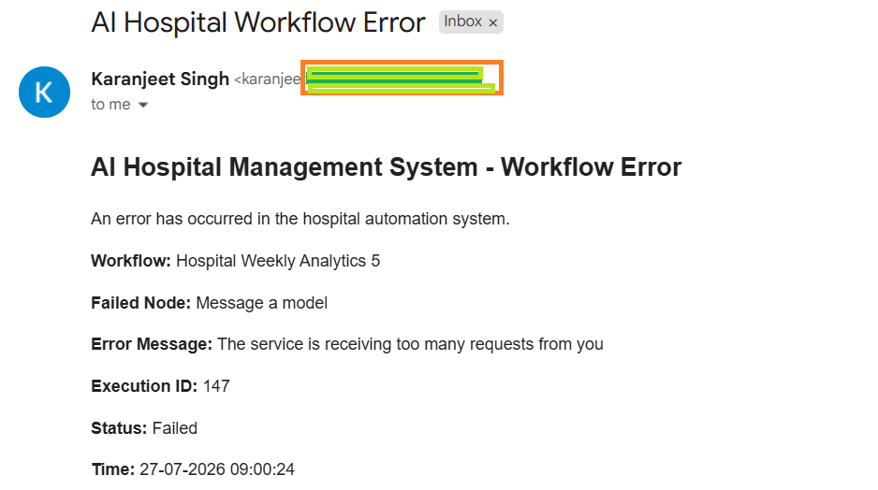
MONITORING
Activity Log + Error Handling
The project records normal activity and also surfaces failures.
REAL ERROR EXAMPLE
Hospital Weekly Analytics Failed node: Message a model
Cause shown by OpenAI: API quota / too many requests
Figure 13 — Activity Log
Why it matters: The administrator receives enough execution information to investigate the failure.
Figure 14 — Error Notification
12

Slide 13
IMPLEMENTATION
Technology Stack
n8n
OpenAI
OCR.Space
Automation engine
AI processing
Report OCR
Google Sheets
Google Calendar
Gmail
Project database
Scheduling
Notifications
Design choice: managed services keep the prototype focused on workflow logic rather than a custom backend.
13

Slide 14
RESULTS
What the prototype demonstrates
✓
Registration
✓
Appointments
✓
Reports
✓
Reminders
Duplicate check + record
Calendar + confirmation
OCR + AI summary
Scheduled Gmail
✓
Billing
✓
Analytics
✓
Logs
✓
Errors
Calculated + stored
Weekly summary
Execution history
Automatic alert
One project • multiple independent workflows • shared data and monitoring
14

Slide 15
SCOPE
Limitations & Future Scope
Current Prototype
Future Improvements
• Google Sheets is suitable for the academic prototype, not a full production EHR.
• OpenAI output can be affected by API quota and model limitations.
• AI medical output must be reviewed by qualified healthcare professionals.
• Production deployment would require stronger privacy, security and validation controls.
• Patient, doctor and administrator interfaces.
• Production-grade database and role-based authentication.
• EHR/HIS and insurance integrations.
• Operational dashboards and richer analytics.
• Human-reviewed clinical AI with stronger governance.
15

Slide 16
PROJECT CLOSING
THANK YOU
AI Hospital Patient Management System
PROJECT HIGHLIGHTS
Patient Registration
Appointment Booking
cCccc
AI Medical Report Analysis
Medication Reminder
Automated Billing
n8n
OpenAI
OCR.Space
Sheets
Calendar
Gmail
Weekly Analytics
Activity & Error Monitoring

