Slide 1
Assessment task
Karan j Khanna

Slide 2
Introduction
I strongly urge you to kindly complement this presentation with the word document enclosed, which will provide you a much more comprehensive, and analytical perspective of the visualizations you will see here. Thank you!

Slide 3
Introduction
We are given 4 disjointed healthcare datasets, all in CSV format:
clinical_data : past medical records | primary key : id
demographics : patients’ personal info | primary key : patient_id
bill_id : bill tracking info | primary key : bill_id | foreign key : patient_id
bill_amount : bill cost | primary key : bill_id

Slide 4
OBJECTIVE
Our end objective is as follows:
To build a solitary comprehensive dataframe using python, containing actionable information from all the 4 datasets. We need to figure out a way to join all the tables together in a meaningful, neat, and organised manner. This will facilitate smoother analysis of the data.
To conduct exploratory data analysis on the newly generated comprehensive dataframe. The end goal is to obtain insights behind the drivers responsible for medical costs.

Slide 5
EXECUTIVE SUMMARY
Analysis of primary cost drivers:
resident_status => high negative correlation of almost -14% | foreigners pay the highest amount | citizens pay the lowest | reason behind is straightforward, government policies
symptom_5 => high positive correlation of almost 17% | patients who have this symptom pay almost 75% more than those who don’t | reasons behind = ambiguous, speculative at best
age => high positive correlation of 10.70% | as one gets older, healthcare costs increase | interestingly there are various combinations, such as being overweight, or having symptom_5 persistently, that can raise the bill amount even higher over time | check relevant scatterplots
bmi => relatively high positive correlation of 4.60% | the more overweight the person, the higher the amount | teams up well with other factors contributing to higher amount

Slide 6
EXECUTIVE SUMMARY
Analysis of primary cost drivers:
race => high positive correlation of almost 11% | astonishingly, malay patients pay around 17% higher than Indian patients, and a whopping 46% higher than chinese patients.
medical_history_1 => high positive correlation of almost 7.50% | patients with this history pay around 40% more | direct positive correlation with being overweight, age | more popular among females | relatively lower frequency among Indians | possible heart condition indicator
gender => low positive correlation of 1.9% | minor disparity between male / female | males pay slightly more

Slide 7
EXECUTIVE SUMMARY
Analysis of medical history classification:
medical_history_3 => there is a high chance this is associated with type 2 diabetes | it affects the overweight far more than it does other BMI categories
medical_history_6 => there is a high chance this is associated with a children’s disease (like chicken pox, measles, rashes etc.) | it affects the young far more than it does other age categories

Slide 8
ISSUES ADDRESSed
We have tried to answer the following (among many other) questions in our analysis:
Are foreigners paying more than locals?
Is there any disparity between bill amount and patient’s race?
Is the amount higher for overweight patients?
Do healthcare costs increase with age?
Why is the correlation of symptom_5 so high (17%) with amount?
What are the implications of having medical_history_1?
Is there disparity between bill amount for men and women?
Is medical_history_3 possibly diabetes type 2?
Is medical_history_6 a children’s disease (chicken pox, measles, etc.)?

Slide 9
DATA pRe-processing
Technologies leveraged:
Python3
Pandas
Numpy
Python Operating System
Matplotlib
Seaborn v 0.9.0 ( please make sure you have the latest version ☺ )
Bokeh
Scikit-learn
Warnings

Slide 10
DATA pRe-processing
Challenges Faced
Disjointed datasets
Tedious parsing of date-time objects
Cumbersome derivation of patient’s age from two separate date-time objects
Generating BMI column

Slide 11
DATA pRe-processing
Challenges Faced
Manual conversion of categorical data
Transformation of dirty data within multiple categorical variables
Missing values in two columns
Encoding of categorical variables to allow for correlation analysis

Slide 12
DATA pRe-processing
In this presentation, I will not provide a comprehensive explanation of the entire data pre-processing mechanism I followed.
Kindly refer to the enclosed Word document for a step-by-step explanation of the same.
I will, however, provide here a snapshot of the data transformation phase, using screenshots in the process.

Slide 13
DATA pRe-processing
I loaded the datasets into pandas dataframes, using read_csv
I then proceeded to merge bill_id with bill_amount using an INNER merge (pd.merge) on bill_id (PK)
In bill, there was an object column called date_of_admission , I converted this into pandas date-time.
In clinical_data, the primary key is id. Upon inspection, I confirmed that this is identical to patient_id in demographics.
I proceeded to rename the id column in clinical_data, to patient_id, to match with the primary key of demographics.

Slide 14
DATA pRe-processing
I merged demographics with clinical_data using a RIGHT merge (pd.merge) on patient_id. The resulting dataframe was named patient.
I converted all the date columns in patient, to pandas date-time.
I proceeded to generate an age column in patient. I did this by subtracting date_of_birth from date_of_admission.
I created age categories based on the age column.
I generated a BMI (Body Mass Index) column, which I felt would be a better indicator of a patient’s weight status, than simply weight itself.

Slide 15
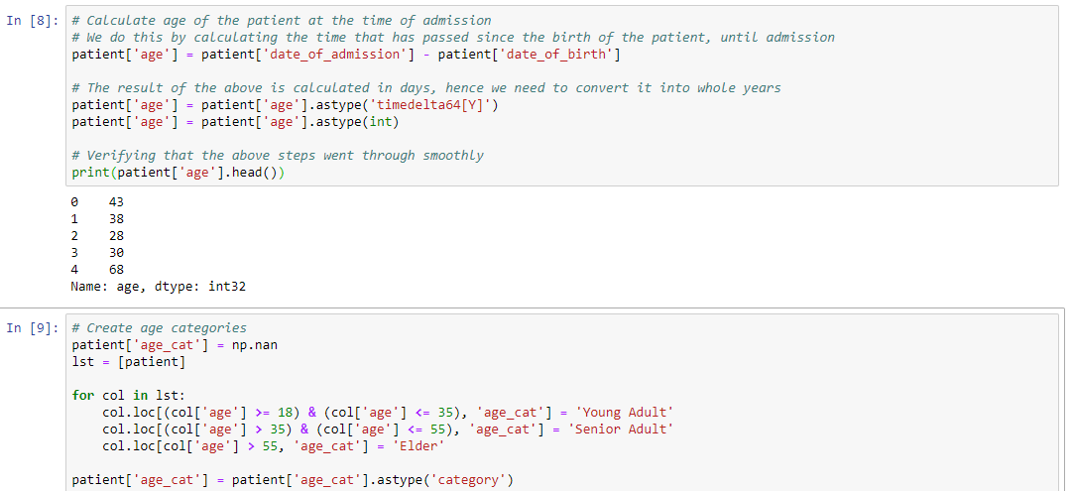
DATA pRe-processing

Slide 16
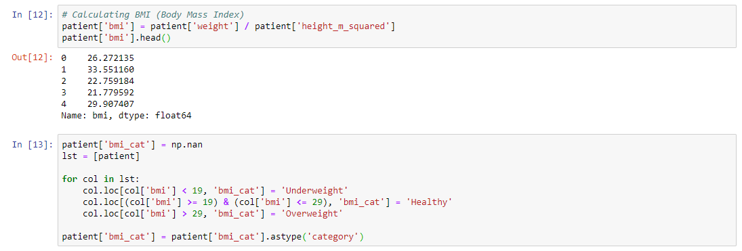
DATA pRe-processing

Slide 17
DATA pRe-processing
I created BMI categories based on the BMI column.
I re-aligned the dataframe to make it more tidy and neat, storing all demographic data in one section on the left.
I converted object columns into categorical ones, where I felt this was required.
I transformed dirty data in multiple categorical columns.
I cleaned the medical_history_x datasets.

Slide 18
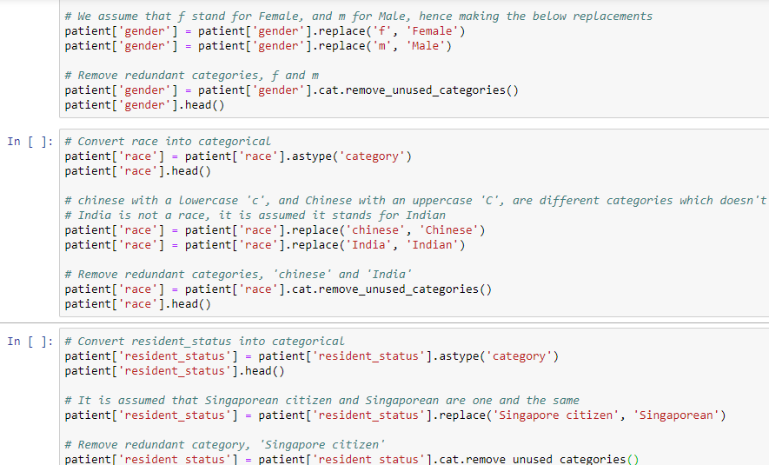
DATA pRe-processing

Slide 19
DATA pRe-processing
I chose to create a separate category for missing values in medical_history_2 and medical_history_5.
I merged patient and bill using a RIGHT merge on patient_id and also on date_of_admission. The resulting dataframe is called merged.
I exported bill, patient, and merged to CSV. Always nice to have clean data handy.
I encoded categorical variables using sklearn’s LabelEncoder, to allow for smooth correlation analysis of categorical data.

Slide 20
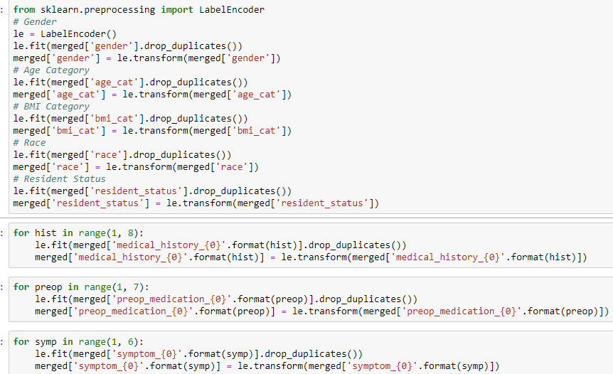
DATA pRe-processing

Slide 21
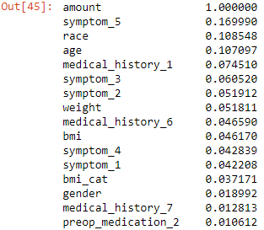
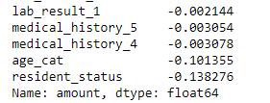
DATA ANALysis
Correlation of amount column with other relevant columns:

Slide 22
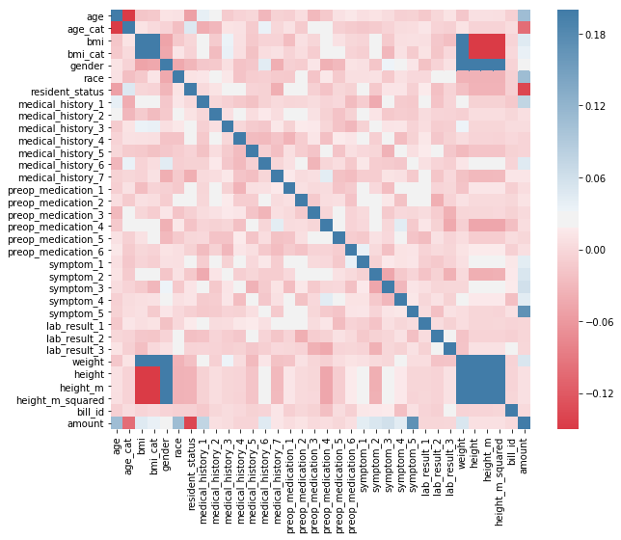
Heatmap of the correlation of amount:

Slide 23
DATA ANALysis
Symptom_5 has a whopping 17% correlation with the amount. Certain ailments like fever, headaches, weakness are common in a large variety of medical conditions. This needs to be investigated accordingly. We will do this later on.
Race has almost 11% correlation with the amount. We’ll look into this as well.
Age has almost 11% correlation with the amount. Let’s investigate!
Medical_history_1 has over 7% correlation. Maybe the cost of taking care of this particular kind of medical history is generally expensive in Singapore. One reason could be that the medication to treat the same is imported from a monopoly or a patented manufacturer.

Slide 24
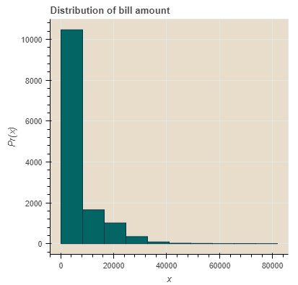
DATA ANALysis
Let’s now take a look at the distribution of bill amount:
The majority of the bills amount to below $10,000 each.
Distribution plot made using Bokeh

Slide 25
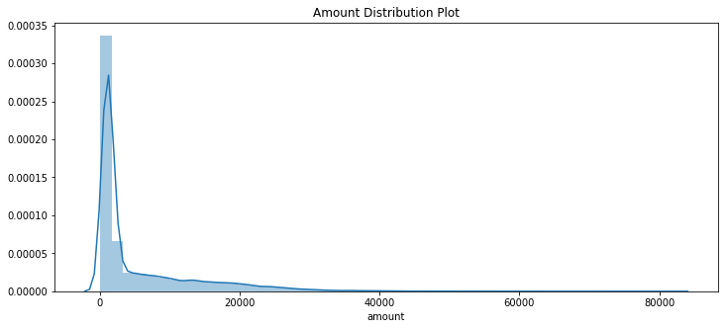
DATA ANALysis
Let’s now take a look at the distribution of bill amount:
Distribution plot made using Seaborn 0.9.0

Slide 26
DO Foreigners pay more for healthcare?
Resident status has a negative correlation of -14% with amount.
I suspect healthcare is cheaper for locals in Singapore, as compared to that for foreigners.
It is obvious that the government would subsidize its own country’s citizens’ healthcare. And not those of other countries.

Slide 27
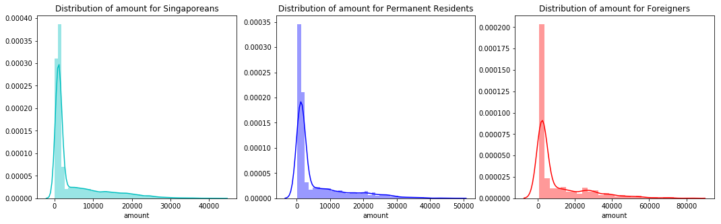
DO Foreigners pay more for healthcare?

Slide 28
DO Foreigners pay more for healthcare?
Indeed, the data confirms that foreigners pay far more than locals- both Singaporeans and Permanent Residents.
This is probably because the government of Singapore may be subsidizing the cost of healthcare for its citizens and permanent residents.
Let’s see exactly where each category of inhabitants stands in terms of shelling out for healthcare in Singapore, with the help of a boxplot:

Slide 29
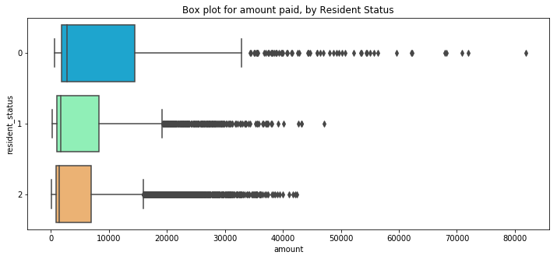
DO Foreigners pay more for healthcare?
Legend: 0 = Foreigners 1 = PRs 2 = Singaporeans

Slide 30
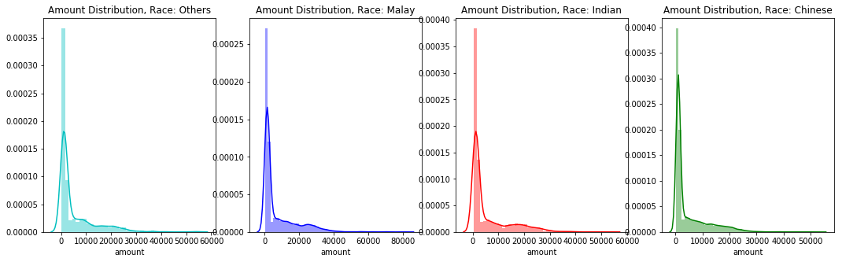
Link between amount and race

Slide 31
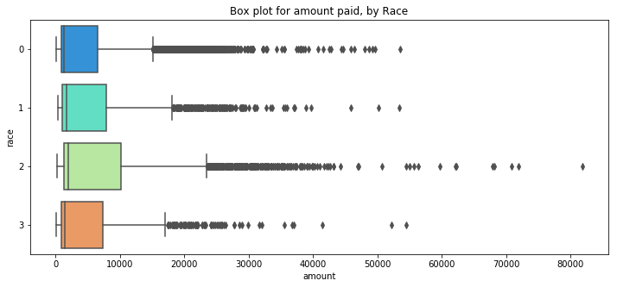
Link between amount and race
0 = Chinese 1 = Indian 2 = Malay 3 = Others

Slide 32
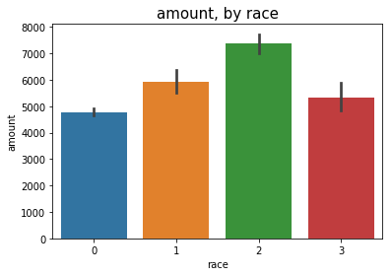
Link between amount and race
0 = Chinese 1 = Indian 2 = Malay 3 = Others

Slide 33
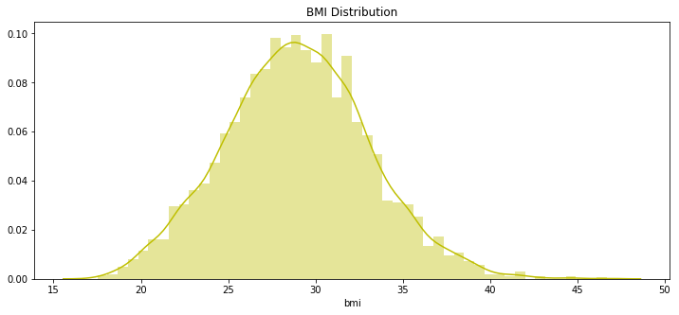
do overweight patients pay more?

Slide 34
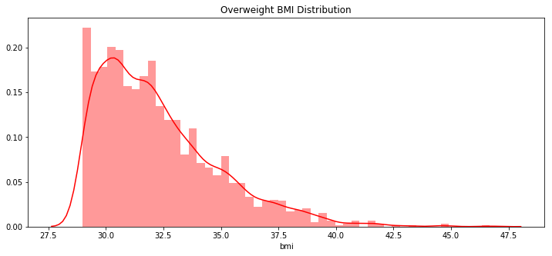
do overweight patients pay more?

Slide 35
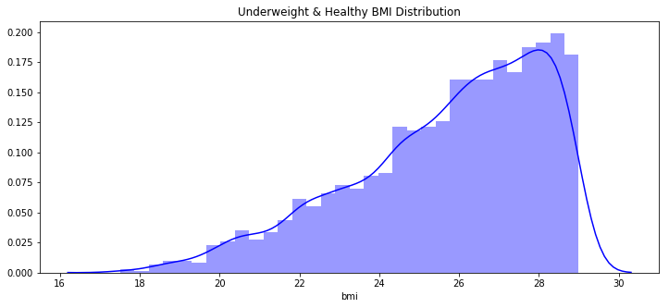
do overweight patients pay more?

Slide 36
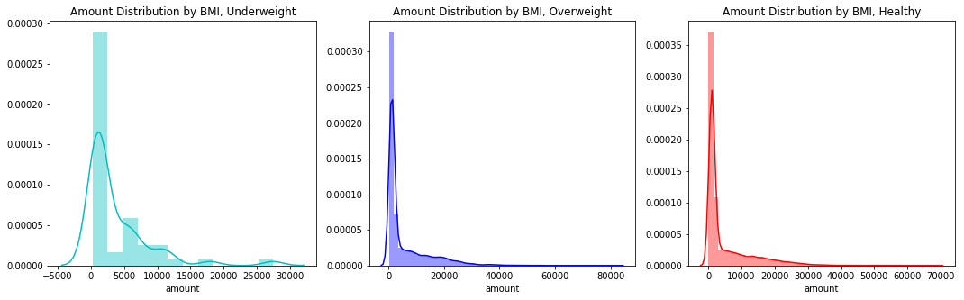
do overweight patients pay more?
0 = Healthy 1 = Overweight 2 = Underweight

Slide 37
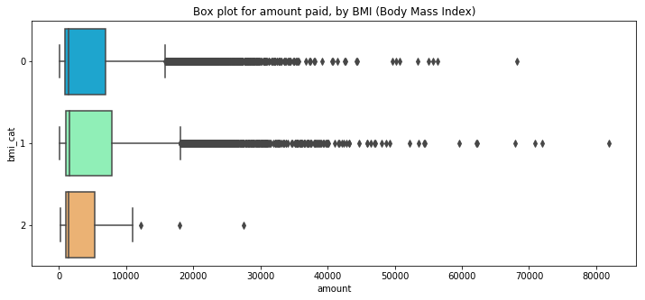
do overweight patients pay more?
0 = Healthy 1 = Overweight 2 = Underweight

Slide 38
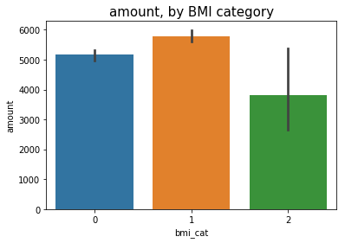
DO OVERWEIGHT PATIENTS PAY MORE?
It can be seen from the above figures that yes, in fact, overweight patients do have to pay a higher amount. Let’s see by how much:
0 = Healthy 1 = Overweight 2 = Underweight

Slide 39
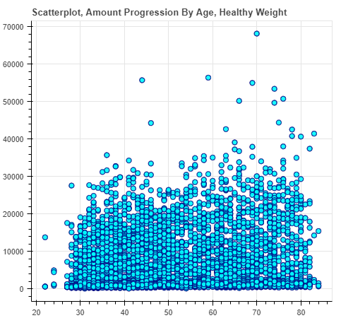
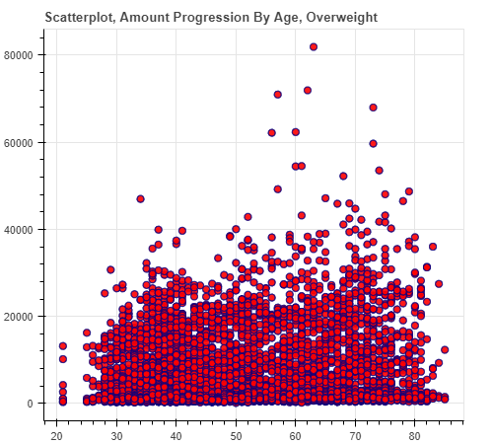
do overweight patients pay more?
X = Age | Y = Amount
Amount Progression by Age, if patients stay healthy
Amount Progression by Age, if patients stay overweight

Slide 40
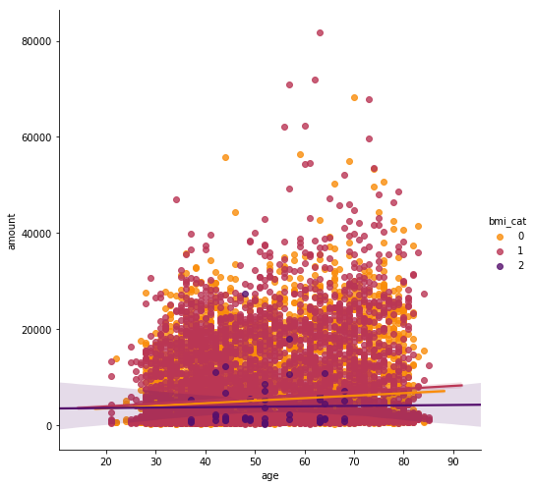
Scatterplot, Amount Progression By Age, All BMI Categories
0 = Healthy 1 = Overweight 2 = Underweight

Slide 41
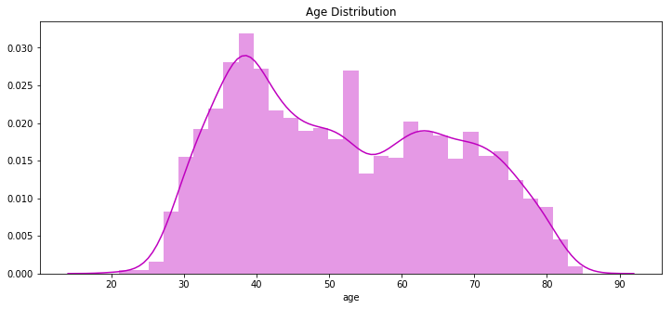
DO HEALTHCARE COSTS INCREASE WITH AGE?

Slide 42
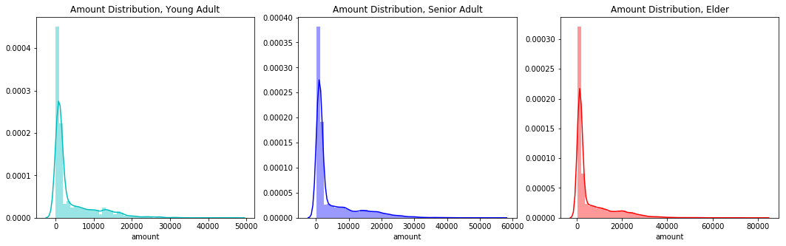
DO HEALTHCARE COSTS INCREASE WITH AGE?
Young: B/W 18 and 34 Senior: B/W 35 and 55 Elder: Above 55

Slide 43
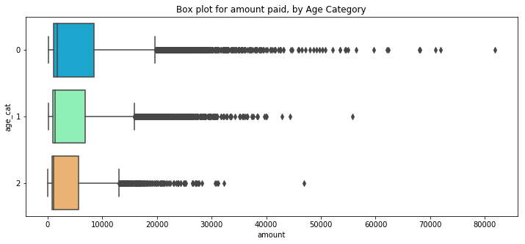
DO HEALTHCARE COSTS INCREASE WITH AGE?
0 = Elder 1 = Senior 2 = Young

Slide 44
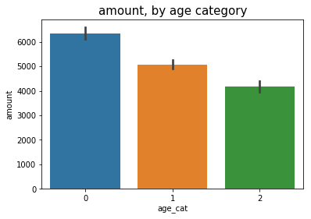
DO HEALTHCARE COSTS INCREASE WITH AGE?
0 = Elder 1 = Senior 2 = Young

Slide 45
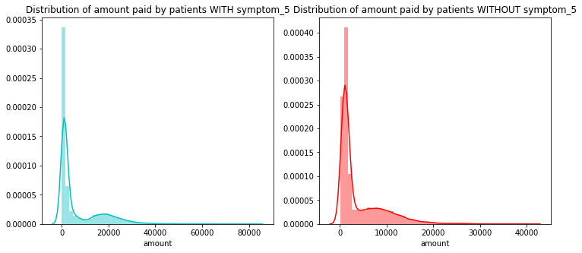
What’s the deal with symptom_5?
Symptom_5 has a 17% positive correlation with amount.

Slide 46
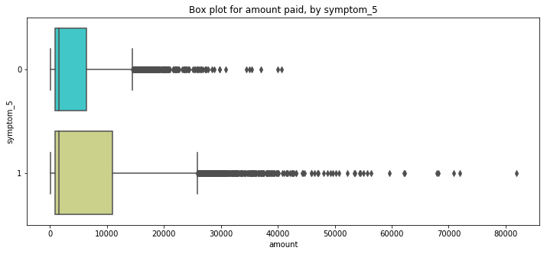
What’s the deal with symptom_5?

Slide 47
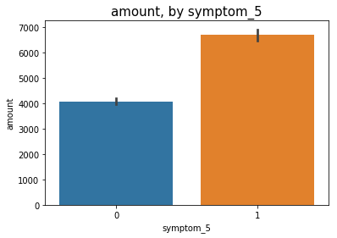
What’s the deal with symptom_5?

Slide 48
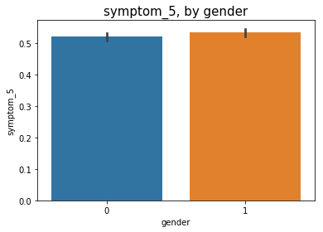
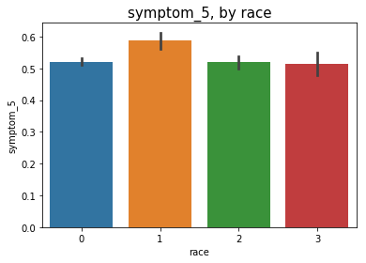
What’s the deal with symptom_5?
0 = Female, 1 = Male
0 = Chinese, 1 = Indian, 2 = Malay, 3 = Others

Slide 49
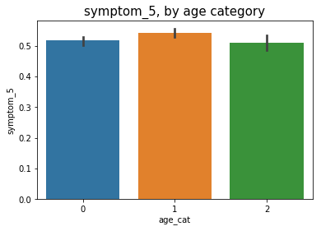
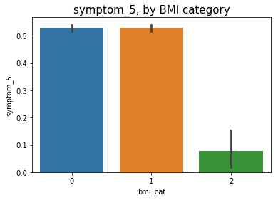
What’s the deal with symptom_5?
0 = Elder, 1 = Senior, 2 = Young
0 = Healthy, 1 = Overweight, 2 = Underweight

Slide 50
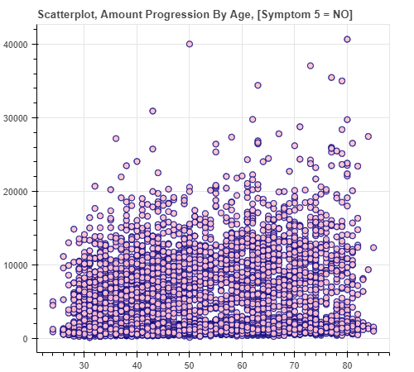
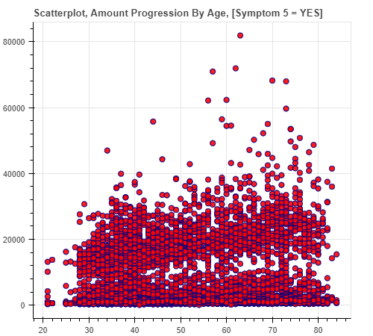
What’s the deal with symptom_5?
X = Age | Y = Amount
X = Age | Y = Amount

Slide 51
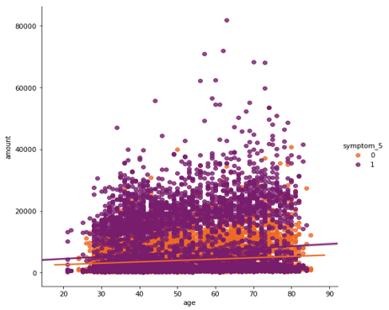
Scatterplot, Amount Progression By Age, Symptom 5 = Yes & Symptom 5 = No
0 = Healthy 1 = Overweight 2 = Underweight

Slide 52
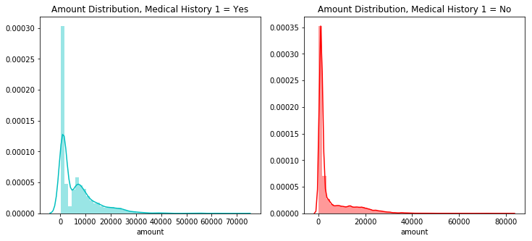
MEDiCAL_HISTORY_1
Medical_history_1 has a correlation of approximately 7.5% with amount.

Slide 53
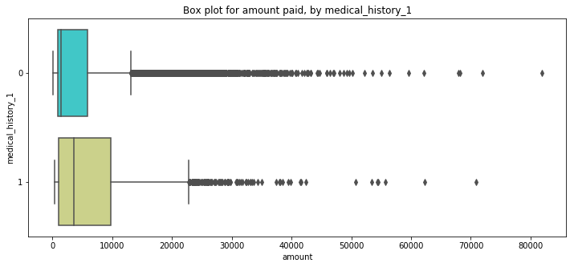
MEDiCAL_HISTORY_1

Slide 54
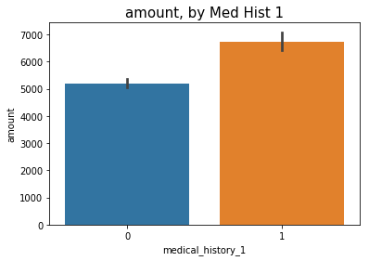
MEDiCAL_HISTORY_1
0 = No | 1 = Yes

Slide 55
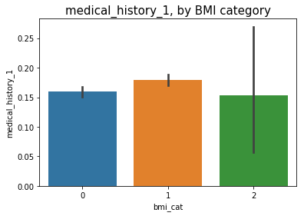
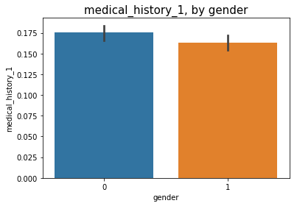
MEDiCAL_HISTORY_1
0 = Healthy, 1 = Over, 2 = Under
0 = Female, 1 = Male

Slide 56
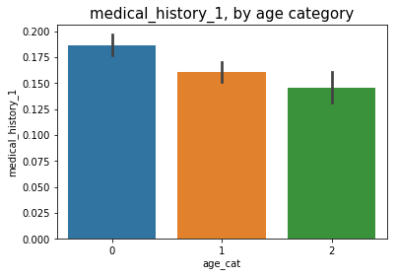
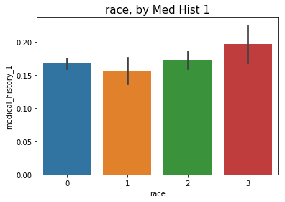
MEDiCAL_HISTORY_1
0 = Elder 1 = Senior 2 = Young
0 = Chinese, 1 = Indian, 2 = Malay, 3 = Others

Slide 57
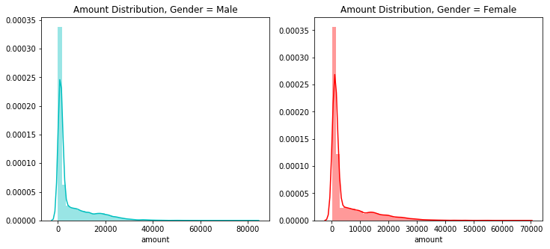
DO MEN and women pay differently?

Slide 58
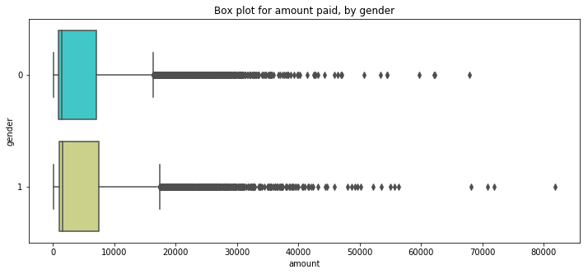
DO MEN and women pay differently?
0 = Female, 1 = Male

Slide 59
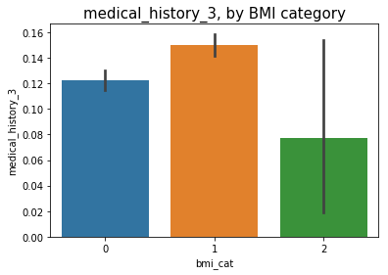
IS MEDICAL_HISTORY_3 Type 2 diabetes?
0 = Healthy, 1 = Overweight, 2 = Underweight

Slide 60
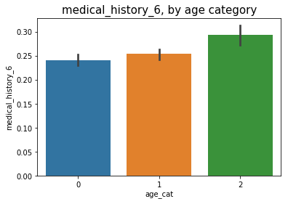
IS MEDICAL_HISTORY_6 A CHiLDREN’s DISEASE?
0 = Elder, 1 = Senior, 2 = Young

Slide 61
CONCLUDING NOTES
resident_status => high negative correlation of almost -14% | foreigners pay the highest amount | citizens pay the lowest | reason behind is straightforward, government policies
symptom_5 => high positive correlation of almost 17% | patients who have this symptom pay almost 75% more than those who don’t | reasons behind are ambiguous, speculative at best
age => high positive correlation of 10.70% | as one gets older, healthcare costs increase | interestingly there are various combinations, such as being overweight, or having symptom_5 persistently, that can raise the bill amount even higher over time | check relevant scatterplots
bmi => relatively high positive correlation of 4.60% | the more overweight the person, the higher the amount | teams up well with other factors contributing to higher amount

Slide 62
CONCLUDING NOTES
race => high positive correlation of almost 11% | astonishingly, malay patients pay around 17% higher than Indian patients, and a whopping 46% higher than chinese patients.
medical_history_1 => high positive correlation of almost 7.50% | patients with this history pay around 40% more | direct positive correlation with being overweight, age | more popular among females | relatively lower frequency among Indians | possible heart condition indicator
gender => low positive correlation of 1.9% | minor disparity between male / female | males pay slightly more
preop_medication_4 => likely a type of a weight booster given to underweight patients, so that their weight can be elevated to a point which would allow for a smoother operation | an example of this is liquid glucose which is pumped into a patient’s body using tubes.

Slide 63
CONCLUDING NOTES
medical_history_3 => there is a high chance this is associated with type 2 diabetes | it affects the overweight far more than it does other BMI categories
medical_history_6 => there is a high chance this is associated with a children’s disease (like chicken pox, measles, rashes etc.) | it affects the young far more than it does other age categories

Slide 64
CONCLUDING NOTES
I recommend you to read the word document enclosed, in order to get a bigger picture perspective of my analysis.
Last but not least, thank you Sankha for shortlisting me! 😊

