Slide 1
Assessment task
Karan j Khanna

Slide 2
Introduction
We are given 4 disjointed healthcare datasets, all in CSV format:
clinical_data : past medical records | primary key : id
demographics : patients’ personal info | primary key : patient_id
bill_id : bill tracking info | primary key : bill_id | foreign key : patient_id
bill_amount : bill cost | primary key : bill_id

Slide 3
OBJECTIVE
Our end objective is as follows:
To build a solitary comprehensive dataframe using python, containing actionable information from all the 4 datasets. We need to figure out a way to join all the tables together in a meaningful, neat, and organised manner. This will facilitate smoother analysis of the data.
To conduct exploratory data analysis on the newly generated comprehensive dataframe. The end goal is to obtain insights behind the drivers responsible for medical costs.

Slide 4
ISSUES ADDRESSed
We have tried to answer the following (among many other) questions in our analysis:
Are foreigners paying more than locals?
Is there any disparity between bill amount and patient’s race?
Is the amount higher for overweight patients?
Do healthcare costs increase with age?
Why is the correlation of symptom_5 so high (17%) with amount?
What are the implications of having medical_history_1?
Is there disparity between bill amount for men and women?
Is medical_history_3 possibly diabetes type 2?
Is medical_history_6 a children’s disease (chicken pox, measles, etc.)?

Slide 5
DATA pRe-processing
Technologies leveraged:
Python3
Pandas
Numpy
Python Operating System
Matplotlib
Seaborn v 0.9.0 ( please make sure you have the latest version ☺ )
Bokeh
Scikit-learn
Warnings

Slide 6
DATA pRe-processing
Challenges Faced:
Disjointed datasets
Tedious parsing of date-time objects
Cumbersome derivation of patient’s age from two separate date-time objects
Generating BMI column
Manual conversion of categorical data
Transformation of dirty data within multiple categorical variables
Missing values in two columns
Encoding of categorical variables to allow for correlation analysis

Slide 7
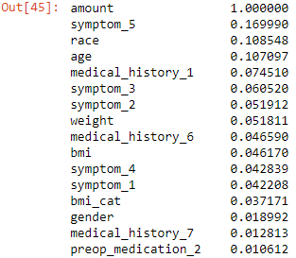
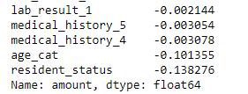
DATA ANALysis
Correlation of amount column with other relevant columns:

Slide 8
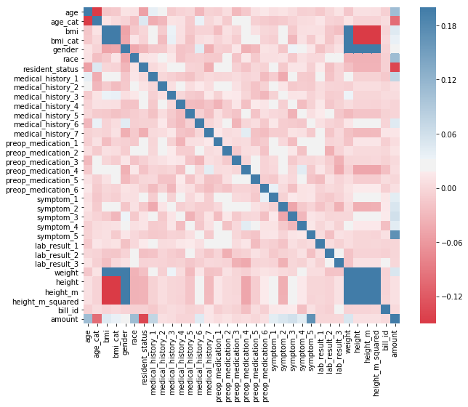
Heatmap of the correlation of amount:

Slide 9
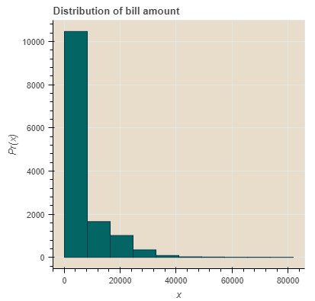
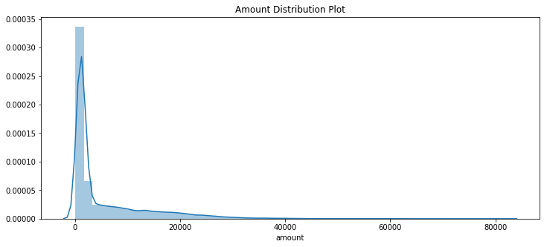
DATA ANALysis
Let’s now take a look at the distribution of bill amount:
The majority of the bills amount to below $10,000 each.

Slide 10
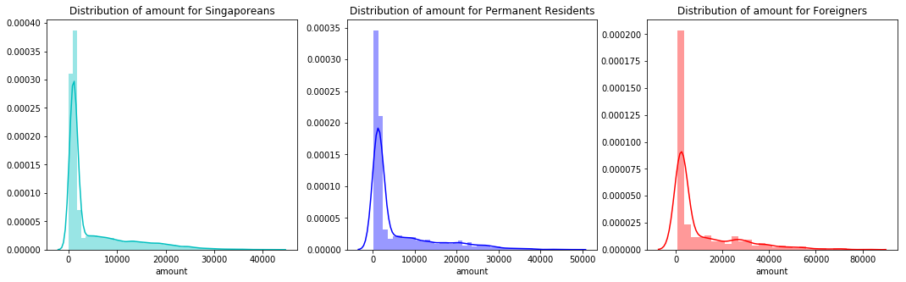
DO Foreigners pay more for healthcare?

Slide 11
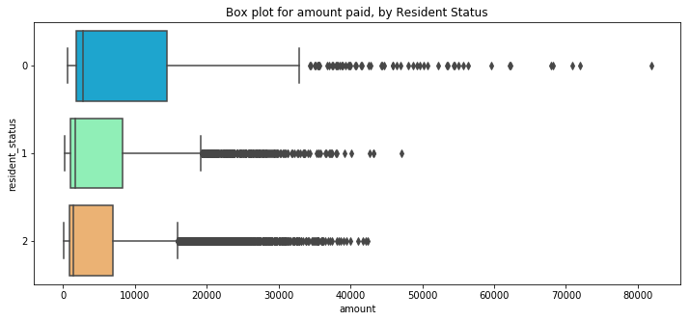
DO Foreigners pay more for healthcare?
Legend: 0 = Foreigners 1 = PRs 2 = Singaporeans

Slide 12
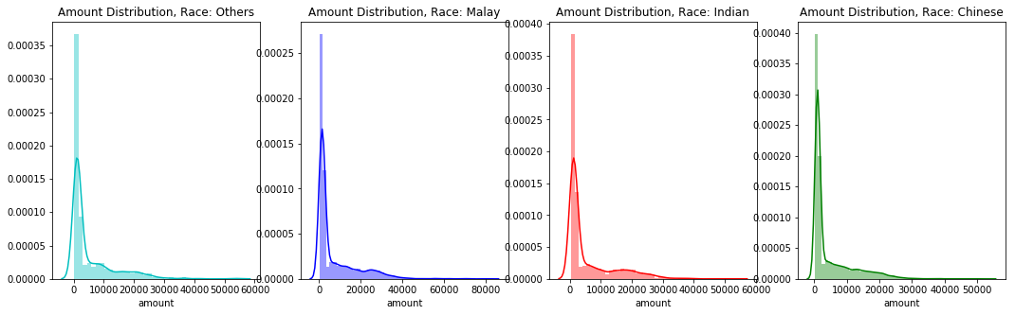
Link between amount and race

Slide 13
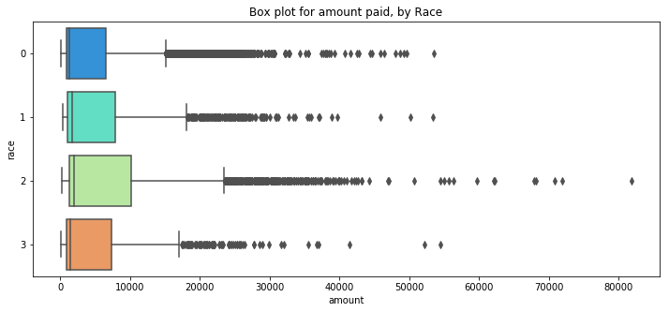
Link between amount and race
0 = Chinese 1 = Indian 2 = Malay 3 = Others

Slide 14
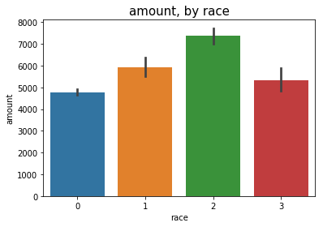
Link between amount and race
0 = Chinese 1 = Indian 2 = Malay 3 = Others

Slide 15
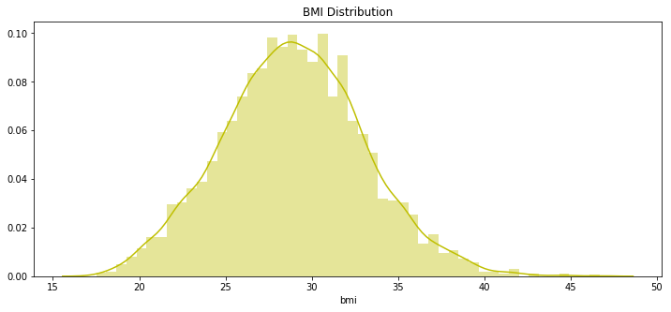
do overweight patients pay more?

Slide 16
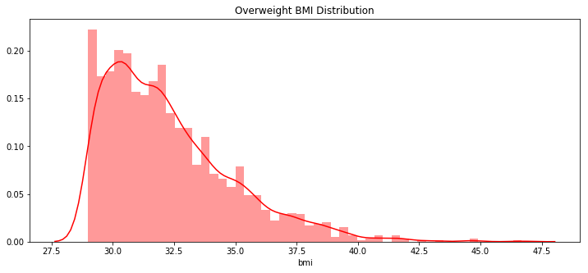
do overweight patients pay more?

Slide 17
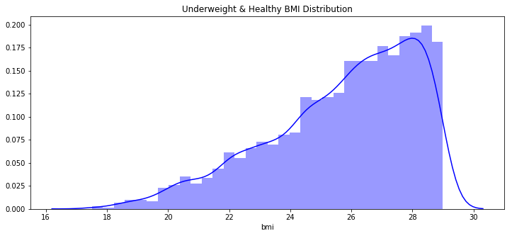
do overweight patients pay more?

Slide 18
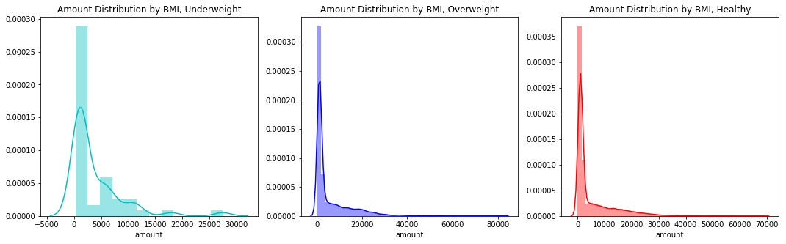
do overweight patients pay more?
0 = Healthy 1 = Overweight 2 = Underweight

Slide 19
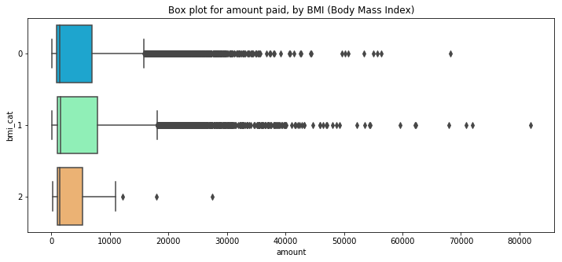
do overweight patients pay more?
0 = Healthy 1 = Overweight 2 = Underweight

Slide 20
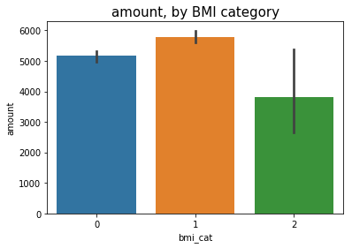
DO OVERWEIGHT PATIENTS PAY MORE?
It can be seen from the above figures that yes, in fact, overweight patients do have to pay a higher amount. Let’s see by how much:
0 = Healthy 1 = Overweight 2 = Underweight

Slide 21
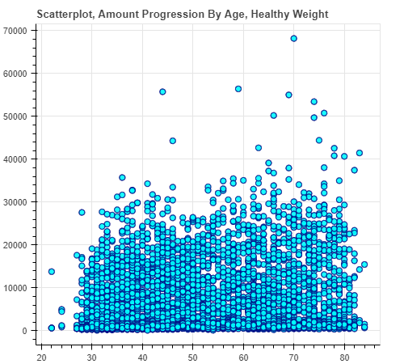
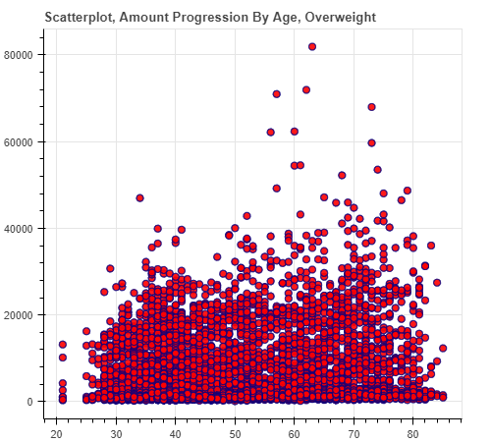
do overweight patients pay more?
X = Age | Y = Amount
Amount Progression by Age, if patients stay healthy
Amount Progression by Age, if patients stay overweight

Slide 22
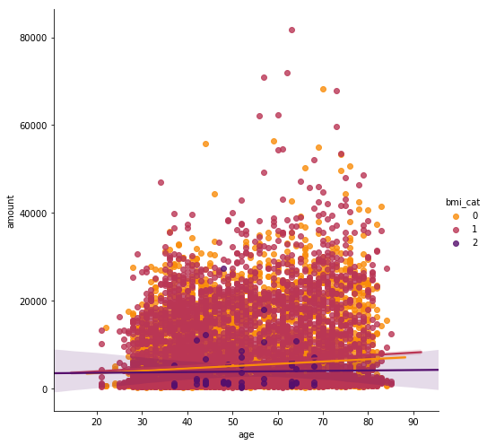
Scatterplot, Amount Progression By Age, All BMI Categories
0 = Healthy 1 = Overweight 2 = Underweight

Slide 23
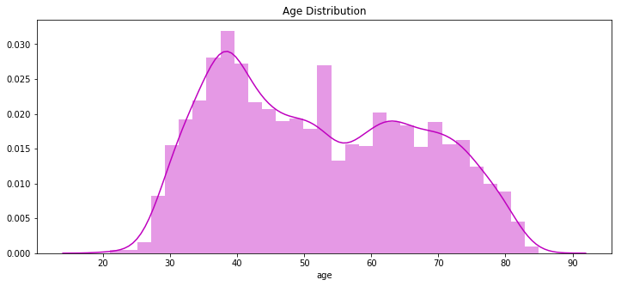
DO HEALTHCARE COSTS INCREASE WITH AGE?

Slide 24
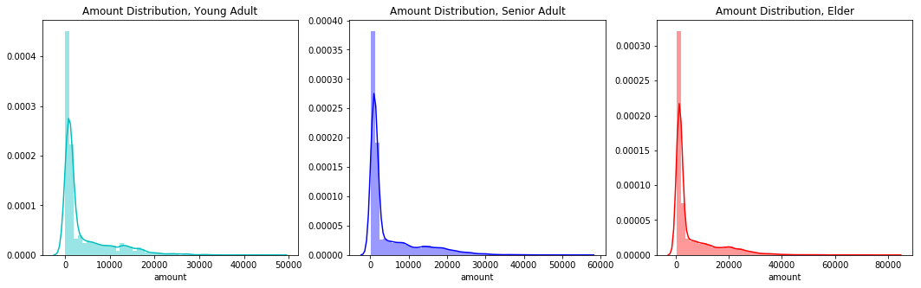
DO HEALTHCARE COSTS INCREASE WITH AGE?
Young: B/W 18 and 34 Senior: B/W 35 and 55 Elder: Above 55

Slide 25
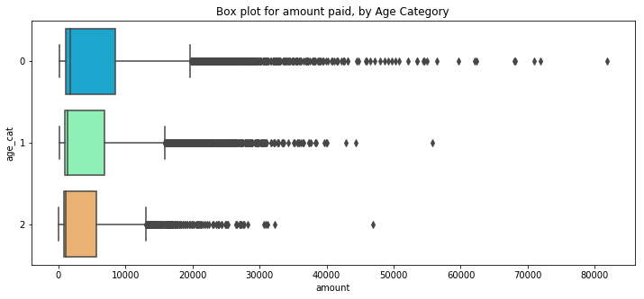
DO HEALTHCARE COSTS INCREASE WITH AGE?
0 = Elder 1 = Senior 2 = Young

Slide 26
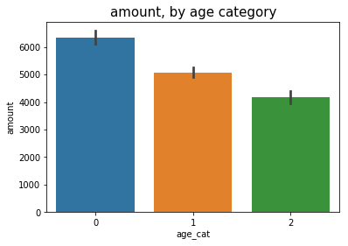
DO HEALTHCARE COSTS INCREASE WITH AGE?
0 = Elder 1 = Senior 2 = Young

Slide 27
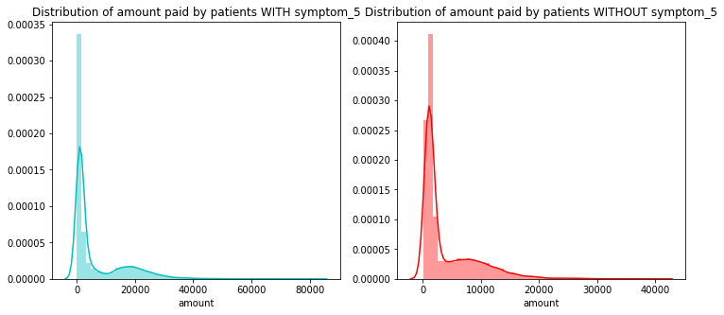
What’s the deal with symptom_5?
Symptom_5 has a 17% positive correlation with amount.

Slide 28
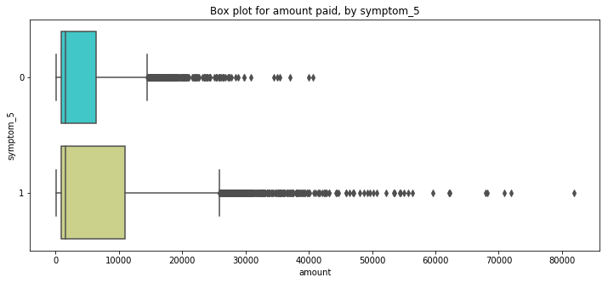
What’s the deal with symptom_5?

Slide 29
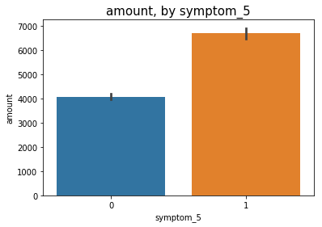
What’s the deal with symptom_5?

Slide 30
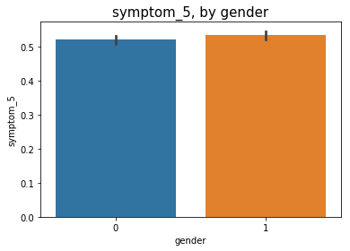
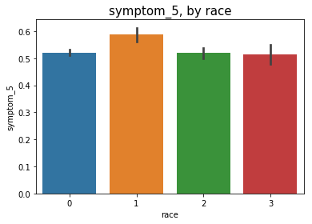
What’s the deal with symptom_5?
0 = Female, 1 = Male
0 = Chinese, 1 = Indian, 2 = Malay, 3 = Others

Slide 31
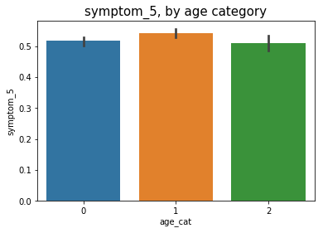
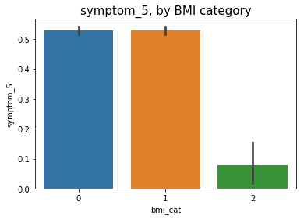
What’s the deal with symptom_5?
0 = Elder, 1 = Senior, 2 = Young
0 = Healthy, 1 = Overweight, 2 = Underweight

Slide 32
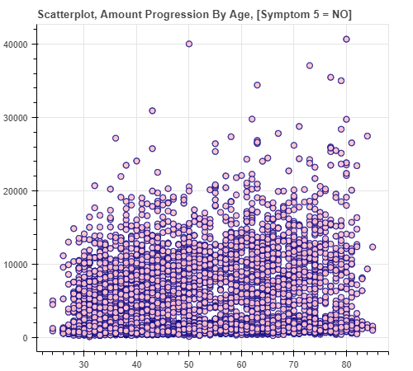
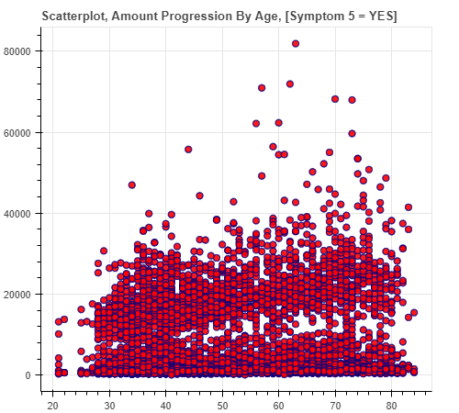
What’s the deal with symptom_5?
X = Age | Y = Amount
X = Age | Y = Amount

Slide 33
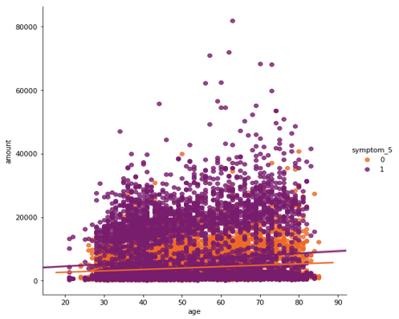
Scatterplot, Amount Progression By Age, Symptom 5 = Yes & Symptom 5 = No
0 = Healthy 1 = Overweight 2 = Underweight

Slide 34
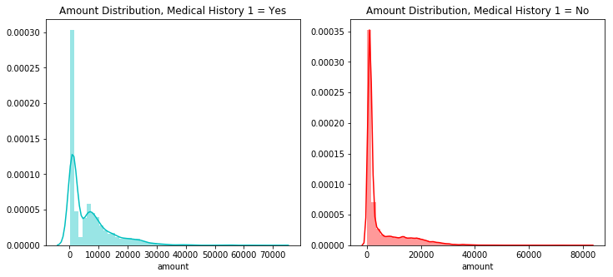
MEDiCAL_HISTORY_1
Medical_history_1 has a correlation of approximately 7.5% with amount.

Slide 35
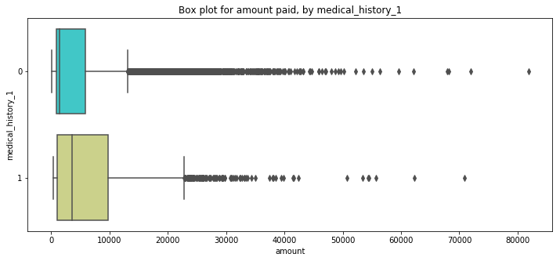
MEDiCAL_HISTORY_1

Slide 36
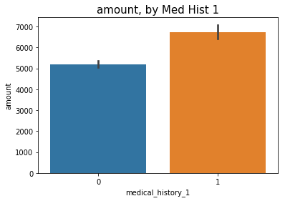
MEDiCAL_HISTORY_1
0 = No | 1 = Yes

Slide 37
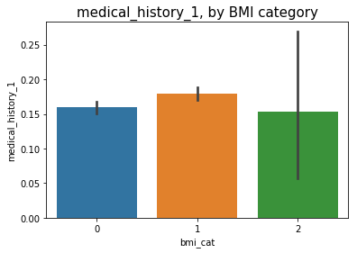
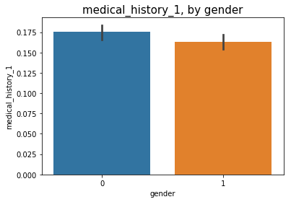
MEDiCAL_HISTORY_1
0 = Healthy, 1 = Over, 2 = Under
0 = Female, 1 = Male

Slide 38
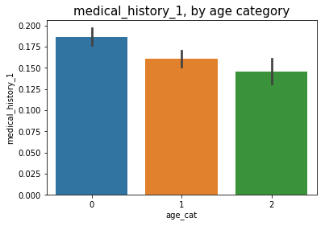
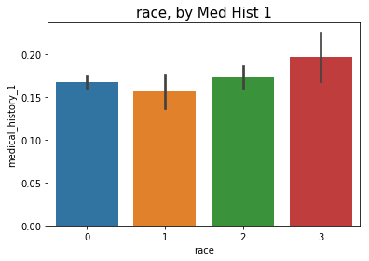
MEDiCAL_HISTORY_1
0 = Elder 1 = Senior 2 = Young
0 = Chinese, 1 = Indian, 2 = Malay, 3 = Others

Slide 39
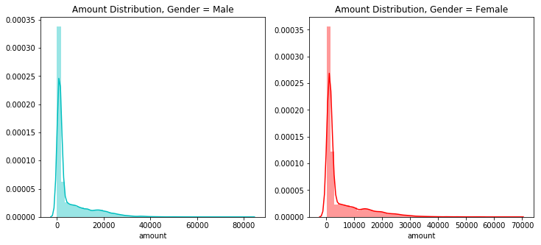
DO MEN and women pay differently?

Slide 40
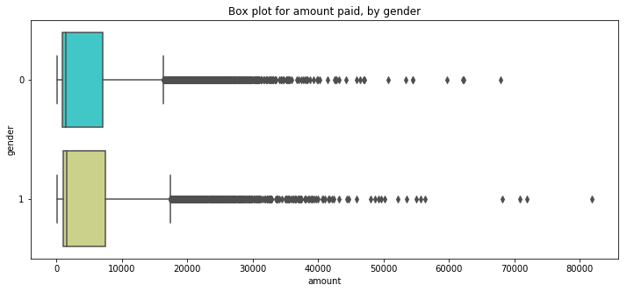
DO MEN and women pay differently?
0 = Female, 1 = Male

Slide 41
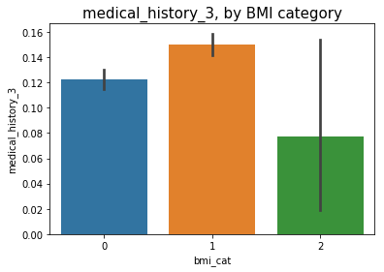
IS MEDICAL_HISTORY_3 Type 2 diabetes?
0 = Healthy, 1 = Overweight, 2 = Underweight

Slide 42
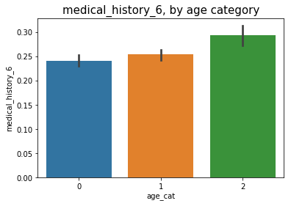
IS MEDICAL_HISTORY_6 A CHiLDREN’s DISEASE?
0 = Elder, 1 = Senior, 2 = Young

Slide 43
insights
resident_status => high negative correlation of almost -14% | foreigners pay the highest amount | citizens pay the lowest | reason behind is straightforward, government policies
symptom_5 => high positive correlation of almost 17% | patients who have this symptom pay almost 75% more than those who don’t | reasons behind are ambiguous, speculative at best
age => high positive correlation of 10.70% | as one gets older, healthcare costs increase | interestingly there are various combinations, such as being overweight, or having symptom_5 persistently, that can raise the bill amount even higher over time | check relevant scatterplots
bmi => relatively high positive correlation of 4.60% | the more overweight the person, the higher the amount | teams up well with other factors contributing to higher amount

Slide 44
insights
race => high positive correlation of almost 11% | astonishingly, malay patients pay around 17% higher than Indian patients, and a whopping 46% higher than chinese patients.
medical_history_1 => high positive correlation of almost 7.50% | patients with this history pay around 40% more | direct positive correlation with being overweight, age | more popular among females | relatively lower frequency among Indians | possible heart condition indicator
gender => low positive correlation of 1.9% | minor disparity between male / female | males pay slightly more
preop_medication_4 => likely a type of a weight booster given to underweight patients, so that their weight can be elevated to a point which would allow for a smoother operation | an example of this is liquid glucose which is pumped into a patient’s body using tubes.

Slide 45
insights
medical_history_3 => there is a high chance this is associated with type 2 diabetes | it affects the overweight far more than it does other BMI categories
medical_history_6 => there is a high chance this is associated with a children’s disease (like chicken pox, measles, rashes etc.) | it affects the young far more than it does other age categories

Slide 46
CONCLUDING NOTES
I recommend you to read the word document enclosed, in order to get a bigger picture perspective of my analysis.
Last but not least, thank you Sankha for shortlisting me! 😊

