Slide 1
AMINOT Outpass and Notification Portal
Presented by Group 13 :
Deepansh Sood
Chaitanya Mittal
Abhyuday
Karan Joshi

Slide 2
What Is Aminot?
AMINOT is a web application,a universal solution for book-keeping and notification. It being a web application makes it easily accessible over any device as it works on web browser. It brings a digital work solution. This out-pass and notification application provides a communication system between the students and their respective guardians.

Slide 3
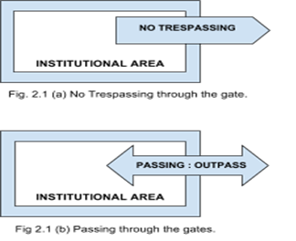
Ethics-Pass-Through
It should be lawful for an institution to maintain a carefully discussed set of codes for allowing individuals to pass through or exit.

Slide 4
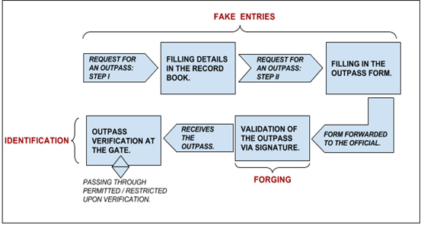
Present Scenario Along with it’s falls

Slide 5
Technologies Used And Software Requirements
J2EE -Servlets and JSP,Database Connectivity,Java Mail
HyperText MarkUp Language And Cascading Style Sheets
JavaScript
SQL DataBase -Apache Derby
Server -Glassfish Server
Selenium Web Browser Automation
Web server with JRE 1.8 properties.
Java development kit and Java Runtime Environment. (1.8 recommended)
Netbeans IDE. (8.2 or higher)
MySQL software.
Web Browser (Chrome recommended)

Slide 6
DESIGN
Explanation Through The Data Flow Diagram

Slide 7
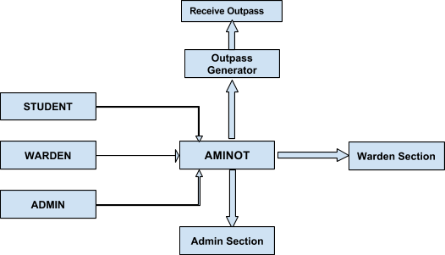
Application Overview

Slide 8
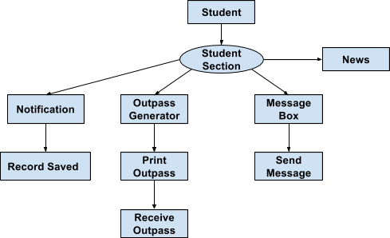
Student’s View

Slide 9
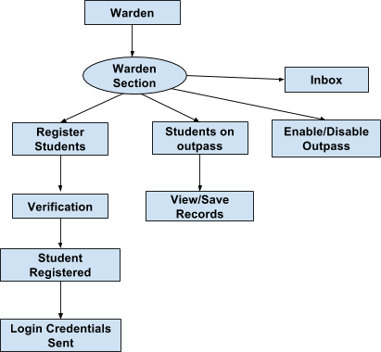
Warden’s View

Slide 10
Admin’s View

Slide 11
IMPLEMENTATION

Slide 12
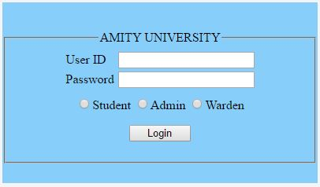
OUTPASS PORTAL
Login page in Outpass Portal
One can login to this portal using his/her login credentials where,
User ID is the Enrollment no. assigned uniquely to everyone.
Password is a secret String set by the user itself.
There are two roles to login in this portal,
One is for the hostlers to apply for and generate outpass.
Second is for the warden to verify outpass details and provide outpass services.

Slide 13
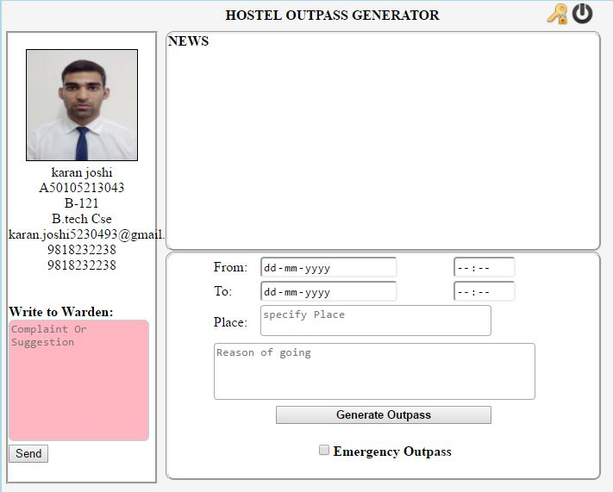
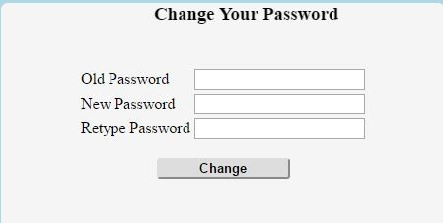
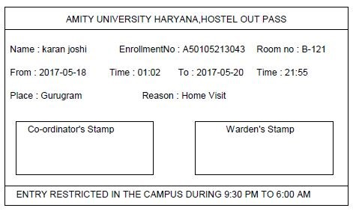
OUTPASS PORTAL FOR HOSTELLERS

Slide 14
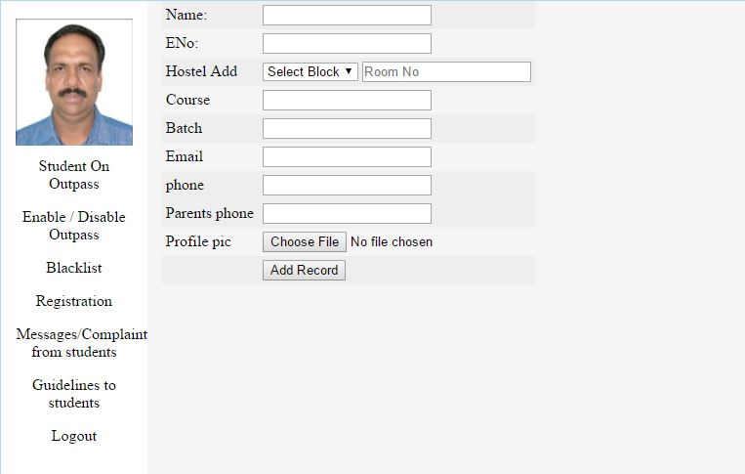
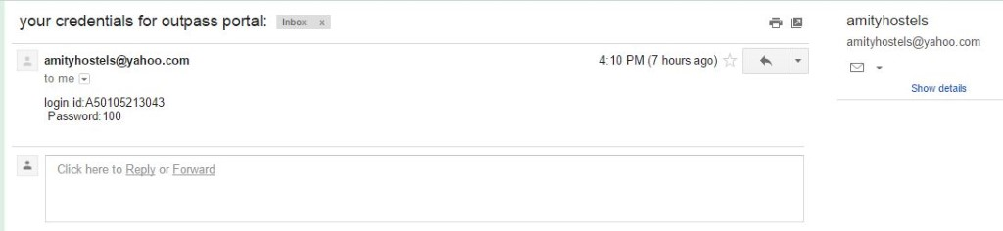
OUTPASS PORTAL FOR WARDEN

Slide 15
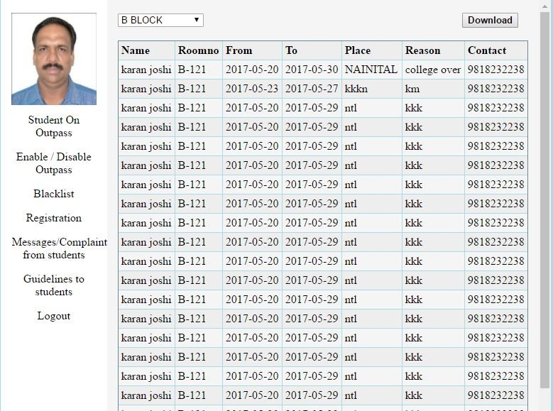
OUTPASS PORTAL FOR WARDEN

Slide 16
OUR JOURNEY
Our journey so far has been quite staggering. It began with the thought of helping others. Being a part of this institution, some of the problems that we face as students are annoying and time consuming.
Implementing this idea was quite a deal and required a lot of sessions of brainstorming. On our way, we encountered many restrictions which always threw us a step backwards. But we all stood up against them and found other alternatives for most of our problems.
This project as a part of a student’s life has taught us many things including teamwork and time management. It has also introduced us to various novel technological concepts and instilled in us important and necessary lessons of life. In addition, we have tried to achieve the best outcome thus, this project primarily focuses on improving the lives of students and the hostel staff. The technological difficulties have been supressing the workflow and therefore coping with the ideas and their successful execution was quite a challenging task.
In conclusion, we would like to acknowledge the efforts put by our supervisors – Ms. Divanshi Wangoo and Ms. Ulya Sabeel, in making time to listen to our problems and gently nudging us to do our bests.
Thank You.

