Slide 1
Name: Karan Puran Kankaria
Registration No. WRO0708322
Batch No. 7
PC. No. 18
Subject: ITT
Topic: Cryptocurrency

Slide 2

CRYPTOCURRENCY
Digital currency based on cryptography.
Decentralized and not controlled by a central authority.
Enables secure and transparent transactions.

Slide 3
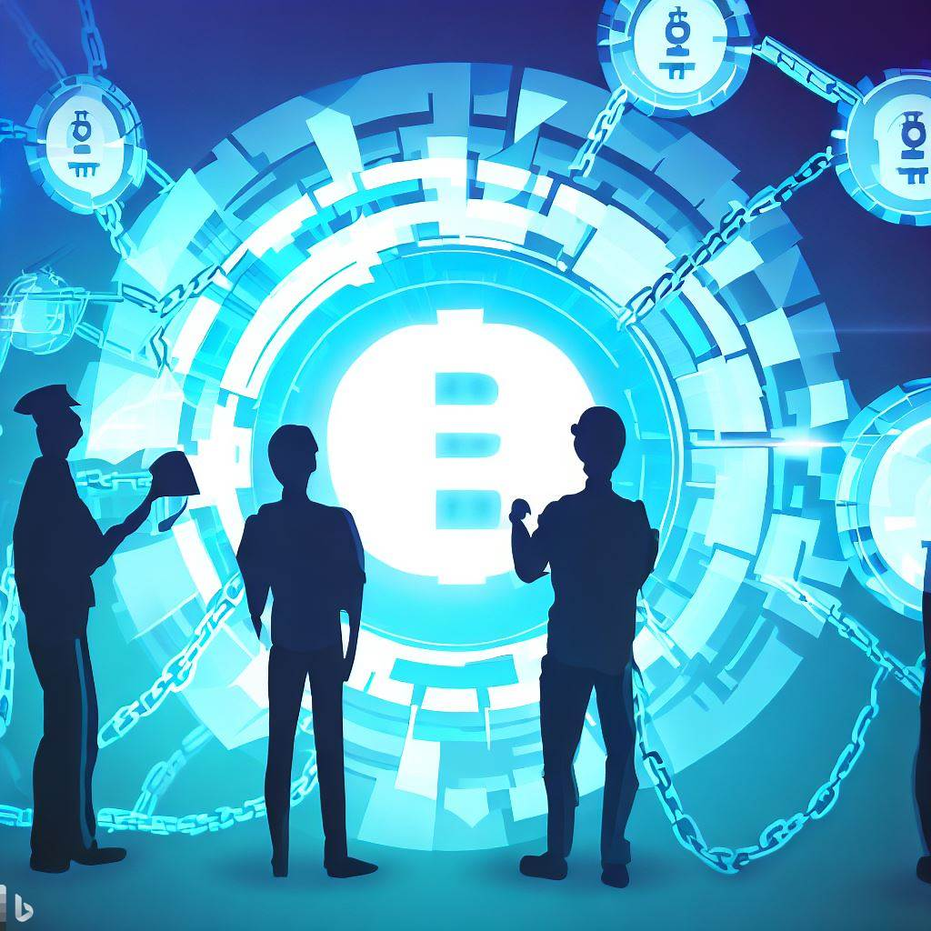
BLOCKCHAIN TECHNOLOGY
Distributed ledger technology.
Transparent and immutable records.
Enables secure and decentralized transactions

Slide 4
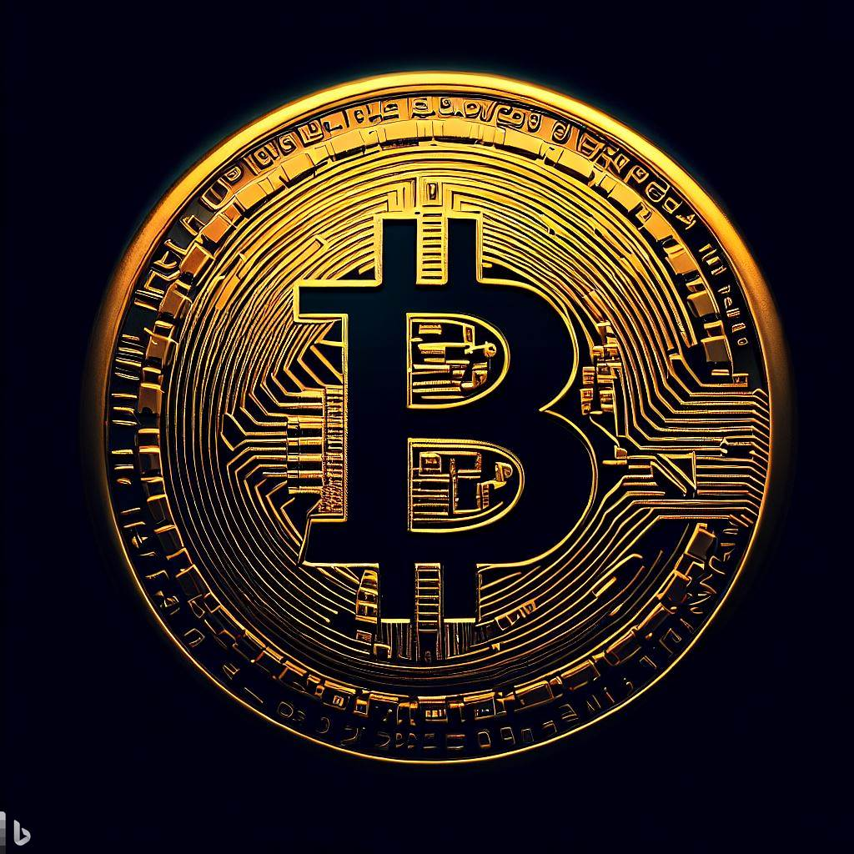
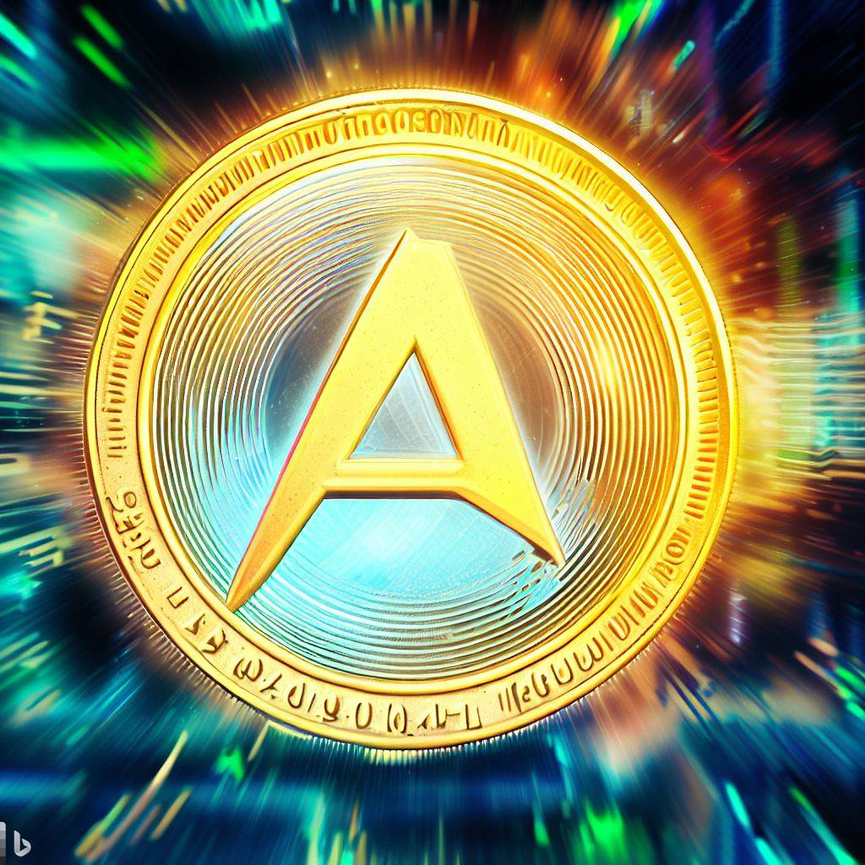

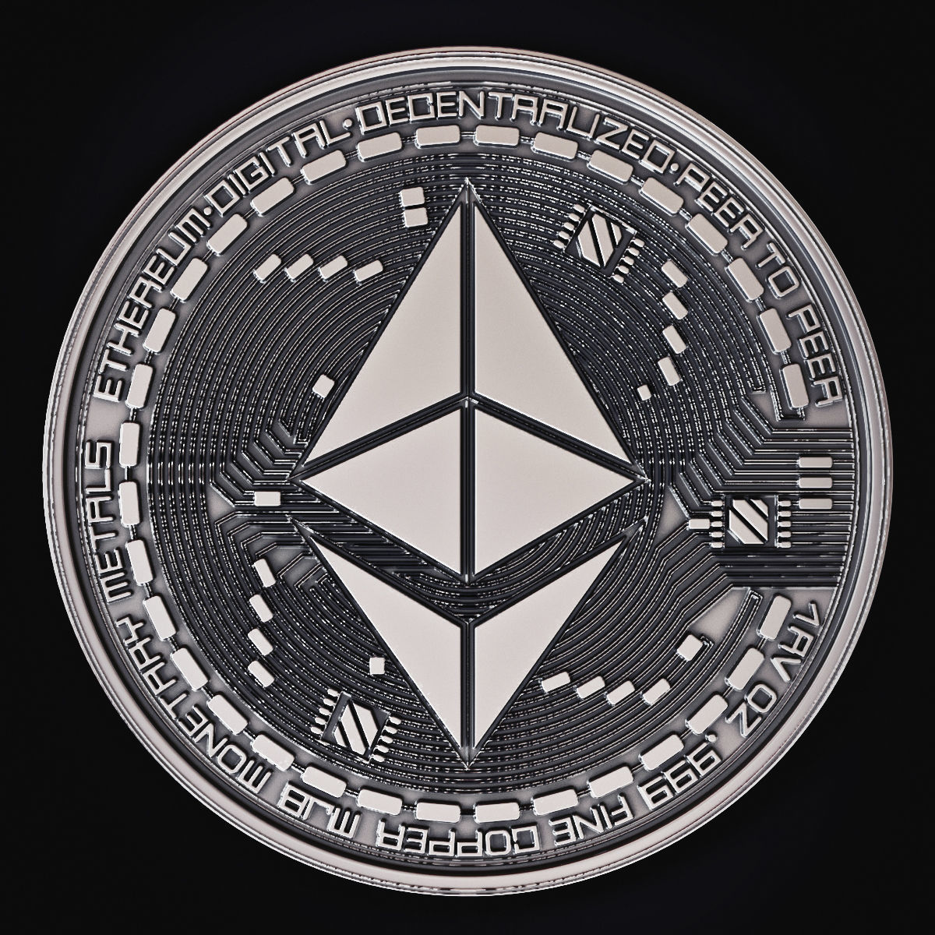
TYPES OF CRYPTOCURRENCY
Bitcoin
Alt Coins
Stable Coins
Platform Coins
Bitcoin
Alt Coins
Stablecoin
Platform Coin

Slide 5




Benefits
Cryptocurrency solves a lot of problems which are connected to centralized nature of assets/currencies
Anonymity
No Identity Theft
Immediate Settlement
Access to Everyone

Slide 6




CHALLENGES
User Education & Awareness
Security Risks
Volatility
Energy Consumption

Slide 7
CRYPTOCURRENCY WALLETS
SOFTWARE WALLETS
PAPER WALLETS
ONLINE EXCHANGE WALLETS
HARDWARE WALLETS

Slide 8




TOP
CRYPTOCURRENCY EXCHANGES 2023
COINBASE
KRAKEN
BINANCE
BITSTAMP

Slide 9

FUTURE TRENDS IN CRYPTO CURRENCY
Tokenization of assets.
Enhanced regulatory frameworks.
Increased scalability solutions.
Integration with Internet of Things (IoT).

Slide 10




POPULAR CRYPTOCURRENCIES

Slide 11

CRYPTOCURRENCY AND GLOBAL ECONOMY
Financial inclusivity and empowerment.
Disrupting traditional banking.
Cross-border transactions made efficient.
Decentralization of monetary systems.

Slide 12

CONCLUSION
Cryptocurrency transforms finance.
Adapt to evolving landscape.
Financial freedom through decentralization.
Embrace innovation, disrupt conventions.

Slide 13

Thank You!

