Slide 1
Pre-seed · 2026
CV COVER
Cover letters written from the real job posting, not from a guess.
coveritt.vercel.app · live, deployed, no account required
Built on Bright Data · Into the Scrape-Verse (WeMakeDevs × Bright Data)
01

Slide 2
THE PROBLEM
Applying to ten jobs means writing ten cover letters.
So people paste the ad into ChatGPT. That produces a letter that reads like ChatGPT wrote it: the same three-paragraph shape, the same "I am writing to express my enthusiasm", and an increasingly detectable statistical fingerprint that applicant tracking systems now screen for.
LETTERS PER SEARCH
WHAT THE SHORTCUT RETURNS
THE NEW FAILURE MODE
10×
Generic
Flagged
Every posting wants a letter that cites that posting. The work scales linearly with applications.
A chatbot only sees what you pasted. Miss a detail from the ad, and the letter is filler.
ATS-side AI detection turns the shortcut into a liability, not just a weak letter.
But the writing is the easy half. The hard half is acquiring the job posting reliably, as structured data, from a page built for human eyes and redesigned without notice. That acquisition problem is what this company is built around.
02

Slide 3
THE SOLUTION
Upload a CV. Paste job links. Get one letter per posting.
Each letter is drafted from the actual scraped job ad and your real resume, in the posting's own language, and downloads as a formal PDF laid out to the German DIN 5008 letter standard.
CV + job URLs
Collector router
Structured JobPosting
Letter draft
DIN 5008 PDF
No account, no payment, no setup
→
Picks a scrape path per URL, runs them concurrently
→
Title, company, seniority, location, duties
→
LLM in JSON mode, language-matched
→
Single file, or ZIP for a batch
Grounded, not generic
Written to pass as human
Correct by locale
The prompt must cite a named responsibility from the posting and a real project or role from the CV. No filler claims.
No em dashes, no "thrilled to apply", no rule-of-three adjective stacks, deliberately varied sentence length.
A German posting produces a German Anschreiben even from an English CV. That is the right behaviour, not a bug.
03

Slide 4
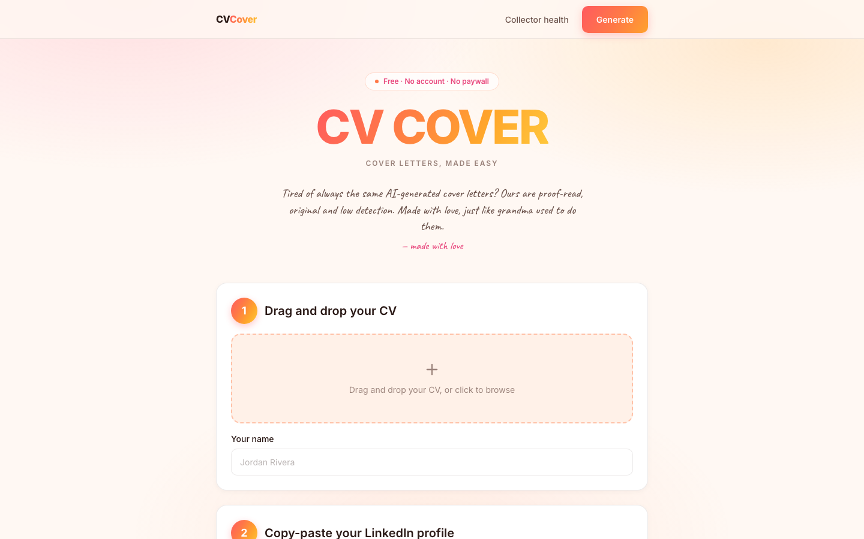
DEMO · THE PRODUCT
Three inputs, one screen.
Drag in a CV, paste the job links, hit generate. There is no onboarding, no signup wall and no pricing page in the way. The entire product is one page and a results modal.
Any LinkedIn URL shape works — including the messy one from your address bar with the job id buried in a query string.
Several jobs at once — scraped concurrently, bundled into a ZIP.
Letterhead auto-fills — name, address, phone, email and LinkedIn are parsed out of the CV itself.
Live at coveritt.vercel.app — screenshot captured from production.
04

Slide 5
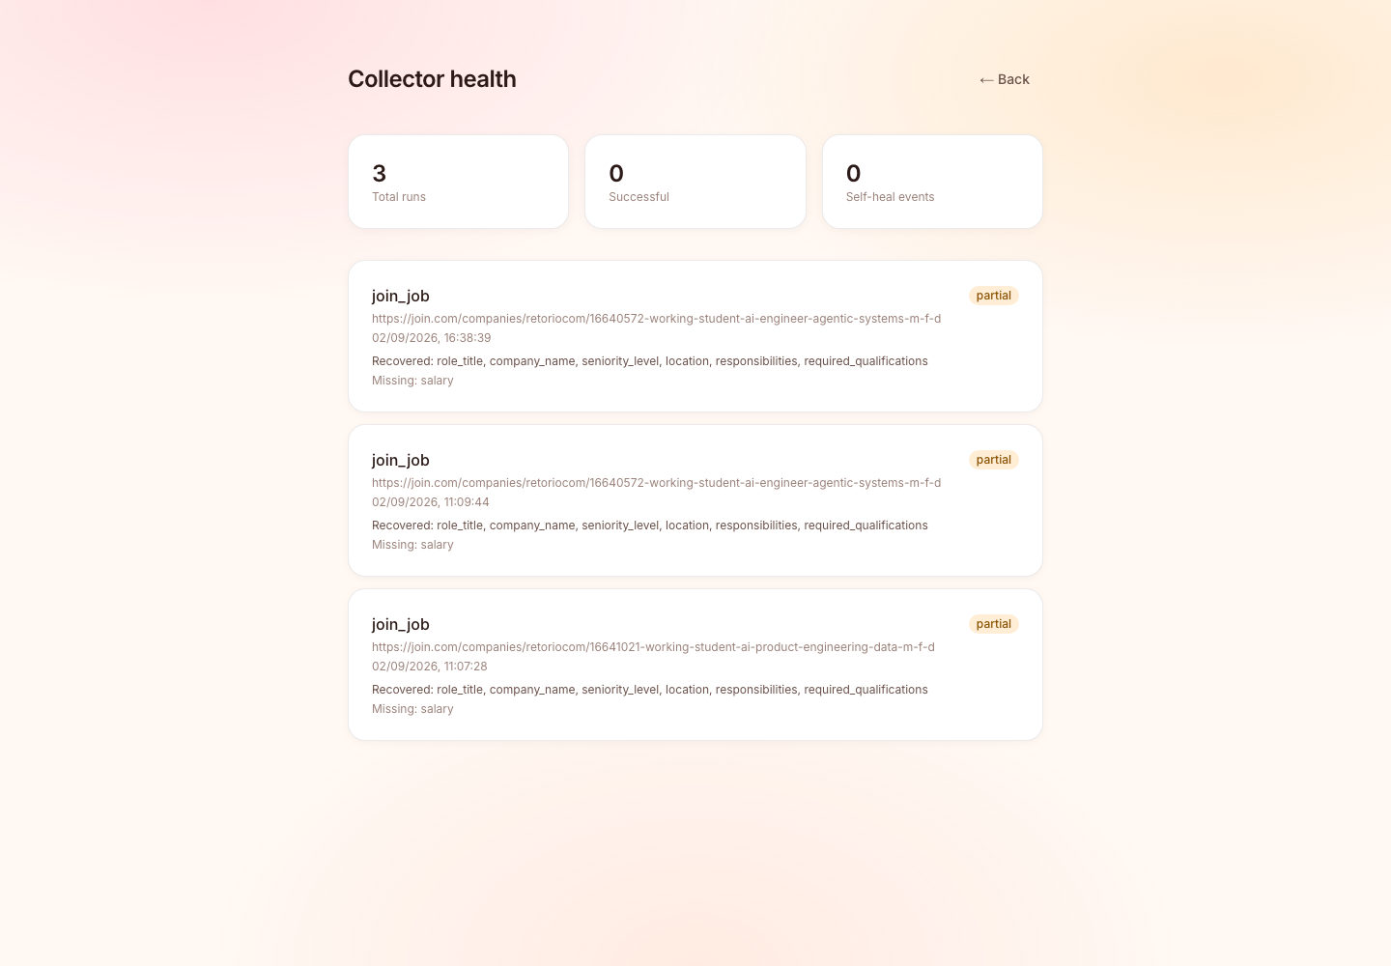
DEMO · THE DIFFERENTIATOR
Every scrape reports what it actually recovered.
Field by field, per run, in production. Note the status on these runs: partial — not a green checkmark. The postings listed no salary, so the run says so.
// real, unedited production record
{
"collector_name": "linkedin_job",
"status": "partial",
"fields_missing": ["salary"],
"self_heal_events": []
}
A scraper that quietly degrades is worse than one that crashes, because the output still looks plausible. Naming the missing fields is how you tell the difference.
05

Slide 6
THE INSIGHT · WHY THIS IS DEFENSIBLE
A scraper that fails loudly is a bug report.
A scraper that fails plausibly sends your application to the wrong company.
What actually happened
The fix — at the application layer
The Scraper Studio collector was built against Greenhouse. Pointed at Lever and Ashby — unfamiliar layouts — it did not return empty fields.
It returned the training company's name, every time, with the record otherwise perfectly well-formed. The app happily generated letters addressed to the wrong employer.
Self-healing does not catch this, because from the collector's point of view nothing is broken. It found a company name.
# collectors/router.py
if not posting.role_title:
raise BrightDataError(...)
Treat a missing role title as proof the scrape did not land.
This is the moat in miniature. Anyone can call an LLM. The durable asset is a validated acquisition layer that knows when it is wrong — and a body of hard-won knowledge about how job boards fail.
06

Slide 7
HOW IT WORKS
Three collection paths, on purpose. One schema.
The router picks a path per URL. Everything downstream is path-agnostic, so adding a board is additive, never a rewrite.
URL | PATH | WHY THIS PATH
linkedin.com | Prebuilt LinkedIn Jobs dataset | LinkedIn is aggressively hostile to generic scraping and requires a session for most postings. The prebuilt dataset returns a fixed schema synchronously.
join.com | schema.org JobPosting collector | join.com renders client-side, so a generic collector reads nothing. Every posting ships a structured JSON-LD block — exact, and stable across layout changes.
everything else | Bright Data Scraper Studio collector | Fields are defined in plain language, not CSS selectors, so the collector can be repaired in place when a site's layout shifts.
FRONTEND
BACKEND
ACQUISITION
DEPLOY
Next.js 16, Tailwind v4, client-side PDF + ZIP
FastAPI, httpx, pydantic, concurrent scrapes
Bright Data Scraper Studio + prebuilt datasets
Vercel + Railway, live in production today
07

Slide 8
RELIABILITY
Three layers, cheapest first.
Scraping is not a one-time build. It is a maintenance liability, and the architecture is designed around that fact.
01
02
03
Plain-language fields
Automated healing
Guard against being confidently wrong
Extraction is driven by what a field means ("the job title for this posting"), not by a selector. A renamed CSS class does not silently produce empty strings.
bdata scraper heal repairs the collector against the live page when extraction genuinely regresses — no hand-written selectors to rewrite.
The one that matters. Validate that what came back is actually about the page you asked for — and refuse when it is not.
Three run statuses, reported honestly
What we refuse to do
success
every expected field came back
Unsupported boards are rejected with a clear message rather than silently mis-scraped. Company context is optional and off by default, because it is unreliable on JS-heavy marketing sites. When it returns noise, the letter is written from the posting and CV alone rather than absorbing nonsense.
partial
the scrape landed, some fields were absent
failed
nothing usable came back
08

Slide 9
MARKET
MODELLED — ASSUMPTIONS STATED
Bottom-up, from applications actually written.
Sized from applicant behaviour rather than from a top-down "HR tech is $30B" number, so every input below can be argued with individually.
TAM
SAM
SOM — 3 YR
$2.4B
$310M
$4.6M
~400M white-collar job seekers globally × ~$6/yr blended willingness-to-pay for application tooling.
~26M active seekers in EU + UK + North America who apply through the supported boards, at ~$12/yr realised.
1.5% of SAM. ~32k paying users at $144/yr (see pricing), reached via the free tier already live.
Why the beachhead is German-language applications
DIN 5008 is a real barrier. German applications have a formal layout standard. Generic tools output an American business letter, which reads as wrong to a German recruiter.
Language matching is non-trivial. A German posting needs a German Anschreiben with the right conventions, not a translation. Already shipped.
join.com is a DACH board. Supporting it is a deliberate wedge into a market the US-built incumbents ignore.
All figures are modelled from public population and pricing anchors, not from observed revenue. The product currently has no paid tier.
09

Slide 10
UNIT ECONOMICS
MODELLED — LIST PRICES
Cost per letter, from the real call graph.
One letter = one scrape + one LLM draft. Both are metered, both are small, and the PDF is rendered client-side at zero marginal cost.
COST COMPONENT | PER LETTER
Bright Data scrape 1 collector run or dataset call | $0.0060
LLM draft ~4k in / ~700 out, JSON mode | $0.0100
CV parse + PDF render server CPU + client-side jsPDF | $0.0004
Marginal COGS | $0.0164
UNIT MODEL — PRO TIER | VALUE
Price | $12 / mo
Letters included | 40 / mo
Assumed real usage | 14 / mo
COGS at that usage | $0.23
Payment + infra overhead | $0.72
Gross margin | 92%
Scrape and draft costs are list-price estimates for the current call pattern, not negotiated rates or measured spend.
CAC · CONTENT + SEO
LIFETIME · SEASONAL
LTV / CAC · $55 LTV
$18
5 mo
3.1×
Churn is structural, not a defect: users leave because they got the job. Re-acquisition on the next search is the retention model.
10

Slide 11
BUSINESS MODEL
PROPOSED — NOT YET LIVE
Free stays free. The batch is what converts.
The product is free and account-less today. That is the top of the funnel, not the business model — and it is why the free tier keeps a real, unlimited-feeling allowance.
FREE
PRO — THE CORE
CAREERS SERVICES
$0
$12/mo
$450/yr
3 letters / month. No account. Full DIN 5008 PDF, no watermark.
40 letters, ZIP batching, saved CV profiles, letter history.
Per seat, for university and bootcamp career offices. Cohort dashboards.
Purpose: prove the letter quality is different before asking for anything.
The trigger is volume: the day someone applies to eight roles at once, the ZIP is worth $12.
Solves the churn problem: the institution renews annually even as students cycle through.
Why not charge per letter? Per-letter pricing makes users ration the product at exactly the moment it is most useful — a big application push. Subscription pricing aligns with how job searches actually happen: nothing for months, then everything in three weeks.
11

Slide 12
COMPETITION
Everyone has the LLM. Almost nobody has the acquisition layer.
The differentiator is not letter quality in the abstract. It is that the letter is written from a verified, structured posting instead of from whatever the user managed to paste.
APPROACH | GETS THE POSTING HOW | FAILS HOW | WHERE COVERIT DIFFERS
ChatGPT / Claude direct | User copy-pastes | Silently incomplete input | We scrape the full posting as structured fields, so nothing depends on what the user remembered to paste.
Cover-letter SaaS Teal, Kickresume, et al. | Paste, or a thin URL fetch | Generic US business-letter output | DIN 5008 layout and true language matching — a German posting yields a German Anschreiben.
LinkedIn Easy Apply | Native, no letter | No differentiation at all | We compete on the letter being specific, which is the only part a recruiter reads twice.
Build-it-yourself | Own scraper | Confidently wrong data | The failure mode on slide 06 is invisible until it has already cost someone an application. We built the guard.
Acquisition breadth
Failure literacy
Locale correctness
Three collection paths converging on one schema. Adding a board is additive.
Per-field run records in production. We know when we are wrong, and we say so.
DIN 5008 and language matching are shipped, not roadmap.
12

Slide 13
STATUS
Built and deployed, not a prototype.
Everything below is live in production today. There is no paid tier and no user base yet — that is the honest position, and the next section is what changes it.
Shipped
Known limitations — stated, not hidden
Three collection paths — LinkedIn (any URL shape), join.com, Greenhouse
Three boards supported. Others are refused with a clear message.
Resume parsing — PDF, TXT, Markdown, plus sender-block extraction
Extraction completeness varies by layout; incomplete runs report partial.
Language-matched generation — one letter per job URL
Contact extraction is regex-based. Unusual CV layouts may miss a field.
DIN 5008 PDF output — individual files and ZIP bundling
Run history is in-memory and resets on backend restart.
Editable letters and letterhead — review before download
Collector health tracking — per-field recovery, publicly visible
No paid tier, no auth, no user accounts yet.
The confident-wrongness guard — refuses rather than misattributes
The health view exposes these anyway. Stating them here is cheaper than being found out.
13

Slide 14
THE ASK
PROPOSED
$400k pre-seed — 18 months to a proven paid funnel.
The engineering risk is retired: it works, it is deployed, and the hard failure mode is understood and guarded. What is unproven is willingness to pay. That is what this round buys an answer to.
ENGINEERING
ACQUISITION
INFRA + DATA
RESERVE
45%
30%
15%
10%
Board coverage 3 → 15, persistent storage, accounts and billing.
Content and board SEO against the CAC assumption on slide 10.
Bright Data and LLM spend at 10× current volume.
Runway buffer past the 18-month mark.
MILESTONE | TARGET | WHAT IT PROVES
Month 3 | Accounts, billing, 15 job boards | The acquisition layer generalises beyond the three boards it was built against.
Month 6 | 1,000 paying users | The $12 price point clears against a genuinely useful free tier.
Month 12 | First 10 careers-services contracts | The institutional channel solves structural churn.
Month 18 | $45k MRR, LTV/CAC ≥ 3 | The unit model on slide 10 survives contact with real users.
14

Slide 15
The writing was never the hard part.
Knowing the posting is real is.
Coverit is a validated job-posting acquisition layer with a cover-letter product on top. The letter is what users buy. The acquisition layer is what competitors cannot copy from a screenshot.
LIVE PRODUCT
COLLECTOR HEALTH
SOURCE
coveritt.vercel.app
/health
github.com/karankartikeya/cvsmart
Built for Into the Scrape-Verse · WeMakeDevs × Bright Data
15

