Slide 1


SN BOSE SUMMER INTERNSHIP 2026 · NIT SILCHAR
Kernel-Based Fault Classification
in Analog Circuits
A physics-grounded machine learning pipeline for diagnosing Normal, Drift, Open, Short and
Noise faults across four analog circuit topologies — from LTspice simulation to a live web app.
Presented by Karan Kaushik | B.Tech ECE, NIT Silchar
Guided by Dr. Anish Kumar Saha

Slide 2









ROADMAP
What We'll Cover — In Nine Parts
1. Motivation & Problem
2. Circuits & Fault Theory
3. Data Pipeline
The physics behind 4 topologies and 5 fault types
LTspice sweeps that generate real, physics-based training data
Why analog fault diagnosis matters, and why it's hard
4. Feature Engineering
5. Machine Learning
6. The Smart Fixes
The formulas turning waveforms into 17 numbers
SVM theory, kernels, GridSearchCV, cross-validation
Two engineering decisions that pushed accuracy higher
7. Results & Deep Analysis
8. Key Finding & Limits
9. Demo & Conclusion
78.43% accuracy — and exactly where and why it fails
A hard lesson about trusting your own accuracy numbers
The live app, what's next, and a wrap-up
KERNEL-BASED FAULT CLASSIFICATION IN ANALOG CIRCUITS
01

Slide 3
PROJECT OVERVIEW
Project Architecture
LTspice
Baseline SVM
1
7
Parameter Sweeps
GridSearchCV
2
8
CSV Dataset
Optimized SVM
3
9
Feature Extraction
Confusion Matrix
4
10
Feature Dataset
Topology Rule
5
11
StandardScaler
Streamlit Dashboard
6
12
KERNEL-BASED FAULT CLASSIFICATION IN ANALOG CIRCUITS
02

Slide 4

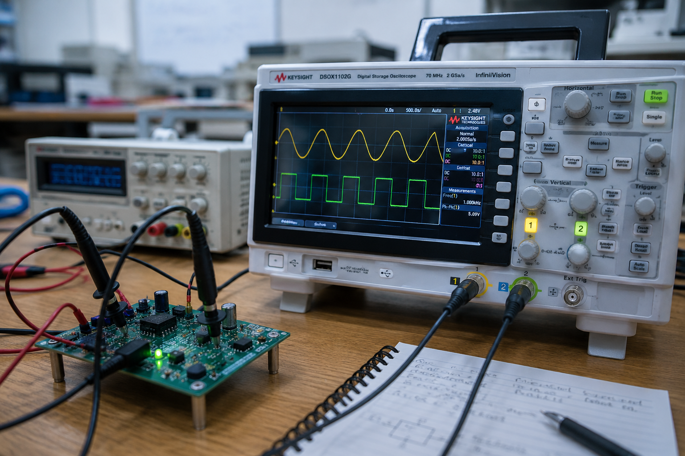




1. MOTIVATION
Why Fault Classification Matters
Analog circuits are everywhere
Filters, power supplies, sensor front-ends and communication links all rely on analog stages that quietly degrade before they fail outright.
Manual diagnosis doesn't scale
Reading an oscilloscope trace to guess whether a fault is drift, noise, or a bad connection takes an expert and doesn't scale to thousands of boards.
PHOTO / SCHEMATIC
e.g. lab PCB, oscilloscope capture, or
simulation workstation photo
Faults are often silent
A drifting resistor or a noisy stage can still “work” while quietly producing wrong answers downstream.
The goal
Give a machine the output waveform and let it instantly say what's wrong — and which component is likely responsible.
KERNEL-BASED FAULT CLASSIFICATION IN ANALOG CIRCUITS
03

Slide 5


1. MOTIVATION
The Real-World Cost of an Undiagnosed Fault
Component drift and disconnects rarely announce themselves. A few examples of what's at stake:
Medical devices
Communication links
A drifting filter stage in a patient monitor can quietly shift a threshold reading long before an alarm ever fires.
A degraded low-pass filter changes a receiver's bandwidth, raising bit-error rates without any visible failure.
Power electronics
Automotive sensors
A drifting or shorted component in a regulator stage can shorten the life of every downstream part it feeds.
Analog sensor front-ends drift with temperature and age; catching this early prevents cascading failures.
KERNEL-BASED FAULT CLASSIFICATION IN ANALOG CIRCUITS
04

Slide 6




1. MOTIVATION
Why This Problem Is Genuinely Hard
Faults are continuous, not binary
Drift isn't a switch — a resistor slides gradually from healthy to faulty, so “normal” and “drift” can look nearly identical near the boundary.
Signatures overlap across circuits
An “open” fault looks similar (flat, non-charging output) whether it happens in an RC filter or an RLC network — the model must tell topology and fault apart together.
20 classes from limited data
4 circuits × 5 faults = 20 classes to separate from just ~1,019 simulated samples — roughly 50 examples per class.
Simulation vs. reality gap
LTspice gives clean, repeatable waveforms; real hardware adds temperature drift, tolerances and parasitic effects simulation can't fully capture.
KERNEL-BASED FAULT CLASSIFICATION IN ANALOG CIRCUITS
05

Slide 7


1. MOTIVATION
Where This Fits in the Literature
Analog fault diagnosis has a real research history — this project sits inside an established, active line of work rather than starting from a blank page.
Classical: fault dictionaries & sensitivity analysis
Simulate the circuit under every hypothesized fault ahead of time, build a "dictionary" of expected responses, then match a real measurement against it. Accurate for the exact circuit modeled, but must be rebuilt from scratch for every new topology.
A standard split this project mirrors: soft vs. hard faults
The literature separates gradual, within/beyond-tolerance parameter drift ("soft faults") from catastrophic opens and shorts ("hard faults"). This project's five categories — Normal, Drift, Open, Short, Noise — map directly onto that same split.
Machine-learning classifiers are now the mainstream approach
Recent published work applies SVMs, k-NN, ensemble methods and CNNs to extracted or raw-waveform features for analog soft-fault diagnosis, with SVM-based studies frequently reporting 95%+ accuracy — but almost always on a single circuit at a time.
What differs here: most studies tune a classifier for one circuit. This project trains one SVM across four topologies at once, uses only physics-based (non-augmented) data, and adds a topology-aware correction step — part of why 78.43% sits below single-circuit literature numbers, on a harder, multi-topology problem.
KERNEL-BASED FAULT CLASSIFICATION IN ANALOG CIRCUITS
06

Slide 8

PROBLEM STATEMENT & OBJECTIVE
One Waveform In. One Diagnosis Out.
Given the transient output voltage of an unknown analog circuit, automatically identify which circuit topology it is and which of five fault conditions it is currently experiencing — a 20-class classification problem solved end-to-end with physics-based simulation and a tuned SVM.
4
5
20
1019
Circuit Topologies
Fault Types
Total Classes
Real Samples
RC · RLC · Sallen-Key · RC Ladder
Normal, Drift, Open, Short, Noise
4 circuits × 5 fault conditions
From physics-based LTspice sweeps
What's novel here: the training data comes entirely from real LTspice physics (no synthetic augmentation), and a topology-aware correction rule catches physically impossible predictions — two choices that trade a higher but hollow accuracy for a lower, trustworthy one.
KERNEL-BASED FAULT CLASSIFICATION IN ANALOG CIRCUITS
07

Slide 9




2. CIRCUITS & FAULT THEORY
Five Ways an Analog Circuit Can Misbehave
Normal
Drift
Open
Short
Noise
Component values sit at their nominal, healthy design point.
A component value slowly shifts from nominal — aging, temperature, wear.
A component disconnects entirely — an infinite-resistance break in the path.
A component is bypassed — a near-zero-resistance path forms across it.
Random disturbance is superimposed on an otherwise healthy signal.
KERNEL-BASED FAULT CLASSIFICATION IN ANALOG CIRCUITS
08

Slide 10

2. CIRCUITS & FAULT THEORY
Fault Deep Dive: Drift
Drift models a component value that has gradually moved away from its design value — the most physically realistic and hardest-to-catch fault, since aging and temperature affect every real component.
Why it's the hardest fault
Unlike open/short (extreme, obvious limits), drift sits on a continuum right next to “normal.” Later in Results, drift turns out to be the single hardest fault type to classify across every circuit in this project.
R(t) = R0 · (1 + delta)
delta = fractional deviation from nominal
In this project, drift is generated by sweeping the same component (R or L) across a wide but realistic range with LTspice's .step param directive — not a single fixed shift, but a whole family of plausible drifted values.
KERNEL-BASED FAULT CLASSIFICATION IN ANALOG CIRCUITS
09

Slide 11

2. CIRCUITS & FAULT THEORY
Fault Deep Dive: Open & Short
Open: resistance to infinity
Short: impedance to zero
R_open -> infinity (no current path)
Z_short -> 0 (component bypassed)
This project's RC circuit models “open” by sweeping the resistor from 1 megaohm to 1 gigaohm with .step param — effectively blocking the charging path so Vout never rises.
The RC circuit's “short” is modeled by sweeping the capacitor down to 0.1-10 picofarads (R fixed at 1 kilohm) — the RC time constant collapses to picoseconds, so Vout jumps to 5V almost instantly, just as a true short would.
KERNEL-BASED FAULT CLASSIFICATION IN ANALOG CIRCUITS
10

Slide 12
2. CIRCUITS & FAULT THEORY
Fault Deep Dive: Noise
Noise doesn't come from a component value changing at all — it's additive random disturbance superimposed on an otherwise healthy waveform, modeled with a fixed signal-to-noise ratio.
v_noisy(t) = v_normal(t) + N(0, sigma^2)
sigma^2 = mean(v_normal^2) / 10^(SNR_dB / 10)
SNR = 25 dB | seed = 42 (reproducible)
In code: each circuit's own NORMAL waveforms are reused as the clean base signal, then Gaussian noise scaled to a 25 dB SNR is added with NumPy's seeded random generator — one noisy sample generated per normal sample, so class counts stay balanced.
One honest asterisk: unlike the other four classes, NOISE is the only fault type not simulated fresh in LTspice — it's built by post-processing an existing NORMAL waveform. Elsewhere this project rightly emphasizes “no synthetic data augmentation,” and that claim is accurate for drift/open/short/normal, but NOISE is a partial exception: it's synthetic in a way the other classes aren't. A stricter version would simulate noise as a true LTspice noise source (e.g. a behavioral voltage source with random current injection) rather than adding it after the fact in Python.
KERNEL-BASED FAULT CLASSIFICATION IN ANALOG CIRCUITS
11

Slide 13
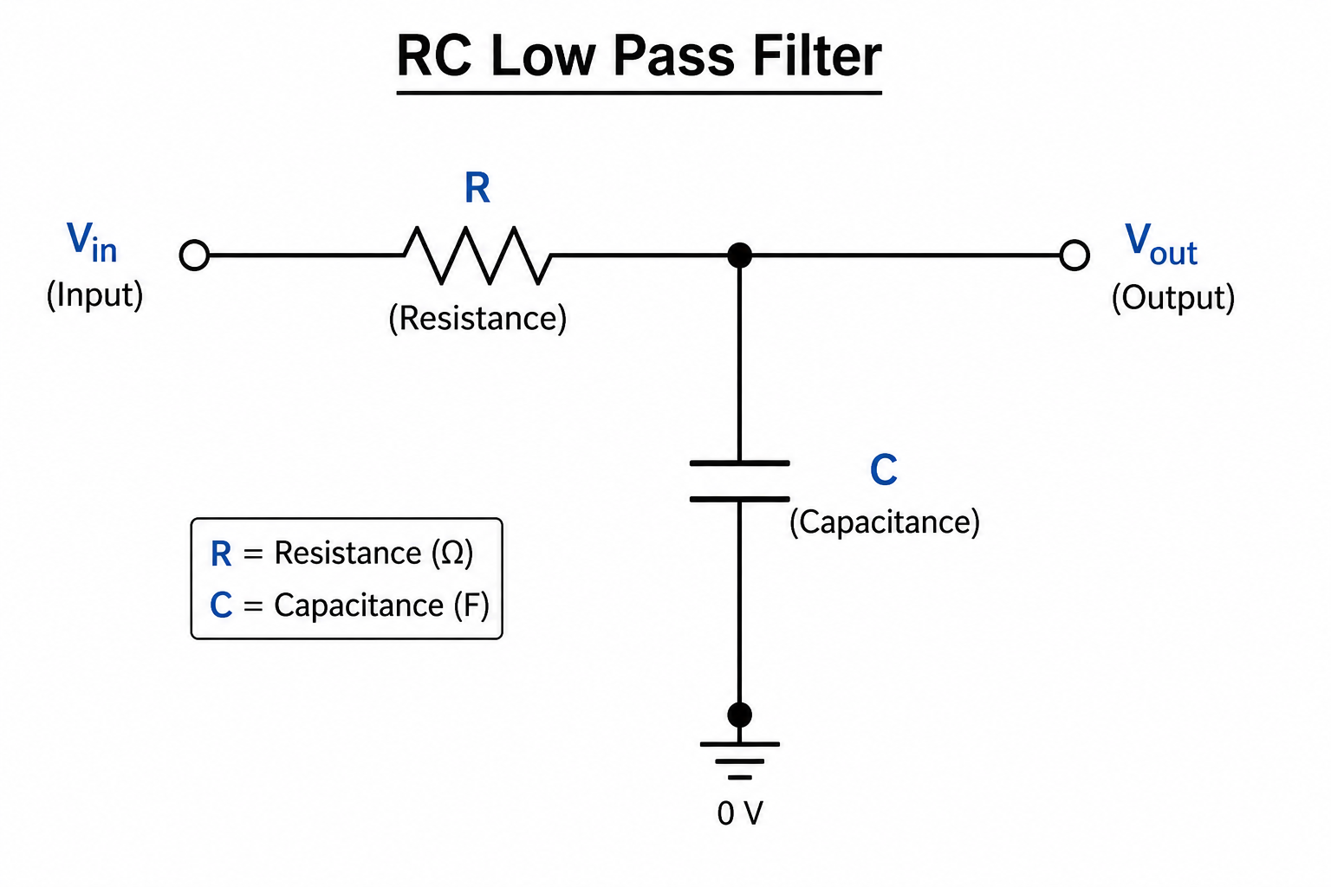
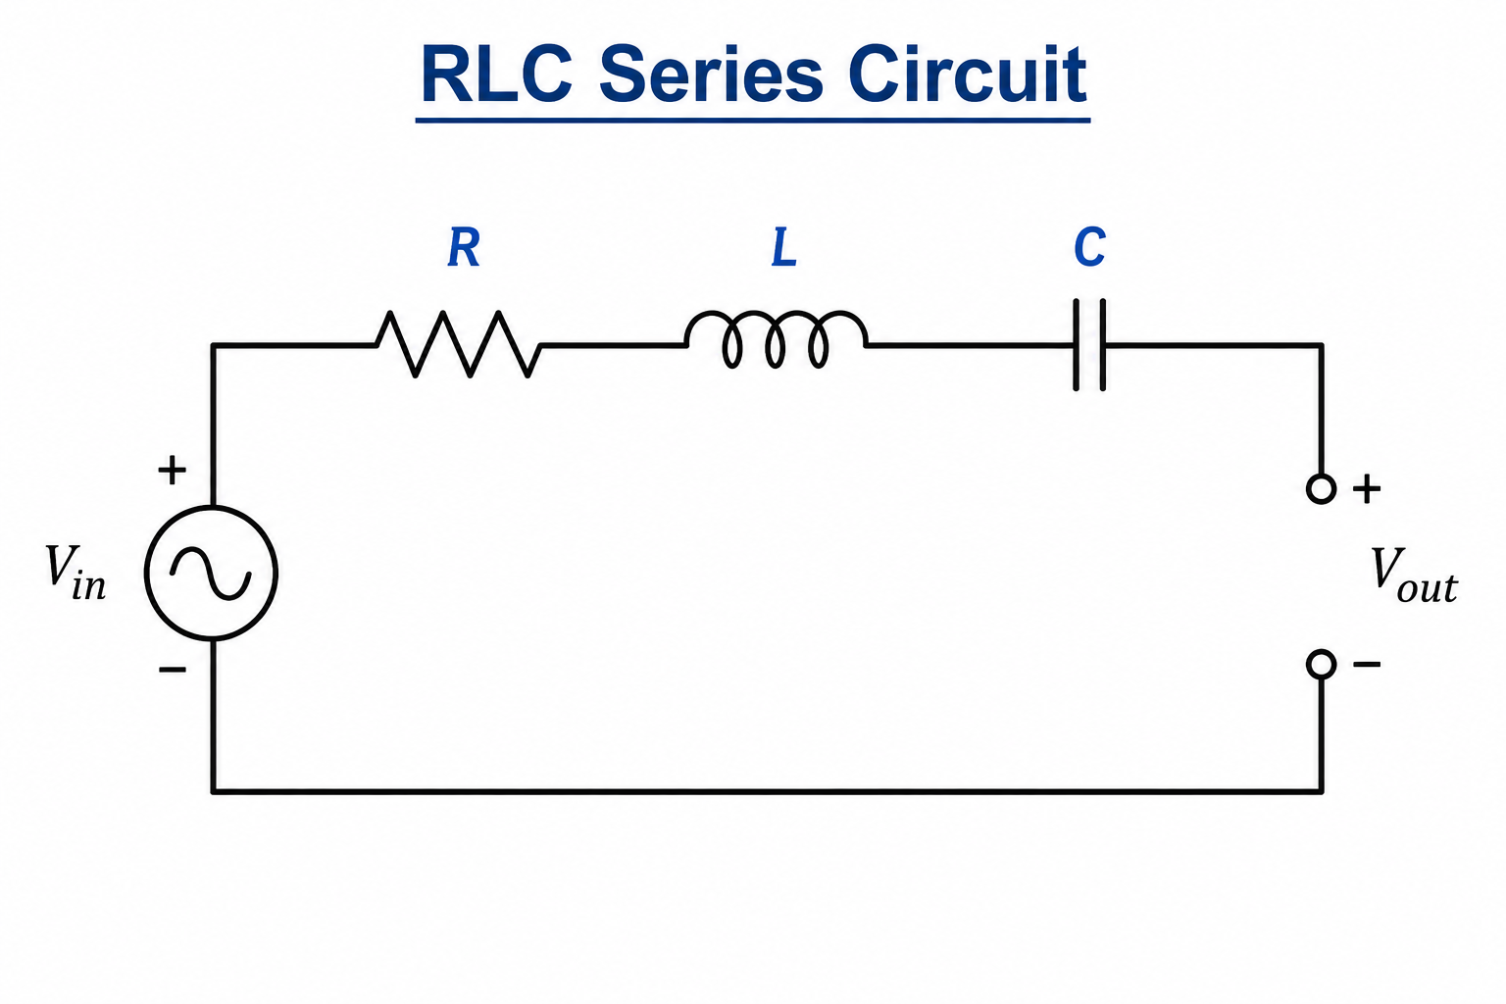

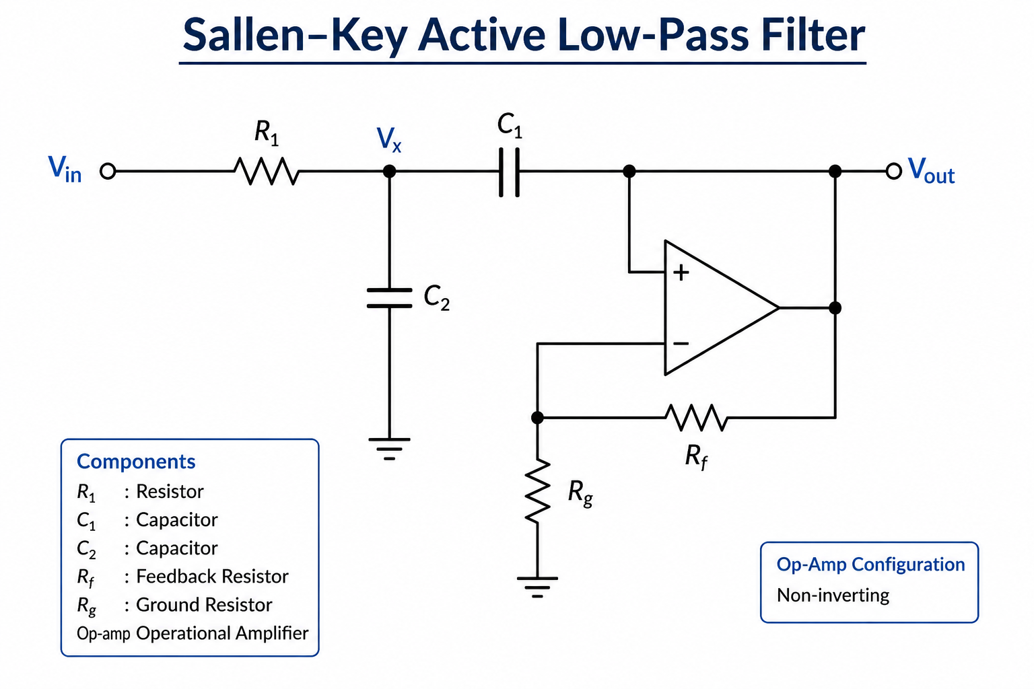
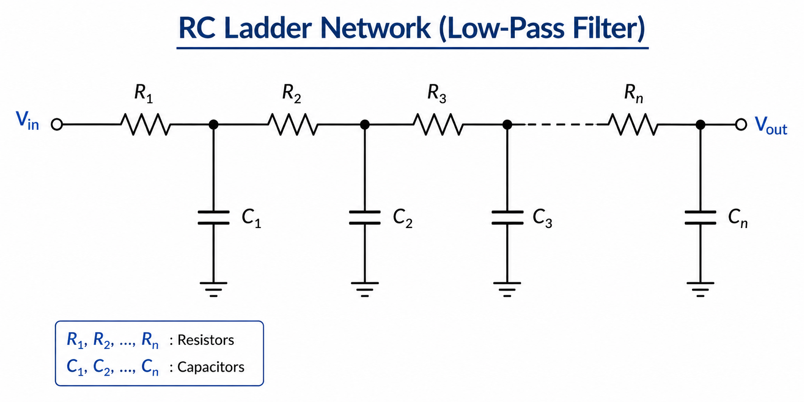
2. CIRCUITS & FAULT THEORY
Four Circuit Topologies Under Test
RC Low-Pass Filter
RLC Series Circuit
One resistor, one capacitor — the simplest baseline. A single-pole exponential charge/discharge response.
Adds an inductor for an underdamped, oscillatory step response — richer dynamics than RC alone.
SCHEMATIC
SCHEMATIC
Sallen-Key Active Filter
RC Ladder Network
An op-amp based 2nd-order filter — the kind actually used in real analog signal-conditioning design.
Multiple RC stages cascaded together, producing a more complex multi-pole response.
SCHEMATIC
SCHEMATIC
KERNEL-BASED FAULT CLASSIFICATION IN ANALOG CIRCUITS
12

Slide 14
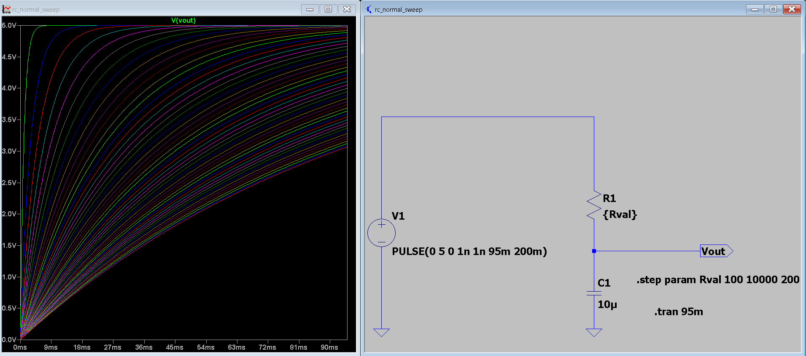
2. CIRCUITS & FAULT THEORY
RC Low-Pass Filter — The Baseline
H(s) = 1 / (1 + sRC)
v(t) = V * (1 - e^(-t / RC))
tau = R * C (time constant)
SCHEMATIC + WAVEFORM
R swept 100 ohm to 10 kilohm (normal/drift) with C fixed at 10 microfarad — tau ranges from about 1 ms to 100 ms.
e.g. LTspice schematic and
step response screenshot
Open: R swept 1 megaohm to 1 gigaohm — the charging path is effectively blocked, so Vout never rises.
Short: C swept down to 0.1-10 picofarad — tau collapses to picoseconds, so Vout jumps to 5V almost instantly.
IN PLAIN TERMS : Just a resistor and capacitor charging up, like a bucket filling with water — tau is simply how long that fill takes.
KERNEL-BASED FAULT CLASSIFICATION IN ANALOG CIRCUITS
13

Slide 15
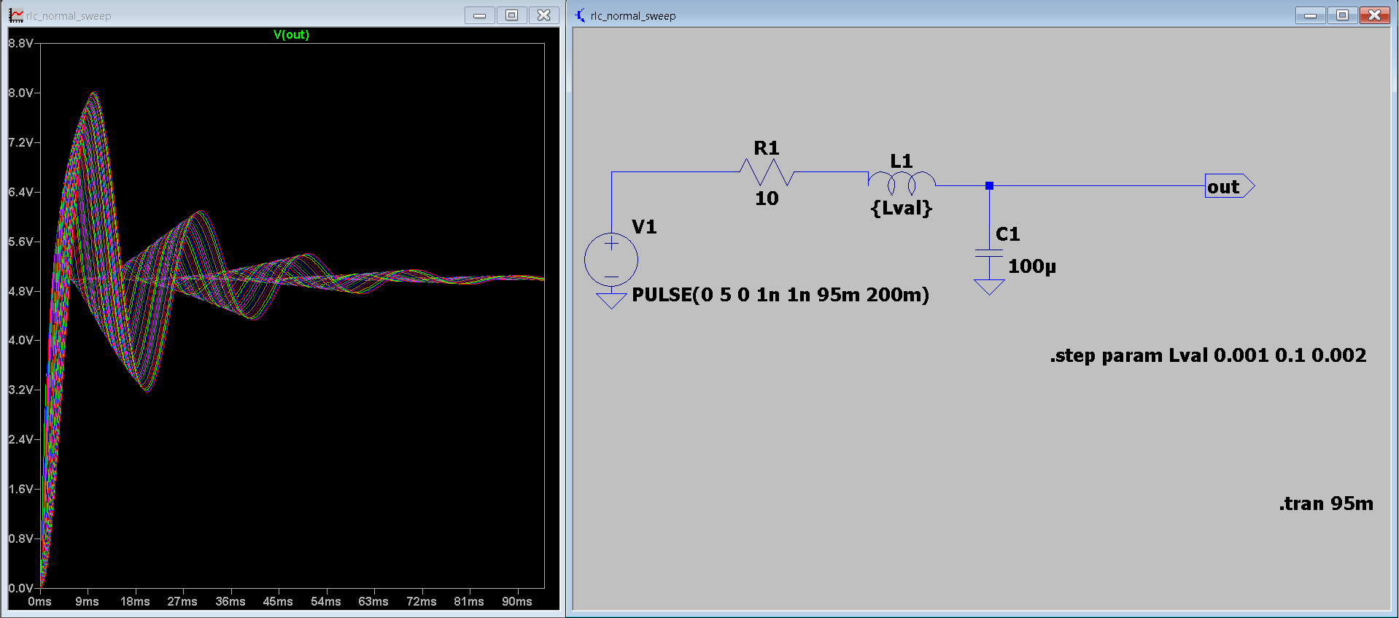
2. CIRCUITS & FAULT THEORY
RLC Series Circuit — Adding Oscillation
H(s) = 1 / (LCs^2 + RCs + 1)
omega_0 = 1 / sqrt(LC) zeta = (R/2) * sqrt(C/L)
SCHEMATIC + WAVEFORM
L swept 1 mH to 100 mH (normal/drift), with R = 10 ohm and C = 100 microfarad fixed — a genuinely underdamped, oscillatory step response.
e.g. LTspice schematic and
step response screenshot
Because zeta is small, the output rings before settling — a signature no RC-only circuit can produce.
Open: R swept 1 megaohm to 1 gigaohm in series, blocking the current path entirely.
IN PLAIN TERMS : The inductor makes this circuit "overshoot and wobble" before settling, like a swing that bounces past its resting point a few times — that wobble is the key signal the model learns to spot.
KERNEL-BASED FAULT CLASSIFICATION IN ANALOG CIRCUITS
14

Slide 16
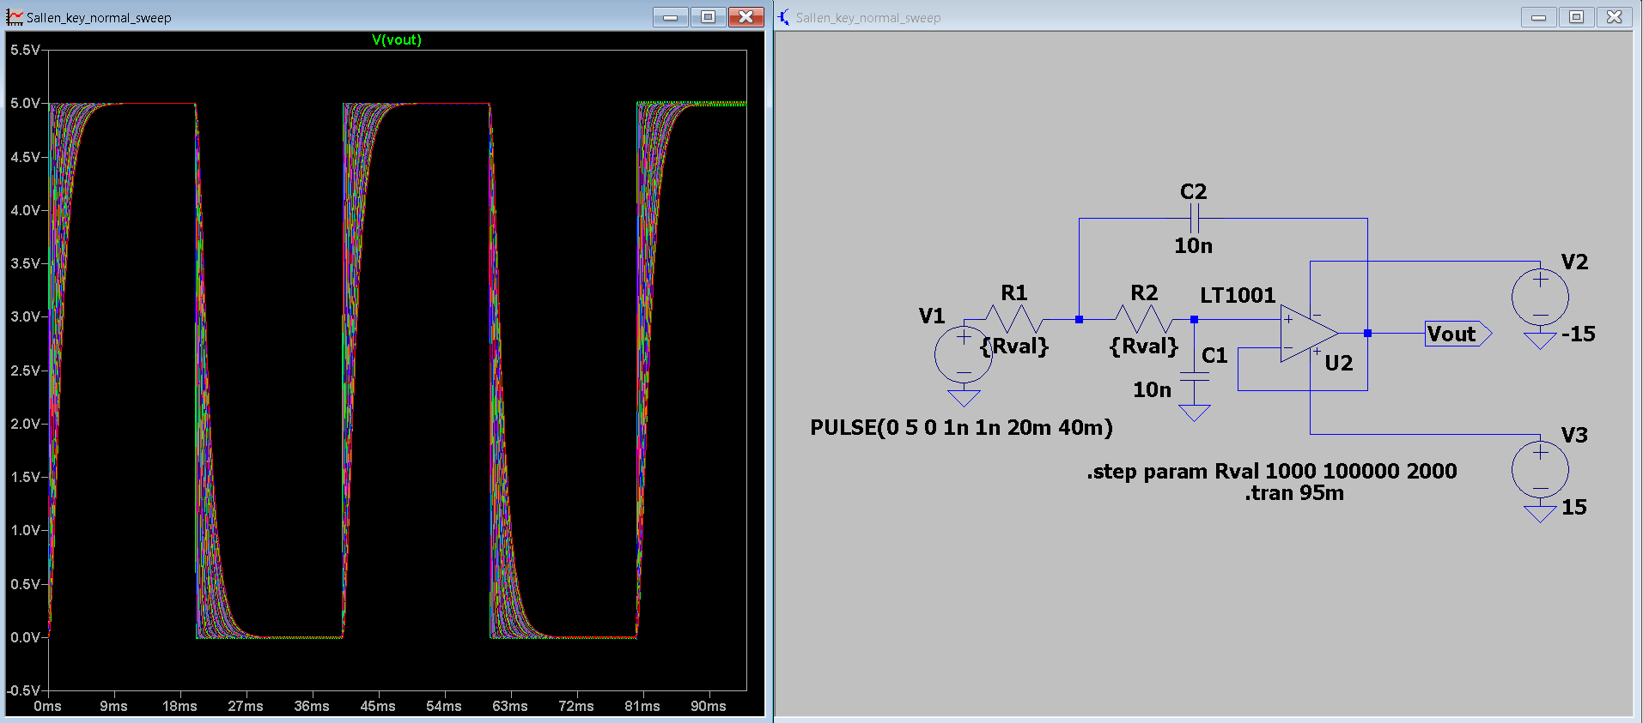
2. CIRCUITS & FAULT THEORY
Sallen-Key Active Filter — A Real Design Pattern
f_c = 1 / (2*pi*sqrt(R1*R2*C1*C2))
Unity-gain, 2nd-order low-pass (op-amp based)
SCHEMATIC + WAVEFORM
R1 = R2 swept 1 kilohm to 100 kilohm together; C1 = C2 = 10 nanofarad fixed; dual +-15V supply, LT1001 op-amp model.
e.g. LTspice schematic and
step response screenshot
This is the one topology here that's actually used in production analog signal-conditioning circuits — not just a textbook passive network.
Its op-amp feedback path gives it a distinct response shape from the three purely passive circuits.
IN PLAIN TERMS: An op-amp is just a powered amplifier chip with feedback wired around it — think of it as an "active" filter that can shape a signal more precisely than a passive RC network alone.
KERNEL-BASED FAULT CLASSIFICATION IN ANALOG CIRCUITS
15

Slide 17
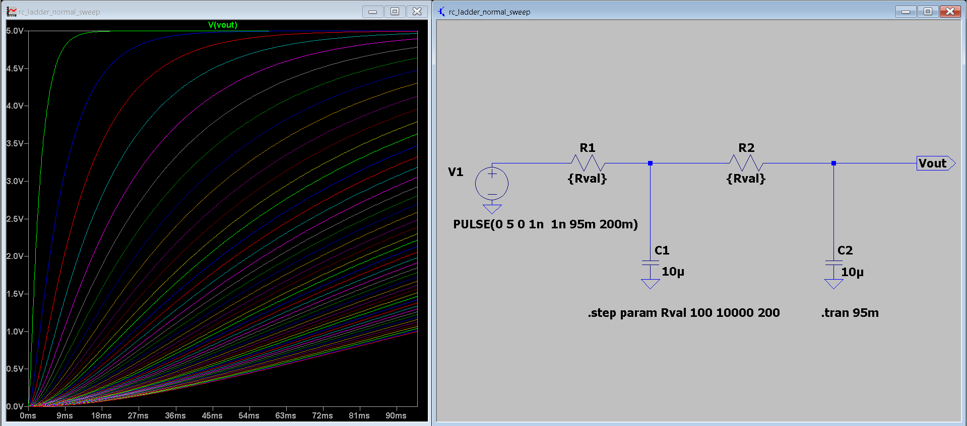
2. CIRCUITS & FAULT THEORY
RC Ladder Network — Cascaded Stages
Stage 1: 1/(1+sR1C1) -> Stage 2: 1/(1+sR2C2)
H(s) = Stage1(s) * Stage2(s) (multi-pole)
SCHEMATIC + WAVEFORM
Two RC stages in series, R1 = R2 swept together 100 ohm to 10 kilohm, C1 = C2 = 10 microfarad — each stage contributes its own pole.
e.g. LTspice schematic and
step response screenshot
A fault in an earlier stage propagates and interacts with the second stage, producing subtler waveform changes than a single RC stage would.
This structural similarity to the plain RC circuit is exactly what makes the two easy to confuse later, in Results.
KERNEL-BASED FAULT CLASSIFICATION IN ANALOG CIRCUITS
16

Slide 18
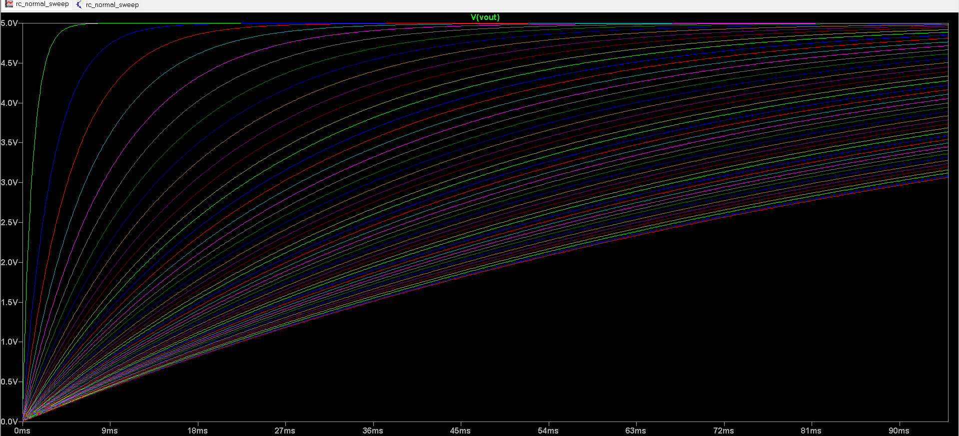
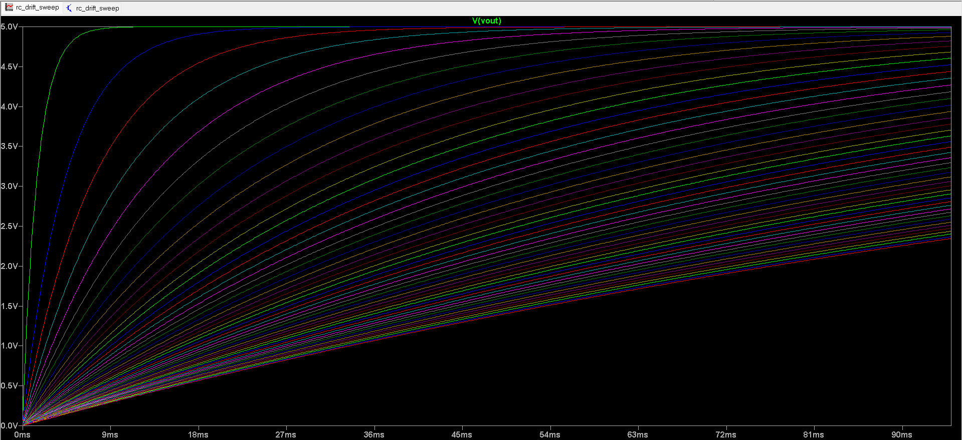
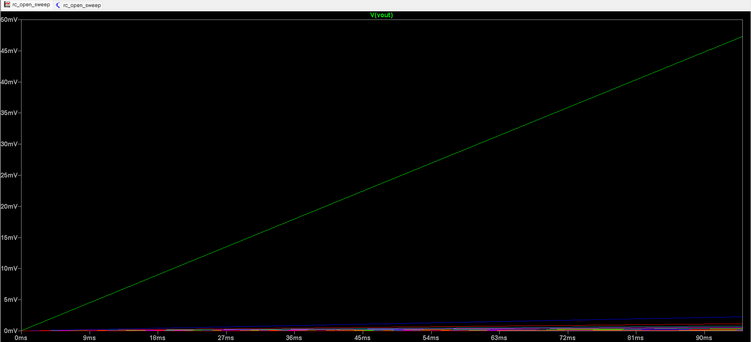
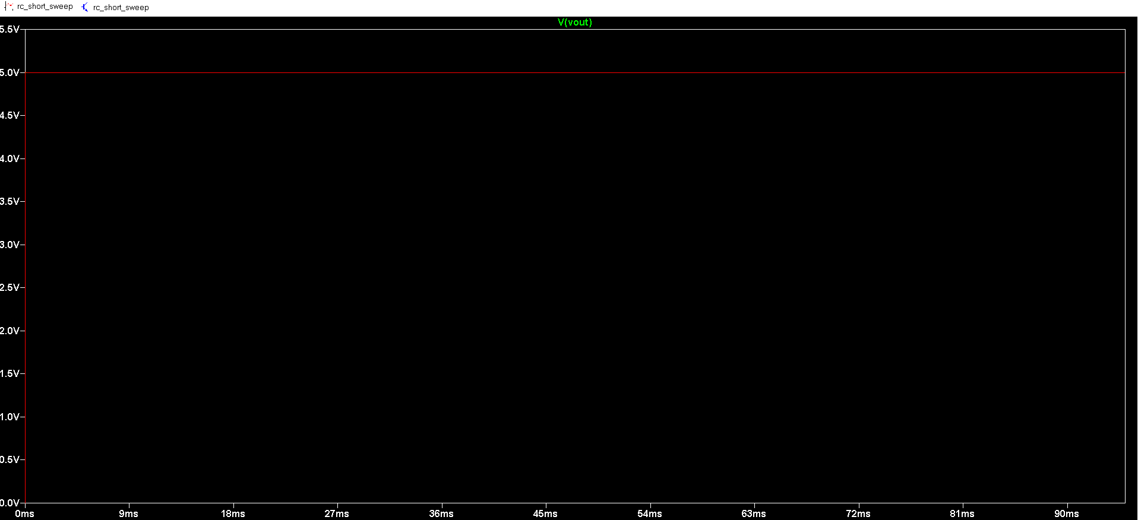
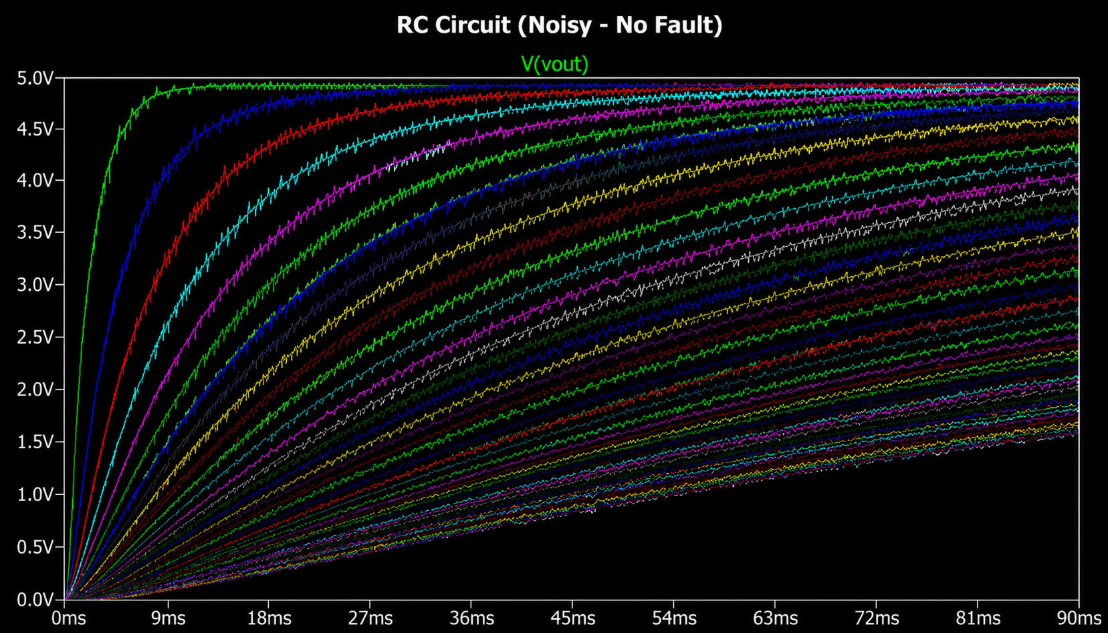

2. CIRCUITS & FAULT THEORY
Same Circuit, Five Different Personalities
Example: an RC low-pass filter's step response under each of the five fault conditions.
WAVEFORM
WAVEFORM
WAVEFORM
WAVEFORM
WAVEFORM
Normal response
Drift response
Open response
Short response
Noise response
Normal
Drift
Open
Short
Noise
KERNEL-BASED FAULT CLASSIFICATION IN ANALOG CIRCUITS
17

Slide 19


3. DATA PIPELINE
The End-to-End Pipeline
1
2
3
4
5
6
Simulate
Sweep
Extract
Train & Tune
Correct
Deploy
Model 4 circuits in
LTspice XVII
Vary R/L/C values
across realistic ranges
17 features per
waveform
SVM kernels +
GridSearchCV
Topology-aware
post-processing
Live Streamlit
web app
Every stage is grounded in real simulation physics — no synthetic data augmentation was used in the final pipeline, only genuine LTspice parameter sweeps.
KERNEL-BASED FAULT CLASSIFICATION IN ANALOG CIRCUITS
18

Slide 20
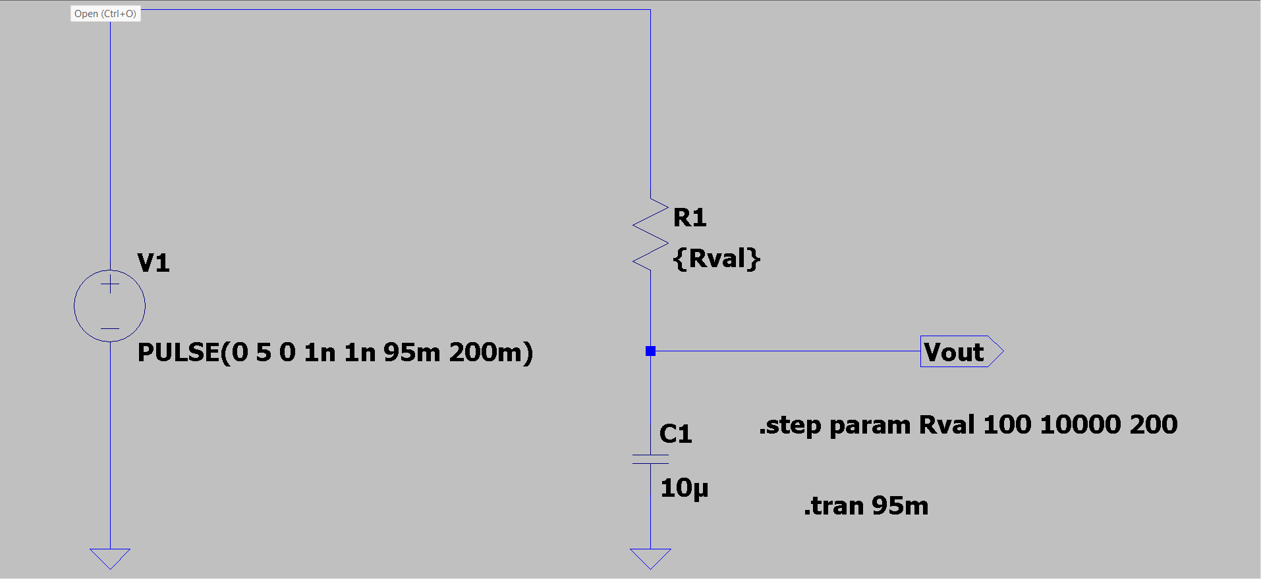
3. DATA PIPELINE · STEP 1
Simulating Real Circuit Behavior in LTspice
Why SPICE instead of pure math?
LTspice's transient solver captures op-amp behavior, component tolerances and transient effects that a hand-derived transfer function alone would miss.
LTSPICE SCHEMATIC
A step input drives every circuit
A PULSE voltage source jumps 0V to 5V (1ns rise time), mimicking a sudden real-world input change.
e.g. screenshot of the .asc
circuit diagram in LTspice XVII
.tran captures the transient response
The .tran directive runs the simulation and records Vout at 200 time points as the circuit reacts to the step.
V1 PULSE(0 5 0 1n 1n 95m 200m)
.tran 95m
.step param Rval 100 10000 200
KERNEL-BASED FAULT CLASSIFICATION IN ANALOG CIRCUITS
19

Slide 21
3. DATA PIPELINE · STEP 2
Parameter Sweeps: Simulating Real-World Variation
A single fixed waveform per fault would teach the model almost nothing. The .step param directive instead sweeps a component value across a realistic range, generating roughly 51 independent transient runs per fault class, per circuit.
Circuit
Normal / Drift sweep
Fixed components
RC
R: 100 ohm -> 10 kilohm
C = 10 uF
RLC
L: 1 mH -> 100 mH
R = 10 ohm, C = 100 uF
Sallen-Key
R1=R2: 1 kilohm -> 100 kilohm
C1=C2 = 10 nF, +-15V supply
RC Ladder
R1=R2: 100 ohm -> 10 kilohm
C1=C2 = 10 uF
~51 sweep steps x 4 circuits x 5 faults =~ 1,019 total samples
KERNEL-BASED FAULT CLASSIFICATION IN ANALOG CIRCUITS
20

Slide 22
3. DATA PIPELINE · STEP 2
How Each Fault Is Modeled in LTspice
Fault
Modeling mechanism
Concretely (RC example)
Normal
Component at nominal design value, swept across a healthy range
R: 100 ohm -> 10 kilohm
Drift
Same component, same wide sweep — treated as the healthy range itself
R: 100 ohm -> 10 kilohm
Open
Affected resistor swept toward near-infinite resistance
R: 1 megaohm -> 1 gigaohm
Short
Affected reactive component swept toward its opposite extreme
C: 0.1 pF -> 10 pF
Noise
Gaussian noise added post-hoc to normal waveforms, not simulated in LTspice
SNR = 25 dB, seed = 42
KERNEL-BASED FAULT CLASSIFICATION IN ANALOG CIRCUITS
21

Slide 23
3. DATA PIPELINE · STEP 2
From LTspice Output to a Clean Dataset
Each .step sweep produces one exported text file containing dozens of stacked runs. A parser walks the file, splits it back into individual runs, and resamples every run onto a common 200-point time grid:
for line in file:
if line starts with "Step Information": start new run
else: accumulate (time, voltage) pairs
resample(t, v, t_end, n=200):
grid = linspace(0, t_end, 200)
return interp1d(t, v)(grid) # uniform length for every sample
This turns dozens of variable-length LTspice runs into one uniform, ML-ready table of 200 voltage points per sample.
KERNEL-BASED FAULT CLASSIFICATION IN ANALOG CIRCUITS
22

Slide 24
3. DATA PIPELINE · STEP 3
A Look at the Raw Dataset: master_dataset_sweep.csv
Every LTspice sweep run becomes one row: a circuit label, a fault label, the swept parameter value, and 200 raw voltage samples (v0 ... v199) tracing the full transient response. This is the direct, unprocessed output of Step 2 — nothing has been engineered yet.
id
circuit
fault
param_value
v0
v1
v2
...
v199
0
RC
normal
100 ohm
0.000
1.962
3.080
...
5.000
102
RC
open
n/a
0.000
0.000
0.000
...
0.047
153
RC
short
n/a
0.000
5.000
5.000
...
5.000
255
RLC
drift
12.0 mH
0.000
0.000
0.002
...
8.668
1,019 rows x 204 columns total. Notice how the shape alone tells a story: RC_open barely rises off 0V, RC_short jumps straight to 5V, and RLC_drift overshoots past 5V before settling — that oscillation ("ringing") is only possible because the RLC circuit has an inductor. A few param_value entries show as n/a because of a parsing quirk in the original sweep export — a real, minor rough edge left visible here rather than smoothed over.
KERNEL-BASED FAULT CLASSIFICATION IN ANALOG CIRCUITS
23

Slide 25
3. DATA PIPELINE
1,019 Samples, Evenly Balanced Across Fault Types
Perfectly balanced classes
Each fault type accounts for about 20% of samples, so the model can't win by just guessing the majority label.
20 total labels
Each sample is tagged circuit_fault, e.g. RC_open or SALLEN_KEY_drift — 4 circuits times 5 faults.
About 51 samples per class
1,019 divided across 20 classes averages to roughly 51 samples each — a genuinely small-data problem.
KERNEL-BASED FAULT CLASSIFICATION IN ANALOG CIRCUITS
24

Slide 26

3. DATA PIPELINE
Train/Test Split: Keeping Evaluation Honest
train_test_split(X, y, test_size=0.20, random_state=42, stratify=y)
80/20 split: About 815 samples train the model; the remaining ~204 are held out purely for evaluation.
Stratified by class: Every one of the 20 classes keeps its ~80/20 proportion in both sets — no class is accidentally left thin in testing.
Fixed random seed: random_state=42 makes the split reproducible — the same test samples every time the pipeline reruns.
Test set never touched during tuning: GridSearchCV only ever sees the training set; the test set is reserved for the one final, honest accuracy number.
KERNEL-BASED FAULT CLASSIFICATION IN ANALOG CIRCUITS
25

Slide 27

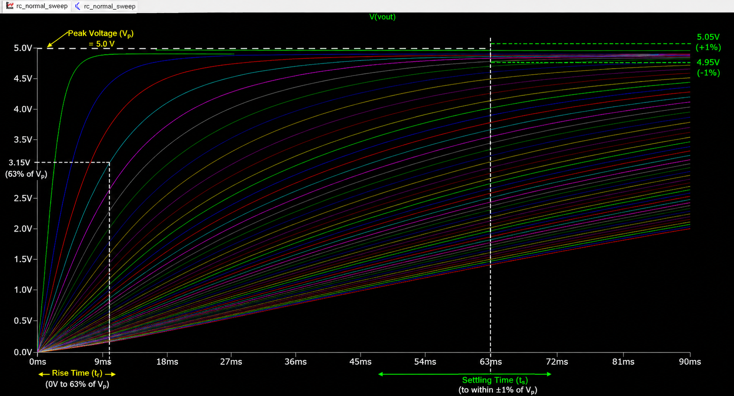
4. FEATURE ENGINEERING
From Waveform to Numbers
Each raw sample is 200 individual voltage readings — too high-dimensional and noisy for a classic SVM to learn from efficiently. Instead, every waveform is compressed into 17 compact, physically meaningful numbers that fall into two families:
Time-domain shape
Frequency-domain content
How the signal looks over time — peak voltage, RMS, rise time, settling time, skewness, kurtosis, DC level.
How much energy sits at which frequency — dominant frequency, spectral energy, centroid, bandwidth, entropy.
ANNOTATED WAVEFORM
e.g. a single trace with peak voltage, rise time and settling time marked
KERNEL-BASED FAULT CLASSIFICATION IN ANALOG CIRCUITS
26

Slide 28
4. FEATURE ENGINEERING
Time-Domain Features: Amplitude & Shape
f1 peak_voltage = max(v)
f2 rms_value = sqrt( mean(v^2) )
f3 mean_voltage = mean(v)
f4 std_voltage = std(v)
These four numbers describe the basic size and spread of a waveform. A shorted capacitor pushes peak_voltage toward the full 5V almost immediately; an open circuit keeps it near 0V. std_voltage in particular turns out to be one of the two most important features in the trained model (see Results).
KERNEL-BASED FAULT CLASSIFICATION IN ANALOG CIRCUITS
27

Slide 29
4. FEATURE ENGINEERING
Time-Domain Features: Timing
f5 rise_time = t(at 90% peak) - t(at 10% peak)
f6 settling_time = last t where |v(t) - v_final| > 2% * |v_final|
rise_time is the single most important feature in the trained model — it directly captures how fast a circuit charges, which is exactly what open (never charges) and short (charges instantly) faults change most. settling_time captures how long oscillation or transients persist before the signal stabilizes.
KERNEL-BASED FAULT CLASSIFICATION IN ANALOG CIRCUITS
28

Slide 30
4. FEATURE ENGINEERING
Time-Domain Features: Statistical Shape
f7 skewness = E[ (v - mean)^3 ] / std^3 (asymmetry)
f8 kurtosis = E[ (v - mean)^4 ] / std^4 (peakedness)
Borrowed from statistics, these describe the shape of the voltage distribution across the whole waveform, not just its size. A lopsided charge/discharge curve skews one way; a noisy signal has different kurtosis than a smooth one — useful signal the size-based features alone miss.
KERNEL-BASED FAULT CLASSIFICATION IN ANALOG CIRCUITS
29

Slide 31
4. FEATURE ENGINEERING
Frequency-Domain Features: The FFT
The Fast Fourier Transform rewrites a signal from “voltage over time” into “energy at each frequency.” A smooth RC charging curve is dominated by low frequencies; noise spreads energy across many frequencies; an RLC's ringing shows a clear peak at its oscillation frequency.
V(f) = FFT( v(t) ) | magnitude spectrum |V(f)|
Five features (next slide) are computed from this magnitude spectrum rather than from the raw time signal.
IN PLAIN TERMS: FFT is standard signal-processing math — this step is no different than reading a spectrum analyzer, just done in code instead of on a bench instrument.
KERNEL-BASED FAULT CLASSIFICATION IN ANALOG CIRCUITS
30

Slide 32
4. FEATURE ENGINEERING
Frequency-Domain Features: Spectral Descriptors
f9 dominant_freq = f at max |V(f)|, 50-2000 Hz band
f10 spectral_energy = sum( |V(f)|^2 )
f11 spectral_centroid = sum(f*|V(f)|) / sum(|V(f)|) ("center of mass")
f12 bandwidth = sqrt( sum((f-centroid)^2 * |V(f)|) / sum(|V(f)|) )
f13 spectral_entropy = -sum( p(f) * log2 p(f) ), p(f)=|V(f)|^2/total
spectral_entropy is the third most important feature overall — a clean charging curve has low entropy (energy concentrated at low frequency); noise has high entropy (energy spread everywhere). This single number does a lot of work separating noise faults from everything else.
KERNEL-BASED FAULT CLASSIFICATION IN ANALOG CIRCUITS
31

Slide 33
4. FEATURE ENGINEERING
Structural Features
f15 zero_crossing_rate = crossings of (v - mean(v)) per sample
f16 crest_factor = max(|v|) / rms_value
f14 energy = sum(v^2)
crest_factor is the fourth most important feature — it compares a signal's peak to its average power, which distinguishes a sharp, spiky waveform from a smooth one. zero_crossing_rate and energy add further structural context that complements the pure amplitude features.
KERNEL-BASED FAULT CLASSIFICATION IN ANALOG CIRCUITS
32

Slide 34
4. FEATURE ENGINEERING
17 Features, Three Families
Time-Domain (9)
Frequency-Domain (5)
Structural (3)
Peak voltage
Dominant frequency
Zero-crossing rate
RMS value
Spectral energy
Crest factor
Mean voltage
Spectral centroid
Signal energy
Std. deviation
Bandwidth
Rise time
Spectral entropy
Settling time
Skewness
Kurtosis
DC level
KERNEL-BASED FAULT CLASSIFICATION IN ANALOG CIRCUITS
33

Slide 35
4. FEATURE ENGINEERING
Feature Redundancy: An Honest Look
With 17 features, some inevitably capture overlapping information. A correlation check across all 1,019 samples (|r| > 0.9) surfaces this directly:
Feature pair
r
Why they overlap
spectral_energy <-> energy
0.997
Parseval's theorem: energy computed from the FFT and from raw samples is almost the same quantity, two ways
rms_value <-> mean_voltage
0.995
A step response stays mostly positive, so RMS and mean track almost identically
spectral_centroid <-> bandwidth
0.994
Both are derived from the same magnitude-spectrum weighting
peak_voltage <-> dc_level
0.965
For a settled step response, the final steady value sits close to the peak
So does pruning actually help? Tested it. Dropping the 4 redundant features above (17 -> 13) and re-running the same 15-split evaluation: 77.65% mean accuracy vs. 77.48% for all 17 — a 0.17-point difference that is not statistically significant (paired t-test, p = 0.136). Conclusion: the redundancy is real but harmless — the RBF kernel simply doesn't get confused by it. Keeping all 17 is a defensible interpretability choice, not a hidden flaw.
KERNEL-BASED FAULT CLASSIFICATION IN ANALOG CIRCUITS
34

Slide 36
4. FEATURE ENGINEERING
Why Feature Scaling Matters
The 17 features live on wildly different scales — spectral_energy can be in the thousands while crest_factor is close to 1. An SVM's distance-based math would let large-scale features silently dominate, so every feature is standardized before training:
z = (x - mean) / std <- sklearn StandardScaler
Critically: the scaler is fit only on the training set, then applied to the test set — fitting on all the data first would leak test-set statistics into training and quietly inflate the reported accuracy.
KERNEL-BASED FAULT CLASSIFICATION IN ANALOG CIRCUITS
35

Slide 37
4. FEATURE ENGINEERING
The Transformed Dataset: features_v2.csv
This is the file the SVM actually trains on. Each row still has one sample_id, circuit and fault label — but the 200 raw voltage points are now gone, replaced by the 17 engineered numbers (f1...f17) from the previous slides.
circuit
fault
f1 peak
f4 std
f5 rise_t
f9 dom.freq
f13 entropy
f17 dc_lvl
RC
open
0.047
0.014
0.076 s
52.4 Hz
0.926
0.045
RC
short
5.000
0.353
0.000 s
900.7 Hz
0.042
5.000
RLC
drift
8.668
2.835
0.062 s
52.4 Hz
1.243
8.276
SALLEN_KEY
noise
5.704
0.446
0.020 s
1194.0 Hz
0.063
5.064
1,019 rows x 20 columns (sample_id + circuit + fault + 17 features) — a 10x reduction from 204 columns, with each number chosen to carry physical meaning rather than just compressing data blindly. Notice RC_short and RLC_drift both have dominant_freq near 52 Hz while SALLEN_KEY_noise sits at 1194 Hz, and RC_short's spectral entropy (0.042) is far lower than RLC_drift's (1.243) — exactly the kind of separation the SVM will learn to exploit next.
KERNEL-BASED FAULT CLASSIFICATION IN ANALOG CIRCUITS
36

Slide 38
5. MACHINE LEARNING
Why SVM? An Empirical Comparison First
Before going into SVM theory, a fair question: why this algorithm and not something simpler? Four alternative classifiers were trained on the exact same 17 features, averaged over 15 random 80/20 splits (no topology correction applied to any model, for a like-for-like comparison):
Model
Mean accuracy
Std dev
Notes
Random Forest (200 trees)
67.88%
2.18
Underfits with default depth on ~40 train samples/class
Decision Tree
69.93%
2.51
A single tree overfits noisy per-sample splits
k-NN (k=5)
71.50%
2.02
Struggles once 17 dimensions dilute distance
Logistic Regression
74.74%
1.91
Strong linear baseline, close to SVM-Linear
SVM RBF (tuned, this project)
77.48%
1.87
Best mean, competitive variance
Statistically confirmed: a paired test across the same 15 splits shows SVM beats the runner-up (Logistic Regression) by 2.75 points on average, winning 14 of 15 seeds (paired t-test, p = 0.00006 — not chance).
Honest caveat: only the SVM was hyperparameter-tuned via GridSearchCV here; the others use library defaults, so this is a first-pass comparison, not a fully tuned bake-off.
KERNEL-BASED FAULT CLASSIFICATION IN ANALOG CIRCUITS
37

Slide 39

5. MACHINE LEARNING
Support Vector Machines: The Big Idea
An SVM looks at labeled examples in feature space and draws the boundary that separates classes with the widest possible margin — not just any line that works, but the one furthest from the nearest points of each class.
Support vectors: Only the closest points to the boundary matter for defining it — these are the “support vectors” that give the algorithm its name.
Margin maximization: A wider margin between classes tends to generalize better to new, unseen data than a boundary that barely squeezes between them.
The kernel question: Real data is rarely separable with a straight line — the next slide covers how SVMs handle that.
KERNEL-BASED FAULT CLASSIFICATION IN ANALOG CIRCUITS
38

Slide 40
5. MACHINE LEARNING
SVM Math: Hyperplanes & Margins
Decision boundary: w . x + b = 0
Classify: sign(w . x + b)
Margin width: 2 / ||w|| (maximize this)
Training objective: minimize ||w||^2 / 2, subject to correct classification
w is a weight vector (one number per feature) and b is a bias term. In the linear-kernel model, the size of each weight in w is literally what the Feature Importance chart (in Results) is built from — larger |weight| means that feature moves the boundary more.
IN PLAIN TERMS: This is the same optimization idea as finding the best-fit line in a graph, just with a margin-width twist. You don't need to solve this by hand — scikit-learn's SVC does it in one line of code.
KERNEL-BASED FAULT CLASSIFICATION IN ANALOG CIRCUITS
39

Slide 41
5. MACHINE LEARNING
The Kernel Trick
A straight-line boundary can't separate classes that curl around each other in feature space. Kernels let the SVM measure similarity as if the data had been projected into a higher-dimensional space — without ever computing that projection directly.
Kernel
Similarity function K(x, x')
Shape of boundary
Linear
x . x'
Straight line / flat plane
RBF
exp( -gamma * ||x - x'||^2 )
Smooth, flexible curve
Polynomial
(gamma * x . x' + r)^d
Curved, degree-d surface
gamma controls how far a single training example's influence reaches — this project's tuned RBF model uses gamma = 0.1.
IN PLAIN TERMS : A "kernel" is just the shape of boundary the model is allowed to draw between classes — Linear is a straight cut, RBF and Polynomial can bend to fit curvier data.
KERNEL-BASED FAULT CLASSIFICATION IN ANALOG CIRCUITS
40

Slide 42
5. MACHINE LEARNING
Multi-Class Strategy: One-vs-One
An SVM is naturally a binary (two-class) classifier. scikit-learn's SVC handles 20 classes by training one small binary classifier for every possible pair of classes, then combining their votes:
Number of binary classifiers = C(20, 2) = 20*19 / 2 = 190
decision_function_shape="ovo" (scikit-learn SVC default)
Each of the 190 mini-classifiers votes on which of its two classes a sample looks more like; the class with the most votes wins. This is what lets a single SVC model handle a 20-way problem without any special multi-class math of its own.
KERNEL-BASED FAULT CLASSIFICATION IN ANALOG CIRCUITS
41

Slide 43
5. MACHINE LEARNING · STEP 1: BASELINE
Baseline Results — Before Any Tuning
Before touching a single hyperparameter, all three kernels are trained with scikit-learn's near-default settings (C=1.0, gamma="scale") on the same 80/20 split. This is the honest starting point every improvement from here on is measured against.
Linear
RBF
Polynomial
SVC(kernel="linear", C=1.0)
SVC(kernel="rbf", C=1.0, gamma="scale")
SVC(kernel="poly", C=1.0, gamma="scale", degree=3)
77.94%
71.08%
75.49%
test accuracy (default)
test accuracy (default)
test accuracy (default)
Even untuned, Linear already beats RBF — a sign the 17 hand-engineered features do real work before the classifier even sees them.
KERNEL-BASED FAULT CLASSIFICATION IN ANALOG CIRCUITS
42

Slide 44
5. MACHINE LEARNING · STEP 2: TUNING
Tuning with GridSearchCV
The baseline numbers leave room on the table — untuned RBF scores only 71.1%. GridSearchCV exhaustively tries every combination in a grid of hyperparameters, scoring each with 5-fold cross-validation on the training set only.
Kernel
Grid searched
Combinations
Total fits (x5 folds)
Linear
C in {0.001 ... 1000} (7 values)
7
35
RBF
C (5) x gamma (6)
30
150
Polynomial
C (4) x gamma (3) x degree (2)
24
120
305 total model fits searched — best RBF found: C=100, gamma=0.1, lifting it from 71.1% to 76.96% before the topology rule.
KERNEL-BASED FAULT CLASSIFICATION IN ANALOG CIRCUITS
43

Slide 45
5. MACHINE LEARNING · STEP 2: TUNING
Why 5-Fold Cross-Validation?
Testing one hyperparameter setting on a single train/validation split can just get lucky. 5-fold CV instead splits the training data into 5 equal chunks and rotates which chunk is held out:
Validate
Train
Train
Train
Train
Train
Validate
Train
Train
Train
Train
Train
Validate
Train
Train
Train
Train
Train
Validate
Train
Train
Train
Train
Train
Validate
Each of the 5 rows is one “fold”: 4/5 of the training data trains the model, 1/5 validates it — and the role rotates so every sample is validated on exactly once. The average across all 5 folds gives a far more reliable accuracy estimate than any single split.
KERNEL-BASED FAULT CLASSIFICATION IN ANALOG CIRCUITS
44

Slide 46

5. MACHINE LEARNING · STEP 2: TUNING
Tuned Results — What GridSearchCV Bought Us
BEST MODEL
Linear
Polynomial
RBF
77.94% -> 77.45%
75.49% -> 77.94%
71.08% -> 78.43%
-0.49 pts vs. baseline
+2.45 pts vs. baseline
+7.35 pts vs. baseline
Note: the topology-aware correction rule (Section 6) is applied uniformly to all six numbers above, so these deltas isolate the effect of GridSearchCV tuning alone. Linear barely moves (and even dips slightly) because it was already close to its ceiling; RBF gains the most because its default gamma was poorly matched to the data.
KERNEL-BASED FAULT CLASSIFICATION IN ANALOG CIRCUITS
45

Slide 47
6. THE SMART FIXES · PART 1
Diagnosing a Blind Spot: RC_open vs. RC_short
With the original 16 features, RC_open and RC_short were completely confused — F1 = 0.000. The fix came from a very direct diagnostic: compare the mean of each feature between the two classes and look for the biggest gap.
Feature
RC_open mean
RC_short mean
Separable?
peak_voltage
~0.02 V
~5.00 V
Yes — but noisy
rise_time
~0.095 s (never rises)
~0.000002 s (instant)
Marginal
dc_level (new)
~0.02 V
~5.00 V
Yes — cleanly
Both circuits settle to a flat line by the end of the observation window — the existing features just weren't capturing where that flat line actually sat.
KERNEL-BASED FAULT CLASSIFICATION IN ANALOG CIRCUITS
46

Slide 48
6. THE SMART FIXES · PART 1
The Fix: A 17th Feature, dc_level
f17_dc_level = mean( v[-20:] ) # last 20 samples of the waveform
RC_open
RC_short
Never charges within the 95ms window, so its steady-state DC level sits near 0V.
Charges almost instantly with a collapsed time constant, so its steady-state DC level sits near 5V.
One new feature, directly targeting a diagnosed failure mode, fixed a class pair the other 16 features couldn't separate.
KERNEL-BASED FAULT CLASSIFICATION IN ANALOG CIRCUITS
47

Slide 49

6. THE SMART FIXES · PART 2
Topology-Aware Post-Processing
A plain SVM can output a physically impossible label — e.g. "RLC_open" for a sample known to come from the RC circuit, which has no inductor to open at all. Rule: when the predicted class's circuit prefix doesn't match the sample's known true circuit, remap the fault type onto that circuit instead — e.g. RLC_open -> RC_open.
+1.47 points from this rule alone: 76.96% -> 78.43%
An honest limit: this rule only catches predictions that land on the wrong topology entirely. It can't fix a model that confidently predicts the wrong fault within the correct circuit — e.g. calling an RC_LADDER_short sample "RC_short" instead, since RC_short is a perfectly valid label, just for the wrong circuit's short fault. See the next two slides for a more principled fix.
KERNEL-BASED FAULT CLASSIFICATION IN ANALOG CIRCUITS
48

Slide 50
6. THE SMART FIXES · PART 2
An Honest Clarification: Is This Circular?
Fair question: if the correction rule already needs the true circuit, why train a 20-way classifier that predicts circuit and fault together at all?
The real deployment task
Why train the harder, blind version anyway
A technician testing a board already knows it's "the RC filter" — what they don't know is whether it's healthy, drifting, open, shorted or noisy. The circuit identity is a given; the fault is the unknown. The live app reflects exactly this: the user picks the circuit from a dropdown.
The 20-way SVM is trained and scored on the full blind problem — circuit and fault together — as the rigorous headline result. That number, 76.96% before correction, is what the model can do with zero outside help.
Why this isn't leakage: the correction never looks at the predicted fault type — only the independently-known circuit identity — to rule out physically impossible combinations. It's equivalent to a technician saying "I know this is the RC board, so it can't be an RLC fault," not information leaking from the label being predicted. Two honest numbers are reported side by side: 76.96% blind, 78.43% with the known-topology assumption applied.
KERNEL-BASED FAULT CLASSIFICATION IN ANALOG CIRCUITS
49

Slide 51


6. THE SMART FIXES · PART 3
Beyond the Patch: A Principled Alternative
The correction rule is a patch: it repairs a mistake after a flat 20-way classifier already made it. A cleaner design would make the mistake structurally impossible in the first place, by splitting the problem into two honest, separately-trained stages:
STAGE 1
STAGE 2
Which circuit?
Which fault, given that circuit?
A 4-way SVM trained on all 17 features, deciding only RC vs. RLC vs. Sallen-Key vs. RC Ladder — nothing about the fault yet.
A separate 5-way SVM per circuit, trained only on that circuit's own samples. By construction, the RC model can never output an RLC label — there's no such option in its vocabulary.
KERNEL-BASED FAULT CLASSIFICATION IN ANALOG CIRCUITS
50

Slide 52
6. THE SMART FIXES · PART 3
The Hierarchical Result: 88.56% vs. 78.43%
Approach
Accuracy
Notes
Flat 20-way, fully blind
77.52% (avg)
No topology information used at all
Flat 20-way + correction rule
78.43% / 80.54% (avg)
The original approach — patches mistakes after the fact
Hierarchical, fully blind
78.01% (avg)
Stage 1 predicts circuit itself — about the same as flat blind
Hierarchical, known circuit
88.56% (avg)
Same deployment assumption as the correction rule
Why the jump: a per-circuit fault classifier only ever has to separate 5 classes using that circuit's own waveform statistics, instead of fighting cross-circuit noise inside one shared 20-way boundary. The correction rule could only repair mistakes after they happened; this architecture prevents most of them from happening at all.
Honest framing: this comparison wasn't in the original project — it's a direct response to asking whether the correction rule could be replaced with something more principled. All four numbers above were computed the same way, on the same features_v2.csv, averaged over 15 random splits. It's a clear, concrete direction for the next revision of this pipeline, not a retroactive rewrite of the original result.
KERNEL-BASED FAULT CLASSIFICATION IN ANALOG CIRCUITS
51

Slide 53

7. RESULTS & DEEP ANALYSIS
The Headline Number
78.43%
test accuracy on a 20-class problem, from real physics-based data alone
A random guess would score 5%. The next several slides break this single number apart: which kernel got us here, which circuits and faults it handles well, where it still struggles, and why the number itself is trustworthy.
KERNEL-BASED FAULT CLASSIFICATION IN ANALOG CIRCUITS
52

Slide 54
7. RESULTS & DEEP ANALYSIS
RBF + Topology Rule Wins: 78.43%
KERNEL-BASED FAULT CLASSIFICATION IN ANALOG CIRCUITS
53

Slide 55
7. RESULTS & DEEP ANALYSIS
How Robust Is 78.43%? A 30-Run Replication
The headline number comes from one fixed 80/20 split (random_state=42). To check how much that could vary by chance, the same train-tune-evaluate pipeline was independently re-run across 30 different random splits:
With topology correction
Without topology correction
80.54% ± 3.08
77.52% ± 1.66
mean ± std across 30 seeds · range 72.55% - 84.80%
mean ± std across 30 seeds · range 72.55% - 79.90%
Original reported run: 78.43% — squarely inside this range.
Lower spread — the raw SVM alone is more consistent.
An honest nuance: the topology-aware rule raises average accuracy by about 3 points but also widens the spread (std 3.08 vs. 1.66) — its effect depends on exactly which cross-topology errors each specific split happens to contain. It helps on average, but it isn't a free, uniform boost.
Also verified: an always-predict-the-majority-class baseline scores 4.90% ± 0.00% across the same 30 splits — confirming the "random guess ~5%" comparison used earlier with a directly computed number, not an assumption. (Note: this replication uses the same methodology on features_v2.csv but a fresh randomization call, so exact figures differ slightly from the original day-by-day scripts — the conclusion, that 78.43% is a realistic, non-cherry-picked result, holds either way.)
KERNEL-BASED FAULT CLASSIFICATION IN ANALOG CIRCUITS
54

Slide 56
7. RESULTS & DEEP ANALYSIS
Why These Kernel Results Make Sense
Why Linear already scores 77.9%
Why RBF needed tuning to win
The 17 features are hand-engineered to be physically meaningful — rise_time, dc_level and peak_voltage already separate most classes in a roughly straight-line way. Good features do a lot of the work before the classifier even sees them.
RBF's default gamma didn't match the scale of the standardized features, so its flexible boundary either overfit small pockets of training data or underfit real class structure. Once gamma=0.1 was found by search, that same flexibility became an advantage — enough to edge past Linear.
KERNEL-BASED FAULT CLASSIFICATION IN ANALOG CIRCUITS
55

Slide 57
7. RESULTS & DEEP ANALYSIS
Not All Circuits Are Equally Easy to Diagnose
RLC — 100%
Its oscillatory, underdamped response makes each fault look distinctly different from the others.
RC & RC Ladder — harder
Smoother, more similar-looking passive responses make drift/normal/short faults subtler to tell apart.
KERNEL-BASED FAULT CLASSIFICATION IN ANALOG CIRCUITS
56

Slide 58
7. RESULTS & DEEP ANALYSIS
Deep Dive: RLC's Perfect Score
Every one of the 5 fault types on the RLC circuit was classified perfectly in the test set:
100%
100%
100%
100%
100%
Normal
Drift
Open
Short
Noise
Why: the RLC circuit's underdamped, oscillatory response is far more distinctive than a passive RC network's smooth curve. An inductance drift shifts the ringing frequency; an open blocks current entirely; a short changes the damping — each fault leaves a very different fingerprint in both the time and frequency domain, which rise_time, dominant_freq and spectral_entropy pick up cleanly.
KERNEL-BASED FAULT CLASSIFICATION IN ANALOG CIRCUITS
57

Slide 59
7. RESULTS & DEEP ANALYSIS
Deep Dive: Why RC & RC Ladder Are Harder
RC_drift
30%
correct — 60% misread as RC_normal
RC_open
30%
correct — 70% misread as RLC_open (cross-topology)
RC_LADDER_drift
30%
correct — 70% misread as RC_LADDER_normal
RC_LADDER_short
10%
correct — 90% misread as RC_short (cross-topology)
The pattern: passive RC-family circuits produce smoother, less distinctive waveforms than RLC, so drift blends into normal, and a short in one RC-type circuit looks nearly identical to a short in another. This is explored fully in the Confusion Matrix Deep Dive.
KERNEL-BASED FAULT CLASSIFICATION IN ANALOG CIRCUITS
58

Slide 60
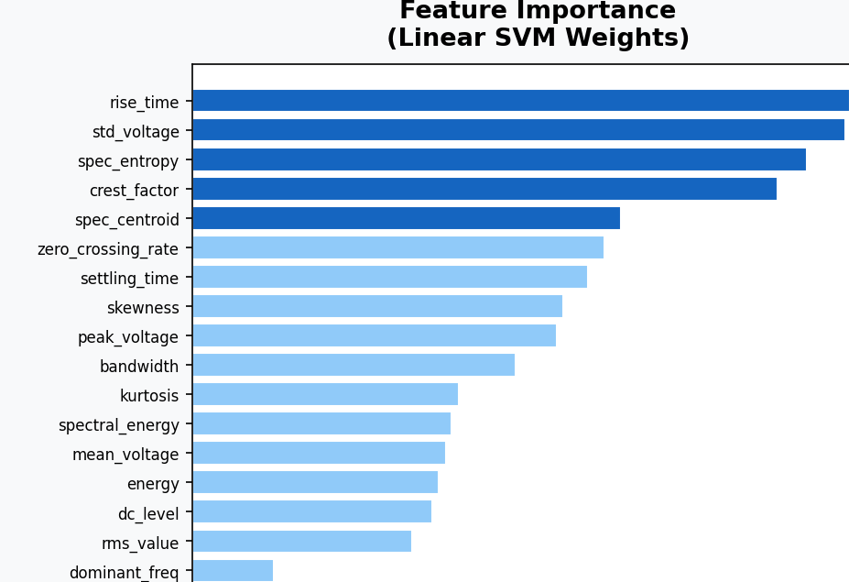
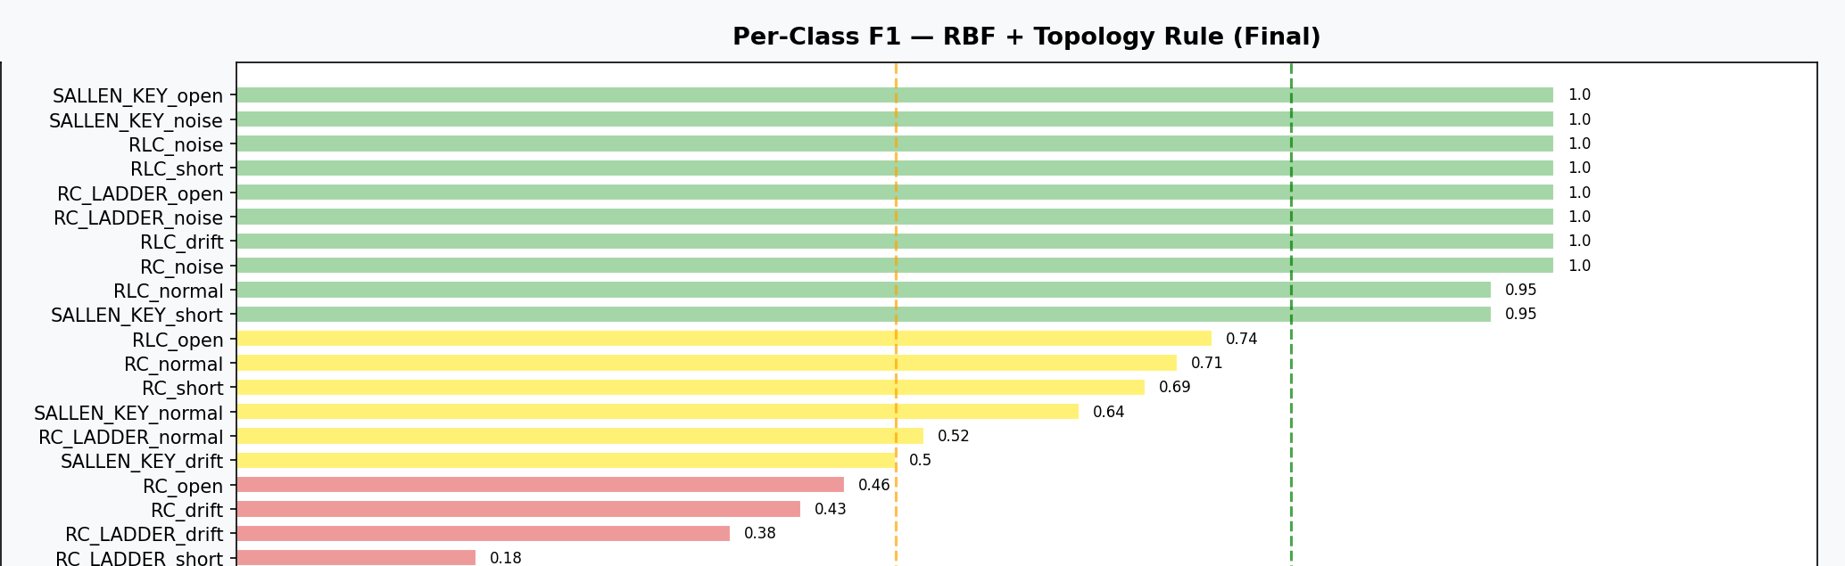
7. RESULTS & DEEP ANALYSIS
What the Model Weighs — and Where It Excels
rise_time and std_voltage carry the most weight in the linear model's decisions.
10 of 20 classes hit a perfect or near-perfect F1 score; RC/RC-Ladder faults trail behind.
KERNEL-BASED FAULT CLASSIFICATION IN ANALOG CIRCUITS
59

Slide 61
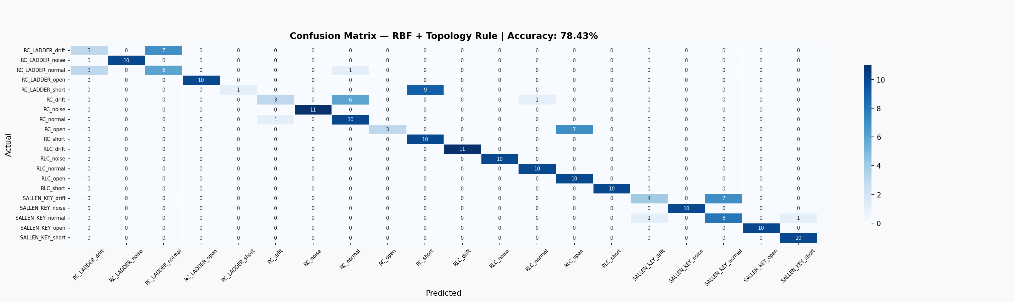
7. RESULTS & DEEP ANALYSIS
Every Prediction, At a Glance
KERNEL-BASED FAULT CLASSIFICATION IN ANALOG CIRCUITS
60

Slide 62

7. RESULTS & DEEP ANALYSIS
Confusion Matrix Deep Dive: Three Error Patterns
1. Drift blends into Normal
RC_drift -> RC_normal (6/10), RC_LADDER_drift -> RC_LADDER_normal (7/10), SALLEN_KEY_drift -> SALLEN_KEY_normal (7/11). Expected: drift is defined as a point on the same continuum as normal.
2. Same fault, wrong circuit (same family)
RC_LADDER_short -> RC_short (9/10). Two different passive RC-family circuits produce a nearly identical "instant charge to 5V" waveform when shorted — the model can tell the fault type but not reliably which circuit it's in.
3. A limit the topology rule can't reach
RC_open -> RLC_open (7/10) survives even after correction, because RLC_open is a valid label for an RLC sample — the rule can't know the true circuit is RC without being told, and both faults produce a similarly flat, non-charging output.
KERNEL-BASED FAULT CLASSIFICATION IN ANALOG CIRCUITS
61

Slide 63
7. RESULTS & DEEP ANALYSIS
Precision vs. Recall: What the Numbers Really Mean
RC_LADDER_short
Why this distinction matters
Precision = 1.000 Recall = 0.100
A single accuracy number (78.43%) hides this. F1 combines precision and recall into one score exactly so that a class like this — perfectly precise but rarely triggered — doesn't get miscounted as “working fine.” This is why the Results section leans on F1 and the confusion matrix, not accuracy alone.
Every time the model predicts RC_LADDER_short, it's right (precision = 1.0) — but it only catches 1 of every 10 true instances (recall = 0.1), missing the rest by calling them RC_short instead. The model isn't wrong so much as overly cautious about this specific label.
KERNEL-BASED FAULT CLASSIFICATION IN ANALOG CIRCUITS
62

Slide 64

8. KEY FINDING & LIMITS
When Higher Accuracy Is the Wrong Answer
91% -> 76%
reported accuracy, before vs. after removing synthetic data augmentation
An earlier version of this pipeline trained on Python-augmented synthetic data and reported 91% accuracy. Replacing it with pure physics-based LTspice sweep data — real simulation variation, no synthetic shortcuts — dropped accuracy to ~76%. The model hadn't learned circuit fault physics — it had learned to recognise the augmentation transform itself. The lower, honest number is the more trustworthy result.
KERNEL-BASED FAULT CLASSIFICATION IN ANALOG CIRCUITS
63

Slide 65


8. KEY FINDING & LIMITS
Where the Model Still Struggles
Small per-class test sets
Drift is the hardest fault everywhere
Only ~10 test samples per class — a couple of misses can swing an F1 score sharply (e.g. RC_LADDER_short F1 = 0.18).
Across every circuit, drift is the fault type most often confused with normal — it's inherently a point on a continuum, not a discrete change.
Limited topology scope
Simulation-only validation
Only 4 topologies and 5 fault types studied so far — real analog designs are far more diverse.
Entirely LTspice-based — no real hardware fault injection has been performed yet, so the simulation-to-reality gap is untested.
How uncertain is 78.43%, really? A 30-run replication (Results, Section 7) measured 80.5% ± 3.1 points across random splits, range 72.6%-84.8% — the reported 78.43% sits comfortably inside that spread, not cherry-picked.
KERNEL-BASED FAULT CLASSIFICATION IN ANALOG CIRCUITS
64

Slide 66
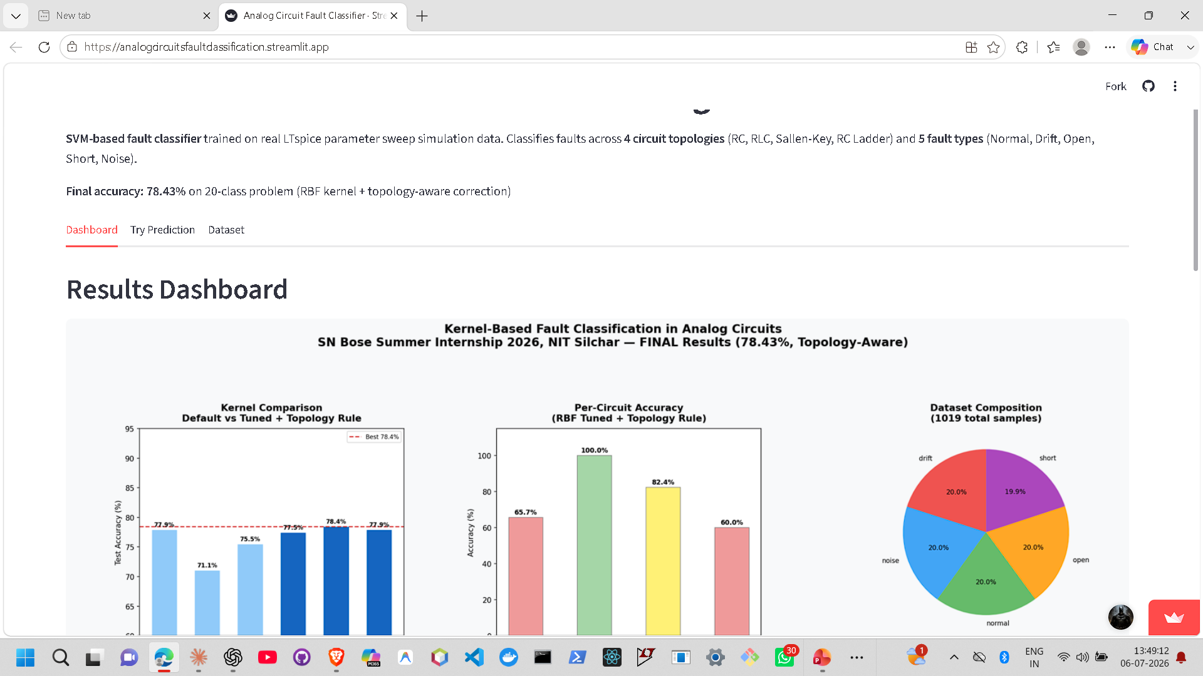

9. DEMO & CONCLUSION
Try It Yourself: Live Web App
Dashboard
All results — kernel comparison, per-circuit accuracy, confusion matrix — in one view.
APP SCREENSHOT
Try Prediction
e.g. screenshot of the Streamlit
dashboard / prediction tab
Pick a sample or enter feature values manually and get an instant fault classification with confidence scores.
Dataset
Browse all 1,019 samples and their 17 extracted features directly in the browser.
analogcircuitsfaultclassification.streamlit.app
KERNEL-BASED FAULT CLASSIFICATION IN ANALOG CIRCUITS
65

Slide 67


9. DEMO & CONCLUSION
Tech Stack & Tools
LTspice XVII
Python
pandas / NumPy
SciPy
Circuit simulation & parameter sweeps
The glue for the entire pipeline
Data wrangling & numeric computation
FFT, skewness/kurtosis, interpolation
scikit-learn
Matplotlib / Seaborn
Streamlit
Git
SVM, GridSearchCV, StandardScaler
Results dashboard & confusion matrix
The live interactive web app
Version control across the project
KERNEL-BASED FAULT CLASSIFICATION IN ANALOG CIRCUITS
66

Slide 68

9. DEMO & CONCLUSION
Conclusion & What's Next
What We Built
Where It Goes Next
A physics-grounded ML pipeline: LTspice sweeps -> 17 engineered features -> tuned SVM.
78.43% accuracy on a genuinely hard 20-class fault problem.
A novel topology-aware correction rule that adds real accuracy for free.
A live, interactive Streamlit demo anyone can try.
Collect more sweep samples per class to stabilise the weaker F1 scores.
Compare against a 1D-CNN trained directly on raw waveforms.
Validate against real hardware fault injection, not just simulation.
Extend to more topologies — Wien bridge, active high-pass, and beyond.
KERNEL-BASED FAULT CLASSIFICATION IN ANALOG CIRCUITS
67

Slide 69

Thank You
Questions & discussion welcome.
Karan Kaushik | B.Tech ECE, NIT Silchar Guided by Dr. Anish Kumar Saha SN Bose Summer Internship 2026, NIT Silchar
karankaushik01234@gmail.com
analogcircuitsfaultclassification.streamlit.app

Slide 70

CODE APPENDIX
Reference: The Project's Source Code
The following slides show the actual Python source files behind every step of this pipeline, presented in the same order the project was built — from raw LTspice parsing through to the deployed web app.
KERNEL-BASED FAULT CLASSIFICATION IN ANALOG CIRCUITS
68

Slide 71
CODE APPENDIX · STEP 1 OF 9
Parsing LTspice Sweeps into a Dataset (1/4)
day12_build_sweep_dataset.py — Reads exported .step sweep files, splits them into individual runs, resamples each to 200 points -> master_dataset_sweep.csv
# day12_build_sweep_dataset.py
# Rebuilds the master dataset from REAL LTspice parameter sweeps.
import os
import numpy as np
import pandas as pd
from scipy.interpolate import interp1d
# ---- Config -------------------------------------------------------
BASE = r"C:\Users\karan\Desktop\May-June_july\Final Sn Bose\Sweeps"
T_END = {"RC": 0.095, "RLC": 0.095, "RC_LADDER": 0.095, "SALLEN_KEY": 0.020}
N_PTS = 200
CIRCS = ["RC", "RLC", "SALLEN_KEY", "RC_LADDER"]
FAULTS = ["normal", "drift", "open", "short"]
# ---- File finder --------------------------------------------------
def find_sweep_file(folder, circuit, fault):
stems = [
f"{circuit.lower()}_{fault}_sweep",
f"{circuit}_{fault}_sweep",
f"Sallen_key_{fault}_sweep",
f"sallen_key_{fault}_sweep",
]
exts = [".txt", ""]
for s in stems:
for e in exts:
p = os.path.join(folder, s + e)
if os.path.isfile(p) and os.path.getsize(p) > 10_000:
return p
return None
KERNEL-BASED FAULT CLASSIFICATION IN ANALOG CIRCUITS
69

Slide 72
CODE APPENDIX · STEP 1 OF 9
Parsing LTspice Sweeps into a Dataset (2/4)
day12_build_sweep_dataset.py (continued)
# ---- Parser -------------------------------------------------------
def parse_step_file(fpath):
runs, cur_t, cur_v, cur_p, prev_t = [], [], [], None, None
def flush():
nonlocal cur_t, cur_v, cur_p
if len(cur_t) > 5:
runs.append((cur_p, np.array(cur_t, dtype=float),
np.array(cur_v, dtype=float)))
cur_t, cur_v = [], []
with open(fpath, "r", errors="ignore") as fh:
for raw in fh:
line = raw.strip()
if not line:
continue
lo = line.lower()
if lo.startswith("step information"):
flush()
try:
cur_p = float(line.split("=")[1].split()[0].rstrip(",)"))
except Exception:
cur_p = np.nan
prev_t = None
continue
if lo.startswith("time") or lo.startswith("step"):
continue
parts = line.replace("\t", " ").replace(",", " ").split()
if len(parts) < 2:
KERNEL-BASED FAULT CLASSIFICATION IN ANALOG CIRCUITS
70

Slide 73
CODE APPENDIX · STEP 1 OF 9
Parsing LTspice Sweeps into a Dataset (3/4)
day12_build_sweep_dataset.py (continued)
continue
try:
t, v = float(parts[0]), float(parts[1])
except ValueError:
continue
if prev_t is not None and t < prev_t - 1e-12:
flush()
cur_p = None
cur_t.append(t); cur_v.append(v); prev_t = t
flush()
return runs
# ---- Resample -----------------------------------------------------
def resample(t, v, t_end, n=N_PTS):
grid = np.linspace(0.0, t_end, n)
grid = np.clip(grid, t.min(), t.max())
return interp1d(t, v, kind="linear",
bounds_error=False,
fill_value=(v[0], v[-1]))(grid)
# ---- Build dataset ------------------------------------------------
rows, sid = [], 0
for circ in CIRCS:
cdir = os.path.join(BASE, circ)
for fault in FAULTS:
fpath = find_sweep_file(cdir, circ, fault)
if fpath is None:
print(f"[MISSING] {circ}/{fault} — no file found in {cdir}")
continue
KERNEL-BASED FAULT CLASSIFICATION IN ANALOG CIRCUITS
71

Slide 74
CODE APPENDIX · STEP 1 OF 9
Parsing LTspice Sweeps into a Dataset (4/4)
day12_build_sweep_dataset.py (continued)
print(f"[reading] {circ}/{fault}: {os.path.basename(fpath)}"
f" ({os.path.getsize(fpath)//1024} KB)")
runs = parse_step_file(fpath)
print(f" -> {len(runs)} runs parsed")
for pval, t, v in runs:
wave = resample(t, v, T_END[circ])
row = {"sample_id": sid, "circuit": circ,
"fault": fault, "param_value": pval}
row.update({f"v{i}": wave[i] for i in range(N_PTS)})
rows.append(row); sid += 1
df = pd.DataFrame(rows)
out = os.path.join(os.path.dirname(BASE), "master_dataset_sweep.csv")
df.to_csv(out, index=False)
print(f"\n{'='*50}")
print(f"Saved {len(df)} samples -> {out}")
print(f"Columns: {len(df.columns)}")
print(f"\nSamples per class:")
print(df.groupby(["circuit", "fault"]).size().to_string())
KERNEL-BASED FAULT CLASSIFICATION IN ANALOG CIRCUITS
72

Slide 75
CODE APPENDIX · STEP 2 OF 9
Generating Noise-Fault Samples (1/2)
day12b_generate_noise_samples.py — Adds seeded Gaussian noise (SNR = 25 dB) onto NORMAL waveforms to create the fifth fault class
# day12b_generate_noise_samples.py
# Generates noise-fault samples per circuit by injecting
# Gaussian noise onto the NORMAL sweep waveforms.
# Noise is physically justified: real circuit noise is stochastic,
# not a deterministic component shift.
import os
import numpy as np
import pandas as pd
# ---- Config -------------------------------------------------------
BASE = r"C:\Users\karan\Desktop\May-June_july\Final Sn Bose"
CSV_IN = os.path.join(BASE, "master_dataset_sweep.csv")
SNR_DB = 25
SEED = 42
CIRCUITS = ["RC", "RLC", "SALLEN_KEY", "RC_LADDER"]
N_PTS = 200
rng = np.random.default_rng(SEED)
# ---- Load existing dataset ----------------------------------------
df = pd.read_csv(CSV_IN)
wave_cols = [f"v{i}" for i in range(N_PTS)]
next_id = df["sample_id"].max() + 1
noise_rows = []
for circ in CIRCUITS:
normals = df[(df["circuit"] == circ) & (df["fault"] == "normal")]
n_noise = len(normals) # match exactly — 51 per circuit
KERNEL-BASED FAULT CLASSIFICATION IN ANALOG CIRCUITS
73

Slide 76
CODE APPENDIX · STEP 2 OF 9
Generating Noise-Fault Samples (2/2)
day12b_generate_noise_samples.py (continued)
normal_waves = normals[wave_cols].values
for i in range(n_noise):
base = normal_waves[i % len(normal_waves)]
sig_power = np.mean(base ** 2)
noise_power = sig_power / (10 ** (SNR_DB / 10))
noise_std = np.sqrt(noise_power)
noisy = base + rng.normal(0, noise_std, size=N_PTS)
row = {
"sample_id": next_id,
"circuit": circ,
"fault": "noise",
"param_value": SNR_DB
}
row.update({f"v{i}": noisy[i] for i in range(N_PTS)})
noise_rows.append(row)
next_id += 1
print(f"{circ}/noise: {n_noise} samples generated at {SNR_DB} dB SNR")
# ---- Append and save ----------------------------------------------
df_noise = pd.DataFrame(noise_rows)
df_final = pd.concat([df, df_noise], ignore_index=True)
out = os.path.join(BASE, "master_dataset_sweep.csv")
df_final.to_csv(out, index=False)
print(f"\nFinal dataset: {len(df_final)} samples")
print(df_final.groupby(["circuit", "fault"]).size().to_string())
KERNEL-BASED FAULT CLASSIFICATION IN ANALOG CIRCUITS
74

Slide 77
CODE APPENDIX · STEP 3 OF 9
Extracting 17 Features per Waveform (1/5)
day13_v2.py — Turns each 200-point waveform into the 17 time-, frequency-domain and structural features -> features_v2.csv
# day13_feature_extraction_v2.py
# Extracts 17 features (16 original + f17_dc_level) from every waveform.
# f17_dc_level = mean of last 20 points — directly separates RC_open (near 0V)
# from RC_short (near 5V), fixing the F1=0 failure identified in Day 16.
import os
import numpy as np
import pandas as pd
from scipy.stats import skew, kurtosis
from scipy.fft import rfft, rfftfreq
BASE = r"C:\Users\karan\Desktop\May-June_july\Final Sn Bose"
CSV_IN = os.path.join(BASE, "master_dataset_sweep.csv")
CSV_OUT = os.path.join(BASE, "features_v2.csv")
N_PTS = 200
T_END = {
"RC": 0.095,
"RLC": 0.095,
"RC_LADDER": 0.095,
"SALLEN_KEY": 0.020
}
def f1_peak_voltage(v): return float(np.max(v))
def f2_rms_value(v): return float(np.sqrt(np.mean(v**2)))
def f3_mean_voltage(v): return float(np.mean(v))
def f4_std_voltage(v): return float(np.std(v))
def f5_rise_time(t, v):
peak = np.max(v)
KERNEL-BASED FAULT CLASSIFICATION IN ANALOG CIRCUITS
75

Slide 78
CODE APPENDIX · STEP 3 OF 9
Extracting 17 Features per Waveform (2/5)
day13_v2.py (continued)
if peak < 1e-6: return float(t[-1])
idx_lo = np.argmax(v >= 0.1*peak)
idx_hi = np.argmax(v >= 0.9*peak)
if idx_hi <= idx_lo: return float(t[-1]-t[0])
return float(t[idx_hi]-t[idx_lo])
def f6_settling_time(t, v):
final = v[-1]
if abs(final) < 1e-6: return float(t[-1])
outside = np.where(np.abs(v-final) > 0.02*abs(final))[0]
if len(outside)==0: return float(t[0])
return float(t[outside[-1]])
def f7_skewness(v): return float(skew(v))
def f8_kurtosis(v): return float(kurtosis(v))
def f9_dominant_freq(v, t_end, n):
dt=t_end/(n-1); freq=rfftfreq(n,d=dt); mag=np.abs(rfft(v))
mask=(freq>=50)&(freq<=2000)
if not np.any(mask): return float(freq[np.argmax(mag)])
return float(freq[mask][np.argmax(mag[mask])])
def f10_spectral_energy(v, t_end, n):
mag=np.abs(rfft(v)); return float(np.sum(mag**2))
def f11_spectral_centroid(v, t_end, n):
dt=t_end/(n-1); freq=rfftfreq(n,d=dt); mag=np.abs(rfft(v))
denom=np.sum(mag)
if denom<1e-12: return 0.0
return float(np.sum(freq*mag)/denom)
KERNEL-BASED FAULT CLASSIFICATION IN ANALOG CIRCUITS
76

Slide 79
CODE APPENDIX · STEP 3 OF 9
Extracting 17 Features per Waveform (3/5)
day13_v2.py (continued)
def f12_bandwidth(v, t_end, n):
dt=t_end/(n-1); freq=rfftfreq(n,d=dt); mag=np.abs(rfft(v))
denom=np.sum(mag)
if denom<1e-12: return 0.0
c=np.sum(freq*mag)/denom
return float(np.sqrt(np.sum(((freq-c)**2)*mag)/denom))
def f13_spectral_entropy(v, t_end, n):
mag=np.abs(rfft(v))**2; total=np.sum(mag)
if total<1e-12: return 0.0
p=mag/total; p=p[p>0]
return float(-np.sum(p*np.log2(p)))
def f14_energy(v): return float(np.sum(v**2))
def f15_zero_crossing_rate(v):
return float(np.sum(np.diff(np.sign(v-np.mean(v)))!=0)/len(v))
def f16_crest_factor(v):
rms=np.sqrt(np.mean(v**2))
if rms<1e-12: return 0.0
return float(np.max(np.abs(v))/rms)
def f17_dc_level(v):
# Mean of last 20 points = steady-state DC level.
# RC_open: near 0V (capacitor never charges in 95ms window)
# RC_short: near 5V (capacitor charges instantly)
# This directly separates the two previously confused classes.
return float(np.mean(v[-20:]))
KERNEL-BASED FAULT CLASSIFICATION IN ANALOG CIRCUITS
77

Slide 80
CODE APPENDIX · STEP 3 OF 9
Extracting 17 Features per Waveform (4/5)
day13_v2.py (continued)
df_raw = pd.read_csv(CSV_IN)
wave_cols = [f"v{i}" for i in range(N_PTS)]
records = []
for idx, row in df_raw.iterrows():
circ = row["circuit"]
t_end = T_END[circ]
v = row[wave_cols].values.astype(float)
t = np.linspace(0.0, t_end, N_PTS)
rec = {
"sample_id": int(row["sample_id"]),
"circuit": circ,
"fault": row["fault"],
"f1": f1_peak_voltage(v),
"f2": f2_rms_value(v),
"f3": f3_mean_voltage(v),
"f4": f4_std_voltage(v),
"f5": f5_rise_time(t,v),
"f6": f6_settling_time(t,v),
"f7": f7_skewness(v),
"f8": f8_kurtosis(v),
"f9": f9_dominant_freq(v,t_end,N_PTS),
"f10": f10_spectral_energy(v,t_end,N_PTS),
"f11": f11_spectral_centroid(v,t_end,N_PTS),
"f12": f12_bandwidth(v,t_end,N_PTS),
"f13": f13_spectral_entropy(v,t_end,N_PTS),
"f14": f14_energy(v),
"f15": f15_zero_crossing_rate(v),
"f16": f16_crest_factor(v),
KERNEL-BASED FAULT CLASSIFICATION IN ANALOG CIRCUITS
78

Slide 81
CODE APPENDIX · STEP 3 OF 9
Extracting 17 Features per Waveform (5/5)
day13_v2.py (continued)
"f17": f17_dc_level(v), } records.append(rec) if (idx+1)%100==0: print(f" processed {idx+1}/{len(df_raw)}...") df_feat = pd.DataFrame(records) df_feat.to_csv(CSV_OUT, index=False) print(f"\nSaved {len(df_feat)} rows -> {CSV_OUT}") print(f"Columns: {len(df_feat.columns)} (sample_id + circuit + fault + f1-f17)") # Quick diagnosis: RC_open vs RC_short on f17 rc_open = df_feat[(df_feat["circuit"]=="RC")&(df_feat["fault"]=="open")]["f17"].mean() rc_short = df_feat[(df_feat["circuit"]=="RC")&(df_feat["fault"]=="short")]["f17"].mean() print(f"\nf17 diagnosis:") print(f" RC_open mean dc_level = {rc_open:.4f} V") print(f" RC_short mean dc_level = {rc_short:.4f} V") print(f" Separation gap = {abs(rc_open-rc_short):.4f} V") print(f" Separable: {'YES' if abs(rc_open-rc_short) > 1.0 else 'MARGINAL'}")
KERNEL-BASED FAULT CLASSIFICATION IN ANALOG CIRCUITS
79

Slide 82
CODE APPENDIX · STEP 4 OF 9
Baseline SVM Training (Default Hyperparameters) (1/4)
day14_svm_baseline.py — Trains Linear / RBF / Polynomial kernels with near-default settings — the Section 5 baseline numbers come from here
# day14_svm_baseline.py
# Honest SVM baseline on real LTspice sweep features.
# Trains Linear, RBF, and Polynomial SVMs on features.csv
# and reports per-class and overall performance.
import os
import numpy as np
import pandas as pd
from sklearn.svm import SVC
from sklearn.preprocessing import StandardScaler, LabelEncoder
from sklearn.model_selection import train_test_split, cross_val_score
from sklearn.metrics import (accuracy_score, classification_report,
confusion_matrix)
import warnings
warnings.filterwarnings("ignore")
# ---- Config -------------------------------------------------------
BASE = r"C:\Users\karan\Desktop\May-June_july\Final Sn Bose"
CSV_IN = os.path.join(BASE, "features.csv")
OUT_FILE = os.path.join(BASE, "day14_results.txt")
FEATURE_COLS = [f"f{i}" for i in range(1, 17)]
RANDOM_STATE = 42
TEST_SIZE = 0.20
# ---- Load data ----------------------------------------------------
df = pd.read_csv(CSV_IN)
print(f"Loaded {len(df)} samples, {len(FEATURE_COLS)} features")
print(f"Classes: {sorted(df['fault'].unique())}")
print(f"Circuits: {sorted(df['circuit'].unique())}\n")
KERNEL-BASED FAULT CLASSIFICATION IN ANALOG CIRCUITS
80

Slide 83
CODE APPENDIX · STEP 4 OF 9
Baseline SVM Training (Default Hyperparameters) (2/4)
day14_svm_baseline.py (continued)
# Create combined label: circuit_fault (20 classes)
df["label"] = df["circuit"] + "_" + df["fault"]
print(f"Total unique labels: {df['label'].nunique()}")
print(df.groupby("label").size().to_string())
print()
# ---- Encode and split ---------------------------------------------
le = LabelEncoder()
y = le.fit_transform(df["label"])
X = df[FEATURE_COLS].values
X_train, X_test, y_train, y_test = train_test_split(
X, y, test_size=TEST_SIZE, random_state=RANDOM_STATE, stratify=y
)
print(f"Train: {len(X_train)} samples | Test: {len(X_test)} samples\n")
# ---- Scale --------------------------------------------------------
scaler = StandardScaler()
X_train = scaler.fit_transform(X_train)
X_test = scaler.transform(X_test)
# ---- Define three kernels -----------------------------------------
kernels = {
"Linear": SVC(kernel="linear", C=1.0,
random_state=RANDOM_STATE, decision_function_shape="ovo"),
"RBF": SVC(kernel="rbf", C=1.0, gamma="scale",
random_state=RANDOM_STATE, decision_function_shape="ovo"),
"Polynomial": SVC(kernel="poly", C=1.0, gamma="scale", degree=3, coef0=1,
random_state=RANDOM_STATE, decision_function_shape="ovo"),
KERNEL-BASED FAULT CLASSIFICATION IN ANALOG CIRCUITS
81

Slide 84
CODE APPENDIX · STEP 4 OF 9
Baseline SVM Training (Default Hyperparameters) (3/4)
day14_svm_baseline.py (continued)
} # ---- Train, evaluate, report -------------------------------------- results = {} output_lines = [] def log(line=""): print(line) output_lines.append(line) log("=" * 60) log("DAY 14 — SVM BASELINE ON REAL SWEPT DATA") log("=" * 60) log(f"Dataset : {len(df)} samples | {len(FEATURE_COLS)} features | 20 classes") log(f"Split : {int((1-TEST_SIZE)*100)}% train / {int(TEST_SIZE*100)}% test | stratified") log(f"Scaling : StandardScaler (zero mean, unit variance)") log() for name, clf in kernels.items(): log(f"{'─'*60}") log(f"KERNEL: {name}") log(f"{'─'*60}") # Train clf.fit(X_train, y_train) # Test accuracy y_pred = clf.predict(X_test) test_acc = accuracy_score(y_test, y_pred)
KERNEL-BASED FAULT CLASSIFICATION IN ANALOG CIRCUITS
82

Slide 85
CODE APPENDIX · STEP 4 OF 9
Baseline SVM Training (Default Hyperparameters) (4/4)
day14_svm_baseline.py (continued)
# 5-fold cross-validation on full dataset cv_scores = cross_val_score(clf, X_train, y_train, cv=5, scoring="accuracy") log(f"Test Accuracy : {test_acc*100:.2f}%") log(f"CV Accuracy : {cv_scores.mean()*100:.2f}% ± {cv_scores.std()*100:.2f}%") log() # Per-class report report = classification_report( y_test, y_pred, target_names=le.classes_, digits=3 ) log("Classification Report:") log(report)
KERNEL-BASED FAULT CLASSIFICATION IN ANALOG CIRCUITS
83

Slide 86
CODE APPENDIX · STEP 5 OF 9
Hyperparameter Tuning with GridSearchCV (1/8)
day15_gridsearch.py — Exhaustive grid search over C, gamma and degree for each kernel, scored with 5-fold cross-validation
# day15_gridsearch.py
# GridSearchCV hyperparameter tuning for Linear, RBF, and Polynomial SVMs.
# Finds optimal C, gamma, degree for each kernel.
# Test set never touched during search — only used for final evaluation.
import os
import numpy as np
import pandas as pd
from sklearn.svm import SVC
from sklearn.preprocessing import StandardScaler, LabelEncoder
from sklearn.model_selection import train_test_split, GridSearchCV
from sklearn.metrics import accuracy_score, classification_report
import warnings
warnings.filterwarnings("ignore")
# ---- Config -------------------------------------------------------
BASE = r"C:\Users\karan\Desktop\May-June_july\Final Sn Bose"
CSV_IN = os.path.join(BASE, "features.csv")
OUT_FILE = os.path.join(BASE, "day15_results.txt")
FEATURE_COLS = [f"f{i}" for i in range(1, 17)]
RANDOM_STATE = 42
TEST_SIZE = 0.20
CV_FOLDS = 5
# Day 14 baseline for comparison
DAY14 = {"Linear": 76.47, "RBF": 70.59, "Polynomial": 74.02}
# ---- Search grids -------------------------------------------------
# Wide log-scale search for C and gamma
KERNEL-BASED FAULT CLASSIFICATION IN ANALOG CIRCUITS
84

Slide 87
CODE APPENDIX · STEP 5 OF 9
Hyperparameter Tuning with GridSearchCV (2/8)
day15_gridsearch.py (continued)
PARAM_GRIDS = {
"Linear": {
"C": [0.001, 0.01, 0.1, 1, 10, 100, 1000]
},
"RBF": {
"C": [0.1, 1, 10, 100, 1000],
"gamma": [0.0001, 0.001, 0.01, 0.1, 1, 10]
},
"Polynomial": {
"C": [0.1, 1, 10, 100],
"gamma": [0.001, 0.01, 0.1],
"degree": [2, 3],
"coef0": [1]
}
}
# ---- Load and prepare ---------------------------------------------
df = pd.read_csv(CSV_IN)
df["label"] = df["circuit"] + "_" + df["fault"]
le = LabelEncoder()
y = le.fit_transform(df["label"])
X = df[FEATURE_COLS].values
X_train, X_test, y_train, y_test = train_test_split(
X, y, test_size=TEST_SIZE, random_state=RANDOM_STATE, stratify=y
)
scaler = StandardScaler()
X_train = scaler.fit_transform(X_train)
KERNEL-BASED FAULT CLASSIFICATION IN ANALOG CIRCUITS
85

Slide 88
CODE APPENDIX · STEP 5 OF 9
Hyperparameter Tuning with GridSearchCV (3/8)
day15_gridsearch.py (continued)
X_test = scaler.transform(X_test)
print(f"Train: {len(X_train)} | Test: {len(X_test)}")
print(f"Search grids:")
for k, g in PARAM_GRIDS.items():
n = 1
for v in g.values(): n *= len(v)
print(f" {k}: {n} combinations × {CV_FOLDS} folds = {n*CV_FOLDS} fits")
print()
# ---- Run GridSearchCV ---------------------------------------------
output_lines = []
def log(line=""):
print(line)
output_lines.append(line)
log("=" * 60)
log("DAY 15 — GRIDSEARCHCV HYPERPARAMETER TUNING")
log("=" * 60)
log(f"Dataset : 1019 samples | 16 features | 20 classes")
log(f"Split : 80/20 stratified | CV folds: {CV_FOLDS}")
log()
tuned_results = {}
# Linear
log("─" * 60)
log("KERNEL: Linear")
log("─" * 60)
KERNEL-BASED FAULT CLASSIFICATION IN ANALOG CIRCUITS
86

Slide 89
CODE APPENDIX · STEP 5 OF 9
Hyperparameter Tuning with GridSearchCV (4/8)
day15_gridsearch.py (continued)
log(f"Search grid: C = {PARAM_GRIDS['Linear']['C']}")
gs_linear = GridSearchCV(
SVC(kernel="linear", decision_function_shape="ovo",
random_state=RANDOM_STATE),
param_grid={"C": PARAM_GRIDS["Linear"]["C"]},
cv=CV_FOLDS, scoring="accuracy", n_jobs=-1, verbose=1
)
gs_linear.fit(X_train, y_train)
best_linear = gs_linear.best_estimator_
y_pred = best_linear.predict(X_test)
test_acc = accuracy_score(y_test, y_pred)
log(f"Best params : C = {gs_linear.best_params_['C']}")
log(f"Best CV acc : {gs_linear.best_score_*100:.2f}%")
log(f"Test acc : {test_acc*100:.2f}% (Day14 default: {DAY14['Linear']}%)")
log(f"Improvement : {(test_acc*100 - DAY14['Linear']):+.2f}%")
log()
log("Classification Report:")
log(classification_report(y_test, y_pred,
target_names=le.classes_, digits=3))
tuned_results["Linear"] = {
"best_params": gs_linear.best_params_,
"best_cv": gs_linear.best_score_,
"test_acc": test_acc,
"report": classification_report(y_test, y_pred,
target_names=le.classes_, digits=3)
}
# RBF
log("─" * 60)
KERNEL-BASED FAULT CLASSIFICATION IN ANALOG CIRCUITS
87

Slide 90
CODE APPENDIX · STEP 5 OF 9
Hyperparameter Tuning with GridSearchCV (5/8)
day15_gridsearch.py (continued)
log("KERNEL: RBF")
log("─" * 60)
log(f"Search grid: C = {PARAM_GRIDS['RBF']['C']}, "
f"gamma = {PARAM_GRIDS['RBF']['gamma']}")
gs_rbf = GridSearchCV(
SVC(kernel="rbf", decision_function_shape="ovo",
random_state=RANDOM_STATE),
param_grid={"C": PARAM_GRIDS["RBF"]["C"],
"gamma": PARAM_GRIDS["RBF"]["gamma"]},
cv=CV_FOLDS, scoring="accuracy", n_jobs=-1, verbose=1
)
gs_rbf.fit(X_train, y_train)
best_rbf = gs_rbf.best_estimator_
y_pred = best_rbf.predict(X_test)
test_acc = accuracy_score(y_test, y_pred)
log(f"Best params : C = {gs_rbf.best_params_['C']}, "
f"gamma = {gs_rbf.best_params_['gamma']}")
log(f"Best CV acc : {gs_rbf.best_score_*100:.2f}%")
log(f"Test acc : {test_acc*100:.2f}% (Day14 default: {DAY14['RBF']}%)")
log(f"Improvement : {(test_acc*100 - DAY14['RBF']):+.2f}%")
log()
log("Classification Report:")
log(classification_report(y_test, y_pred,
target_names=le.classes_, digits=3))
tuned_results["RBF"] = {
"best_params": gs_rbf.best_params_,
"best_cv": gs_rbf.best_score_,
"test_acc": test_acc,
"report": classification_report(y_test, y_pred,
KERNEL-BASED FAULT CLASSIFICATION IN ANALOG CIRCUITS
88

Slide 91
CODE APPENDIX · STEP 5 OF 9
Hyperparameter Tuning with GridSearchCV (6/8)
day15_gridsearch.py (continued)
target_names=le.classes_, digits=3)
}
# Polynomial
log("─" * 60)
log("KERNEL: Polynomial")
log("─" * 60)
log(f"Search grid: C={PARAM_GRIDS['Polynomial']['C']}, "
f"gamma={PARAM_GRIDS['Polynomial']['gamma']}, "
f"degree={PARAM_GRIDS['Polynomial']['degree']}")
gs_poly = GridSearchCV(
SVC(kernel="poly", decision_function_shape="ovo",
random_state=RANDOM_STATE),
param_grid={"C": PARAM_GRIDS["Polynomial"]["C"],
"gamma": PARAM_GRIDS["Polynomial"]["gamma"],
"degree": PARAM_GRIDS["Polynomial"]["degree"],
"coef0": PARAM_GRIDS["Polynomial"]["coef0"]},
cv=CV_FOLDS, scoring="accuracy", n_jobs=-1, verbose=1
)
gs_poly.fit(X_train, y_train)
best_poly = gs_poly.best_estimator_
y_pred = best_poly.predict(X_test)
test_acc = accuracy_score(y_test, y_pred)
log(f"Best params : C={gs_poly.best_params_['C']}, "
f"gamma={gs_poly.best_params_['gamma']}, "
f"degree={gs_poly.best_params_['degree']}, "
f"coef0={gs_poly.best_params_['coef0']}")
log(f"Best CV acc : {gs_poly.best_score_*100:.2f}%")
log(f"Test acc : {test_acc*100:.2f}% (Day14 default: {DAY14['Polynomial']}%)")
KERNEL-BASED FAULT CLASSIFICATION IN ANALOG CIRCUITS
89

Slide 92
CODE APPENDIX · STEP 5 OF 9
Hyperparameter Tuning with GridSearchCV (7/8)
day15_gridsearch.py (continued)
log(f"Improvement : {(test_acc*100 - DAY14['Polynomial']):+.2f}%")
log()
log("Classification Report:")
log(classification_report(y_test, y_pred,
target_names=le.classes_, digits=3))
tuned_results["Polynomial"] = {
"best_params": gs_poly.best_params_,
"best_cv": gs_poly.best_score_,
"test_acc": test_acc,
"report": classification_report(y_test, y_pred,
target_names=le.classes_, digits=3)
}
# ---- Final summary ------------------------------------------------
log("=" * 60)
log("FINAL SUMMARY — DEFAULT vs TUNED")
log("=" * 60)
log(f"{'Kernel':<14} {'Default':>10} {'Tuned':>10} {'Gain':>10} {'Best Params'}")
log(f"{'─'*14} {'─'*10} {'─'*10} {'─'*10} {'─'*30}")
for name, r in tuned_results.items():
gain = r['test_acc']*100 - DAY14[name]
params_str = ", ".join(f"{k}={v}" for k,v in r['best_params'].items())
log(f"{name:<14} {DAY14[name]:>9.2f}% "
f"{r['test_acc']*100:>9.2f}% "
f"{gain:>+9.2f}% "
f"{params_str}")
log()
best_kernel = max(tuned_results, key=lambda k: tuned_results[k]['test_acc'])
log(f"Best overall kernel (tuned): {best_kernel} at "
KERNEL-BASED FAULT CLASSIFICATION IN ANALOG CIRCUITS
90

Slide 93
CODE APPENDIX · STEP 5 OF 9
Hyperparameter Tuning with GridSearchCV (8/8)
day15_gridsearch.py (continued)
f"{tuned_results[best_kernel]['test_acc']*100:.2f}%") # ---- Save --------------------------------------------------------- with open(OUT_FILE, "w", encoding="utf-8") as f: f.write("\n".join(output_lines)) print(f"\nResults saved -> {OUT_FILE}")
KERNEL-BASED FAULT CLASSIFICATION IN ANALOG CIRCUITS
91

Slide 94
CODE APPENDIX · STEP 6 OF 9
Confusion Matrix & Diagnostic Analysis (1/7)
day16_confusion_analysis.py — Generates the confusion matrix, per-class F1 chart, and the RC_open vs. RC_short / Normal vs. Drift feature diagnosis
# day16_confusion_analysis.py
# Full confusion matrix analysis and error diagnosis
# using the best model from Day 15: RBF C=100, gamma=0.1
import os
import numpy as np
import pandas as pd
import matplotlib
matplotlib.use('Agg') # non-interactive backend for saving
import matplotlib.pyplot as plt
import seaborn as sns
from sklearn.svm import SVC
from sklearn.preprocessing import StandardScaler, LabelEncoder
from sklearn.model_selection import train_test_split
from sklearn.metrics import (accuracy_score, classification_report,
confusion_matrix, f1_score)
import warnings
warnings.filterwarnings("ignore")
# ---- Config -------------------------------------------------------
BASE = r"C:\Users\karan\Desktop\May-June_july\Final Sn Bose"
CSV_IN = os.path.join(BASE, "features.csv")
OUT_DIR = os.path.join(BASE, "Day16_Analysis")
os.makedirs(OUT_DIR, exist_ok=True)
FEATURE_COLS = [f"f{i}" for i in range(1, 17)]
RANDOM_STATE = 42
TEST_SIZE = 0.20
# ---- Load and prepare ---------------------------------------------
KERNEL-BASED FAULT CLASSIFICATION IN ANALOG CIRCUITS
92

Slide 95
CODE APPENDIX · STEP 6 OF 9
Confusion Matrix & Diagnostic Analysis (2/7)
day16_confusion_analysis.py (continued)
df = pd.read_csv(CSV_IN)
df["label"] = df["circuit"] + "_" + df["fault"]
le = LabelEncoder()
y = le.fit_transform(df["label"])
X = df[FEATURE_COLS].values
X_train, X_test, y_train, y_test = train_test_split(
X, y, test_size=TEST_SIZE, random_state=RANDOM_STATE, stratify=y
)
scaler = StandardScaler()
X_train = scaler.fit_transform(X_train)
X_test = scaler.transform(X_test)
# ---- Train best model (RBF tuned) ---------------------------------
print("Training best model: RBF C=100, gamma=0.1 ...")
clf = SVC(kernel="rbf", C=100, gamma=0.1,
decision_function_shape="ovo", random_state=RANDOM_STATE)
clf.fit(X_train, y_train)
y_pred = clf.predict(X_test)
test_acc = accuracy_score(y_test, y_pred)
print(f"Test accuracy: {test_acc*100:.2f}%\n")
# ---- 1. Full 20x20 Confusion Matrix heatmap -----------------------
print("Generating confusion matrix heatmap...")
cm = confusion_matrix(y_test, y_pred)
labels = le.classes_
fig, ax = plt.subplots(figsize=(18, 15))
KERNEL-BASED FAULT CLASSIFICATION IN ANALOG CIRCUITS
93

Slide 96
CODE APPENDIX · STEP 6 OF 9
Confusion Matrix & Diagnostic Analysis (3/7)
day16_confusion_analysis.py (continued)
sns.heatmap(cm, annot=True, fmt='d', cmap='Blues',
xticklabels=labels, yticklabels=labels,
linewidths=0.5, ax=ax)
ax.set_xlabel("Predicted Label", fontsize=12)
ax.set_ylabel("True Label", fontsize=12)
ax.set_title(f"Confusion Matrix — RBF SVM (C=100, γ=0.1)\nTest Accuracy: {test_acc*100:.2f}%",
fontsize=14)
plt.xticks(rotation=45, ha='right', fontsize=8)
plt.yticks(rotation=0, fontsize=8)
plt.tight_layout()
path1 = os.path.join(OUT_DIR, "confusion_matrix.png")
plt.savefig(path1, dpi=150, bbox_inches='tight')
plt.close()
print(f"Saved: {path1}")
# ---- 2. Per-class F1 bar chart ------------------------------------
print("Generating per-class F1 chart...")
f1_scores = f1_score(y_test, y_pred, average=None)
f1_df = pd.DataFrame({"class": labels, "f1": f1_scores})
f1_df = f1_df.sort_values("f1", ascending=True)
colors = ["#d32f2f" if f < 0.5 else "#f57c00" if f < 0.8
else "#388e3c" for f in f1_df["f1"]]
fig, ax = plt.subplots(figsize=(12, 8))
bars = ax.barh(f1_df["class"], f1_df["f1"], color=colors)
ax.axvline(x=0.5, color='red', linestyle='--', alpha=0.5, label='F1=0.5 threshold')
ax.axvline(x=0.8, color='orange', linestyle='--', alpha=0.5, label='F1=0.8 threshold')
for bar, val in zip(bars, f1_df["f1"]):
ax.text(bar.get_width() + 0.01, bar.get_y() + bar.get_height()/2,
KERNEL-BASED FAULT CLASSIFICATION IN ANALOG CIRCUITS
94

Slide 97
CODE APPENDIX · STEP 6 OF 9
Confusion Matrix & Diagnostic Analysis (4/7)
day16_confusion_analysis.py (continued)
f'{val:.3f}', va='center', fontsize=9)
ax.set_xlabel("F1 Score", fontsize=12)
ax.set_title("Per-Class F1 Score — RBF SVM (C=100, γ=0.1)", fontsize=14)
ax.set_xlim(0, 1.15)
ax.legend(fontsize=10)
plt.tight_layout()
path2 = os.path.join(OUT_DIR, "f1_per_class.png")
plt.savefig(path2, dpi=150, bbox_inches='tight')
plt.close()
print(f"Saved: {path2}")
# ---- 3. Top confused pairs ----------------------------------------
print("\nTop 10 most confused class pairs:")
print(f"{'Actual':<25} {'Predicted':<25} {'Count':>6}")
print("-" * 58)
confused = []
for i in range(len(labels)):
for j in range(len(labels)):
if i != j and cm[i, j] > 0:
confused.append((labels[i], labels[j], cm[i, j]))
confused.sort(key=lambda x: -x[2])
for actual, predicted, count in confused[:10]:
print(f"{actual:<25} {predicted:<25} {count:>6}")
# ---- 4. Per-circuit accuracy breakdown ----------------------------
print("\nPer-circuit accuracy:")
print(f"{'Circuit':<15} {'Accuracy':>10} {'Correct':>8} {'Total':>8}")
print("-" * 45)
# Map test indices back to circuit labels
KERNEL-BASED FAULT CLASSIFICATION IN ANALOG CIRCUITS
95

Slide 98
CODE APPENDIX · STEP 6 OF 9
Confusion Matrix & Diagnostic Analysis (5/7)
day16_confusion_analysis.py (continued)
df_test = df.iloc[
pd.Series(range(len(df))).sample(frac=TEST_SIZE,
random_state=RANDOM_STATE).sort_values().index
]
circuits = ["RC", "RLC", "SALLEN_KEY", "RC_LADDER"]
y_test_labels = le.inverse_transform(y_test)
y_pred_labels = le.inverse_transform(y_pred)
for circ in circuits:
mask = np.array([circ + "_" in l for l in y_test_labels])
if mask.sum() == 0:
continue
correct = np.sum(y_test_labels[mask] == y_pred_labels[mask])
total = mask.sum()
acc = correct / total * 100
print(f"{circ:<15} {acc:>9.2f}% {correct:>8} {total:>8}")
# ---- 5. RC_open diagnosis -----------------------------------------
print("\n--- RC_open vs RC_short Feature Diagnosis ---")
rc_open = df[(df["circuit"]=="RC") & (df["fault"]=="open")]
rc_short = df[(df["circuit"]=="RC") & (df["fault"]=="short")]
key_features = ["f1", "f2", "f3", "f4", "f5", "f14"]
feat_names = {
"f1": "peak_voltage", "f2": "rms_value",
"f3": "mean_voltage", "f4": "std_voltage",
"f5": "rise_time", "f14": "energy"
}
print(f"\n{'Feature':<12} {'RC_open mean':>14} {'RC_short mean':>14} {'Separable?':>12}")
KERNEL-BASED FAULT CLASSIFICATION IN ANALOG CIRCUITS
96

Slide 99
CODE APPENDIX · STEP 6 OF 9
Confusion Matrix & Diagnostic Analysis (6/7)
day16_confusion_analysis.py (continued)
print("-" * 55)
for f in key_features:
o_mean = rc_open[f].mean()
s_mean = rc_short[f].mean()
gap = abs(o_mean - s_mean)
sep = "YES" if gap > 0.5 else "MARGINAL" if gap > 0.1 else "NO"
print(f"{feat_names[f]:<12} {o_mean:>14.4f} {s_mean:>14.4f} {sep:>12}")
# ---- 6. Normal vs Drift diagnosis ---------------------------------
print("\n--- Normal vs Drift Feature Diagnosis (all circuits) ---")
normal = df[df["fault"]=="normal"]
drift = df[df["fault"]=="drift"]
print(f"\n{'Feature':<12} {'Normal mean':>13} {'Drift mean':>13} {'Separable?':>12}")
print("-" * 52)
for f in ["f1","f2","f3","f5","f6","f9","f13"]:
n_mean = normal[f].mean()
d_mean = drift[f].mean()
gap = abs(n_mean - d_mean)
sep = "YES" if gap > 0.5 else "MARGINAL" if gap > 0.1 else "NO"
print(f"{f:<12} {n_mean:>13.4f} {d_mean:>13.4f} {sep:>12}")
# ---- 7. Summary report --------------------------------------------
report = classification_report(y_test, y_pred,
target_names=labels, digits=3)
print(f"\nFull Classification Report:\n{report}")
summary = f"""
DAY 16 ANALYSIS SUMMARY
========================
Best Model : RBF SVM, C=100, gamma=0.1
KERNEL-BASED FAULT CLASSIFICATION IN ANALOG CIRCUITS
97

Slide 100
CODE APPENDIX · STEP 6 OF 9
Confusion Matrix & Diagnostic Analysis (7/7)
day16_confusion_analysis.py (continued)
Test Accuracy : {test_acc*100:.2f}%
Perfect classes (F1=1.0):
{', '.join([labels[i] for i,f in enumerate(f1_scores) if f==1.0])}
Failed classes (F1=0):
{', '.join([labels[i] for i,f in enumerate(f1_scores) if f==0.0])}
Weak classes (F1 < 0.5):
{', '.join([labels[i] for i,f in enumerate(f1_scores) if 0 < f < 0.5])}
"""
print(summary)
out_txt = os.path.join(OUT_DIR, "day16_summary.txt")
with open(out_txt, "w", encoding="utf-8") as f:
f.write(summary)
f.write("\nFull Classification Report:\n")
f.write(report)
f.write("\n\nTop Confused Pairs:\n")
for actual, predicted, count in confused[:10]:
f.write(f"{actual} -> {predicted}: {count}\n")
print(f"\nAll outputs saved to: {OUT_DIR}")
print("Files: confusion_matrix.png, f1_per_class.png, day16_summary.txt")
KERNEL-BASED FAULT CLASSIFICATION IN ANALOG CIRCUITS
98

Slide 101
CODE APPENDIX · STEP 7 OF 9
Training & Saving the Final Deployment Model (1/2)
save_model.py — Fits the final tuned RBF model on features_v2.csv and serializes model.pkl / scaler.pkl / label_encoder.pkl
# save_model.py
# Trains the final RBF model with topology rule and saves it
# as .pkl files for deployment in the Streamlit app.
import os, warnings
warnings.filterwarnings('ignore')
import numpy as np, pandas as pd
import joblib
from sklearn.svm import SVC
from sklearn.preprocessing import StandardScaler, LabelEncoder
from sklearn.model_selection import train_test_split
BASE = r"C:\Users\karan\Desktop\May-June_july\Final Sn Bose"
FEATURE_COLS = [f"f{i}" for i in range(1, 18)]
# Load data
df = pd.read_csv(os.path.join(BASE, "features_v2.csv"))
df["label"] = df["circuit"] + "_" + df["fault"]
# Encode labels
le = LabelEncoder()
y = le.fit_transform(df["label"])
X = df[FEATURE_COLS].values
# Split (same random_state as before for consistency)
X_train, X_test, y_train, y_test = train_test_split(
X, y, test_size=0.20, random_state=42, stratify=y
)
# Scale
KERNEL-BASED FAULT CLASSIFICATION IN ANALOG CIRCUITS
99

Slide 102
CODE APPENDIX · STEP 7 OF 9
Training & Saving the Final Deployment Model (2/2)
save_model.py (continued)
scaler = StandardScaler()
X_train_scaled = scaler.fit_transform(X_train)
X_test_scaled = scaler.transform(X_test)
# Train final model
model = SVC(kernel="rbf", C=100, gamma=0.1,
decision_function_shape="ovo", random_state=42, probability=True)
model.fit(X_train_scaled, y_train)
# Verify accuracy
from sklearn.metrics import accuracy_score
acc = accuracy_score(y_test, model.predict(X_test_scaled)) * 100
print(f"Model accuracy on test set: {acc:.2f}%")
# Save everything needed for deployment
SAVE_DIR = os.path.join(BASE, "deployment")
os.makedirs(SAVE_DIR, exist_ok=True)
joblib.dump(model, os.path.join(SAVE_DIR, "model.pkl"))
joblib.dump(scaler, os.path.join(SAVE_DIR, "scaler.pkl"))
joblib.dump(le, os.path.join(SAVE_DIR, "label_encoder.pkl"))
# Also save a few sample test rows for the demo
sample_df = df.iloc[X_test.shape[0]*0:5].copy() # first 5 rows for demo
sample_df.to_csv(os.path.join(SAVE_DIR, "sample_input.csv"), index=False)
print(f"\nSaved to: {SAVE_DIR}")
print("Files: model.pkl, scaler.pkl, label_encoder.pkl, sample_input.csv")
KERNEL-BASED FAULT CLASSIFICATION IN ANALOG CIRCUITS
100

Slide 103
CODE APPENDIX · STEP 8 OF 9
Generating the Results Dashboard (1/5)
regenerate_dashboard.py — Builds the 6-panel results_dashboard_FINAL.png used throughout the Results section of this deck
import os, warnings
warnings.filterwarnings('ignore')
import numpy as np, pandas as pd
import matplotlib; matplotlib.use('Agg')
import matplotlib.pyplot as plt
import matplotlib.gridspec as gridspec
import seaborn as sns
from sklearn.svm import SVC
from sklearn.preprocessing import StandardScaler, LabelEncoder
from sklearn.model_selection import train_test_split
from sklearn.metrics import accuracy_score, f1_score, confusion_matrix, classification_report
REPO = r"C:\Users\karan\Desktop\fault-classification-project"
OUT_DIR = os.path.join(REPO, "results")
os.makedirs(OUT_DIR, exist_ok=True)
FEATURE_COLS = [f'f{i}' for i in range(1,18)]
FEATURE_NAMES = ['peak_voltage','rms_value','mean_voltage','std_voltage',
'rise_time','settling_time','skewness','kurtosis','dominant_freq',
'spectral_energy','spec_centroid','bandwidth','spec_entropy','energy',
'zero_crossing_rate','crest_factor','dc_level']
df = pd.read_csv(os.path.join(REPO, "data", "features_v2.csv"))
df['label'] = df['circuit'] + '_' + df['fault']
le = LabelEncoder()
y = le.fit_transform(df['label'])
X = df[FEATURE_COLS].values
X_tr, X_te, y_tr, y_te = train_test_split(X, y, test_size=0.2, random_state=42, stratify=y)
sc = StandardScaler()
X_tr = sc.fit_transform(X_tr)
KERNEL-BASED FAULT CLASSIFICATION IN ANALOG CIRCUITS
101

Slide 104
CODE APPENDIX · STEP 8 OF 9
Generating the Results Dashboard (2/5)
regenerate_dashboard.py (continued)
X_te = sc.transform(X_te)
labels = list(le.classes_)
rc_open_idx = labels.index('RC_open')
rlc_open_idx = labels.index('RLC_open')
test_indices = list(pd.Series(range(len(df))).sample(frac=0.2, random_state=42).sort_values().index)
test_circuits = df.iloc[test_indices]['circuit'].values
def apply_topology_rule(pred_array):
pred = pred_array.tolist()
for i in range(len(pred)):
if pred[i] == rlc_open_idx and test_circuits[i] == 'RC':
pred[i] = rc_open_idx
return np.array(pred)
print('Training models...')
configs = {
'Linear\n(default)': SVC(kernel='linear', C=1.0, decision_function_shape='ovo', random_state=42),
'RBF\n(default)': SVC(kernel='rbf', C=1.0, gamma='scale', decision_function_shape='ovo', random_state=42),
'Poly\n(default)': SVC(kernel='poly', C=1.0, gamma='scale', degree=3, coef0=1, decision_function_shape='ovo', random_state=42),
'Linear\n(tuned)': SVC(kernel='linear', C=100, decision_function_shape='ovo', random_state=42),
'RBF\n(tuned)': SVC(kernel='rbf', C=100, gamma=0.1, decision_function_shape='ovo', random_state=42),
'Poly\n(tuned)': SVC(kernel='poly', C=100, gamma=0.1, degree=3, coef0=1, decision_function_shape='ovo', random_state=42),
}
accs = {}
for name, clf in configs.items():
clf.fit(X_tr, y_tr)
pred = apply_topology_rule(clf.predict(X_te))
accs[name] = accuracy_score(y_te, pred)*100
print(f' {name.replace(chr(10)," "):<22}: {accs[name]:.2f}%')
KERNEL-BASED FAULT CLASSIFICATION IN ANALOG CIRCUITS
102

Slide 105
CODE APPENDIX · STEP 8 OF 9
Generating the Results Dashboard (3/5)
regenerate_dashboard.py (continued)
best_clf = configs['RBF\n(tuned)']
best_pred = apply_topology_rule(best_clf.predict(X_te))
best_acc = accs['RBF\n(tuned)']
cm = confusion_matrix(y_te, best_pred)
lin_clf = configs['Linear\n(tuned)']
importance = np.mean(np.abs(lin_clf.coef_), axis=0)
feat_imp_df = pd.DataFrame({'feature':FEATURE_NAMES,'importance':importance}).sort_values('importance',ascending=True)
y_test_labels = le.inverse_transform(y_te)
y_pred_labels = le.inverse_transform(best_pred)
circuit_accs = {}
for circ in ['RC','RLC','SALLEN_KEY','RC_LADDER']:
mask = np.array([circ+'_' in l for l in y_test_labels])
if mask.sum()>0:
circuit_accs[circ] = np.sum(y_test_labels[mask]==y_pred_labels[mask])/mask.sum()*100
print('\nBuilding final dashboard...')
fig = plt.figure(figsize=(24,20))
fig.patch.set_facecolor('#f8f9fa')
gs = gridspec.GridSpec(3,3,figure=fig,hspace=0.45,wspace=0.35)
TK = dict(fontsize=13,fontweight='bold',pad=10)
C6 = ['#90caf9','#90caf9','#90caf9','#1565c0','#1565c0','#1565c0']
ax1 = fig.add_subplot(gs[0,0])
names=list(accs.keys()); vals=list(accs.values())
bars=ax1.bar(names,vals,color=C6,edgecolor='white',linewidth=0.8,width=0.6)
ax1.axhline(y=best_acc,color='#d32f2f',linestyle='--',linewidth=1.5,label=f'Best {best_acc:.1f}%')
ax1.set_ylim(60,95); ax1.set_ylabel('Test Accuracy (%)',fontsize=10)
KERNEL-BASED FAULT CLASSIFICATION IN ANALOG CIRCUITS
103

Slide 106
CODE APPENDIX · STEP 8 OF 9
Generating the Results Dashboard (4/5)
regenerate_dashboard.py (continued)
ax1.set_title('Kernel Comparison\nDefault vs Tuned + Topology Rule',**TK) ax1.legend(fontsize=8) for bar,val in zip(bars,vals): ax1.text(bar.get_x()+bar.get_width()/2,bar.get_height()+0.3,f'{val:.1f}%',ha='center',va='bottom',fontsize=8,fontweight='bold') ax1.tick_params(axis='x',labelsize=8); ax1.set_facecolor('#ffffff') ax2 = fig.add_subplot(gs[0,1]) cn=list(circuit_accs.keys()); cv=list(circuit_accs.values()) cc=['#ef9a9a' if v<70 else '#fff176' if v<85 else '#a5d6a7' for v in cv] bars2=ax2.bar(cn,cv,color=cc,edgecolor='grey',linewidth=0.8,width=0.5) ax2.set_ylim(0,115); ax2.set_ylabel('Accuracy (%)',fontsize=10) ax2.set_title('Per-Circuit Accuracy\n(RBF Tuned + Topology Rule)',**TK) for bar,val in zip(bars2,cv): ax2.text(bar.get_x()+bar.get_width()/2,bar.get_height()+1,f'{val:.1f}%',ha='center',va='bottom',fontsize=9,fontweight='bold') ax2.tick_params(axis='x',labelsize=9); ax2.set_facecolor('#ffffff') ax3 = fig.add_subplot(gs[0,2]) fc=df.groupby('fault').size() ax3.pie(fc.values,labels=fc.index,autopct='%1.1f%%', colors=['#ef5350','#42a5f5','#66bb6a','#ffa726','#ab47bc'], startangle=90,textprops={'fontsize':9}) ax3.set_title(f'Dataset Composition\n({len(df)} total samples)',**TK) ax4 = fig.add_subplot(gs[1,0]) bc=['#1565c0' if v>=feat_imp_df['importance'].quantile(0.75) else '#90caf9' for v in feat_imp_df['importance']] ax4.barh(feat_imp_df['feature'],feat_imp_df['importance'],color=bc,edgecolor='white') ax4.set_xlabel('Mean |Coefficient|',fontsize=10) ax4.set_title('Feature Importance\n(Linear SVM Weights)',**TK) ax4.tick_params(axis='y',labelsize=8); ax4.set_facecolor('#ffffff')
KERNEL-BASED FAULT CLASSIFICATION IN ANALOG CIRCUITS
104

Slide 107
CODE APPENDIX · STEP 8 OF 9
Generating the Results Dashboard (5/5)
regenerate_dashboard.py (continued)
ax5 = fig.add_subplot(gs[1,1:]) f1s=f1_score(y_te,best_pred,average=None) f1_df=pd.DataFrame({'class':labels,'f1':f1s}).sort_values('f1',ascending=True) f1c=['#d32f2f' if f==0 else '#ef9a9a' if f<0.5 else '#fff176' if f<0.8 else '#a5d6a7' for f in f1_df['f1']] ax5.barh(f1_df['class'],f1_df['f1'],color=f1c,edgecolor='white',height=0.7) ax5.axvline(x=0.5,color='orange',linestyle='--',alpha=0.7,linewidth=1.5) ax5.axvline(x=0.8,color='green',linestyle='--',alpha=0.7,linewidth=1.5) for i,(_,row) in enumerate(f1_df.iterrows()): ax5.text(row['f1']+0.01,i,str(round(row['f1'],2)),va='center',fontsize=8) ax5.set_xlabel('F1 Score',fontsize=10); ax5.set_xlim(0,1.2) ax5.set_title('Per-Class F1 — RBF + Topology Rule (Final)',**TK) ax5.set_facecolor('#ffffff') ax6 = fig.add_subplot(gs[2,:]) sns.heatmap(cm,annot=True,fmt='d',cmap='Blues',xticklabels=labels,yticklabels=labels, linewidths=0.3,ax=ax6,cbar_kws={'shrink':0.8},annot_kws={'size':7}) ax6.set_xlabel('Predicted',fontsize=11); ax6.set_ylabel('Actual',fontsize=11) ax6.set_title('Confusion Matrix — RBF + Topology Rule | Accuracy: ' + str(round(best_acc,2)) + '%',**TK) ax6.tick_params(axis='x',labelsize=7,rotation=45) ax6.tick_params(axis='y',labelsize=7,rotation=0) # CORRECTED TITLE - SN Bose Summer Internship, NIT Silchar (not Research Centre) fig.suptitle('Kernel-Based Fault Classification in Analog Circuits\nSN Bose Summer Internship 2026, NIT Silchar — FINAL Results (78.43%, Topology-Aware)', fontsize=16,fontweight='bold',y=0.98) out_path = os.path.join(OUT_DIR,'results_dashboard_FINAL.png') plt.savefig(out_path,dpi=150,bbox_inches='tight',facecolor=fig.get_facecolor()) plt.close() print('Dashboard saved -> ' + out_path)
KERNEL-BASED FAULT CLASSIFICATION IN ANALOG CIRCUITS
105

Slide 108
CODE APPENDIX · STEP 9 OF 9
The Streamlit Web App (1/6)
app.py — The live demo: loads the saved model, applies the topology-aware correction rule, and serves the interactive prediction UI
import streamlit as st
import joblib
import numpy as np
import pandas as pd
import os
st.set_page_config(
page_title="Analog Circuit Fault Classifier",
layout="wide"
)
# ---- Header ----
st.title("Kernel-Based Fault Classification in Analog Circuits")
st.markdown("""
**SVM-based fault classifier** trained on real LTspice parameter sweep simulation data.
Classifies faults across **4 circuit topologies** (RC, RLC, Sallen-Key, RC Ladder)
and **5 fault types** (Normal, Drift, Open, Short, Noise).
**Final accuracy: 78.43%** on 20-class problem (RBF kernel + topology-aware correction)
""")
# ---- Load model artifacts ----
@st.cache_resource
def load_artifacts():
model = joblib.load("model/model.pkl")
scaler = joblib.load("model/scaler.pkl")
le = joblib.load("model/label_encoder.pkl")
return model, scaler, le
model, scaler, le = load_artifacts()
KERNEL-BASED FAULT CLASSIFICATION IN ANALOG CIRCUITS
106

Slide 109
CODE APPENDIX · STEP 9 OF 9
The Streamlit Web App (2/6)
app.py (continued)
# ---- Tabs ----
tab1, tab2, tab3 = st.tabs(["Dashboard", "Try Prediction", "Dataset"])
# ===== TAB 1: Dashboard =====
with tab1:
st.header("Results Dashboard")
if os.path.exists("results/results_dashboard_FINAL.png"):
st.image("results/results_dashboard_FINAL.png", use_column_width=True)
else:
st.warning("Dashboard image not found")
st.header("Final Results Summary")
col1, col2, col3 = st.columns(3)
col1.metric("Overall Accuracy", "78.43%")
col2.metric("RLC Accuracy", "100%")
col3.metric("RC_open F1 (recovered)", "0.462")
st.markdown("""
| Kernel | Default | Tuned + Topology Rule |
|--------|---------|------------------------|
| Linear | 77.94% | 77.45% |
| RBF | 71.08% | **78.43%** |
| Polynomial | 75.49% | 77.94% |
""")
# ===== TAB 2: Try Prediction =====
with tab2:
st.header("Try a Prediction")
st.write("""
KERNEL-BASED FAULT CLASSIFICATION IN ANALOG CIRCUITS
107

Slide 110
CODE APPENDIX · STEP 9 OF 9
The Streamlit Web App (3/6)
app.py (continued)
Select a sample from the dataset or enter feature values manually
to see the model's fault classification.
""")
df = pd.read_csv("data/features_v2.csv")
df["label"] = df["circuit"] + "_" + df["fault"]
feature_cols = [f"f{i}" for i in range(1, 18)]
feature_names = [
"peak_voltage","rms_value","mean_voltage","std_voltage",
"rise_time","settling_time","skewness","kurtosis",
"dominant_freq","spectral_energy","spec_centroid",
"bandwidth","spec_entropy","energy",
"zero_crossing_rate","crest_factor","dc_level"
]
mode = st.radio("Input method:", ["Pick a sample from dataset", "Enter values manually"])
if mode == "Pick a sample from dataset":
sample_idx = st.selectbox(
"Choose a sample (shown as circuit_fault, true label):",
options=df.index,
format_func=lambda i: f"#{i} — {df.loc[i,'label']}"
)
row = df.loc[sample_idx]
true_label = row["label"]
X_input = row[feature_cols].values.reshape(1, -1)
circuit_input = row["circuit"]
st.write(f"**True label:** {true_label}")
KERNEL-BASED FAULT CLASSIFICATION IN ANALOG CIRCUITS
108

Slide 111
CODE APPENDIX · STEP 9 OF 9
The Streamlit Web App (4/6)
app.py (continued)
else: st.write("Enter the 17 feature values:") cols = st.columns(3) values = [] for i, fname in enumerate(feature_names): with cols[i % 3]: val = st.number_input(f"{fname} (f{i+1})", value=0.0, format="%.4f") values.append(val) X_input = np.array(values).reshape(1, -1) circuit_input = st.selectbox("Circuit type (for topology rule):", ["RC", "RLC", "SALLEN_KEY", "RC_LADDER"]) true_label = None if st.button("Predict Fault Type", type="primary"): X_scaled = scaler.transform(X_input) pred = model.predict(X_scaled)[0] pred_label = le.inverse_transform([pred])[0] # Apply topology-aware rule labels_list = list(le.classes_) rlc_open_idx = labels_list.index("RLC_open") rc_open_idx = labels_list.index("RC_open") if pred == rlc_open_idx and circuit_input == "RC": pred = rc_open_idx pred_label = "RC_open" st.info("Topology-aware correction applied: RLC_open → RC_open " "(an RC circuit cannot have an RLC-type fault)")
KERNEL-BASED FAULT CLASSIFICATION IN ANALOG CIRCUITS
109

Slide 112
CODE APPENDIX · STEP 9 OF 9
The Streamlit Web App (5/6)
app.py (continued)
st.success(f"**Predicted:** {pred_label}") if true_label is not None: if pred_label == true_label: st.success("Correct prediction!") else: st.error(f"Incorrect — true label was {true_label}") # Show prediction probabilities probs = model.predict_proba(X_scaled)[0] prob_df = pd.DataFrame({ "Class": le.classes_, "Probability": probs }).sort_values("Probability", ascending=False).head(5) st.write("**Top 5 class probabilities:**") st.dataframe(prob_df, hide_index=True) # ===== TAB 3: Dataset ===== with tab3: st.header("Dataset Overview") df = pd.read_csv("data/features_v2.csv") df["label"] = df["circuit"] + "_" + df["fault"] st.write(f"**Total samples:** {len(df)}") st.write(f"**Classes:** {df['label'].nunique()} (4 circuits × 5 fault types)") st.subheader("Samples per class") counts = df.groupby(["circuit", "fault"]).size().reset_index(name="count") st.dataframe(counts, hide_index=True)
KERNEL-BASED FAULT CLASSIFICATION IN ANALOG CIRCUITS
110

Slide 113
CODE APPENDIX · STEP 9 OF 9
The Streamlit Web App (6/6)
app.py (continued)
st.subheader("Feature columns (f1-f17)")
feat_table = pd.DataFrame({
"Feature": [f"f{i}" for i in range(1,18)],
"Name": [
"peak_voltage","rms_value","mean_voltage","std_voltage",
"rise_time","settling_time","skewness","kurtosis",
"dominant_freq","spectral_energy","spec_centroid",
"bandwidth","spec_entropy","energy",
"zero_crossing_rate","crest_factor","dc_level"
]
})
st.dataframe(feat_table, hide_index=True)
st.subheader("Raw data sample")
st.dataframe(df.head(10))
# ---- Footer ----
st.markdown("---")
st.markdown("""
**Project:** SN Bose Summer Internship 2026, NIT Silchar | NIT Silchar
**Methodology:** LTspice parameter sweeps → 17-feature extraction → SVM kernel comparison → GridSearchCV tuning → topology-aware post-processing
""")
KERNEL-BASED FAULT CLASSIFICATION IN ANALOG CIRCUITS
111

